Slide 1






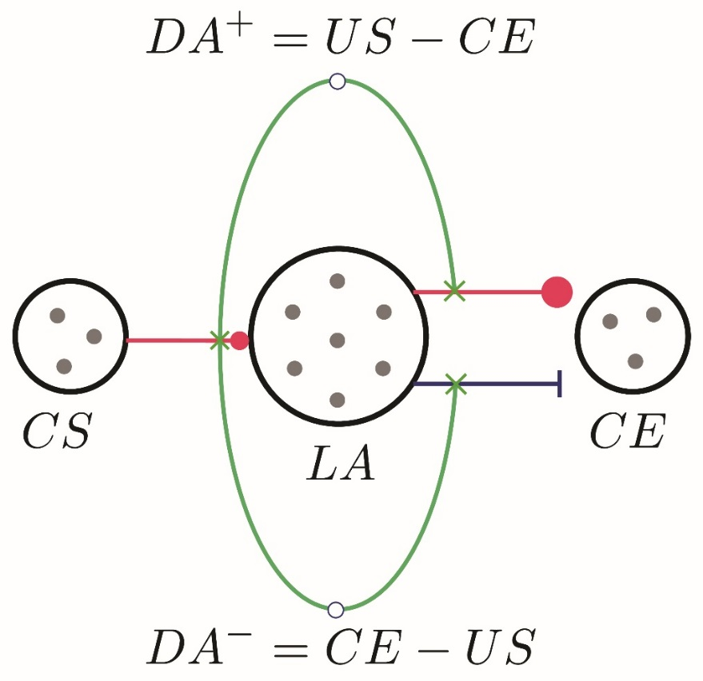
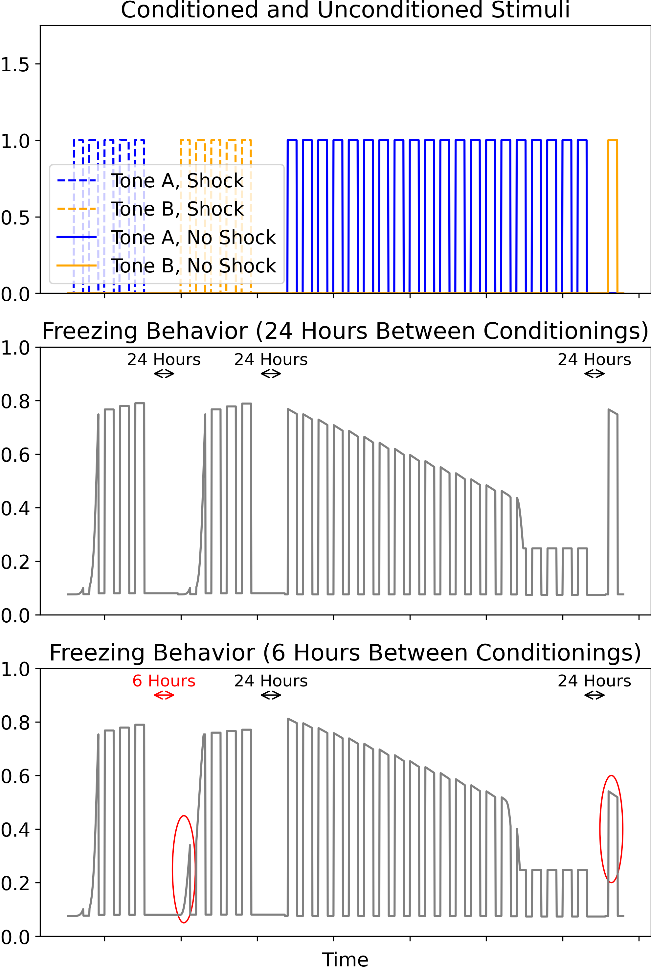
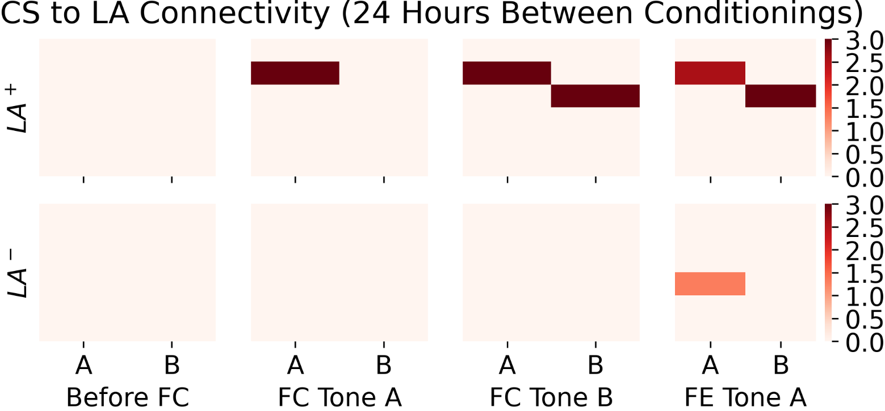
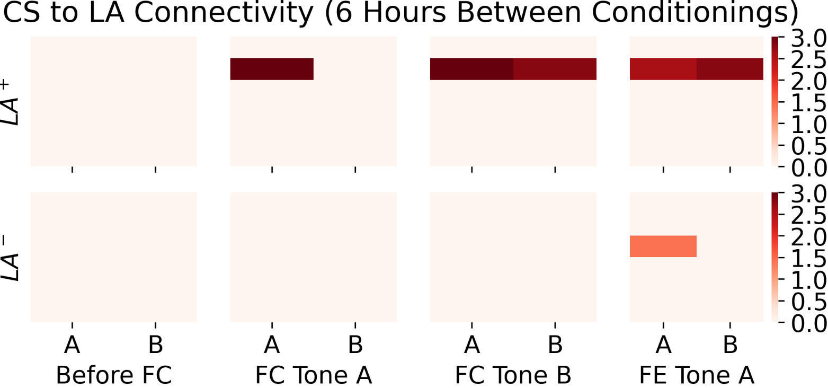
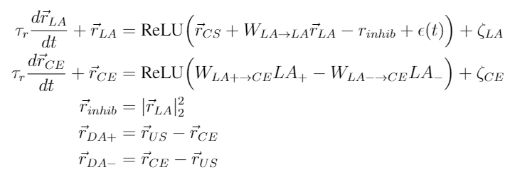
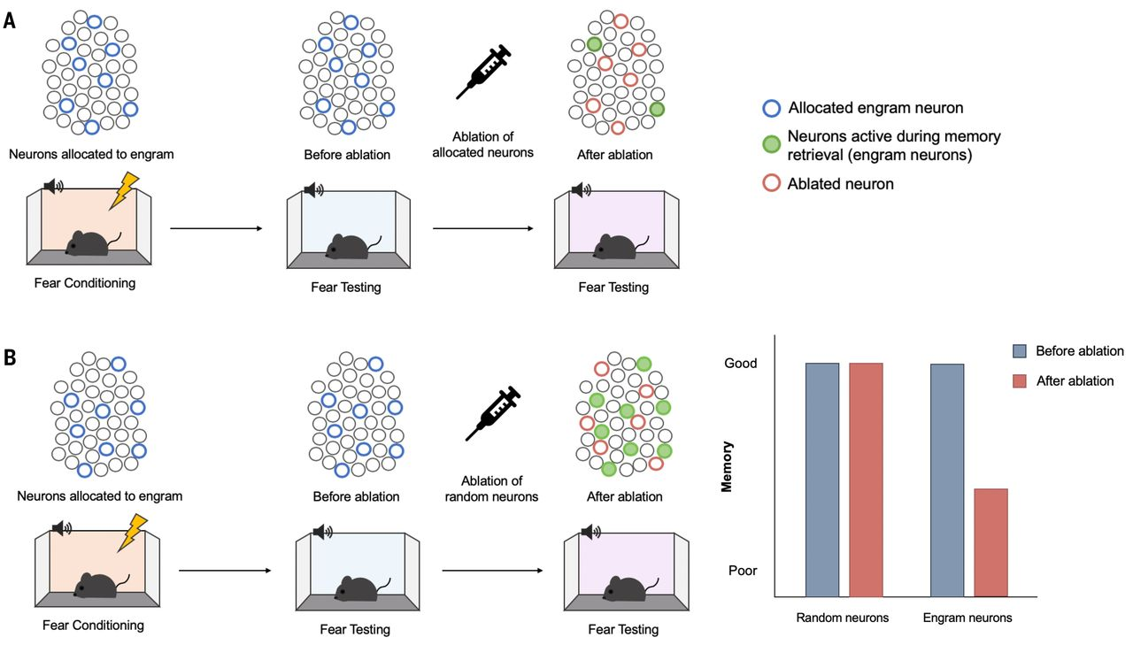

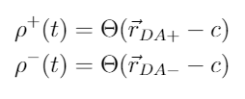
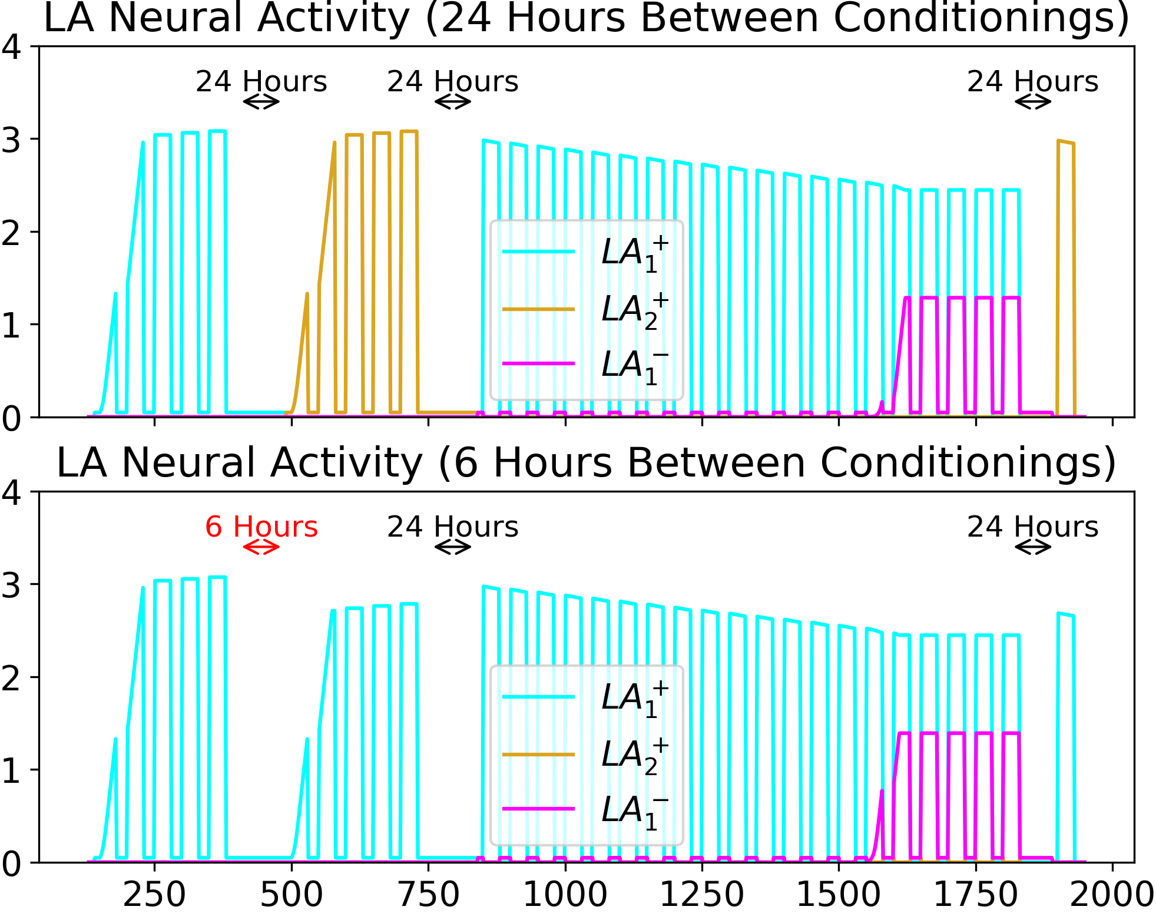
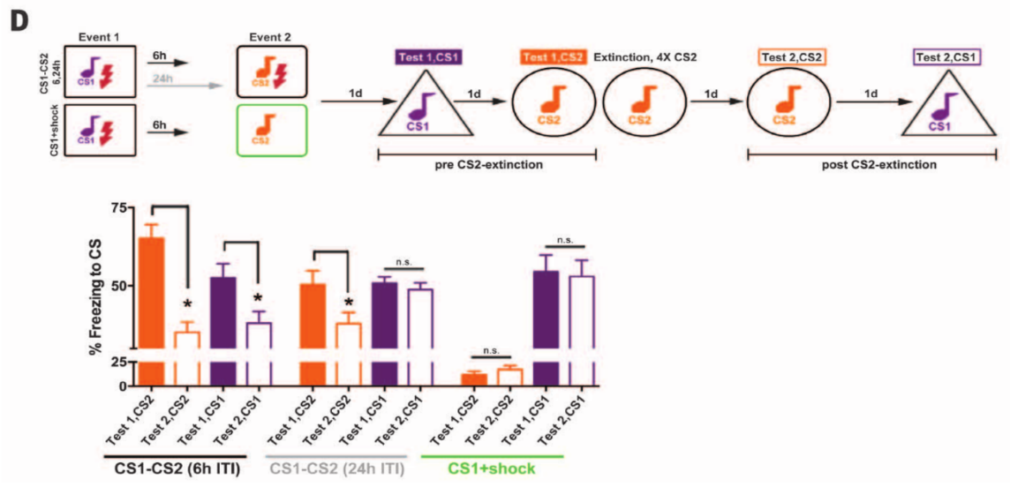
COSYNE 2021 Poster 2-082
Neural network model of amygdalar memory engram formation and function
Rylan Schaeffer^{1,2}, Nimrod Shaham^{3,4,5}, Gabriel Kreiman^{3,6}, Haim Sompolinsky^{3,4,5}
¹Harvard School of Engineering and Applied Sciences, ²MIT Department of Brain and Cognitive Sciences, ³Harvard Center for Brain Science, ⁴Hebrew University of Jerusalem, ⁵Edmond and Lily Safra Center for Brain Sciences, ⁶Department of Ophthalmology, Children’s Hospital, Harvard Medical School, Boston, MA
Introduction
Rate-Based Neural Network
Results
Results Continued
How does the brain perform associative learning at the systems level?
Growing body of experimental evidence points toward memory engrams¹
Theoretical understanding lags experimental work, leaving important questions unanswered
Connectivity
Behavior
Engram Connectivity
For concreteness, we propose a model of auditory fear conditioning in lateral amygdala. Our model has 5 nuclei:
Experiment: Fear Condition Tone A followed by Tone B. Then extinguish Tone A and test fear response to B.
Excitability and competition can create entangled engrams, with temporal distance playing the decisive role.
Excitability and competition together filter for subpopulation that will form the engram
Excitability timescale (6 hours vs 24 hours) significantly changes connectivity of engrams
Research Contributions
Propose a bespoke rate-based neural network that:
- relies on key circuit-level findings: excitability, competition, and dopamine-controlled synaptic plasticity
- is consistent with both neuroanatomy and biologically plausible learning mechanisms
Explain key experimental findings such as:
1. how extinguishing one conditioned stimulus can affect responses to an unrelated conditioned stimulus
2. when and how unlearning or new learning occurs following a chance in reward contingencies
CS: Conditioned Stimulus (e.g. auditory input)
US: Unconditioned Stimulus (e.g. shock)
LA: Lateral Amygdala
CE: Central Amygdala (controls animal’s freezing response)
DA: Dopaminergic Neurons
Review of Memory Engrams
What are memory engrams?
distributed sub-populations of neurons
undergo enduring changes in response to learning
both sufficient and necessary to retrieve association
What are key experimental findings?
Endogenous time-varying excitability
Neurons compete for recruitment to engrams
Excitable neurons are preferentially recruited
After conditioning, engram activation induces recall
Engram size is sparse and consistent within regions
Entangled Engrams: During two fear conditionings, second fear response is acquired more quickly and extinguishing one fear response partially extinguishes the other fear response if the conditionings are separated by 6 hours, but not 24 hours²
Dynamics
Rate Dynamics:
Synaptic Weight Dynamics:
Synaptic Plasticity Dynamics
After learning, the engram is the population in LA that is now activated by the CS.
Conclusion
Fig from Josselyn & Tonegawa 2020¹
Our neural network model leverages known neural mechanisms to parsimoniously explain experimental findings, especially entangled engrams
Three experimental findings (excitability, competition and altered synaptic plasticity) are all necessary for the model to work
Two types of synaptic plasticity modifiers are necessary, one for each sign of the prediction error
Prediction: At the end of Rashid et al.’s experimental paradigm, artificially activating the Tone A fear extinction engram while presenting Tone B should result in reduced fear response
Future Work: Following a change in stimulus-reward contingencies, when does learning a new association occur versus unlearning an old association?
Engram Activity
Excitability timescale (6 hours vs 24 hours) plays key role in reproducing Rashid 2016 neural findings
Key Roles of Excitability, Competition
and Dopamine-Altered Plasticity
Excitability is implemented as a time-varying excitatory input to a random subset (∼ 15%) of LA neurons
Competition is implemented as an inhibitory input to all LA neurons proportional to the summed rates of LA neurons.
Dopamine gates Hebbian plasticity in the following way: DA⁺ (DA⁻) enables Hebbian learning of CS to LA⁺ (CS to LA⁻) and of LA⁺ to CE (LA⁻ to CE) and accelerates the decay of LA⁻ to CE (LA⁺ to CE) synapses.
References
Sheena Josselyn and Susumu Tonegawa. Memory engrams: Recalling the past and imagining the future. Science 2020.
Rashid et al. Competition between engrams influences fear memory formation and recall. Science 2016.
Fig from Rashid et al. 2016²

