Slide 1
Ecological data: Animal movement
Types: GPS data, accelerometer data, and dive data
Structures:
GPS: Typically collected their locations over time at regular intervals like 5 mins or 10 mins (if there are missing data between some intervals, can be filled).
Accelerometer: fine scale data such as collecting data at 20 Hertz → summarize them in terms of one second intervals or every few seconds → having some metrics as a proxy of energy expenditure or activity levels.
Michelot. 2022; Leos-Barajas. 2022
Notes:
HMMs can be applied to different ecological datasets - mainly animal movement, occupancy, and mark-recapture data – but here I am only providing animal movement focused HMM applications.

Slide 2
Hidden Markov models (HMMs)
Motivation:
Behavior segmentation (R packages: moveHMM and momentuHMM)
(1) Using trajectories of animals → (2) quantifying what behavior the animal was in at aech time step through time series by applying hidden Markov models (HMMs).
Structures:
Y_{t-1}
Y_{t}
Y_{t+1}
Observation process (e.g., animal movement)
S_{t-1}
S_{t}
S_{t+1}
Latent state process (e.g., behavior)
Michelot. 2022; Leos-Barajas. 2022
Notes:
The application of HMMs in animal movement essentially aim to use the data we collect to inform some main ecological or behavioral processes that we cannot observe.
A HMM (a doubly stochastic process) is composed of (1) observation process (animal movement) and (2) latent state process (behaviors we want to infer) – taken to be a Markivan chain mathematically – which means, rely sorely on the t-1 state-dependent process).

Slide 3
Implementing HMMs in R
[include the original slide…]

Slide 4
HMMs for animal movement (discrete time)
Different behaviors lead to different movement patterns.
Y_{t-1}
Y_{t}
Y_{t+1}
Observation process (e.g., animal movement)
S_{t-1}
S_{t}
S_{t+1}
Latent state process (e.g., behavior)
Michelot. 2022; Leos-Barajas. 2022
Notes:
The core idea of HMMs in animal movement is that different behaviors (states) lead to different movement patterns…

Slide 5
HMMs for animal movement (discrete time)
Different behaviors lead to different movement patterns.
Y_{t-1}
Y_{t}
Y_{t+1}
Observation process (e.g., animal movement)
S_{t-1}
S_{t}
S_{t+1}
Latent state process (e.g., behavior)
A number of states of interests
(e.g., exploring/resting)
Michelot. 2022; Leos-Barajas. 2022
Notes:
For example, if we are interested in identifying exploring and resting behaviors given our movement dataset (colored blue) at time t…

Slide 6
HMMs for animal movement (discrete time)
Different behaviors lead to different movement patterns.
Example: if S can be either an exploring (“E”) or resting (“R”) state at time t, the transition between E and R at each time sequence can be modelled using the Markov chain. → transitional probabilities
0.8
E
R
0.2
0.6
Y_{t-1}
Y_{t}
Y_{t+1}
Observation process (e.g., animal movement)
0.4
S_{t-1}
S_{t}
S_{t+1}
Latent state process (e.g., behavior)
A number of states of interests
(e.g., exploring/resting)
Michelot. 2022; Leos-Barajas. 2022
Notes:
We use Markov chain (set transitoinal probabilities) between exploring and resting states - given at time t if the animal is in exploring mode, the next time t+1, it has the chance to transition from exploring to resting (0.4).

Slide 7
HMMs for animal movement (discrete time)
Different behaviors lead to different movement patterns.
Example: if S can be either an exploring (“E”) or resting (“R”) state at time t, the transition between E and R at each time sequence can be modelled using the Markov chain. → transitional probabilities
E R
( )
E
R
0.6 0.4
0.2 0.8
Y_{t-1}
Y_{t}
Y_{t+1}
Observation process (e.g., animal movement)
S_{t-1}
S_{t}
S_{t+1}
Latent state process (e.g., behavior)
A number of states of interests
(e.g., exploring/resting)
Michelot. 2022; Leos-Barajas. 2022

Slide 8
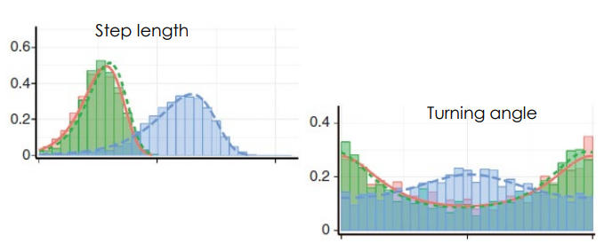
HMMs for animal movement (discrete time)
Different behaviors lead to different movement patterns.
Use modelled movement metrics (Step lengths, turn angles) by state-dependent distributions.
Y_{t-1}
Y_{t}
Y_{t+1}
Observation process (e.g., animal movement)
S_{t-1}
S_{t}
S_{t+1}
Latent state process (e.g., behavior)
A number of states of interests
(e.g., exploring/resting)
Michelot. 2022; Leos-Barajas. 2022
Notes:
Now we have some of the building blocks to understand how HMMs would work using animal movement data → let’s go back to the overall modeling framework. We set a number of states of interests (exploring/resting) that each time seuqnece - the transition between the states is governed by Markov chain via transitional probabilities. Now we use movement metrics such step lengths and turn angles to model them by state-dependent distributions (step lengths with gamma and turn angle with von mises based on the unique state). – denoted with brown colored

Slide 9
HMMs for animal movement (discrete time)
Different behaviors lead to different movement patterns.
In other words, the steps and angles are modelled by state-dependent distributions. (e.g., at time t, if the animals is in a state of exploring → will affect distributions of step lengths and turn angles)
Y_{t-1}
Y_{t}
Y_{t+1}
Observation process (e.g., animal movement)
S_{t-1}
S_{t}
S_{t+1}
Latent state process (e.g., behavior)
A number of states of interests
(e.g., exploring/resting)
Michelot. 2022; Leos-Barajas. 2022

Slide 10
HMM Parameters
[include the original slide…]

