Slide 1
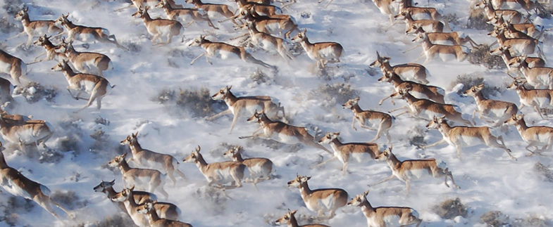
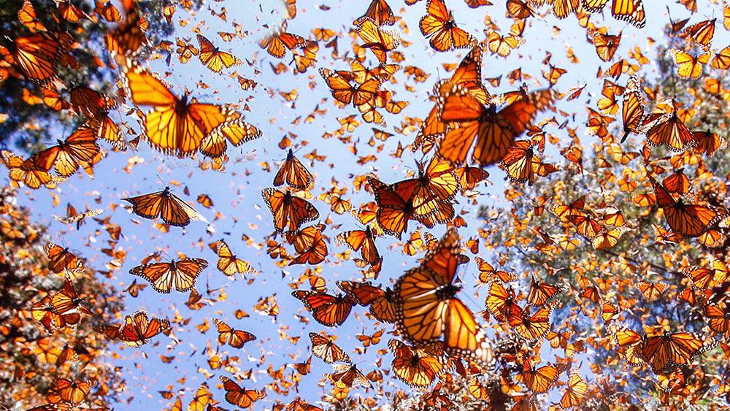

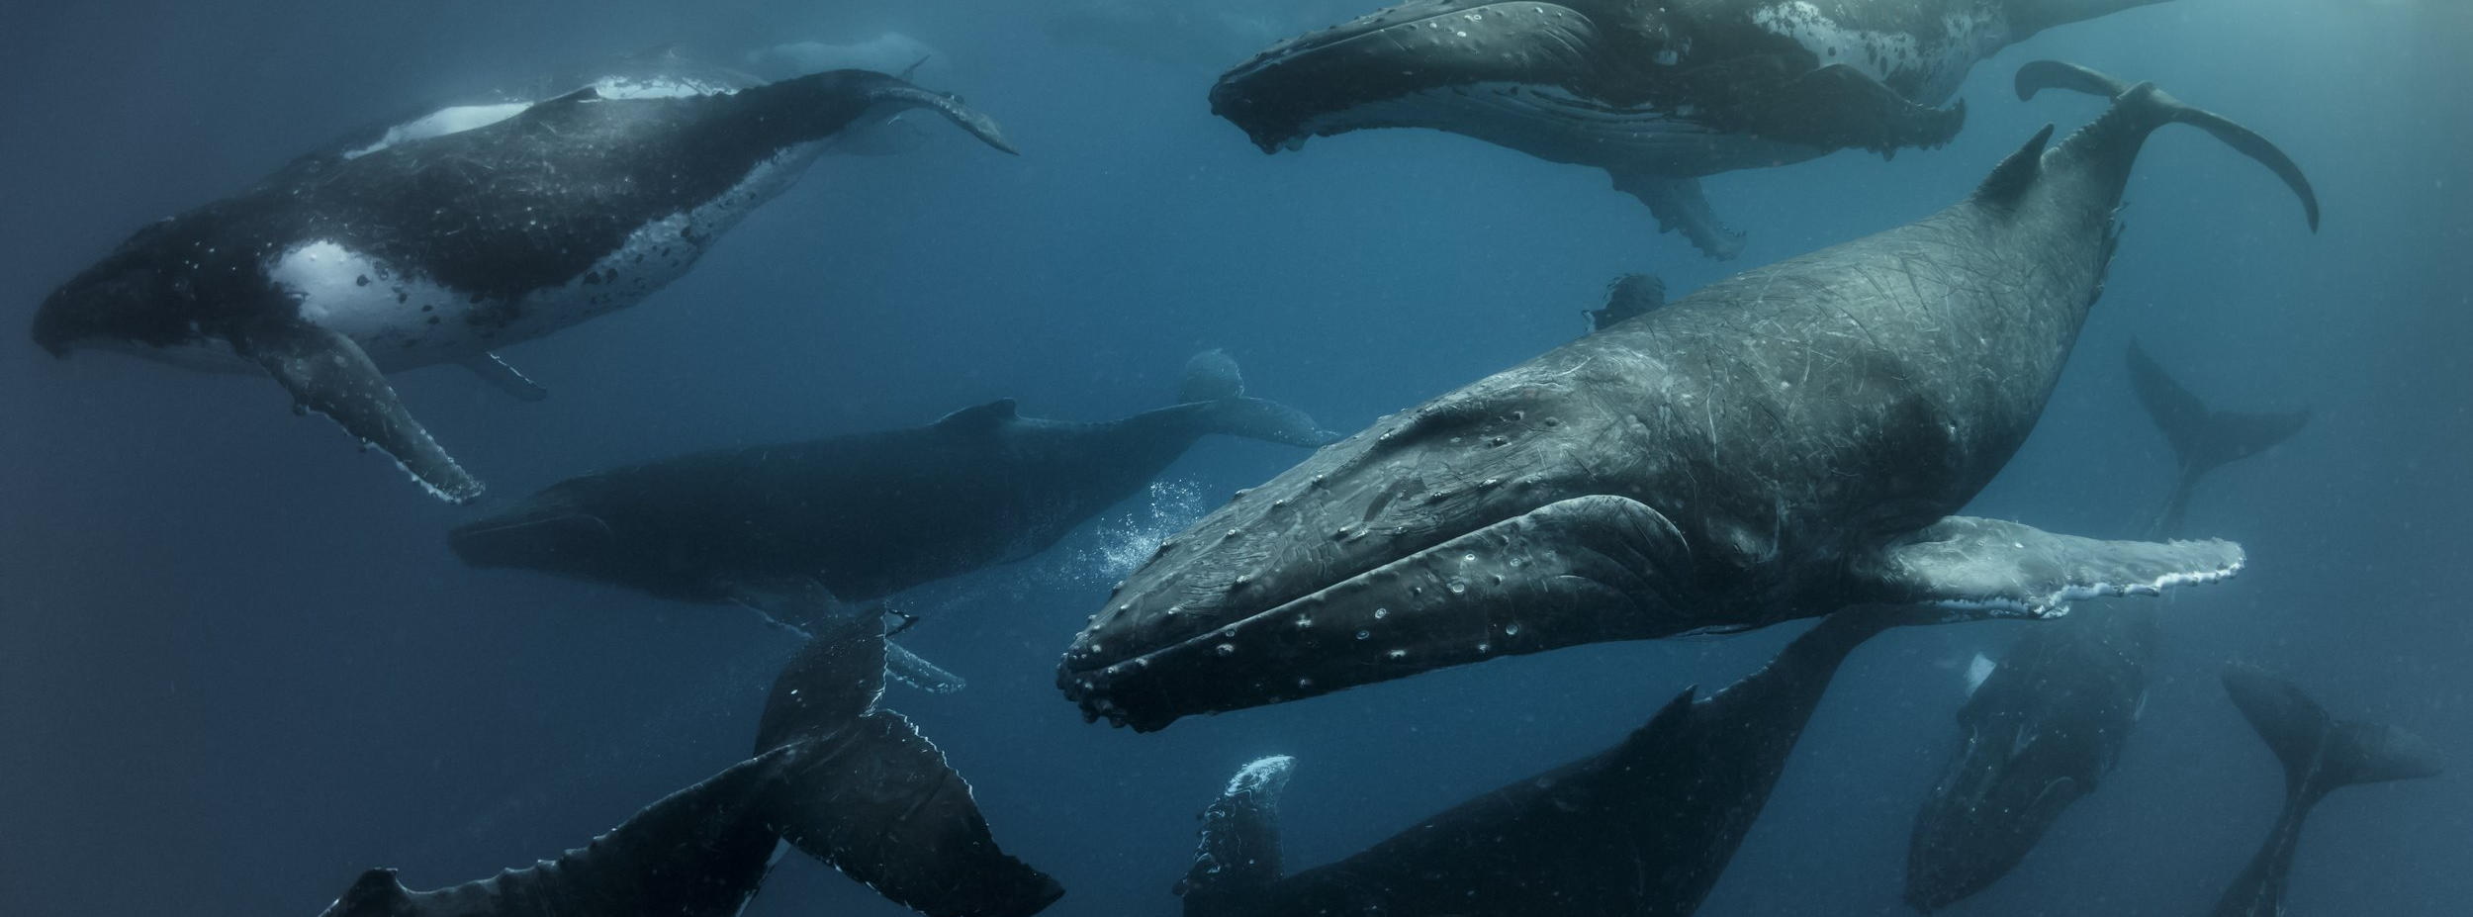
Clustering, Segmentation, and Behavior Classification
Wenjing Xu 徐雯靓 | wenjingxu@umass.edu
Movement Ecology Workshop @ Fudan | August 2025

Slide 2
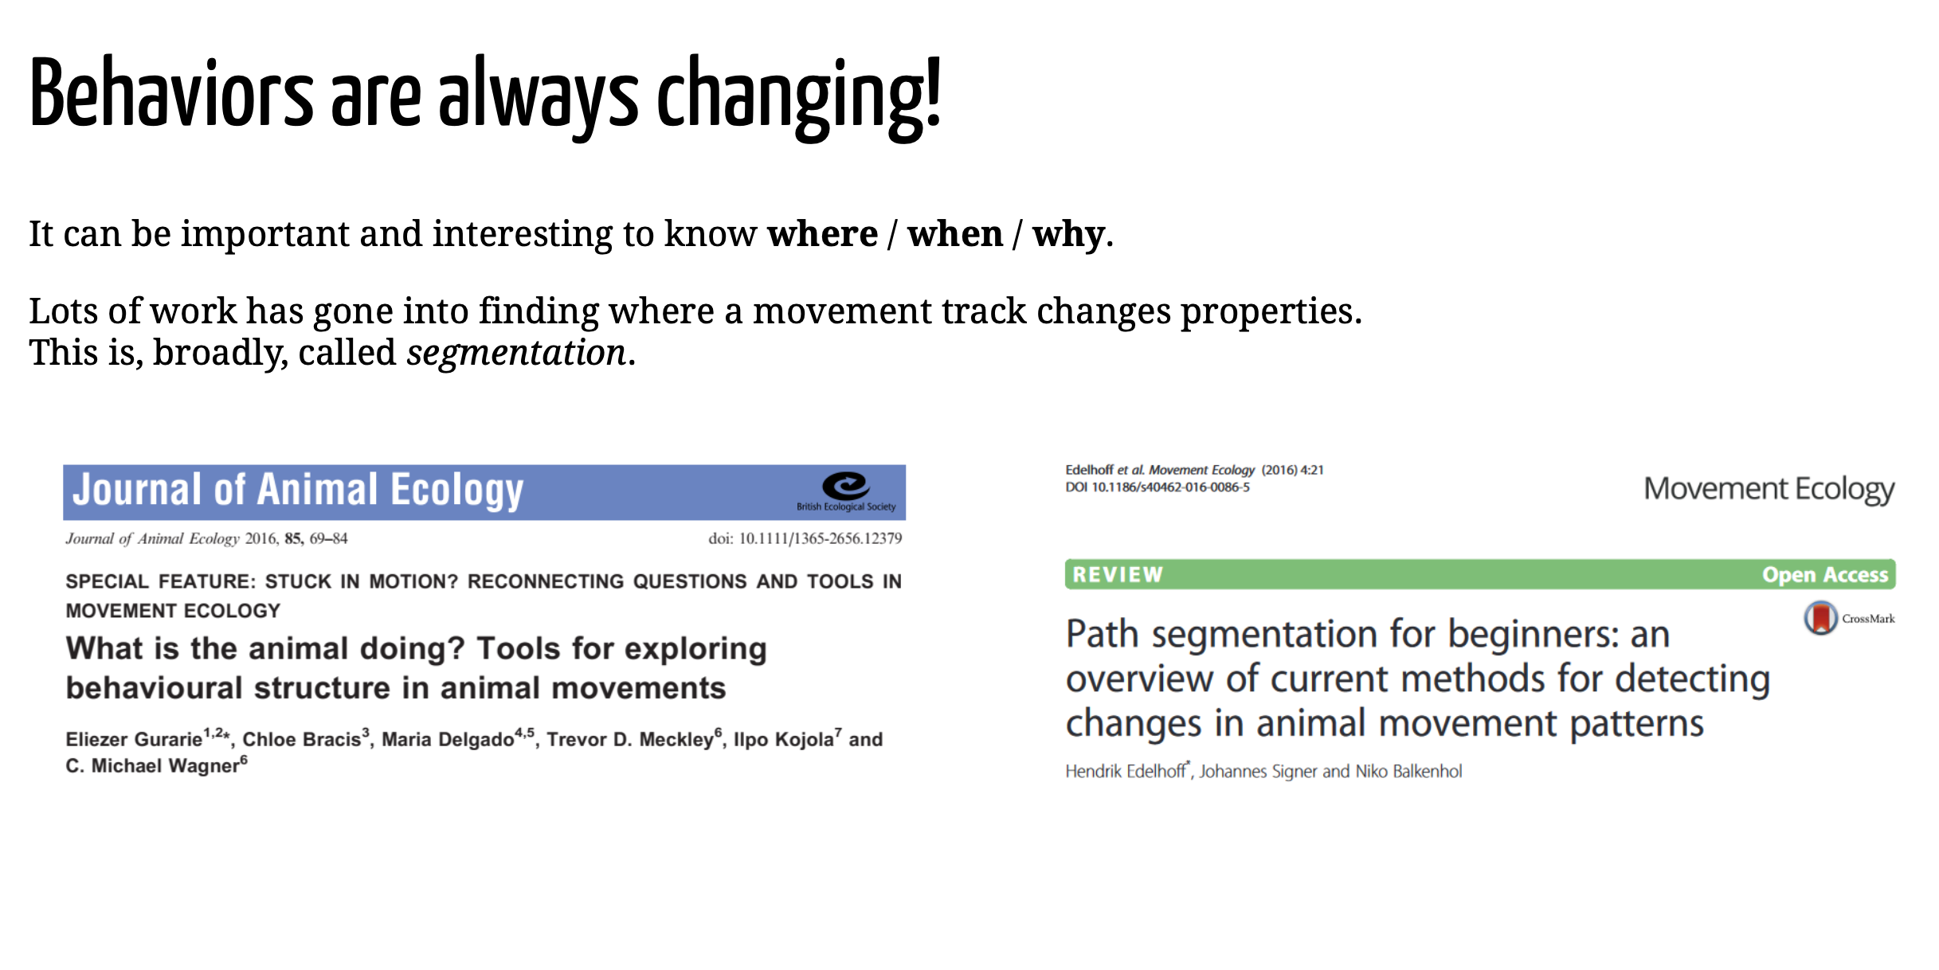

Slide 3
Another common goal in movement ecology is to get a proxy of the individual's behaviour through the observed movement patterns, based on either the locations themselves or second-/third-order variables such as distance, speed or turning angles. Covariates, mainly related to the environment, are frequently used for behavioural pattern identification.
We classify the methods in this section as follows: (a) non-sequential classification or clustering techniques, where each fix in the track is classified as a given type of behaviour, independently of the classification of the preceding or following fixes (i.e. independently of the temporal sequence); (b) segmentation methods, which identify change in behaviour in time series of movement patterns to cut them into several segments; and (c) hidden Markov models, centred upon a hidden state Markovian process (representing the sequence of non-observed behaviours) that conditions the observed movement patterns (Langrock et al., 2012).

Slide 4
▪TRESHOLDING/CLUSTERING
▪ Changepoints (BPMM / BCPA)
▪ Hidden Markov Models

