Slide 1
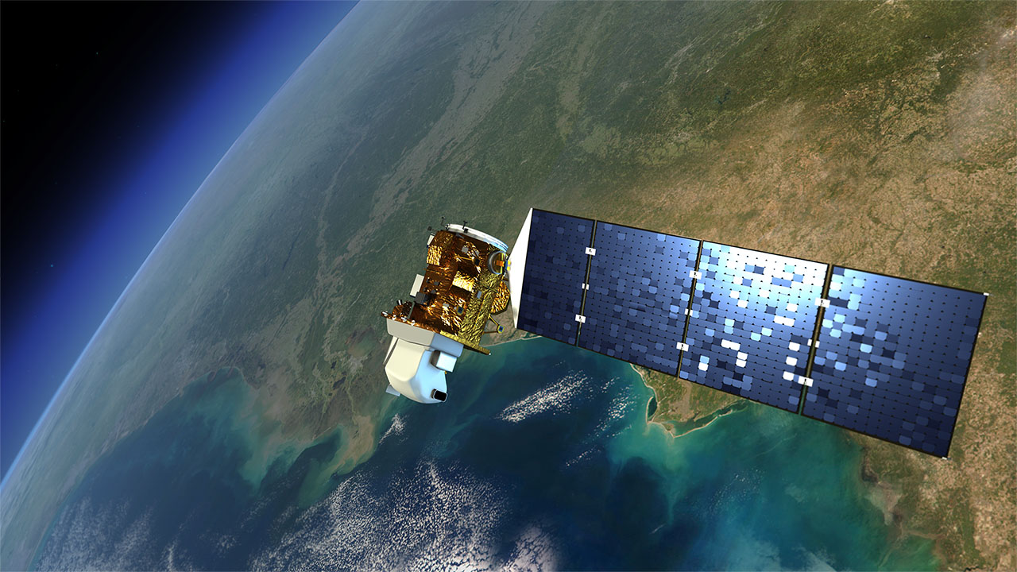
Remote Sensing Applications

Slide 3
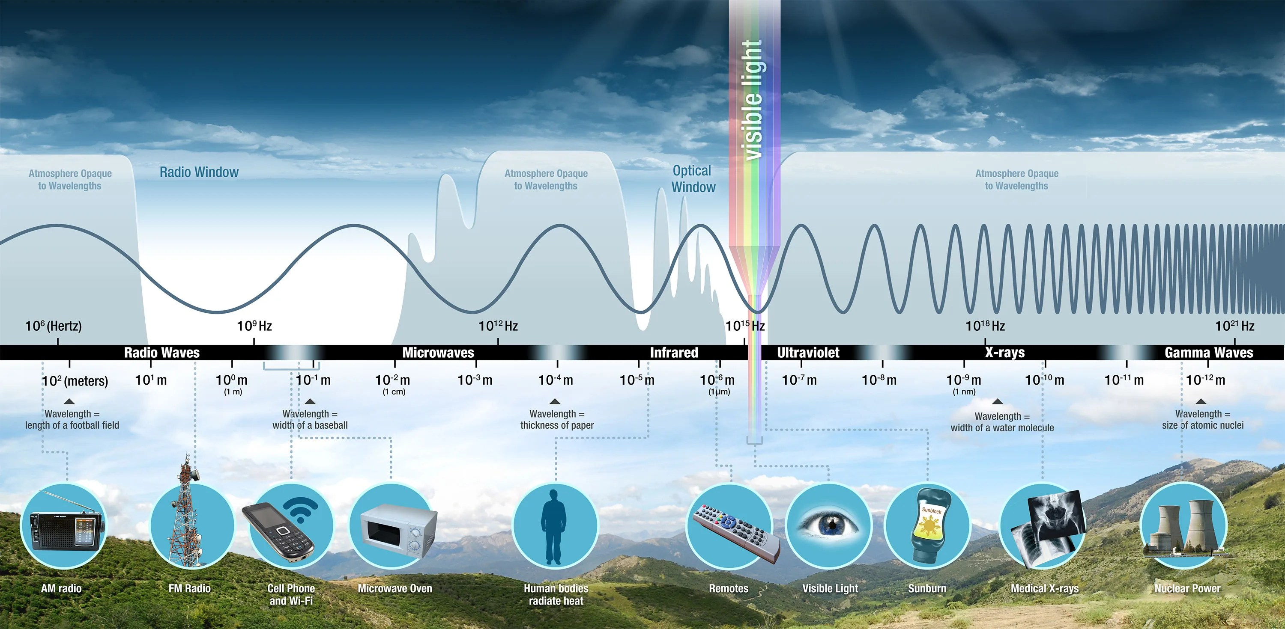
Notes:
Electromagnetic energy travels in waves and spans a broad spectrum from very long radio waves to very short gamma rays. The human eye can only detect only a small portion of this spectrum called visible light. A radio detects a different portion of the spectrum, and an x-ray machine uses yet another portion.

Slide 4
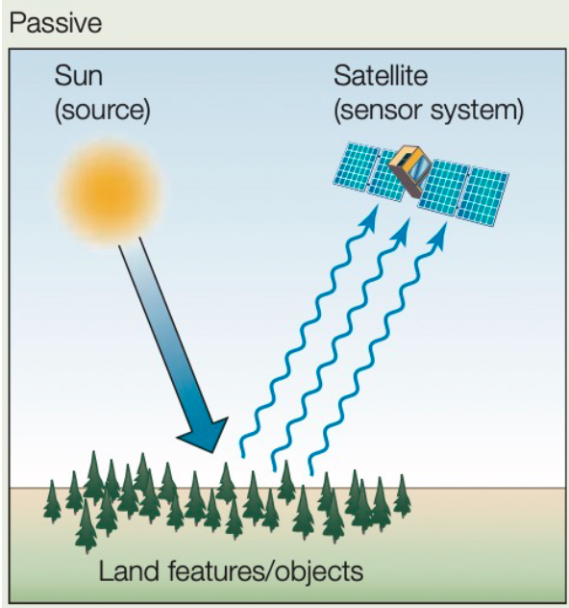
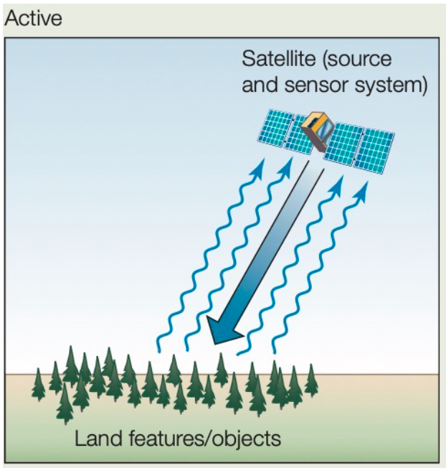
Key Concept
Active vs Passive Remote Sensing
Versus

Slide 5
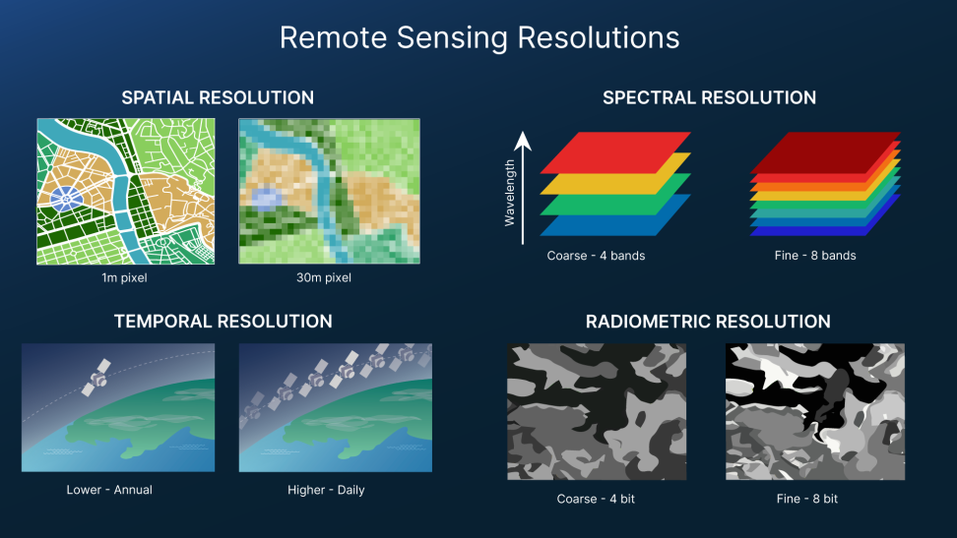
Key Concept
Spatial, Spectral, Temporal, and Radiometric Resolution

Slide 6
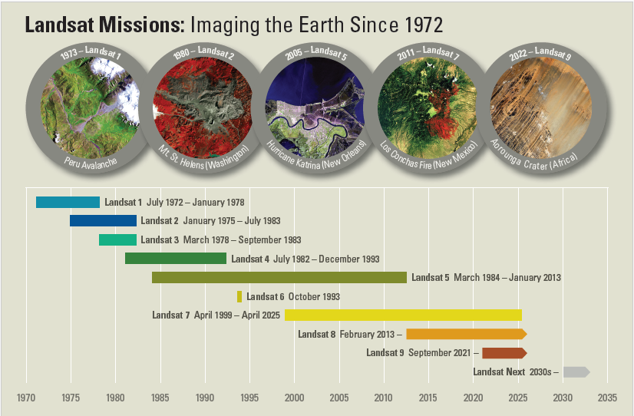

Slide 7
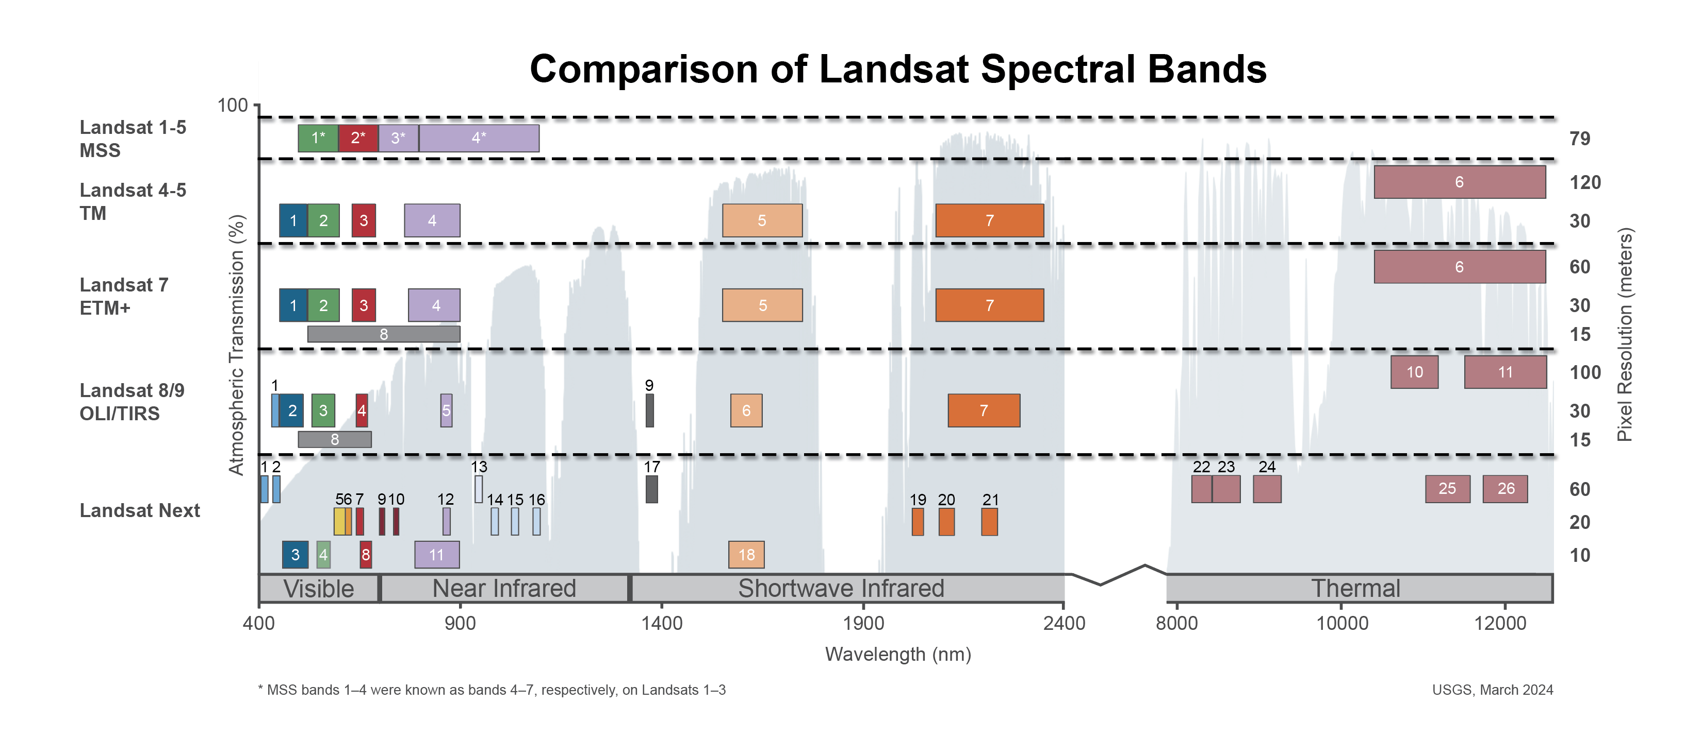

Slide 8
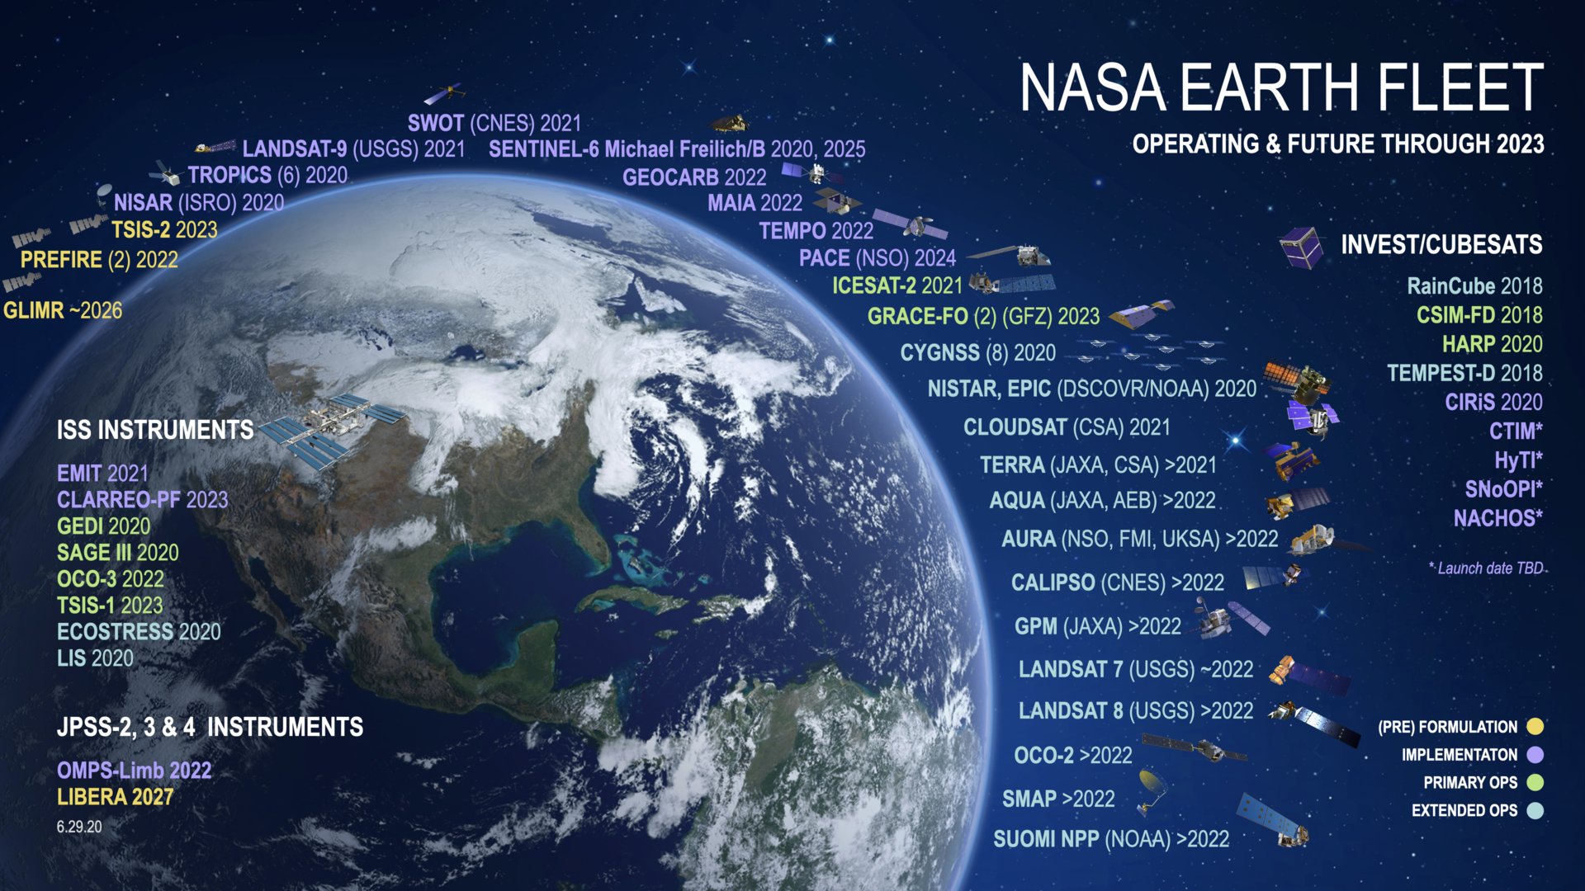

Slide 9
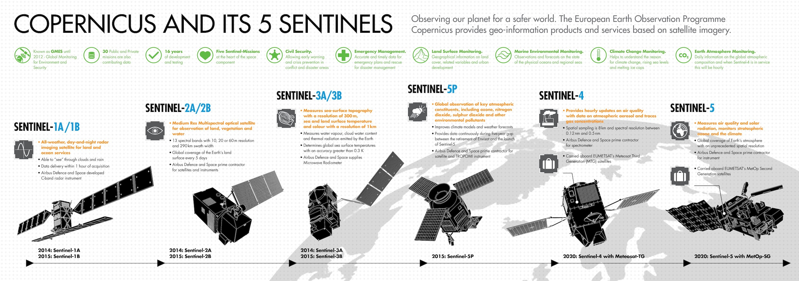

Slide 10
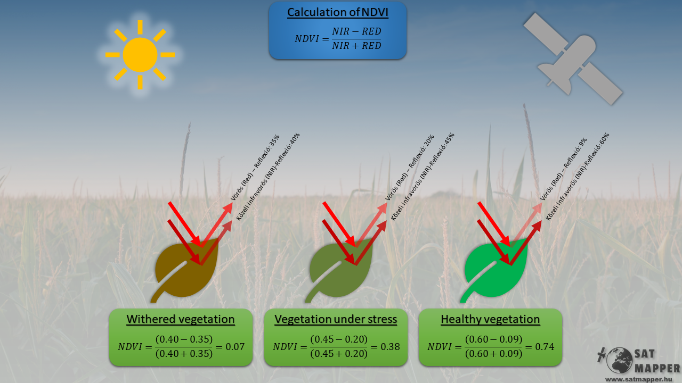

Slide 11
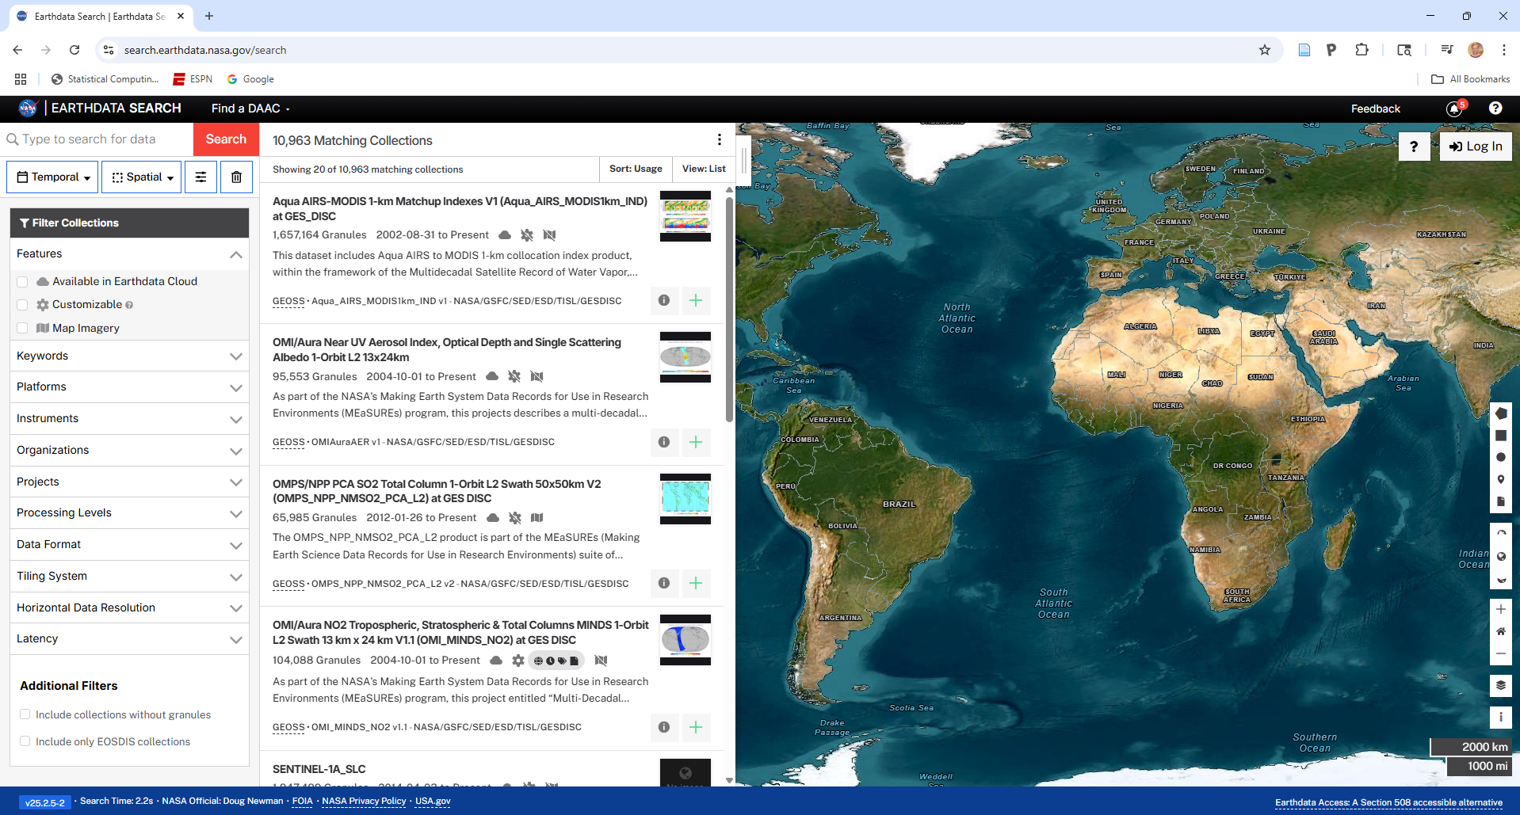
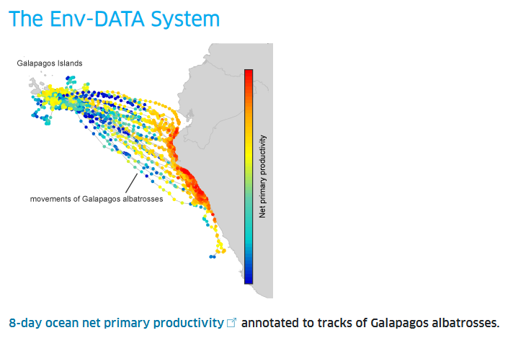
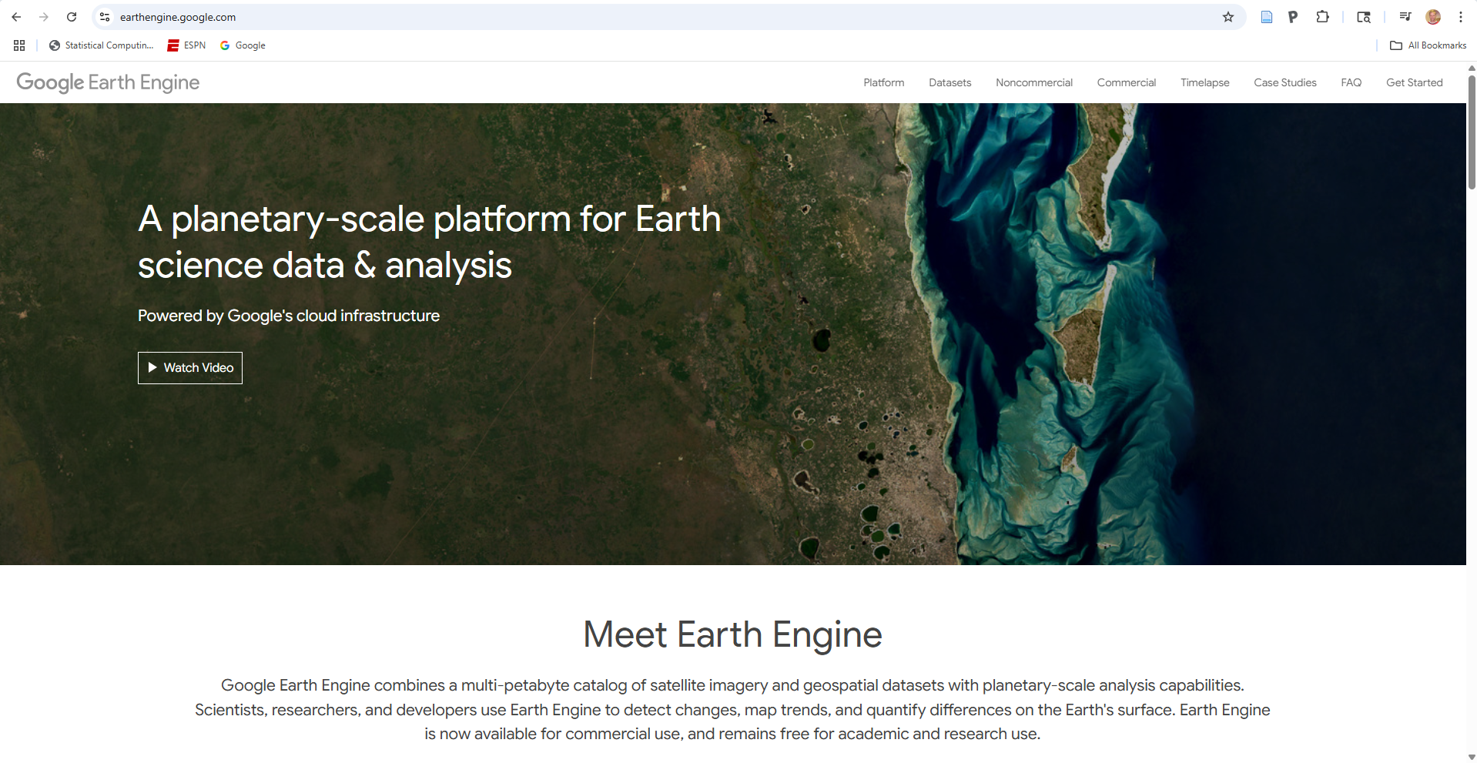
Where to Locate Satellite Data
Many sites exist to access data
Navigate to:
NASA Earth Data - https://search.earthdata.nasa.gov/search
Movebank ENV Data Tool - https://www.movebank.org/cms/movebank-content/env-data
Google Earth Engine - https://earthengine.google.com/
Derived from information provided by NASA’s ARSET program – Introduction to the Integration of Animal Tracking and Remote Sensing

Slide 12
NASA Earth Data
Navigate to:
https://search.earthdata.nasa.gov/search
Derived from information provided by NASA’s ARSET program – Introduction to the Integration of Animal Tracking and Remote Sensing

Slide 13
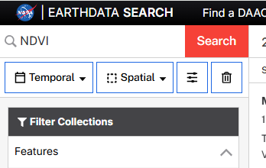
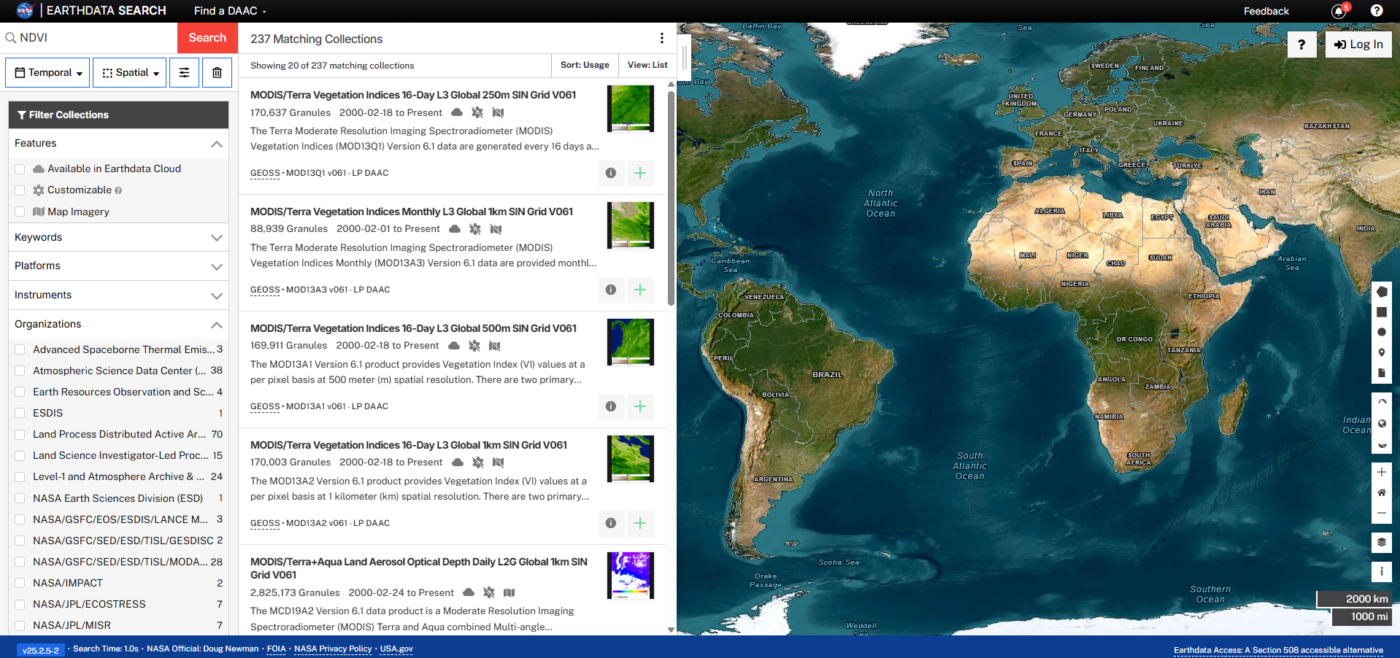
NASA Earth Data
Enter Search Terms (vegetation, sea surface temperature, land cover, elevation, NDVI, …)
Derived from information provided by NASA’s ARSET program – Introduction to the Integration of Animal Tracking and Remote Sensing

Slide 14
NASA Earth Data
Select product
Derived from information provided by NASA’s ARSET program – Introduction to the Integration of Animal Tracking and Remote Sensing

Slide 15
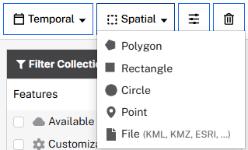
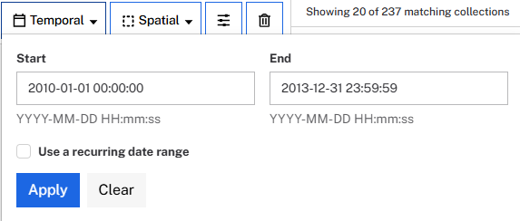
NASA Earth Data
Filter by spatial and temporal extent
Reduce the amount of data necessary to download
Derived from information provided by NASA’s ARSET program – Introduction to the Integration of Animal Tracking and Remote Sensing

Slide 16
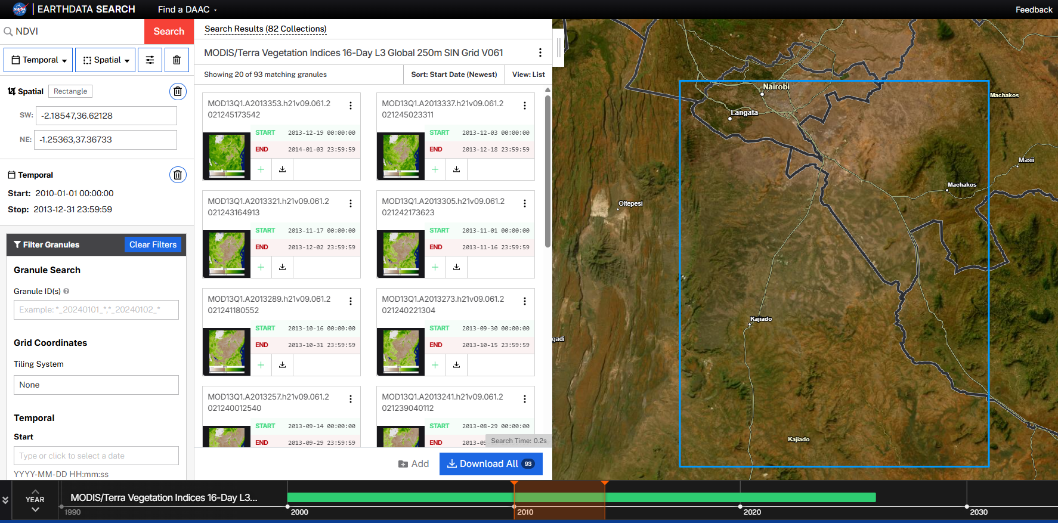
NASA Earth Data
Check map and number of granules
Derived from information provided by NASA’s ARSET program – Introduction to the Integration of Animal Tracking and Remote Sensing

Slide 17
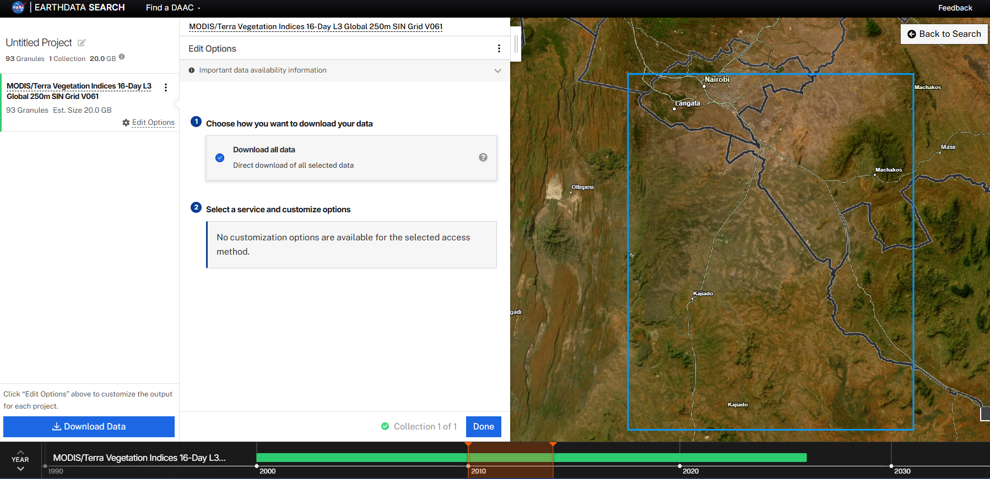
NASA Earth Data
Follow download instructions
Derived from information provided by NASA’s ARSET program – Introduction to the Integration of Animal Tracking and Remote Sensing

Slide 18
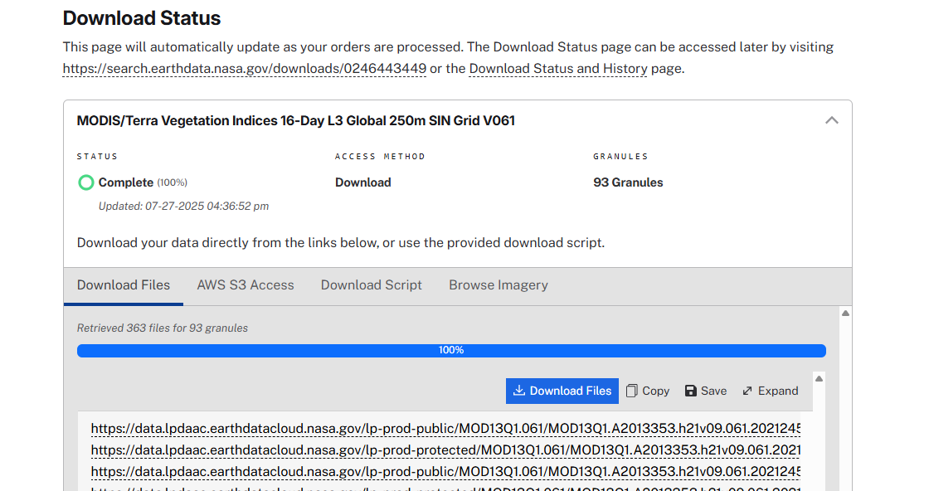
NASA Earth Data
Follow download instructions
Option 1: Use the Earthdata Download tool (https://nasa.github.io/earthdata-download/)
Option 2: Use command-line tools (“Download Script” tab)
Derived from information provided by NASA’s ARSET program – Introduction to the Integration of Animal Tracking and Remote Sensing

Slide 19
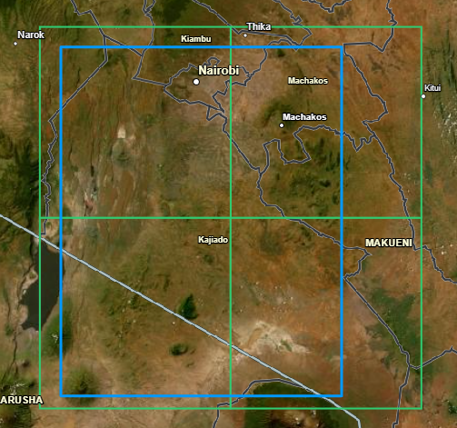
NASA Earth Data
Important Notes on Post-Processing
Many products will include multiple granules
E.g., Different locations or date/times
Many granules will include multiple layers
E.g., MODIS has multiple files for individual bands or projects (NDVI, EVI)
Requires GIS analyses
Mosaicking to combine spatial tiles
Stacking to combine temporal files
Cropping to include only need area
Example using SRTM elevation data: 4 tiles
Derived from information provided by NASA’s ARSET program – Introduction to the Integration of Animal Tracking and Remote Sensing

Slide 20

Movebank ENV Data
Navigate to:
Movebank ENV Data Tool - https://www.movebank.org/cms/movebank-content/env-data
A set of free tools on Movebank to help you link animal movement data with information from global environmental datasets
Derived from information provided by NASA’s ARSET program – Introduction to the Integration of Animal Tracking and Remote Sensing

Slide 21
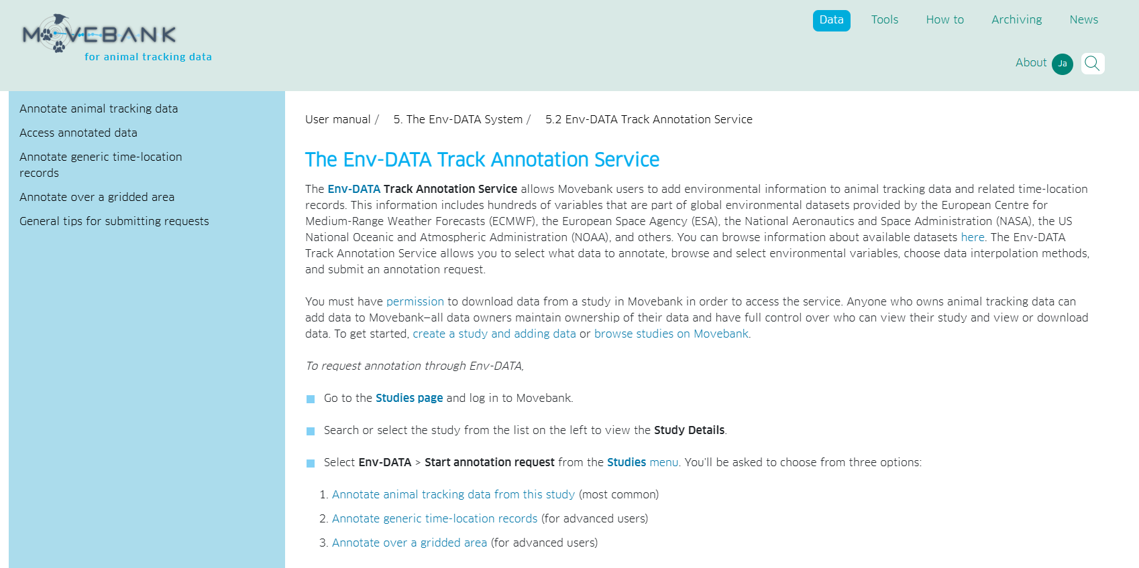
Movebank ENV Data
Go to Tools – EnvDATA:
Choose from:
Annotate animal tracking data from this study (most common)
Annotate generic time-location records (for advanced users)
Annotate over a gridded area (for advanced users)
Derived from information provided by NASA’s ARSET program – Introduction to the Integration of Animal Tracking and Remote Sensing

Slide 22
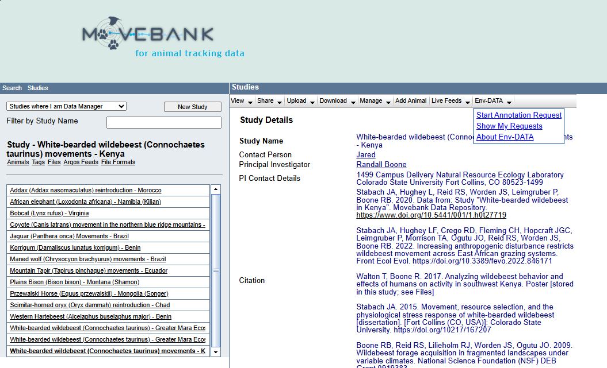
Movebank ENV Data
Start Annotation Request:
Go to Study and select Start Annotation Request
Derived from information provided by NASA’s ARSET program – Introduction to the Integration of Animal Tracking and Remote Sensing

Slide 23
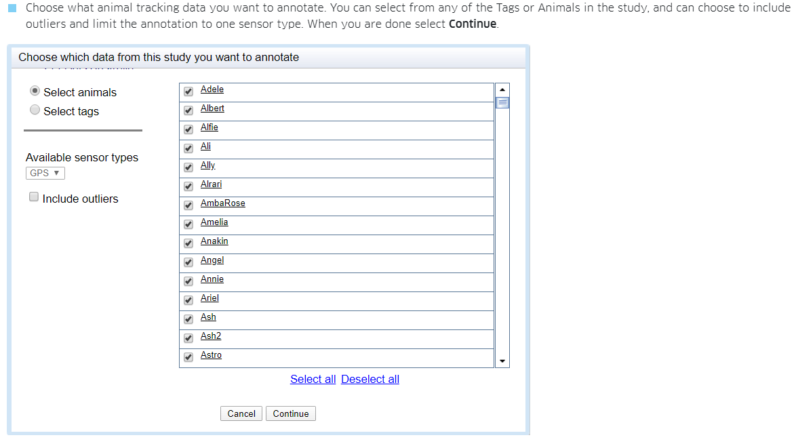
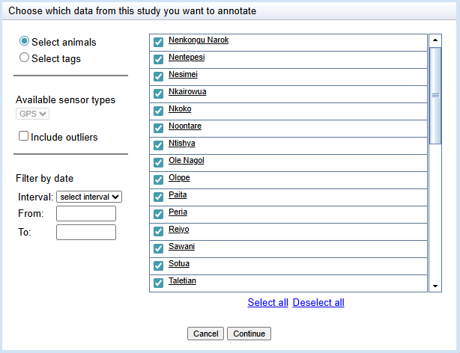
Movebank ENV Data
Annotate animal tracking data
Derived from information provided by NASA’s ARSET program – Introduction to the Integration of Animal Tracking and Remote Sensing

Slide 24
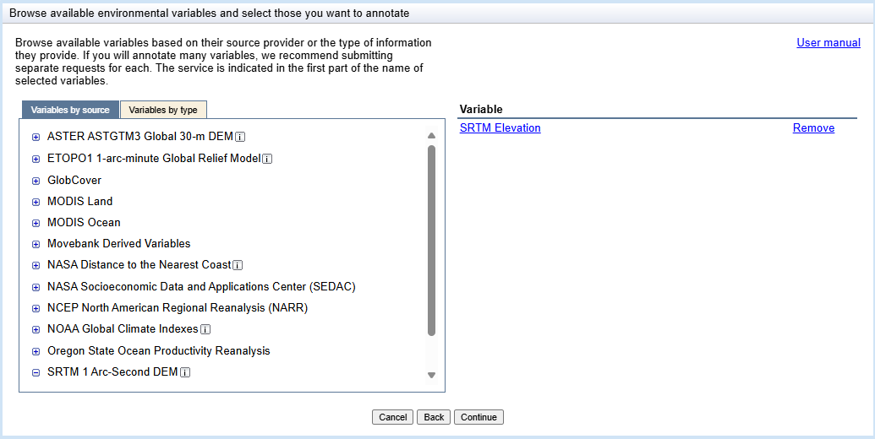
Movebank ENV Data
Annotate animal tracking data
Derived from information provided by NASA’s ARSET program – Introduction to the Integration of Animal Tracking and Remote Sensing

Slide 25
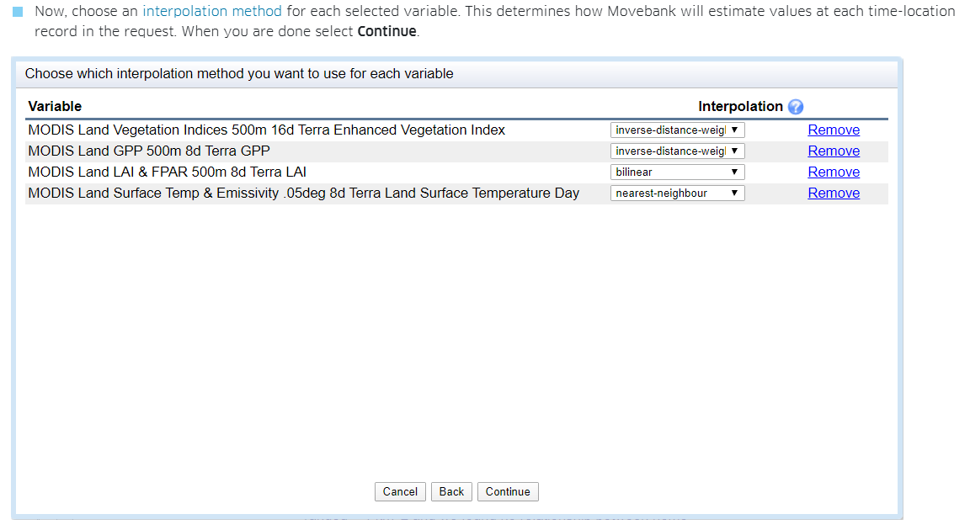
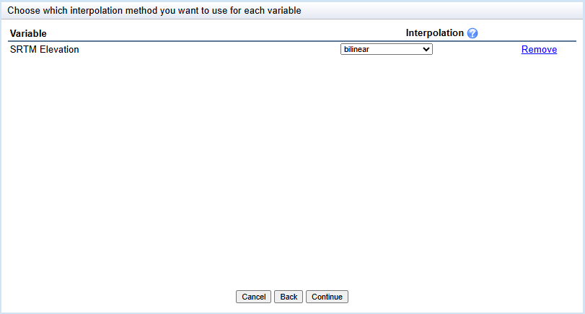
Movebank ENV Data
Interpolate
Derived from information provided by NASA’s ARSET program – Introduction to the Integration of Animal Tracking and Remote Sensing

Slide 26
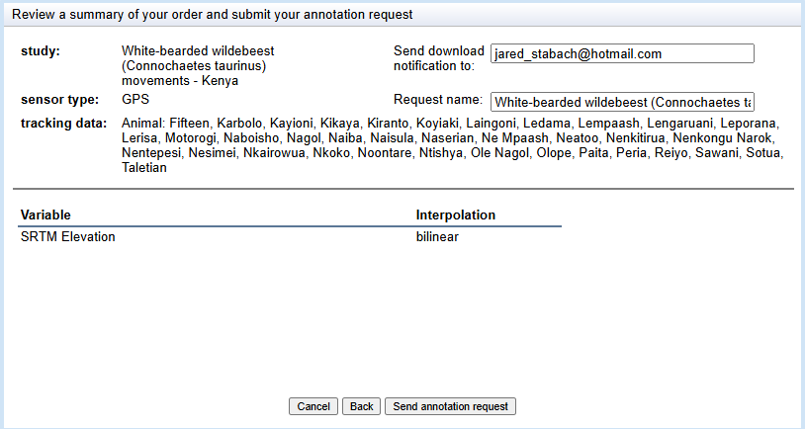
Movebank ENV Data
Review and Submit (Send Annotation Request)
- Data requests are available for download for two weeks as a .zip file
- Annotated data will be shown as available in the My requests table (under Env-Data
> Show my requests in the Studies menu).
Note: Movebank requests can be time consuming. Best to split your data into smaller parts (i.e., create data subsets (a few animals) and request fewer environmental datasets (one or two) for annotation)
Derived from information provided by NASA’s ARSET program – Introduction to the Integration of Animal Tracking and Remote Sensing

Slide 27
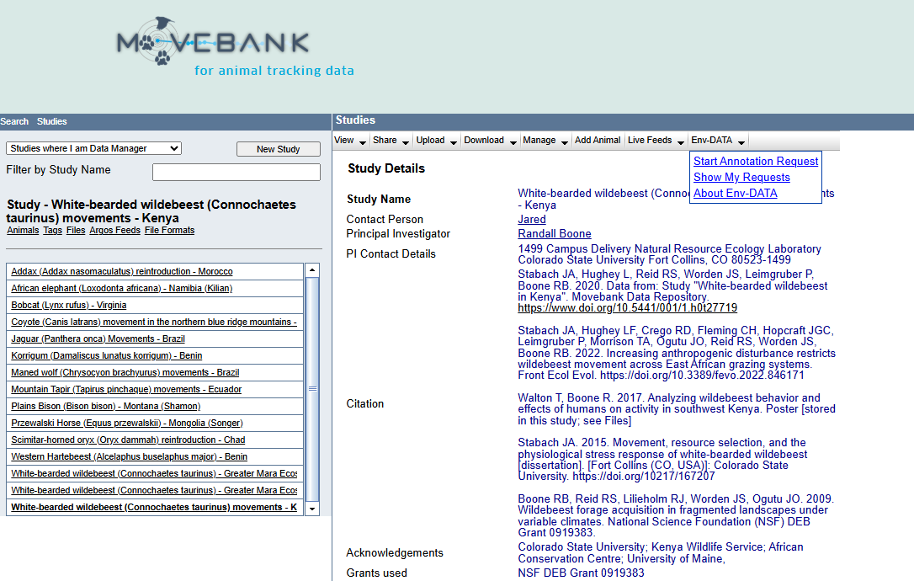
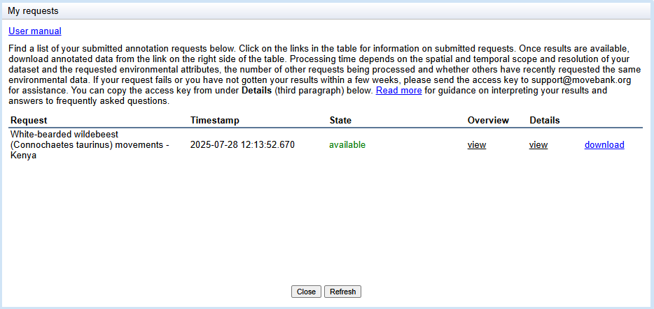
Movebank ENV Data
Review and Submit (Send Annotation Request)
- Data requests are available for download for two weeks as a .zip file
- Annotated data will be shown as available in the My requests table (under Env-Data
> Show my requests in the Studies menu).
Note: Movebank requests can be time consuming. Best to split your data into smaller parts (i.e., create data subsets (a few animals) and request fewer environmental datasets (one or two) for annotation)
Derived from information provided by NASA’s ARSET program – Introduction to the Integration of Animal Tracking and Remote Sensing

Slide 28
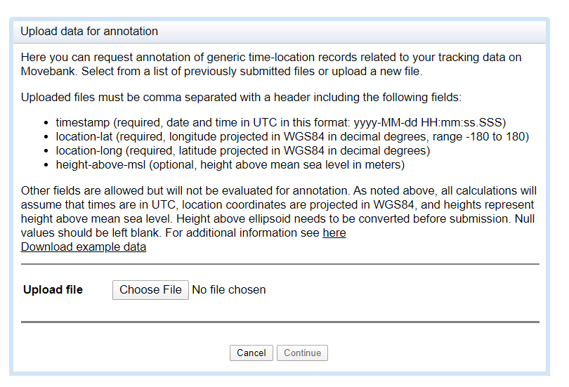
Movebank ENV Data – Other Applications
Annotate generic time-location records
Get environmental information for times and locations related to but not the same as the animal location themselves (e.g., simulated trajectories or randomly sampled locations)
Note: Make sure the uploaded files matches the required format EXACTLY
Derived from information provided by NASA’s ARSET program – Introduction to the Integration of Animal Tracking and Remote Sensing

Slide 29
Typical datasets needed
Srtm – elevation
NDVI/EVI/nSAVI
Soil
Night-time lights (500m?) - Human Population Density
10-m Global Settlement Footprint (GEE)
River layer – JRC Global Surface waters – 30m temporal variability – Monthly Data Product
HydroSheds.org – another source for vector river
Tropical Moist Forest – Forest Cover
Land Cover
Roads – Open Street Map
Climate change future predictions
Vegetation Structure
Gridded Livestock Data of the World and impact of livestock on grazing conditions

Slide 30
Google Earth Engine
A Multi-petabyte catalog and geospatial datasets with planetary-scale analysis capabilities
Navigate to:
Google Earth Engine - https://earthengine.google.com/
Derived from information provided by NASA’s ARSET program – Introduction to the Integration of Animal Tracking and Remote Sensing

Slide 31
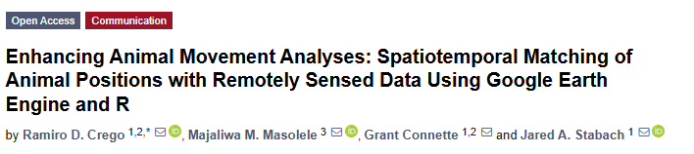
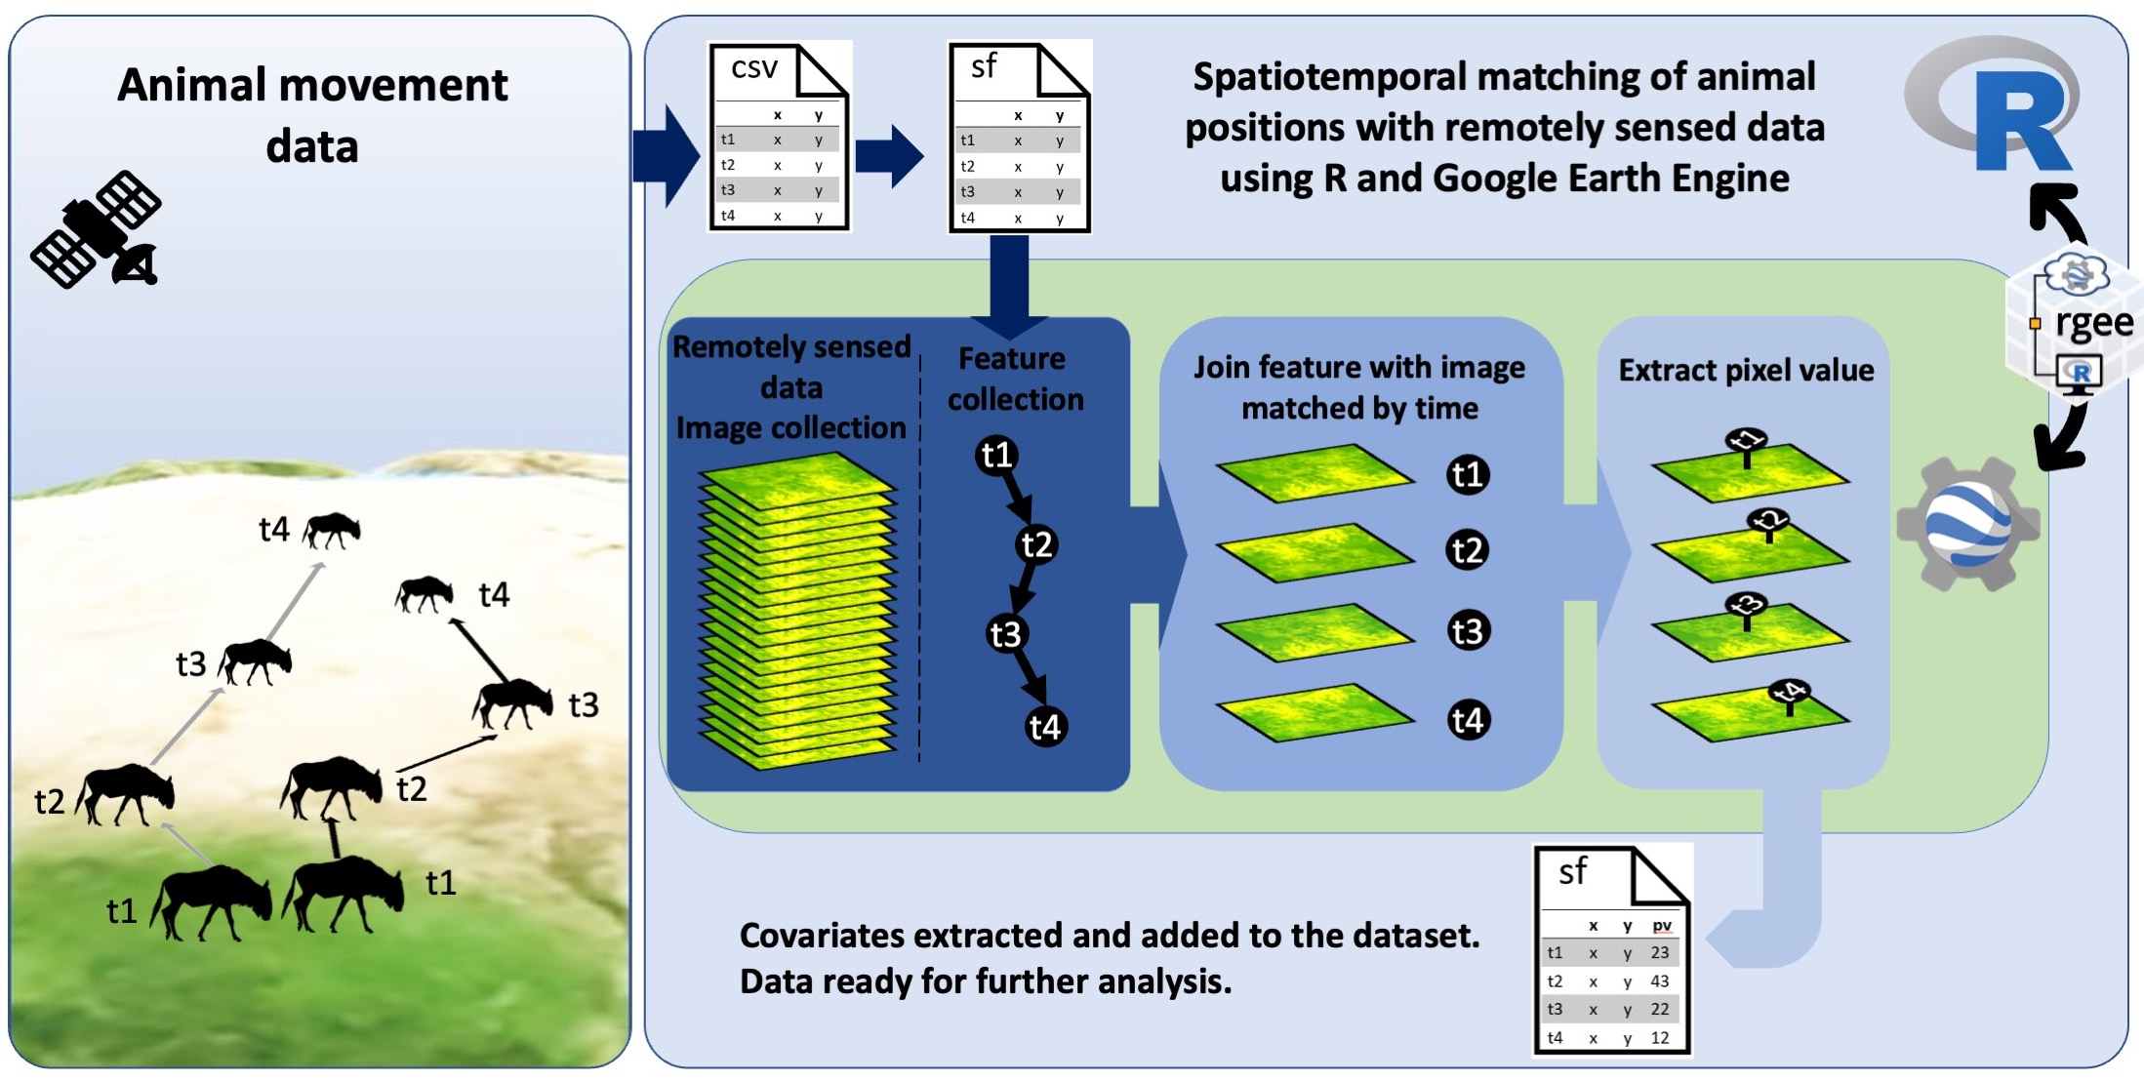
Google Earth Engine
Follow GEE workflow
Derived from information provided by NASA’s ARSET program – Introduction to the Integration of Animal Tracking and Remote Sensing

