Slide 1
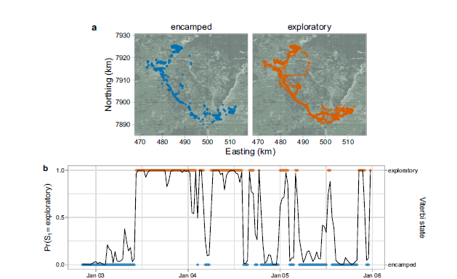
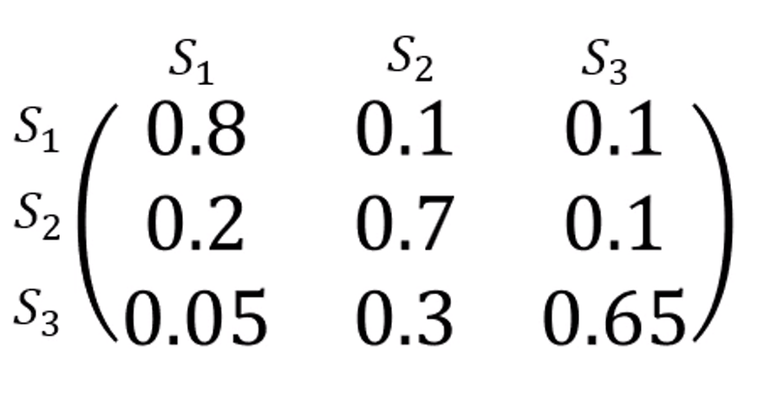

Introduction to Animal Movement Analyses
Categorizing Behavioral States
This lecture is based on a graduate training course taught
at the Smithsonian-Mason School of Conservation
Many thanks to Dr. Joe Kolowski for sharing his notes.
https://smconservation.gmu.edu/programs/graduate-and-professional/
Notes:
Today we’ll investigate what else we can infer about the animal’s we’ve fitted with tracking devices.
As you all are aware, it is very difficult to physically observe animals in the wild. As a result, researchers often use the movement path to infer information about the animal’s behavior. Is the animal resting? Is it feeding? How much time does it spend moving or feeding? And, importantly, what habitats does it frequent and what resources does it need for survival?
One way to address these questions is by Behavioral partitioning.

Slide 2
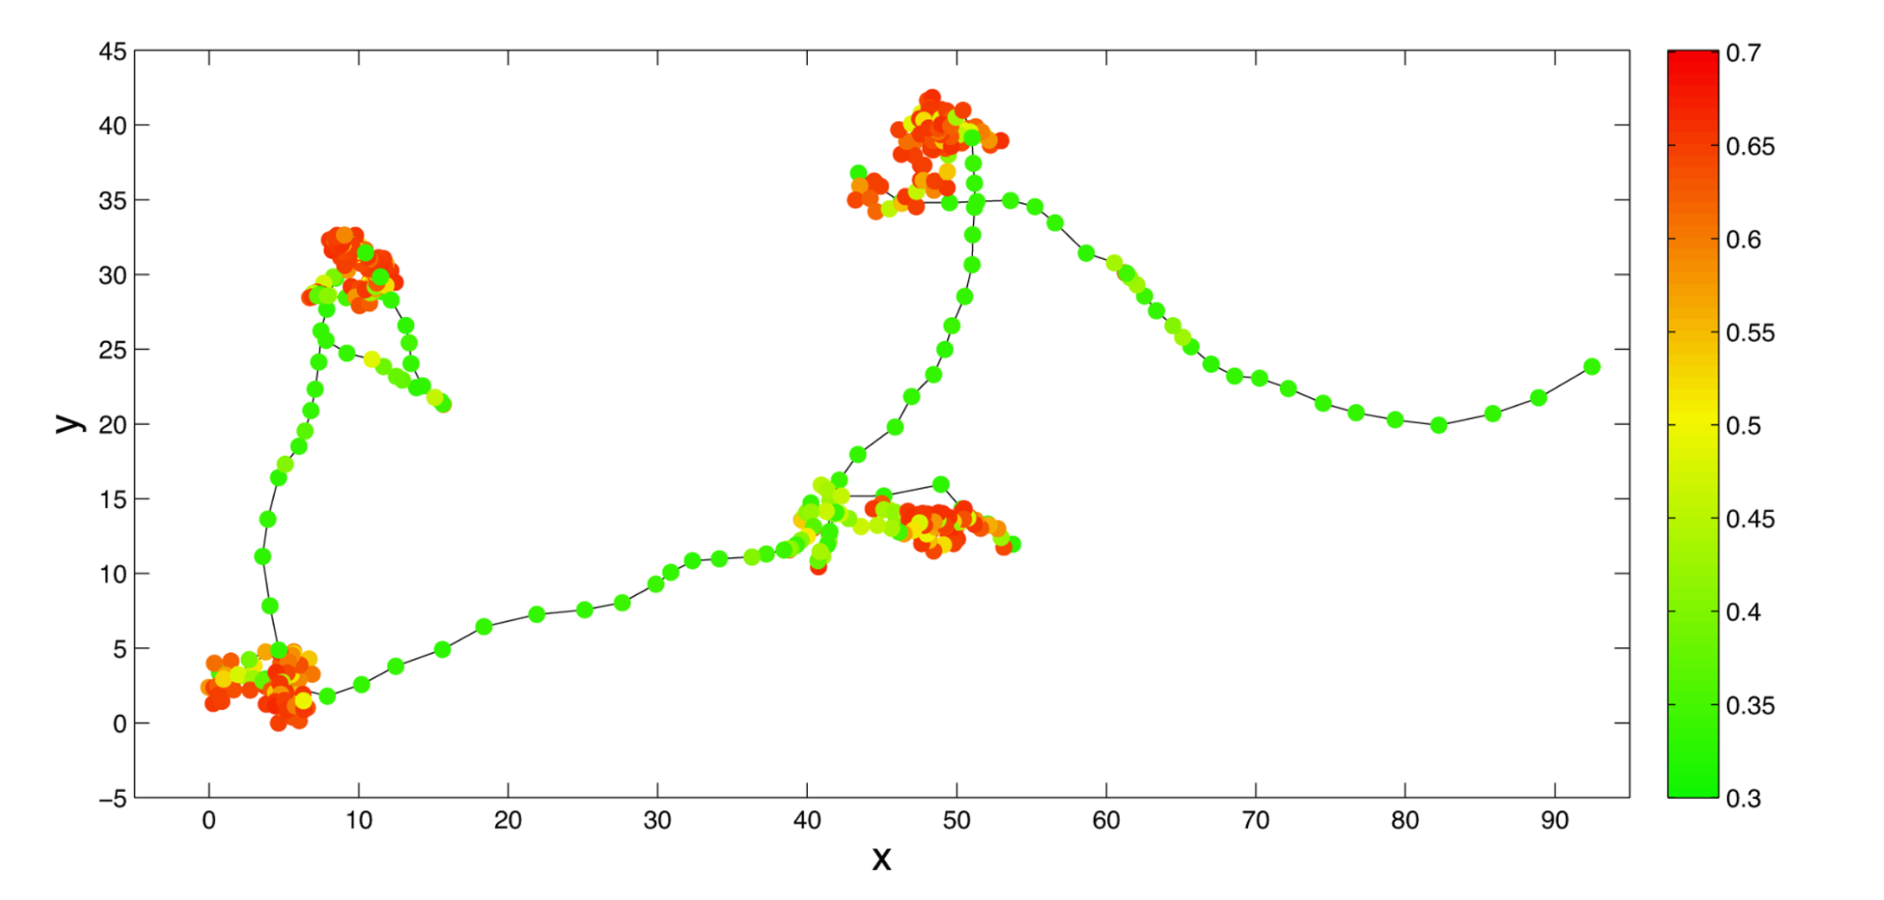
Behavioral Partitioning
Hidden Markov Models (State-switching State Space Models)
Behavioral Change Point Analysis (BCPA)
First Passage Time/Residence Time
Multi-state Random Walk
Hidden Markov Models (State-switching State Space Models)
Behavioral Change Point Analysis (BCPA)
First Passage Time/Residence Time
Multi-state Random Walk
See Gurarie et al. 2016
for summary and comparison of methods
Notes:
Behavioral Partitioning involves using characteristics of the movement information, typically across all individuals, in order to assign a label to segments of the movement path to identify what the animal or animals were doing. More technically correct, what we are doing is identifying when is the animal doing something different from what it was previously doing. Has the movements changed over time and what does that change in movement mean?
From this, we are trying to associate these changes in movement with a specific behavior.
We have a few options available to us to answer these types of questions, these include Hidden Mark Models or so-called State-Switching State Space Models, Behavioral Change Point Analysis (BCPA), First Passage Time or Residence Time, and Multi-state Random Walks. We’ll walk through some example code to fit a HMM, but I’ve also listed Gurarie et al 2016 paper which provides a very nice summary of these methods.

Slide 3
Applications of Behavior State Assignment
Exploratory
(What is the animal doing?)
Explanatory
(Why is the animal doing it?)
Predictive
(Can we anticipate movement from behavior?)
If we modify the environment in some way, how will movement behavior change?
Metrics to describe and quantify the movement track
Are there distinct behaviors? If so, how many?
What distinguishes the behaviors?
When and where do the behaviors occur?
Associate behaviors and transitions with covariates
Season
Environmental cues
Predation or conspecifics
Notes:
One of the things the Gurarie paper does well is to break apart the objectives of animal movement studies into three main categories: Exploratory, Explanatory, and Predictive.
In the Exploratory phase, we are interested in what the animal is doing? This entails generating metrics to describe and quantify the movement track. How fast or slow is the animal moving? How far did it move? Then, we can start asking whether there are distinct behaviors in the animal movement track and if so, how many? What characteristics distinguish these behavior and we can investigate when and where these behaviors occur? This get’s very interesting, as we start to look at the preferences of the animal and how their movements are related to habitat, climate, and/or disturbance.
Then we can start to ask Explanatory behaviors. Why is the animal doing something? This allows us to associate behaviors with something in the animal’s environment or how the transitions are related to particular covariates, like season or some sort of environmental cue, or potential related to predation or social factors like the rank of the animal in a group or how many animals might be in a group.
And then finally we ask predictive questions. If we modify the environment in some way, how would that be expected to impact the animal.
It’s really these Explanatory and Predictive aspects that are most interesting, but require us to start at the Exploratory phase.

Slide 4
Hidden Markov Models
Discrete time, discrete state, state space models
Operate on time-series data for step lengths and turning angles
Could also be used on accelerometry data, but also occupancy data, capture-recapture data…
Parameters of step length distribution and turning angle distribution determined by an underlying observed state
Notes:
HMMs are discrete time, discrete state, state space models. The behavioral state of the animal is the unobserved, or the latent state, that we are trying to predict.
These models operate on time series data where the response variable is step length and turning angle, but this framework could be used on other time series data, for instance accelerometry data, occupancy data, capture-recapture data, and others
The key assumption is that we have some unknown number of unobserved behavioral states and these behavioral states can be distinguished by distinct statistical distributions of step lengths and turning angles.

Slide 5
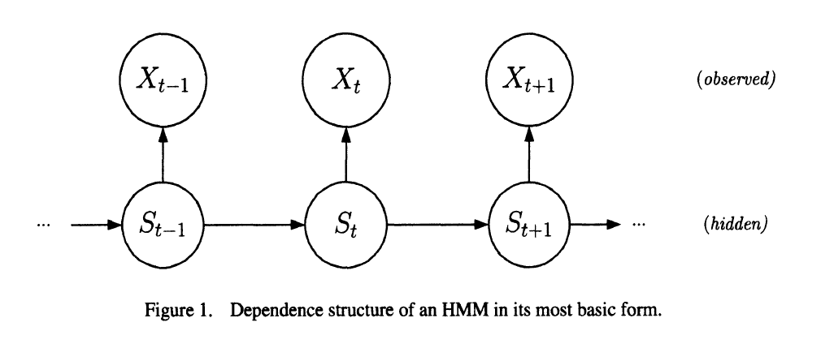
Hidden Markov Models
Observation process and latent state process
Locations are the observation process, behavior state is the latent state process
Latent state process taken to be a Markov Chain
Discrete random variable, (1,2,…N)
N is # of potential states (typically <= 4)
Data distributions (step length and turn angle) vary by state
Transition probability matrix
Governs the sequence of switching most likely and how probable these switches are
Pohle et al. 2017
Notes:
So what does this look like.
We have two processes…this is what makes this a hierarchical modeling approach. We have our observation process, which in this case is our location observations with associated step lengths and turning angles….the movement data. And, we have our latent or unobserved state…our hidden state. This is what we want to learn about.
We assume that this latent state process is a Markov process, meaning that information about the current state is used to make inference about the following or future state.
You might also hear the term 1st order 2nd order Markov process. This just mean how many previous states are used (1 or 2 or more) to inform the current or future state. So a 1st order Markov process indicates that we are only using the current state to predict our future state.
We have discrete (arguably) random variables, in this case step length and turning angles. And we have N, our number of states, which in most cases is typically 4 or less. Most likely 2 or 3 states. This is what we are trying to estimate effectively. What is the animal doing? Is it resting or feeding?
Again, the key is that these states vary in the distributions of the step length and turning angles. We’ll also have a transition matrix included in these models. This governs how likely it is for animal to switch from one state to another state.

Slide 6
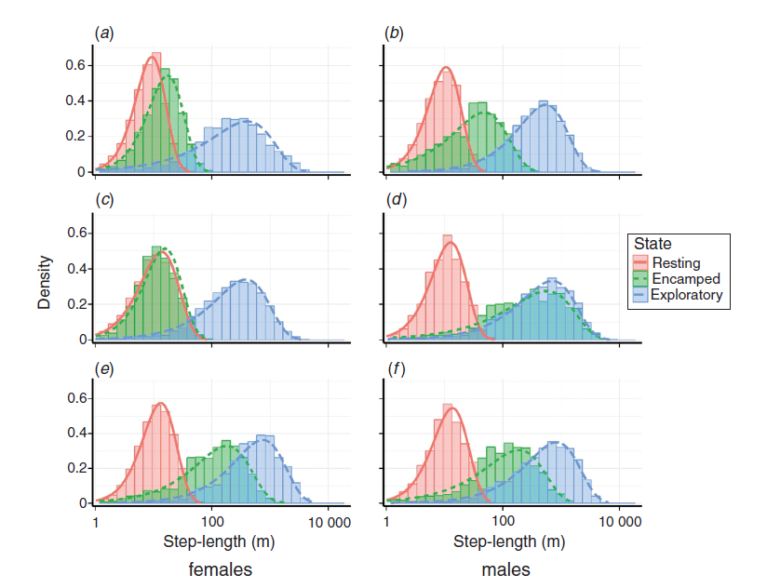
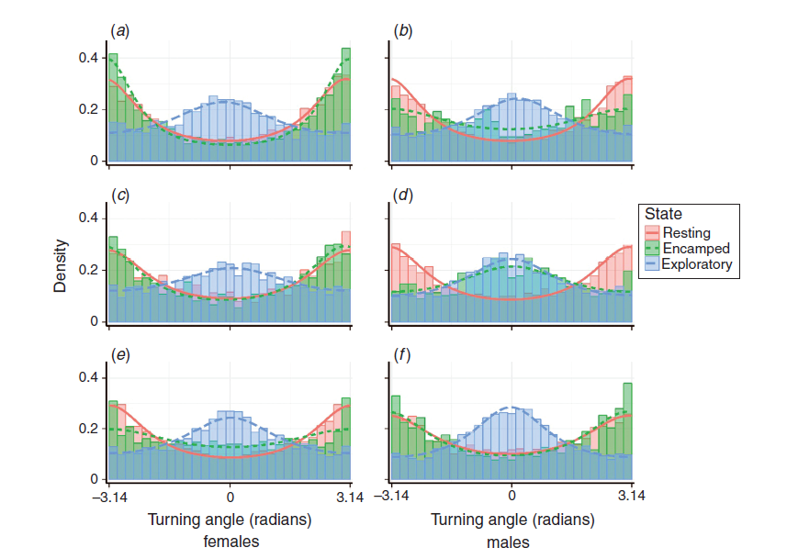
Implementing HMMs in R
Models estimate:
Transition probabilities
Mean and variance of step length and turn angle for all states
Transition probabilities can be modeled as function of covariates
Step length
Turning angle
Notes:
So with these models, we are going to estimate transition probabilities, which we see in the matrix table on the bottom left. And it’s going to estimate the parameters of the statistical distributions of step length and turning angles for each of our states. This is the kind of output that we will see with these models. On the right, which is taken from XXX,, shown as thick curved lines. Step lengths are at the top and turning angles on the bottom. Most important for you at this point is simply to notice the difference in the distributions between each of these states.
We also see the numerical transitions which estimates the likelihood that animals switch from 1 state to the next. This matrix is easiest read in rows…so the probability that an animal will transition from State 1 to State 1, that is stay within that state is very high (0.8 or 80 %), with smaller probabilities of transitioning from State 1 to State 2 or State 1 to State 3. Similarly, we see that this animal transitions from State 2 to State 1 with a 20% probability and from State 2 to State 3 with a 10% probability.
Interestingly, the diagonals are all quite high. This make sense. When you are in a particular state, you tend to stay in that state.
Probably most important is that we can incorporate covariates that influence the transitions between different states. So, for instance, does the habitat type or time of day influence your behavioral state. This is what we will be looking at when we fit models.

Slide 7
HMM Parameters for Animal Movement
N = # of states
Distribution of step lengths (for each state)
Gamma, Weibull, log-normal and exponential distributions
Mean
Variance (SD)
Distribution of turning angles (for each state)
von Mises and wrapped Cauchy distributions
Mean
Clustering parameter
Notes:
When we setup these models, we need to provide starting values. This can be a frustrating part, as the models will often fail if improper starting values are provided.
We have to input the number of states. This is not an estimable parameter in these models. It must be provided.
Then, we need to setup the distributions for step length and turning angles and we need to do this for each of the states. This means we first need to specify the shape of the distribution. For the steplengths, we have a few potential distributions to choose from. A gamma distribution is the default, but we could also choose a Weibull, a log-normal, or an exponential distribution. These dictate the shape and behavior of the curves. For Gamma, we then need to provide the mean and variance.
For our turning angles, we have a few potential distribution options, the von Mises and the wrapped Cauchy. Both are circular distributions, which require the mean turning angle and the clustering parameter which is similar to the variance of the turning angle distribution.

Slide 8
Implementing HMMs in R
Connecting location data to latent states (decoding algorithms)
Viterbi
Finds most probable sequence of states that generated the data
Stationary probabilities available
Assume regular sampling with negligible error
Paths can be smoothed prior to analysis if error on same scale as step lengths
No date/time information is included
User specifies # of state (<= 4) and models with varying states can be compared with AIC
Notes:
Once models are run….we can then use what are called decoding algorithms to assess the most likely state for every one of our locations. In R, we have access to three different algorithms, which differ slightly with how they decode the state values. The default is called the Viterbi algorithm.
We also have access to stationary probabilities. So instead of assigning a state to every point, we can look at the state probability of each point, often times providing a value of confidence to each particular state assignment.
It’s important to note that with these models we are assuming regular sampling intervals with negligible error. If this assumption can’t be met, pre-processing of the data would be necessary. There are a few ways to simulate movement paths, once of which would be to use CTMM. The problem here is that the latent states that we are estimating are completing based on the steplengths and turning angles. And, if these are incorrect or biased in some way, it can have a huge on these distributions and impact our results.
There is no date/time included in these models……we have to make sure we are feeding the data in an ordered sequence (Chronologically). As a result, we need to be very careful about irregularly sampled data, as the model won’t differentiate.
We also can use standard model comparison techniques like AIC to assess individual models.

Slide 9
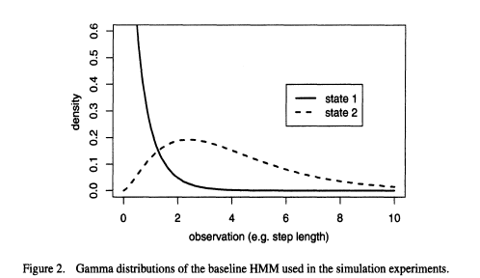
Pohle et al. 2017
Notes:
Here, I’m showing you the gamma distribution. The nice aspect of this distribution and why it’s used is that values cannot go below 0. You can’t have a negative steplength, so it’s more appropriate, that is, it has the statistical support to be used with the animal movement data.
Here, we have 2 states. State 1 is described with a mean value of 0.5 and a shape parameter of 0.7, that’s essentially the variance in this distribution. State 2 has a mean of 4, with a shape or variance of 2.5. What you can see is the difference in the shapes for each of these states…representative of different behaviors.

Slide 10
Hidden Markov Models with momentuHMM
my_mod <- fitHMM(data = my_move_object,
nbStates= 2,
dist = list(step = “gamma”, angle = “vm”),
Par0 = list(step = stepPar0, angle = anglePar0),
formula = ~ 1)
plot(my_mod)
# Needs to be specified (≤ 4)
# Distributions
# Starting values
Ability to investigate impact of covariates on transition probabilities
Notes:
Okay, so in R and using the package momentuHMM, this is the structure of the function that we will use.
The syntax requires us to specify the movement object….again, we need to format this data object, as momentuHMM does NOT recognize the data as a time series. So, it’s very important to we clean these data and align the sequence properly before starting the modeling process. This is what we will be doing next.
We then need to specify the number of states we are interested in estimating. We then need to specify our initial starting values for the steplength and turning angles of each of these states. We then can also include a formula to investigate the impact of various covariates on our transition probabilities. These are the factors that influence whether the animal is in 1 state or another. Here, we’ve specified this in normal model notation as a null model….that is, the covariates have no impact on the transition probabilities. This could, however, be distance to water, time of day, amount of anthropogenic or human disturbance. Note, these covariates must a continuous predictor variable….something that varies over time (i.e., continuous, time varying predictors). So, for instance, you wouldn’t include something like sex, since this would not vary over time. Habitat type can also be difficult to include as the data are categorical. You could include age or age class (juvenile, sub-adult, adult) as these items do change and could have an impact on the animal transitioning from different states.
Once you have a fitted model, you can then plot the model to visualize the results by plotting the model output.

Slide 11
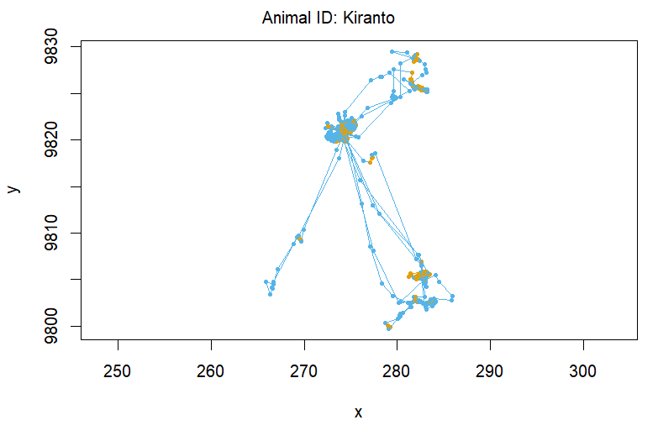
Notes:
Here’s the type of output that you will receive after fitting your HMM. The movement trajectory, in this case it’s one of my wildebeest that we will be using, is divided into different colors. It’s then up to the researcher to assign a name to the behaviors. We don’t actually know what these behaviors are. All that we do know is that the model has identified these as two unique behavior based solely on the step lengths and turning angles. Here, we can reasonably say that one of the states, colored in orange, is more of an encamped or area restricted search behavior and the blue, is more of an exploratory state that is characterized by longer steplengths and more directed movements.

Slide 12
Postlethwaite and Dennis 2013
Notes:
In the previous graph, each point was coded based on a predictive state assignment. But, since you also get a probability of being in one particular state, you can also graph this probability assignment over time. Here, I’m showing a simulated track from Postlethwaite and Dennis where the probabilities of being in one particular state are displayed. So you can see that the model predicts with a high level of certainty the state in red, but a lower probability of that particular state in green. So, just another visual tool to see what’s happening behind the scenes and perhaps convince yourself that the model is doing what you expect.

Slide 13
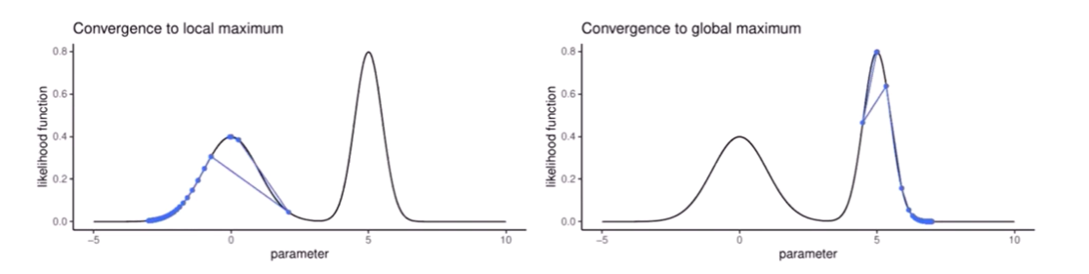
Common Challenges
Choosing Starting Values
HMMs are fitted by numerical optimization (to find parameters that maximise the likelihood
User needs to set a starting point
Convergence to “global” maximum (i.e., best model) requires a good starting point
Partial solution: try many starting values; look at data to pick plausible values
Slide from T. Michelot

Slide 14
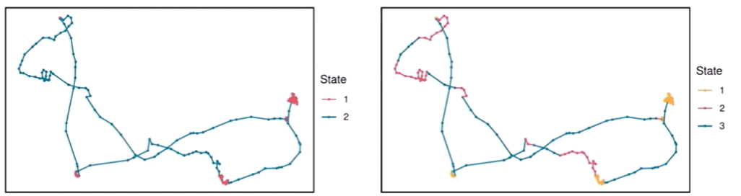
Common Challenges
Choosing the Number of States
We need to choose the number of states
Most studies use 2 states (“slow” and “fast”)
3-4 can sometimes be interpreted biologically – beyond that it may be difficult
AIC/BIC often select much more complex models
Partial solution: Use a combination of model checking and biological knowledge
Slide from T. Michelot

Slide 15
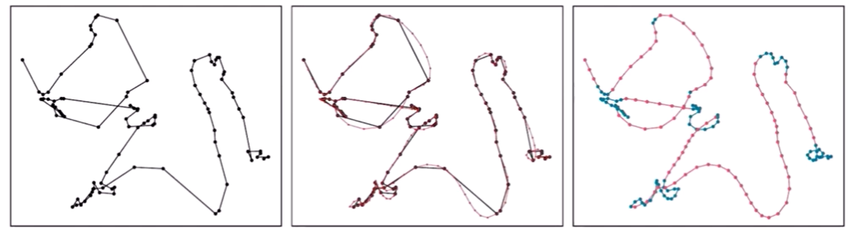
Common Challenges
Irregular or Noisy Locations
HMM requirements:
Measurement error should be negligible
Locations should be observed at regularly time intervals
Partial solution: Filter noise and regularize tracks with a state-space or simulation approach
Slide from T. Michelot

Slide 16
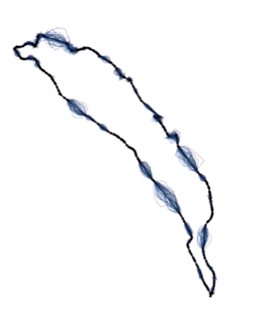
Multiple Imputation Procedure:
Generate several plausible filtered/regularized tracks
Fit an HMM to each imputed regular track
Combine HMMs to get parameters with better uncertainty estimates
Slide from T. Michelot

Slide 17
Challenges to HMMs
Starting parameters values and correct distributional forms
Choosing the # of states to model (Pohle et al. 2017)
Impact of sampling schedule (Postlethwaite and Dennis, 2013)
Higher resolution tends to improve identification of behavioral states as long as error is much smaller than step length
Irregular sampling
State space models with crawl or aniMotum or continuous time models with ctmm
Notes:
Some things to keep in mind.
First, we need to identify starting parameter values and the correct form of the distributions. We can test for the correct forms using sensitivity analyses, but this can be difficult, especially when models become more complex.
Second, we need to choose the # of states we aim to predict in the model. The Pohle et al paper is a particular good reference, providing recommendations on how to choose the number of states to include in your model. The model comparison tends to favor a model with more states, so that researcher really needs to think about his or her research question, rather than relying solely on quantitative metrics.
Third, the sampling schedule is absolutely going to impact your ability to identify behavioral states. This is largely due to the scale at which your species is making movement decisions. If your animal is making fine-scale complex movements, but you are sampling just a few times per day, you will be less likely to identify these behavioral changes. It’s also important to consider the error associated with your positions. You want to be modeling the movement process related to an animal’s behavior, not the error process.
Lastly, the model assumes regular sampling, which often is not the case with animal movement data. To get your data in the format required, you may need to resample your data to a different temporal interval, like crawl or aniMotum, before ingesting the data into moveHMM. These packages then smooth or regularlize the movement track so that the data can be integrated. This isn’t much of an issue when few data points are missing, but large gaps in data could be problematic and may require that you simply analyze the movement track with areas that are highly irregular.`

Slide 18
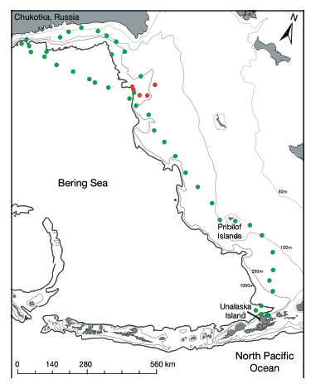
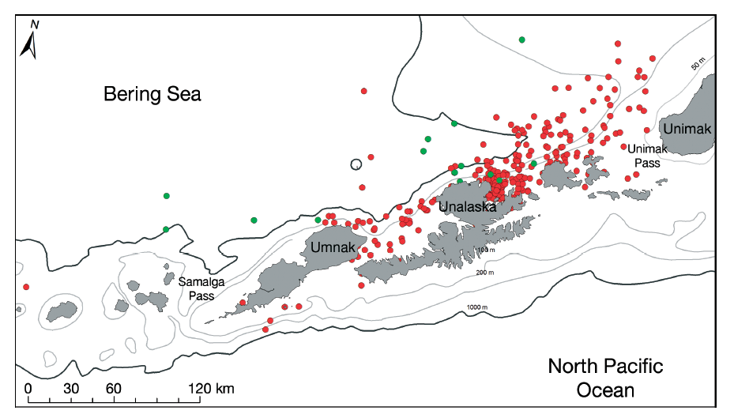
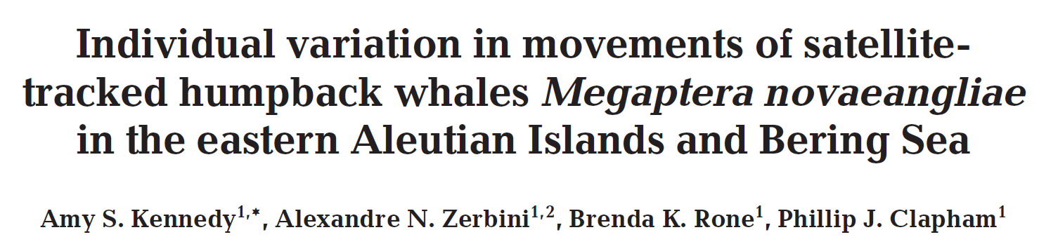
HMM Examples/Applications
Humpback whales
Notes:
To give you an appreciation for some of the applications of using a HMM to characterize animal behavior, I’ve provided a few examples for you to read through. The first is a humpback whale study where the researchers separated whale movements into two states, a foraging state which is shown in red and a traveling state in green. It’s hard to see from the graph, but you should see the difference in the scales of both of these maps. In the map of the left, whales are movement across a much smaller area, feeding mostly along the costline of these relatively small islands. In the graph on the right, the scale is much larger, with whales moving broadly across the area and almost exclusively traveling rather than foraging.

Slide 19
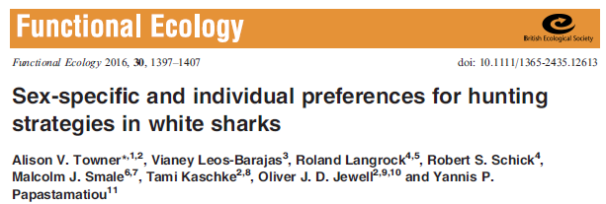
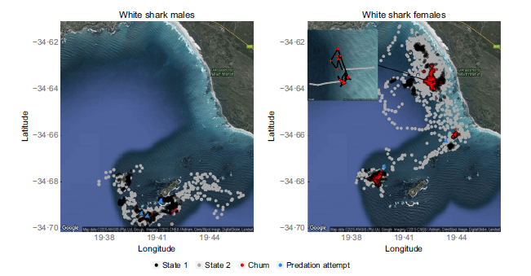
HMM Examples/Applications
White sharks
Notes:
This next example is of white sharks that are colored (black and grey) to highlight two different behavioral states. The black denotes an area restrictive search behavior and the grey denotes patrolling behavior. What they found was that area restrictive search behavior increase during morning periods and when tourist operations were chumming the water to facilitate shark viewing. They also found that the proportion of time that individuals spent in each state, different between sexes, the main point of the figure to show the dramatic differences observed.

Slide 20
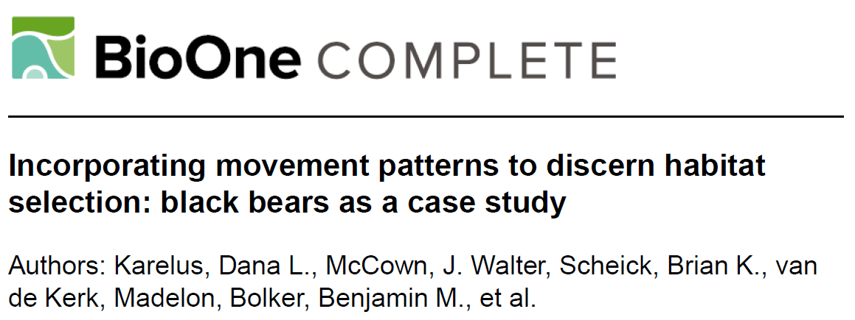
HMM Examples/Applications
Black bears
Winter
Summer
Fall
Notes:
In this next example, I wanted to show the type of output that is common to HMM analyses. These graphs are from a black bear study, showing the turning angles and steplength distributions of male and female bears in winter, summer, and fall. This is pretty interesting, as it shows changes in movement behavior across seasons. You can see that exploratory movements generally result in longer steplengths and straight line movements, with turning angles centered around zero. When animals are resting or encamped, however, they generally move with shorter steplengths and in a circular fashion…so much more of this area restricted search behavior that I mentioned previously. It’s also interesting because we can look at differences between sexes and while it’s not shown here, the authors separate out segments of these tracks based on these behaviors (resting, encamped, exploratory) to perform behavioral-based resource selection/habitat modeling. So, recognizing that habitat selection may differ when the animal is resting or foraging.

Slide 21
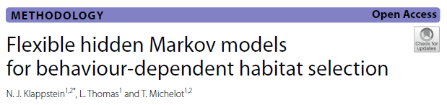
HMM Examples/Applications
Plains zebra
Notes:
This paper integrates the results from a Hidden Markov Model into a step selection function analyses and tries to pull as much information from the movement track to improve a habitat selection analyses. This seems like the direction that this field is heading. Here we see two different behavioral states for plains zebra, displayed in a figure we can generate from the moveHMM package to visualize the switches in behavior that occurred over a 3 year tracking period. From the graph we see that this animal spent long periods in one behavior compared to another, allowing us to investigate other potentially more interesting questions about why this might be. Is it related, for example, to changes in habitat or climate, etc.

Slide 22
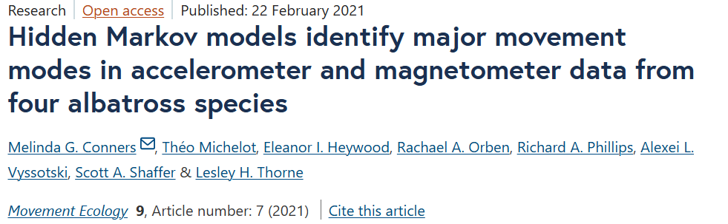
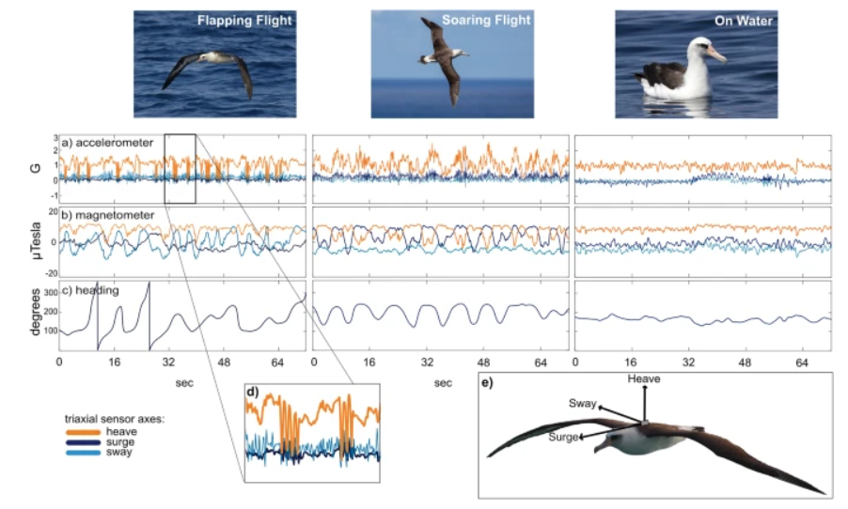
HMM Examples/Applications
Albatross

Slide 23
References
Cagnacci, F., Focardi, S., Ghisla, A., van Moorter, B., Merrill, E.H., Gurarie, E., Heurich, M., Mysterud, A., Linnell, J., Panzacchi, M., May, R., Nygård, T., Rolandsen, C. and Hebblewhite, M. (2016), How many routes lead to migration? Comparison of methods to assess and characterize migratory movements. J Anim Ecol, 85: 54-68.
Karelus, D.L., J. Walter McCown, Brian K. Scheick, Madelonvan de Kerk, Benjamin M. Bolker, Madan K. Oli "Incorporating movement patterns to discern habitat selection: black bears as a case study," Wildlife Research, 46(1), 76-88, (15 February 2019)
Kennedy, A. S., A. N. Zerbini, B. K. Rone, and P. J. Clapham. 2014. Individual variation in movements of satellite-tracked humpback whales Megaptera novaeangliae in the eastern Aleutian Islands and Bering Sea. Endangered Species Research 23:187195
Klappstein NJ, Thomas L, Michelot T. Flexible hidden Markov models for behaviour-dependent habitat selection. Mov Ecol. 2023 Jun 3;11(1):30. doi: 10.1186/s40462-023-00392-3.
McClintock, B.T. and Michelot, T. (2018), momentuHMM: R package for generalized hidden Markov models of animal movement. Methods Ecol Evol, 9(6): 1518-1530. https://doi.org/10.1111/2041-210X.12995.
Michelot, T., Langrock, R. and Patterson, T.A. (2016), moveHMM: an R package for the statistical modelling of animal movement data using hidden Markov models. Methods Ecol Evol, 7: 1308-1315.

Slide 24
References (Cont’d)
Nicholson, K.L., Matthew J. Warren, Camille Rostan, Johan Månsson, Thomas F. Paragi, HåkanSand. 2019. Using fine-scale movement patterns to infer ungulate parturition. Ecological Indicators 101: 22-30. https://doi.org/10.1016/j.ecolind.2019.01.004.
Patin, R, Etienne, M-P, Lebarbier, E, Chamaillé-Jammes, S, Benhamou, S. Identifying stationary phases in multivariate time series for highlighting behavioural modes and home range settlements. J Anim Ecol. 2020; 89: 44–56.
Pohle, J., Langrock, R., van Beest, F.M. et al. Selecting the Number of States in Hidden Markov Models: Pragmatic Solutions Illustrated Using Animal Movement. JABES 22, 270–293 (2017). https://doi.org/10.1007/s13253-017-0283-8
Postlethwaite CM, Dennis TE (2013) Effects of Temporal Resolution on an Inferential Model of Animal Movement. PLoS ONE 8(5): e57640.
Towner, A.V., Leos-Barajas, V., Langrock, R., Schick, R.S., Smale, M.J., Kaschke, T., Jewell, O.J.D. and Papastamatiou, Y.P. (2016), Sex-specific and individual preferences for hunting strategies in white sharks. Funct Ecol, 30: 1397-1407.
Zucchini, W., MacDonald, I. L., and Langrock, R. (2016). Hidden Markov models for time series: an introduction using R, Second Edition. Chapman and Hall/CRC.

