Slide 1
Jenkins Shared Pipelines
Notes:
My name is.
Work for animal logic
Who is using Jenkins pipelines? Who has attended or watched Malcom’s awesome presentation.
And last onw. Who is currently using shared pipelines… (what is your name?)
Let’s make this presentation interactive, so feel to interrupt at any point and ask questions that will be answered by NAME
As you might have already read in the description of this presentation
At Animal we have been using Jenkins for the last eight years, Jenkins pipelines for about a year (when Jenkins 2.0 was released) and Shared pipelines for about 4 months now.
I have to say that before pipelines and shared pipelines we hit several limitations were we had to create some man in the middle and some glue code. and I was on the search for of a replacement, but I have to say that things have improved a lot since Jenkins 2. we have removed many of those workarounds and we are enjoying the benefits of pipelines in general.
We have X number of Jenkins jobs running
And we made X number of builds over this years.
Not all are pipelines we are in the process of moving all to pipelines. (for the benefits just watch Malcolm's presentation)
Among others, one limitation was to apply changes to lots of jobs. You could use some power shell power to do some grepping and string replacement on the config.xml in the JENKINS_HOME or use a plugin called Configuration Slicing (https://wiki.jenkins.io/display/JENKINS/Configuration+Slicing+Plugin) . Has someone here gone thru that?
Somehow painful, no?
We went a long run using Managed Scripts. (The good part of that is that they can be written in groovy but also in python and bash and we a big number of python programmers)

Slide 2
What & Why Shared pipelines
Maintainability
  Promote code reuse
  Avoid code duplication
Batch changes
  Apply changes to all pipeline jobs at once
    i.e you change from
Avoid monster pipelines
Notes:
The same thing you do with c ++, java, python code is to create a library (a dll or dso file) so you want to write it once and have multiple pieces of software using it.
Jenkins pipeline are code as well either pure groovy or declarative pipeline but code in the end so we want to reuse it and avoid writing the same thing twice.
But more importantly we can change things In one place and that gets applied to all our jobs. (there used to be a slice configuration plugin that allowed you to find jeniks jobs
To give you some context we had hundred of tools and they all have their own build and release scripts. (and of course de documentation in the wiki was outdated)
But after some work and with the help of a tool called rez we managed to build tests and release all the tools with the same command. We have now more than one thousand interdependent pieces of software in for of rez packages and about 15000 packages versions.
And to avoid monster pipelines!!!!
Show examples..
Analogy of pipelines making a movie -→ pipelines to build /test/deploy.
Against our pipeline that go to test build and use the farm

Slide 3
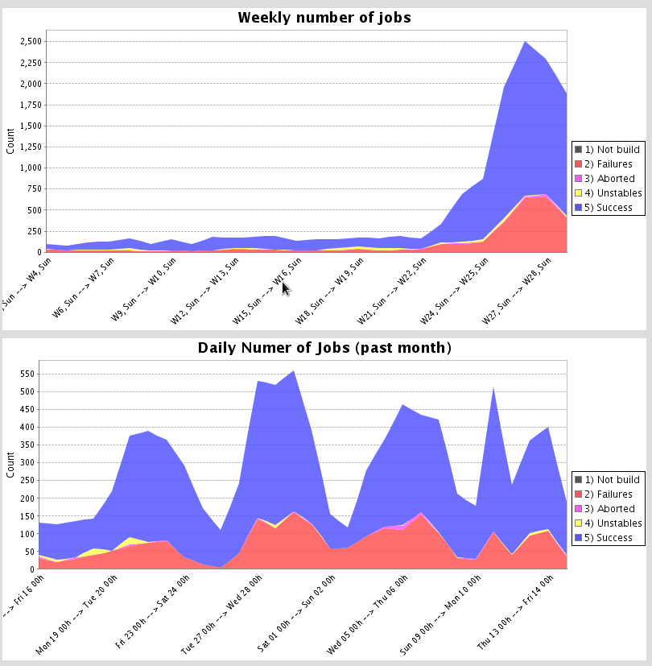
STATS

Slide 4
Agenda
Configuration and options
Library structure
Usage
Modification workflow
Notes:
Enough introduction let’s see what we are going to see today

Slide 5
Configuration
Two modes
  Legacy mode (single git repo hosted in jenkins)
  General mode
    Any scm
    Multiple sources
Notes:
It used to be a separated plugin but now it is bundled in the Jenkins core / Jenkins pipeline Pipeline Shared Groovy Libraries Plugin (workflow-cps-global-lib)
For this presentation we are only going to focus in the General mode only. The instruction to use the legacy mode are on a link at the end of the slides.

Slide 6
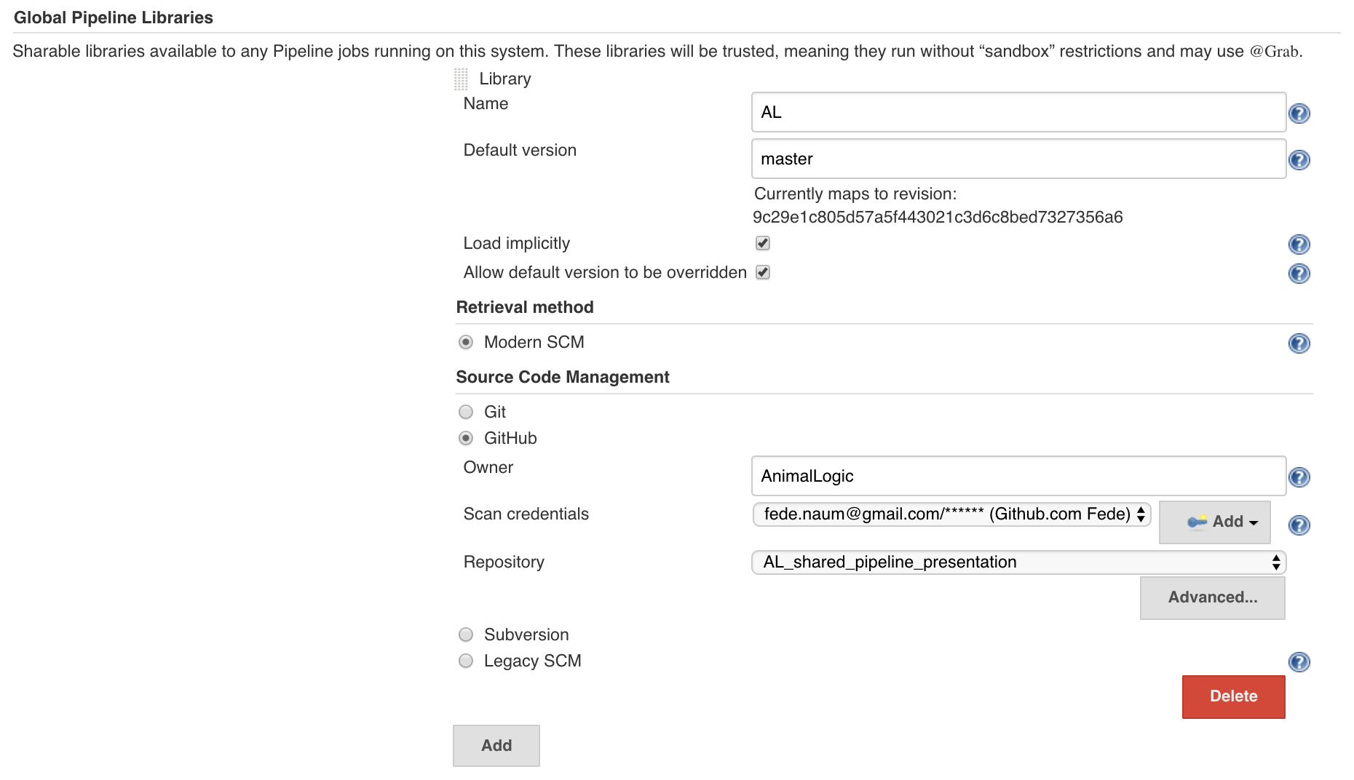
Configuration
Notes:
Jump to jenkins and use this parameters.
User: AnimalLogic
Repo:
One particular note here is that this shared pipeline are not sandboxed, so if you have being hitting this annoying thing that need to approve each groovy method on the In-process Script Approval
These libraries are considered "trusted:" they can run any methods in Java, Groovy, Jenkins internal APIs, Jenkins plugins, or third-party libraries. This allows you to define libraries which encapsulate individually unsafe APIs in a higher-level wrapper safe for use from any Pipeline. Beware that anyone able to push commits to this SCM repository could obtain unlimited access to Jenkins.
Furthermore, if you specify a version in Jenkins configuration, you can block scripts from selecting a different version
We have not setup our Shared library. You can define as many as you want.
Create a job and make it fail.
Luckily this gives a descriptive error saying that “ “ (if you are been working with Jenkins pipeline you’ll already know that this is not true all the time, some time the error are quite obscure)
So that brings us to the next slide, What is the library structure

Slide 7
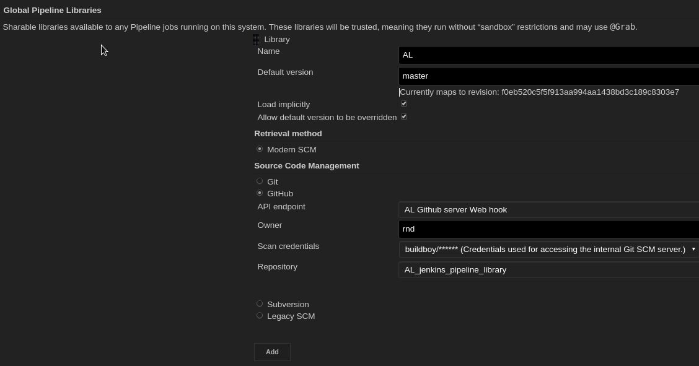
Configuration
Notes:
Jump to jenkins and use this parameters.
User: AnimalLogic
Repo:
One particular note here is that this shared pipeline are not sandboxed, so if you have being hitting this annoying thing that need to approve each groovy method on the In-process Script Approval
These libraries are considered "trusted:" they can run any methods in Java, Groovy, Jenkins internal APIs, Jenkins plugins, or third-party libraries. This allows you to define libraries which encapsulate individually unsafe APIs in a higher-level wrapper safe for use from any Pipeline. Beware that anyone able to push commits to this SCM repository could obtain unlimited access to Jenkins.
Furthermore, if you specify a version in Jenkins configuration, you can block scripts from selecting a different version
We have not setup our Shared library. You can define as many as you want.
Create a job and make it fail.
Luckily this gives a descriptive error saying that “ “ (if you are been working with Jenkins pipeline you’ll already know that this is not true all the time, some time the error are quite obscure)
So that brings us to the next slide, What is the library structure

Slide 8
Configuration
Two modes
  Legacy mode (single git repo hosted in jenkins)
  General mode
    Any scm
    Multiple sources
Notes:
It used to be a separated plugin but now it is bundled in the Jenkins core / Jenkins pipeline Pipeline Shared Groovy Libraries Plugin (workflow-cps-global-lib)
For this presentation we are only going to focus in the General mode only. The instruction to use the legacy mode are on a link at the end of the slides.

Slide 9
Directory structure
(root)
+- src # Groovy source files
| +- org
| +- foo
| +- Bar.groovy # for org.foo.Bar class
+- vars
| +- foo.groovy # for global 'foo' variable
| +- foo.txt # help for 'foo' variable
+- resources # resource files (external lib only)
| +- org
| +- foo
| +- bar.json # static helper data for org.foo.Bar
Notes:
As you can see the src directory looks like a Java source directory structure. This directory gets added to the classpath when executing Pipelines., so you do your imports as you would with an groovy
In the vars directory you can store scripts that define global variables and functions that can be accessed from your pipeline. That’s the one that we are using the most, since from our team of 30-40 developers only 10 are java developers . Most of the people writing pipelines come from python, so not much structured Java
To be picked up you need the files to be .groovy. The matching txt file is optional but I recommend that you always document them because that documentation is displayed in the UI and users can just have a look there to see what is available and how to use it.
The documentation file need to be called the same name as the groovy file and needs to have the txt extension
The contents can be written in HTML or Markdown, but in my experience we were only able to make it work with HTLM (I haven’t tried again with the latest changes)
The Groovy source files in these directories get the same “CPS transformation” as in Scripted Pipeline.
A resources directory allows the libraryResource step to be used from an external library to load associated non-Groovy files. Currently this feature is not supported for internal libraries.
Go ahead and create the

Slide 10
Global Functions vs class libraries
 | Global Variables/Functions | Class library
Contetns | Any Groovy code | Any Groovy code
Static Invocation (Annotation) | @Library('my-shared-library') _ | @Library(‘rez') import com.al.rez.BuildClass
Dynamic invocation (step) | library 'my-shared-library' | library(’rez’).com.al.rez.BuildClass.builds()
Resolution | At run time | At compile time
Access pipeline steps directly | YES | NO
Access env vars directly | YES | NO
Notes:
There is a reason for that _ that took it more than a day to figure it out. Currently that notation and the explanation is on the main documentation.
What it says is that instead of annotating an unnecessary import statement, the symbol _ is annotated.
For Class libraries the Annotation goes on an import statement
But when I was re-reading the documentation to create this presentation I found that after one of the release they have created a library step , so you can now at any time in your pipeline call library ‘my-shared-lib’ and after that you can use any method or global variable defined there. ( I tested and works fine)
3) The difference is that in when accessing branches of that library you could for example have something like library "my-shared-library@$BRANCH_NAME”
4) Libraries are resolved and loaded during compilation of the script, before it starts executing. This allows the Groovy compiler to understand the meaning of symbols used in static type checkin
Global Variables however, are resolved at runtime.
Internally, scripts in the vars directory are instantiated on-demand as singletons. This allows multiple methods or properties to be defined in a single .groovy file which interact with each other
5) It feels to me that when you write global functions is like abstracting some common usage in existing pipelines, and code in the class libraries is more like new functionality. But it might be just me. The code in Global functions could look like declarative pipelines where class reassemble more like java code.

Slide 11
Usage
@Library('my-shared-library') _
/* Using a version specifier, such as branch, tag, etc */
@Library('my-shared-library@1.0') _
/* Accessing multiple libraries with one statement */
@Library(['my-shared-library', 'otherlib@abc1234']) _
Notes:
So how to access it
@Library('my-shared-library') _
/* Using a version specifier, such as branch, tag, etc */
@Library('my-shared-library@1.0') _
/* Accessing multiple libraries with one statement */
@Library(['my-shared-library', 'otherlib@abc1234']) _
When referring to class libraries (with src/ directories), conventionally the annotation goes on an import statement:
@Library('somelib')
import com.mycorp.pipeline.somelib.UsefulClass
For Shared Libraries which only define Global Variables (vars/), or a Jenkinsfile which only needs a Global Variable, the annotation pattern @Library('my-shared-library') _ may be useful for keeping code concise. In essence, instead of annotating an unnecessary import statement, the symbol _ is annotated.
It is not recommended to import a global variable/function, since this will force the compiler to interpret fields and methods as static even if they were intended to be instance. The Groovy compiler in this case can produce confusing error messages.

Slide 12
Usage Examples
Notes:
Concrete examples could be something that runs a sonar build PR
On as a global varaible
One as class
One as a step
Built in acepting a strin i.e shell’’ git ‘’
Build in aceptiing a block i.e node{} script {}
Defining a more structured DSL

Slide 13

Notes:
Now we have all nicely setup , we have few libraries and helpers that give use we abstracted all the functionality in shared pipelines
And now we write a pipelines like this.
***Show stefano pipeline
And it does that.!!
Explain what it does… farm ..input step lightweight executors….
Now we easily add another 10 projects that use the same workflow we are happy ( happy slide -> paradise) Cloud cooks loand!!!
Now comes a developer and want to add something do an extra step, he goes change the code and introduced a bug.. Now all hour beautiful pipelines get destroyed (Cloud land destroyed)
That’s when you need to start using branches of your piepeline

Slide 14
Modification Workflow
Create a branch of you pipeline
Access you modification with @branchname
Submit pull request.
Get approval.
Merge to master.
Notes:
Other more secure/restrictive way will be in the configuration to set a

Slide 15
DO and DONTS
Do not import global variables
  If you do variables/functions became static
Do not Allow direct commits to master (modification of pipelines thru branches/PR)
Do use the linter when creating shared libraries (they save time)
Notes:
Even if they were intended to be instance. The Groovy compiler in this case can produce confusing error messages.
Use the _ at the end of the library directive
Workflow use library instead of pipeline editor (in reply) If you are using things from the library that can
They have the potential of destructing all your pipelines at once. And also they pose a security concerns.

Slide 16
GOTCHAS
PR not working the first time you add a Jenkinsfile, it needs to exists in the base branch
Libraries name are case sensitive (The linter does not catches that)
When you are modifying a script in the reply copy/paste first since it can fail
Or use the linter
Notes:
Even if they were intended to be instance. The Groovy compiler in this case can produce confusing error messages.
Use the _ at the end of the library directive
Workflow use library instead of pipeline editor (in reply) If you are using things from the library that can
They have the potential of destructing all your pipelines at once. And also they pose a security concerns.

Slide 17
Gotchas

Slide 18
Documentation
Notes:
A variable defined in a shared library will only show up in Global Variables Reference (under Pipeline Syntax) after Jenkins loads and uses that library as part of a successful Pipeline run.
Show example!!

Slide 19
Back up slides
Notes:
Folder-level Shared Libraries
Any Folder created can have Shared Libraries associated with it. This mechanism allows scoping of specific libraries to all the Pipelines inside of the folder or subfolder.
Folder-based libraries are not considered "trusted:" they run in the Groovy sandbox just like typical Pipelines.
Dinamic retrieval
Usually you define in Jenkins your shared libraries, but there is a way to retrieve a shared library dynamically without jenkins know about it. The syntax is hard to remmeber you can look that in the documentation. We haven’t had the need to use it. But I have it on the back of my mind in case someone propose me an use case. Like this.

Slide 20
Documentation links
https://jenkins.io/doc/book/pipeline/shared-libraries/

