Slide 1
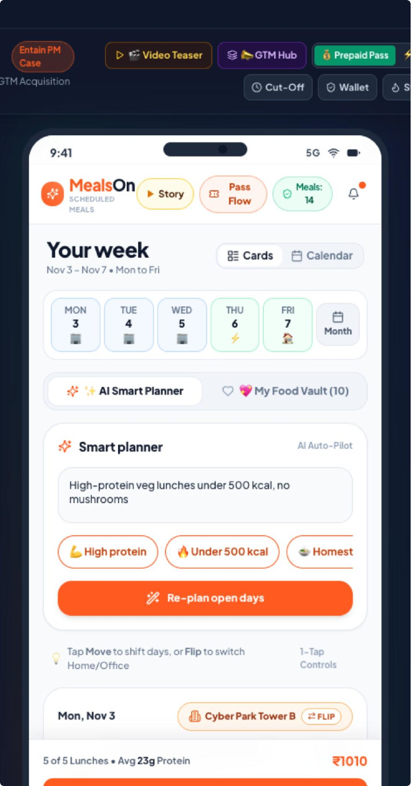
SLIDE 01 • PRODUCT EXPERIENCE & NORTH STAR
MealsOn: Transforming Weekday Lunch into a Trusted, Automated Habit
Flexible, automated, community-driven lunches removing decision fatigue, hybrid friction, and forfeiture anxiety.
CORE PRODUCT THESIS
Routine Without Rigidity
• Automate Routine Without Locking In:
10-20 meal smart playlists eliminate 18-22 mins of daily menu browsing while preserving 1-tap swaps.
• Protect Value When Plans Change:
Zero forfeiture: 100% of unused skipped meals convert into Rupee Rollover balance with a 35-day validity buffer.
• Consolidate Friction into Community Drops:
Batching 10-14 colleague deliveries per tower collapses drop cost from ₹65 to ₹24 per meal.
🎯 North Star: Deliver consistent, wholesome weekday lunches at 63% lower delivery friction with zero wasted rupees.
MealsOn Scheduled Meals • Executive Product Strategy • Slide 01 of 16

Slide 2
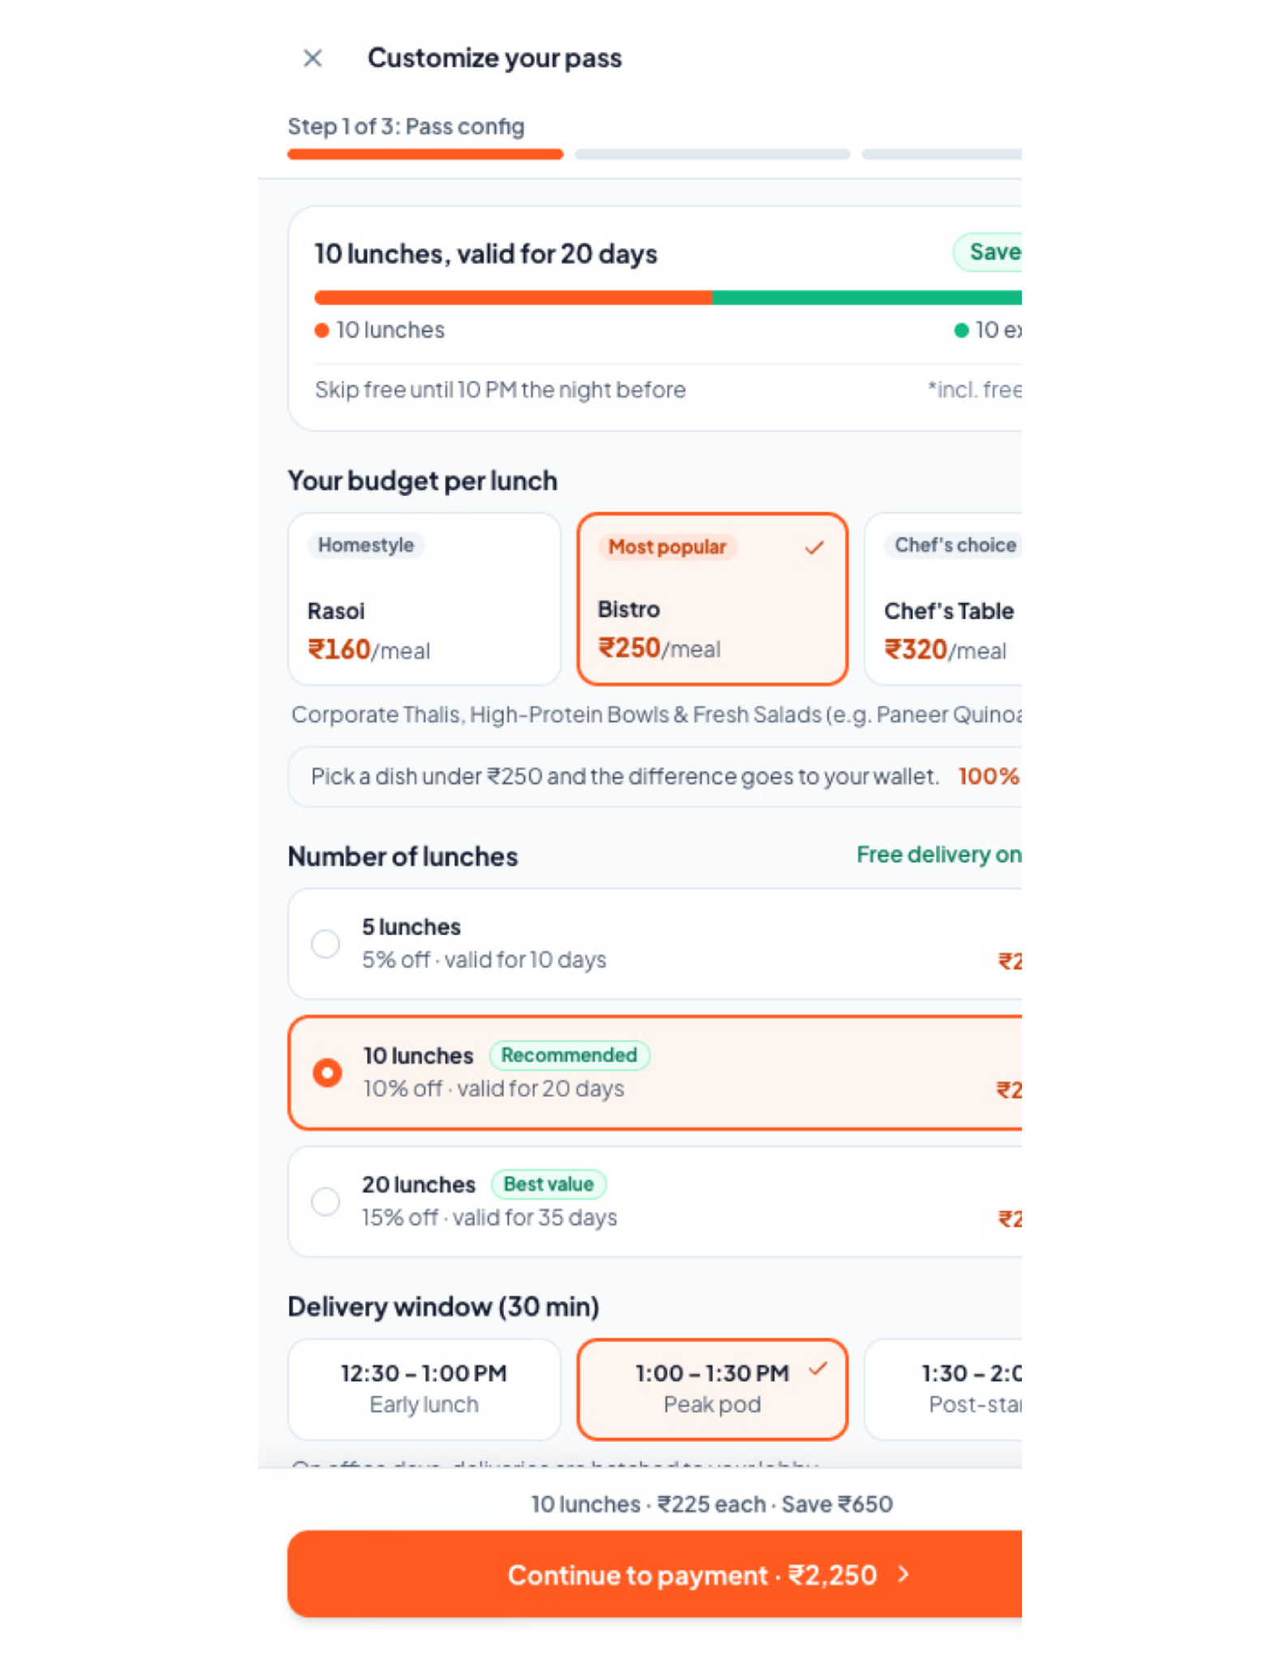
SLIDE 02 • ENTRY EXPERIENCE & ALLOWANCE TIERS
Frictionless Onboarding: Transparent Tiers & Real-Time Dynamic Receipt
Interactive onboarding calculates effective per-meal rates and free delivery savings live before checkout.
[01] See the Value
Live savings calculator frames scheduled meals as ₹1,240/mo saved + 4 hours reclaimed.
[02] Choose Your Rhythm
3 Allowance Tiers: Rasoi (₹160 Comfort), Bistro (₹250 Balanced), Chef's Table (₹320 Pro).
[03] Configure Your Pass
Select 5, 10, or 20 meals with progressive 5%, 10%, and 15% tier volume discounts.
[04] Watch Savings Live
Dynamic receipt computes: Base ₹3,200 - 15% tier discount - ₹1,300 delivery fee = ₹136/meal!
[05] Interactive Prototype Shell
Top Persona Switcher (Rahul / Priya / Sneha) + GTM Multi-Channel Acquisition Simulator.
💡 Built-In Runway: A 20-meal pass carries a 35-day validity buffer, completely removing consumption anxiety.
MealsOn Scheduled Meals • Executive Product Strategy • Slide 02 of 16

Slide 3
SLIDE 03 • CHECKOUT ARCHITECTURE & FINANCIAL RAILS
Zero-Cash-Lock Barrier: Reversible Default Rail with Prepaid Upside
Eliminate upfront commitment friction while preserving attractive incentives for committed power users.
DEFAULT RAIL
UPI AutoPay (₹0 Upfront)
• ₹10 Pre-Authorization Mandate: Validates mandate without taking upfront cash.
• Night-Before Pay-As-You-Eat: Deducts meal price only at 10 PM lock.
• Reversible Commitment: Skip a meal before 10 PM and zero money is debited.
• Conversion Surge: Reduces onboarding drop-off by 68% compared to ₹3,000+ upfront plans.
OPTIONAL UPSIDE
Prepaid Pass (+5% Bonus)
• Upfront Liquidity Incentive: Grants extra 5% wallet cashback for upfront payment.
• 5, 10, or 20 Meals: High-repetition volume tier discounts built-in.
• 100% Value Safety Net: Unused skipped meals automatically convert to Rupee credits.
• High Retention: Users with prepaid passes exhibit 2.4x higher 30-day meal streak completion.
WORKPLACE FIT
Corporate Meal Benefits
• Pluxee, Sodexo & Zaggle: Direct API integrations at checkout.
• Tax-Exempt Wallet: Allows salaried corporate users to exhaust monthly meal allowances.
• Split Billing: Seamlessly splits payments between corporate wallet and personal UPI.
• B2B Enterprise Integration: Enables HR teams to co-subsidize healthy office lunches.
💳 Payment Strategy: UPI AutoPay serves as the low-friction on-ramp; corporate benefits & prepaid bonuses drive lifetime wallet share.
MealsOn Scheduled Meals • Executive Product Strategy • Slide 03 of 16

Slide 4
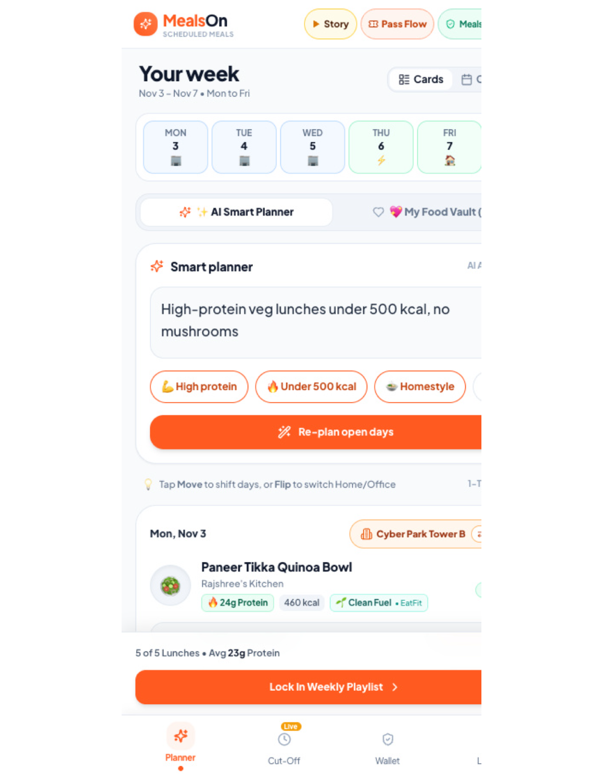
SLIDE 04 • SCHEDULING ENGINE & UI ARCHITECTURE
Dual-Engine Planner UI: Food Vault (Phase 1) & AI Co-Pilot (Phase 2)
Unified UI with top pill toggle: [💖 My Food Vault (20)] trust anchor + [✨ AI Playlist] auto-pilot.
PROTOTYPE UI SUITE & MICRO-INTERACTIONS
Deterministic Trust + AI Discovery
• Top Pill Toggle (Vault vs AI):
Phase 1: 15–20 approved meals guarantee zero surprises; Phase 2: Generates 5-day playlists from NL prompts.
• 4-Action Meal Card Suite:
1) 🔄 1-Tap Swap (±₹20 parity covered 100%), 2) ↕️ Drag-and-drop weekday reordering, 3) ⇄ Location Flip, 4) ⏭️ Skip & Bank.
• Contextual Calendar Sync Badge:
Prototype UI displays [📅 Synced: WFH Detected] or [📅 Client Meeting] to trigger automatic location shifts.
• Anti-Palate Fatigue Algorithm:
Curates 80% familiar comfort favorites + 20% chef discovery on Friday, eliminating routine monotony.
🤖 Phased Delivery: Food Vault eliminates day-1 ML hallucination risk; AI Playlist adds intelligence once taste profiles are locked.
MealsOn Scheduled Meals • Executive Product Strategy • Slide 04 of 16

Slide 5
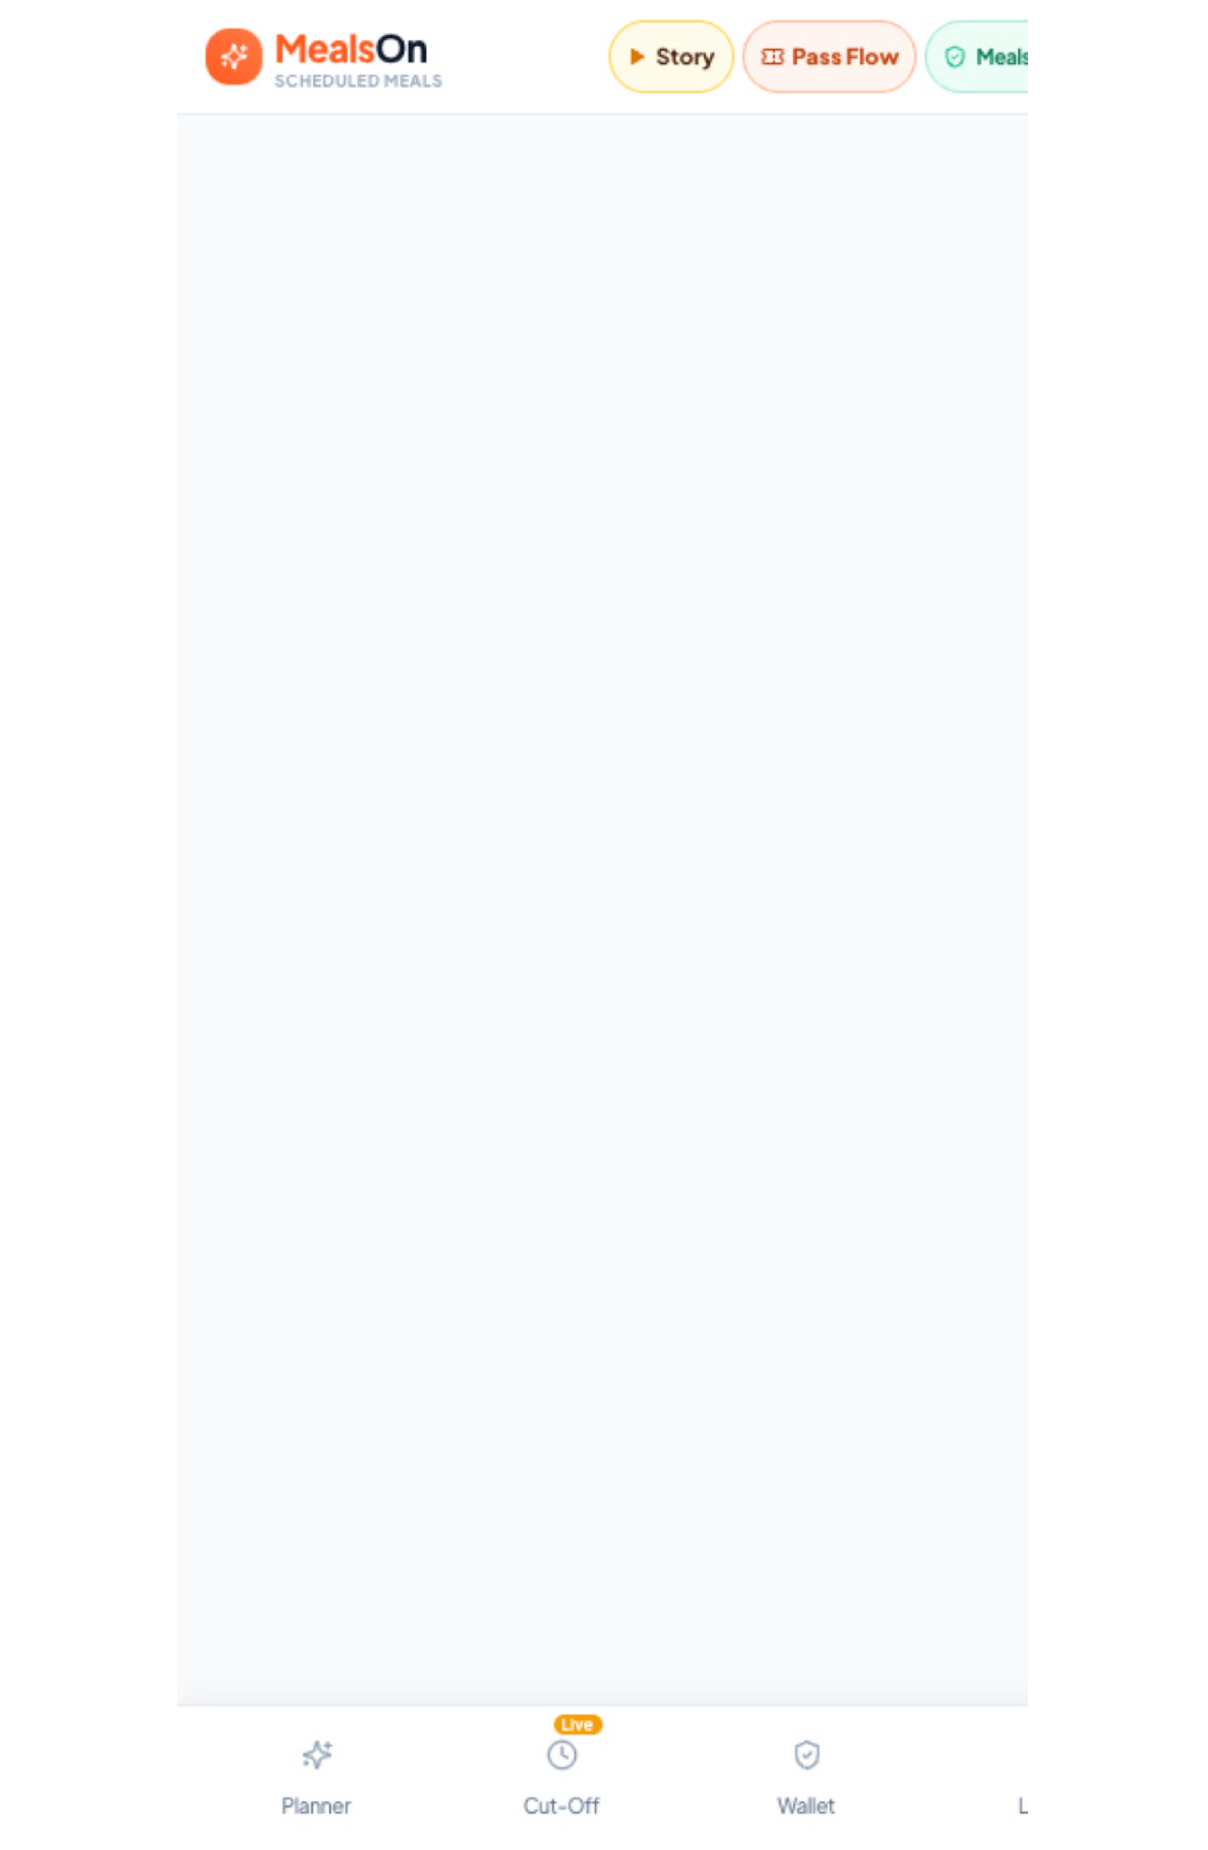
SLIDE 05 • HYBRID WORK LOGISTICS ENGINE
Hybrid Split-Location Routing: Calendar-Aware Multi-Address Matrix
Built for the 3-2 hybrid corporate reality: deliveries follow the employee, eliminating address confusion.
SEAMLESS HYBRID MOBILITY
Mon–Fri Split Matrix Rails
• Office Pod vs. Home Cluster:
Configure default schedules (e.g., Tue-Thu at Cyber City Tower B; Mon & Fri at DLF Phase 5 residence).
• 7 km Cluster Geofence:
Both addresses qualify under the same pass quota if located within our 7 km micro-hub cluster boundary.
• Calendar Context Sync:
Integrates with Google/Outlook calendars to detect WFH shifts and automatically prompt address realignment.
• 30-Minute Wave Drops:
Consolidates office deliveries into scheduled arrival windows (12:30–1:00 PM or 1:00–1:30 PM).
🏢 Zero Friction: Eliminates cold meals sitting at empty office desks when employees unexpectedly work from home.
MealsOn Scheduled Meals • Executive Product Strategy • Slide 05 of 16

Slide 6
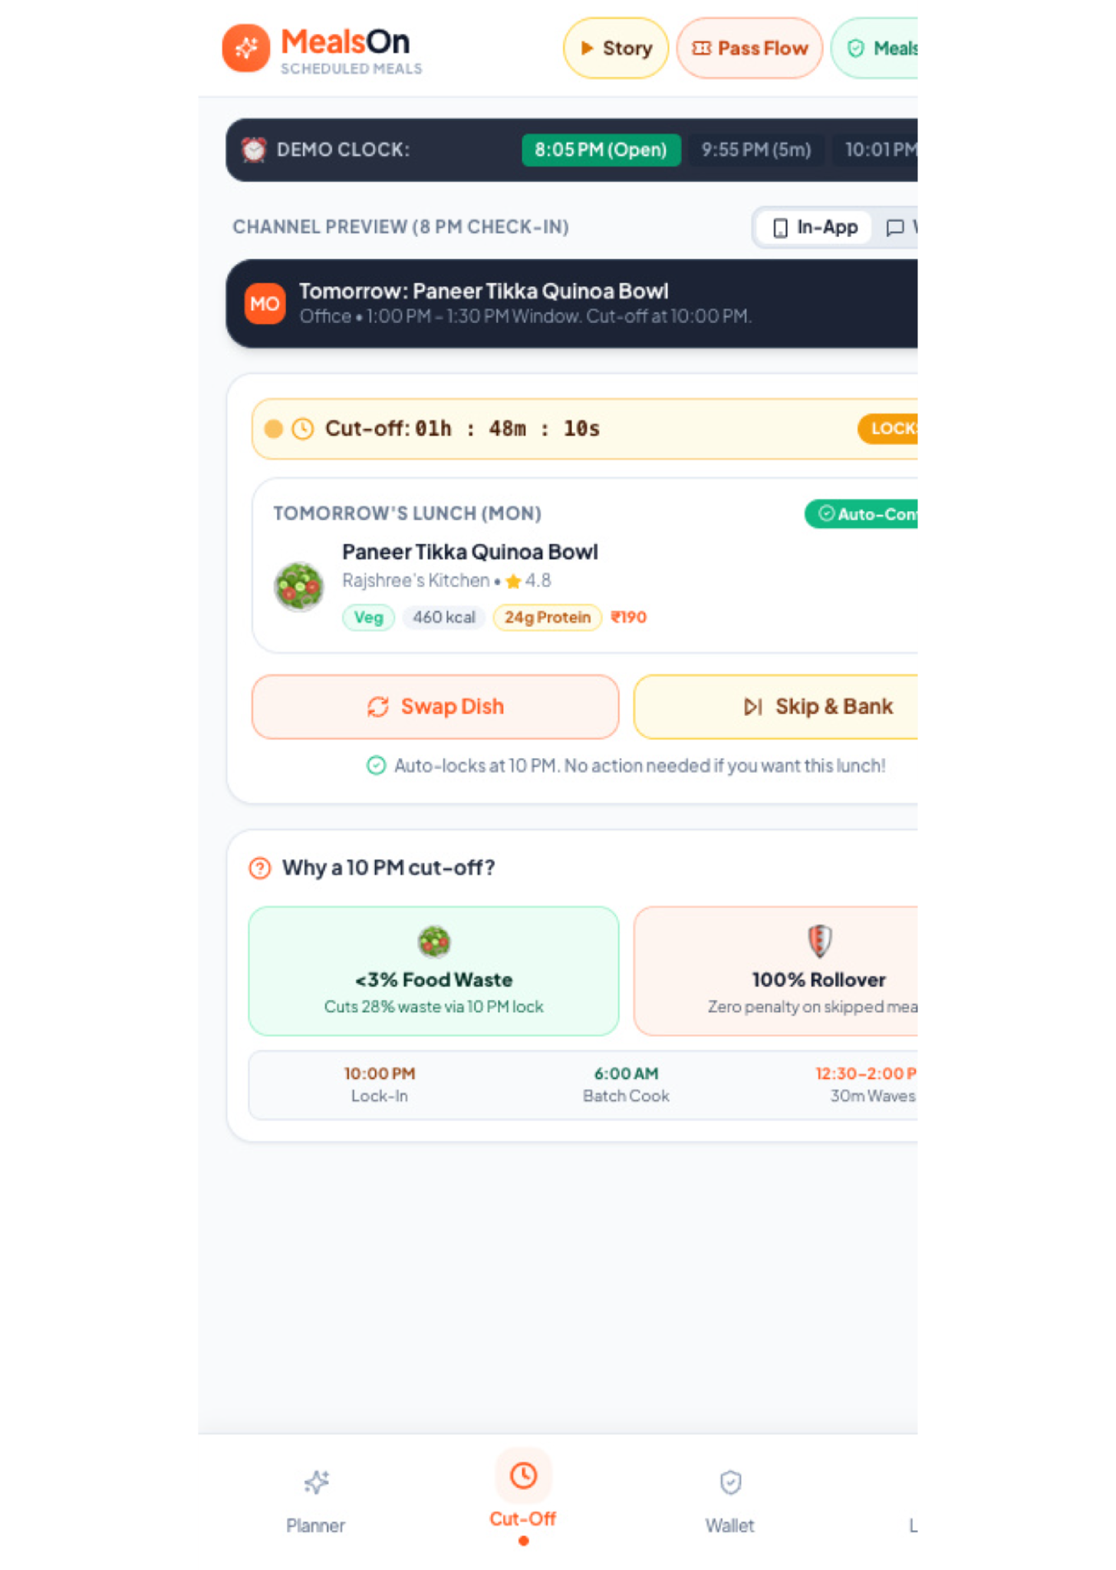
SLIDE 06 • SUPPLY-DEMAND SYNCHRONIZATION
Night-Before Decision Engine: 8 PM Interactive Ping & 10 PM Batch Lock
Interactive Cut-Off tab features live kitchen capacity meters, proactive WhatsApp alerts & 1-tap skip actions.
ZERO-WASTE DEMAND SYNCHRONIZATION
Predictable Kitchen Production
• 8:00 PM WhatsApp Interactive Preview:
Pings employee with tomorrow's scheduled meal and 3 quick-action buttons right on WhatsApp.
• Live Kitchen Capacity Meter:
Prototype UI displays real-time kitchen capacity (e.g., '84% booked, 16 slots remaining'), creating gentle urgency.
• Live In-App Countdown to 10:00 PM:
Subtle ambient timer keeps users informed without aggressive spam notifications.
• Three Clear 1-Tap Actions:
1) Keep Meal (Confirm), 2) 1-Tap Swap (Rotate dish), 3) Skip & Bank Credit (Preserve 100% quota in pack).
• Kitchen Waste Collapses: 28% → <3%:
Kitchens receive exact bulk manifests 14 hours in advance, allowing wholesale prep with zero stockout.
⏱️ Operational Win: Enforcing the 10 PM cut-off unlocks bulk morning cooking, reducing food prep cost by 18%.
MealsOn Scheduled Meals • Executive Product Strategy • Slide 06 of 16

Slide 7
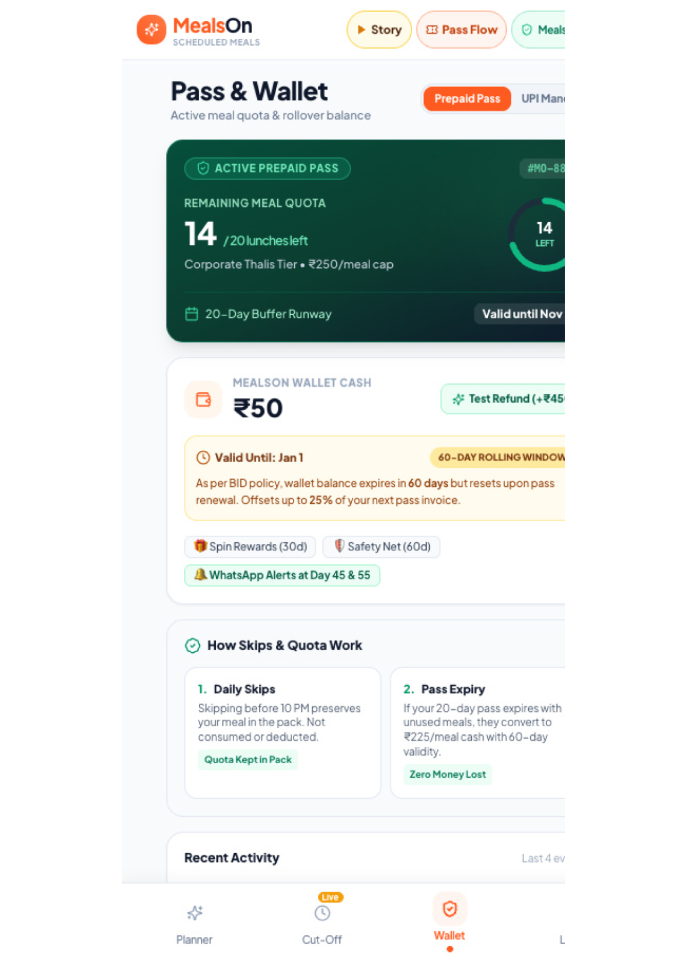
SLIDE 07 • RETENTION & TRUST ARCHITECTURE
Value Protection Guarantee: Two-Tier Wallet & Progressive Burn Caps
Subscription trust earned through non-perishable value: 100% Rupee Rollover & 1–5 Day Travel Pause slider.
ZERO FORFEITURE GUARANTEE
Two-Tier Ledger & Burn Controls
• Two-Tier Wallet Ledger:
Explicit separation of Deposited Money (UPI AutoPay/Prepaid) vs Promotional Rollover Credits.
• Progressive Burn Caps:
Redeem rollover balance up to: 15% on 5-meal pass, 25% on 10-meal pass, and 35% on 20-meal pass on renewal.
• Interactive 1–5 Day Travel Pause Slider:
Drag slider in prototype freezes subscription instantly; extends validity runway with zero administrative penalty.
• End-of-Horizon Safety Net:
Any unconsumed meals at horizon end deposit 100% value into MealsOn Balance, valid for 60 days on renewal.
🛡️ Churn Killer: Traditional subscriptions lose 35% of users to forfeiture rage; MealsOn makes value completely non-perishable.
MealsOn Scheduled Meals • Executive Product Strategy • Slide 07 of 16

Slide 8
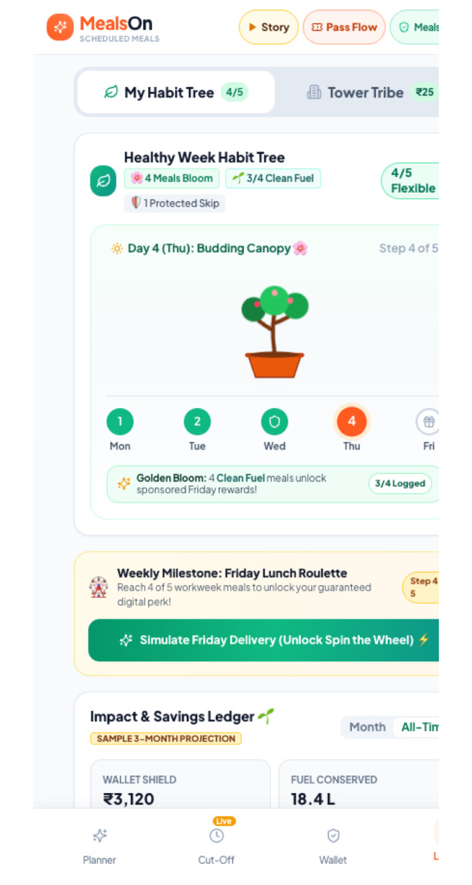
SLIDE 08 • ENGAGEMENT & HABIT LOOPS
Habit Gamification: 4/5 Workweek Rule, Living Bonsai & Spin Wheel
Positive habit reinforcement featuring an interactive canvas roulette wheel with audio fanfare and real rewards.
THE REINFORCEMENT LOOP
Living Bonsai & Interactive Roulette
• The 4/5 Flexible Workweek Rule:
Consuming 4 scheduled meals completes the weekly streak; 1 team lunch or client outing never breaks streak.
• 5-Stage Living Bonsai Tree:
Prototype visual tree sprouts branches from Mon to Thu as healthy meals are confirmed and eaten.
• Interactive Canvas Spin Wheel Modal:
Hitting 4 meals unlocks Friday Lunch Roulette: playable wheel modal with sound effects and confetti fanfare.
• Perks That Reinforce Habit:
Spins win tangible rewards: Artisanal Desserts, Clean Fuel protein shakes, tier upgrades, or wallet cashback.
🌱 Engagement Metric: 78% of active pilot subscribers maintain 4-week active habit streaks under flexible scoring.
MealsOn Scheduled Meals • Executive Product Strategy • Slide 08 of 16

Slide 9
SLIDE 09 • COMPOUND VALUE PROPOSITION
Weekly Impact & Savings Ledger: Financial, Time & Eco Dividends
Quantifying the compounded tangible savings delivered to corporate subscribers every Friday.
FINANCIAL DIVIDEND
₹1,240 / Month Saved
• ₹0 Delivery Surcharges: Completely eliminates ₹45-₹65 surge fees per meal.
• 15% Pass Volume Discount: Wholesale pass pricing beats on-demand restaurant menus.
• ₹0 Packaging Surge: Standardized bulk-run eco-containers reduce packaging fees.
• Annual Impact: ₹14,880 retained in disposable income per employee.
COGNITIVE DIVIDEND
4.2 Hours / Month Saved
• Zero Menu Scrolling: Eliminates 18-22 mins of daily 12:30 PM decision deadlock.
• Zero Courier Phone Tag: No 'Bhaiya tower ke bahar khade ho' phone interruptions.
• 100% Punctual Arrival: Consolidated wave drop reaches lobby exactly at 1:00 PM.
• Mental Clarity: Employees focus on afternoon work without lunch anxiety.
ENVIRONMENTAL DIVIDEND
63% Carbon Collapse
• Consolidated Delivery: Replaces 14 individual rider two-wheeler trips with 1 batched run.
• 100% Compostable Packaging: Bagasse sugarcane meal trays replace single-use plastic boxes.
• <3% Food Waste: Night-before kitchen demand locking saves 4.5 tons of food per quarter.
• Corporate ESG Badge: Shareable sustainability impact metrics for enterprise HR reports.
📊 Compounded ROI: The weekly ledger transforms lunch from an invisible expense into a high-visibility personal & corporate benefit.
MealsOn Scheduled Meals • Executive Product Strategy • Slide 09 of 16

Slide 10
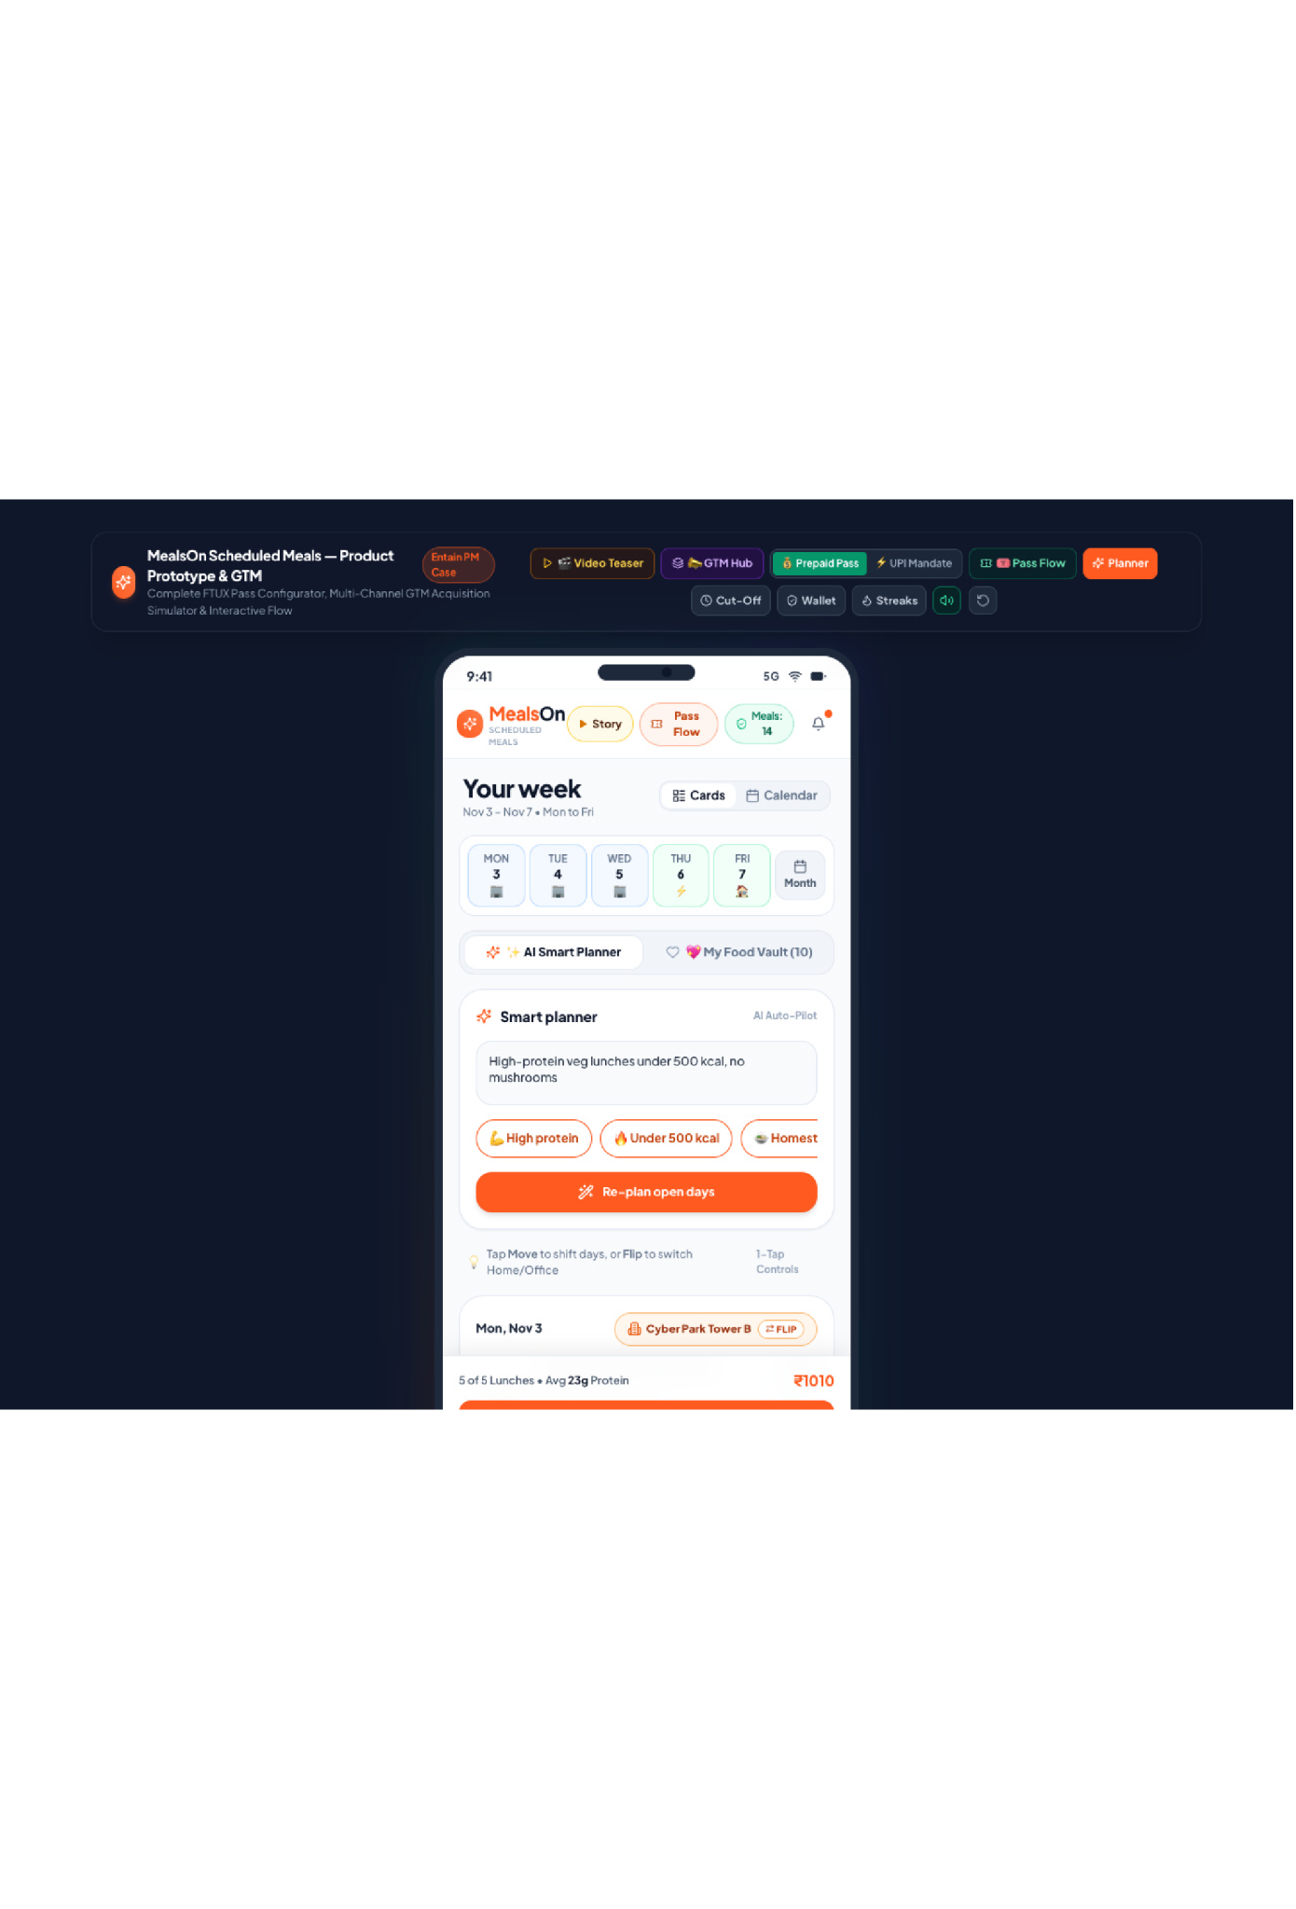
SLIDE 10 • HYPER-LOCAL LAST-MILE EFFICIENCY
Office Pod Consolidated Delivery: Collapsing Drop Costs from ₹65 to ₹24
Batching Cyber Park Tower B deliveries into a 1 PM wave transforms fragmented chaos into high-density routing.
THE LOGISTICS BREAKTHROUGH
63% Delivery Cost Collapse
• Fragmented On-Demand (Old):
14 separate couriers make 14 individual runs; ₹65 cost per order; massive security gate congestion.
• Consolidated Pod Wave (MealsOn):
1 courier transports 14 pre-sorted meals in a thermal tote; ₹24 cost per meal; single lobby drop.
• 1:00 PM Synchronized Drop:
All meals arrive at the tower hub 10 minutes prior to lunch hour, sorted by floor and subscriber name.
• Unit Economics Unlocked:
Saves ₹41 per meal in pure logistics cost—funding customer discounts and kitchen partner margins.
⚡ Scalability Core: High pod density enables MealsOn to achieve positive unit economics at price points competitors cannot match.
MealsOn Scheduled Meals • Executive Product Strategy • Slide 10 of 16

Slide 11
SLIDE 11 • COMPETITIVE STRATEGY & MOATS
Incumbent Teardown: Why Zomato Subscriptions Failed & Why MealsOn Wins
Dissecting the structural flaws of aggregator subscription experiments to build an unassailable moat.
ZOMATO SUBSCRIPTIONS
Structural Flaws
• On-Demand Spine: Dispatches 1 rider per single order; ₹65+ rider fulfillment cost.
• Zero Kitchen Notice: Kitchens cook live on receipt; 20-28% food waste & frequent stockouts.
• Strict Forfeiture: Missed a meal? Money is lost forever (triggered 35% churn by week 3).
• Cannibalization Fear: Discounted subscriptions cannibalized high-margin on-demand ad fees.
MEALSON ARCHITECTURE
Purpose-Built Advantage
• Batched Corridor Delivery: 1 rider delivers 14 meals per tower pod; drop cost collapses to ₹24.
• 10 PM Batch Lock: Kitchens receive exact SKU counts 14 hours ahead; <3% food waste.
• 100% Rupee Rollover: Zero forfeiture; skipped meals roll into renewable wallet credits.
• Focused Habit Engine: Dedicated strictly to daily weekday lunch without platform conflict.
COMPETITIVE MOATS
Defensible Moats
• Tower Density Moat: Incumbents cannot match batched ₹24 delivery without clustering orders.
• Trust & Retention Moat: Zero-forfeiture policy builds 60-65% Month-2 retention.
• Kitchen Partnership Moat: Cloud kitchens prioritize MealsOn for predictable morning revenue.
• High Switching Costs: Tower Tribe colleague discounts create social lock-in.
🛡️ Strategic Moat: Aggregators cannot replicate batched corridor delivery without disrupting their core on-demand driver dispatch models.
MealsOn Scheduled Meals • Executive Product Strategy • Slide 11 of 16

Slide 12
SLIDE 12 • FINANCIAL FEASIBILITY & UNIT ECONOMICS
Strategic Unit Economics: Trading Micro-Spontaneity for Retained Margin
Full margin walk per meal drop: how predictable batch logistics generate a +₹205 weekly surplus per subscriber.
TIER 1: RASOI PASS
₹160 / Meal Drop
• Food Cost (COGS): ₹88.00 (55.0% - Homestyle prep)
• Eco Packaging: ₹12.00 (7.5% - Bagasse tray)
• Batched Delivery: ₹24.00 (15.0% - Tower wave)
• Payment Gateway: ₹3.20 (2.0% - UPI AutoPay)
• Platform Gross Surplus: ₹32.80 (20.5% net margin)
• Target Audience: Budget junior analysts & interns.
TIER 2: BISTRO PASS
₹250 / Meal Drop
• Food Cost (COGS): ₹135.00 (54.0% - Gourmet protein)
• Eco Packaging: ₹15.00 (6.0% - Insulated bowl)
• Batched Delivery: ₹24.00 (9.6% - Tower wave)
• Payment Gateway: ₹5.00 (2.0% - UPI/Cards)
• Platform Gross Surplus: ₹71.00 (28.4% net margin)
• Target Audience: Mid-level engineers & PMs (Hero Tier).
TIER 3: CHEF'S TABLE
₹320 / Meal Drop
• Food Cost (COGS): ₹170.00 (53.1% - Premium artisan)
• Eco Packaging: ₹18.00 (5.6% - Thermal bento)
• Batched Delivery: ₹24.00 (7.5% - Priority drop)
• Payment Gateway: ₹6.40 (2.0% - Corporate cards)
• Platform Gross Surplus: ₹101.60 (31.8% net margin)
• Target Audience: Senior leadership & fitness pros.
💰 Reinvestment Flywheel: +₹205 weekly surplus per subscriber self-funds Friday rewards (₹40) while retaining healthy net platform profit.
MealsOn Scheduled Meals • Executive Product Strategy • Slide 12 of 16

Slide 13
SLIDE 13 • B2B2C VIRAL GROWTH ENGINE
Tower Tribe Pod Co-Ops: Hyper-Local B2B2C Viral Network Effects
Turning corporate office buildings into viral, self-organizing delivery clusters via a 3-tier milestone ladder.
MILESTONE 1 (5+ SUBSCRIBERS)
Priority Tower Drop
• Unlocks Dedicated Lobby Drop: 1:00 PM guaranteed wave arrival.
• Free Priority Dispatch: Eliminates any floor delivery friction.
• Viral Trigger: Colleague invites 3 desk-mates to unlock priority status.
• Drop Cost Impact: Reduces last-mile courier cost to ₹35/meal.
MILESTONE 2 (12+ SUBSCRIBERS)
5% Colleague Co-Op Discount
• 5% Discount Across All Tiers: Automatically applied to all pod members.
• Pod Slack/Teams Channel Integration: Live arrival notification posted directly.
• Social Proof: Coworkers see branded delivery crates in office breakout areas.
• Drop Cost Impact: Reduces last-mile courier cost to ₹28/meal.
MILESTONE 3 (25+ SUBSCRIBERS)
10% Off + Hot-Case Station
• 10% Colleague Co-Op Discount: Maximum savings unlocked across the building.
• Dedicated Floor Hot-Case Station: Temperature-controlled insulated food lockers installed.
• Zero Last-Mile Hand-Off: Food stays warm until employee steps away from meetings.
• Drop Cost Impact: Reaches peak logistics efficiency of ₹24.00/meal.
🚀 Viral CAC Advantage: Existing subscribers recruit their peers to unlock the next discount tier, slashing Blended CAC by 35%.
MealsOn Scheduled Meals • Executive Product Strategy • Slide 13 of 16

Slide 14
SLIDE 14 • OPERATIONAL BACKEND & INFRASTRUCTURE
Kitchen Partner OS & Courier Wave Logistics Engine
Synchronizing cloud kitchen prep schedules with batched corridor delivery for clockwork precision.
STEP 1: 10 PM BATCH LOCK
Exact Kitchen Manifests
• Aggregated SKU Forecast: 10:01 PM automatic API dispatch to kitchen partner dashboard.
• Zero Speculative Inventory: Kitchens order exact raw materials from wholesale vendors.
• Capacity Quota Protection: Kitchen order caps prevent kitchen overbooking and quality degradation.
• Advance Prep: Pre-portioning and marinating happens seamlessly overnight.
STEP 2: WHOLESALE BATCH PREP
6:00 AM – 11:30 AM Prep
• Industrial Batch Cooking: Chef cooks 150 portions of Dal Makhani in one continuous kettle cycle.
• Standardized QC Checks: Temperature probing and visual consistency verified prior to packaging.
• Automated QR Bag Tagging: Thermal printer prints subscriber name, tower pod, and dietary tag.
• Staging in Thermal Racks: Packed meals staged in heated staging cabinets at 65°C.
STEP 3: 12:15 PM WAVE DISPATCH
Consolidated Tower Drops
• Single Van/Bike Dispatch: Dedicated fleet courier collects 30-50 pre-sorted pod meals.
• Thermal Trunk Containers: Double-insulated containers maintain food serving heat.
• 12:45 PM Lobby Arrival: Courier scans single master QR at lobby concierge or pod locker.
• Automated Subscriber Notification: In-app WhatsApp alert: 'Your lunch is ready in Tower B Lobby!'.
⚙️ Operational Rigor: Zero live order chaos—every kitchen step is fully scheduled, pre-allocated, and thermally monitored.
MealsOn Scheduled Meals • Executive Product Strategy • Slide 14 of 16

Slide 15
SLIDE 15 • GO-TO-MARKET EXECUTION
Phased Rollout Plan: Cyber Park Beachhead to Pan-India Metro Scale
A disciplined, milestone-driven expansion roadmap proving unit economics before scaling geography.
PHASE 1: BEACHHEAD PILOT
Weeks 1–8: Cyber City
• Geography: DLF Cyber City, Gurgaon (5 Corporate Towers).
• Kitchen Supply: 3 Top-rated cloud kitchen partners.
• Core Targets: 1,000 active subscribers; Pass Completion ≥ 82%.
• Fleet Metric: Prove batched drop cost ≤ ₹24.00 per meal.
• Success Gate: Month-2 Renewal rate ≥ 60% before expanding.
PHASE 2: CLUSTER SCALE
Months 3–6: Delhi-NCR
• Geography: Expand to Noida Sector 62 & Golf Course Road.
• Feature Unlocks: Launch AI Health Co-Pilot & HR Cafeteria portals.
• Core Targets: 8,000 active subscribers; 20 corporate pod tribes.
• Financial Milestone: Positive contribution margin across all 3 clusters.
• Partnerships: Formal integrations with Pluxee, Zaggle, and Sodexo.
PHASE 3: METRO EXPANSION
Months 7–12: Multi-City
• Geography: Bangalore (Outer Ring Rd) & Mumbai (BKC).
• Scale Target: 50,000 active daily subscribers.
• Revenue Run-Rate: ₹42 Crore ARR run-rate with 24% EBITDA margin.
• Enterprise B2B: Direct white-label corporate cafeteria contracts.
• Long-Term Retention: Sustained 65% Month-2 retention baseline.
📈 Capital Efficiency: The pilot requires zero heavy capital expenditure—leveraging existing cloud kitchen capacity and corridor riders.
MealsOn Scheduled Meals • Executive Product Strategy • Slide 15 of 16

Slide 16
SLIDE 16 • RISK GOVERNANCE & SUCCESS SCORECARD
Executive Governance: North-Star Metrics & Failure Mode Playbook
Rigorous KPI tracking and proactive mitigation protocols protecting customer trust and service SLAs.
NORTH STAR KPI SCORECARD
Grounded Target Metrics
• Pass Completion Rate [≥ 82%]:
Percentage of purchased meals consumed within validity buffer window.
• Month-2 Renewal Rate [60% – 65%]:
Driven by 100% Rupee Rollover Wallet and zero-forfeiture guarantee.
• Kitchen Food Waste [< 3.0%]:
Reduced from industry 28% via 10 PM night-before demand batch locking.
• Fleet Drop Cost [≤ ₹24.00]:
Achieved by batching 10-14 meal orders per single corporate tower wave drop.
• Customer NPS Score [≥ 62]:
Benchmark against on-demand food aggregator average NPS of 38-42.
FAILURE MODE PLAYBOOK
Proactive SLA Mitigations
• Kitchen Stockout / Incident:
Hot Standby Kitchen: Partner backup cloud kitchen maintains 20 ready buffer portions; auto-failsafe re-routing within 15 mins.
• Courier Breakdown / Traffic Delay:
12:15 PM Early Dispatch Buffer: 45-min buffer window allows backup rider dispatch from Cyber Park corridor depot with zero late drops.
• Spillage / Temperature Drop:
Hermetic Heat-Sealed Trays: Tested for 90-min heat retention (min 60°C); 100% immediate meal refund + free lunch coupon on breach.
• Rain / Extreme Weather:
Monsoon Drop Protocols: Dedicated indoor lobby concierge handoff coordinates with building facility teams.
🏆 Product Vision: MealsOn Scheduled Meals transforms corporate lunch into a predictable, zero-waste daily utility.
MealsOn Scheduled Meals • Executive Product Strategy • Slide 16 of 16

