Slide 1
Int
Detection of Diabetic Retinopathy using Convolution Neural Network (CNN) and Explainable Artificial Intelligence (XAI)
Presented by :
Ashutosh Saurabh Pandey
Btech CSE 5th SEM
Graphic Era deemed to be university
Dehradun
Mentorship by:-
Mr. Jyotir Moy Chatterjee
Assistant Professor
Graphic Era deemed to be university
Dehradun

Slide 2
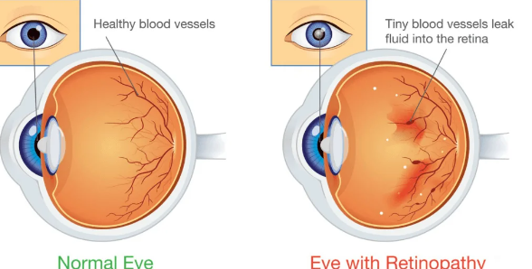

Introduction
Diabetic retinopathy is a leading cause of vision loss among working-age adults.
It occurs due to damage to the retina caused by diabetes..

Slide 3
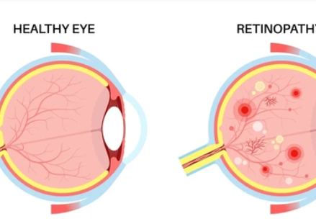
Problem Statement
Early detection of diabetic retinopathy is critical for effective treatment and prevention of vision loss.
Manual diagnosis is time-consuming and requires expertise.
Need for a robust automated system with explainability for detecting diabetic retinopathy using retinal images.

Slide 4

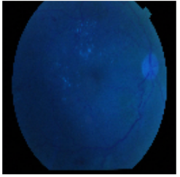
Methodology
Step 1- Data Loading and Preprocessing
Step 2- Model Development
Step 3- Training
Step 4:-Model Evaluation
Step5:- Explainability by Shap
Original Image
Processed Image

Slide 5
Collection:-
Using the APTOS blindness dataset
Preprocessing:
Applying Gaussian blur to reduce noise.
Normalizing pixel values to [0, 1].
Model Development:
Input layer 128x128 RGB Two convolutional layers followed by max-pooling layers to extract features from the images.
Batch normalization- stabilize learning process.
dense fully - learn complex patterns.
A final dense layer with a sigmoid activation function to output a binary classification (0 or 1).
Training –trained model for 20 epochs with early stopping and ReduceLRonPlateau
Model Evaluation:
Accuracy.
SHAP (SHapley Additive exPlanations):-Identifies pixel regions critical to the model’s predictions.
Resizing to 128x128 pixels.
Splitting :- training testing sets and validation.
Augmentation:-Zooming ,rotating ,etc.

Slide 6
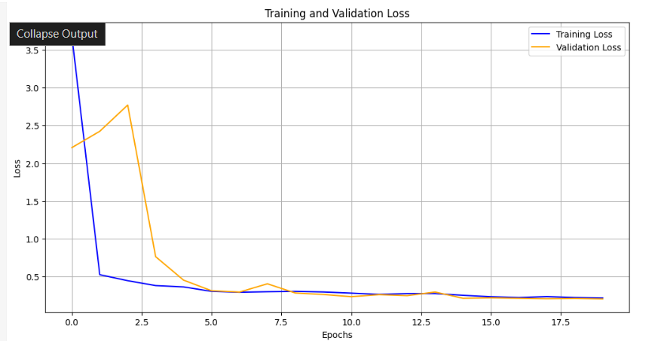
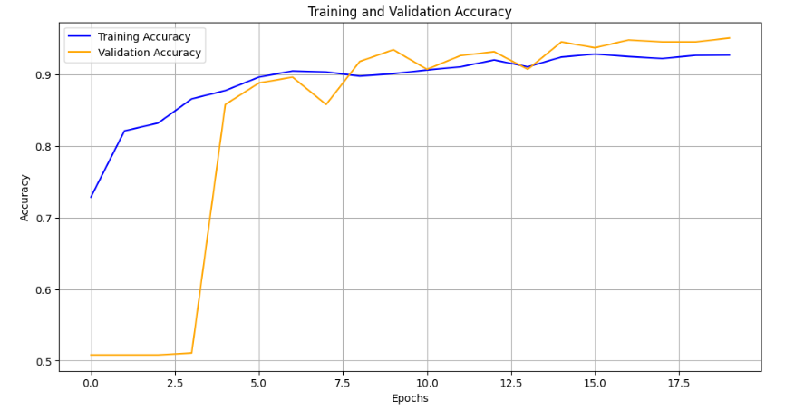
Result and Discussion
Performance Metrics
Test Loss: 19.81%
Test Accuracy: 94.27%
Observations
High accuracy.
Model effectively distinguishes .

Slide 7
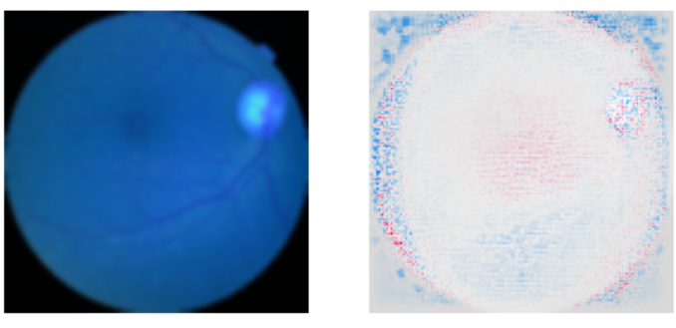
Discussion
SHAP Analysis
Highlights important regions influencing the model’s decision.
Provides interpretability and trust in model predictions.
Challenges and Limitations
Limited dataset size .
Preprocessing may lose fine details in images.
Binary classification does not tells severity of retinopathy.

Slide 8

Conclusion
Successfully developed a CNN-based system for diabetic retinopathy detection.
1
Data augmentation and SHAP explainability enhance model robustness and interpretability.
2

Slide 9
Future Work
Explore multi-class classification to help wth severity.
Expand dataset and improve model robustness.
Using advanced preprocessing and feature engineering techniques

