Slide 1
Int
Machine Learning based intrusion detection on electric vehicle charging station
Presented by :
Ashutosh Saurabh Pandey
Btech CSE 4rd SEM
Graphic Era deemed to be university
Dehradun
Mentorship by:-
Mr. Siddhant Thapliyal

Slide 2

Introduction
Global warming and the shift towards electric vehicles (EVs).
Benefits of EVs: high performance, quiet operation, cost efficiency.
Increasing adoption of EVs leading to the development of new charging stations.

Slide 3



Problem Statement
Vulnerability of EV charging stations to cyber-attacks.
01
Risks of compromised chargers: data theft, unauthorized changes to EV settings, accidents, data breaches.
02
Need for a robust security solution for EV charging stations.
03

Slide 4
Methodology
Step 1 Data Collection
Step 2 Preprocessing
Step 3 Model Development
Step 4 Model Evaluation

Slide 5
Collection:
Using the CIC-EVSE2024 dataset( power consumption data)
Preprocessing:
remove non usable colums like time,state,label,etc
Remove all the data points which were incomplete
Using smote to maintain the balance
Splittng data into training and testing sets.
Model Development:
Logistic Regression.
Random Forest.
XGBoost.
Deep Neural Networks (DNN).
Long Short-Term Memory (LSTM).
Model Evaluation:
Accuracy.
Precision, Recall, and F1-Score.
Comparison of model performance.

Slide 6
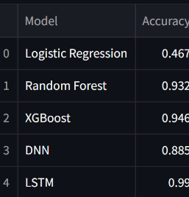
Result and Discussion
The accuracy of each model was as follows:
Logistic Regression: 46.7%
Random Forest: 93.2%
XGBoost: 94.6%
DNN: 88.5%
LSTM: 99.0%

Slide 7
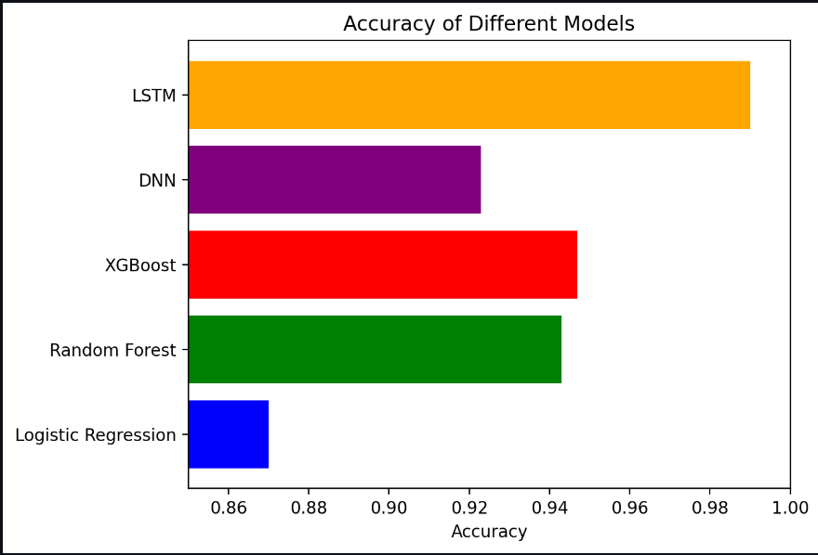
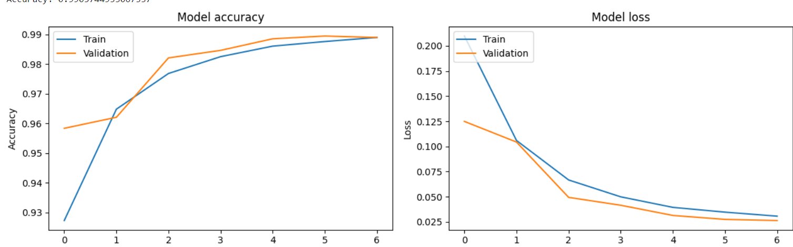
Discusion
The LSTM model outperformed the others with an accuracy of 99.0%. This can be attributed to its ability to capture temporal dependencies in the data. However, the Random Forest and XGBoost models also showed strong performance
Graph of LSTM

Slide 8
Conclusion
The project aimed to address the security vulnerabilities in EV charging stations by developing machine learning models trained on power consumption data.
Utilizing the CIC-EVSE2024 dataset, various models were trained and evaluated, including Logistic Regression, Random Forest, XGBoost, DNN, and LSTM.
The LSTM model was identified as the most effective in detecting cyber-attacks, demonstrating higher accuracy and better performance compared to the other models.
This project highlights the potential of machine learning in enhancing the security of EV charging stations, contributing to safer and more reliable EV infrastructure.

Slide 9
Future Work
Advanced Models: Explore more sophisticated models to further improve detection accuracy and performance.
Additional Features: integration of additional data sources and features, such as network traffic data and host activities, to provide a more comprehensive security solution.
Real-Time Implementation: Develop real-time detection systems and conduct live environment testing to validate the effectiveness of the models in practical scenarios.
Collaborative Research: Encourage collaboration with industry partners to refine the models based on actual usage scenarios and threats.

