Slide 1
TwiGo -DRIVE WITH DREAMS
Founders:-
Animesh Mondal
Arpan Ganguly
Sudisna Choudhury
Apalak Jash

Slide 2
About Us
Vehicle rental service which makes ride easy and comfortable
A bridge between Customer and Renter which makes Customers to book vehicles according to their choice, budget, time and Renters to avail their vehicle in our website for renting purpose

Slide 3
Our Aim
Deliver vehicles according to the customer’s choice, budget and time.
Good income for Renters
Avail vehicles for every occasion accordingly

Slide 4
Advantages of TwiGo
Quick and easy to book vehicle
Good income for renters
Customer feedback importance
Cheap
Reliable

Slide 5
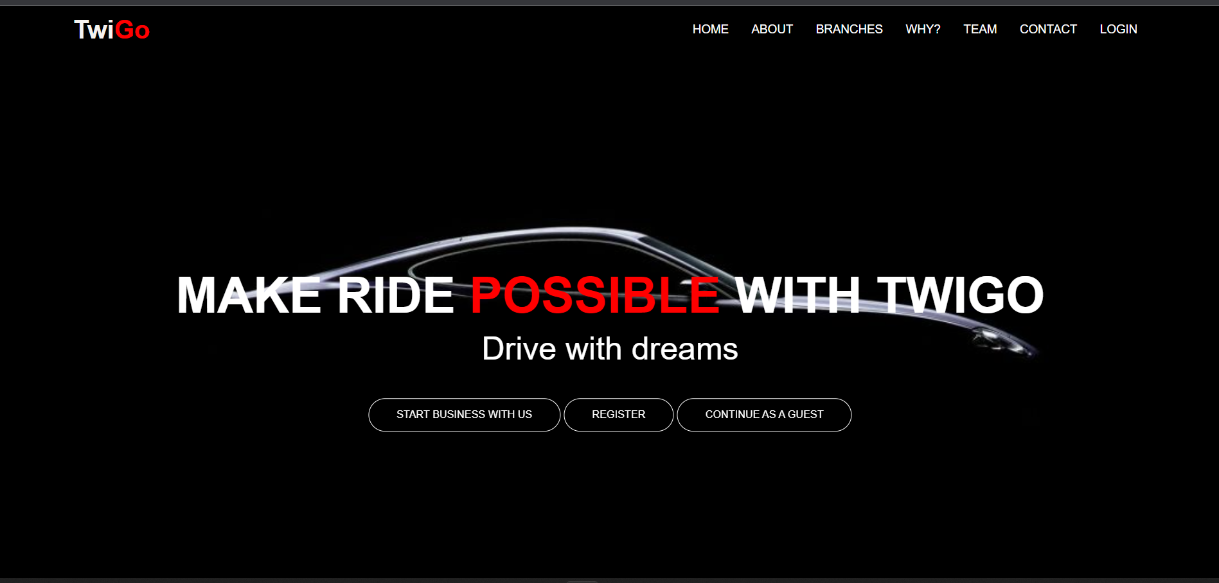
Landing Page
Navbar Options
Home
About
Branches
Why TwiGo
Our Team
Contact
Login
Start business
Register
Continue as guest

Slide 6
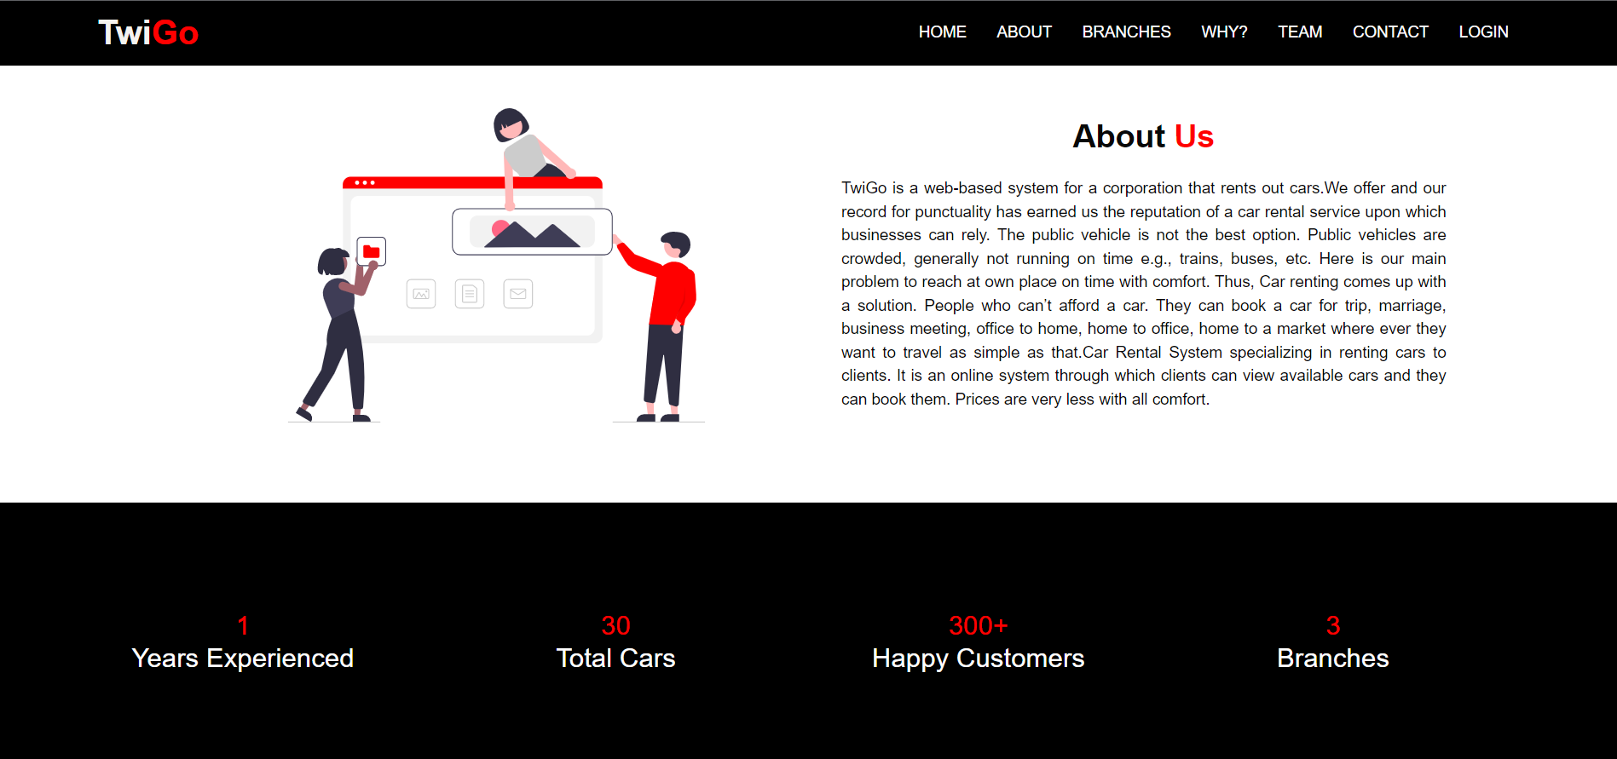
About Us Page
Years Experienced – 1
Total Cars – 30
Happy Customers – 300+
Branches - 3

Slide 7
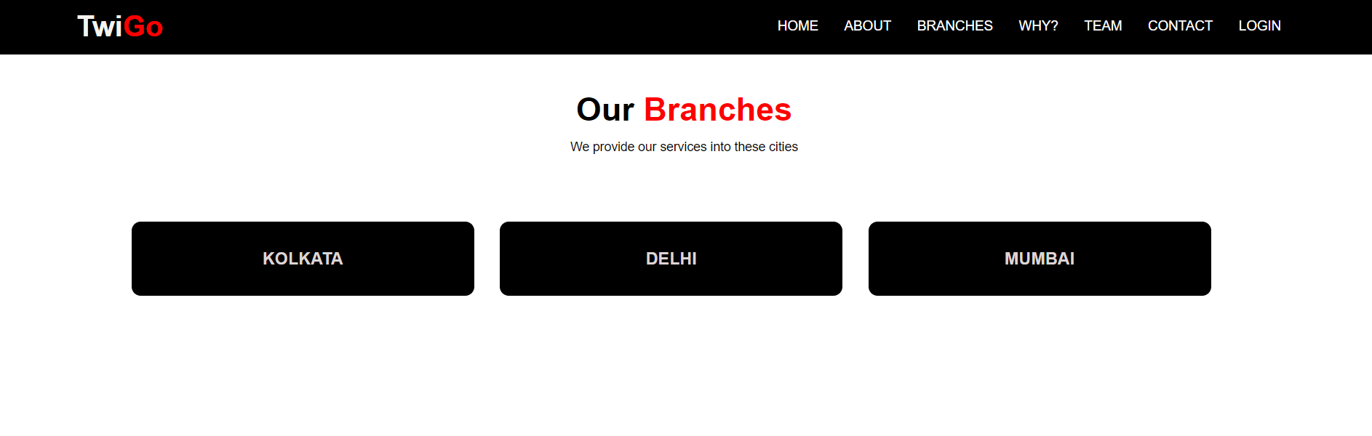
Our Branches
Kolkata
Delhi
Mumbai

Slide 8
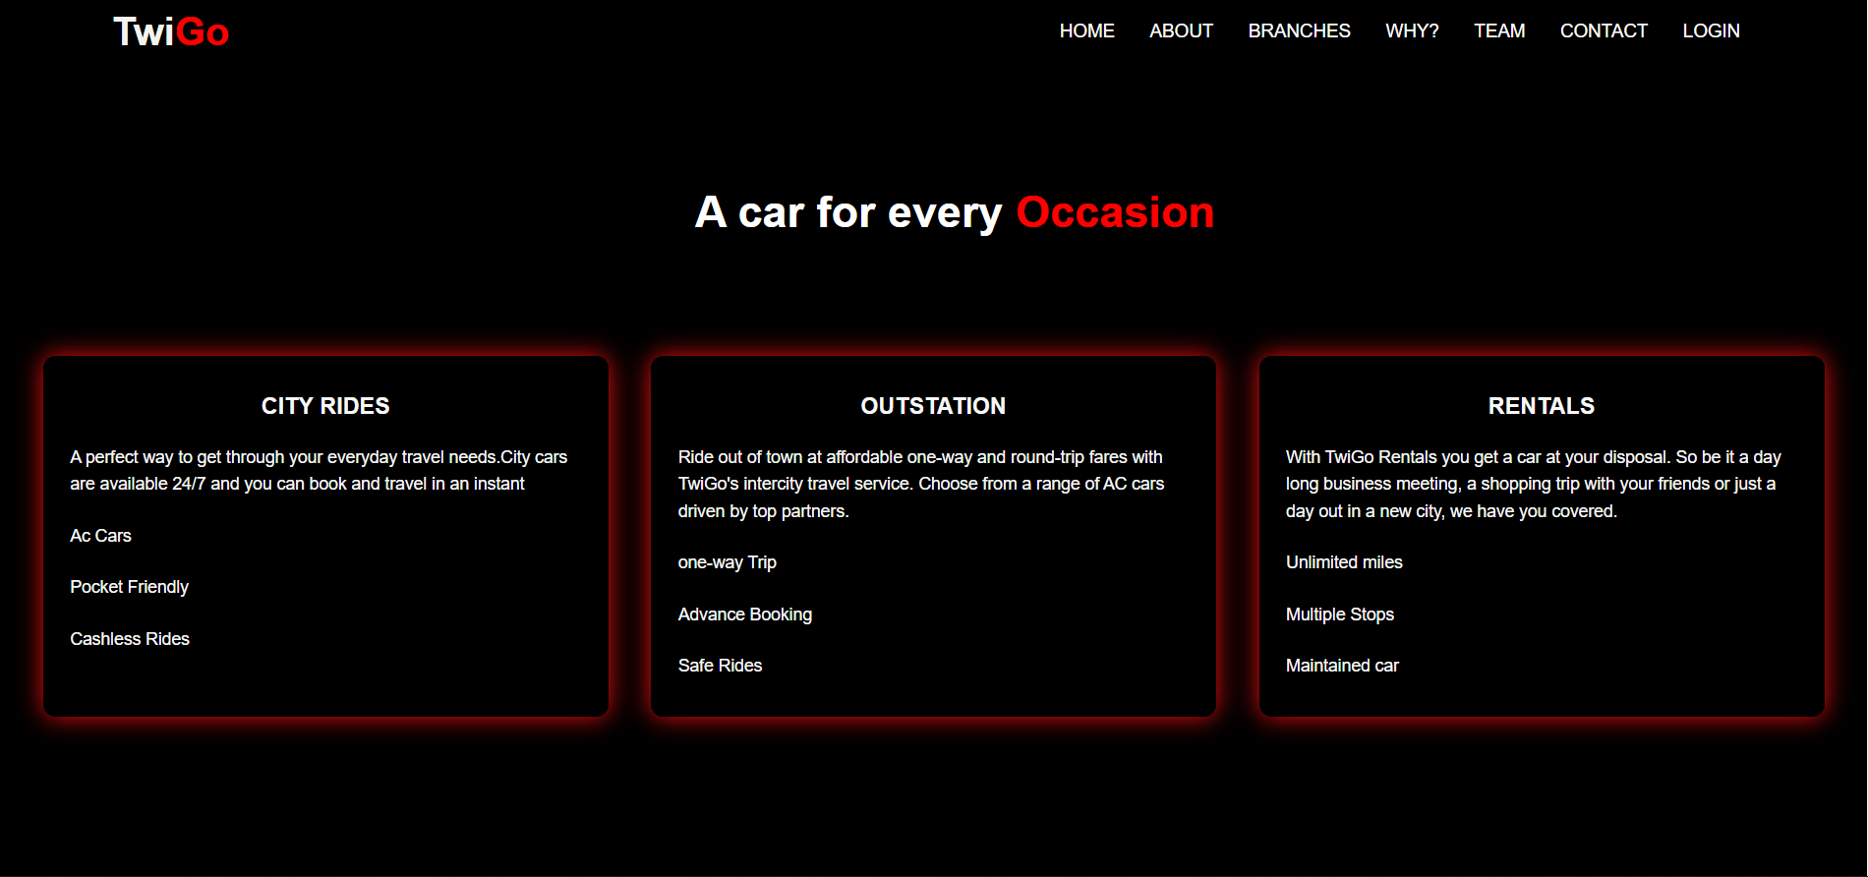
A car for every Occasion
City Rides
Outstation
Rentals

Slide 9
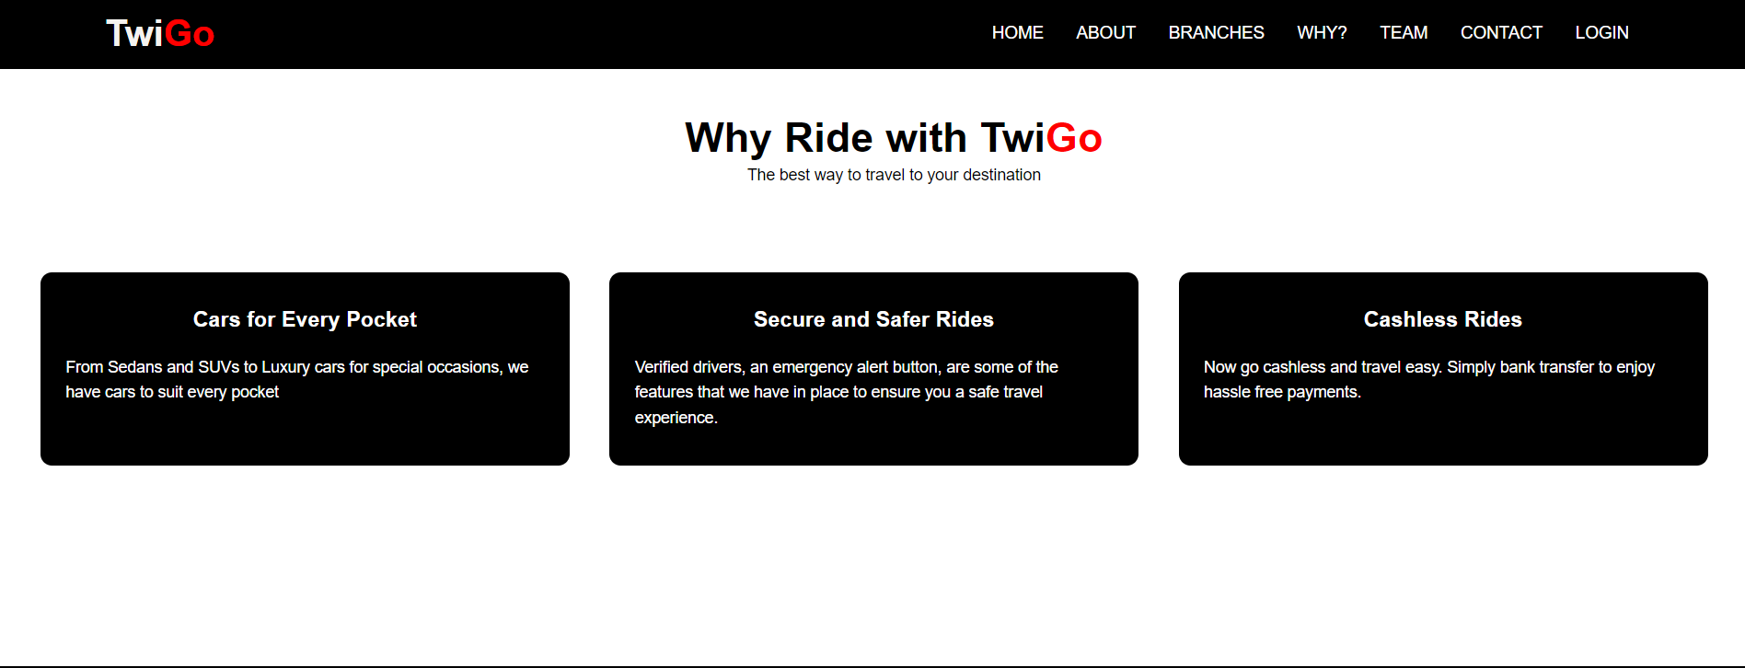
Why TwiGo
Safer
Cashless Rides
Cars for every occasion

Slide 10
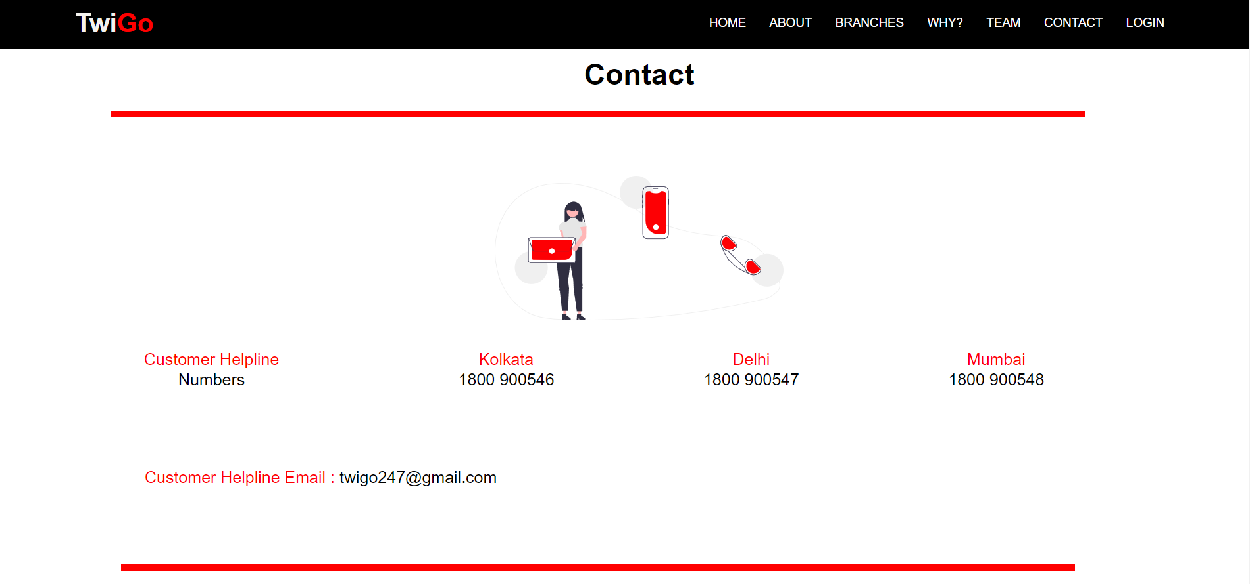
Contact Us

Slide 11

Register Page
Customer
Driver
Admin

Slide 12

Business Page

Slide 13
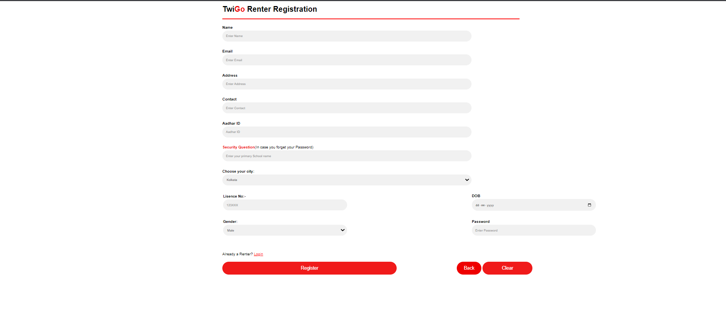
Renter Registration

Slide 14
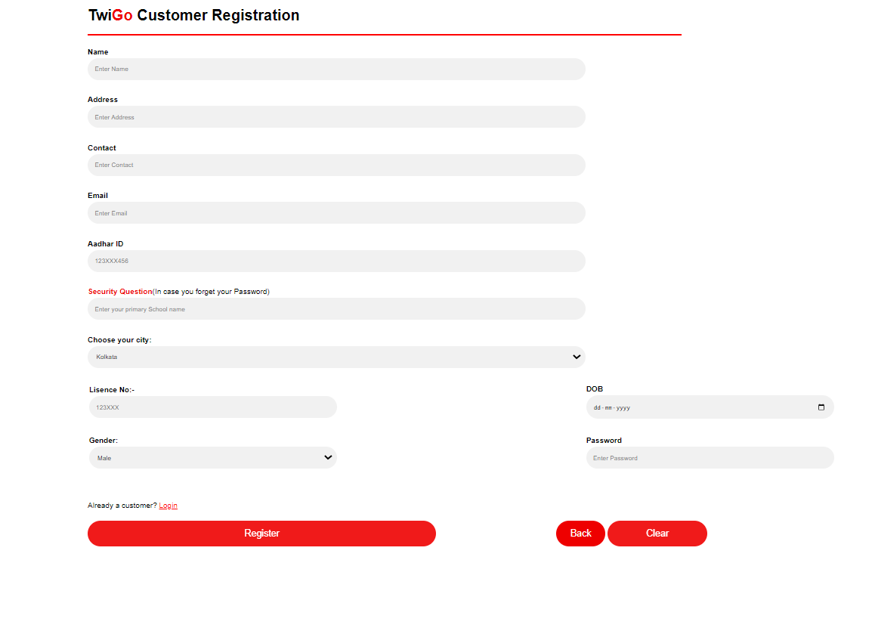
Customer Registration

Slide 15

Login Page
Customer
Renter
Driver
Admin

Slide 16
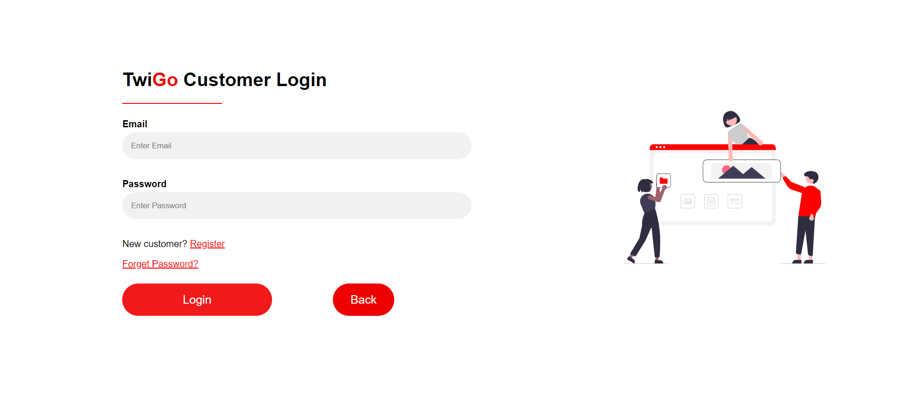
Customer Login

Slide 17
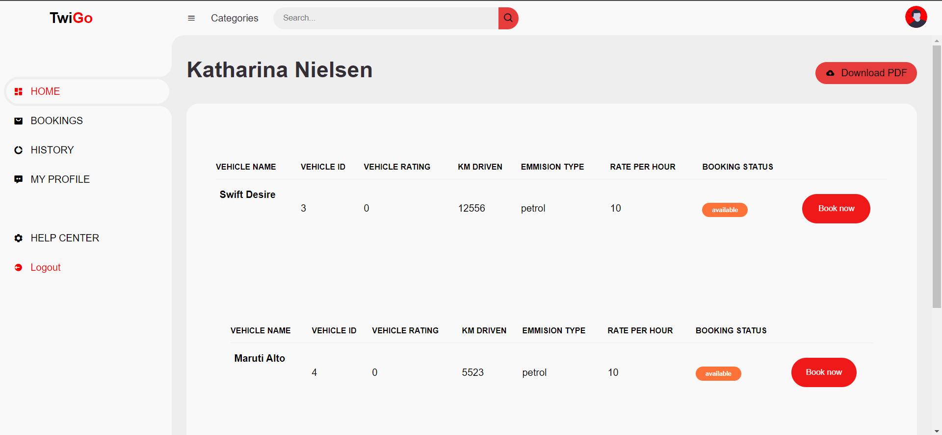
Customer Dashboard
Home
Bookings
History
My Profile
Help Centre
Logout

Slide 18
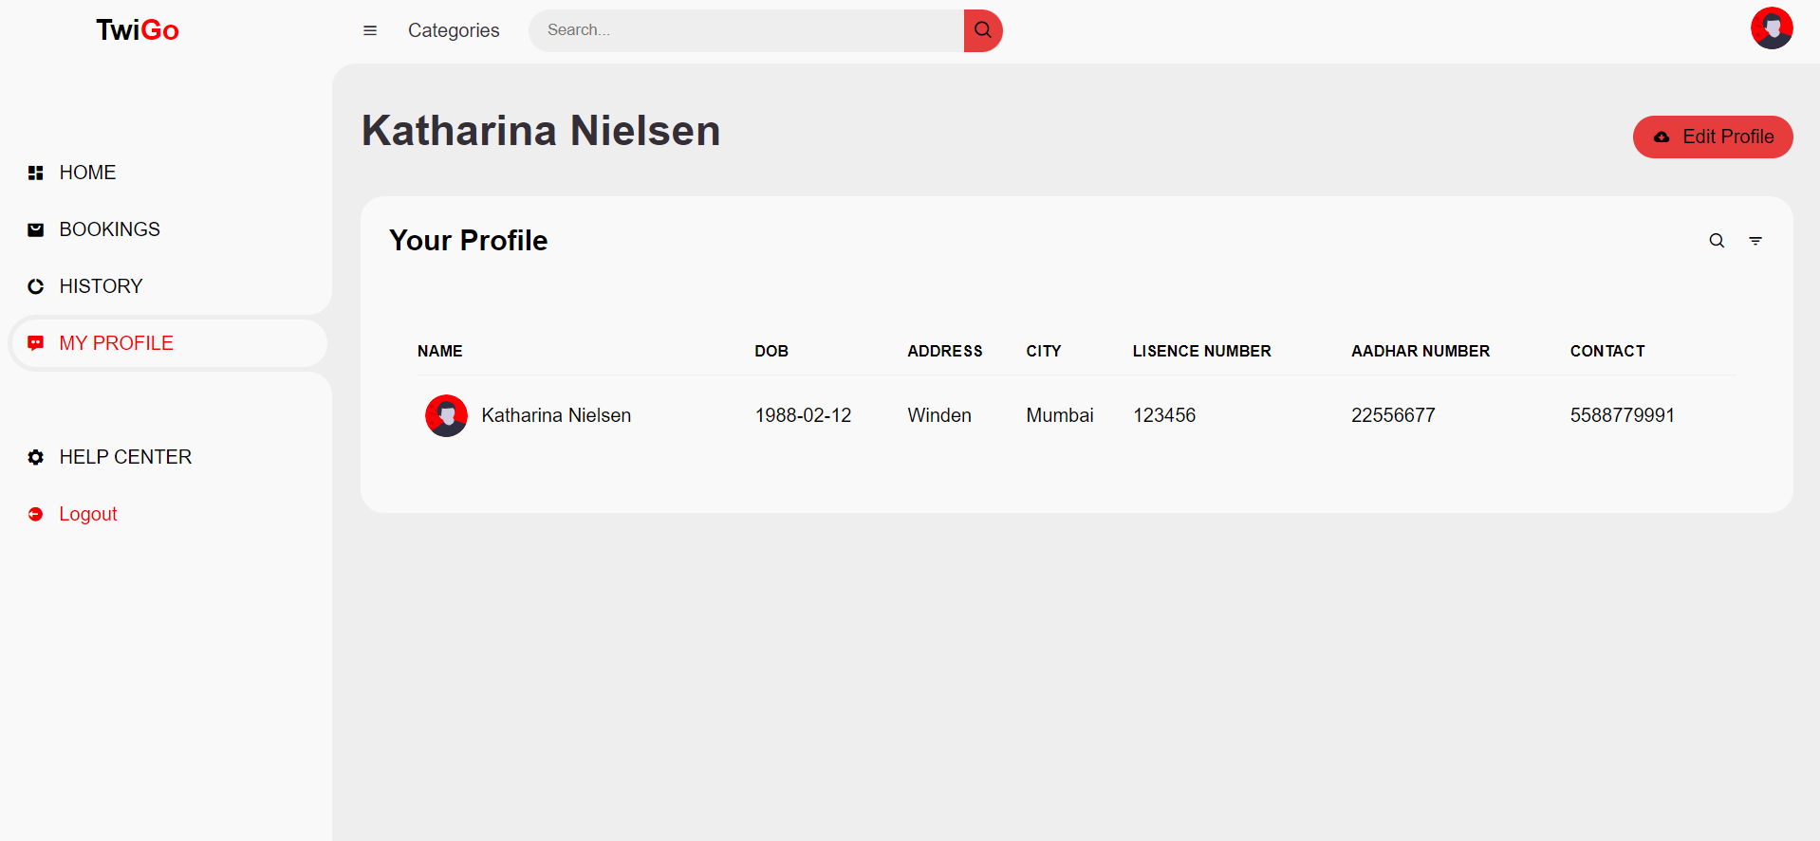
My Profile
Name
DOB
Address
City
Licence Number
Adhar Number
Contact

Slide 19
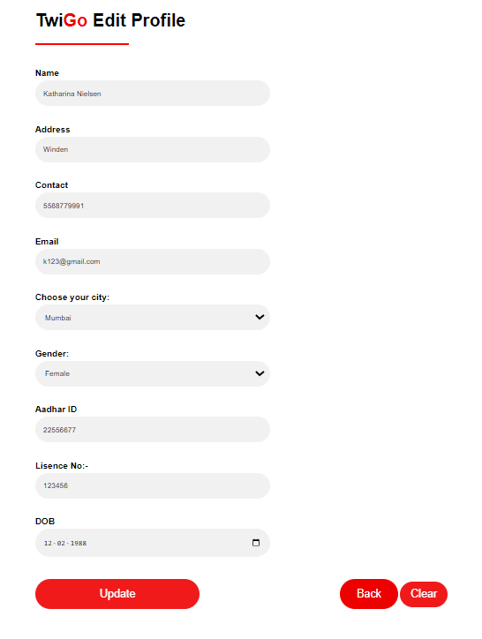
Edit Profile

Slide 20
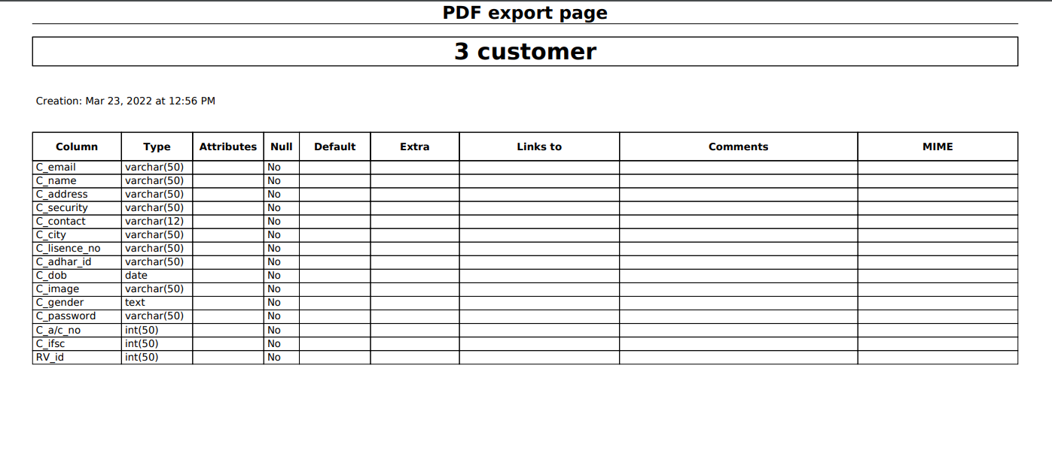
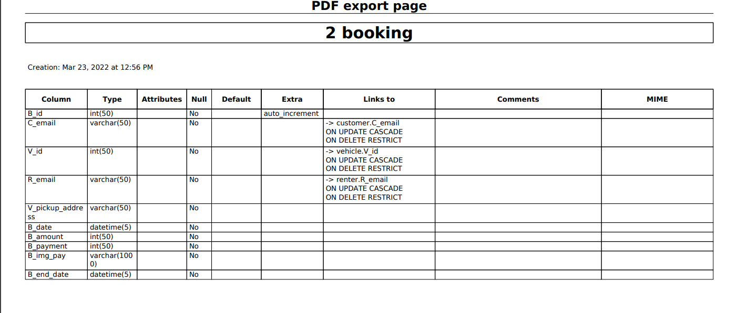
DATABASE SCHEMA

Slide 21
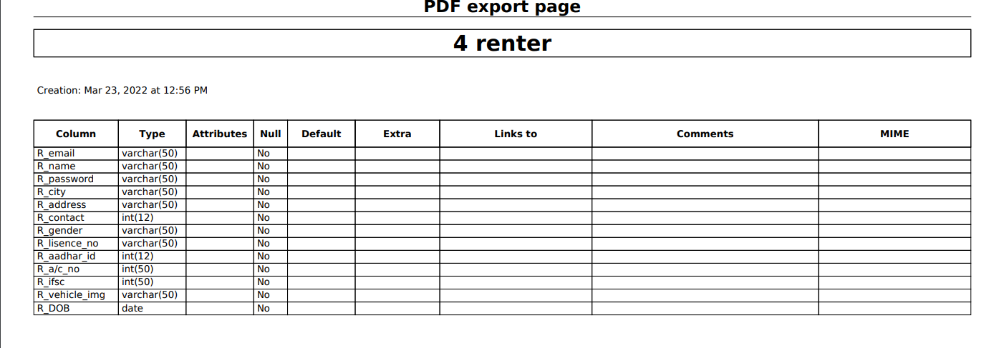
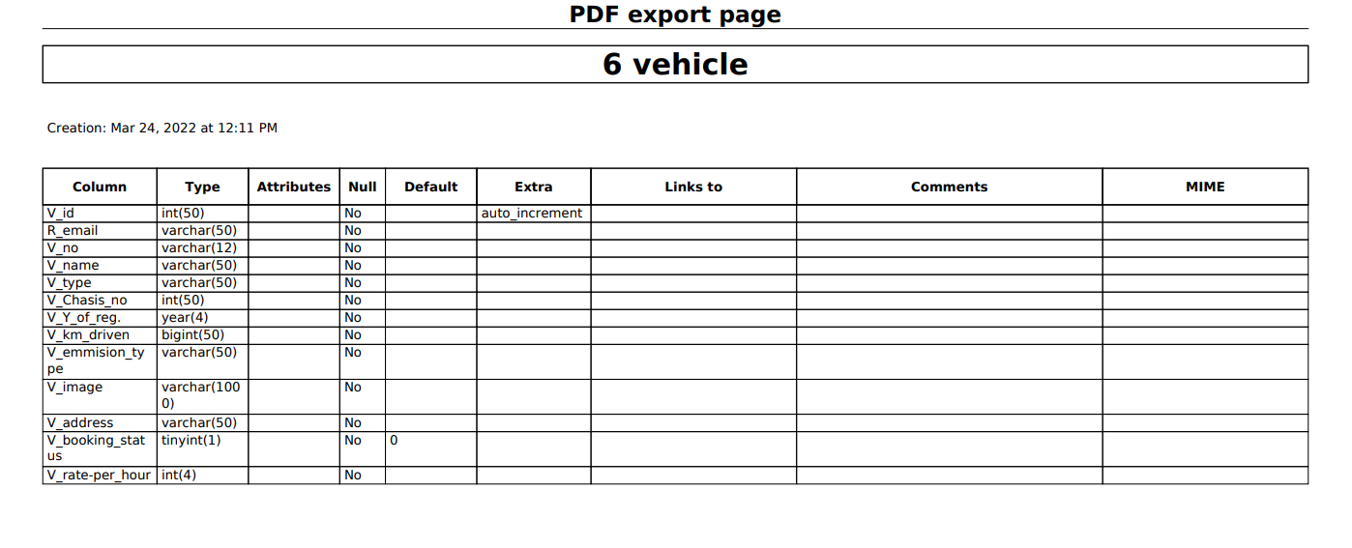

Slide 22
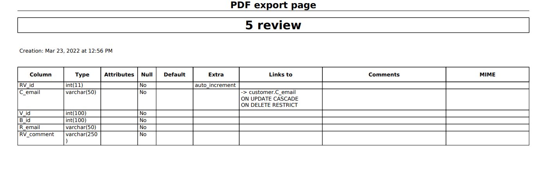
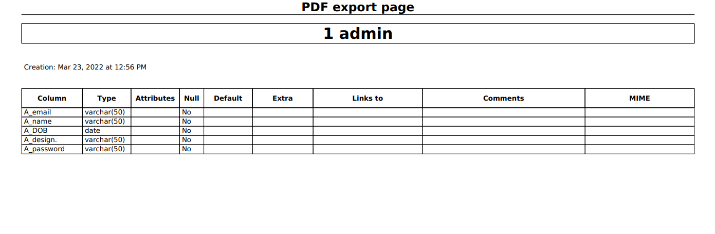

Slide 23
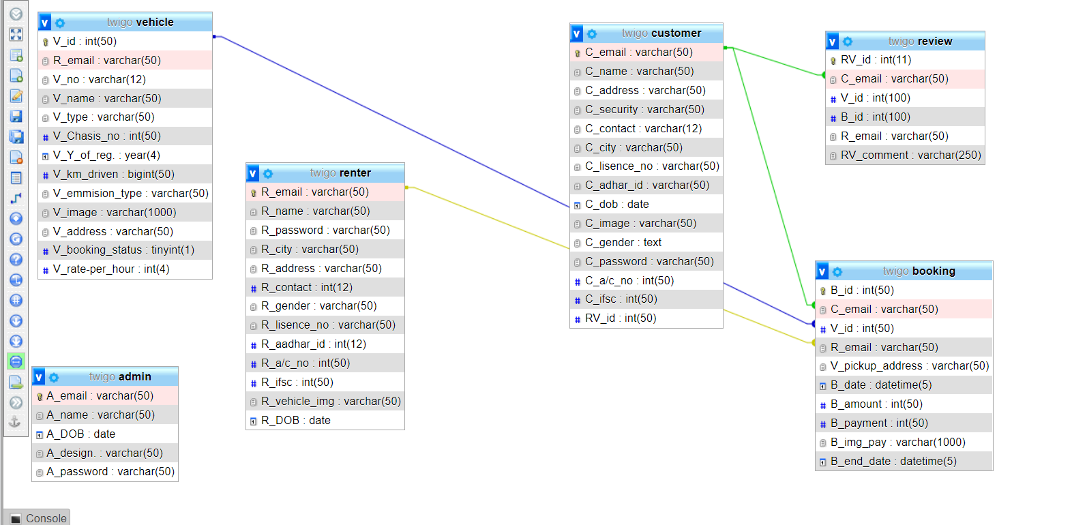
Database ERD

Slide 24
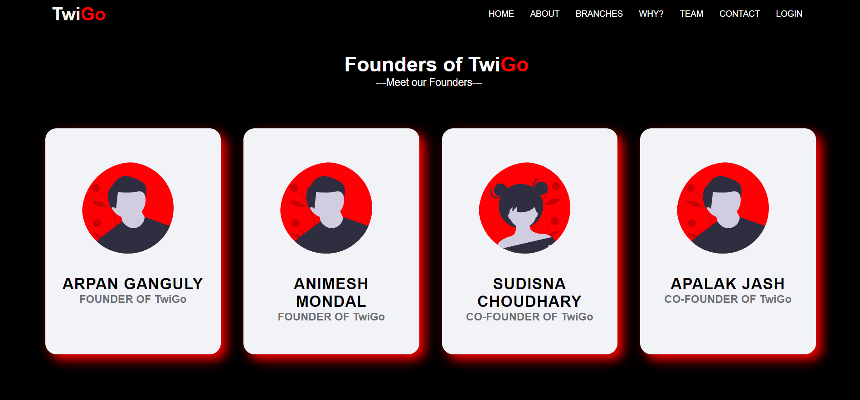
Our Founders

Slide 25
THANK YOU

