Slide 1
ISM 6136 - Final Group Project
Group D
Group Members -
Himanshu Prajapati
Animesh Bhawtankar
Niveditha Yeginati
Sai Kiran Pemmasani

Slide 2
The problem statement -
The bank is facing a concerning trend of increasing customer attrition in their credit card services. To address this issue, they seek a predictive model that can identify customers likely to churn. By proactively engaging with these identified customers, the bank aims to provide personalized services and incentives, with the goal of retaining customers and reversing the decision to leave the credit card services.

Slide 3
Motivation
Retain valuable customers for the bank.
Minimize the revenue loss.
Strategic Decision-Making.
Improve overall customer satisfaction for the bank.
1

Slide 4
Brief Description of Dataset
Index(['Attrition_Flag', 'Customer_Age', 'Gender', 'Dependent_count',
'Education_Level', 'Marital_Status', 'Income_Category', 'Card_Category',
'Months_on_book', 'Total_Relationship_Count', 'Months_Inactive_12_mon',
'Contacts_Count_12_mon', 'Credit_Limit', 'Total_Revolving_Bal',
'Avg_Open_To_Buy', 'Total_Amt_Chng_Q4_Q1', 'Total_Trans_Amt',
'Total_Trans_Ct', 'Total_Ct_Chng_Q4_Q1', 'Avg_Utilization_Ratio'],
dtype='object')

Slide 5
Implementation

Slide 6
Pre processing
Importing the dataset
Cleaning the dataset
Checking for the null values
1
2
3

Slide 7
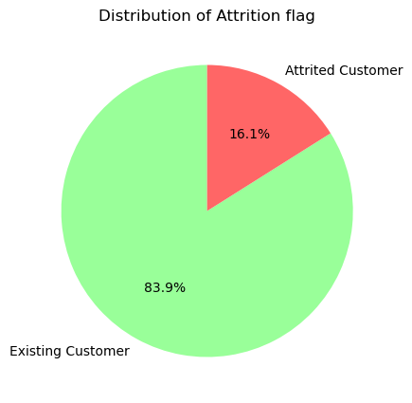
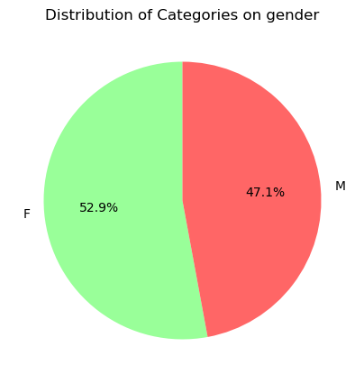
Exploratory data analysis

Slide 8
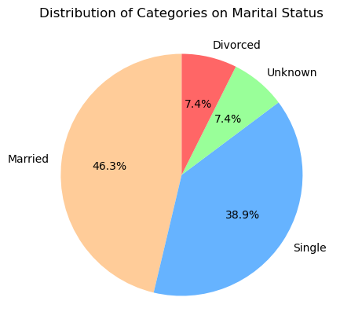
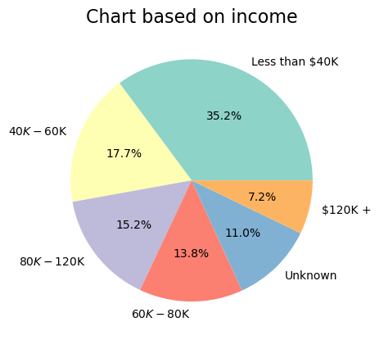

Slide 9
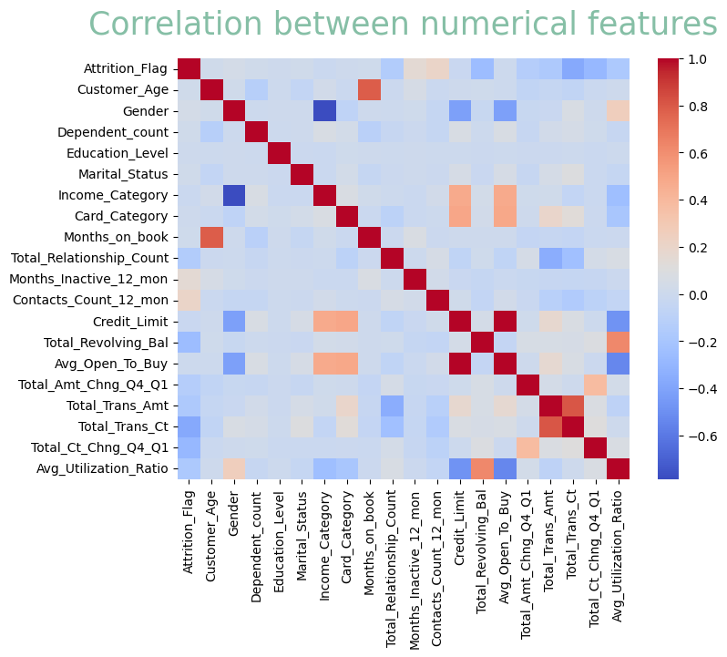

Slide 10
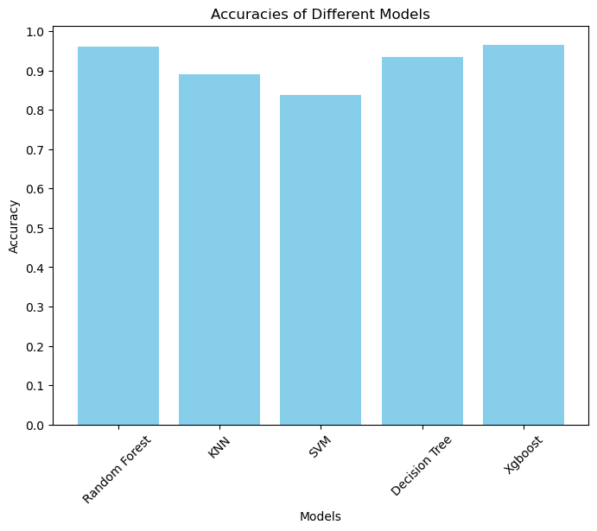
Model implemented - Accuracies
96.1%
96.5%
88.9%
93.3%
83.8%

Slide 11
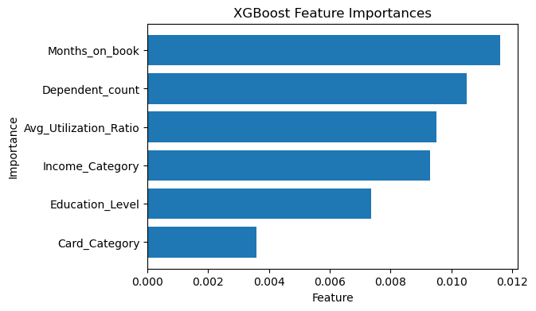
Important features

Slide 12
Business Questions
What is the relationship between "Total Trans Ct" and "Total Trans Amt," and how does their interaction influence the likelihood of customer churn?
How can the company use the information from the heat map to reduce customer churn?

Slide 13
Recommendations
Category of customers to be targeted -
Clients with lower incomes
Clients who lack formal education
Consumers with a low ratio of average utilization

Slide 14


