Slide 1

INDIVIDUAL ACADEMIC PROJECT PRESENTATION
NETRA-GATI
City-Wide AI Engine for Multi-Camera ANPR, Vehicle Trajectory Tracking and Urban Traffic Analytics
YOLOv8
OpenCV
ANPR / OCR
Vehicle Re-ID
Edge AI
Notes:
Cover slide. NETRA-GATI is an individual academic project: a city-wide AI engine that reads number plates across many cameras, reconstructs vehicle trajectories and produces traffic analytics.

Slide 2
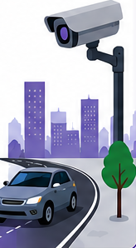








Project Overview & Introduction
NETRA-GATI turns a city’s existing CCTV network into a connected vehicle-intelligence platform. It reads number plates, recognises the same vehicle across non-overlapping cameras, reconstructs its complete city-wide path, and converts the data stream into real-time traffic analytics and predictive insights.
Existing CCTV, upgraded with edge AI
Reads plates with ANPR/OCR
Tracks vehicles across blind spots
Predicts and prevents congestion
Multi-Camera Feeds
Edge AI Processing
ANPR + Re-Identification
Trajectory Tracking
Traffic Insights & Predictions
Notes:
Introduce the project in one breath: existing cameras in, vehicle intelligence out. The five-stage strip at the bottom is the backbone of the whole presentation.

Slide 3




Problem Statement & Motivation
Blind spots between cameras
Motivation: vehicle theft in Raipur
Disconnected feeds lose a vehicle’s complete city-wide path between cameras.
Manual watching and tracking
Operators track vehicles by hand; plates are not read and alerts are not raised automatically.
Blacklisted vehicles go unflagged
Stolen or watch-listed vehicles are hard to catch across disparate camera feeds.
Reactive traffic management
Reported theft cases stay above 1,400 every year (2021–2025), which motivates automated cross-camera vehicle tracking.
Congestion is handled after it forms; planners lack flow data to improve road design.
Notes:
Problem framing: cameras exist everywhere, but they do not talk to each other. The chart uses the Raipur theft-case figures from the source presentation (2021–2025).

Slide 4


Project Objectives & Vision
Vision
01
02
Real-time ANPR
Trajectory reconstruction
Flag blacklisted or stolen vehicles across disparate camera feeds, using cross-camera Re-ID and road-network topology to reconstruct a vehicle’s complete city-wide path in real time.
Detect vehicles and read plates from live city CCTV feeds.
Stitch non-overlapping feeds using Re-ID and road-network topology.
Use real-time AI to predict and prevent congestion, ensuring faster and smoother daily commutes across the city.
03
04
Proactive enforcement
Predictive traffic insight
Instantly flag blacklisted vehicles and violations such as red-light jumping or wrong-way driving.
Heatmaps and forecasts that help prevent congestion before it forms.
Notes:
Vision on the left comes straight from the project concept; the four objectives on the right are the measurable goals the rest of the deck delivers on.

Slide 5
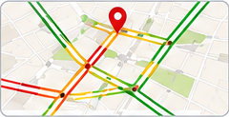
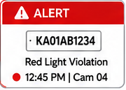
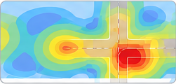



Proposed Solution & Key Features
Predictive congestion
Automated violation alerts
Flow heatmaps
Analyzes live data patterns to predict where jams will occur, enabling proactive route diversions.
ANPR autonomously flags and records violations like red-light jumping or wrong-way driving.
Heatmaps of vehicle and pedestrian flow give planners exact data to design better roads.
INNOVATION & EXCLUSIVITY
Zero-latency edge AI
Plug-and-play integration
Multi-modal predictive engine
Video is processed at the camera, enabling split-second decisions and lower server cost.
Works with the city’s existing CCTV, so it scales without expensive new hardware.
Combines historical data, weather and pedestrian movement to prevent traffic before it forms.
Notes:
Three capabilities (top) and three differentiators (bottom). The key idea: no new cameras, intelligence at the edge.

Slide 6




System Architecture & Technology Stack
Edge layer
TECHNOLOGY STACK
City IP cameras (RTSP) feed NVIDIA Jetson running YOLOv8 + OpenCV
Frontend
React.js, Mapbox / Leaflet
Backend
FastAPI
Streaming layer
Database
PostgreSQL, Redis
Apache Kafka carries lightweight metadata at high speed
AI / Vision
YOLOv8, OpenCV, DeepSORT
Edge hardware
NVIDIA Jetson
Backend & data layer
Streaming
Apache Kafka
FastAPI with PostgreSQL, Redis cache and object storage
Authentication
OAuth 2.0 / JWT
API
GraphQL
Presentation layer
Cloud
AWS
React.js dashboard with Mapbox / Leaflet live maps
NLP & speech
Transformers, Speech-to-Text
Notes:
Four tiers from camera to dashboard. The right-hand table lists the planned technology for each concern.

Slide 7
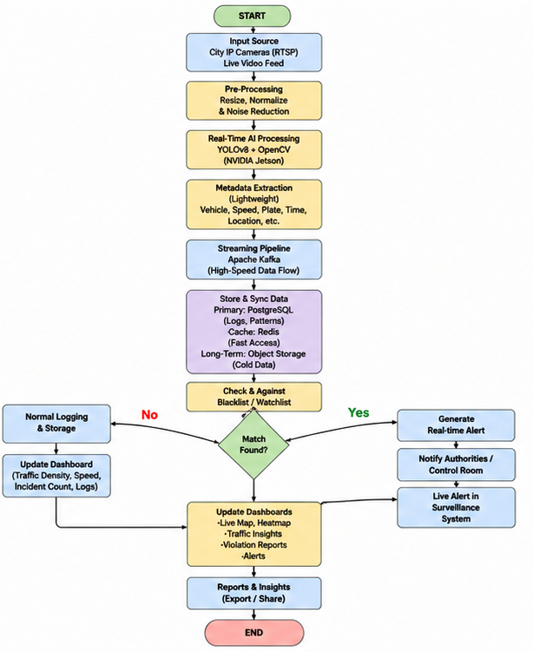
Technical Methodology & Workflow
1
Video ingestion
End-to-end processing flow
Capture live streams from city IP cameras over RTSP.
2
Real-time AI processing
Run YOLOv8 and OpenCV on edge hardware (NVIDIA Jetson) for vehicle tracking and incident detection.
3
High-speed streaming
Send lightweight metadata through Apache Kafka to the FastAPI backend.
4
Data storage & analytics
Keep logs and patterns in PostgreSQL; use Redis for fast lookups.
5
Interactive dashboard
Show live traffic, heatmaps and alerts on a React.js + Mapbox frontend.
Notes:
Left: the five methodology stages. Right: the full processing flowchart, including the watchlist decision (match found: alert; no match: normal logging) and dashboard updates.

Slide 8




Multi-Camera Vehicle Detection & ANPR
MH 02 AB 1234
Pre-processing
Vehicle detection
Crop & extract
OCR
Resize, normalize and reduce noise
YOLOv8 + OpenCV on the edge node
Isolate the vehicle and plate region
Read the plate characters as text
Plate text output (example)
Edge-first processing
Metadata extracted
Robust and privacy-aware
NVIDIA Jetson devices process video at the camera and send only lightweight metadata upstream, saving bandwidth and cost.
For each vehicle: plate, time, location, speed, direction and vehicle count, passed on for storage and alerts.
Adapts to low light and bad weather, and masks pedestrians to support privacy compliance.
Notes:
The ANPR path: pre-process, detect with YOLOv8, crop, OCR the plate. Everything happens at the edge; only metadata travels to the cloud.

Slide 9
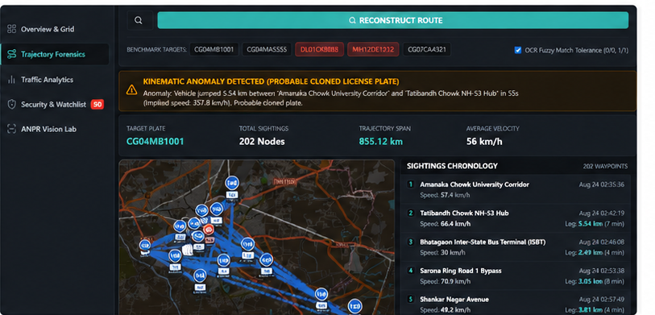





Re-Identification & Trajectory Reconstruction
In-camera tracking
DeepSORT tracks each vehicle within one camera view.
Appearance embeddings
Color, model and type features describe each vehicle.
Plate + Re-ID fusion
Visual features, color and road routes link sightings, not just plates.
Temporal graph mapping
Trajectory Forensics view in the demo dashboard
Sightings are placed on the road-network graph to stitch non-overlapping feeds.
No more blind spots
Kinematic anomaly check
Spatial-temporal database
Road-network topology reconstructs continuous, city-wide vehicle trajectories.
Impossible speeds between sightings flag a probable cloned plate.
Timestamped sightings support route queries.
Notes:
This is the core differentiator: plate text alone is not enough, so Re-ID features and road-network topology link sightings across blind spots. The screenshot shows the dashboard's route reconstruction and an anomaly flag.

Slide 10

Traffic Analytics, Heatmaps & Prediction
Heatmaps for planners
Live congestion map
Vehicle and pedestrian flow heatmaps show where roads are stressed, with traffic density, speed and incident counts.
Live traffic layers on Mapbox / Leaflet highlight slow corridors and route alternatives in real time.
MULTI-MODAL PREDICTIVE ENGINE
Historical traffic data
Prevent traffic before it forms
Weather conditions
Predicts where jams will occur so authorities can divert routes proactively.
LSTM congestion forecasting
Pedestrian movement
Notes:
Descriptive analytics (heatmaps, live map) on top; predictive analytics (LSTM forecasting from historical, weather and pedestrian inputs) at the bottom.

Slide 11




Dashboard & Operational Workflow
Overview & Grid
Trajectory Forensics
Traffic Analytics
Security & Watchlist
ANPR Vision Lab
Traffic management
Law enforcement & security
Forensic investigation
Live density, speed and incident data
Watchlist cross-reference (e.g., stolen vehicle plate)
Historical trajectory reconstruction
Congestion heatmap generation and optimization
Alert trigger generation
Route query tool
Output: dashboard analytics
Output: real-time alerts to the control room
Output: investigative report
Authorized personnel work from the command and control center; instant identification of blacklisted vehicles enables proactive interception.
Notes:
Single data platform, three operational lanes. The dashboard modules at the top are the navigation items of the demo UI.

Slide 12

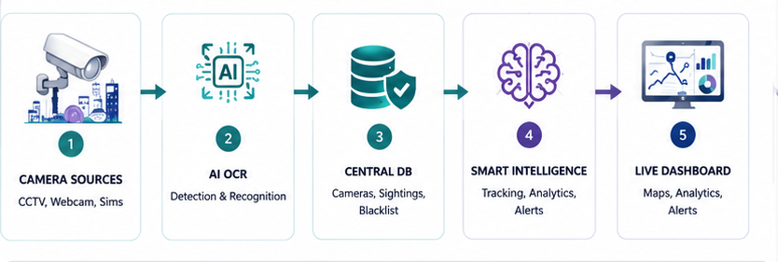



Feasibility, Scalability & Viability
Deployment pipeline
Cost-effective integration
Proven AI technology
Reuses existing CCTV networks, cutting new hardware cost and implementation time.
Battle-tested YOLOv8 models give high-accuracy detection from day one.
Real-world precedent
Scalable edge architecture
Open and future-ready
Video is processed locally and only metadata goes to the cloud, reducing bandwidth and server cost.
An open-source stack eases updates, integration and city-wide expansion.
Backed by real-world Smart City ITMS frameworks such as those in Surat and Pune.
Notes:
Feasibility rests on four points: reuse of existing CCTV, proven models, metadata-only uplink and an open-source stack.

Slide 13





Challenges, Limitations & Mitigation
CHALLENGES & LIMITATIONS
MITIGATION STRATEGIES
Adverse weather & lighting
Weather-adaptive AI
Rain, fog, night glare and dirty lenses can reduce detection accuracy.
Train on diverse conditions with video enhancement; cross-check signals to cut false alarms.
Hardware & network reliability
Robust safeguards
Edge device failures, power issues and network drops can disrupt operations.
Health monitoring, auto-recovery and redundant network paths.
Data & connectivity gaps
Edge caching & failover
Intermittent networks and remote locations may delay data sync and alerts.
Local storage on edge devices with auto-sync once the network returns.
Maintenance overhead
Open-source, monitored stack
Regular device upkeep, monitoring and software updates are required.
Eases updates and integration, backed by health monitoring.
Notes:
Each risk on the left is paired with a concrete mitigation on the right.

Slide 14



Expected Outcomes & Practical Applications
Traffic management
Law enforcement
Forensic investigation
Urban planning
Congestion heatmaps and optimization for smoother flow.
Watchlist alerts and proactive interception of flagged vehicles.
Historical route reconstruction and investigative reports.
Flow data that helps design better road infrastructure.
EXPECTED OUTCOMES
Eliminates manual video inspection across multi-camera feeds
Detects plates and flags blacklisted vehicles automatically
Gives law enforcement instant status alerts
Delivers seamless cross-camera tracking beyond CCTV blind spots
Notes:
Four user groups benefit (top). The dark band lists the concrete outcomes the system is designed to deliver.

Slide 15



Conclusion & Future Scope
CONCLUSION
FUTURE SCOPE
NETRA-GATI shows how existing CCTV infrastructure can become an intelligent, city-wide system. Edge AI reads plates, Re-ID stitches journeys across blind spots, and real-time analytics support enforcement, investigation and traffic planning.
Stronger forecasting
Refine LSTM congestion prediction with weather and pedestrian data.
Voice & language queries
Add Speech-to-Text and Transformer-based NLP for operators.
City-wide cloud scale
Scale to larger camera networks on AWS with GraphQL APIs.
Existing cameras. Edge intelligence. Connected city.
ITMS integration
Align with Smart City ITMS deployments such as Surat and Pune.
Notes:
Close with the one-line takeaway, then the four directions for future work.

Slide 16

References & Demonstration Resources
RESEARCH REFERENCES
Edge AI & vision: YOLOv8 (real-time detection) and DeepSORT (vehicle tracking).
Hardware: NVIDIA Jetson for low-latency, local AI processing.
Data pipeline: Apache Kafka for high-speed metadata streaming.
Predictive analytics: LSTMs (congestion forecasting) and OCR (automatic number plate recognition).
Validation & UI: Mapbox / Leaflet live heatmaps, backed by Smart City ITMS frameworks (e.g., Surat, Pune).
Scan for repository link
SOURCES
Demonstration video
tektronixllc.ae
tektronixllc.ae/anpr-lpr-camera-installation-uae-saudi-arabia-oman-qatar
share.google/9ZiH2DJry2YQOpvjS
youtu.be/uYhBiXGCNos
Notes:
Reference list, source links, repository QR code and the demonstration video link.

