Slide 1
Virtual farms
It’s Farm-monitoring ,Automation app Including an Augmented Reality view of the farms for better visualization and user interface for our Indian farmers.

Slide 2
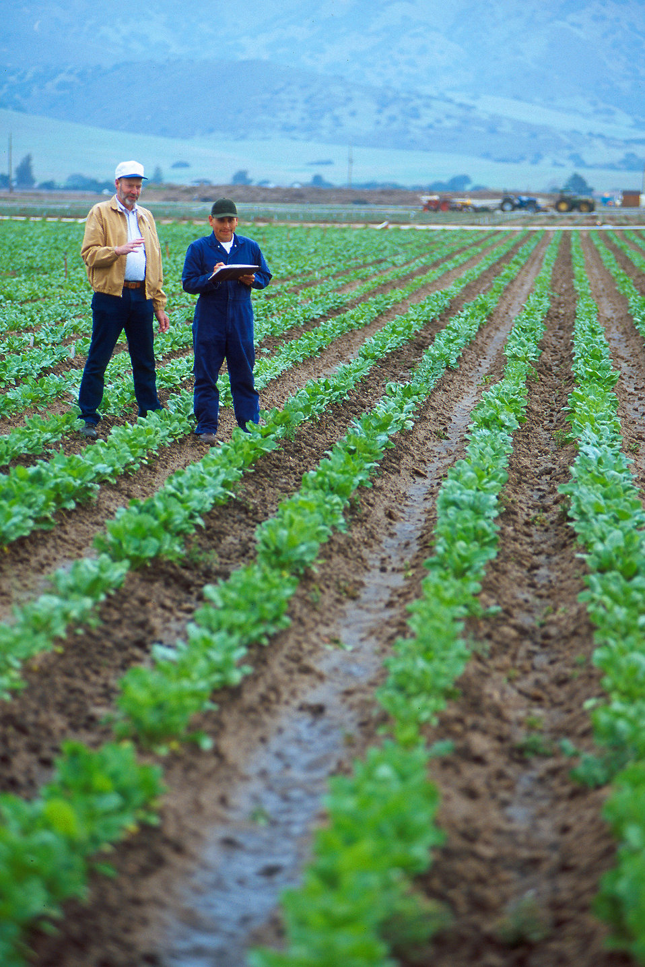
Problem STATEMENT:
In India, our farmers plant samplings with full enthusiasm every year, but due to lack of care and attention, many of them don’t grow to their full length and die at an early stage.
Also usually the farm size is very large and so the different subparts of his field do vary in different aspects and the farmer has no idea of that and treats all of his farm likely and doesn’t care.

Slide 3
Our Solution:
Live Sensor Data
So, we will be deploying these sensor-sets in a large grid format like one sensor-set for one block and for better care we obviously do need the live sensors data for monitoring but we are not restricting our product just to it.
The live-sensor data would be used for:
Automating various tasks in the farm.
Uploading it to the web.
Providing data set to Augmented-Reality App.
for AR app.
Uploading it to the web.
Automating Tasks in the farm

Slide 4
LIST OF SENSORS :
Sensor name
What it does
Automation scope
DHT-11 Sensor
Moisture Sensor
LDR sensor
PIR sensor
Senses Temperature and Humidity.
Senses moisture content of the soil.
Senses the amount of light reaching the farm.
Senses the motion around any grid of the farm.
Tells the pump the amount of water it should pump out and keep it ready.
Tells the water tank when to deploy water to the grids.
Can automate the lighting system in the farm.
Alerts the user about any intruders that may have trace-passed the field.

Slide 5
Now, It’s time for : Demo of live sensor values and updating these values on the webpage in real time .

Slide 6
Why aR ?
Instead of making it headache For the farmers to understand the data sets from the field, it would be better for him to visualize and understand their farm through ar.
It makes the farmer’s experience more interactive at low costs.
To know exactly which part of the farm is lacking In which aspect.
For visualizing the automation tasks being carried on in his field.

Slide 7
Now the exciting part 😍 , the Augmented-reality app Demo :

Slide 8
Future Aspirations:
Self Operating Plantation Fields
Including the NPK sensors to the sensor-set to be able to get the nutrients specifications and recommending the farmer which type of crop and fertilizer he should use.
Automating the whole farming process with the help of bots that can perform seed sowing, weed removal and fertilizer spraying.

