Slide 1
PHASE 1 · MACHINE LEARNING EVALUATION
Forecasting Urban Air Quality
One-Hour-Ahead PM2.5 Prediction for Beijing — a Leakage-Controlled Study
Team T051 · Advance Machine Learning
Animesh Kumar Rai
2401010069
Aditya Shankar
2401010038
Rishiwant Kumar Maurya
2401020102
Drishti Jha
2401010162
Supreet
2401010465
Dataset: UCI Beijing PM2.5 (2010–2014, 43,824 hourly records)
Notes:
Scope in one line: Phase 1, machine-learning only — forecast PM2.5 one hour ahead for Beijing, evaluated honestly against strong naive baselines. Deep learning (LSTM/hybrid) is Phase 2 and deliberately NOT part of this evaluation. Team T051, Advance Machine Learning.

Slide 2
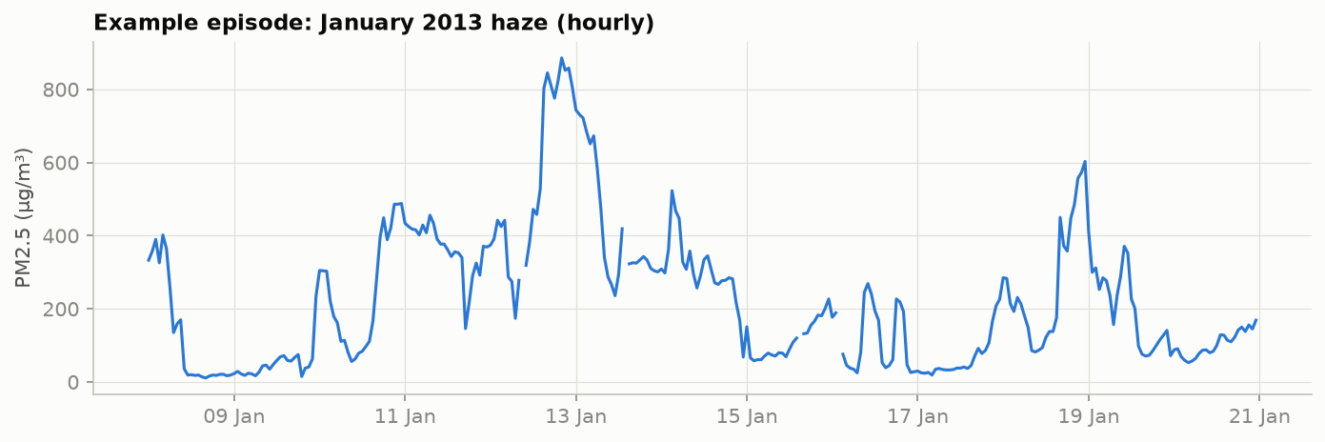
PROBLEM & MOTIVATION
Why forecast PM2.5 one hour ahead?
PM2.5 — airborne particles < 2.5 µm — penetrates deep into the lungs and is a leading environmental health risk.
Beijing suffers severe haze episodes: hourly PM2.5 reached ~900 µg/m³ in January 2013 (right).
The WHO 2021 guideline for 24-h mean PM2.5 is 15 µg/m³ — episode peaks exceed it by more than an order of magnitude.
A reliable next-hour forecast supports exposure avoidance, public alerts and operational decisions.
~900 µg/m³ peak hourly PM2.5
15 µg/m³ WHO 24-h guideline
Hourly PM2.5, Jan 2013 haze episode
PM2.5 Forecasting · Phase 1 (Machine Learning)
2
Notes:
Frame the stakes before the method. PM2.5 has the clearest health burden; Beijing is an extreme, well-studied case. The right figure is real data from our set — the Jan-2013 episode peaks near 900 µg/m³ vs a WHO 24-h guideline of 15. One hour ahead is the shortest, most actionable, and hardest-to-beat horizon (the last value is already a strong guess), so it is an honest test of whether ML adds value. Q 'why not forecast further ahead?' — longer horizons need future weather we don't have at issue time; we restrict inputs to information available at hour t.

Slide 3
OBJECTIVES & SCOPE
What this project sets out to do
Primary objective: predict PM2.5 at hour t+1 and test whether a learned model beats strong naive baselines under a leakage-free protocol.
Build an informative, leakage-safe feature set from history and weather.
Apply and tune XGBoost; compare fairly on identical evaluation hours.
Validate results statistically, not just by a single metric.
In scope — Phase 1 (ML)
Data quality, EDA, feature engineering
Persistence & seasonal-naive baselines
XGBoost (gradient-boosted trees)
Chronological backtesting + significance tests
Deferred to Phase 2 (DL)
LSTM / sequence models
Hybrid ML + DL approaches
(Mentioned here only as future work — not implemented)
TAKEAWAY
Phase 1 is a disciplined ML study; deep learning is explicitly out of scope and reserved for Phase 2.
PM2.5 Forecasting · Phase 1 (Machine Learning)
3
Notes:
State the objective as a testable claim: can a learned model beat naive baselines at t+1 under honest evaluation? The right-hand cards draw the Phase 1 / Phase 2 boundary — we did NOT implement an LSTM; mentioning it is scoping, not a claim. Q 'why beating a baseline rather than high R²?' — R² can look excellent while adding nothing over persistence; the baseline is the bar that matters.

Slide 4
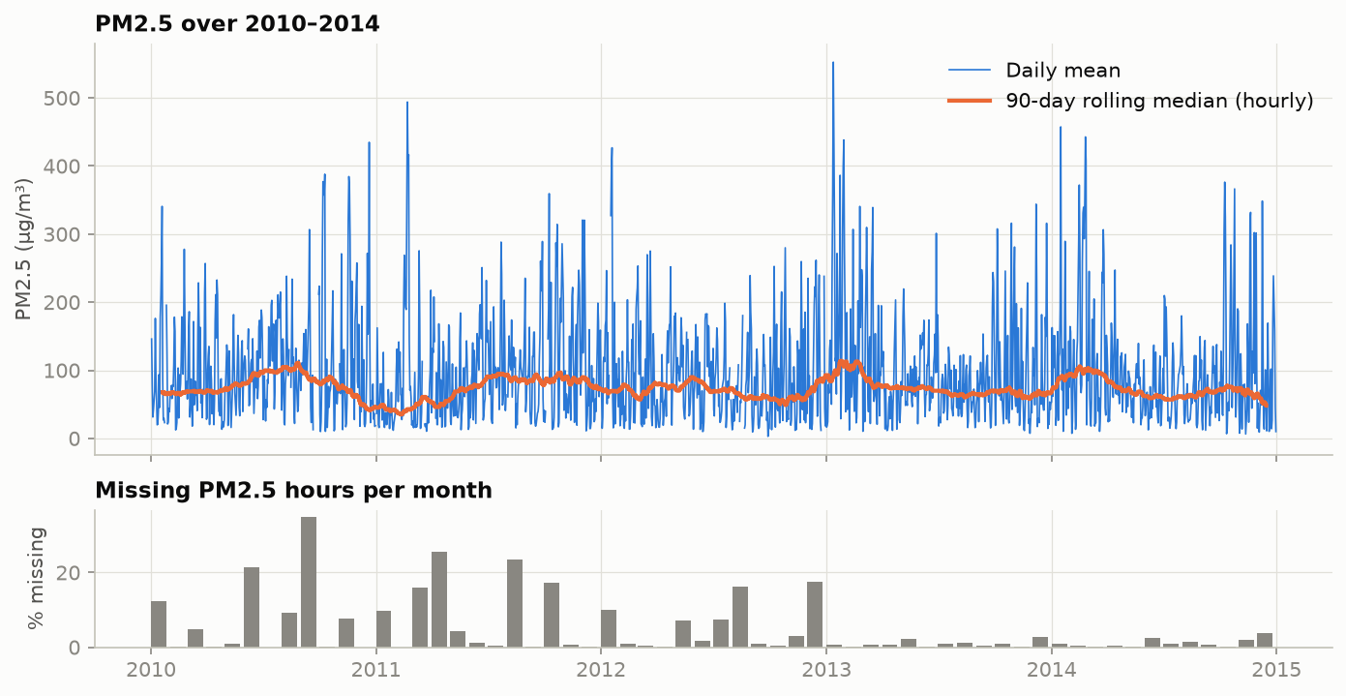
DATASET & DATA QUALITY
UCI Beijing PM2.5 — hourly, five years, validated
43,824
hourly records
2010–2014
full years
8 + 1
inputs + target
4.7%
PM2.5 missing
Target: PM2.5 (µg/m³, US Embassy). Inputs: dew point, temperature, pressure, wind direction, cumulative wind speed, snow & rain hours (Capital Airport).
Missing PM2.5 is concentrated in 2010–2012 and left as NaN — never silently imputed.
Integrity
No imputation
Validated + decoded
SHA-256 checked on every load; gap-free hourly index
PM2.5 gaps left NaN — no leaked/invented values
Range invariants asserted; cumulative wind → hourly speed
PM2.5 series and monthly missingness — note winter peaks and heavier early-year gaps
PM2.5 Forecasting · Phase 1 (Machine Learning)
4
Notes:
The four cards give the data's shape in 20 seconds; the three white chips are our quality pipeline condensed. Two defensible decisions: (1) no imputation of the target or its lags — imputing would leak/invent data; (2) no outlier deletion — the >250 µg/m³ hours are genuine haze and operationally important. Provenance is pinned by a SHA-256 hash on every load. The figure shows the series (winter peaks) and that missingness is worse in 2010–12 than 2013–14 — relevant since validation/test are the cleaner later years. Wind decoding: raw 'Iws' is cumulative since the direction last changed, so we difference within a run to recover hourly speed.

Slide 5
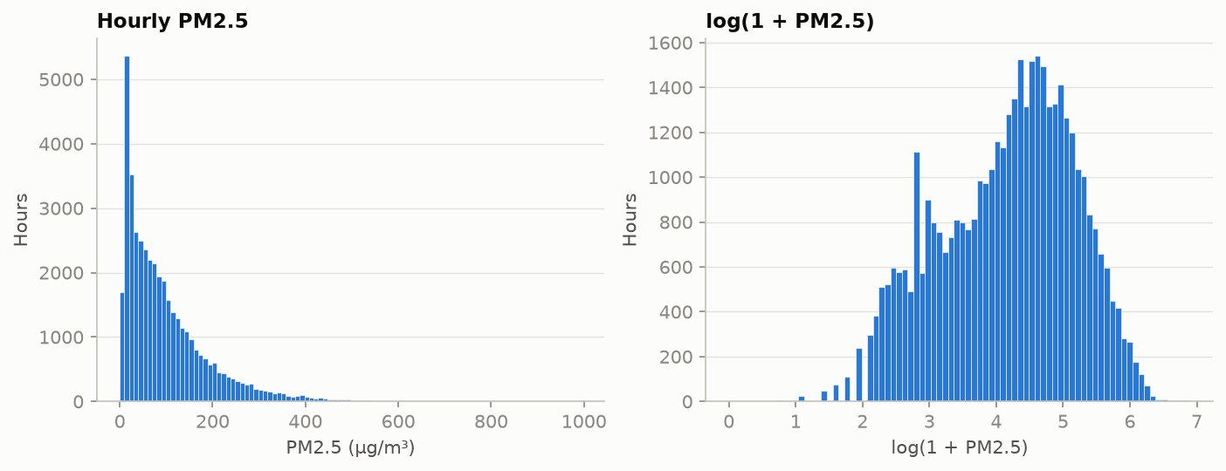
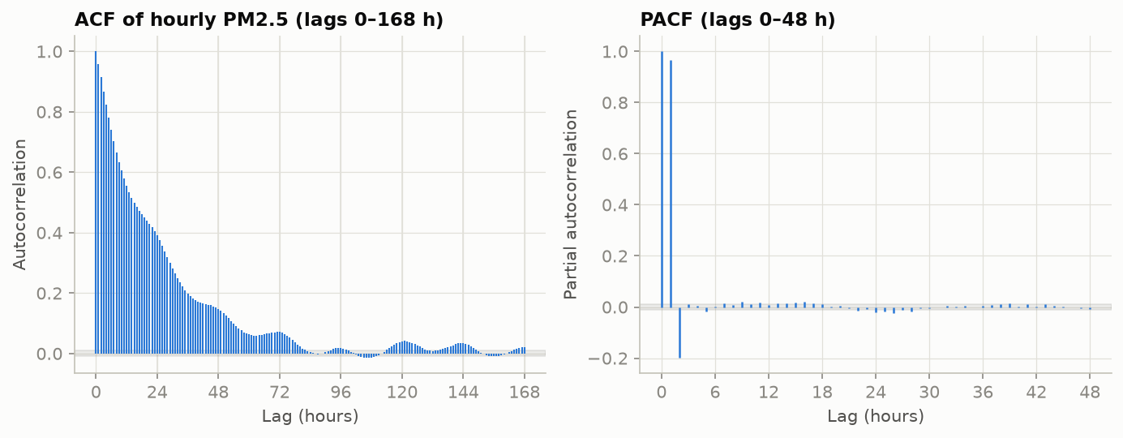
EXPLORATORY DATA ANALYSIS
PM2.5 is heavy-tailed and strongly autocorrelated
Right-skewed target: most hours low, long tail past 400–900 µg/m³ → motivates MAE alongside RMSE and a change-based target.
The log transform is far more symmetric — tested as a model variant.
ACF decays slowly; PACF cuts off sharply after lag 1 → an AR(1)-like process.
This is exactly why persistence (carry the last value) is such a strong baseline, and why short PM2.5 lags are the most useful features.
A daily cycle and higher winter variance are also present (drives calendar features).
TAKEAWAY
The near-AR(1) structure sets a high bar (persistence) and tells us lag features will carry most of the signal.
PM2.5 Forecasting · Phase 1 (Machine Learning)
5
Notes:
Connect each plot to a decision. Raw histogram is heavily right-skewed; the log version is near-symmetric → we report MAE (tail-robust) and test a log target. ACF decays slowly but PACF spikes only at lag 1 → near-AR(1). Consequence: 'tomorrow ≈ today' (persistence) is hard to beat, and recent PM2.5 lags carry most signal — the feature-importance results confirm this. Seasonality: a clear daily cycle and larger winter spread (the mean shifts less than the variance), which motivates the calendar features.

Slide 6
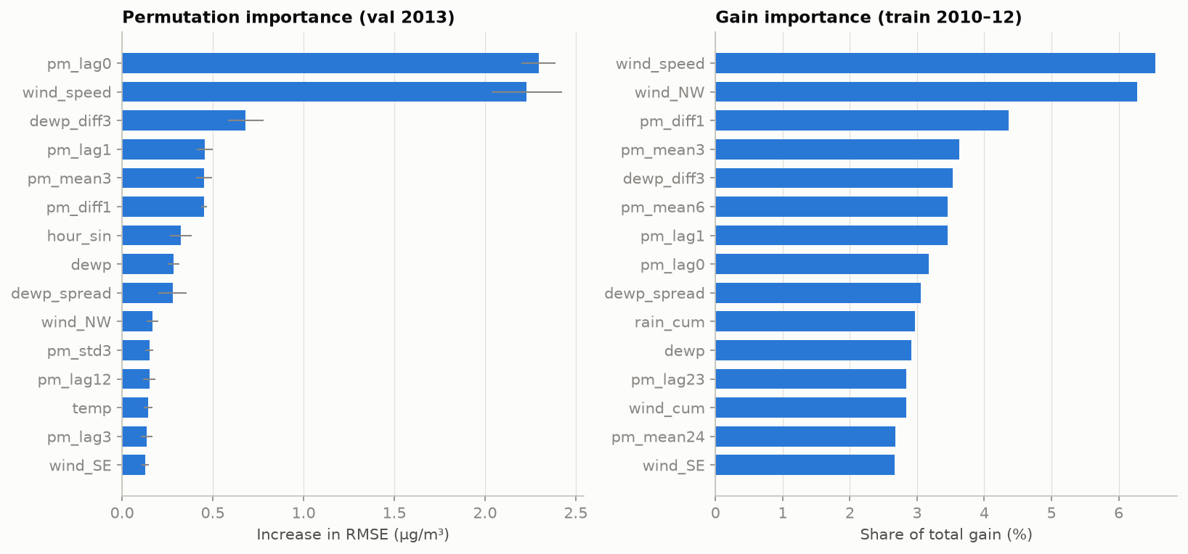
FEATURE ENGINEERING
37 leakage-safe features — and which ones matter
PM2.5 history — 17
Weather — 15
Calendar — 5
Lags t … t−23; rolling mean/std (3/6/12/24 h)
1-hour difference; hours since last obs
Dew point, temp, pressure, dew-point spread
Decoded wind speed/run; wind one-hots; snow/rain
Hour & month (sin/cos), day of week
Describe the TARGET hour t+1 (known ahead)
pm_lag0 and wind_speed dominate — matching the AR structure and the physics of dispersion.
Leakage rule: every input uses only hours ≤ t; calendar fields describe the known target hour.
Importance measures predictive value, not causation.
Permutation importance (validation) and gain importance (training)
PM2.5 Forecasting · Phase 1 (Machine Learning)
6
Notes:
Headline: 37 leakage-safe features (17 PM-history + 15 weather + 5 calendar = 37, verified in features.py), and the importance plot shows which actually drive predictions. PM history encodes the AR dynamics; weather the physical drivers; calendar the cycles — and calendar features describe the TARGET hour t+1, which is legitimate because you always know the next hour/month. Permutation importance (left, on validation = real predictive value) ranks pm_lag0 and wind_speed highest; gain importance (right, on training) agrees on wind and recent PM2.5. Full 37-name list and definitions are in features.py; we also ran a future-perturbation leakage test that passed.

Slide 7
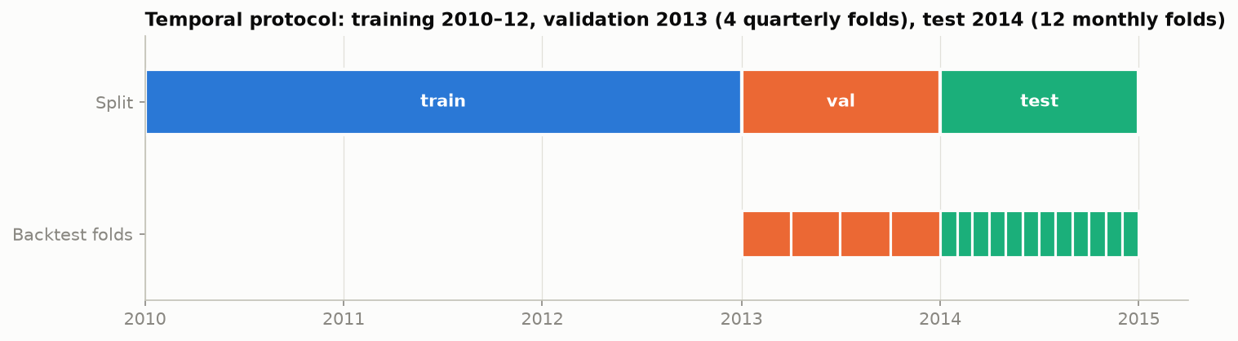
EXPERIMENTAL DESIGN
Chronological protocol prevents leakage
Target: y(t) = PM2.5(t+1); a sample belongs to the split of its target hour, so no training label sits inside validation/test.
Split by whole years: train 2010–12, validate 2013, test 2014.
Tune on 4 expanding-window quarterly folds in 2013.
Test: 12 monthly expanding refits in 2014, config frozen.
Common eval mask: all models scored on identical hours.
No random shuffling or k-fold — that would train on the future and leak.
The 2014 test year is scored once, after freezing the config on 2013 — validation and test are never mixed.
TAKEAWAY
Expanding windows mimic real deployment: always predict forward, never look back from the future.
PM2.5 Forecasting · Phase 1 (Machine Learning)
7
Notes:
The methodological heart — slow down here. Leakage = using information not available at prediction time. Prevented three ways: (1) target-hour split assignment (a 2012 input predicting into 2013 is not training data); (2) chronological expanding windows (never shuffle); (3) a common evaluation mask so every model is judged on the same hours. Timeline: blue train 2010–12, orange validation 2013 (4 quarterly folds), green test 2014 (12 monthly refits). Crucial: 2014 is touched once, after freezing the config on 2013. We also confirmed a fixed-origin variant gives near-identical results (MAE 10.98 vs 10.96).

Slide 8
MODELS & EVALUATION
Two honest baselines, one learned model — scored fairly
Persistence
Seasonal-naive 24 h
XGBoost (change)
BASELINE
BASELINE
LEARNED
ŷ(t+1) = PM2.5(t)
Carry last value; strong (near-AR(1))
ŷ(t+1) = PM2.5(t+1−24)
Same hour yesterday; tests daily cycle
Gradient-boosted trees; learns Δ=PM2.5(t+1)−PM2.5(t)
Captures non-linear weather × history
EVALUATION METRICS
MAE
RMSE
R²
Average |error| (µg/m³). Robust to the tail — headline metric.
Penalises large misses — the extreme haze hours.
Variance explained vs the mean — context only.
TAKEAWAY
All models scored on the same 8,531 hours (2014); significance checked by Diebold–Mariano. Selected XGBoost: change target, depth 6, lr 0.02, 800 trees (tuned on 2013).
PM2.5 Forecasting · Phase 1 (Machine Learning)
8
Notes:
Baselines are the thing to beat, not filler. Persistence (carry last value) is strong because of AR(1); seasonal-naive (same hour yesterday) tests a pure daily cycle and fails badly. XGBoost = ensemble of gradient-boosted regression trees — NOT deep learning. The 'change'/delta target: trees are piecewise-constant, so learning Δ beats re-deriving 'copy pm(t)' (delta RMSE 21.8 vs level 23.8, log 24.3, on 2013 validation). Metrics: MAE (headline, tail-robust), RMSE (big-miss sensitive, the haze hours), R² (context; easy to inflate on autocorrelated data). Common eval = 8,531 identical hours; Diebold–Mariano uses a Newey–West autocorrelation-robust variance. Full selected config: delta, max_depth 6, lr 0.02, 800 trees, min_child_weight 10, subsample 0.85, colsample_bytree 0.6, reg_lambda 5 — all tuned only on 2013, never on test.

Slide 9
RESULTS — TEST 2014
XGBoost achieves the lowest test error
Model | MAE | RMSE | R²
Persistence | 11.93 | 22.03 | 0.944
Seasonal-naive (24 h) | 67.30 | 98.75 | −0.121
XGBoost (change) | 10.96 | 19.96 | 0.954
1-hour-ahead PM2.5 (µg/m³), 8,531 common eval hours. Config frozen after 2013 tuning.
−8.1%
MAE vs persistence
−9.4%
RMSE vs persistence
Persistence vs XGBoost — seasonal-naive omitted for scale (RMSE ≈ 99)
TAKEAWAY
XGBoost beats persistence on both metrics; seasonal-naive is far worse, confirming a daily cycle alone is insufficient.
PM2.5 Forecasting · Phase 1 (Machine Learning)
9
Notes:
The payoff slide. Seasonal-naive is dramatically worse (MAE 67, negative R²) — a daily cycle alone does not forecast next-hour PM2.5. The real contest is persistence vs XGBoost, and XGBoost wins on every metric: −8.1% MAE, −9.4% RMSE. Honesty note: the bar chart omits seasonal-naive on purpose — its RMSE ~99 would flatten the 22-vs-20 bars and HIDE the real result (a misleading scale); it stays in the table. On a near-AR(1) series an 8–9% consistent beat is a meaningful, hard-won gain — and the next slides show it is consistent and significant. The 'change' target won over level/log formulations on validation (RMSE 21.8 vs 23.8/24.3).

Slide 10
ERROR ANALYSIS
Where the model wins — and where it struggles
Gains largest at low–moderate levels (0–250): XGBoost cuts RMSE by 10–15%.
On the most extreme hours (>250 µg/m³) XGBoost does NOT beat persistence (42.0 vs 41.6) and under-predicts them (bias ≈ −13).
Trees interpolate within seen patterns, so they smooth sudden, sharp spikes.
Honest implication: the model helps most in the common regime, least in rare crisis peaks.
TAKEAWAY
XGBoost's advantage is real across the bulk of the distribution but vanishes at the extreme tail — a limitation we report openly.
PM2.5 Forecasting · Phase 1 (Machine Learning)
10
Notes:
Proves we understand the model's behavior, not just its average. Binned by true PM2.5: XGBoost's RMSE is clearly below persistence in every band up to 250 (10–15% lower). In the >250 band the bars cross (41.6 vs 42.0) and the bias turns strongly negative (mean predicted − true ≈ −12.8), i.e. it under-predicts the worst peaks, because boosted trees regress rare extreme values toward typical ones. We report this openly — it directly motivates Phase 2. Fix options (future work): quantile/asymmetric loss, a tail-specialized model, or exogenous forecast inputs.

Slide 11
ROBUSTNESS & STATISTICAL VALIDATION
The improvement is consistent and significant
All 12 months
XGBoost has the lower MAE in every month of 2014 — not one lucky period.
Diebold–Mariano
vs persistence: p = 3.4×10⁻⁷ (squared) — statistically significant.
Stability
5 seeds: RMSE varies < 0.1 µg/m³.
Fixed-origin vs refit: 10.98 vs 10.96 MAE.
Monthly MAE across the 2014 test year (12 expanding refits)
TAKEAWAY
Better every month, significant by Diebold–Mariano (p ≈ 3×10⁻⁷), and stable across seeds and refit scheme — the result is reliable.
PM2.5 Forecasting · Phase 1 (Machine Learning)
11
Notes:
Three independent checks, all agreeing. (1) XGBoost (teal) is below persistence (slate) in all twelve months — not one lucky season. (2) Diebold–Mariano p = 3.4e-7 on squared loss — we reject 'equal accuracy' overwhelmingly. (3) Stability: five seeds move RMSE < 0.1 µg/m³, and a fixed-origin train (2010–13) gives essentially the same MAE as monthly refit (10.98 vs 10.96). Honesty caveat: in a simulation with autocorrelated errors the DM test mildly over-rejected (~8% at nominal 5%), so we treat the p-value as strong but approximate — still far below any threshold.

Slide 12
LIMITATIONS & FUTURE WORK
What we would not yet claim — and what comes next
Limitations
Future work
Extreme hours (>250 µg/m³): no gain over persistence; peaks under-predicted.
Single station, single test year — generalization untested elsewhere.
Inputs use observed weather only — no weather forecasts at issue time.
Cumulative wind/snow/rain fields have a few skipped increments.
Diebold–Mariano p-values are strong but approximate (mild over-rejection).
Phase 2: LSTM / sequence models to track sharp dynamics (not yet implemented).
Hybrid ML + DL where technically justified.
Tail-aware objectives (quantile / asymmetric loss) for extreme peaks.
Multi-station data and longer out-of-sample periods.
Incorporate numerical weather-forecast inputs.
TAKEAWAY
Deep learning appears here only as a Phase 2 direction — in Phase 1 nothing beyond the ML pipeline above is claimed as done.
PM2.5 Forecasting · Phase 1 (Machine Learning)
12
Notes:
Lead with limitations — it signals maturity: the extreme-tail gap, single-station/single-year scope, observed-weather-only inputs, minor cumulative-field artifacts, and the approximate DM p-value. Then future work — and the critical scoping statement: the LSTM/hybrid line is Phase 2 and NOT implemented; we are not presenting planned work as done. The tail-aware loss idea ties back to the error-analysis failure mode, so the roadmap is evidence-driven.

Slide 13
CONCLUSION & KEY FINDINGS
A validated ML model that beats a strong baseline — honestly
1
XGBoost beats both baselines
8.1% lower MAE and 9.4% lower RMSE than persistence on the 2014 test year; seasonal-naive is far behind.
2
The gain is trustworthy
Lower error in all 12 test months, significant by Diebold–Mariano (p≈3×10⁻⁷), stable across seeds.
3
Recent PM2.5 + wind drive it
Permutation importance ranks pm(t) and hourly wind speed highest — matching the AR structure and physics.
4
Limits are at the extremes
No gain above 250 µg/m³; the model smooths rare, sharp spikes — the clearest opening for Phase 2.
Methodological contribution: a reproducible, honestly evaluated ML benchmark that Phase 2 deep learning must beat.
Thank you — questions welcome
Notes:
Combine findings and conclusion. Four evidence-backed claims, each mapping to an earlier slide: XGBoost wins; the win is trustworthy (consistency + significance + stability); the signal is recent PM2.5 and wind (AR + physics); the limits are at the extremes. Close on the contribution — a reproducible, rigorously validated ML benchmark that Phase 2's deep learning must clear. Invite questions; speaker notes carry the deeper detail (hyperparameters, full error table, DM table).

Slide 14
REFERENCES
Key sources cited
1. Liang, X. et al. (2015). Assessing Beijing's PM2.5 pollution: severity, weather impact, APEC and winter heating. Proc. R. Soc. A, 471:20150257.
2. Chen, S. (2015). Beijing PM2.5 Data Set. UCI Machine Learning Repository. doi:10.24432/C5JS49.
3. Chen, T. & Guestrin, C. (2016). XGBoost: A Scalable Tree Boosting System. ACM SIGKDD.
4. Friedman, J. (2001). Greedy function approximation: A gradient boosting machine. Annals of Statistics.
5. Diebold, F. & Mariano, R. (1995). Comparing Predictive Accuracy. J. Business & Economic Statistics.
6. Newey, W. & West, K. (1987). A Simple, Positive Semi-Definite, HAC Covariance Matrix. Econometrica.
7. Tashman, L. (2000). Out-of-sample tests of forecasting accuracy: an analysis and review. Int. J. Forecasting.
8. Bergmeir, C. & Benítez, J. (2012). On the use of cross-validation for time series predictor evaluation. Information Sciences.
9. Zhong, J. et al. (2021). Robust prediction of hourly PM2.5 from meteorological data using LightGBM.
10. WHO (2021). Global Air Quality Guidelines: PM2.5 and PM10, O₃, NO₂, SO₂, CO.
PM2.5 Forecasting · Phase 1 (Machine Learning)
14
Notes:
Concise reference list — the ten sources actually cited across the deck's problem framing, methods and evaluation. Full bibliography (incl. the LSTM Phase-2 references) is in report/references.bib.

