Slide 1
FOOD ADULTERATION
Submitted By:
Group-78
ANIMESH MANDAL
SUBHASHREE PANDA
PRATYUSHA ROUT
KUMAR PRATYUSH
Submitted to:
GIET University

Slide 2
Table Contents
Introduction
Why Food Adulteration?
Causes of Food Adulteration
Methods of Food Adulteration
Prevention of Food Adulteration
Food Adulteration
Conclusion
2
Notes:
SAY: Before we wrap up the course, let’s review what we have learned today.
During this course, we have
<READ the bullets from the slide.>
GO to next slide.

Slide 3
Introduction
Adulterants are the substance or poor quality products added to food items for economic and technical benefits.
Addition of these adulterants reduces the value of nutrients in food and also contaminates the food, which is not fit for consumption.
These adulterants can be available in all food products which we consume daily, including dairy products, cereals, pulses, grains, meat, vegetables, fruits, oils, beverages, etc.
3
Notes:
SAY: Before we wrap up the course, let’s review what we have learned today.
During this course, we have
<READ the bullets from the slide.>
GO to next slide.

Slide 4
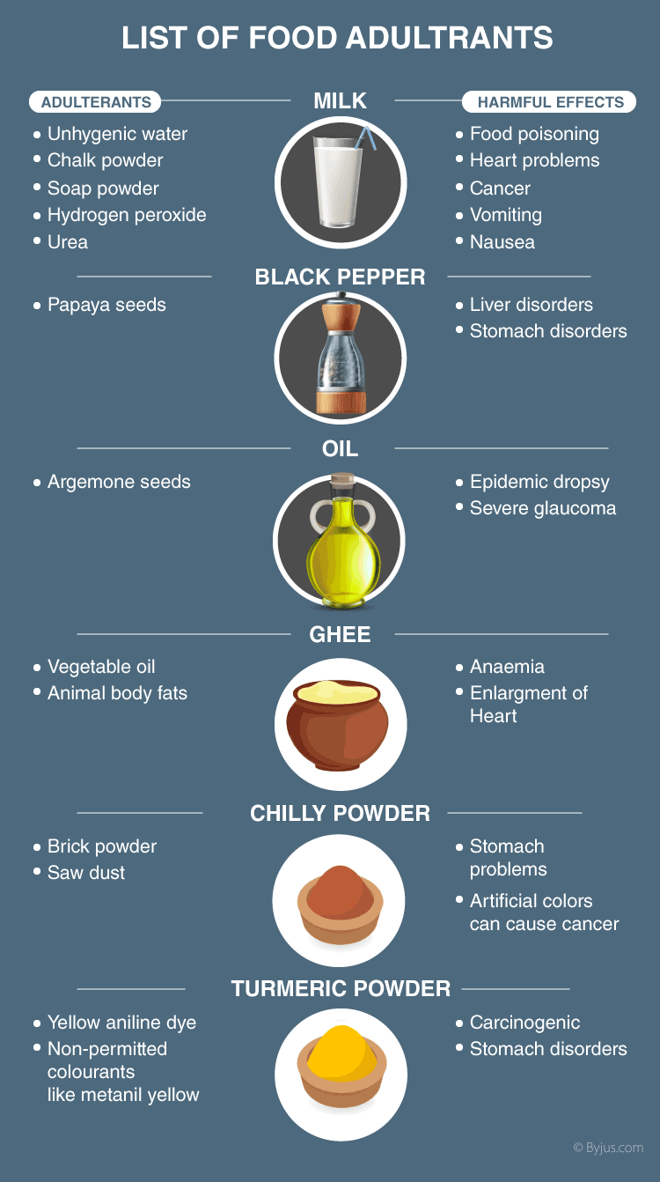
4
Notes:
SAY: Before we wrap up the course, let’s review what we have learned today.
During this course, we have
<READ the bullets from the slide.>
GO to next slide.

Slide 5
Why Food Adulteration?
The process of contaminating food or adding to the food components is a common phenomenon in developing countries.
For instance: Milk can be diluted by adding water to increase its quantity and starch powder is often added to increase its solid content.
●●●
5
Notes:
SAY:
The purpose of epidemiology in public health practice is to
discover the agent, host, and environmental factors that affect health;
determine the relative importance of causes of illness, disability, and death;
identify those segments of the population that have the greatest risk from specific causes of ill health; and
evaluate the effectiveness of health programs and services in improving population health.
GO to next slide.

Slide 6
Causes of Food Adulteration
Practiced as a part of the business strategy.
An imitation of some other food substance.
Lack of knowledge of proper food consumption.
To increase the quantity of food production and sales.
Increased food demand for a rapidly growing population.
To make maximum profit from food items by fewer investments.
6
Notes:
SAY:
The purpose of epidemiology in public health practice is to
discover the agent, host, and environmental factors that affect health;
determine the relative importance of causes of illness, disability, and death;
identify those segments of the population that have the greatest risk from specific causes of ill health; and
evaluate the effectiveness of health programs and services in improving population health.
GO to next slide.

Slide 7
Methods of Food Adulteration
Adding certain chemicals for faster ripening of fruits.
Mixing of decomposed fruits and vegetables with the good ones.
Adding certain natural and chemical dyes to attract consumers.
Mixing of clay, pebbles, stones, sand, and marble chips, to the grains, pulses and other crops.
●●●
7
Notes:
SAY:
The purpose of epidemiology in public health practice is to
discover the agent, host, and environmental factors that affect health;
determine the relative importance of causes of illness, disability, and death;
identify those segments of the population that have the greatest risk from specific causes of ill health; and
evaluate the effectiveness of health programs and services in improving population health.
GO to next slide.

Slide 8
Methods of Food Adulteration
Cheaper and inferior substances are added wholly or partially with the good ones to increase the weight or nature of the product.
Adulteration is an illegal practice of adding raw and other cheaper ingredients to excellent quality products to increase the quantity.
Having this adulterated food is highly toxic and leads to several health issues, including certain nutrition deficiency diseases, kidney disorders, and failure of an individual’s organ systems, including heart, kidney and liver.
8
Notes:
SAY:
The purpose of epidemiology in public health practice is to
discover the agent, host, and environmental factors that affect health;
determine the relative importance of causes of illness, disability, and death;
identify those segments of the population that have the greatest risk from specific causes of ill health; and
evaluate the effectiveness of health programs and services in improving population health.
GO to next slide.

Slide 9
Prevention of Food Adulteration
Avoid dark coloured, junk and other processed foods.
Make sure to clean and store all the grains, pulses and other food products.
Wash fruits and vegetables thoroughly in running water before they are used.
Check if the seal is valid or not, before buying food products like milk, oil and other pouches.
Always make sure to check and buy products having an FSSAI-validated label.
9
Notes:
SAY:
The purpose of epidemiology in public health practice is to
discover the agent, host, and environmental factors that affect health;
determine the relative importance of causes of illness, disability, and death;
identify those segments of the population that have the greatest risk from specific causes of ill health; and
evaluate the effectiveness of health programs and services in improving population health.
GO to next slide.

Slide 10
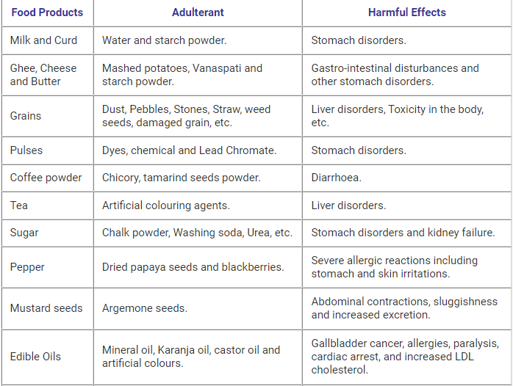
Food Adulteration
●●●
10
Notes:
SAY:
The purpose of epidemiology in public health practice is to
discover the agent, host, and environmental factors that affect health;
determine the relative importance of causes of illness, disability, and death;
identify those segments of the population that have the greatest risk from specific causes of ill health; and
evaluate the effectiveness of health programs and services in improving population health.
GO to next slide.

Slide 11
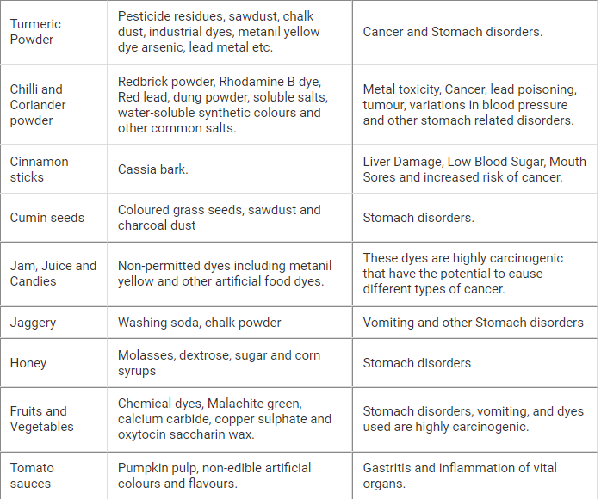
Food Adulteration
11
Notes:
SAY:
The purpose of epidemiology in public health practice is to
discover the agent, host, and environmental factors that affect health;
determine the relative importance of causes of illness, disability, and death;
identify those segments of the population that have the greatest risk from specific causes of ill health; and
evaluate the effectiveness of health programs and services in improving population health.
GO to next slide.

Slide 12
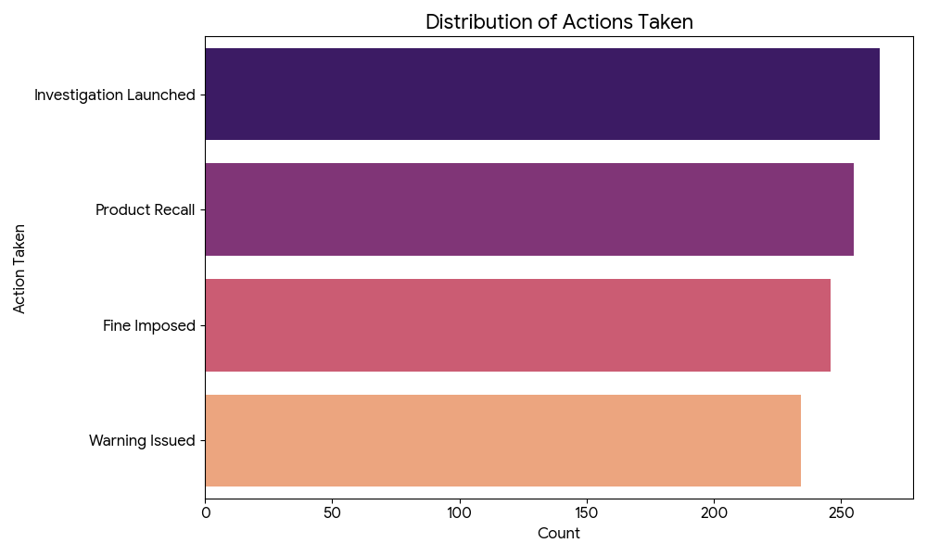
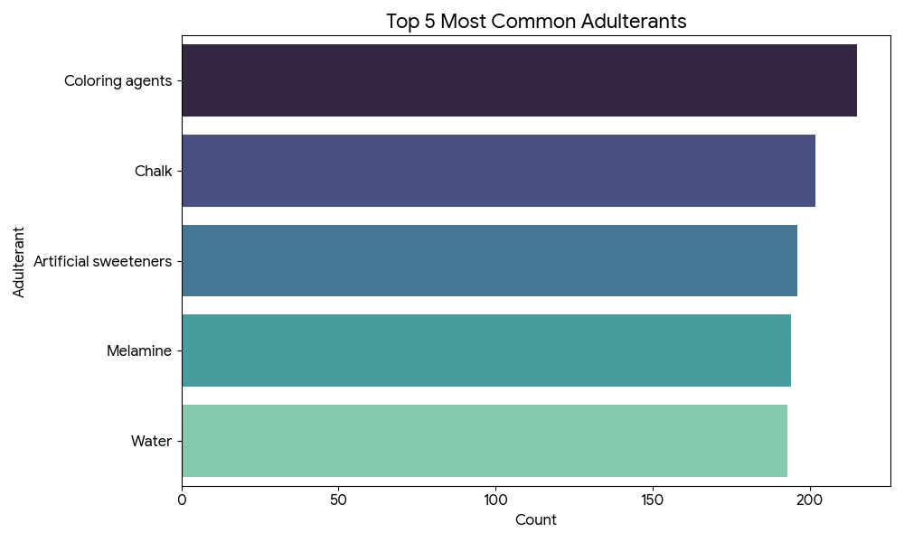
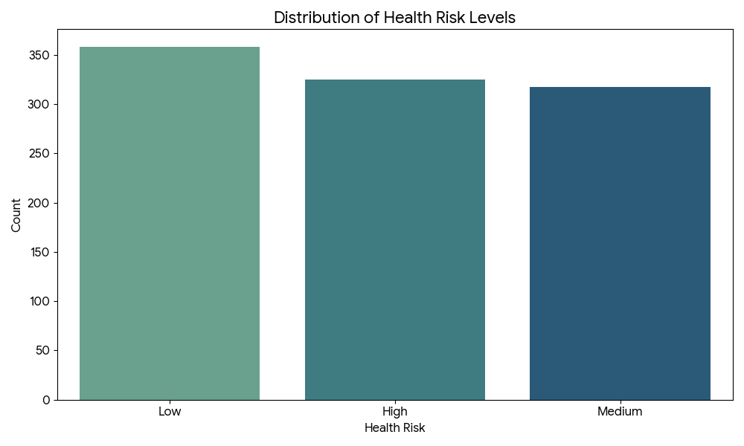
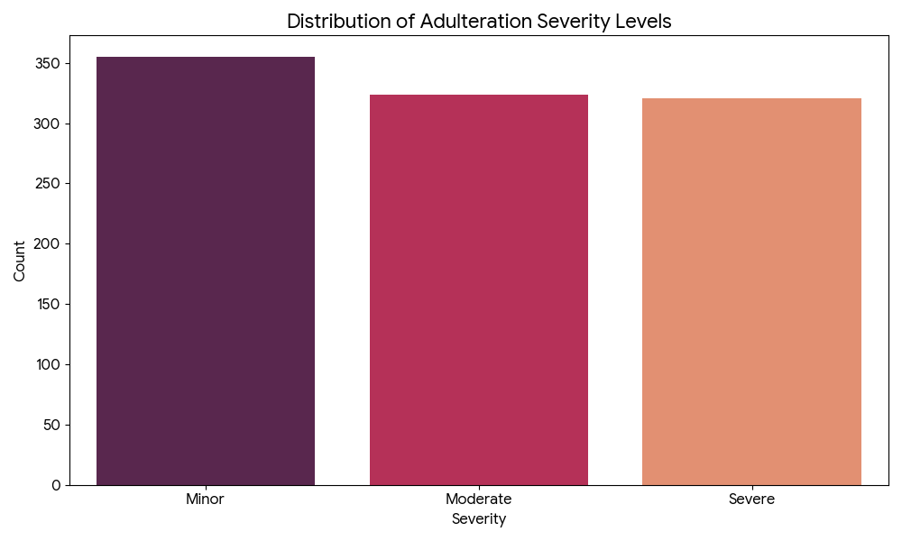

Slide 13
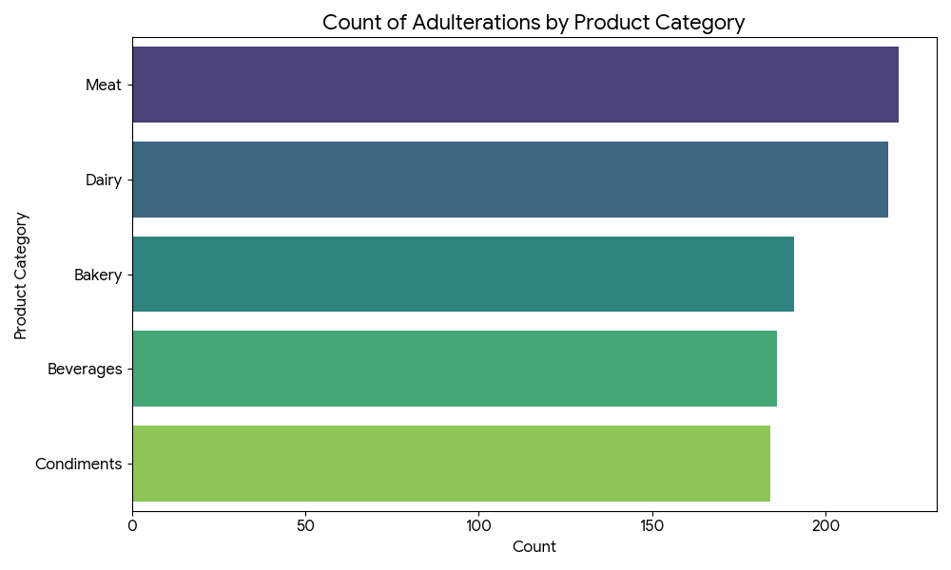
Conclusion
Adulteration not only constitutes a considerable economic problem but also may lead to serious health issues for consumers.
As the methods of adulterating foods have become more sophisticated, very efficient and reliable techniques for the detection of fraudulent manipulations are required.

Slide 14
THANK YOU
14
Notes:
SAY:
The purpose of epidemiology in public health practice is to
discover the agent, host, and environmental factors that affect health;
determine the relative importance of causes of illness, disability, and death;
identify those segments of the population that have the greatest risk from specific causes of ill health; and
evaluate the effectiveness of health programs and services in improving population health.
GO to next slide.

