Slide 1
Federated and Split Learning - an approach in image segmentation
Cardiac MRI and CT segmentation using Fully Convolutional Transformer in Split and Federated Learning

Slide 2
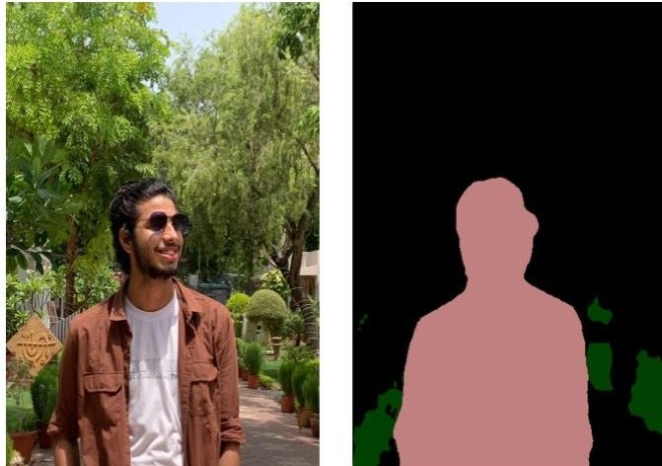
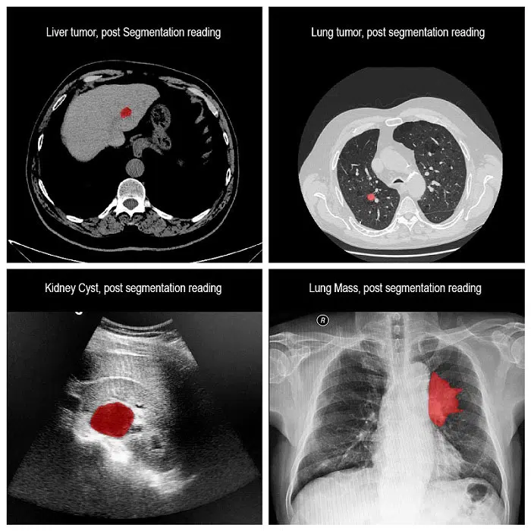
Image segmentation
Image segmentation involves converting an image into a collection of regions of pixels that are represented by a mask or a labeled image. By dividing an image into segments, we can process and analyze only the important segments of the image instead of the entire image.

Slide 3
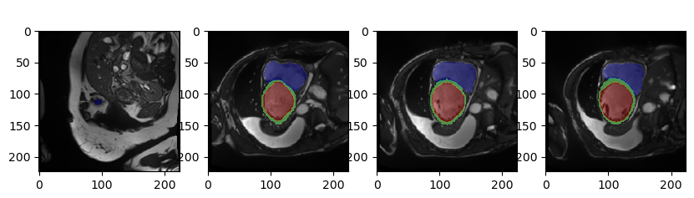
Medical Image dataset
We have taken the Automated Cardiac Diagnosis Challenge (ACDC) dataset that was conducted in 2017 and is now publicly available.
The dataset consists of the cardiac imaging of 150 overall patient with 20% people being normal and rest of the population suffering from cardiac disease
Details can be found in the challenge link.

Slide 4
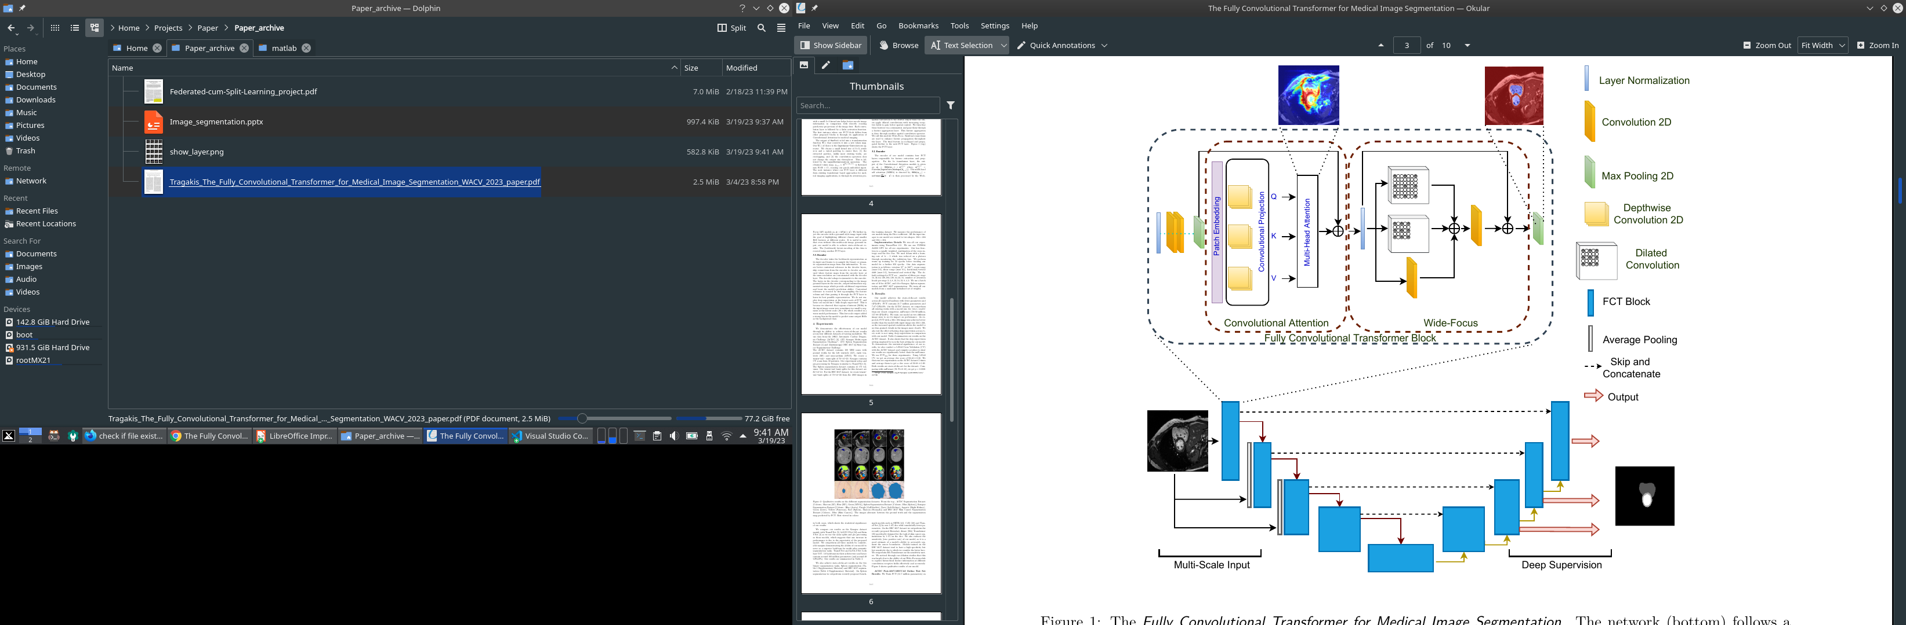
Deep Learning in Segmentation

Slide 5
Deep Learning Layer Explained
The above slide explains the implemented Segmentation which consists of an U-Net Architecture with Transformer to make sense of segmentation
U-Net architecture contains two paths. First path is the contraction path (also called as the encoder) which is used to capture the context in the image. The encoder is just a traditional stack of convolutional and max pooling layers. The second path is the symmetric expanding path (also called as the decoder) which is used to enable precise localization using transposed convolutions or Depth-wise Convolution.
Transformer architecture is added to the UNet architecture to capture long-range dependencies and improve the segmentation performance. The Transformer is a type of NN architecture that’s based on the concept of self-attention, where each position in the input sequence attends to all positions in the sequence to compute a weighted sum of the values at each position. The UNet Transformer specifically uses the Transformer to process the feature maps produced by the contracting path of the UNet, allowing it to capture global contextual information that can improve the segmentation accuracy.

Slide 6
Explanation Cont…
The Architecture used in segmentation is FCT(Fully Convolutional Transformer)
This begins with a Layer Normalized Convolutional operation(apply Conv and Pool layers) on the data , the output then fed to Transformer with convolutional Attention to better capture the spatial data of image. The mention Transformer function takes the output of Conv-Pool and converts it into a new token map, which help extract overlapping patches.
The transformer implements a Multi-Head Self Attention computation is done using Depthwise-Convolutions, instead of the normal transformer that use Linear layer attention mechanism, which contributes to reduce computational costs and maintain spatial context.
A multibranch Convolutional layer is used for fine-grained information processing for medical images.
The encoder contains four FCT layers responsible for feature extraction and propagation.
The decoder takes the bottleneck representation as input and learns to re-sample the binary or semantic segmentation maps.
Skip connections from the encoder to decoder are used for better contextual relevance. The layers in the decoder corresponding to the image pyramid layers in the encoder output intermediate segmentation maps, linking encoder output and decoder input, which provide additional supervision and boost the model’s prediction ability.

Slide 7
The Good, The Bad and The Ugly
Good:
- FCT is currently the SOTA in medical segmentation for Medical MRI images. - Has the Image Pyramid encoder layer data mapped to Decoder, along with Depth-Conv layer that estimate medical segmentation very granular approximation. - Avg Dice score at 93% better than most U-Net Transformer based approach.
Bad:
- FCT uses Depth convolution, which has huge, memory and CPU hog during training. - The computation power can increase exponentially by taking up a large image size(3000x3000) and deprecate rapidly with very small images(28x28). - Implementation of skiplayer would be very important for ability to generalize data but that can cause privacy issue of inferring about the image information and later stage of model
Ugly : - The medical data is prone to attack as all data and model are available in same area. - New data addition to train is very important but not all data can be generated in same place and not all institution would be happy sharing their internal data for ML purpose.

Slide 8
Improvement to above model
Enter Robust Federated and Split Learning for Distributed ML
This paper tries to address few concern of general centralized ML using both Split and Federated Learning to :-
Balance the local computational cost of overall model
Assist in model Privacy and restrict data sharing
Parallel training simultaneously on the computational server
For Federated Learning one is able to achieve by sending a part of model to each client and as data is completely limited to client, it has high data privacy but whole model is available with client plus its the training of the model is resource extensive for client
For Split Learning the model is divided in to two parts the client and server, basically a complete data can be trained on client and overall model be combined in a computational server, it overcomes the computation server issue but due to possession of part of overall model with client and server data privacy is not completely preserved.
So to combine the best of both world Robust Federated and Split Learning Framework is suggested

Slide 9
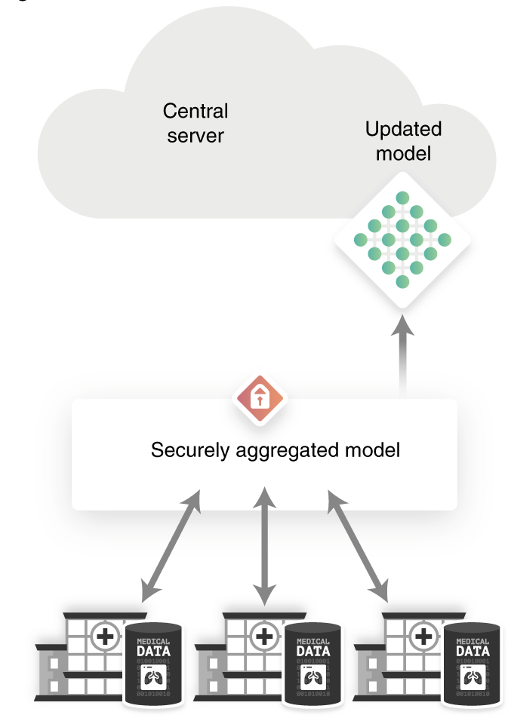
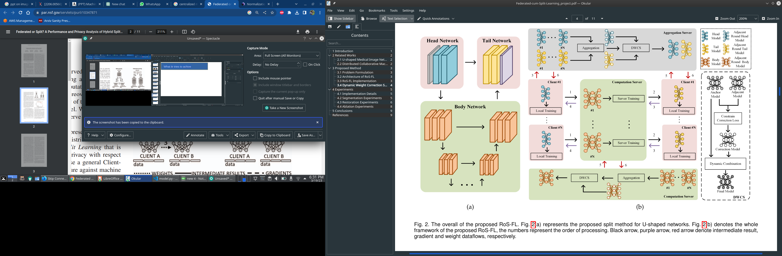
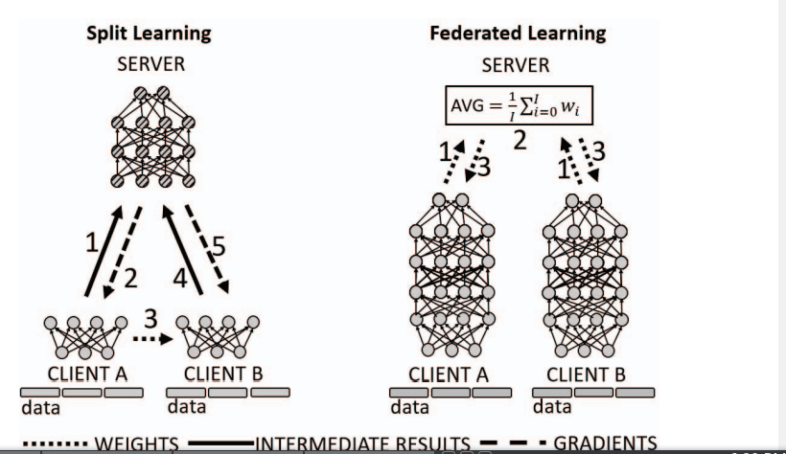
Implementation
Split Learning
Federated Learning
Centralized
Ro-SFL

Slide 10
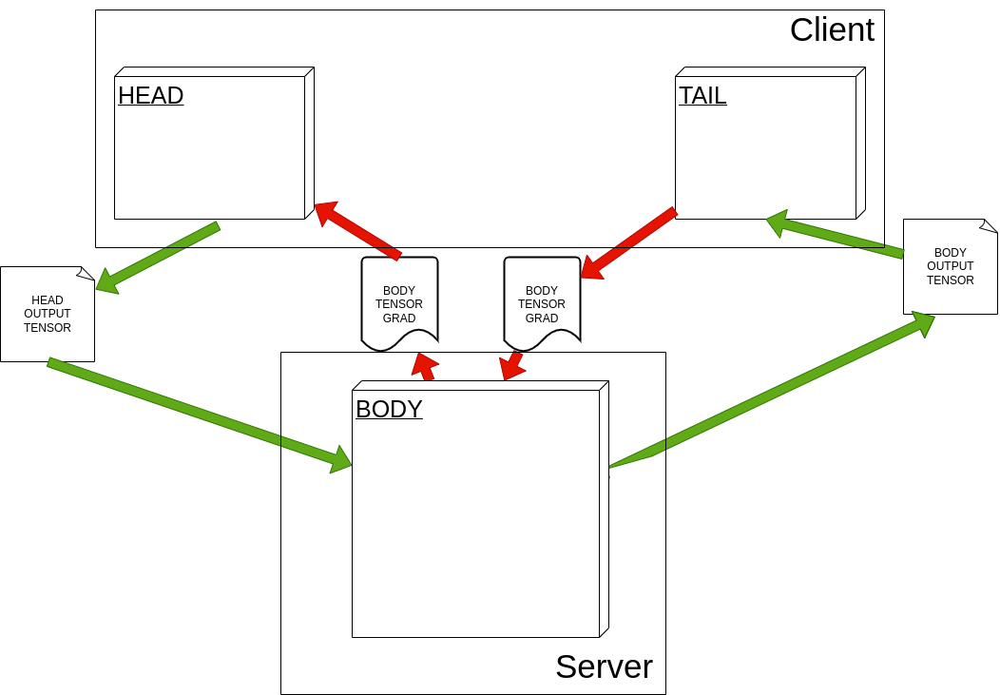

How FCT impleted with RoSFL

Slide 11
Framework Workflow
The proposed RoS-FL architecture is a parallel DCML method that protects model and data privacy
The proposed architecture, Robust Split Federated Learning (RoS-FL), involves three part: Client Head, Body as computation server, and Tail for aggregation server. Each party is authorized to access only a part of the model to protect model privacy.
For a number of client N there can be N number of head and tail model in client/aggregator server, and there can be N body models built and running in the computation server to train model in parallel which reduce time overhead.
The forward propagation of head models is executed locally by clients, and the forward propagation of body models is executed in parallel on the computation server. Backpropagation is performed between clients and the server, and the models are aggregated by averaging local models to obtain the global model.
A Dynamic Weight Correction Strategy (DWCS) is proposed to avoid the data heterogeneity problem and the model drift problem.

Slide 12
Compare
To compare the overall performance implementation of the program we would be measuring the following details on overall CL and Ro-SFL
Average Dice Score
Time taken to train
Average resource utilization
Privacy improvement

Slide 13
References
https://doi.org/10.48550/arXiv.2206.00566
https://doi.org/10.48550/arXiv.2212.06378
https://www.creatis.insa-lyon.fr/Challenge/acdc/databases.html
https://www.paperspace.com/
<githublink>

