Slide 1
Indian Institute of Technology Roorkee | Department of Computer Science and Engineering
HVAC Service Planner
Using machine learning for HVAC system providers such as Aire Serv
Demand forecasting, failure prediction and customer retention
CSC-505 Machine Learning | Group 1
Kriti Vajpayee
25931008
Stages 1 and 2
Under the guidance of
Dhruv Aggarwal
25911019
Stages 3 and 4
Dr. Durga Toshniwal
Professor, Department of Computer Science and Engineering, IIT Roorkee
Ankit Kumar
26911002
Stages 5 and 6
Animesh Basak
26911001
Stages 7 and 8
Sourav Kumar Boro
26535026
Stages 9 and 10
October 2026
Notes:
Introduce the group and the product: three decisions an HVAC franchise makes every week, answered with three machine learning tools.

Slide 2
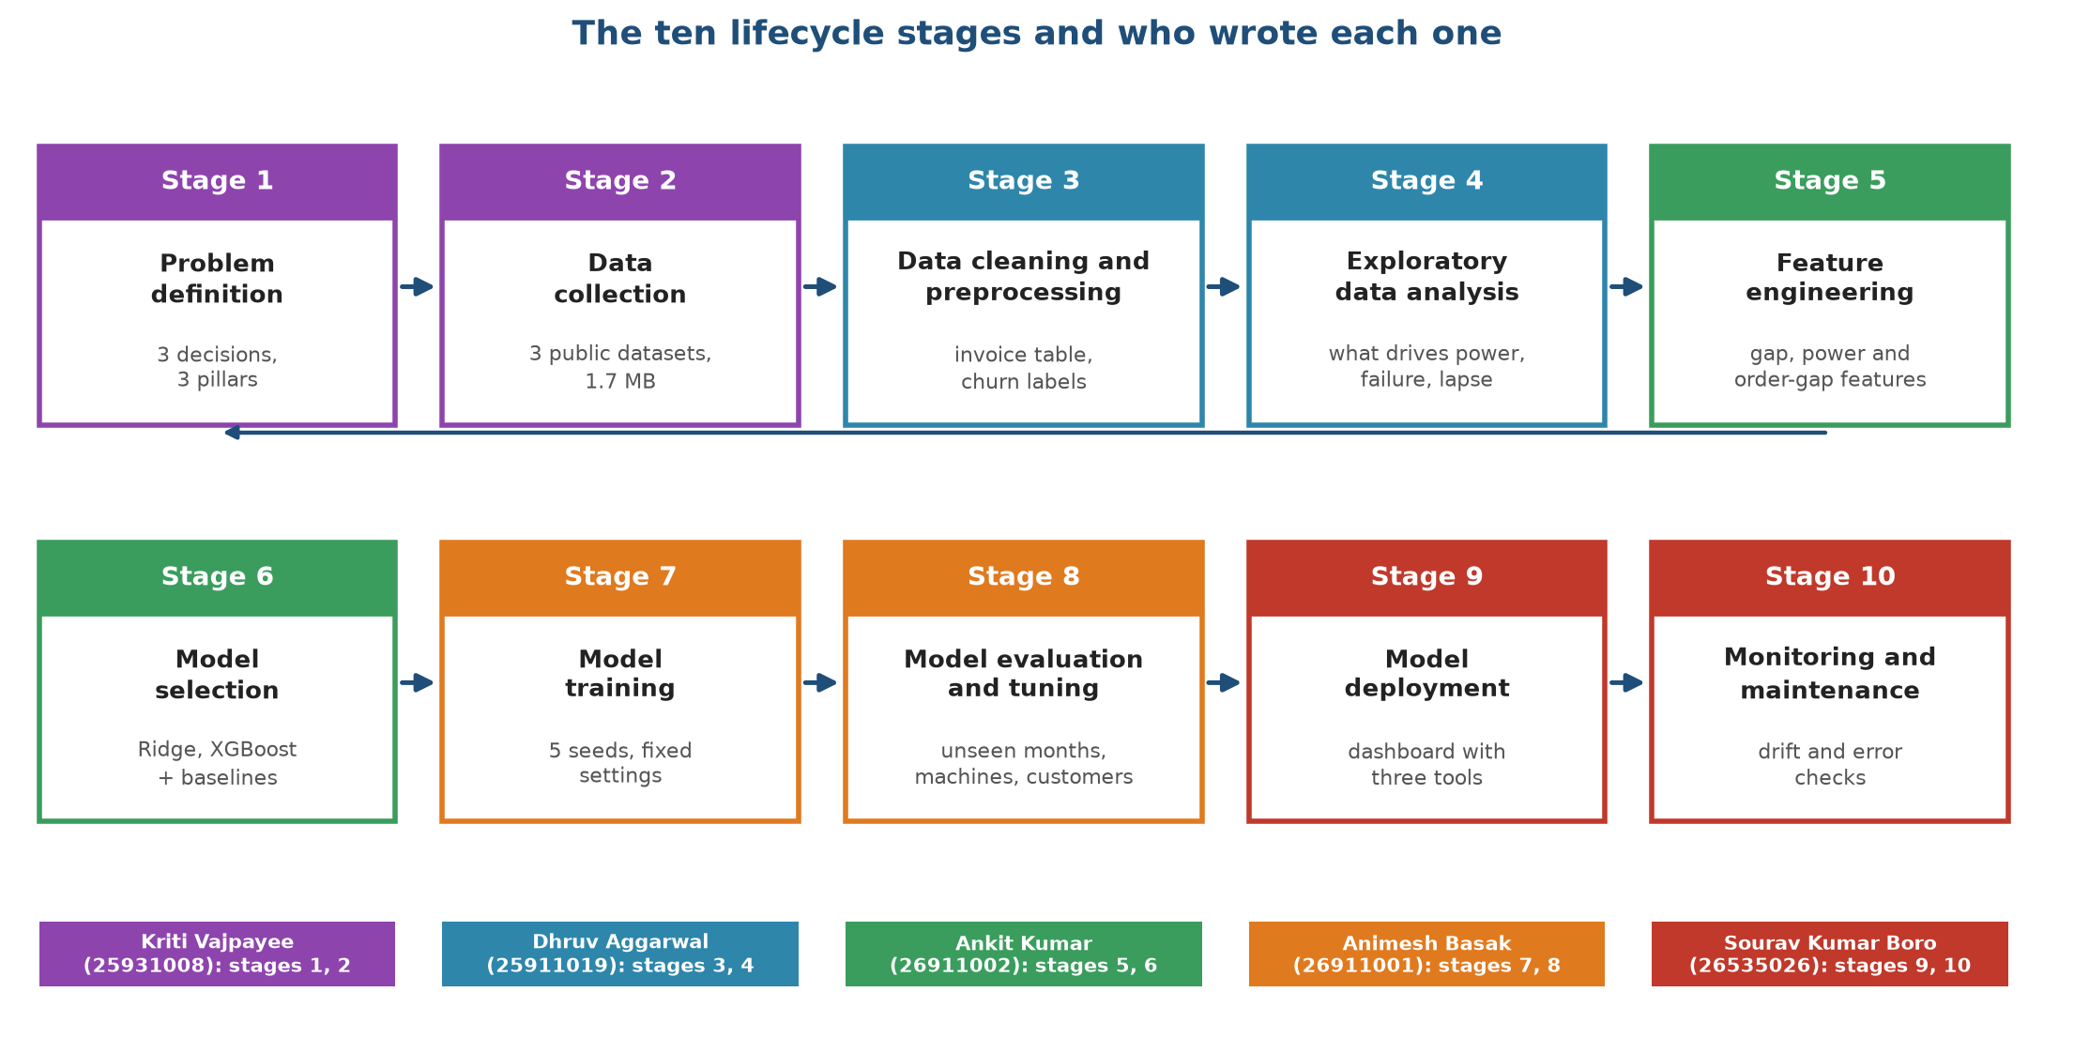
Ten lifecycle stages, five authors, one product
Summary
Whole group
HVAC Service Planner | Group 1 | CSC-505 Machine Learning, IIT Roorkee
2
Notes:
We follow the machine learning lifecycle from problem definition to monitoring. Each member wrote two stages and built the matching part of the project.

Slide 3
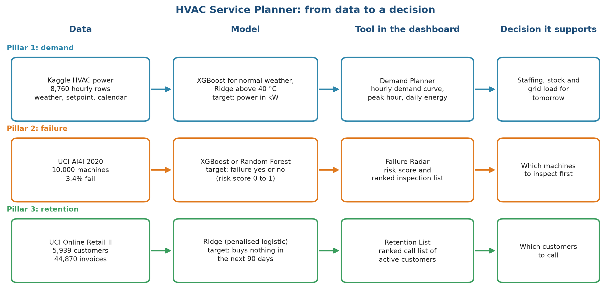
One dashboard, three decisions
Stage 1: Problem definition
Kriti Vajpayee
HVAC Service Planner | Group 1 | CSC-505 Machine Learning, IIT Roorkee
3
Notes:
Demand Planner predicts power for tomorrow, Failure Radar ranks machines for inspection, Retention List ranks customers to call. Each tool has its own dataset and model.

Slide 4
Each question becomes a precise learning task
Stage 1: Problem definition
Kriti Vajpayee
 | Pillar 1: demand | Pillar 2: failure | Pillar 3: retention
Task type | Regression (a number) | Binary classification, rare event | Binary classification
Unit of prediction | One building-hour | One machine | One active customer at a cutoff date
Inputs | Outdoor and indoor temperature, humidity, hour, month, mode | Air and process temperature, speed, torque, tool wear, type | Purchase history before the cutoff
Output | Power in kW | Failure yes or no, risk score | Lapses yes or no, risk score
Looking ahead | Same hour, weather forecast as input | The recorded failure label | 90 days after the cutoff
Main metric | Mean absolute error in kW | PR-AUC; failures found in the top 10% | ROC-AUC; lapsers found in the top 10%
Why this metric | Average miss, easy to read | Failures are 3.4% of machines, so accuracy is meaningless | A small call budget means the top of the list matters
HVAC Service Planner | Group 1 | CSC-505 Machine Learning, IIT Roorkee
4
Notes:
We fixed these definitions before touching any data. For failure, a model that always says no failure is 96.6% accurate and finds nothing, so we use PR-AUC and top-10% capture.

Slide 5
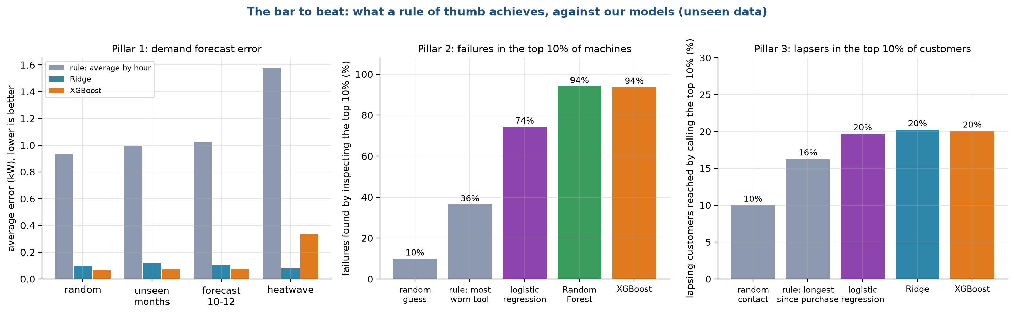
The bar to beat: what a rule of thumb achieves
Stage 1: Problem definition
Kriti Vajpayee
For each pillar we picked the simplest sensible rule a company could use today.
A model must beat it, and also beat a statistical and a classic ML baseline.
HVAC Service Planner | Group 1 | CSC-505 Machine Learning, IIT Roorkee
5
Notes:
For each pillar we picked the simplest sensible rule a company could use today. A model must beat it, and also beat a statistical and a classic ML baseline.

Slide 6
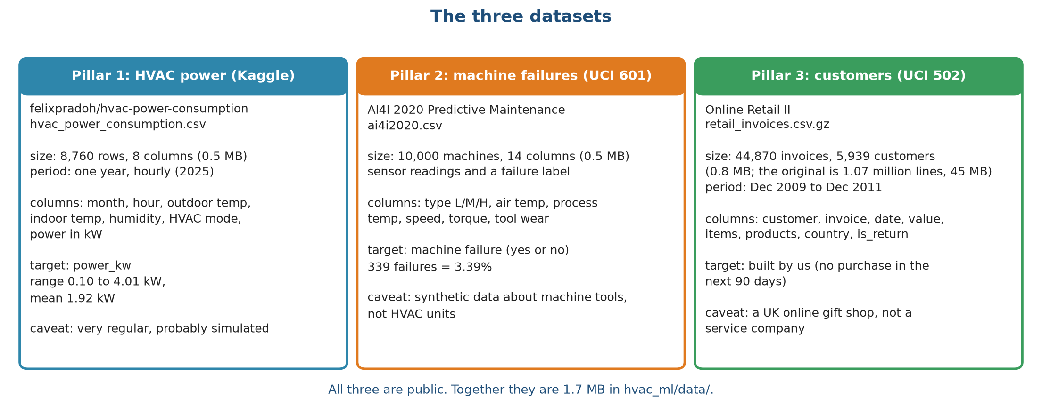
Three public datasets, 1.7 MB in total
Stage 2: Data collection
Kriti Vajpayee
HVAC Service Planner | Group 1 | CSC-505 Machine Learning, IIT Roorkee
6
Notes:
None of the datasets comes from an HVAC company. They are stand-ins, and each card ends with its main caveat.

Slide 7
The datasets at a glance, with sources
Stage 2: Data collection
Kriti Vajpayee
Pillar | Dataset | Rows | Size | Target | Source
1. Demand | HVAC power consumption, hourly 2025 | 8,760 | 0.49 MB | Power in kW | kaggle.com/datasets/felixpradoh/hvac-power-consumption
2. Failure | AI4I 2020 Predictive Maintenance | 10,000 | 0.52 MB | Machine failure, 3.39% | archive.ics.uci.edu/dataset/601
3. Churn | Online Retail II (one row per invoice) | 44,870 invoices | 0.76 MB | No purchase in the next 90 days (built by us) | archive.ics.uci.edu/dataset/502
Caveats: the HVAC file looks simulated, AI4I is synthetic data about machine tools, and Online Retail II is a UK online gift shop.
HVAC Service Planner | Group 1 | CSC-505 Machine Learning, IIT Roorkee
7
Notes:
The Kaggle link was rebuilt from the dataset name we recorded, so check that it opens before submitting.

Slide 8
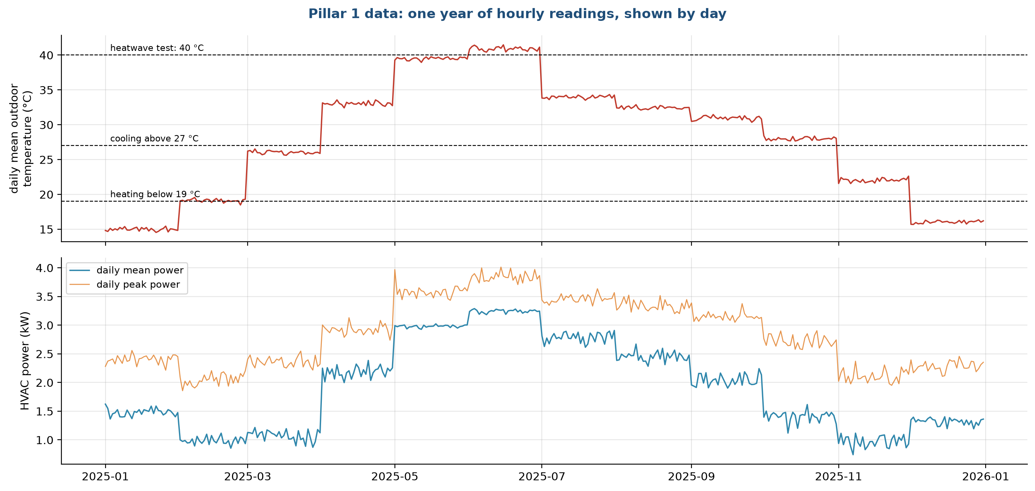
A year of hourly readings that move in monthly steps
Stage 2: Data collection
Kriti Vajpayee
HVAC Service Planner | Group 1 | CSC-505 Machine Learning, IIT Roorkee
8
Notes:
Temperature steps up or down at the start of nearly every month, which is why we think the file is simulated. 824 hours reach 40 degrees or more, which gives us the heatwave test.

Slide 9
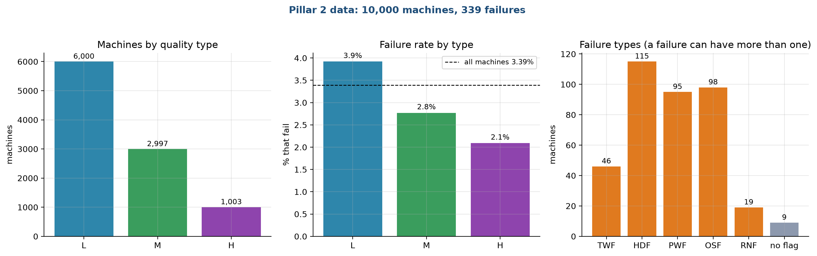
AI4I: 339 failures in 10,000 machines
Stage 2: Data collection
Kriti Vajpayee
Low-quality machines fail most.
Heat dissipation, overstrain and power failures dominate.
The failure-type columns are never used as inputs.
HVAC Service Planner | Group 1 | CSC-505 Machine Learning, IIT Roorkee
9
Notes:
Low-quality machines fail most. Heat dissipation, overstrain and power failures dominate. The failure-type columns are never used as inputs.

Slide 10
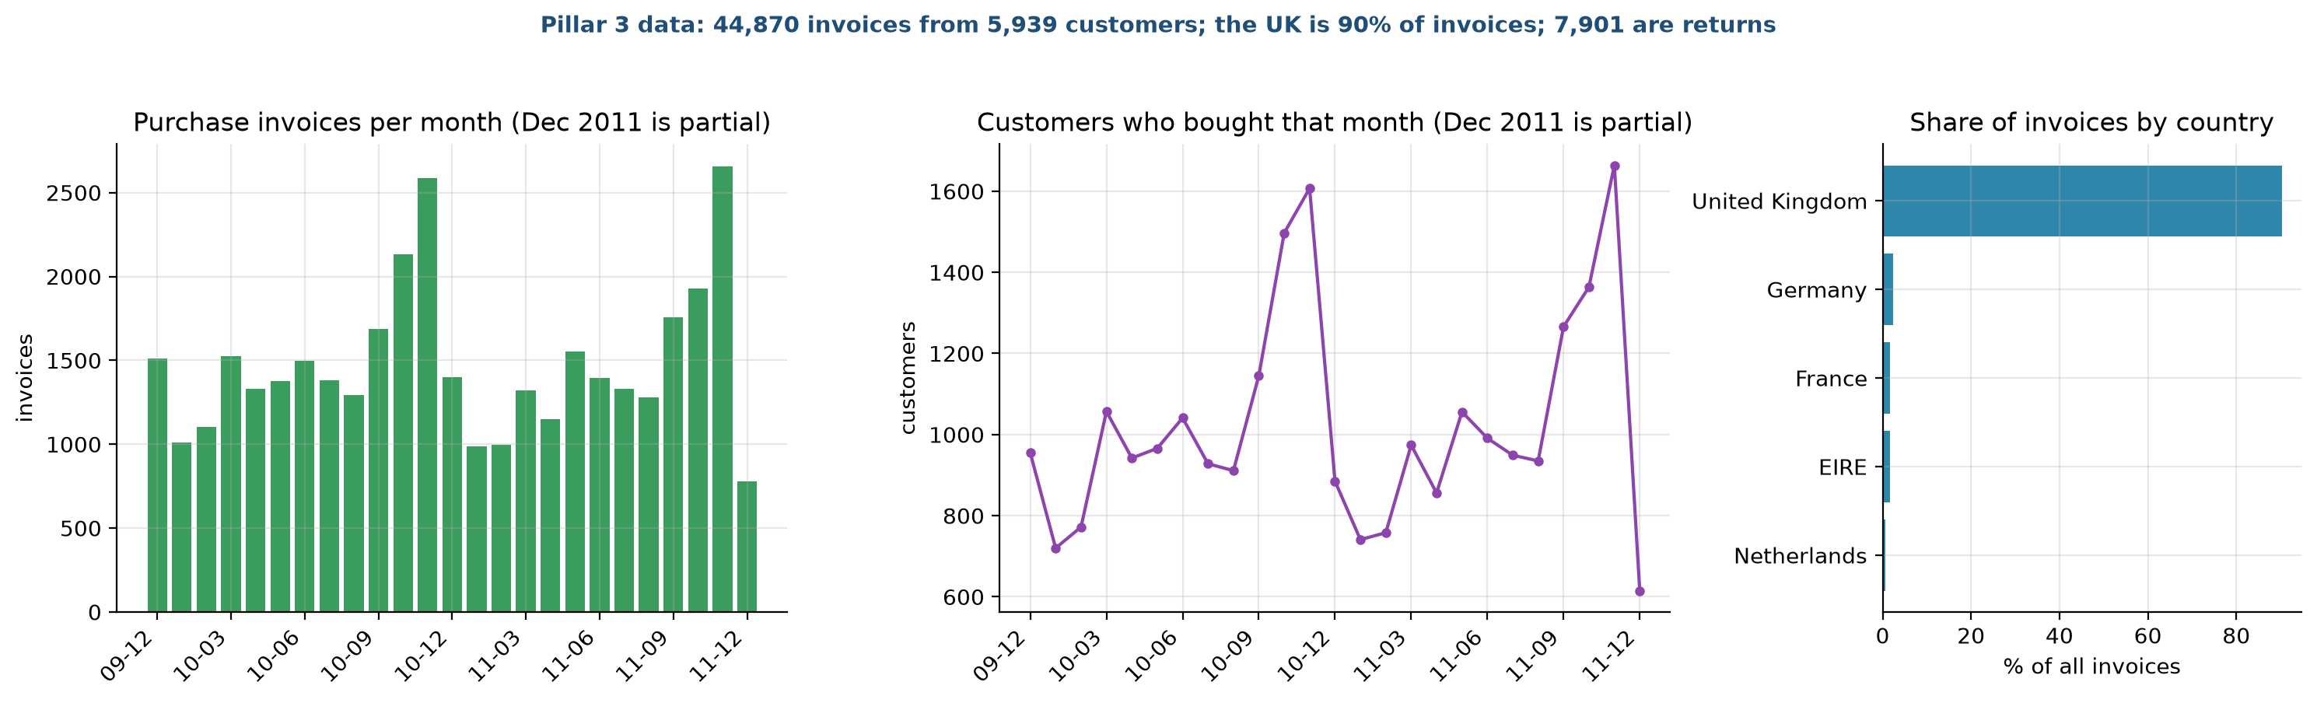
Online Retail II: seasonal peaks, mostly UK customers
Stage 2: Data collection
Kriti Vajpayee
Invoices and active customers peak in October and November.
December 2011 is partial.
This seasonality affects how we read churn.
HVAC Service Planner | Group 1 | CSC-505 Machine Learning, IIT Roorkee
10
Notes:
Invoices and active customers peak in October and November. December 2011 is partial. This seasonality affects how we read churn.

Slide 11
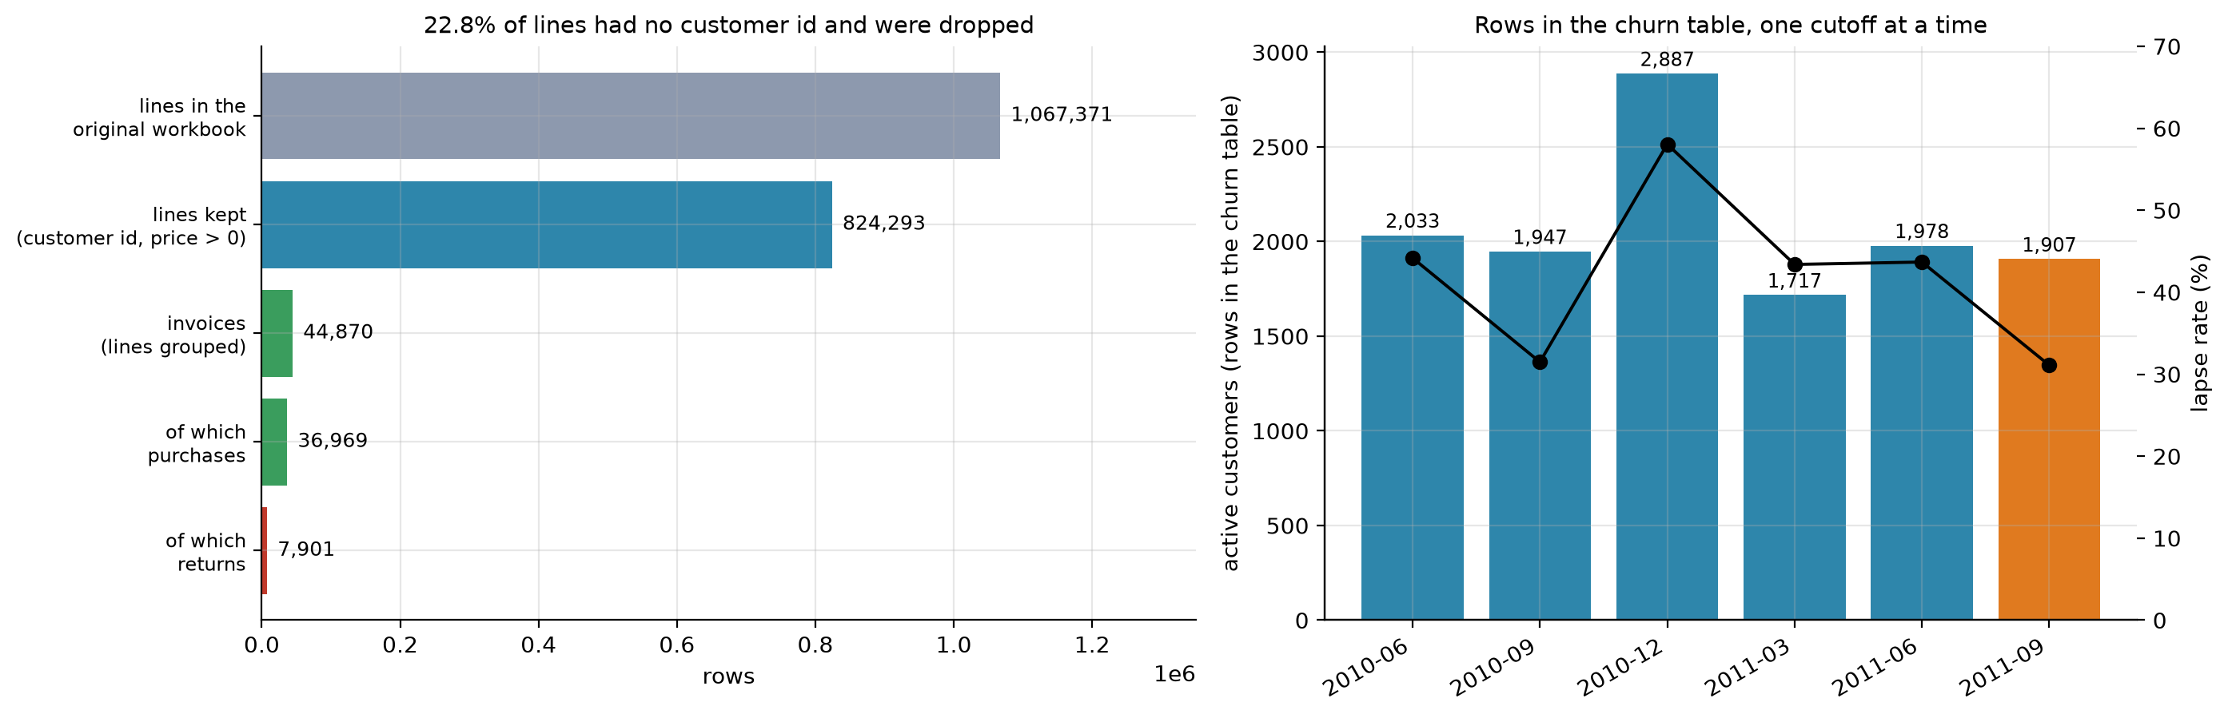
From 1.07 million lines to 44,870 invoices
Stage 3: Data cleaning
Dhruv Aggarwal
We drop lines without a customer id (22.8%) and lines with a price of zero or less, then group by invoice.
The right panel shows rows per churn snapshot and the lapse rate.
HVAC Service Planner | Group 1 | CSC-505 Machine Learning, IIT Roorkee
11
Notes:
We drop lines without a customer id (22.8%) and lines with a price of zero or less, then group by invoice. The right panel shows rows per churn snapshot and the lapse rate.

Slide 12
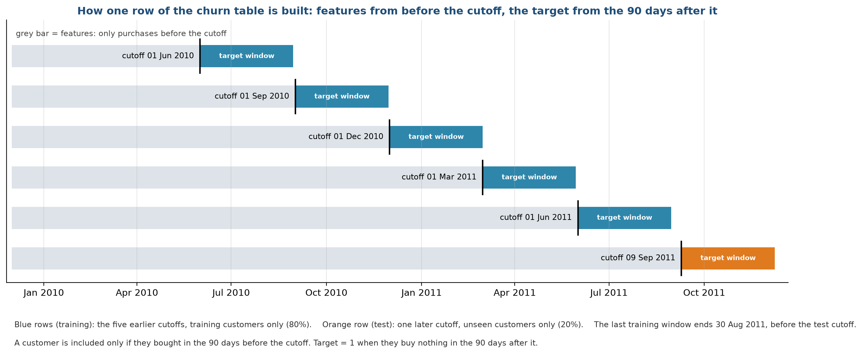
The churn target is built from the future
Stage 3: Data cleaning
Dhruv Aggarwal
HVAC Service Planner | Group 1 | CSC-505 Machine Learning, IIT Roorkee
12
Notes:
Features use only invoices before the cutoff. The target is no purchase in the 90 days after. Five training cutoffs, one later test cutoff.

Slide 13
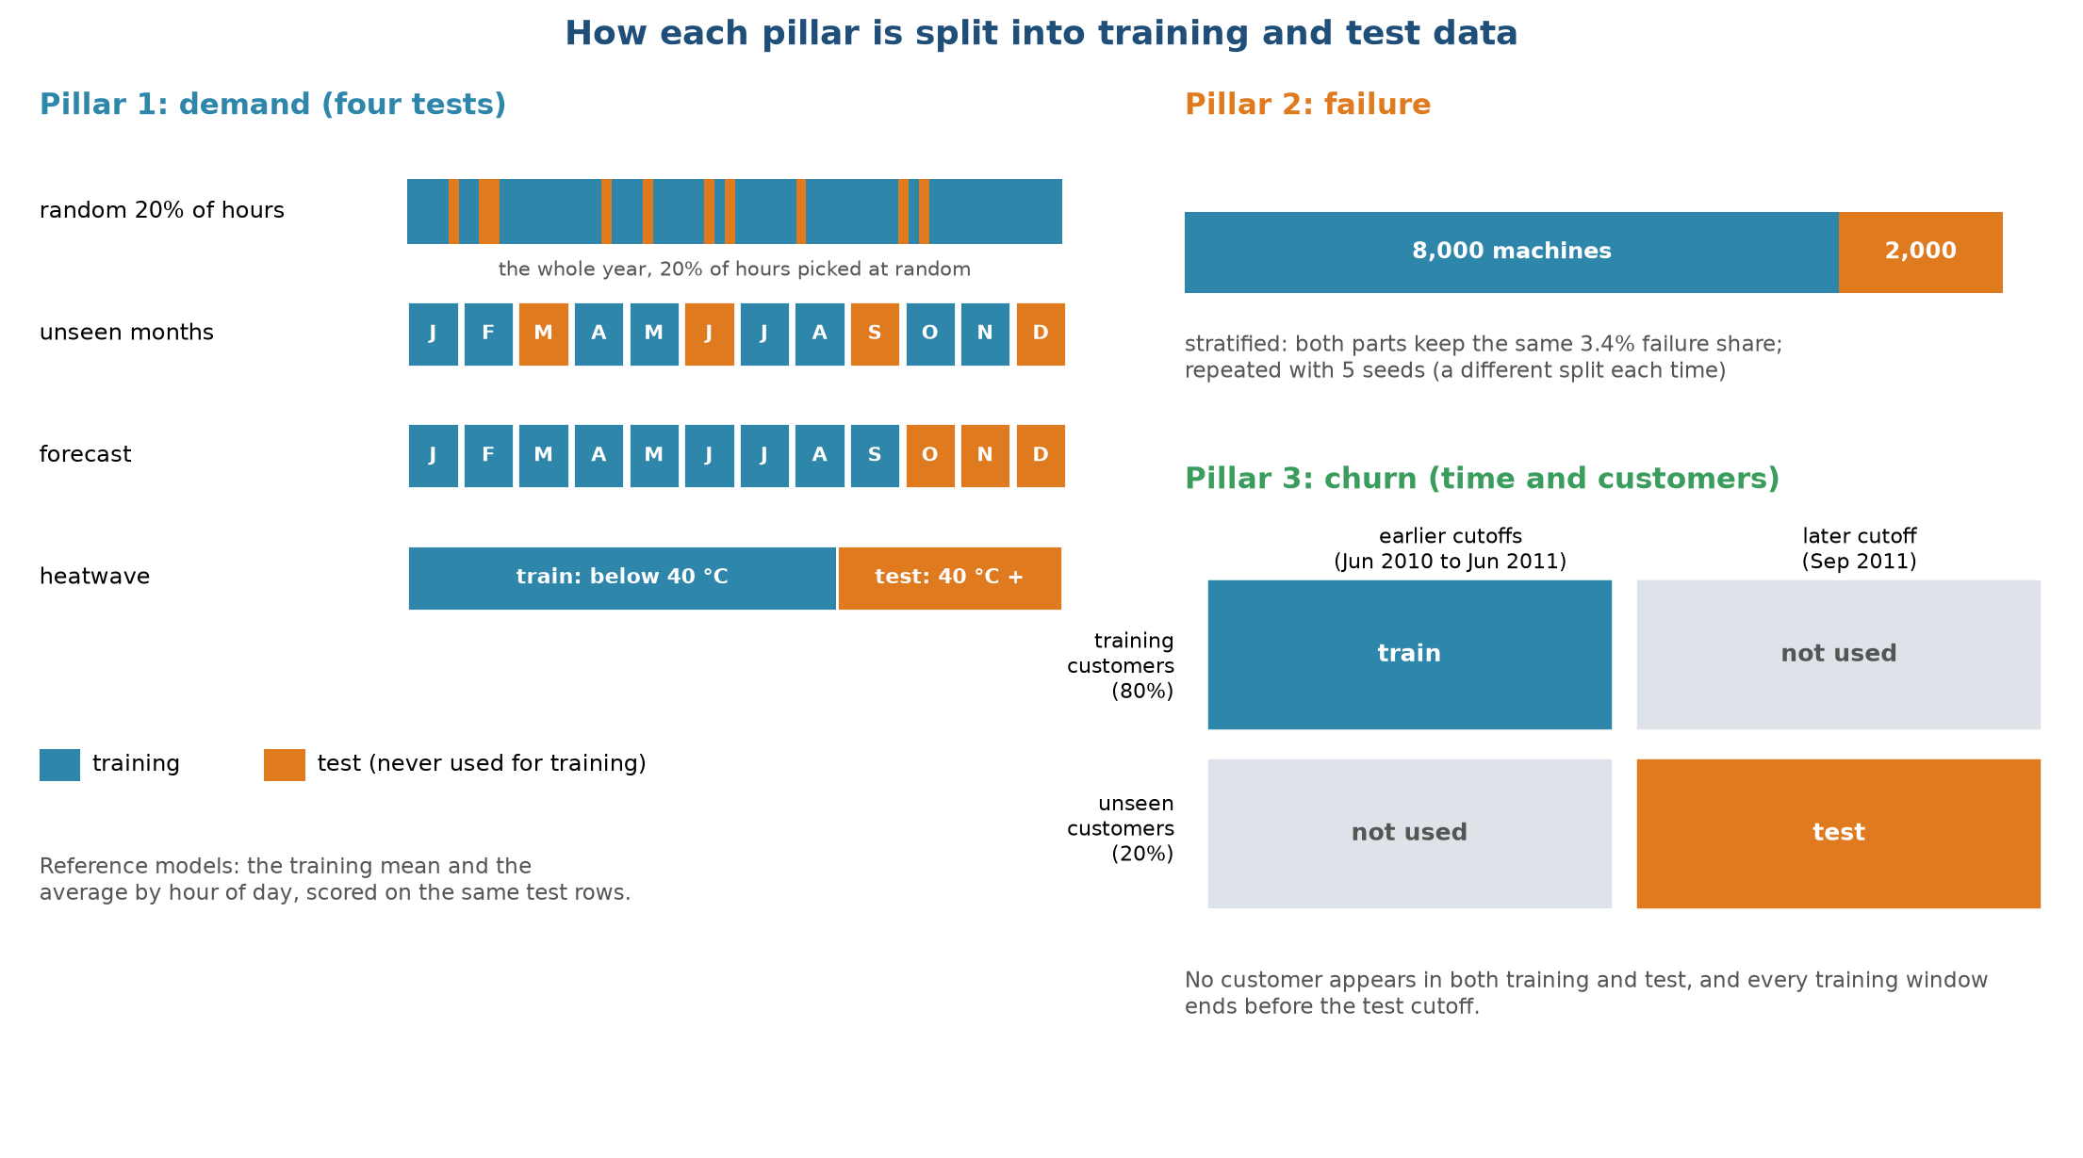
Every test hides data the model never saw
Stage 3: Data cleaning
Dhruv Aggarwal
HVAC Service Planner | Group 1 | CSC-505 Machine Learning, IIT Roorkee
13
Notes:
Demand has four tests: random hours, unseen months, a forecast of months 10 to 12 and a heatwave at 40 degrees or more. Failure uses a stratified split. Churn splits both customers and time.

Slide 14
Seven guards against leakage
Stage 3: Data cleaning
Dhruv Aggarwal
Risk | What we did | Check
Features that use the future (churn) | Features look only at invoices before the cutoff | Automated test deletes later invoices
Target built from the past (churn) | Target looks only at invoices after the cutoff | Automated test
Same customer in training and test | Customers are split before rows are built | Automated test
Overlapping windows | Last training window ends before the test cutoff | Automated test
Answer hidden in the inputs (failure) | The five failure-type columns are never inputs | Automated test
Test statistics in the pipeline | Imputing and scaling sit inside the model pipeline | By design
Threshold chosen on test data | Threshold comes from out-of-fold training scores | By design
HVAC Service Planner | Group 1 | CSC-505 Machine Learning, IIT Roorkee
14
Notes:
Leakage makes scores look excellent and fail in real use. Six of the seven guards are automated tests; 17 tests in all.

Slide 15
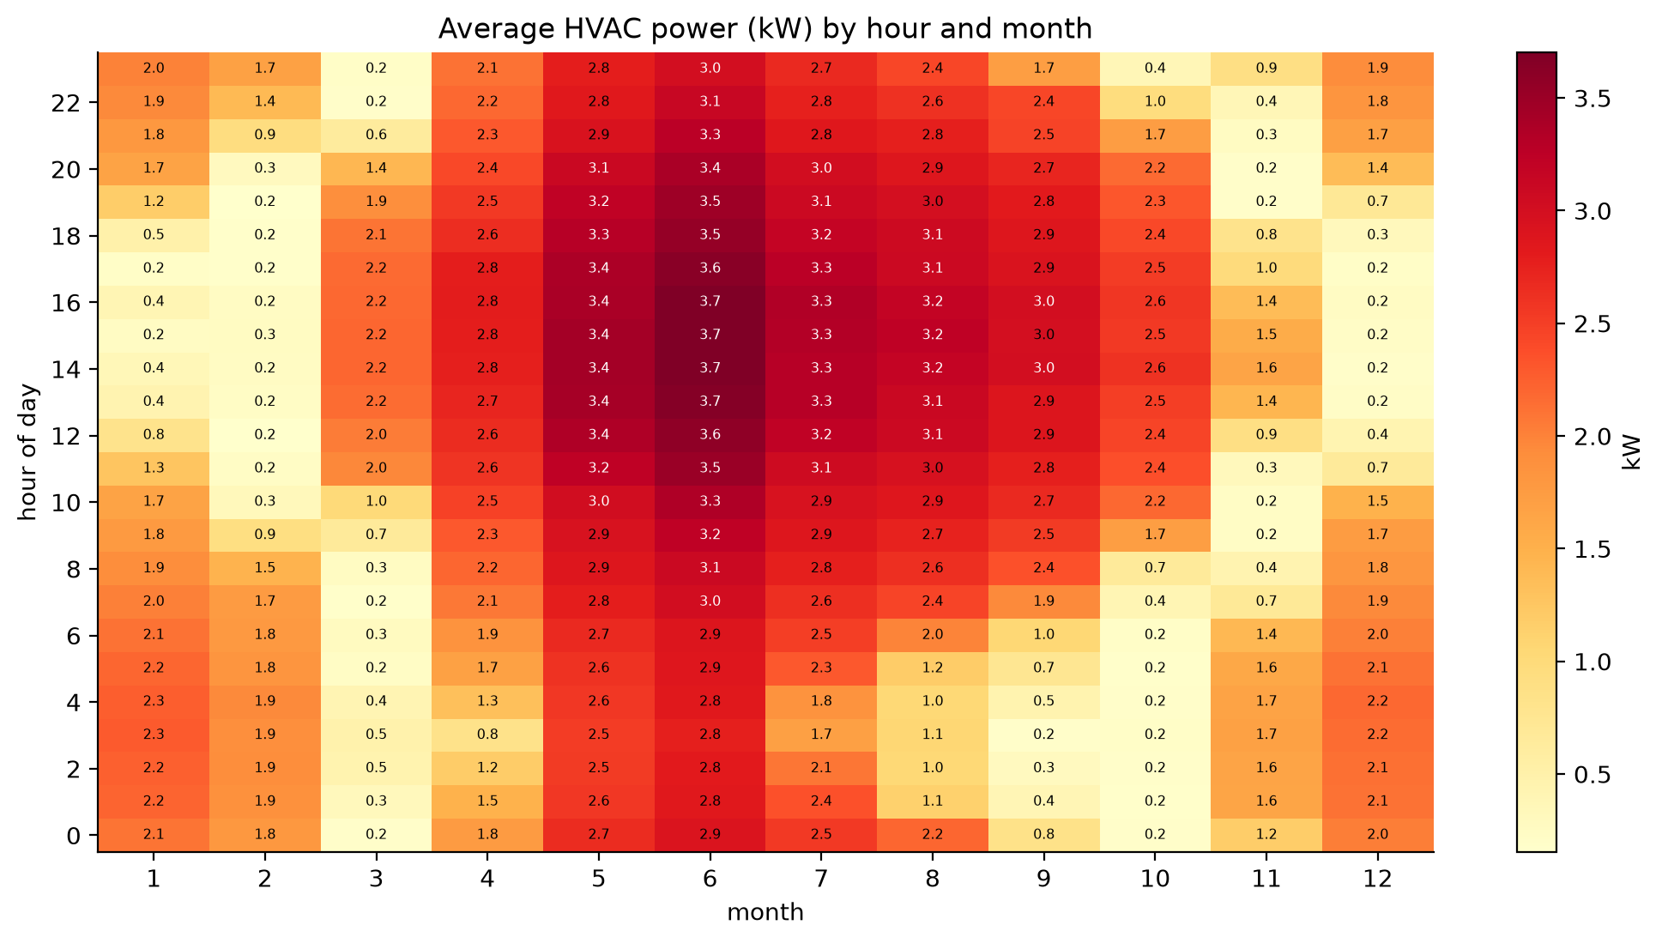
Power depends on the month first, the hour second
Stage 4: Data exploration
Dhruv Aggarwal
HVAC Service Planner | Group 1 | CSC-505 Machine Learning, IIT Roorkee
15
Notes:
May to August are dark all day. February, March, October and November are mostly idle. The monthly steps in the data show up here.

Slide 16
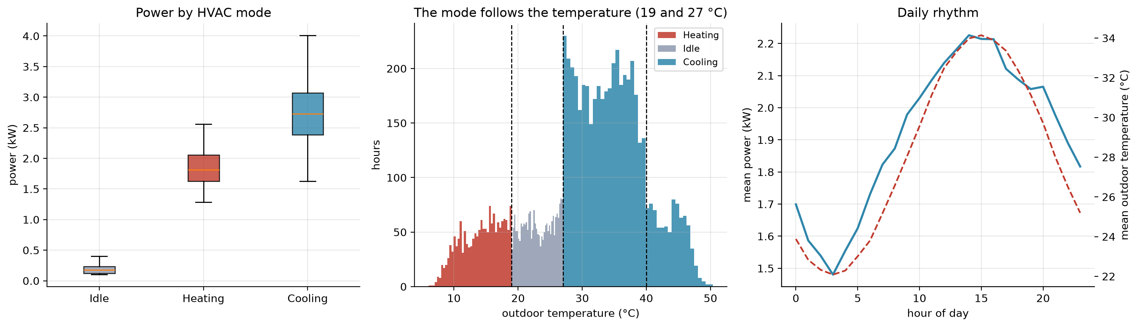
Mode follows temperature; power follows the gap
Stage 4: Data exploration
Dhruv Aggarwal
Idle 0.19 kW, heating 1.84 kW, cooling 2.73 kW.
The 824 hours at 40 degrees or more are all in cooling mode.
HVAC Service Planner | Group 1 | CSC-505 Machine Learning, IIT Roorkee
16
Notes:
Idle 0.19 kW, heating 1.84 kW, cooling 2.73 kW. The 824 hours at 40 degrees or more are all in cooling mode.

Slide 17
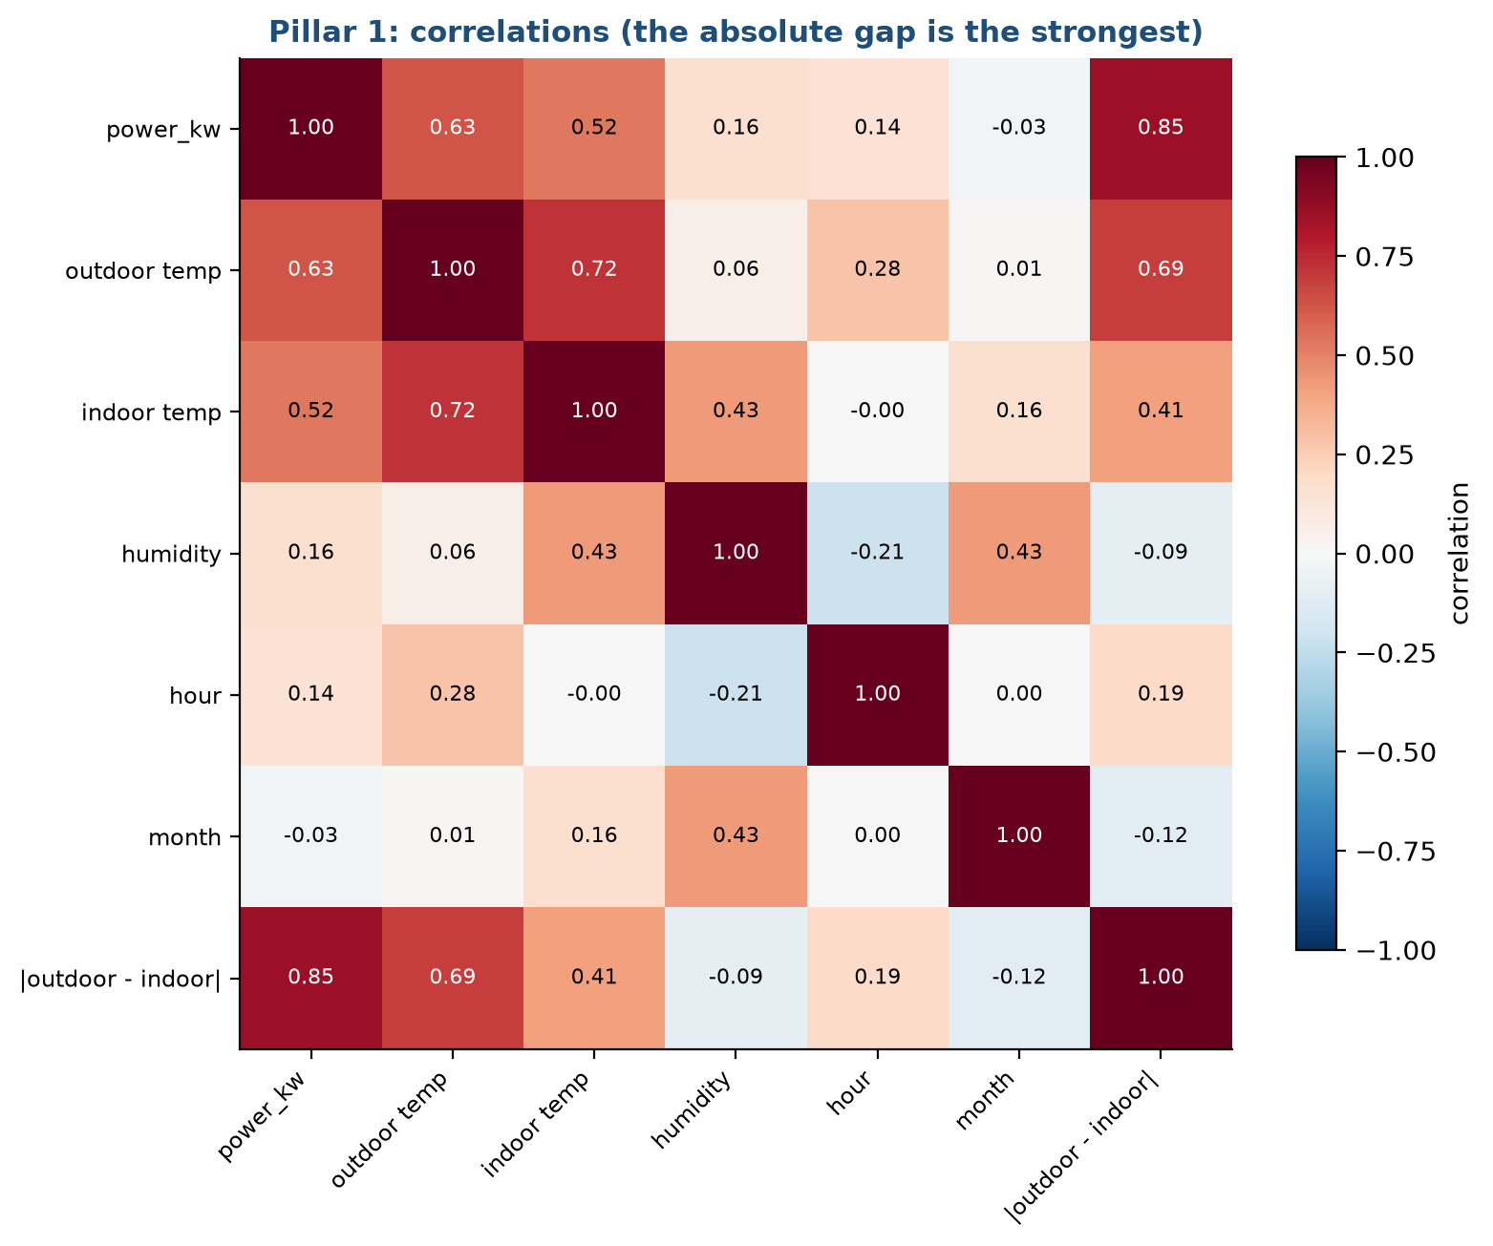
The absolute gap explains power better than temperature
Stage 4: Data exploration
Dhruv Aggarwal
HVAC Service Planner | Group 1 | CSC-505 Machine Learning, IIT Roorkee
17
Notes:
Correlation with power: absolute gap 0.85, outdoor temperature 0.63, indoor 0.52, humidity 0.16, hour 0.14.

Slide 18
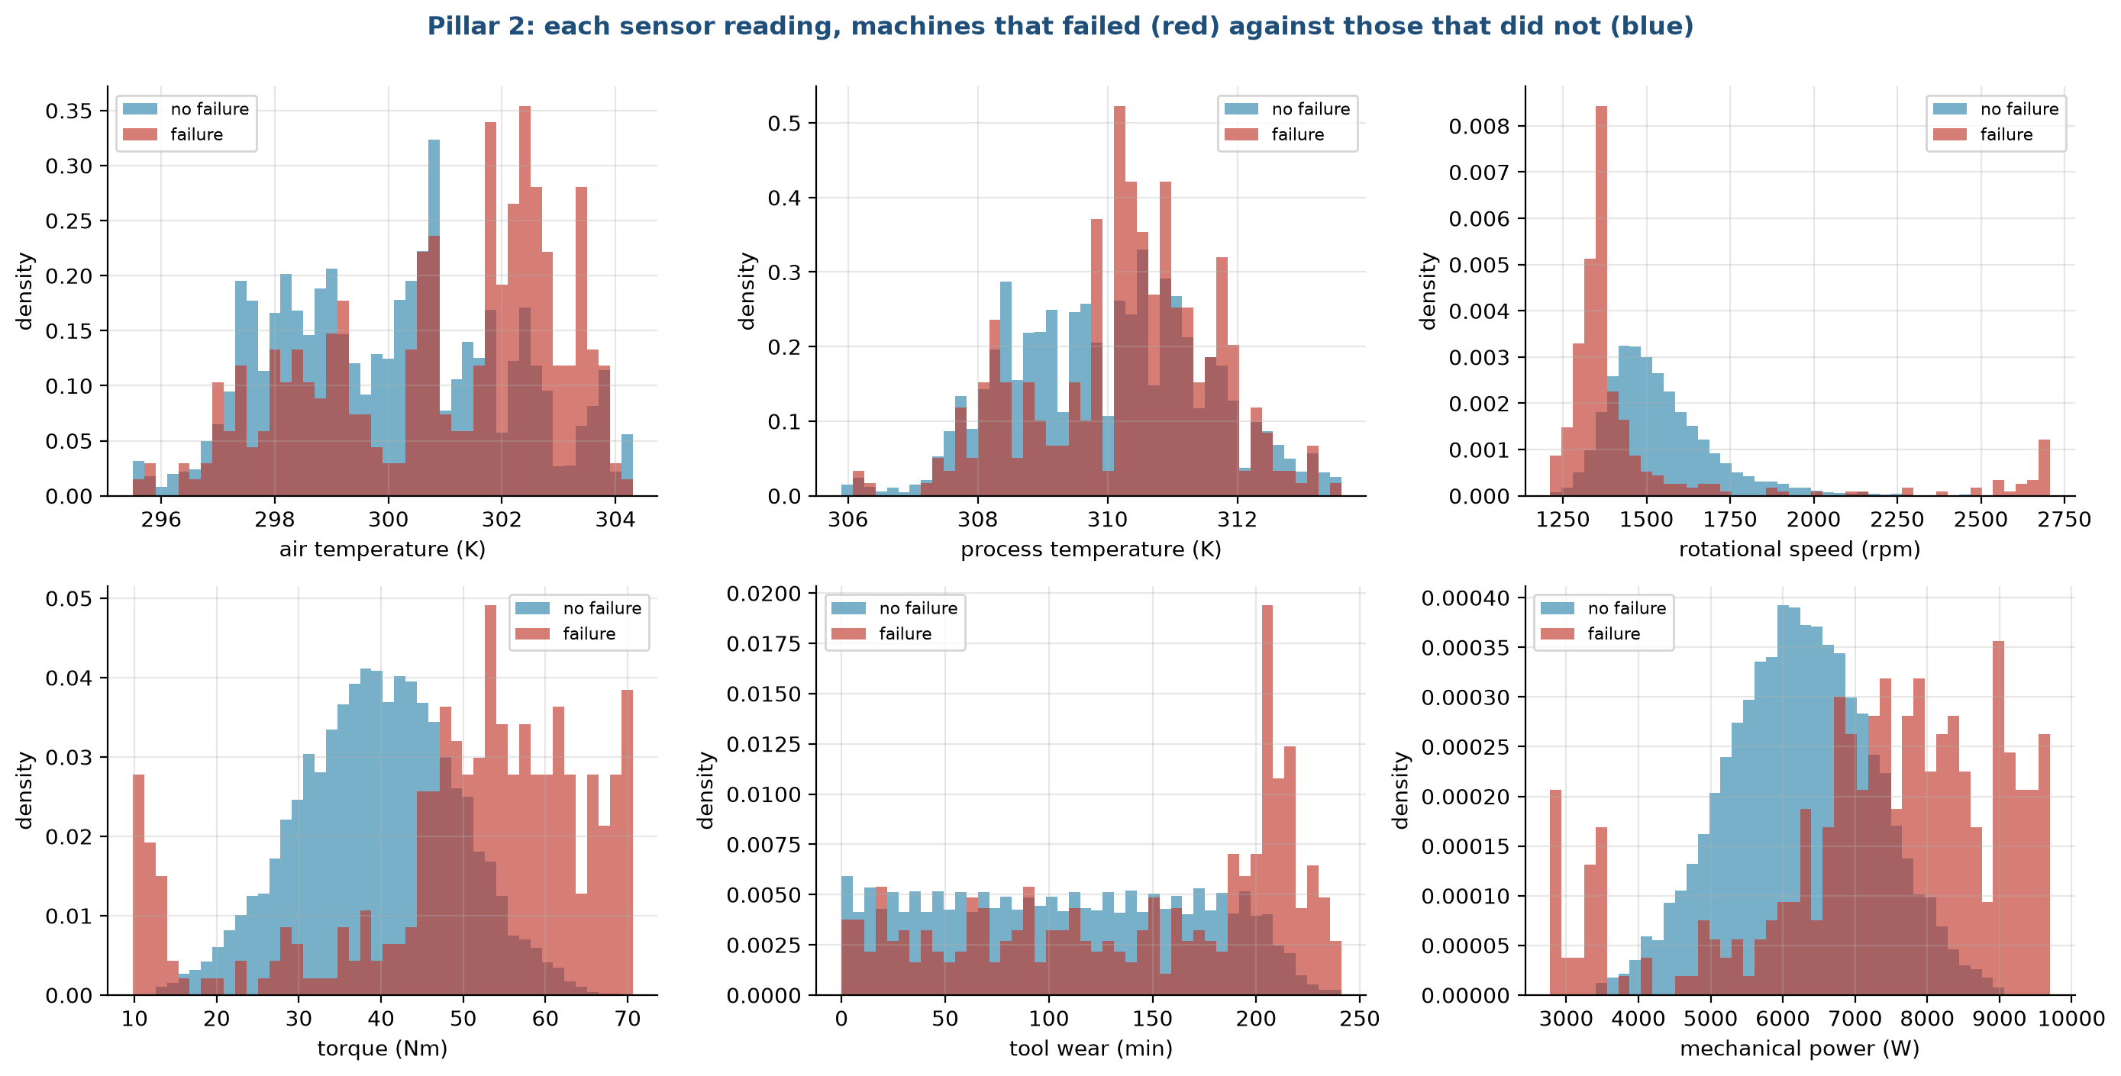
Failing machines sit at both ends of torque and power
Stage 4: Data exploration
Dhruv Aggarwal
HVAC Service Planner | Group 1 | CSC-505 Machine Learning, IIT Roorkee
18
Notes:
A U-shape: a straight line cannot capture it, trees can. This predicts the gap between linear and tree models in stage 8.

Slide 19
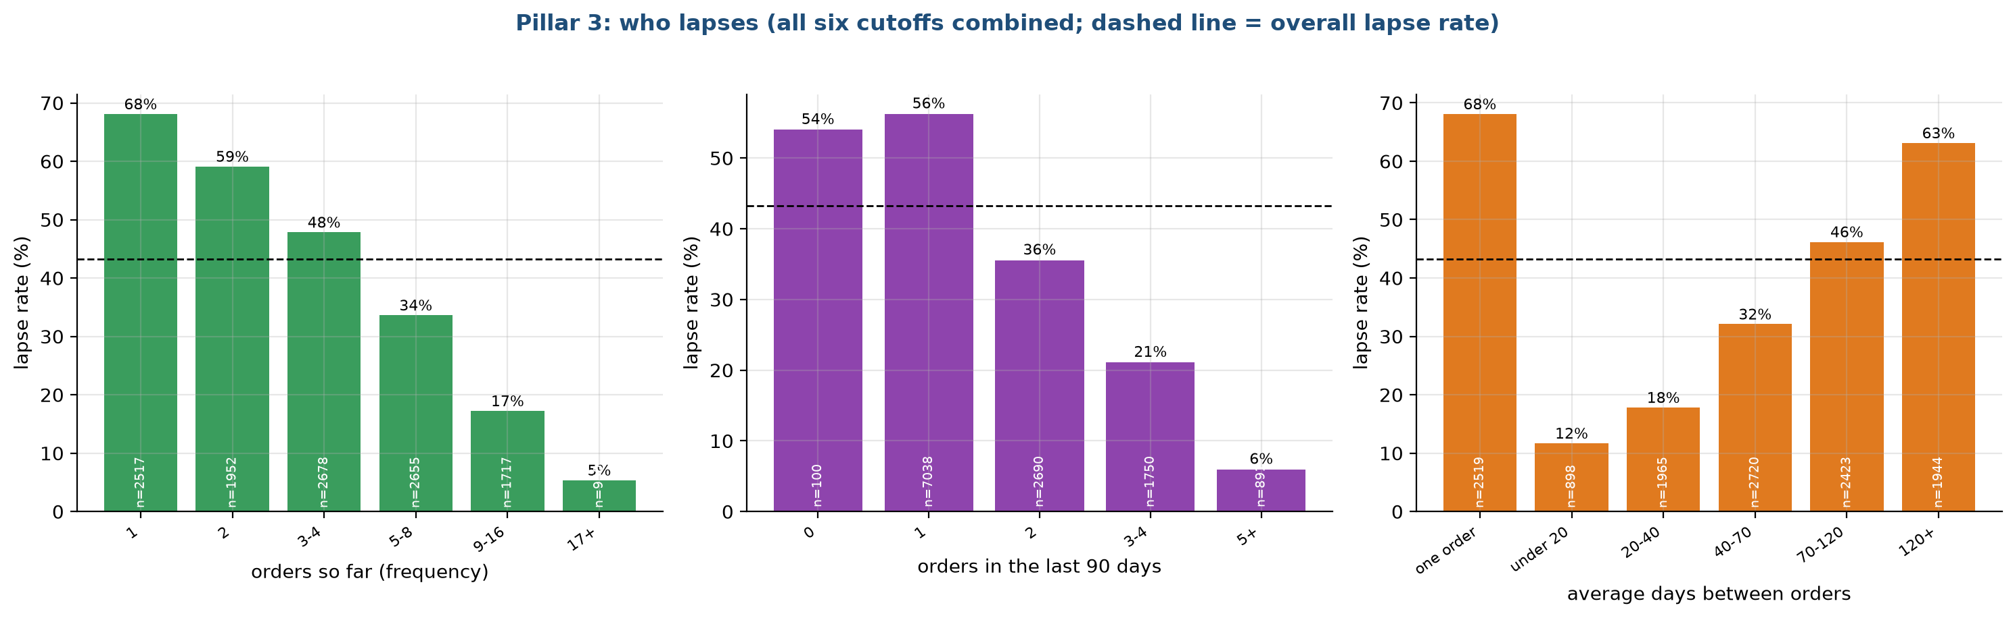
Customers who order often and regularly rarely lapse
Stage 4: Data exploration
Dhruv Aggarwal
Lapse falls from 68% with one order to 5% with 17 or more.
A short order rhythm predicts staying.
Recency, the basis of the usual rule, is the weakest signal.
HVAC Service Planner | Group 1 | CSC-505 Machine Learning, IIT Roorkee
19
Notes:
Lapse falls from 68% with one order to 5% with 17 or more. A short order rhythm predicts staying. Recency, the basis of the usual rule, is the weakest signal.

Slide 20
What the exploration told us to do
Stage 4: Data exploration
Dhruv Aggarwal
Pillar | Finding | Number | Consequence
1 | Power follows the gap between outdoor and indoor temperature | correlation 0.85 | Add the absolute gap; a linear model on it can extrapolate
1 | Idle hours draw 0.19 kW, cooling 2.73 kW | by mode | Keep mode as an input
1 | 824 hours reach 40 °C or more, all in cooling mode | 9.4% of hours | Use them as the heatwave test
2 | Failure is U-shaped in torque, speed and power | 17% to 18% in top decile, against 3.4% | Trees should beat linear models
2 | No single input correlates strongly with failure | at most 0.19 | Combine inputs; use PR-AUC
3 | Lapse falls from 68% to 5% as order count rises | frequency | The signal is in the order history
3 | Recency is the weakest of the main signals | correlation 0.16 | The recency rule should be a weak baseline
3 | Money columns are very skewed | top 1% hold 32% of spend | Use log versions
HVAC Service Planner | Group 1 | CSC-505 Machine Learning, IIT Roorkee
20

Slide 21
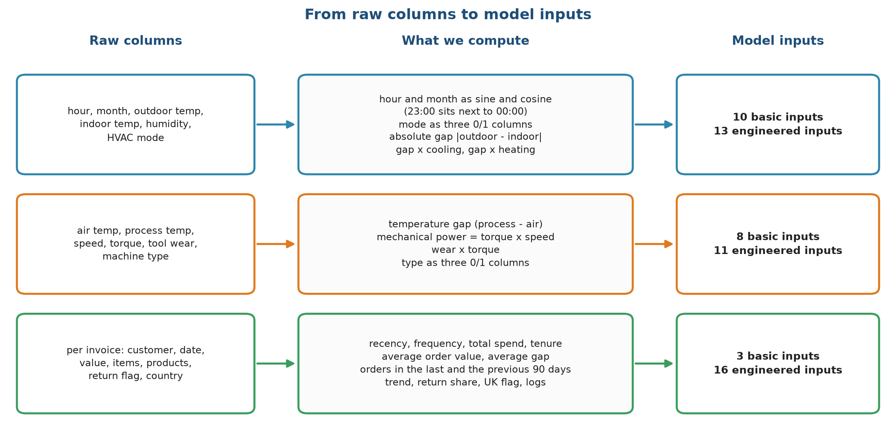
Engineered inputs come from the physics and the business
Stage 5: Feature engineering
Ankit Kumar
HVAC Service Planner | Group 1 | CSC-505 Machine Learning, IIT Roorkee
21
Notes:
Pillar 1 goes from 10 to 13 inputs, Pillar 2 from 8 to 11, Pillar 3 from 3 to 16. Every new input has a one-sentence reason.

Slide 22
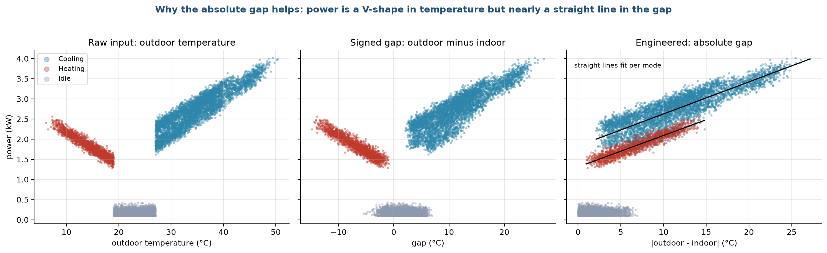
Folding the V: absolute gap turns two slopes into one
Stage 5: Feature engineering
Ankit Kumar
Power against temperature is a V.
Against the absolute gap it becomes a single rising band, which a straight line follows well.
HVAC Service Planner | Group 1 | CSC-505 Machine Learning, IIT Roorkee
22
Notes:
Power against temperature is a V. Against the absolute gap it becomes a single rising band, which a straight line follows well.

Slide 23
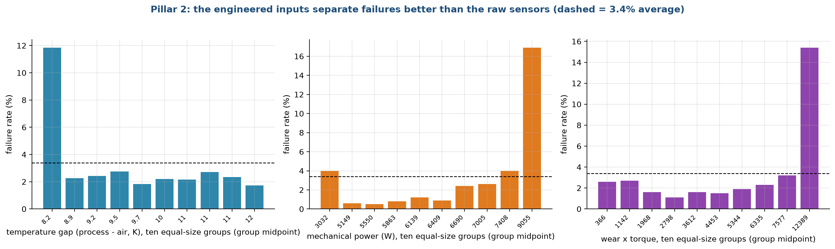
Engineered failure inputs expose the thresholds
Stage 5: Feature engineering
Ankit Kumar
The lowest temperature-gap tenth fails 12% of the time, the top mechanical-power tenth 17% and the top wear-times-torque tenth 15%.
HVAC Service Planner | Group 1 | CSC-505 Machine Learning, IIT Roorkee
23
Notes:
The lowest temperature-gap tenth fails 12% of the time, the top mechanical-power tenth 17% and the top wear-times-torque tenth 15%.

Slide 24
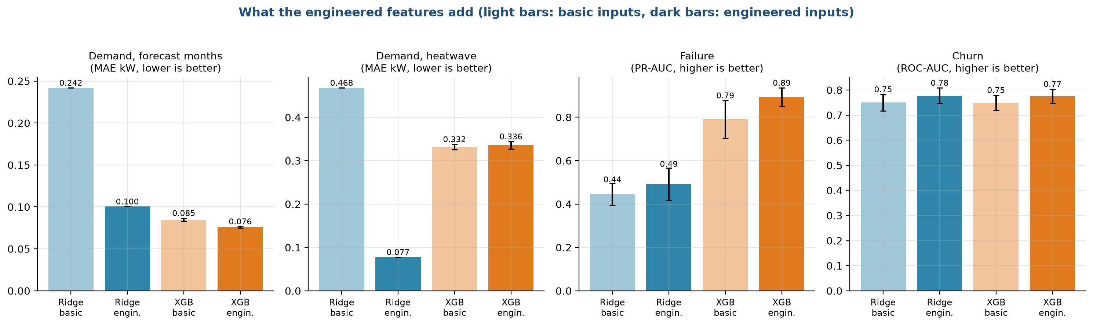
Engineering halves Ridge error, and does little for trees
Stage 5: Feature engineering
Ankit Kumar
Linear models need the gap handed to them.
XGBoost builds such shapes itself by splitting.
HVAC Service Planner | Group 1 | CSC-505 Machine Learning, IIT Roorkee
24
Notes:
Linear models need the gap handed to them. XGBoost builds such shapes itself by splitting.

Slide 25
Basic against engineered inputs, on unseen data
Stage 5: Feature engineering
Ankit Kumar
Test | Ridge, basic | Ridge, engineered | XGBoost, basic | XGBoost, engineered
Demand, random split (MAE, kW) | 0.182 | 0.096 | 0.065 | 0.065
Demand, unseen months (MAE, kW) | 0.224 | 0.118 | 0.070 | 0.072
Demand, forecast (MAE, kW) | 0.242 | 0.100 | 0.085 | 0.076
Demand, heatwave (MAE, kW) | 0.468 | 0.077 | 0.332 | 0.336
Failure (PR-AUC) | 0.445 | 0.492 | 0.790 | 0.893
Churn (ROC-AUC) | 0.750 | 0.777 | 0.749 | 0.775
Churn (PR-AUC) | 0.547 | 0.578 | 0.529 | 0.580
HVAC Service Planner | Group 1 | CSC-505 Machine Learning, IIT Roorkee
25
Notes:
Lower is better for demand, higher is better for failure and churn.

Slide 26
Five kinds of predictor, from a rule of thumb to boosted trees
Stage 6: Model selection
Ankit Kumar
Model | Role in this project | How it fits | Beyond the training range? | Main point
Rule of thumb | No learning | Average by hour; most worn tool first; longest since last purchase | Not applicable | What a company does today
Linear / logistic regression | Statistical baseline | One weight per input, no penalty | Yes (straight line) | Explainable; cannot bend
Ridge | Our model 1 | Same, with an L2 penalty chosen by cross-validation | Yes (straight line) | Stable with many inputs
Random Forest | Classic ML baseline | 300 trees on random subsets, averaged | No (flat beyond training range) | Few settings; handles thresholds
XGBoost | Our model 2 | 400 or 300 small trees, each fixing the errors of the previous ones | No (flat beyond training range) | Most accurate on tables
HVAC Service Planner | Group 1 | CSC-505 Machine Learning, IIT Roorkee
26
Notes:
The column about extrapolation decides the heatwave test.

Slide 27
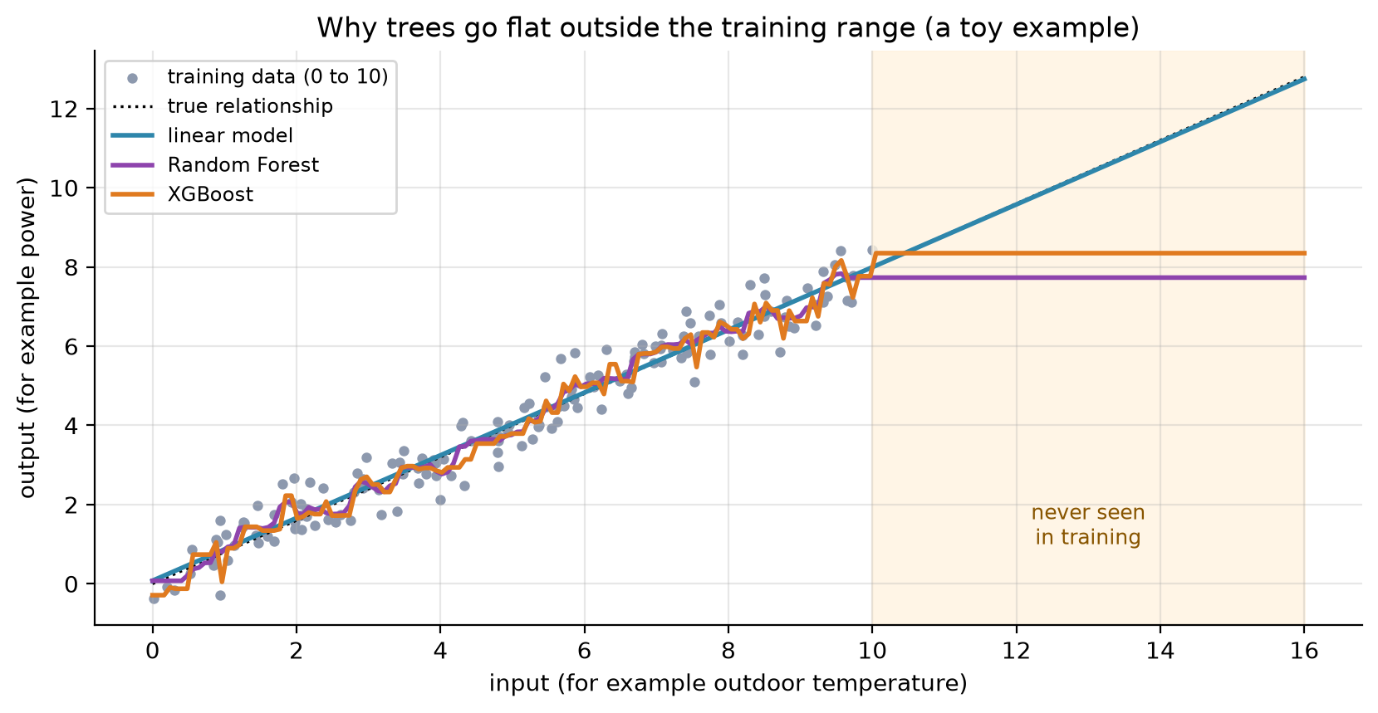
Why trees go flat outside their training range
Stage 6: Model selection
Ankit Kumar
HVAC Service Planner | Group 1 | CSC-505 Machine Learning, IIT Roorkee
27
Notes:
A toy example: the linear model continues the trend, Random Forest and XGBoost stay at the last value they saw. Our heatwave hours are above anything in training.

Slide 28
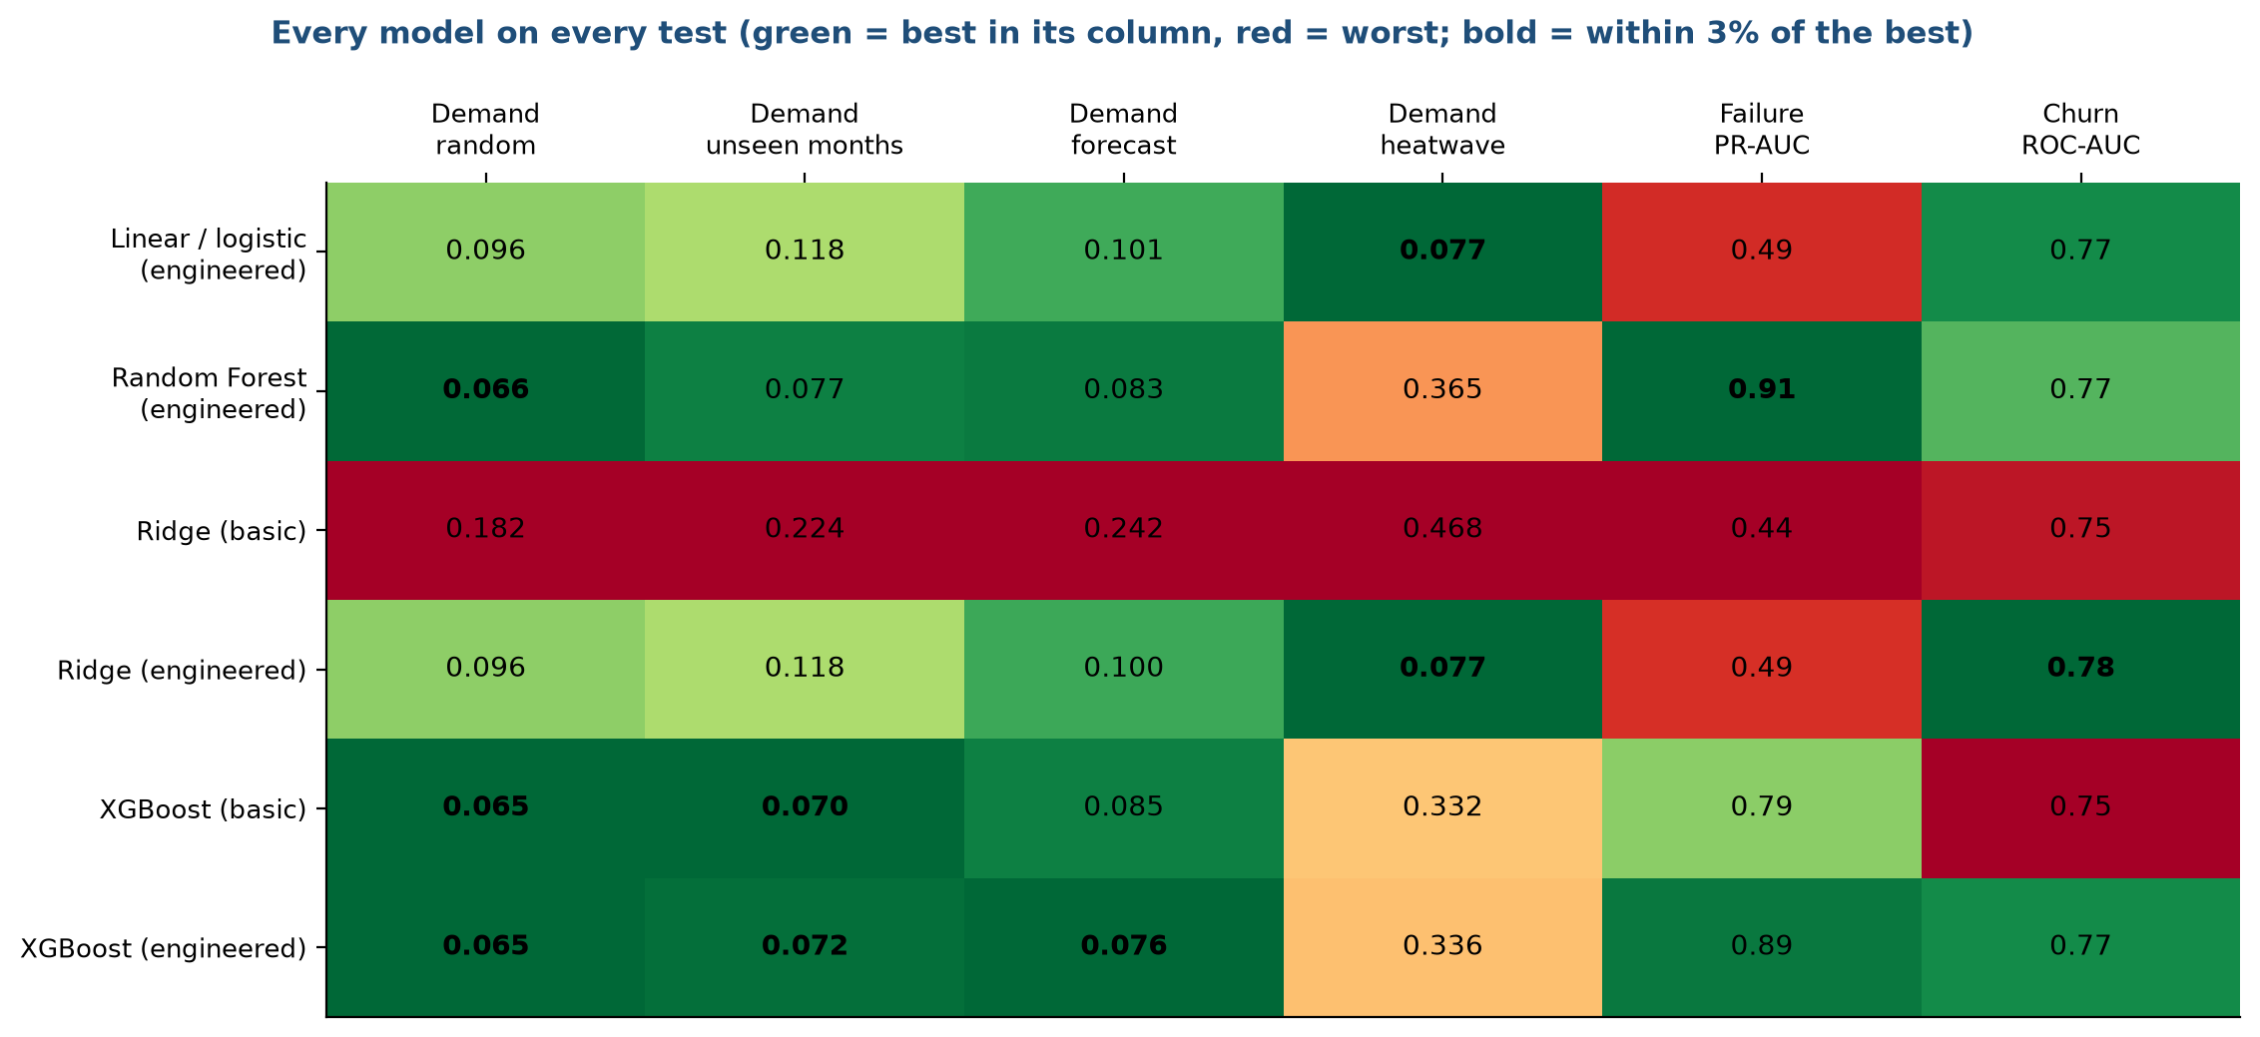
Every model on every test
Stage 6: Model selection
Ankit Kumar
HVAC Service Planner | Group 1 | CSC-505 Machine Learning, IIT Roorkee
28
Notes:
Trees are green on ordinary demand and on failure. In the heatwave the linear models are green and the trees are four to five times worse. Churn is a tie.

Slide 29
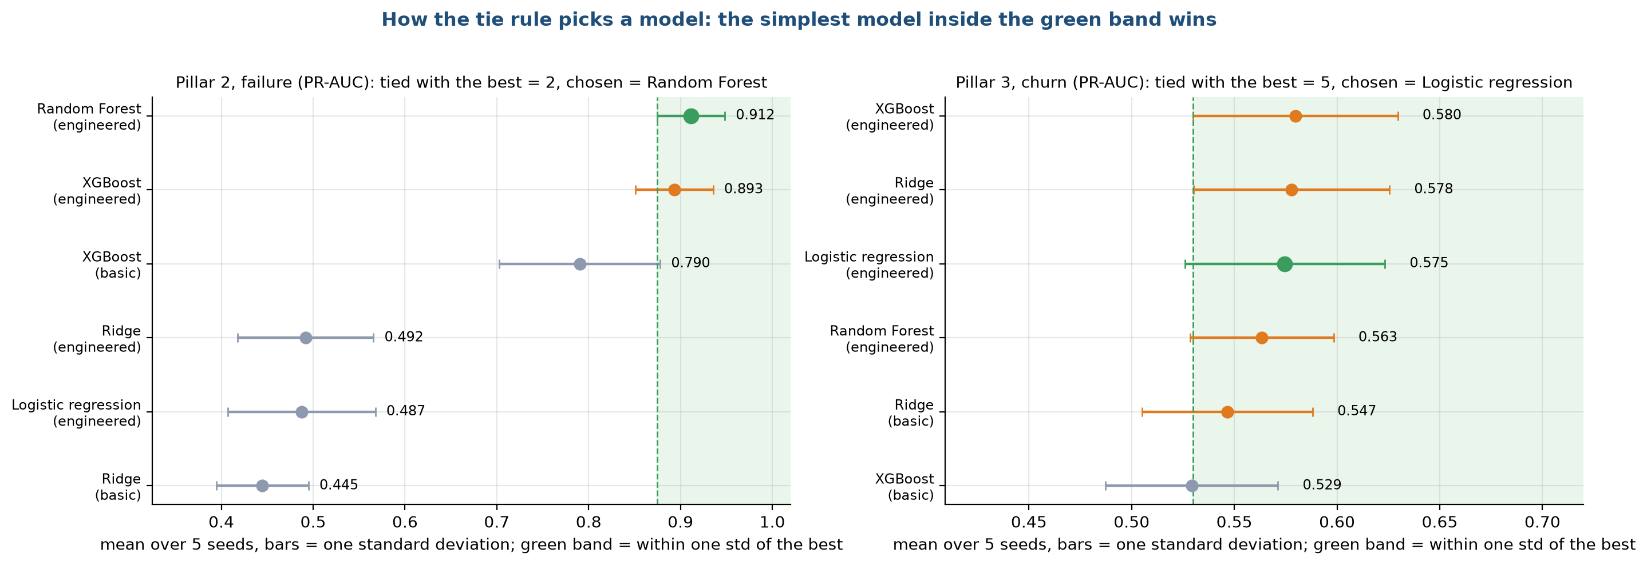
Tie rule: the simplest model within one std wins
Stage 6: Model selection
Ankit Kumar
For failure, Random Forest and XGBoost tie.
For churn, five models tie, so the simplest, logistic regression, wins.
HVAC Service Planner | Group 1 | CSC-505 Machine Learning, IIT Roorkee
29
Notes:
For failure, Random Forest and XGBoost tie. For churn, five models tie, so the simplest, logistic regression, wins. We ship XGBoost for failure and Ridge for churn, which are inside the same band.

Slide 30
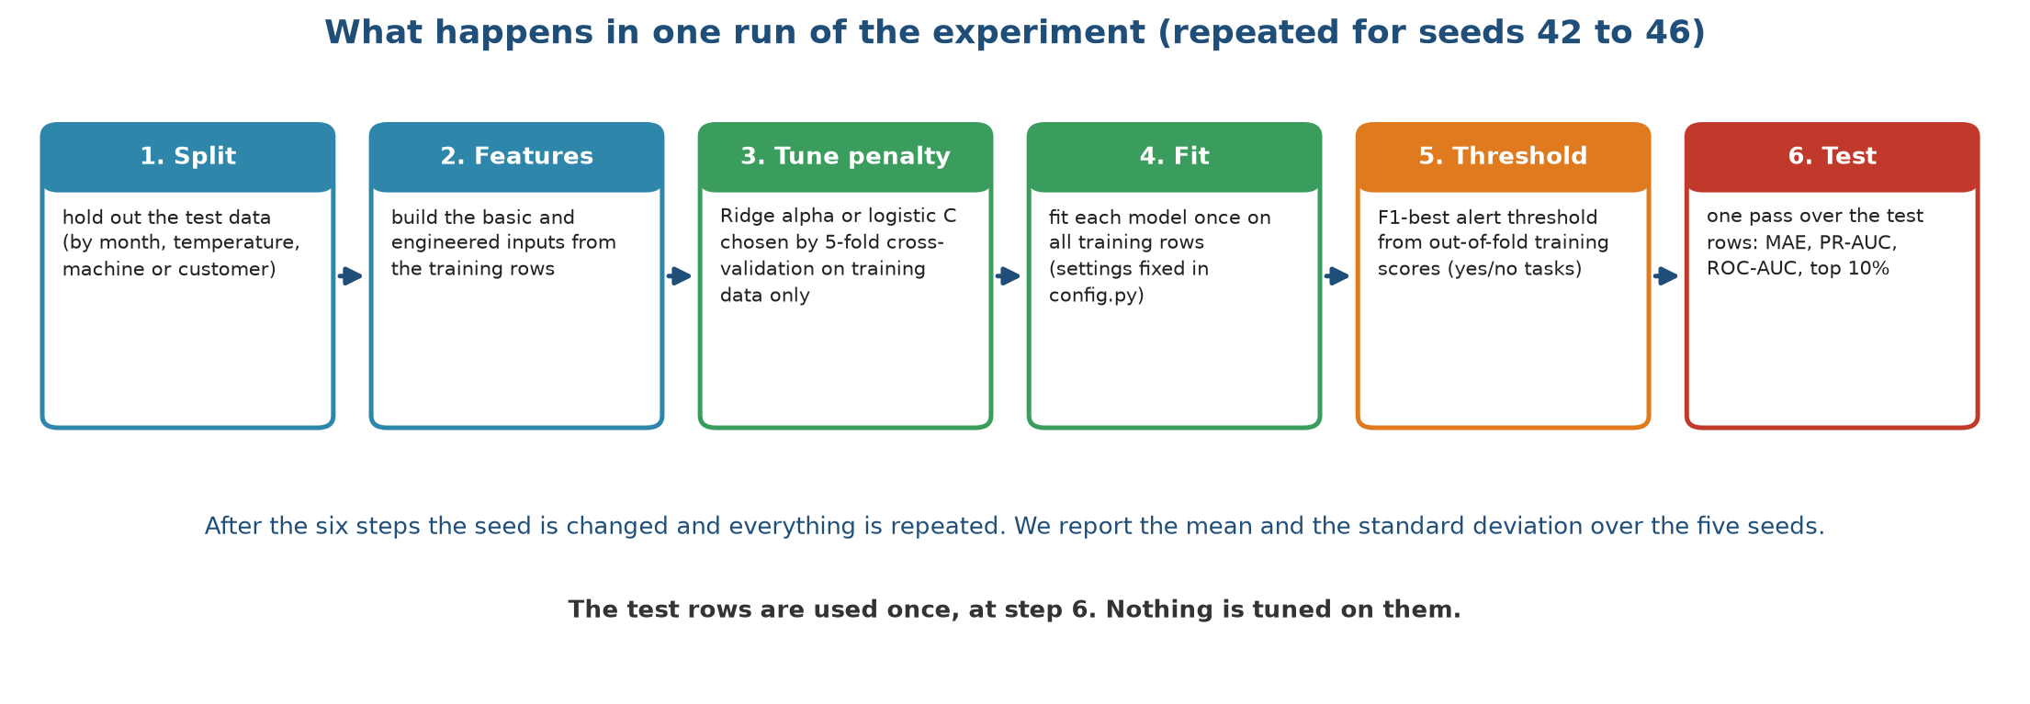
One protocol for every model, repeated with five seeds
Stage 7: Model training
Animesh Basak
Split, features, tune the penalty by cross-validation on training rows, fit once, choose the threshold from out-of-fold scores, test once.
HVAC Service Planner | Group 1 | CSC-505 Machine Learning, IIT Roorkee
30
Notes:
Split, features, tune the penalty by cross-validation on training rows, fit once, choose the threshold from out-of-fold scores, test once. Seeds 42 to 46.

Slide 31
Settings fixed in advance
Stage 7: Model training
Animesh Basak
Setting | Value | Applies to
Seeds | 42, 43, 44, 45, 46 | All experiments
Held-out share | 20% of rows, customers or hours | All pillars
Held-out months / forecast months | 3, 6, 9, 12 / 10, 11, 12 | Demand
Heatwave threshold | 40 °C | Demand
Churn cutoffs | 1 Jun, 1 Sep, 1 Dec 2010; 1 Mar, 1 Jun 2011; test 9 Sep 2011 | Churn
Ridge penalty candidates | 0.001 to 1,000 (alpha); 0.01 to 100 (C); 5-fold cross-validation | Demand; failure and churn
XGBoost, demand | 400 trees, depth 4, learning rate 0.05, 80% rows and columns | Pillar 1
XGBoost, failure and churn | 300 trees, depth 3, learning rate 0.05, 80% rows and columns | Pillars 2 and 3
Random Forest | 300 trees, at least 5 rows per leaf | All pillars
Linear and logistic regression | No penalty | Statistical baseline
HVAC Service Planner | Group 1 | CSC-505 Machine Learning, IIT Roorkee
31
Notes:
Nothing is tuned on test data. Cross-validation picked alpha 0.1 for demand and C 0.1 for failure and churn.

Slide 32
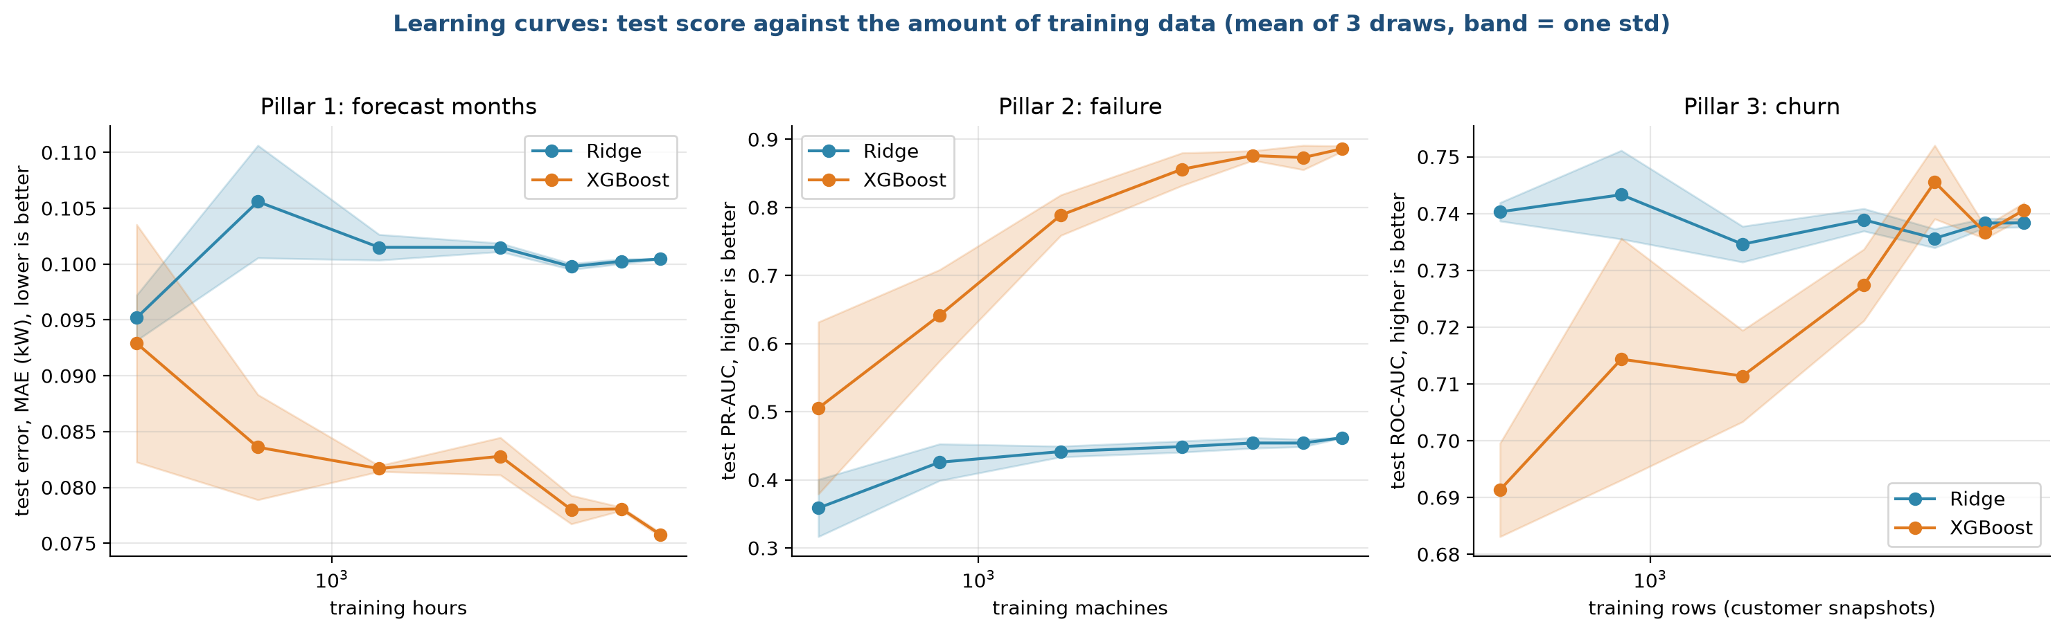
Trees need more data than Ridge, and for churn never pass it
Stage 7: Model training
Animesh Basak
Ridge learns its straight line early.
XGBoost climbs for failure and keeps improving slowly.
For churn both end at about 0.74 ROC-AUC.
HVAC Service Planner | Group 1 | CSC-505 Machine Learning, IIT Roorkee
32
Notes:
Ridge learns its straight line early. XGBoost climbs for failure and keeps improving slowly. For churn both end at about 0.74 ROC-AUC.

Slide 33
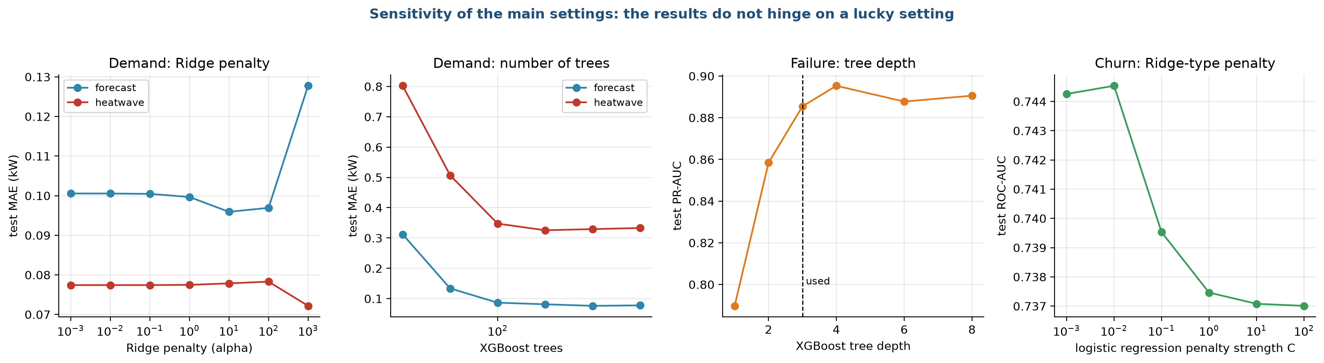
The results do not hinge on a lucky setting
Stage 7: Model training
Animesh Basak
Ridge penalty, number of trees, tree depth and churn penalty all move the score only a little.
In the heatwave no number of trees fixes XGBoost.
HVAC Service Planner | Group 1 | CSC-505 Machine Learning, IIT Roorkee
33
Notes:
Ridge penalty, number of trees, tree depth and churn penalty all move the score only a little. In the heatwave no number of trees fixes XGBoost.

Slide 34
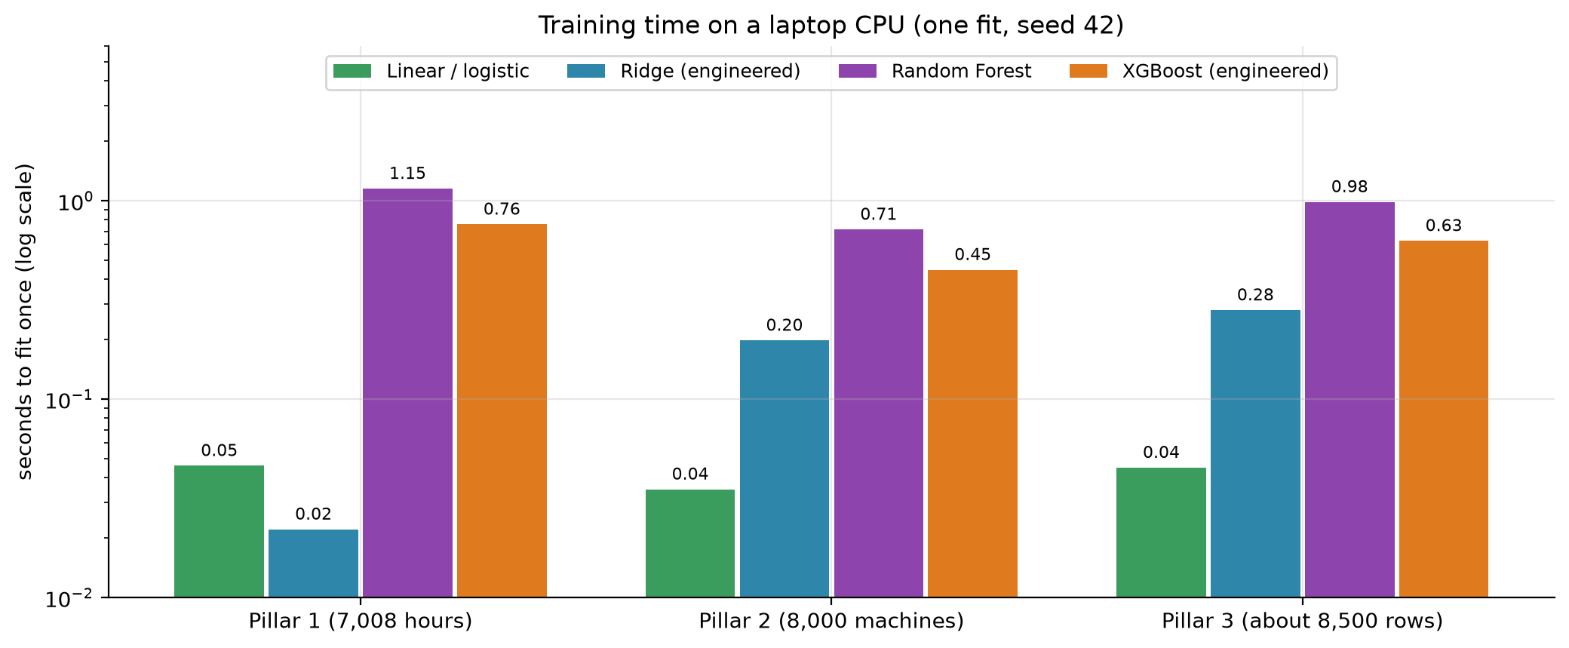
Training costs seconds, not hours
Stage 7: Model training
Animesh Basak
HVAC Service Planner | Group 1 | CSC-505 Machine Learning, IIT Roorkee
34
Notes:
Every model fits in under 1.2 seconds on a laptop. The whole experiment takes about 11 minutes. One prediction takes 1.4 to 2.4 milliseconds.

Slide 35
Demand: error in kW on unseen data
Stage 8: Evaluation and tuning
Animesh Basak
Test | Rule: training mean | Rule: average by hour | Linear regression | Ridge, basic | Ridge | Random Forest | XGBoost, basic | XGBoost
Random 20% of hours | 0.942 | 0.934 | 0.096 | 0.182 | 0.096 | 0.066 | 0.065 | 0.065
Unseen months | 1.017 | 0.995 | 0.118 | 0.224 | 0.118 | 0.077 | 0.070 | 0.072
Forecast, months 10-12 | 1.012 | 1.024 | 0.101 | 0.242 | 0.100 | 0.083 | 0.085 | 0.076
Heatwave, 40 °C and above | 1.648 | 1.574 | 0.077 | 0.468 | 0.077 | 0.365 | 0.332 | 0.336
Heatwave: Ridge 0.077 kW, XGBoost 0.336 kW, Random Forest 0.365 kW. Trees cannot predict above the temperatures they saw.
HVAC Service Planner | Group 1 | CSC-505 Machine Learning, IIT Roorkee
35
Notes:
Lower is better. Mean over 5 seeds; the std is 0.001 to 0.002 kW on the random test and 0.009 or less in the heatwave. Rules of thumb are wrong by about half of the 1.9 kW average load.

Slide 36
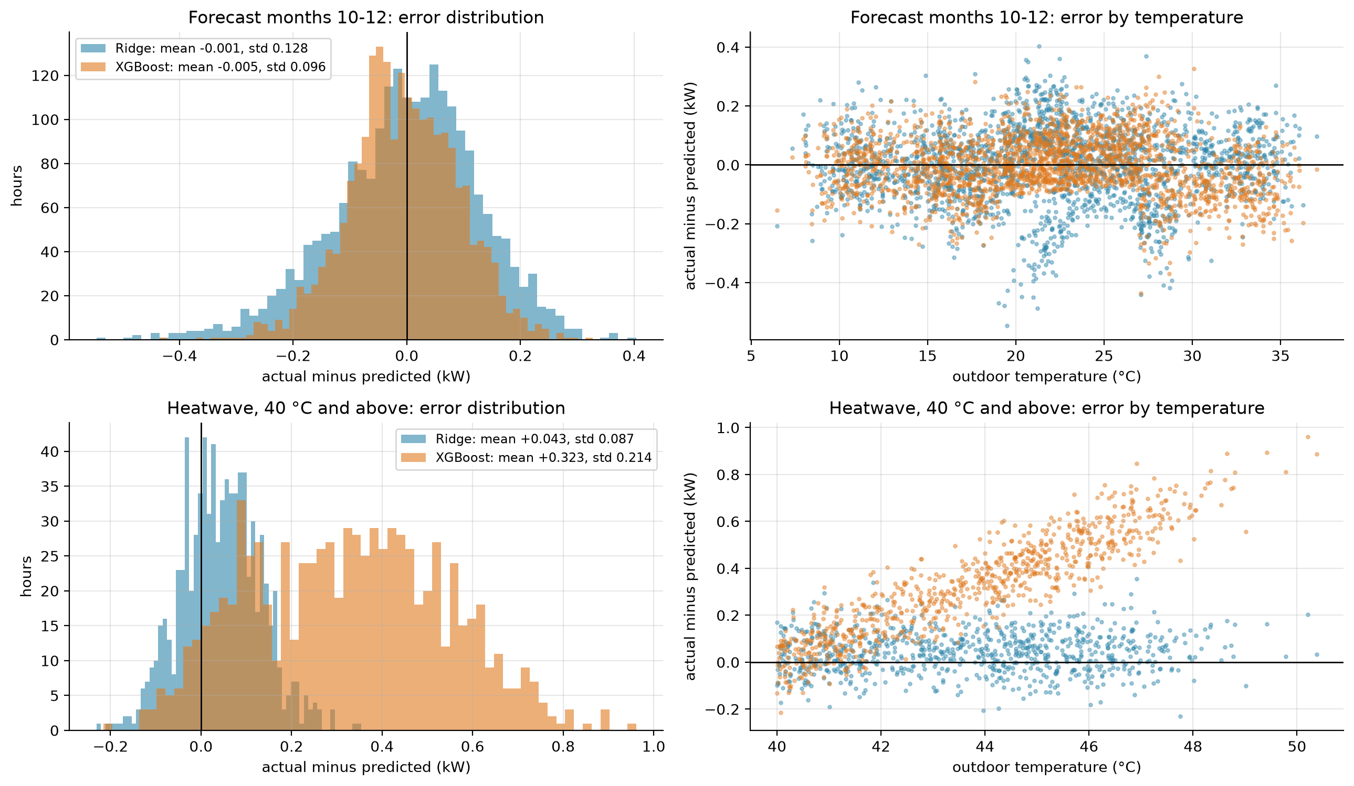
In the heatwave XGBoost under-predicts by up to 0.8 kW
Stage 8: Evaluation and tuning
Animesh Basak
HVAC Service Planner | Group 1 | CSC-505 Machine Learning, IIT Roorkee
36
Notes:
Forecast months: both models are centred on zero, XGBoost is narrower. Heatwave: XGBoost's residual grows with temperature while Ridge stays near zero. That is why the dashboard switches to Ridge at 40 degrees.

Slide 37
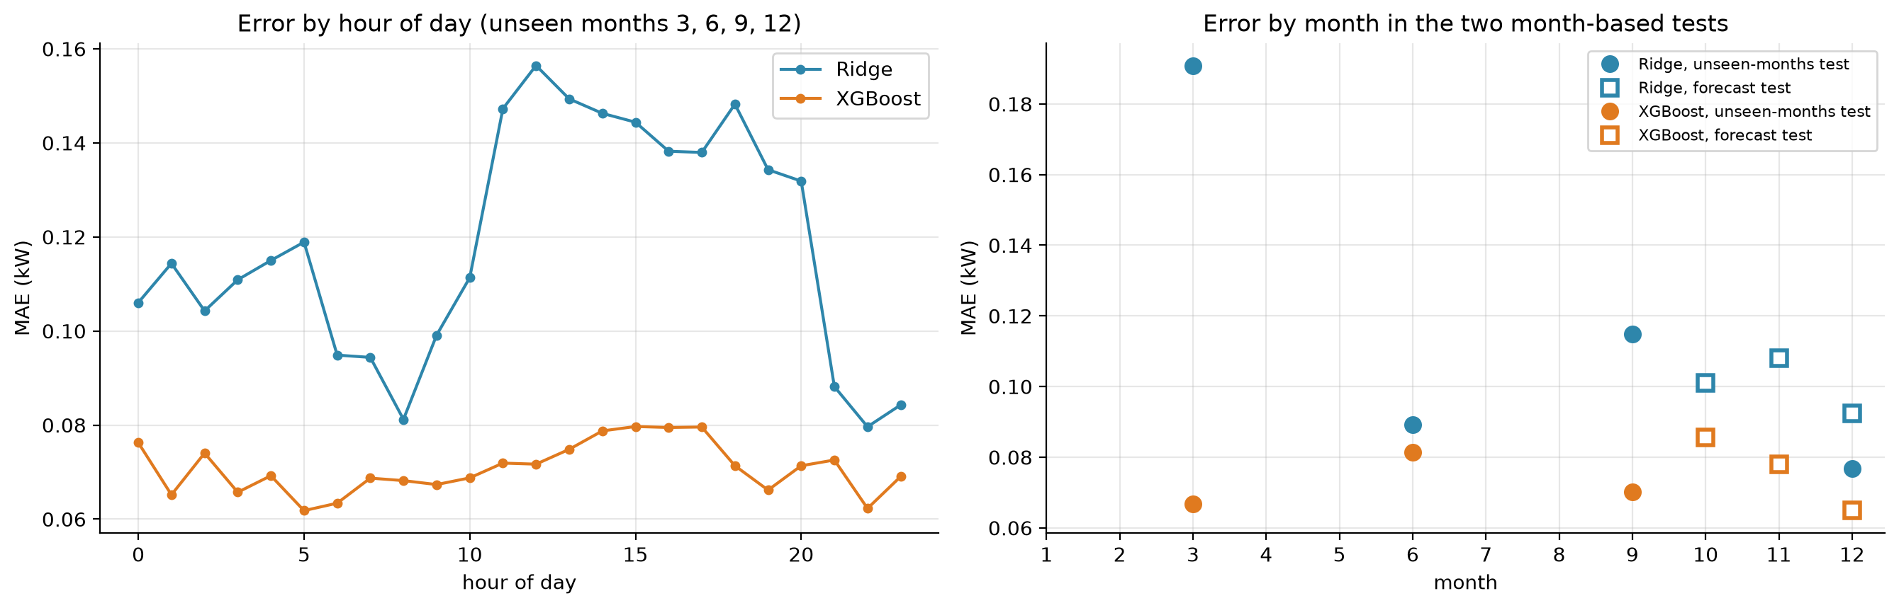
Error by hour and by month
Stage 8: Evaluation and tuning
Animesh Basak
Ridge struggles in the afternoon and in March.
XGBoost stays between 0.06 and 0.085 kW in every held-out month.
HVAC Service Planner | Group 1 | CSC-505 Machine Learning, IIT Roorkee
37
Notes:
Ridge struggles in the afternoon and in March. XGBoost stays between 0.06 and 0.085 kW in every held-out month.

Slide 38
Failure: trees find 94% of failures in the top 10% of machines
Stage 8: Evaluation and tuning
Animesh Basak
Model | ROC-AUC | PR-AUC | F1 | Precision | Recall | Failures in top 10%
Rule: most worn tool first | 0.655 ± 0.027 | 0.123 ± 0.013 | 0.197 ± 0.011 | 0.158 ± 0.013 | 0.262 ± 0.012 | 0.365 ± 0.024
Logistic regression | 0.930 ± 0.021 | 0.487 ± 0.080 | 0.480 ± 0.059 | 0.457 ± 0.065 | 0.512 ± 0.075 | 0.744 ± 0.069
Ridge, basic | 0.898 ± 0.022 | 0.445 ± 0.050 | 0.470 ± 0.048 | 0.456 ± 0.060 | 0.497 ± 0.085 | 0.662 ± 0.067
Ridge | 0.925 ± 0.021 | 0.492 ± 0.074 | 0.489 ± 0.059 | 0.514 ± 0.088 | 0.471 ± 0.045 | 0.732 ± 0.069
Random Forest | 0.988 ± 0.007 | 0.912 ± 0.037 | 0.887 ± 0.041 | 0.927 ± 0.046 | 0.850 ± 0.041 | 0.941 ± 0.040
XGBoost, basic | 0.980 ± 0.009 | 0.790 ± 0.088 | 0.727 ± 0.094 | 0.726 ± 0.138 | 0.738 ± 0.070 | 0.912 ± 0.039
XGBoost | 0.987 ± 0.007 | 0.893 ± 0.042 | 0.851 ± 0.045 | 0.901 ± 0.039 | 0.806 ± 0.052 | 0.938 ± 0.035
HVAC Service Planner | Group 1 | CSC-505 Machine Learning, IIT Roorkee
38
Notes:
2,000 held-out machines, 68 failures per seed. A random guess has PR-AUC 0.034.

Slide 39
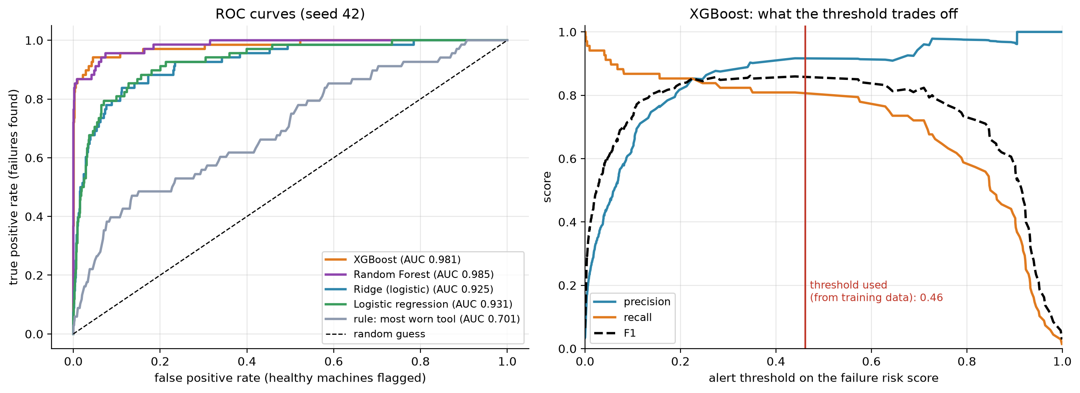
Ranking quality and the alert threshold
Stage 8: Evaluation and tuning
Animesh Basak
Random Forest and XGBoost rise almost vertically on the ROC curve.
F1 is flat from 0.2 to 0.6, so the result does not depend on a precise threshold.
HVAC Service Planner | Group 1 | CSC-505 Machine Learning, IIT Roorkee
39
Notes:
Random Forest and XGBoost rise almost vertically on the ROC curve. F1 is flat from 0.2 to 0.6, so the result does not depend on a precise threshold.

Slide 40
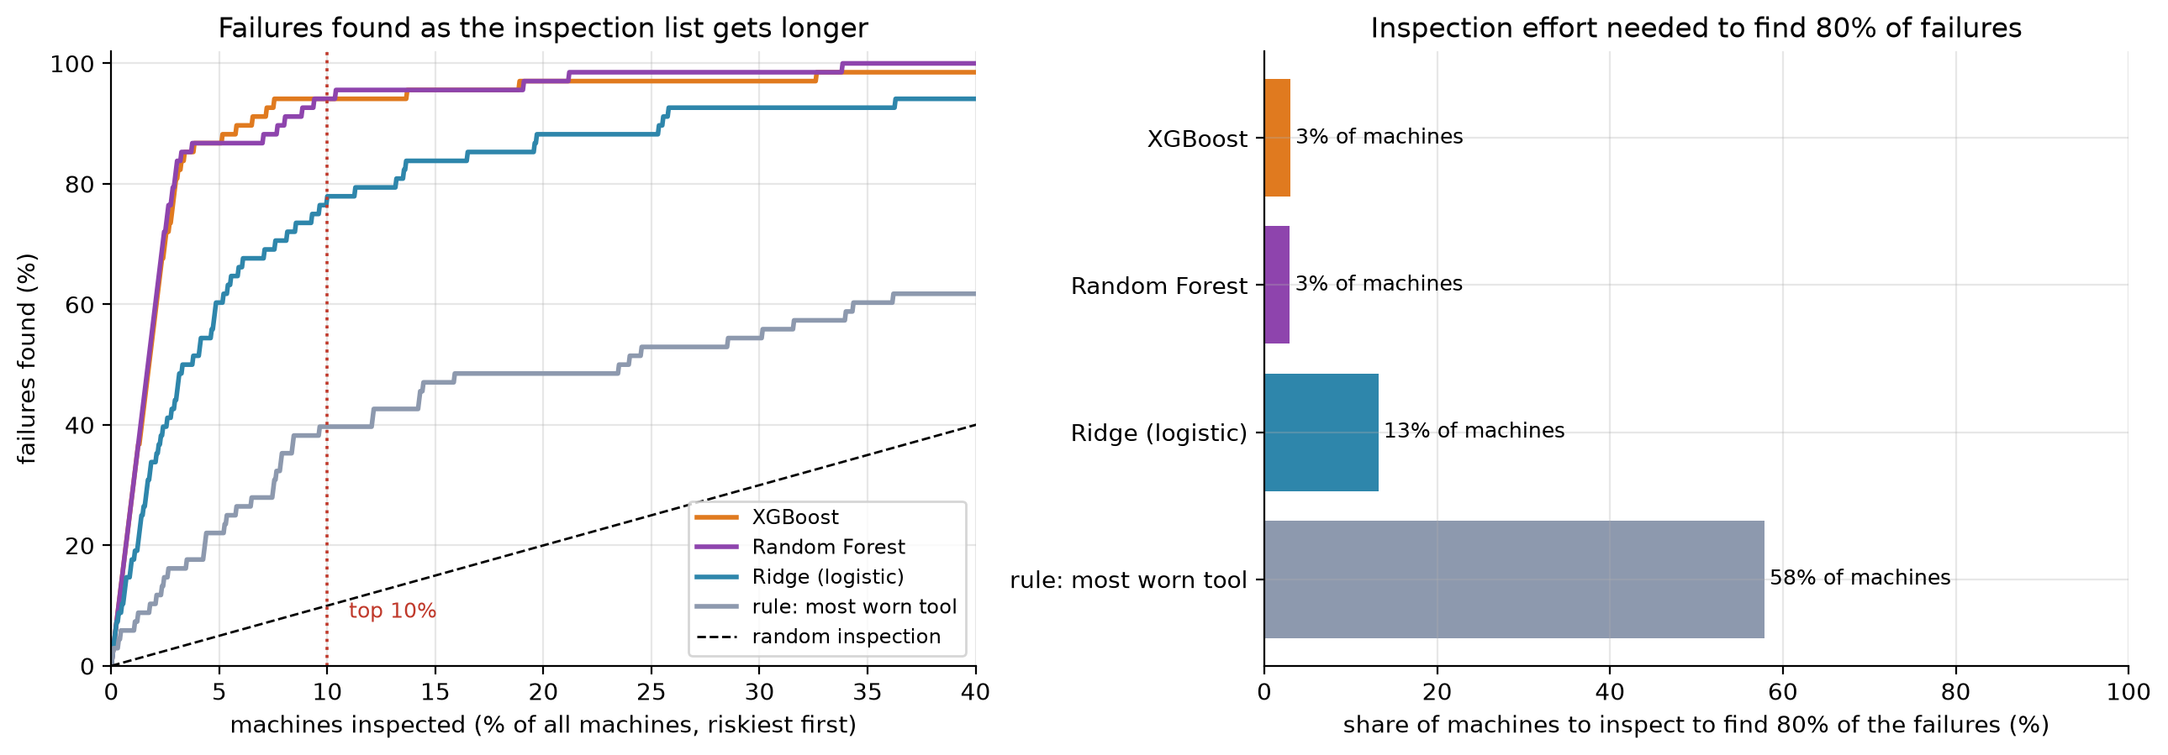
Finding 80% of failures: 3% of machines, not 58%
Stage 8: Evaluation and tuning
Animesh Basak
The rule of thumb needs about 19 times as many inspections as XGBoost to catch the same share of failures.
HVAC Service Planner | Group 1 | CSC-505 Machine Learning, IIT Roorkee
40
Notes:
The rule of thumb needs about 19 times as many inspections as XGBoost to catch the same share of failures.

Slide 41
Churn: every model reaches about 0.78 ROC-AUC
Stage 8: Evaluation and tuning
Animesh Basak
Model | ROC-AUC | PR-AUC | F1 | Precision | Recall | Lapsers in top 10%
Rule: longest since purchase | 0.607 ± 0.041 | 0.417 ± 0.019 | 0.478 ± 0.022 | 0.318 ± 0.020 | 0.964 ± 0.019 | 0.162 ± 0.017
Logistic regression | 0.775 ± 0.033 | 0.575 ± 0.049 | 0.608 ± 0.024 | 0.459 ± 0.024 | 0.903 ± 0.019 | 0.197 ± 0.021
Random Forest | 0.772 ± 0.022 | 0.563 ± 0.035 | 0.595 ± 0.017 | 0.445 ± 0.018 | 0.901 ± 0.030 | 0.201 ± 0.025
Ridge, basic | 0.750 ± 0.033 | 0.547 ± 0.041 | 0.593 ± 0.032 | 0.476 ± 0.034 | 0.788 ± 0.039 | 0.187 ± 0.039
Ridge | 0.777 ± 0.032 | 0.578 ± 0.048 | 0.609 ± 0.032 | 0.465 ± 0.035 | 0.885 ± 0.020 | 0.202 ± 0.020
XGBoost, basic | 0.749 ± 0.031 | 0.529 ± 0.042 | 0.590 ± 0.041 | 0.491 ± 0.039 | 0.741 ± 0.060 | 0.178 ± 0.037
XGBoost | 0.775 ± 0.029 | 0.580 ± 0.050 | 0.609 ± 0.029 | 0.462 ± 0.032 | 0.895 ± 0.019 | 0.200 ± 0.018
HVAC Service Planner | Group 1 | CSC-505 Machine Learning, IIT Roorkee
41
Notes:
About 360 test customers, about 32% lapse. Differences between models are smaller than one standard deviation.

Slide 42
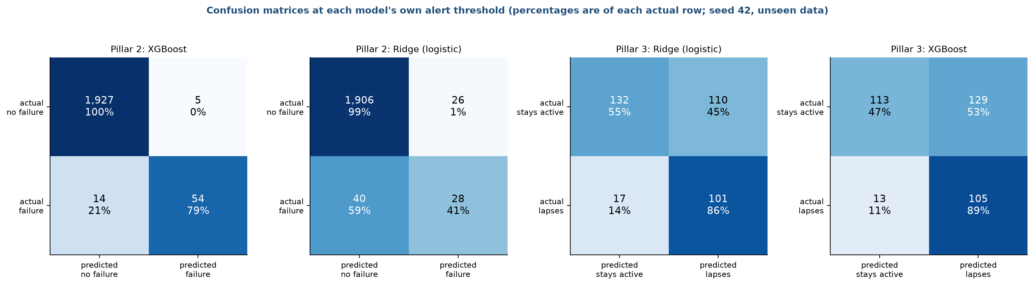
Alerts at each model's own threshold
Stage 8: Evaluation and tuning
Animesh Basak
XGBoost flags 59 of 2,000 machines and 54 are real failures, missing 14 of 68.
Ridge catches only 28.
For churn the lists are long, because the F1 threshold favours recall when lapsing is common.
HVAC Service Planner | Group 1 | CSC-505 Machine Learning, IIT Roorkee
42
Notes:
XGBoost flags 59 of 2,000 machines and 54 are real failures, missing 14 of 68. Ridge catches only 28. For churn the lists are long, because the F1 threshold favours recall when lapsing is common. A manager should work down the ranking, not use the threshold.

Slide 43
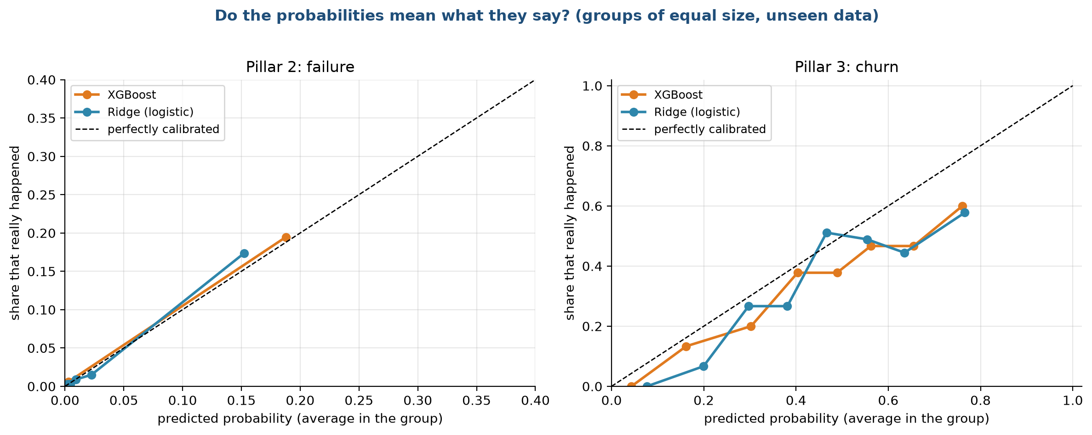
Do the probabilities mean what they say?
Stage 8: Evaluation and tuning
Animesh Basak
HVAC Service Planner | Group 1 | CSC-505 Machine Learning, IIT Roorkee
43
Notes:
For failure the few high scores sit close to the diagonal. For churn both models are over-confident at the high end: about 0.76 predicted, 0.58 to 0.60 observed. We show risk as a rank.

Slide 44
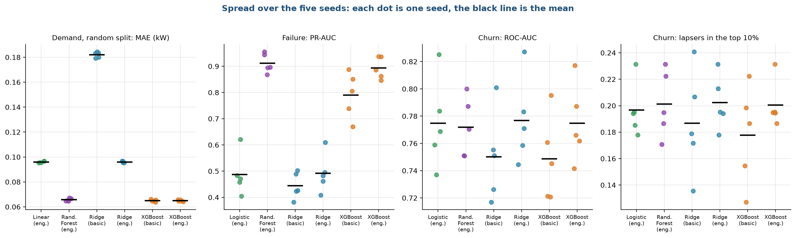
Spread over the five seeds
Stage 8: Evaluation and tuning
Animesh Basak
Demand barely moves.
Failure and especially churn vary because the test sets are small, which is why gaps below one standard deviation count as ties.
HVAC Service Planner | Group 1 | CSC-505 Machine Learning, IIT Roorkee
44
Notes:
Demand barely moves. Failure and especially churn vary because the test sets are small, which is why gaps below one standard deviation count as ties.

Slide 45
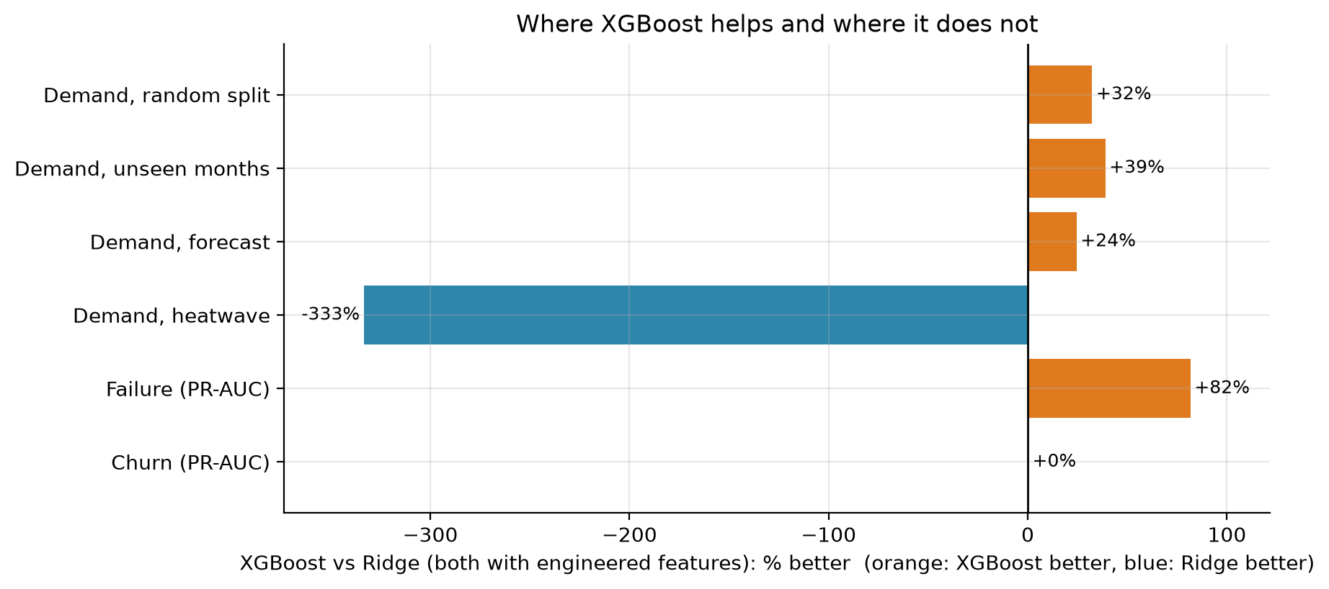
Where XGBoost helps and where it does not
Stage 8: Evaluation and tuning
Animesh Basak
HVAC Service Planner | Group 1 | CSC-505 Machine Learning, IIT Roorkee
45
Notes:
Better by 32%, 39%, 24% on ordinary demand tests and 82% on failure. Worse by 333% in the heatwave. No gain on churn.

Slide 46
Scoreboard: the rule of thumb against our models
Stage 8: Evaluation and tuning
Animesh Basak
Pillar | Measure | Rule of thumb | Statistical baseline | Ridge | XGBoost | Best result
Demand, forecast test | Error in kW (lower) | 1.02 | 0.101 | 0.100 | 0.076 | XGBoost
Demand, heatwave | Error in kW (lower) | 1.57 | 0.077 | 0.077 | 0.336 | Linear models
Failure | PR-AUC (higher) | 0.123 | 0.487 | 0.492 | 0.893 | Random Forest 0.912, XGBoost close
Failure | Failures in top 10% | 36% | 74% | 73% | 94% | Random Forest and XGBoost
Churn | ROC-AUC (higher) | 0.607 | 0.775 | 0.777 | 0.775 | All four models tie
Churn | Lapsers in top 10% | 16% | 20% | 20% | 20% | All four models tie
HVAC Service Planner | Group 1 | CSC-505 Machine Learning, IIT Roorkee
46
Notes:
Statistical baseline: linear regression for demand, logistic regression for failure and churn.

Slide 47
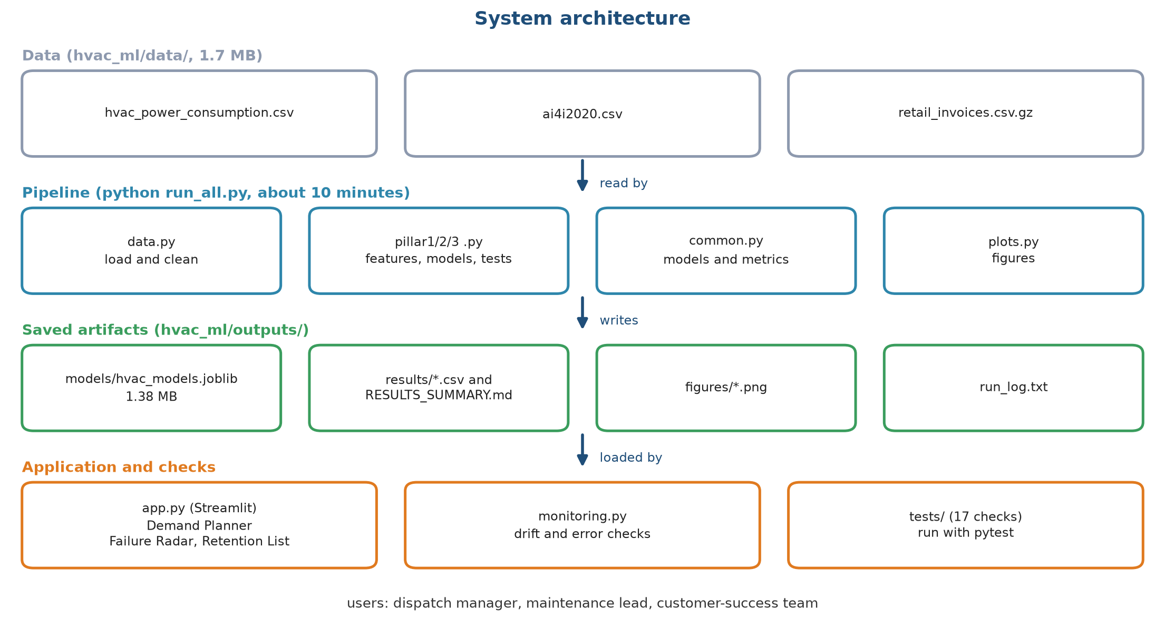
Architecture: train once, serve in milliseconds
Stage 9: Deployment
Sourav Kumar Boro
HVAC Service Planner | Group 1 | CSC-505 Machine Learning, IIT Roorkee
47
Notes:
The pipeline writes a 1.4 MB models file and the dashboard only reads it. Training and serving are kept apart.

Slide 48
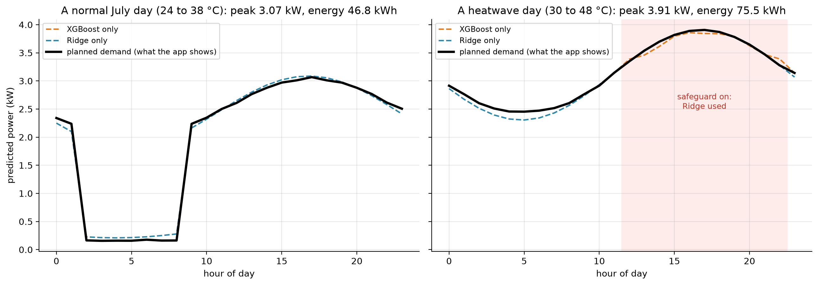
Demand Planner: a normal day and a heatwave day
Stage 9: Deployment
Sourav Kumar Boro
Peak 3.07 kW and 46.8 kWh on a normal July day.
Peak 3.91 kW and 75.5 kWh on a heatwave day, where the safeguard uses Ridge from about 11:00 to 22:00.
HVAC Service Planner | Group 1 | CSC-505 Machine Learning, IIT Roorkee
48
Notes:
Peak 3.07 kW and 46.8 kWh on a normal July day. Peak 3.91 kW and 75.5 kWh on a heatwave day, where the safeguard uses Ridge from about 11:00 to 22:00.

Slide 49
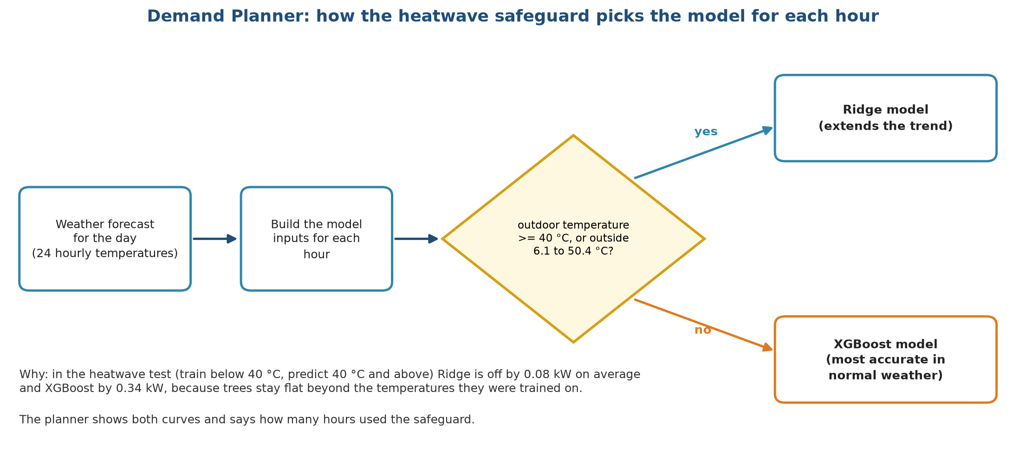
The heatwave safeguard: Ridge at 40 °C and above
Stage 9: Deployment
Sourav Kumar Boro
HVAC Service Planner | Group 1 | CSC-505 Machine Learning, IIT Roorkee
49
Notes:
Planning with XGBoost alone would be low by 0.3 kW or more per hour on the hottest days. The dashboard shows both curves and says how many hours used the safeguard.

Slide 50
Failure Radar: the 12 riskiest machines in a sample of 500
Stage 9: Deployment
Sourav Kumar Boro
Product ID | Type | Torque (Nm) | Speed (rpm) | Tool wear (min) | Risk (%) | Alert | Actually failed
L51822 | L | 54.6 | 1238 | 226 | 99.6 | inspect | yes
L49778 | L | 67.5 | 1320 | 20 | 96.4 | inspect | yes
M20475 | M | 71.3 | 1257 | 122 | 96.0 | inspect | yes
L53705 | L | 73.6 | 1312 | 49 | 95.2 | inspect | yes
L51800 | L | 52.6 | 1336 | 172 | 94.6 | inspect | yes
M19287 | M | 48.9 | 1379 | 107 | 94.1 | inspect | yes
L51801 | L | 51.0 | 1341 | 174 | 94.1 | inspect | yes
M23874 | M | 61.3 | 1340 | 207 | 93.6 | inspect | yes
M21659 | M | 12.2 | 2636 | 100 | 93.0 | inspect | yes
L51724 | L | 55.1 | 1349 | 187 | 92.7 | inspect | yes
L48763 | L | 61.0 | 1310 | 189 | 89.7 | inspect | yes
L54939 | L | 59.2 | 1272 | 198 | 89.4 | inspect | yes
Illustration: the saved model was trained on all 10,000 machines, so this list is a demonstration, not a test. Honest scores are in stage 8.
HVAC Service Planner | Group 1 | CSC-505 Machine Learning, IIT Roorkee
50
Notes:
The tool lists machines by risk and flags those above the alert threshold (44% for XGBoost).

Slide 51
Retention List: the 12 customers most likely to go quiet
Stage 9: Deployment
Sourav Kumar Boro
Customer | Risk (%) | Days idle | Orders | Spend | Orders (90 d) | Actually lapsed
14495 | 93.0 | 29 | 2 | 92 | 1 | no
17660 | 91.5 | 49 | 2 | 359 | 1 | yes
14997 | 90.6 | 86 | 2 | 386 | 1 | no
14171 | 90.5 | 6 | 2 | 499 | 1 | yes
16641 | 90.0 | 13 | 2 | 554 | 1 | yes
17958 | 90.0 | 24 | 2 | 974 | 1 | yes
14079 | 90.0 | 32 | 2 | 619 | 1 | yes
15374 | 89.7 | 36 | 2 | 307 | 1 | yes
18281 | 89.7 | 88 | 2 | 201 | 1 | yes
15256 | 89.3 | 56 | 2 | 170 | 1 | yes
15219 | 89.0 | 84 | 2 | 685 | 1 | yes
13302 | 88.5 | 63 | 2 | 159 | 1 | yes
Illustration: the final model saw these customers. In the honest test, the top 10% of the list reaches 20% of lapsers, twice the random rate.
HVAC Service Planner | Group 1 | CSC-505 Machine Learning, IIT Roorkee
51
Notes:
The team picks how many customers it can contact, and the tool returns the highest-risk ones.

Slide 52
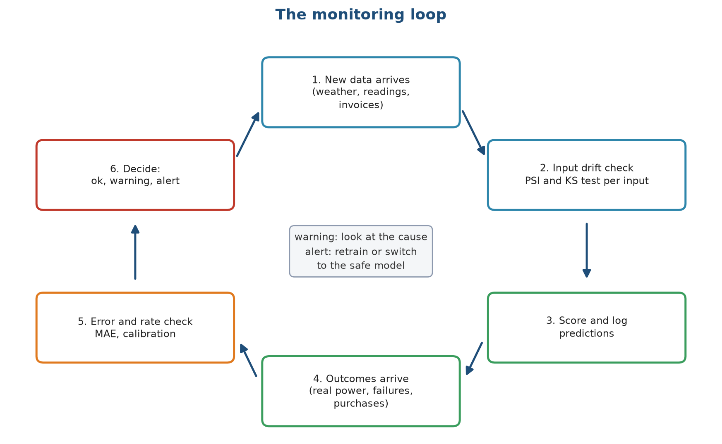
The monitoring loop
Stage 10: Monitoring
Sourav Kumar Boro
HVAC Service Planner | Group 1 | CSC-505 Machine Learning, IIT Roorkee
52
Notes:
Input checks run as soon as data arrives and warn early. Error and rate checks need real outcomes and give the final proof.

Slide 53
Alert rules
Stage 10: Monitoring
Sourav Kumar Boro
Check | What is measured | Warning at | Alert at | Action
Input drift | PSI of each model input | >= 0.10 | >= 0.25 | Check the data source; refit if it persists
Demand error | Monthly MAE against the tested 0.065 kW | >= 1.5 times | >= 2.0 times | Refit on the newest months; check sensors
Heatwave safeguard | Hours above 40 °C that used Ridge | any | Error >= 2 x 0.08 kW | Extend the Ridge range; review features
Failure ranking | Failures found in the top 10% (tested 94%) | < 85% | < 70% | Refit with the new failures; review sensors
Churn calibration | Predicted against actual lapse rate | Gap > 0.10 | Gap > 0.20 | Refit on the latest cutoff; reset the threshold
PSI thresholds are the usual rules of thumb (0.10 moderate, 0.25 large shift), not values fitted to our data.
HVAC Service Planner | Group 1 | CSC-505 Machine Learning, IIT Roorkee
53
Notes:
The first two rows are implemented and tested as functions; the rest are applied by hand for now.

Slide 54
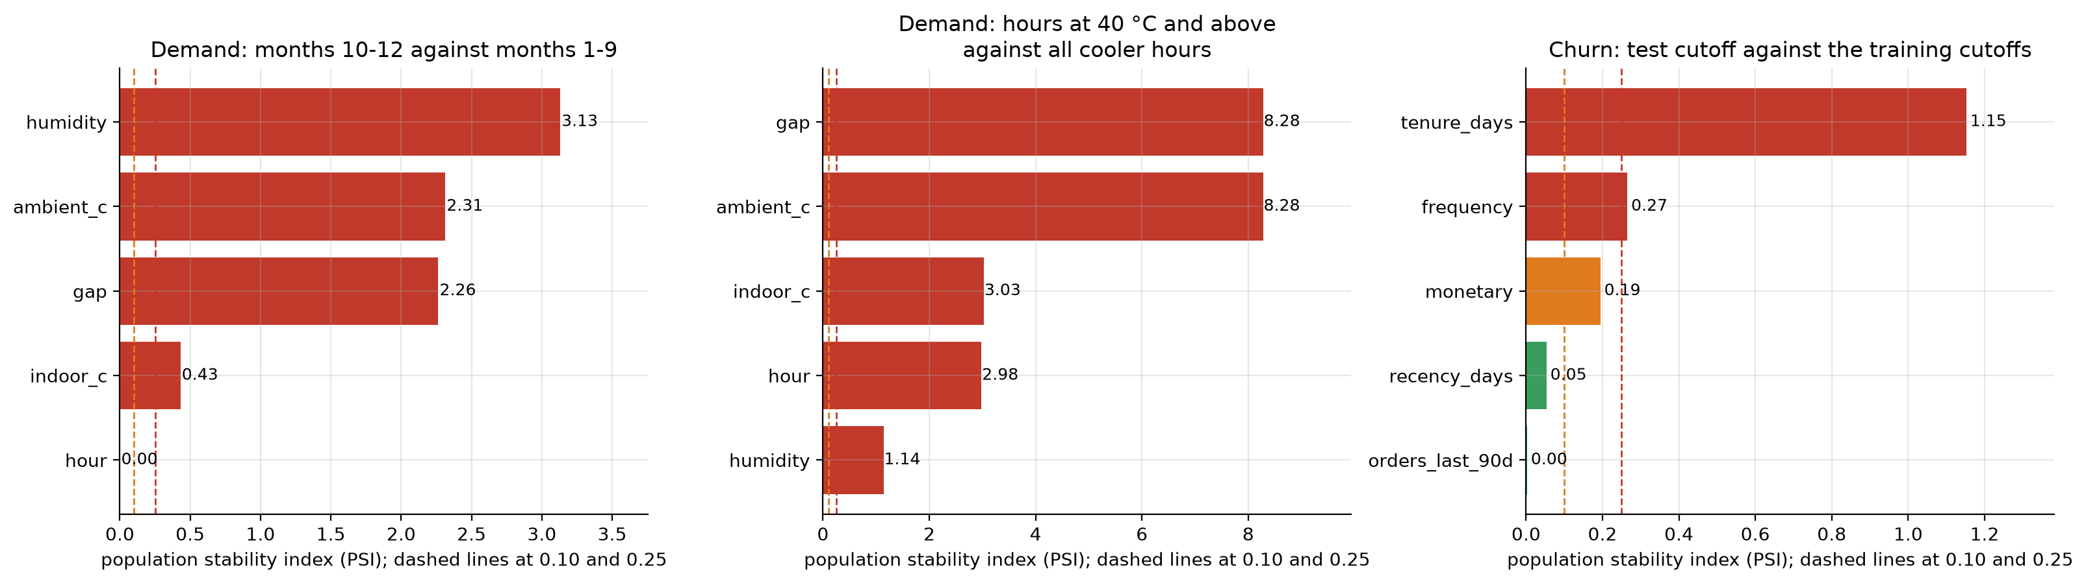
The checks fire when the weather moves into new ground
Stage 10: Monitoring
Sourav Kumar Boro
Months 10 to 12 against months 1 to 9 alert because of the season.
Heatwave hours against cooler hours reach PSI 8.3.
For churn, tenure drifts because customers are a year older.
HVAC Service Planner | Group 1 | CSC-505 Machine Learning, IIT Roorkee
54
Notes:
Months 10 to 12 against months 1 to 9 alert because of the season. Heatwave hours against cooler hours reach PSI 8.3. For churn, tenure drifts because customers are a year older.

Slide 55
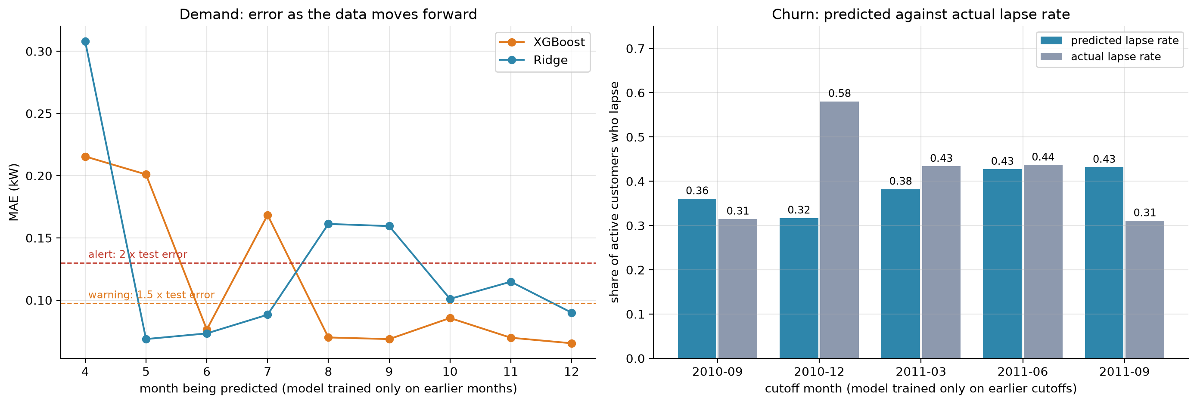
Error over time, and predicted against actual churn
Stage 10: Monitoring
Sourav Kumar Boro
A model trained only on earlier months has large errors in April, May and July.
The churn rate prediction misses by 0.26 in the holiday window, although the ranking stays useful.
HVAC Service Planner | Group 1 | CSC-505 Machine Learning, IIT Roorkee
55
Notes:
A model trained only on earlier months has large errors in April, May and July. The churn rate prediction misses by 0.26 in the holiday window, although the ranking stays useful.

Slide 56
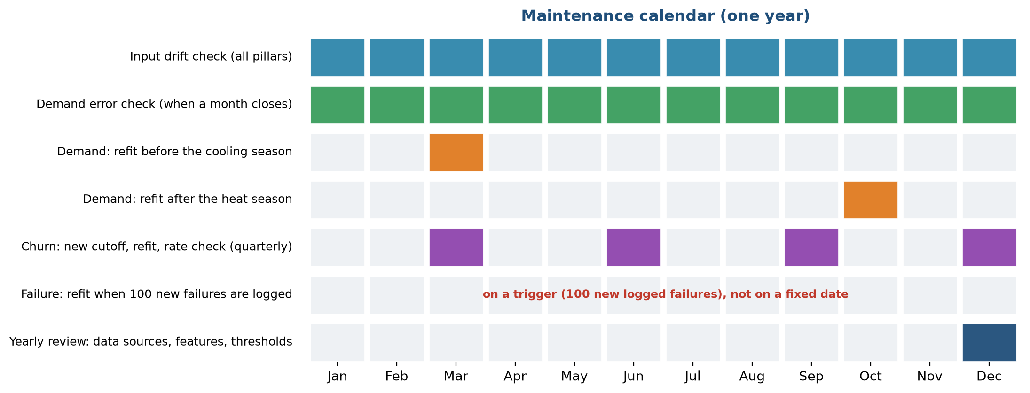
Maintenance calendar
Stage 10: Monitoring
Sourav Kumar Boro
HVAC Service Planner | Group 1 | CSC-505 Machine Learning, IIT Roorkee
56
Notes:
Demand is refitted before and after the cooling season, churn each quarter, failure after 100 new logged failures. Yearly review in December.

Slide 57
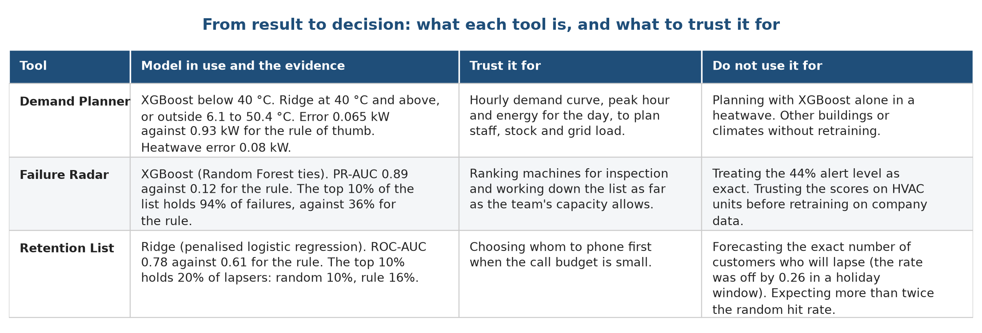
What each tool is for, and what not to use it for
Summary
Whole group
A manager can trust the Demand Planner with its safeguard and the Failure Radar for ranking.
The Retention List is a modest aid.
HVAC Service Planner | Group 1 | CSC-505 Machine Learning, IIT Roorkee
57
Notes:
A manager can trust the Demand Planner with its safeguard and the Failure Radar for ranking. The Retention List is a modest aid.

Slide 58
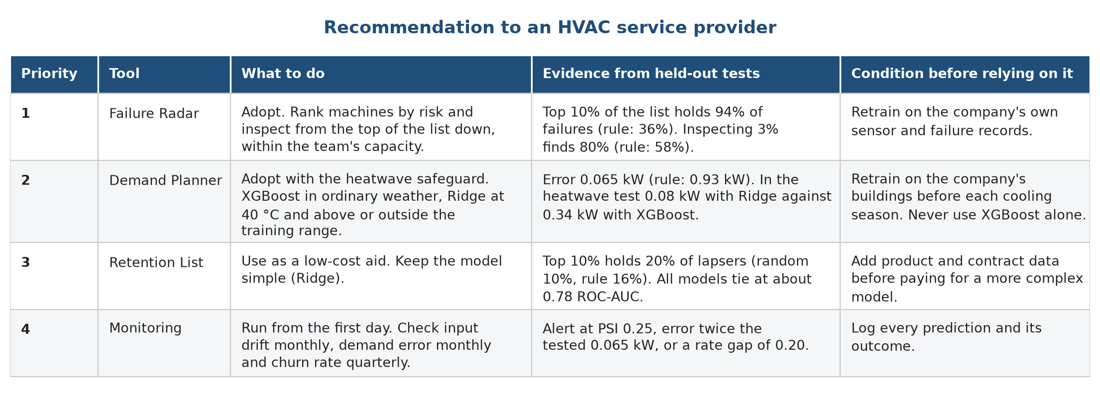
Recommendation: pilot Failure Radar and Demand Planner first
Summary
Whole group
Retrain on company data before relying on any score.
Run a four-week side-by-side pilot.
HVAC Service Planner | Group 1 | CSC-505 Machine Learning, IIT Roorkee
58
Notes:
Retrain on company data before relying on any score. Run a four-week side-by-side pilot. Monitoring starts on day one.

Slide 59
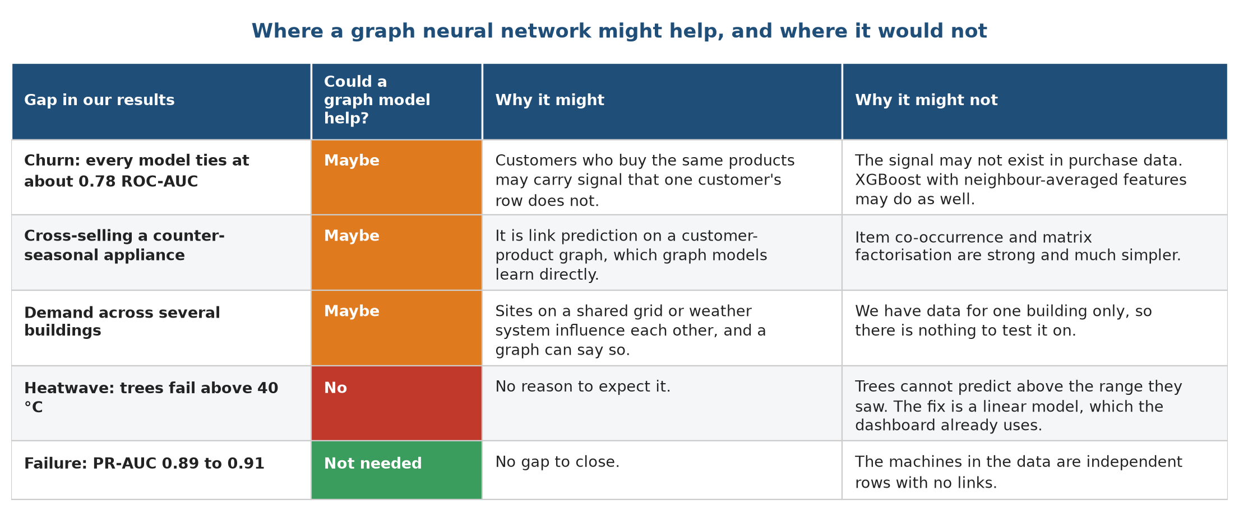
Limits and future work: where a graph model might help
Summary
Whole group
HVAC Service Planner | Group 1 | CSC-505 Machine Learning, IIT Roorkee
59
Notes:
A graph neural network did not beat simple models in an earlier test, so we removed it. Churn, cross-selling and multi-building demand are the places worth a fair test. It would not fix the heatwave.

Slide 60
Conclusion
Summary
Whole group
Machine learning helps most where a ranking drives an action: inspecting machines, with 94% of failures in the top 10% of the list.
Demand can be forecast to 0.065 kW, but only a linear model stays safe in a heatwave, so the planner switches at 40 °C.
Retention gains are modest: about twice the hit rate of random calling, and all models tie.
We recommend a pilot of the Failure Radar and the Demand Planner on company data, with monitoring from the first day.
All scores come from public stand-in data and unseen test data; the method transfers, the numbers do not.
Thank you. Questions?
HVAC Service Planner | Group 1 | CSC-505 Machine Learning, IIT Roorkee
60
Notes:
Close with the recommendation and thank the audience.

Slide 61
References and data sources
Summary
Whole group
Source | Reference
Data 1 | felixpradoh. HVAC Power Consumption (hourly, 2025). Kaggle. kaggle.com/datasets/felixpradoh/hvac-power-consumption
Data 2 | Matzka, S. (2020). AI4I 2020 Predictive Maintenance Dataset. UCI Machine Learning Repository, 601.
Data 3 | Chen, D. (2019). Online Retail II. UCI Machine Learning Repository, 502.
Ridge | Hoerl and Kennard (1970). Ridge regression: biased estimation for nonorthogonal problems. Technometrics 12(1).
Random Forest | Breiman (2001). Random forests. Machine Learning 45(1).
XGBoost | Chen and Guestrin (2016). XGBoost: a scalable tree boosting system. KDD.
scikit-learn | Pedregosa et al. (2011). Scikit-learn: machine learning in Python. JMLR 12.
PR curves | Saito and Rehmsmeier (2015). The precision-recall plot is more informative than the ROC plot on imbalanced data. PLOS ONE 10(3).
PSI | Siddiqi (2006). Credit Risk Scorecards. Wiley.
GraphSAGE | Hamilton, Ying and Leskovec (2017). Inductive representation learning on large graphs. NeurIPS 30.
HVAC Service Planner | Group 1 | CSC-505 Machine Learning, IIT Roorkee
61

