Slide 1
Sales Prediction Model- Using Machine Learning
Project Guide: Project by:
Dr. Nishant Shrivastava Somya Sharma(8817103032)
Animesh Kumar Jain(8817103008)

Slide 2
Introduction
The world has become a competitive market and everyone wishes to know the outcomes before the event occurs. So for the same we aim to analysis historic data and predict the upcoming sales for a particular firm.
Through this project we aim to understand and learn about the Machine Learning technology.

Slide 3
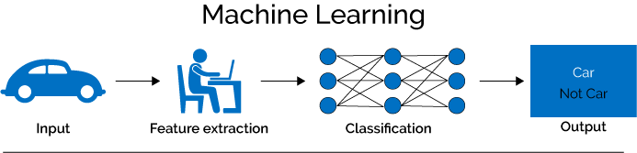
Machine Learning Approach

Slide 4
How does sales prediction works?
Data
Pre-Processing
Data Cleaning
Feature Engineering
Data Analyses
Model Training And Testing
Prediction of results
Data Consistence Check
Feature Selection
Assessing Results
Comparing Different Models

Slide 5
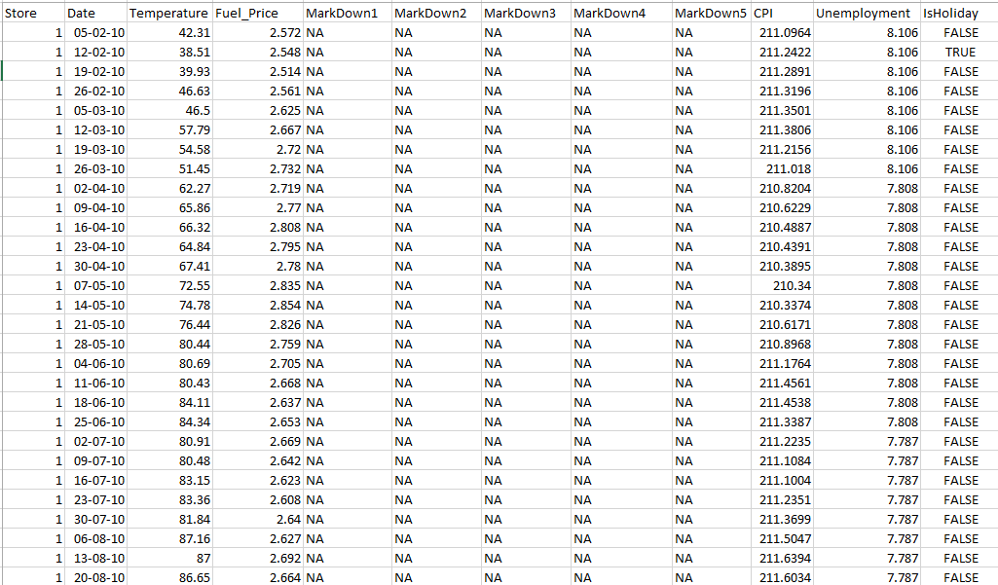
DATASET
We have taken historical sales data for 45 Walmart stores each with 98 department located in different regions. In total there are 15 predictors and 1 target(i.e. weekly sales.)

Slide 6
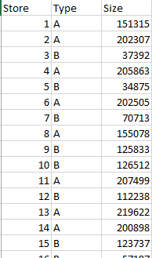
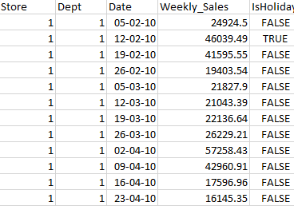

Slide 7
DATA PRE-PROCESSING
For achieving higher accuracy in predictive score our dataset should be consistent, i.e. there should be no missing or null entries.
Techniques Used:
Imputation: Handling of missing values in the data.
Conversion of categorical data into numeric data.
Extracting date

Slide 8
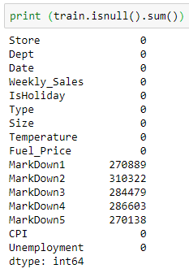
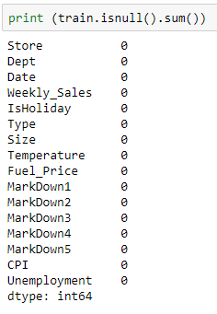
Before After

Slide 9

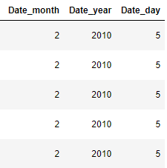
Before After

Slide 10
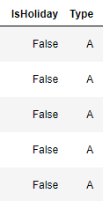
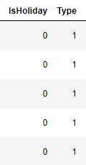
Before After

Slide 11

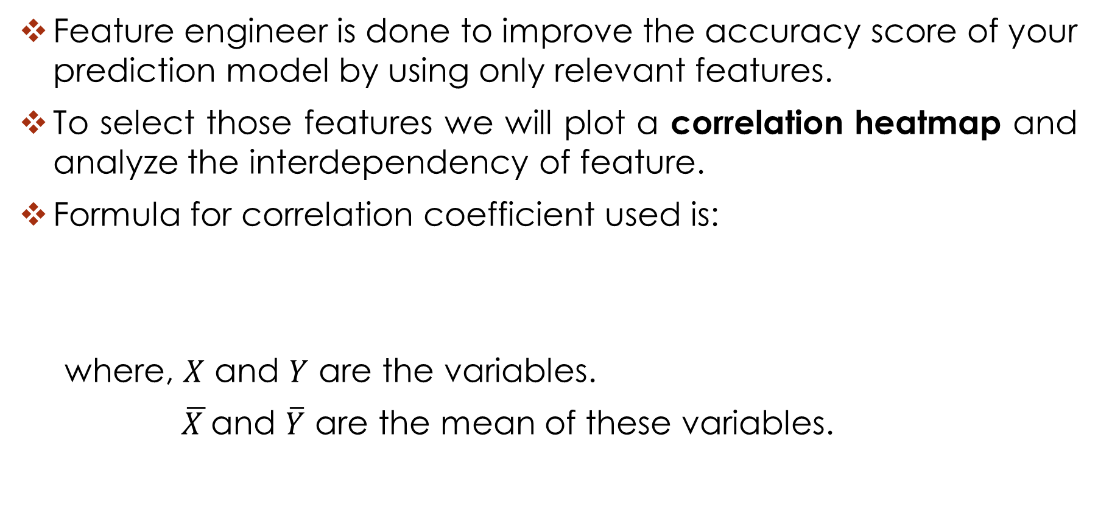
FEATURE ENGINEERING
Feature engineer is done to improve the accuracy score of your prediction model by using only relevant features.
To select those features we will plot a correlation heatmap and analyze the interdependency of feature.
Formula for correlation coefficient used is:
where, $X$ and $Y$ are the variables.
$\overline{X }$and $\overline{Y}$ are the mean of these variables.

Slide 12
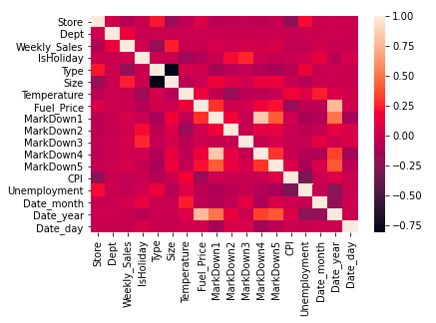

Slide 13
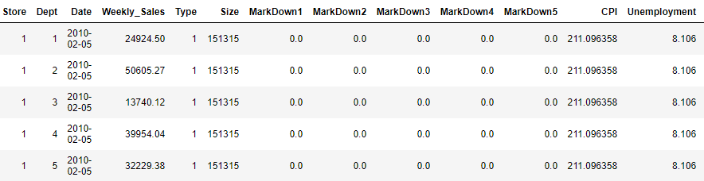
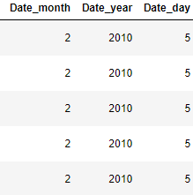
After this, we dropped IsHoliday, Temperature and Fuel Price features as they are least manipulating the weekly sales.
Final Data For Training

Slide 14
PREDICTION MODELS
For predicting the weekly sales we have use:
Linear Regression
Decision Tree
Random Forrest

Slide 15
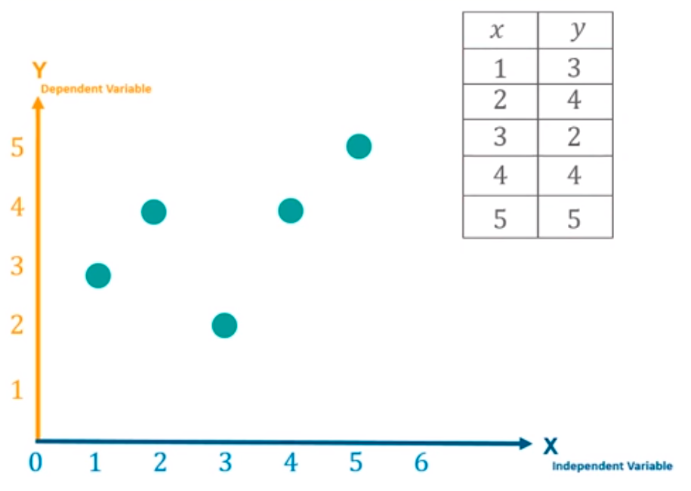
Linear Regression
Regression analysis is a form of predictive modelling technique which investigates the relation between dependent and independent variables.
Step 1: We plot all the entries of dependent and independent variables on a graph.

Slide 16
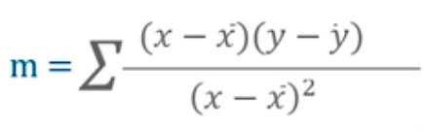
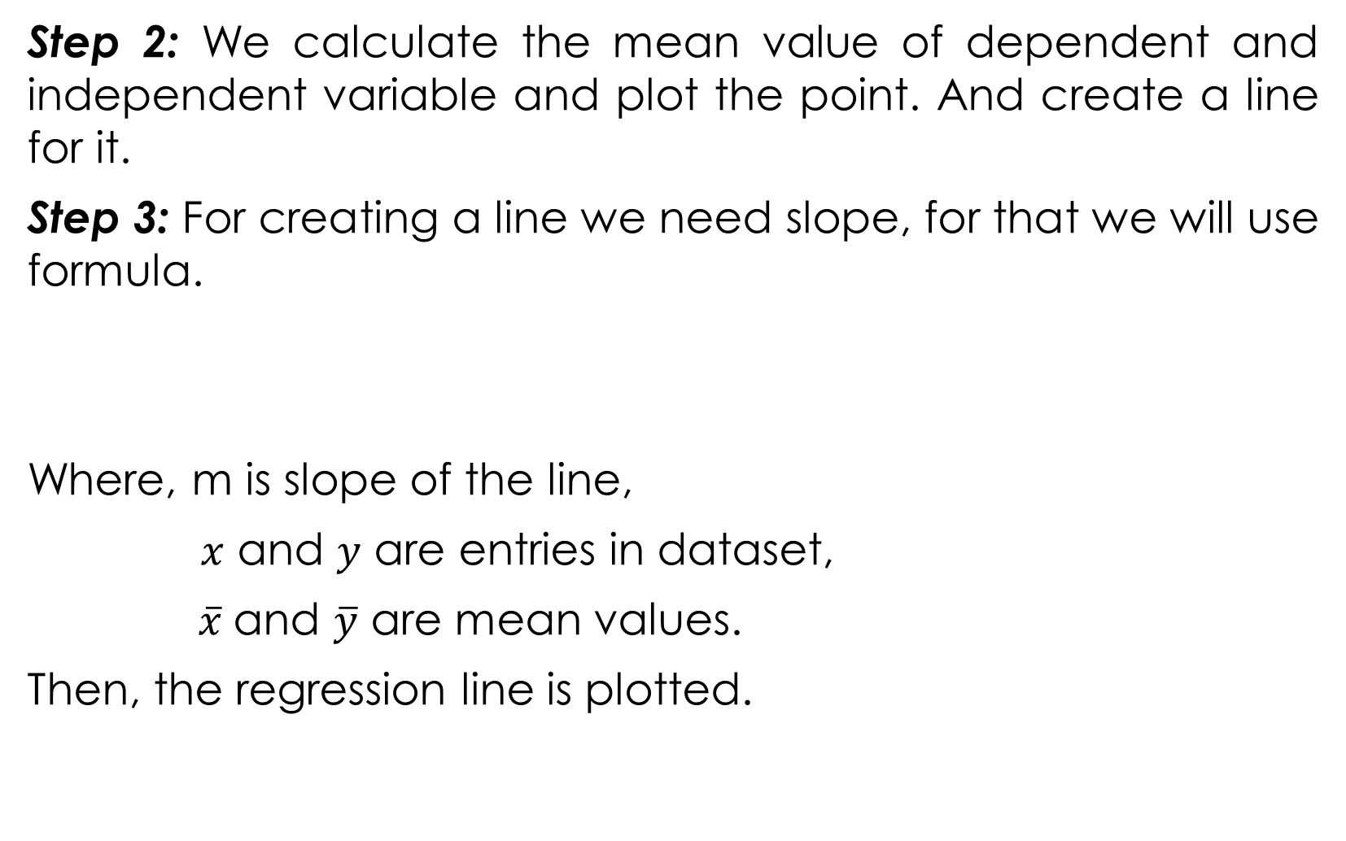
Step 2: We calculate the mean value of dependent and independent variable and plot the point. And create a line for it.
Step 3: For creating a line we need slope, for that we will use formula.
Where, m is slope of the line,
$x$ and $y$ are entries in dataset,
$\overline{x}$and $\overline{y}$ are mean values.
Then, the regression line is plotted.

Slide 17
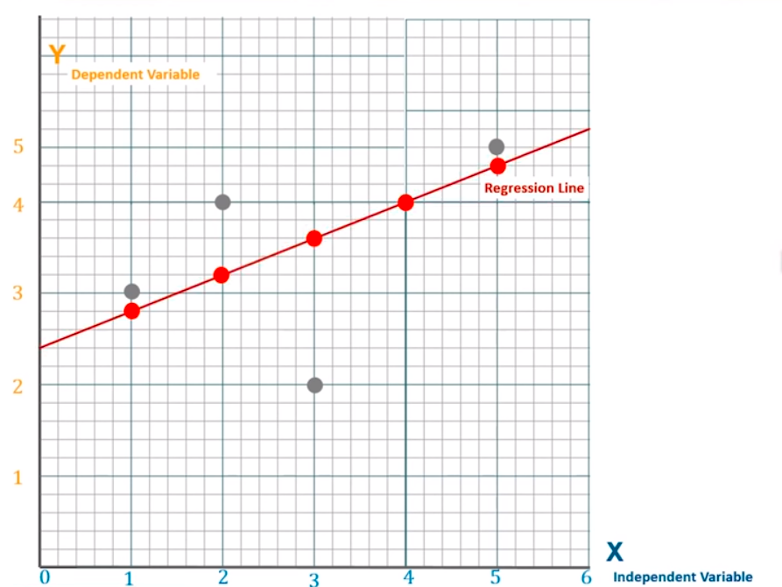
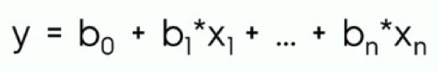
Step 4: Now, we have to minimize the distance between the actual and predicted values. For that we will plot n number of lines with different slopes and the one with the least distance from the actual values will be selected.
Formula for Linear Regression

Slide 18
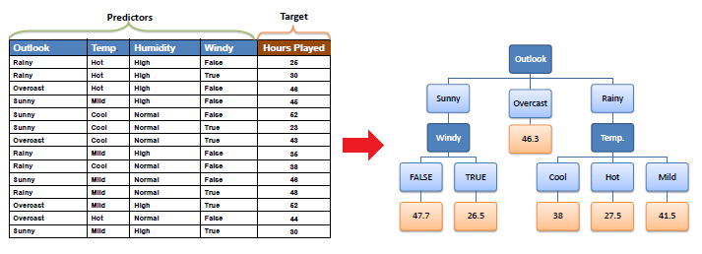
Decision Tree
A decision tree is a regression or classification model built top-down from a root node and involves partitioning the dataset into subsets that contain instances with similar values.

Slide 19
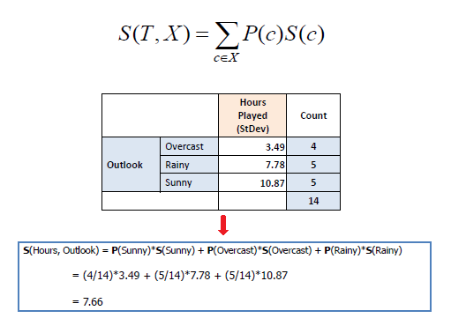
Standard deviation for two attributes
(target and predictor):

Slide 20
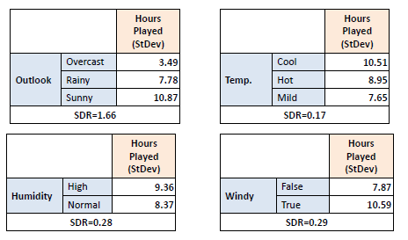
Standard Deviation Reduction
The standard deviation reduction is based on the decrease in standard deviation after a dataset is split on an attribute.
Step 1: The standard deviation of the target is calculated.
Standard deviation (Hours Played) = 9.32
Step 2: The dataset is then split on different attributes and standard deviation for each branch is calculated. The resulting standard deviation is subtracted from the standard deviation before the split.

Slide 21
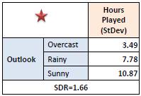
b
Step 3: The attribute with the largest standard deviation reduction is chosen for the decision node.
Step 4: The dataset is divided based on the values of the selected attribute. This process is run recursively, until all data is processed or termination criteria is met. For that we will use coefficient of deviation (CV) for a branch becomes smaller than a certain threshold (e.g., 10%) or when too few instances (n) remain in the branch (e.g., 3).

Slide 22
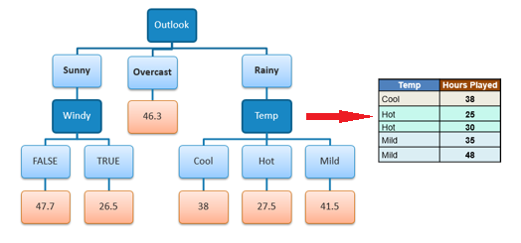
Step 5:When the number of instances is more than one at a leaf node we calculate the average as the final value for the target. Resulting into the final tree.

Slide 23
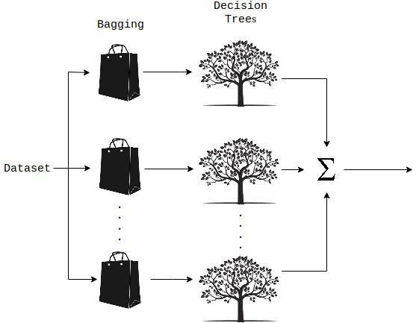
Random Forest
A Random Forest is a technique capable of performing predictions using multiple decision trees and a technique called Bootstrap Aggregation, commonly known as bagging.
Bagging involves training each decision tree on a different data sample where sampling is done with replacement.

Slide 24
Step 1: Pick at random some data points from the dataset, these will be our sampled training datasets.
Step 2: Now, train a decision tree for each sampled training dataset.
Step 3: Repeat step 1 and step 2 ‘n’ times i.e. the no. of decision trees we want to build.
Step 4: Predict the target value using the testing data for each decision tree.
Step 5: Now assign the final predicted value as the average of all the predicted value of each decision tree.

Slide 25
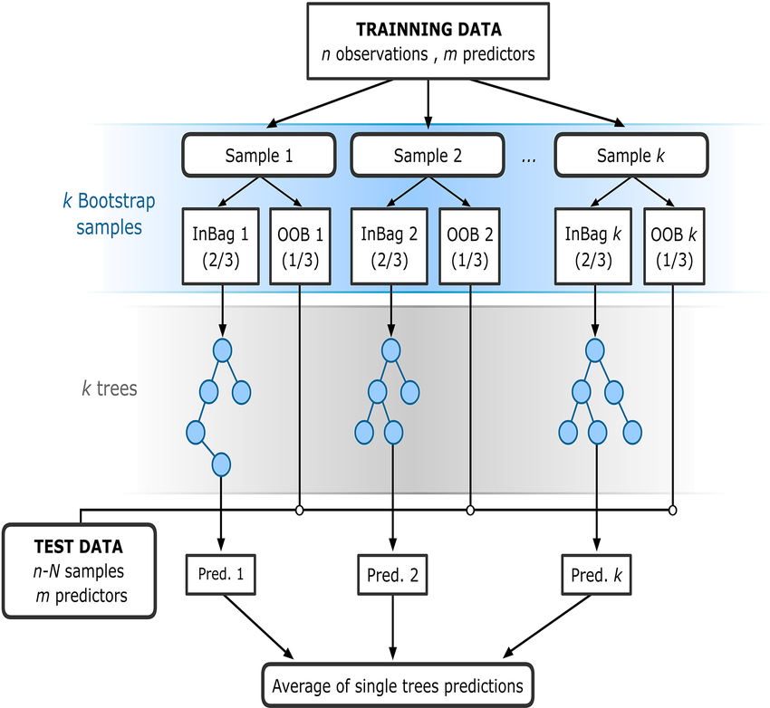

Slide 26

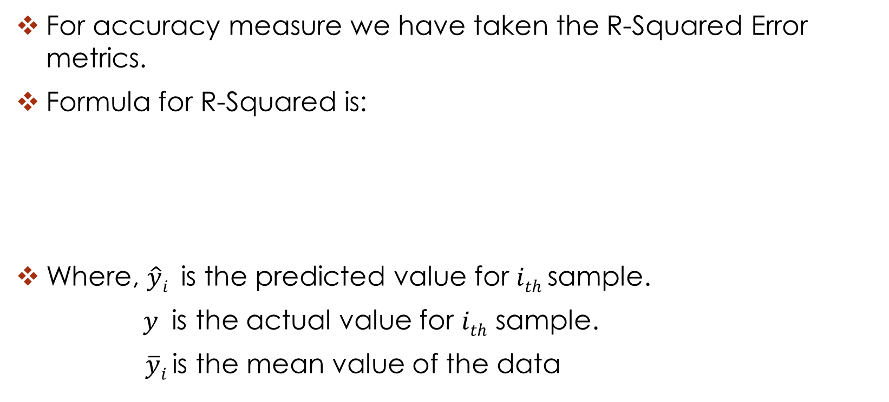
Accuracy Evaluation
For accuracy measure we have taken the R-Squared Error metrics.
Formula for R-Squared is:
Where, $\hat{y}i$is the predicted value for $ith$ sample.
$y$ is the actual value for $ith$ sample.
$\overline{y}i$ is the mean value of the data

Slide 27




Slide 28

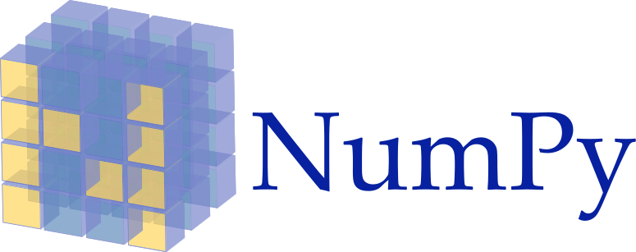



TOOLS TO BE USED
Programming Language:
Python 3.6.5
Libraries:
SKLearn
Numpy
Pandas
Matplotlib
IDE:
Jupyter Notebook

Slide 29

References
Articles-
https://towardsdatascience.com/logistic-regression-detailed-overview-46c4da4303bc
https://medium.com/@aravanshad/how-to-choose-machine-learning-algorithms-9a92a448e0df
Documentation-
https://scikit-learn.org/stable/supervised_learning.html#supervised-learning
Video Lecture-
https://www.youtube.com/watch?v=nz-FrbAa8dY
Dataset-
https://www.kaggle.com/c/walmart-recruiting-store-sales-forecasting/data

Slide 30


