Slide 1

INSTITUTE - UIE
DEPARTMENT- ACADEMIC UNIT-2
Bachelor of Engineering (Computer Science & Engineering)
Subject Name: Introduction to Problem Solving
Code:22CSH-101
EXPRESSIONS AND THEIR EVALUATION
DISCOVER . LEARN . EMPOWER

Slide 2

Course objectives
OBJECTIVES
The course aims to provide exposure to problem solving with programming
The course aims to raise the programming skills of students via logic building capability
With the knowledge of C language students would be able to model real world problems

Slide 3



Course Outcomes
CO Number | Course Outcome
CO1 | Remember the concepts related to fundamentals of C language, draw flowcharts and write algorithm/pseudocode.
CO2 | Understand the way of execution and debug programs in C language.
CO3 | Apply various constructs, loops, functions to solve mathematical and scientific problem.
CO4 | Analyze the dynamic behavior of memory by the use of pointers.
CO5 | Design and develop modular programs for real world problems using control structure and selection structure.

Slide 4
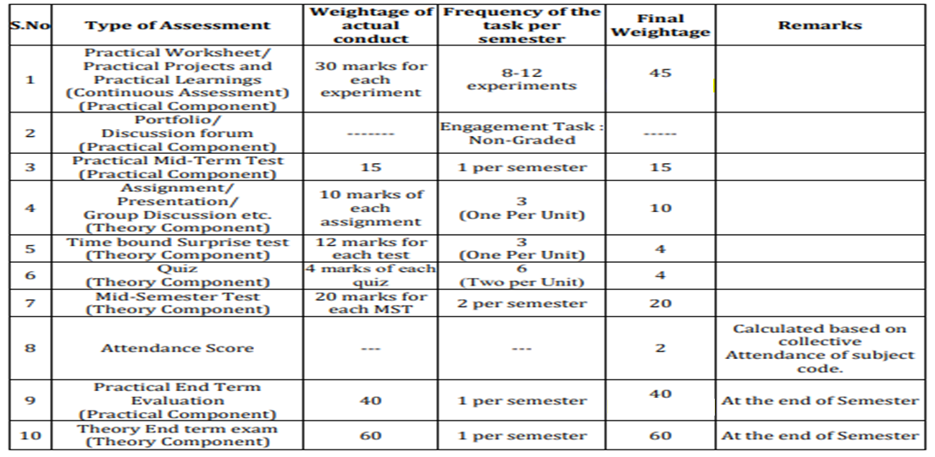
Course scheme

Slide 5
WHY ?
WHEN ?
HOW ?
To carry out the logical and mathematical operations for a problem
While writing a program these expressions are required as must constructs
Rules are there to build expressions and for their evaluation in programing

Slide 6
RESOURCES
To learn about writing expressions in c programming
To learn about the rules for solving expressions
To gain knowledge about precedence and associativity
To implement expressions in programming
LEARNING DIRECTIONS
Based on the knowledge received, students would be able to solve well and code all types of computational problems.

Slide 7
EXPRESSIONS & THEIR EVALUATION
IN
C PROGRAMMING

Slide 8
What is an Expression ?
The symbols which are used to perform logical and mathematical operations are called operators.
These C operators join individual constants and variables to form expressions.
Operators, functions, constants and variables are combined to form expressions.
Expression A + B * 5
Operators +, *
Variables A, B
Constant 5

Slide 9





Expression Examples
Expression could as simple as :
sum = num1 + num2
Example to convert mathematical equations to C expression,
$$A=πr^{2}$$
3.14*r*r
$$\frac{1}{\left(x^{2}+y^{2}\right)}$$
1 / ((x*x) + (y*y))
or
1 / (pow(x, 2) + pow(y, 2))
$$x=\sqrt{b^{2}−4ac}$$
x = sqrt((b*b) – 4*a*c)

Slide 10
LET’S LEARN……
EXPRESSION EVALUATION

Slide 11
Precedence & Associativity
The precedence of operators determines which operator is executed first if there is more than one operator in an expression.
Let us consider an example:
Int x = 35 – 5 * 6
First, 5 * 6 will execute as precedence of “*” is higher than “–” operator
5 * 6 = 30
After multiplication, the result will be used for subtraction
35 – 30 = 5
Final output : 5

Slide 12
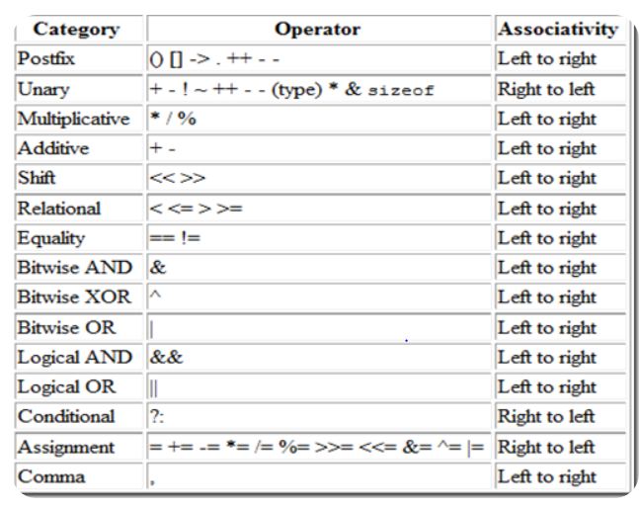
Precedence & Associativity

Slide 13
Associativity of Operators
If two operators of the same precedence (priority) are present, associativity determines the direction in which they execute.
Int x = 2 * 4 + 5 % 1
First, precedence of “*” and “%” is higher than “+” operator. Which operator you will choose ?
Confused ? let’s check associativity now, it says move from left to right.
1. First “*”
2. Second “%” than “+”
Output → 2 * 4 = 8 → 8 + 5 % 1 → 8 + 0 → 8

Slide 14
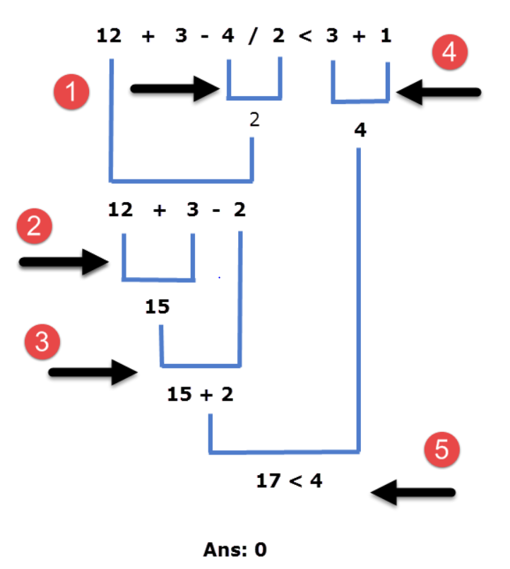
Let’s try another example ….

Slide 15
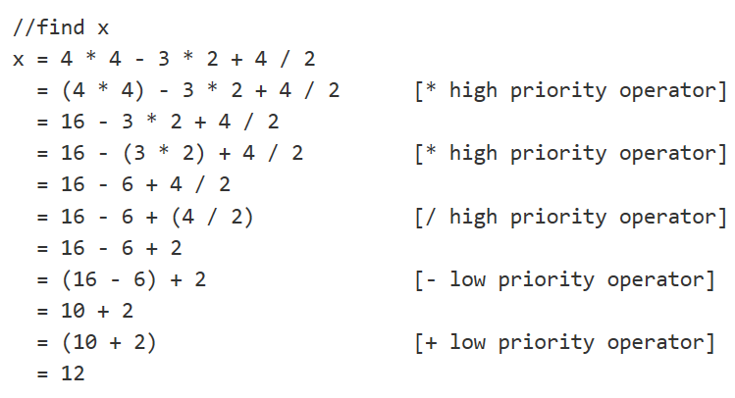

Slide 16
In a nutshell….. Let’s summarize
2
We learned about writing expressions in c language
3
Precedence and associativity rules for solving expressions
1
Implementation examples of expressions in c

Slide 17
 | Solve all these expressions….. 1. What number will z in the sample code given below? int z, x=5, y= -10, a=4, b=2; z=x++ - --y *b/a; 2. let x=1, y=2, z=3 z *= ++y + 5; 3. a) ((a+b) * c)/d; for all take a=20, b=10, c=15, d=5 b) (a+b)*(c/d); c) a + (b*c)/d;
FAQs
Try practicing these frequently asked questions based on the knowledge received from expression solving in c language…..

Slide 18
 | Write down the output ……. #include <stdio.h> int main() { int x, y = 5, z = 5; x = y == z; printf("%d", x); return 0; }
Assessment
Try practicing these frequently asked questions based on the knowledge received from expression solving in c language…..

Slide 19
 | Write down the output ……. #include <stdio.h> int main() { int i = 5, j = 10, k = 15; printf("%d ", sizeof(k /= i + j)); printf("%d", k); return 0; }
Assessment
Try practicing these frequently asked questions based on the knowledge received from expression solving in c language…..

Slide 20

DISCUSION FORUM
There are three kinds of associativity
1.The Associative property in mathematics
2.Order of Operations in programming languages
3. Associativity in CPU caches.
All these types implies the same meaning like what you have studied? What you think ?

Slide 21
references
sources | Links/description
Reference Book | [1] Kanetkar, Y. (2010). Let us C. 15th ed. [2] Thareja Reema (2014) Programming in C. 2nd ed. [3] Zed A. Shaw, Learn C the Hard Way’
Reference Website | [1] https://www.programiz.com/c-programming/precedence- associativity-operators [2] https://www.tutorialspoint.com/operator-precedence-and-associativity-in-c
Online Courses | [1] https://www.classcentral.com/course/swayam-introduction-to-programming-in-c-2486 [2] https://www.coursera.org/learn/c-for-everyone

Slide 22
THANK YOU

