Slide 1

INSTITUTE - UIE
DEPARTMENT- ACADEMIC UNIT-2
Bachelor of Engineering (Computer Science & Engineering)
Subject Name: Introduction to Problem Solving
Code:22CSH-101
Operators
DISCOVER . LEARN . EMPOWER

Slide 2

Introduction to Problem Solving
Course Objectives
The course aims to provide exposure to problem-solving through programming.
The course aims to raise the programming skills of students via logic building capability.
With knowledge of C programming language, students would be able to model real world problems.

Slide 3



Course Outcomes
CO Number | Course Outcome
CO1 | Remember the concepts related to fundamentals of C language, draw flowcharts and write algorithm/pseudocode.
CO2 | Understand the way of execution and debug programs in C language.
CO3 | Apply various constructs, loops, functions to solve mathematical and scientific problem.
CO4 | Analyze the dynamic behavior of memory by the use of pointers.
CO5 | Design and develop modular programs for real world problems using control structure and selection structure.

Slide 4
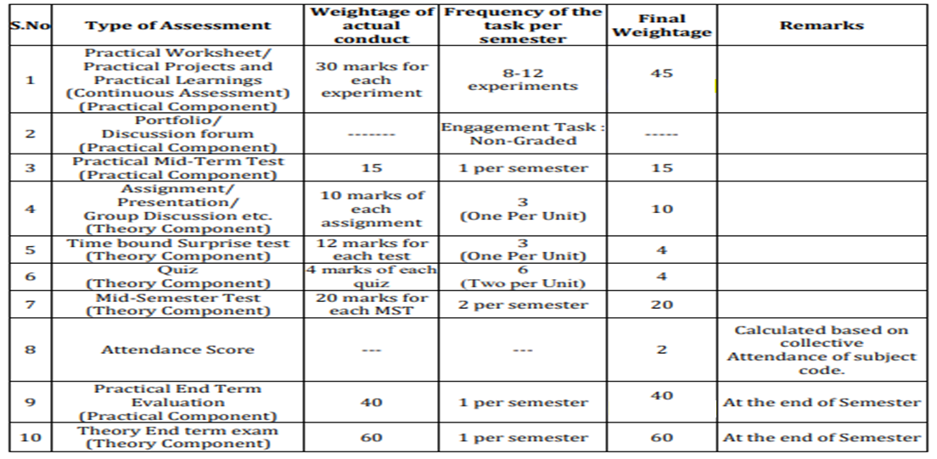
Scheme of Evaluation

Slide 5
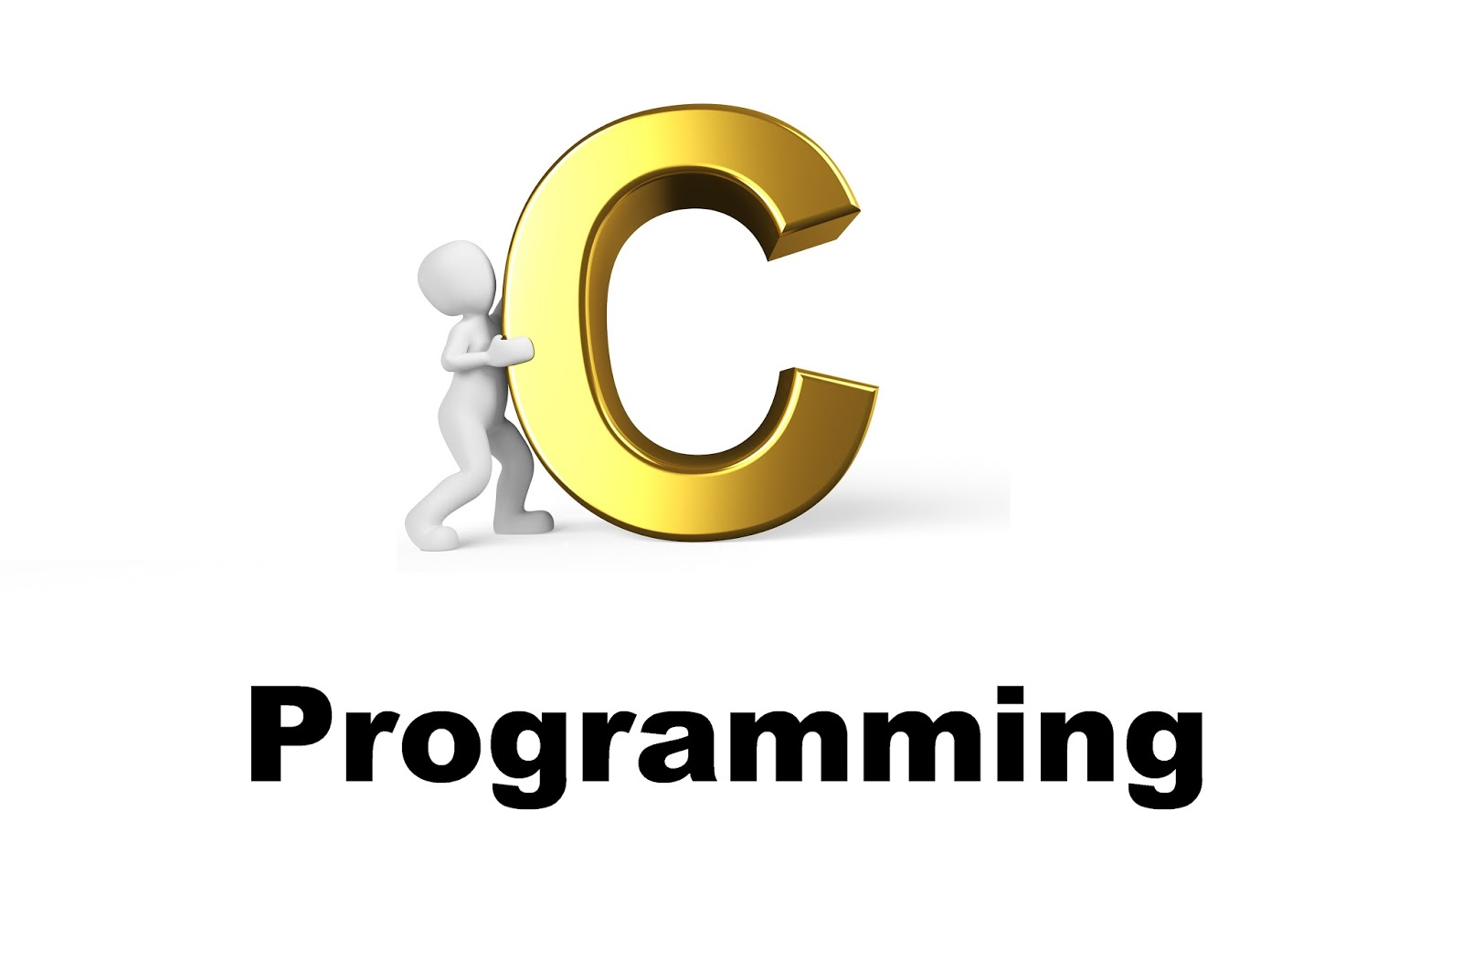
CONTENTS
Space for visual (size 24)
Arithmetic Operator
Relational Operator
Logical Operator
Assignment Operator
Increment and Decrement Operator
Conditional Operator
Misc Operator
Notes:
Computer in the diagram is 3rd generation computer. The period of third generation was from 1965-1971. The computers of third generation used Integrated Circuits (ICs) in place of transistors. A single IC has many transistors, resistors, and capacitors along with the associated circuitry. The main features of third generation are −
IC used
More reliable in comparison to previous two generations
Smaller size
Generated less heat
Faster
Lesser maintenance
Costly
AC required
Consumed lesser electricity
Supported high-level language

Slide 6
Operators
An operator is a symbol that tells the compiler to perform certain mathematical or logical manipulations.
Operators are used in program to manipulate data and variables. The data items that operators act upon are called operands.
Some operators require two operands, while others act upon only one operand. The operators are classified into unary, binary and ternary depending on whether they operate on one, two or three operands respectively.

Slide 7
Types of Operators
Arithmetic Operators
Relational Operators
Logical Operators
Assignment Operators
Increment and Decrement Operator
Bitwise Operators
Conditional Operators
Some Special Operators

Slide 8
Arithmetic Operator
C programming language provides all basic arithmetic operators: +, -, *, / and %.
Operator | Meaning
+ | Addition on unary plus
- | Subtraction or unary minus
* | Multiplication
/ | Division
% | Modulo

Slide 9
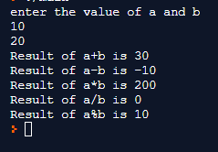
Arithmetic Operator
#include<stdio.h>
int main()
{
int a,b;
printf("enter the value of a and b");
scanf("%d %d",&a,&b); //Input the value of a and b
printf("Result of a+b is %d\n",a+b); //Addition of a and b
printf("Result of a-b is %d\n",a-b); //Substraction of and b
printf("Result of a*b is %d\n",a*b); //Multiplication of a and b
printf("Result of a/b is %d\n",a/b); // Division of A/B
printf("Result of a%b is %d\n",a%b); //Remainder of division
return 0;
}

Slide 10
Relational Operator
Relational operator compares between two operands and returns in true and false.
Operators are as follows:
Operator | Meaning
> | Greater then
< | Less then
>= | Greater then equal to
<= | Less then equal to
== | Equal to
!= | Not equal to

Slide 11
Relational Operator
#include <stdio.h>
int main(void)
{
int a,b,c;
printf("enter the value of a,b and c");
scanf("%d %d %d",&a,&b, &c);
printf("%d == %d is %d \n", a, b, a == b);
printf("%d == %d is %d \n", a, c, a == c);
printf("%d > %d is %d \n", a, b, a > b);
printf("%d > %d is %d \n", a, c, a > c);
printf("%d < %d is %d \n", a, b, a < b);

Slide 12
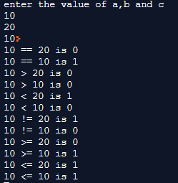
Relational Operator
printf("%d < %d is %d \n", a, c, a < c);
printf("%d != %d is %d \n", a, b, a != b);
printf("%d != %d is %d \n", a, c, a != c);
printf("%d >= %d is %d \n", a, b, a >= b);
printf("%d >= %d is %d \n", a, c, a >= c);
printf("%d <= %d is %d \n", a, b, a <= b);
printf("%d <= %d is %d \n", a, c, a <= c);
return 0;
}

Slide 13
Logical Operator
Logical operator is used to compare or evaluate logical and relational expressions.
Operators are as follows:
Operator | Meaning
&& | Logical AND
|| | Logical OR
! | Logical NOT

Slide 14
Logical Operator
#include <stdio.h>
int main()
{
int a,b,c, result;
printf("enter the value of a,b and c");
scanf("%d %d %d",&a,&b, &c);
result = (a == b) && (c > b);
printf("(a == b) && (c > b) is %d \n", result);
result = (a == b) && (c < b);
printf("(a == b) && (c < b) is %d \n", result);
result = (a == b) || (c < b);

Slide 15
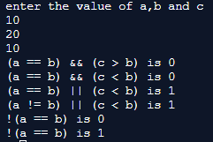
Logical Operator
printf("(a == b) || (c < b) is %d \n", result);
result = (a != b) || (c < b);
printf("(a != b) || (c < b) is %d \n", result);
result = !(a != b);
printf("!(a != b) is %d \n", result);
result = !(a == b);
printf("!(a == b) is %d \n", result);
return 0;
}

Slide 16
Assignment Operator
Assignment operators are used to assign result of an expression to a variable.
‘=’ is the assignment operator in C.
You can use assignment operator for multiple assignments as follows:
x=y=z=2;

Slide 17
Assignment Operator
#include <stdio.h>
int main()
{
int a , c;
printf("Enter the value of a");
scanf("%d",&a);
c = a;
printf("c = %d\n", c);
c += a;
printf("c = %d\n", c);

Slide 18
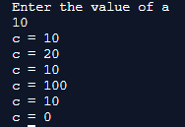
Assignment Operator
c -= a;
printf("c = %d\n", c);
c *= a;
printf("c = %d\n", c);
c /= a;
printf("c = %d\n", c);
c %= a;
printf("c = %d\n", c);
return 0;
}

Slide 19
Increment and Decrement Operator
Increment operator(++)
The increment operator ++ adds 1 to the operand.
Increment operator are of two types:
Pre increment
For example x=10; ++x; 11
Post increment
For example x=10; x++; 10

Slide 20

Pre-Increment & Pre-Decrement
#include <stdio.h>
int main()
{
int a, b;
printf("enter the value of a,b");
scanf("%d %d",&a,&b);
printf("++a = %d \n", ++a);
printf("--b = %d \n", --b);
return 0;
}

Slide 21
Increment and Decrement Operator
Decrement operator(--)
The decrement operator -- subtracts 1 from the operand.
Decrement operator are of two types:
Pre decrement
For example x=10; --x; 9
Post decrement
For example x=10; x--; 10

Slide 22

Post-Increment & Post-Decrement
#include <stdio.h>
int main()
{
int a, b;
printf("enter the value of a,b");
scanf("%d %d",&a,&b);
printf("a++ = %d \n", a++);
printf("b-- = %d \n", b--);
return 0;
}

Slide 23
Conditional Operator
Main features of Conditional operator are as follows:
There are three operands
It works from left to right.
The operator pair “?” and “:” is known as conditional operator.
Syntax: expression1 ? expression2 : expression3 ;
Condition? True part: False part
Example: a = 3 ; b = 5 ;
x = (a > b) ? a : b ;

Slide 24

Conditional Operator
#include <stdio.h>
int main()
{
int year;
printf("Enter a year to check if it is a leap year or not \n");
scanf("%d", &year);
(year%4==0 && year%100!=0) ? printf("Leap year") :
((year%400 ==0 ) ? printf("Leap Year") : printf("not a leap year"));
}

Slide 25
Conditional Operator
Use conditional operator to find greatest among three numbers

Slide 26
Special Operator
C programming supports special operators like comma operator, sizeof operator, pointer operators (& and *) and member selection operators (. and ->). We will discuss Comma operator and sizeof operator in Unit-1.

Slide 27
Comma Operator
The comma operator can be used to link the related expressions together
Evaluation of comma operator is from left to right.
For example:
x = (a = 2, b = 4, a+b)

Slide 28
Comma Operator
Example1:
#include<stdio.h>
int main()
{
int i;
i = 1,2,3;
printf("i:%d\n",i);
return 0;
}
Output:1

Slide 29
Comma Operator
Example2:
#include<stdio.h>
int main()
{
int i;
i = (1,2,3);
printf("i:%d\n",i);
return 0;
}
Output: 3

Slide 30
Sizeof Operator
The sizeof operator is usually used with an operand which may be variable, constant or a data type qualifier.
It calculates the size of data ie. how many bit a specific data is having.
Syntax: sizeof(<variable>);
Example: x = sizeof (a);

Slide 31

Sizeof Operator
#include <stdio.h>
int main()
{
int a;
float b;
double c;
char d;
printf("Size of int=%lu bytes\n",sizeof(a));
printf("Size of float=%lu bytes\n",sizeof(b));
printf("Size of double=%lu bytes\n",sizeof(c));
printf("Size of char=%lu byte\n",sizeof(d));
return 0;
}

Slide 32
Summary
Important points to remember:
C operators operates on one or more operands to produce a value.
The operators that take one operand are called unary operators.
The operators that require two operands are called binary operators.
The operator that accepts three operands is called ternary operator. C has only one ternary operator.

Slide 33
FAQ’s
Q1. Can math operations be performed on a void pointer?
Q2. Why n++ executes faster than n+1?
Q3. What is a modulus Operators in C?
Q4. What are the restrictions of a modulus operator in C?
Q5. How can we find size of a variable without using sizeof() operator?
Q6. How can we add two numbers in C language without using Arithmetic operators?

Slide 34
Assessment
Q1. Predict the output
int main()
{
int x;
x=10,20,30;
printf("%d",x);
return 0;
}
(A) 10
(B) 20
(C) 30
(D) Compilation Error

Slide 35
Assessment
Q2. [Postfix] operator has the highest precedence.
Q3. What will be the output of the C program?
#include<stdio.h>
int main()
{
int x = 2;
(x & 1) ? printf("true") : printf("false");
return 0;
}
A. Compilation error
B. true
C. false
D. Runtime error

Slide 36
Assessment
Q4. Print the output of the program
#include <iostream>
using namespace std;
int main ()
{
int x, y;
x = 2;
y = ++x * ++x;
cout << x << y;
x = 2;
y = x++ * ++x;
cout << x << y;
return 0;
}
Ans: 41649

Slide 37
Assessment
Q5. Your task is to take two numbers of int data type, two numbers of float data type as input and output their sum:Declare variables: two of type int and two of type float.Read lines of input from stdin (according to the sequence given in the 'Input Format' section below) and initialize your variables.Use the and operator to perform the following operations: Print the sum and difference of two int variable on a new line.Print the sum and difference of two float variable rounded to one decimal place on a new line.
Sample Input
10 4
4.0 2.0
Sample Output
14 6
6.0 2.0
Solve the above problem in c.

Slide 38
References
S.No | Title | Content link
1 | Book | Programming in C by Reema Thareja.
2 | Book | Programming with C (Schaum's Outline Series) by Byron Gottfried Jitender Chhabra, Tata McGraw Hill.
3 | Book | The C Programming Language by Brian W. Kernighan, Dennis Ritchie, Pearson education.
4 | Book | Programming in ANSI C by E. Balaguruswamy, Tata McGraw Hill.
5 | Weblink | https://www.tutorialspoint.com/cprogramming/c_operators.htm
6 | Weblink | https://www.programiz.com/c-programming
7 | Weblink | https://fresh2refresh.com/c-programming/

Slide 39
References
S.No | Title | Content link
8 | Weblink | https://www.studytonight.com/c/
9 | Weblink | https://www.javatpoint.com/c-operators
10 | Video Link | https://www.youtube.com/watch?v=t9WKOcRB63Q&list=PLJ5C_6qdAvBFzL9su5J-FX8x80BMhkPy1
11 | Video Link | https://www.youtube.com/watch?v=XTiIiI-LOY8&list=PLJvIzs_rP6R73WlvumJvCQJrOY3U5zq1j
12 | Online Course Link | https://www.coursera.org/
13 | Online Course Link | https://www.udemy.com/
14 | Online Course Link | https://www.niit.com/

Slide 40
THANK YOU

