Slide 1
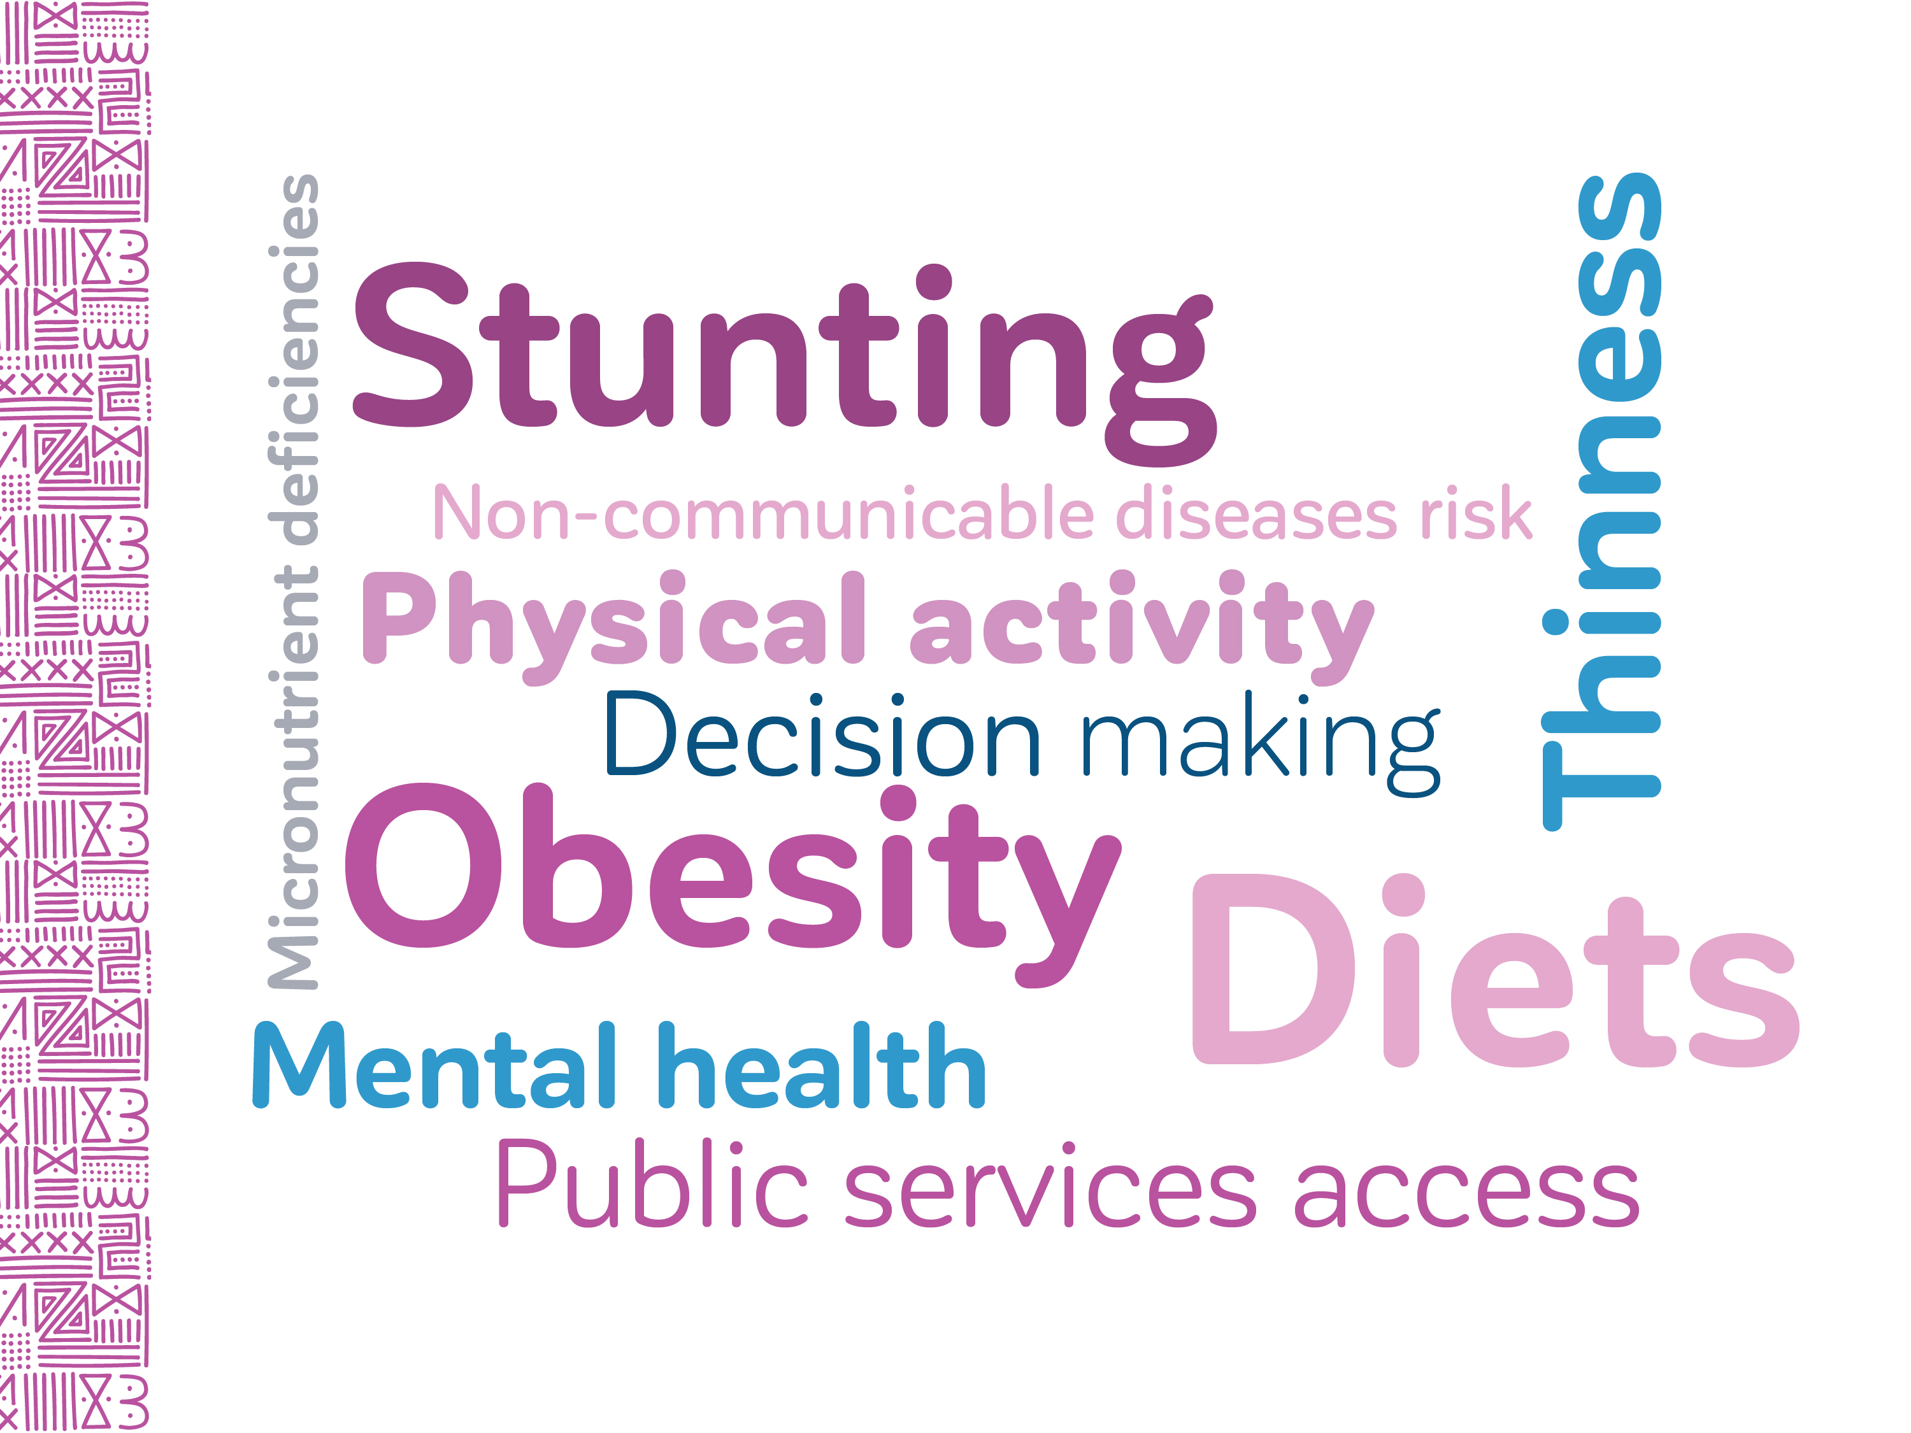
ADOLESCENTS, DIETS AND NUTRITION
Growing well in
a changing world
HIGHLIGHTS
Comprehensive National Nutrition Survey – CNNS 2016-18
First time Nutrition data on 10 to 14 year old Adolescents
Notes:
Adolescents, Diets and Nutrition: Growing well in a changing world, is based on unit level analysis of the CNNS to provide insights to support improving good diets, services and behaviours in “adolescence” 10-19 years.
In interest of time, I present the highlights from this analyses for five themes
Triple burden of malnutrition
Non-communicable diseases risk
Diets
Physical activity
School-based Services

Slide 2
VISIBLE FORMS OF MALNUTRITION
Girls and boys donot have adequate nutritional status
1 in 2 adolescents with visible malnutrition
10% have double burden
10-19 years
Girls
Boys
Notes:
Slide 4
Girls Shorter
But Boys Thinner than girls (29% vs 18% in girls)
In 28+ states atleast 30% adolescents suffer from one of the three conditions
One in 4 girls and 1 in 3 boys enter teens already too thin or too short

Slide 3
TOP-3 MICRONUTRIENT DEFICIENCIES
Girls – Vitamin D, Folate, Iron
Boys - Folate, Zinc and B12
Girls 10-19 y
(prevalence in %)
Boys 10-19 y
(prevalence in %)
Notes:
Top-3 micronutrient deficiencies in Girls are Vitamin D, Folate, Iron
In boys, its Folate, Zinc and B12

Slide 4
MULTIPLE MICRONUTRIENT DEFICIENCIES
1 out of 5 adolescents suffer from atleast 3 out of six micronutrient deficiencies – Vitamins A, B12, D; iron; zinc; folate
Percent
Notes:
At any age in 10 to 19 y 1 in 10 girls suffer from 3 micronutrient deficiencies; 1 in 3 suffer from atleast 1

Slide 5
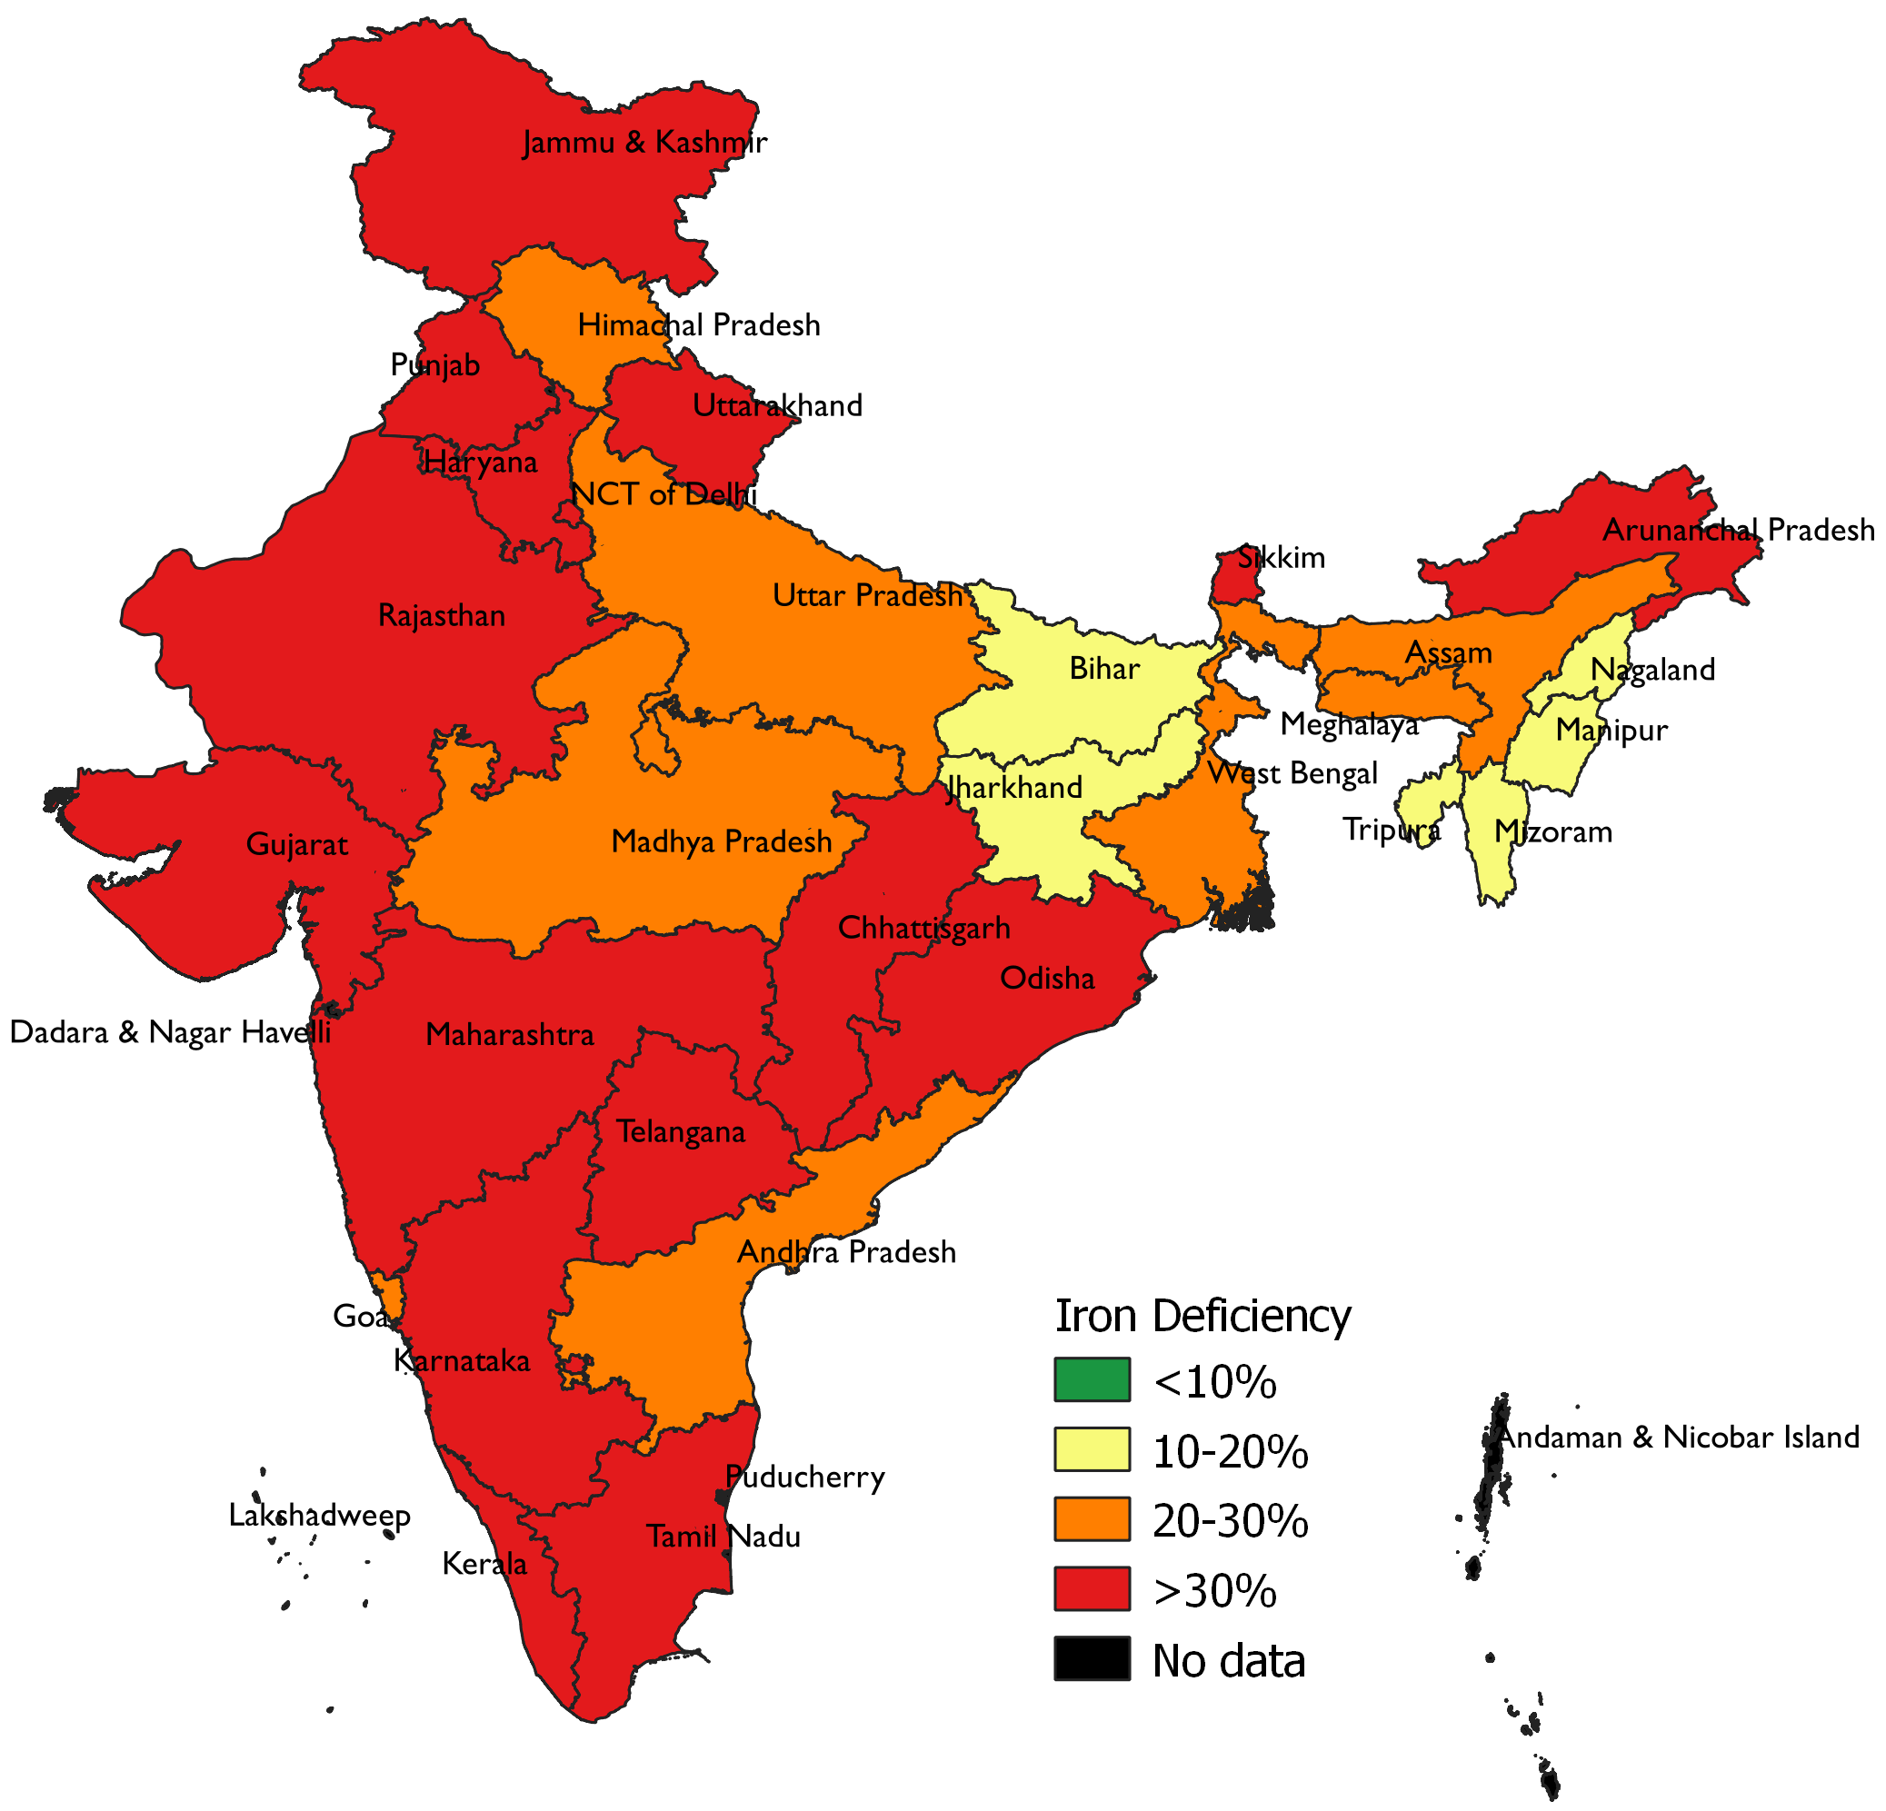
IRON DEFIENCY
Iron deficiency - a problem in girls in most states
Iron Deficiency GIRLS 10-19Y
Notes:
Iron deficiency - a problem in girls in most states

Slide 6
ANEMIA
By 12 y >=40% girls anemic
Notes:
By 12 y >=40% girls anemic
Anemia a severe problem in 12 states and moderate problem in 14 States

Slide 7
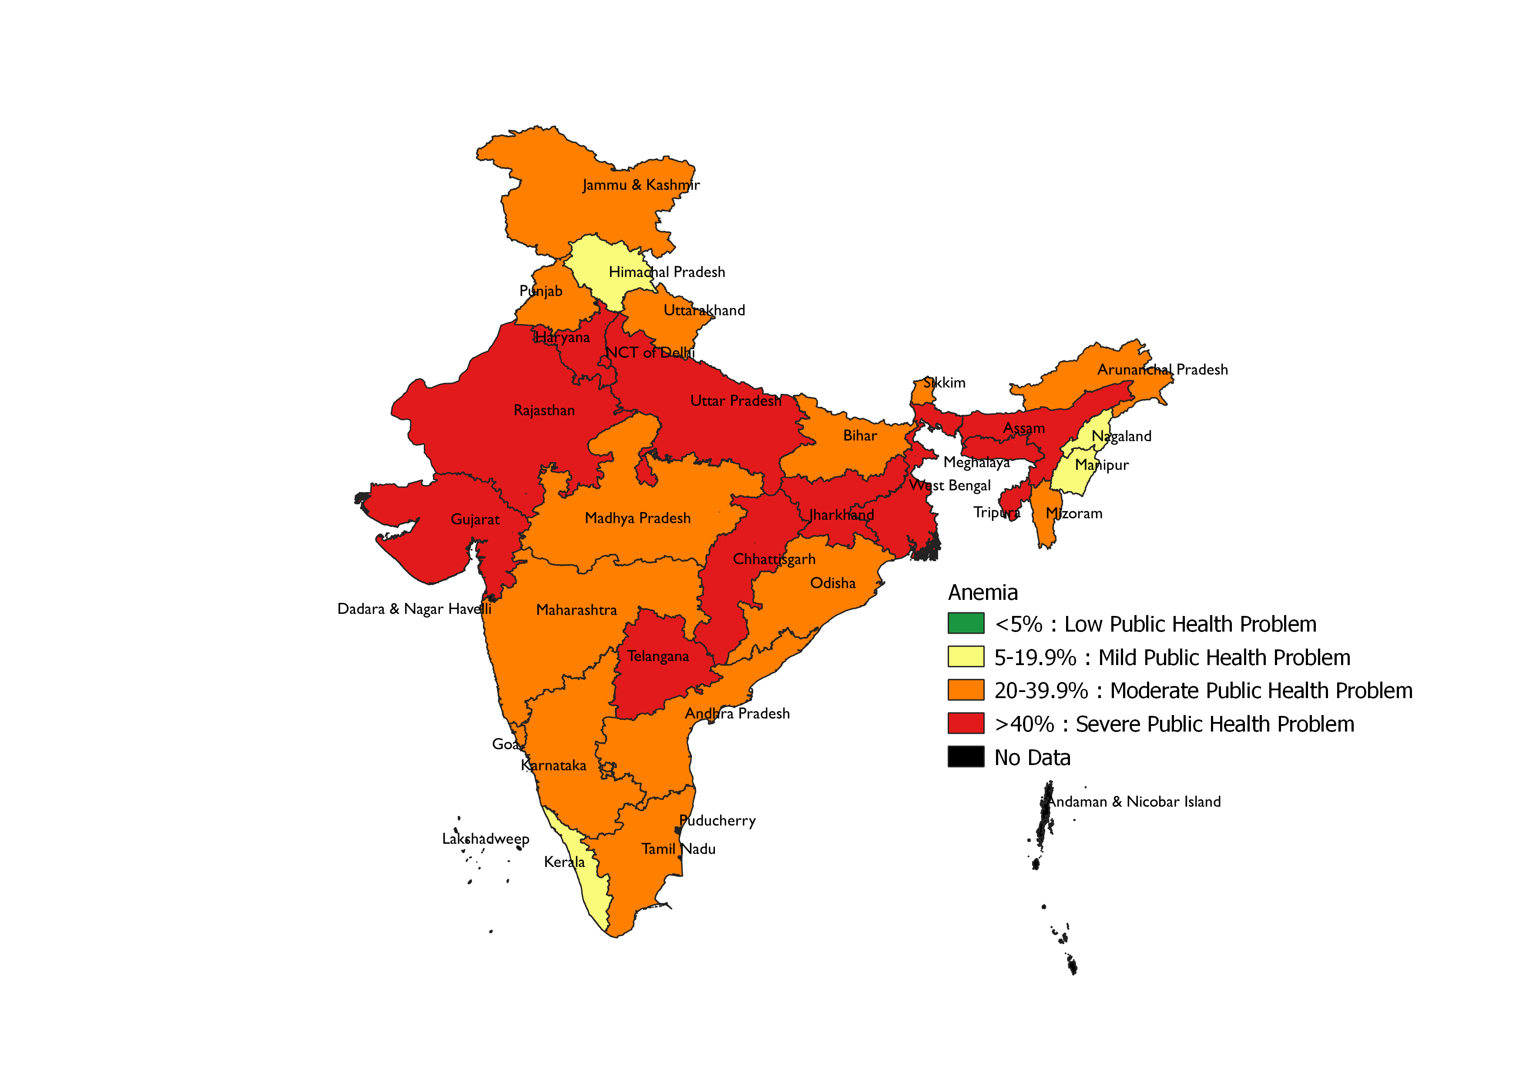
ANEMIA
Anemia in girls - severe problem 12 states
ANEMIA IN GIRLS 10-19Y
Notes:
By 12 y >=40% girls anemic
Anemia a severe problem in 12 states and moderate problem in 14 States

Slide 8
RISK OF THREE NON-COMMUNICABLE DISEASES
1 in 3 adolescents face Low “Good Cholesterol” problem – leading to Cardiovascular disease risk
1 in 10 adolescents face at least 2 risks
Notes:
Low HDL in 1 in 4 adolescents age 10; increases thereafter particularly in Boys.
1 in 10 hypertensive and with high HBA1C (which is a risk for diabetes)
1 in 10 adolescents face atleast 2 risks
Low “good Cholesterol” HDL (>=10%) in 20+ states
Notes:
Pre-diabetes is a condition resulting from lack of physical activity and being overweight/obese. A high carbohydrate diet also contributes to the risk. Pre-diabetes often leads to type 2 diabetes
Cardiovascular diseases include a range of conditions that affect the heart, which could be congenital or lifestyle related. Conditions related to lifestyle factors are more common and are a result of “unhealthy” diets, smoking, stress, excessive alcohol and caffeine intake. Diabetes and high blood pressure also contributes to increased risk of cardiovascular diseases. The early onset of lipid disorders including elevated total or LDL cholesterol levels (bad cholesterol), low levels of HDL cholesterol (good cholesterol), and high levels of triglycerides (fats) is alarming as these conditions in adolescence are predictive of elevated risk for cardiovascular disease in adulthood.
High blood pressure or hypertension is also most commonly lifestyle related. Smoking, alcohol consumption, high salt in diets, lack of physical activity and stress are contributing factors.

Slide 9
DIETS – WHAT’S MISSING FROM THE PLATE?
3 out of 5 girls and boys did not have fruit, greens and egg even once the past week.
Milk missed more in girls.
Boys 10-19 Y
Girls 10-19 Y

Slide 10
DIETS- ARE GIRLS & BOYS EATING AS RECOMMENDED?
Less than 2 out of 5 are eating body building and protective foods as per recommendations. Milk consumption higher compared to other food items
Boys 10-19 y
Girls 10-9 y
Per cent

Slide 11
UNHEALTHY FOODS
Fried Foods is the most common unhealthy food across most states and adolescents
Girls 10-9 y
Boys 10-19 y
Consumption of unhealthy foods atleast three times a week
% adolescents
Notes:
Fried Foods is the most common unhealthy food across most states Consumption of unhealthy foods atleast three times a week
X school going have fried foods

Slide 12
PHYSICAL ACTIVITY HOURS PER DAY
1. Girls spend < 30 mins and boys 45 mins.
2. Screen time increases; outdoor decreases with age in girls
Notes:
Girls spend < 30 mins and boys 45 mins.
Screen time increases; outdoor decreases with age in girls

Slide 13
SCHOOL-BASED NUTRITION SERVICES AND DIETS
3 out of 5 receive noon meal; but 1 out of 10 weekly iron folic acid supplementation. Fried foods consumed daily by 1 in 10 school-goers
Notes:
75% of adolescents are in schools
3 out of 5 receive noon meal; but 1 out of 10 weekly iron folic acid supplementation
13% have fried foods daily

Slide 14
ADOLESCENTS, DIETS AND NUTRITION
10 summary
messages
One in 10 (25 million) face double burden of malnutrition.
One in 3 children enter teens malnourished
At age 12, ≥40% girls anemic. Iron deficiency still a problem among girls
One in 5 (48 million) face ≥3 micronutrient defiencies.
Less than 2 out of 5 are eating body building and protective foods as per recommendations.
6. Less than 2 out of 5 are eating body building and protective foods as per recommendations.
7. At age 10 itself, 3% (~1 million) face Diabetes and hypertensive risk
8. Physical inactiveness - silent epidemic
9. Fried food - most common unhealthy foods. Even by school goers daily (13%) & ≥thrice a week (14%)
10. school-based services co-coverage is low (noon meals-64%; weekly IFA 12%)
Breaking intergenerational cycle of malnutrition interventions in schools and communities to be implemented with full
Coverage Continuity Intensity Quality C²IQ

Slide 15


ADOLESCENTS, DIETS AND NUTRITION
FOR EVERY ADOLESCENT @HEALTHY DIETS
CNNS was conducted with financial support from
Aditya and Megha Mittal

