Slide 1
Stock Price Prediction using
Technical Indicators
and LSTM Based Models
Submitted by Animesh Padhy (B420007)
Virag Jain (B420063)
Rohit Gupta (B420041)
Supervisor Dr. Puspanjali Mohapatra

Slide 2
INTRODUCTION
The stock market is known for its volatility,
driven by various factors such as
economic indicators, company performance
and investor sentiment.
Enhancing stock market prediction accuracy
through the application of Statistical
and Neural Network based models
leveraging technical indicators.

Slide 3
Objectives
Improve performance by leveraging Technical Indicators and Long Short-Term Memory (LSTM) based models.
Better understand and predict stock market trends.
Empower investors to make more informed decisions and optimize their strategies.

Slide 4
Literature Survey
Research paper | Journal | Dataset | Methodology | Conclusions
[1]. Stock Market Prediction with High Accuracy Using Machine Learning Techniques | ScienceDirect - Procedia Computer Science Volume 215, 2022 | Stock price data from Quandl Website and Bombay Stock Exchange (Jan 2015 - April 2021) | Comparing ML algorithms for stock prediction using data from 12 Indian companies | LSTM outperforms other algorithms with high accuracy
[2]. Financial stock market forecast using evaluated linear regression based ML technique | ScienceDirect - Measurement: Sensors, Volume 31, 2024 | S&P 500 index data from Yahoo Finance (2014 - 2024) | Data collection, preprocessing, ELR-ML analysis, decision-making, Performance evaluation | ELR-ML shows high accuracy and Reliability compared to linear regression

Slide 5
[3]. How effective is ML in stock market predictions? | ScienceDirect - Heliyon, Volume 10, Issue 2, 2024 | Daily historical data of stock market indices (2012 - 2021) | comparing 7 ML algorithms for stock indices prediction | ANN and logistic regression perform best, achieving over 70% accuracy
[4]. A comprehensive evaluation of ensemble learning for stock-market prediction | Journal of Big Data 7, 2020 | Daily stock market indices from four exchanges (2012 -2018) | Wavelet transform, Min-max normalization, constructing 25 ensemble models | Decision tree ensemble classifiers achieve highest accuracy
[5]. Forecasting stock prices of fintech companies of India using random forests with high frequency data | ScienceDirect - Journal of Open Innovation: Technology, Market, and Complexity, Volume 10, 2024 | High-frequency stock price data from Policybazaar, Paytm, Niyogin (Oct 2022 -Sep 2023) | High-frequency stock price data from Policybazaar, Paytm, Niyogin (Oct 2022 -Sep 2023) | Random Forest model demonstrates exceptional predictive capabilities

Slide 6
[6]. Stock Market Prediction Using Recurrent Neural Network | International Conference on Current Development in Engineering and Technology (CCET), 2022 IEEE | Stock data from National Stock Exchange, various companies like TATA, Microsoft, TCS, etc. | Exploring RNN and LSTM for stock market price prediction | LSTM model produces accurate results
[7]. Analysis of a Stock Exchange and Future Prediction Using LSTM | 4th International Conference on Recent Trends in Computer Science and Technology (ICRTCST-2021), 2022 IEEE | Stock data from Verizon, Netflix, Salesforce, Amazon | Applying LSTM for stock price trend analysis and prediction | LSTM aligns well with trained and predicted data.
[8]. Stock Market Prediction Using Machine Learning Techniques: Literature Review Analysis | 2023 International Conference On Cyber Management And Engineering (CyMaEn), 2023 IEEE | Paper selection using Google Scholar, methodology review | Reviewing 12 papers on ML and DL techniques for stock prediction | Various models and techniques evaluated, LSTM with sentiment analysis performs well

Slide 7
[9]. Stock Price Prediction Using Machine Learning and Deep Learning | 2021 IEEE Mysore Sub Section International Conference (MysuruCon) | Reliance Industries Limited stock data (1996 - 2021) | Data preprocessing, ARIMA, Random Forest, LSTM models | ARIMA, Random Forest, and LSTM show reliable results
[10]. Stock market prediction using machine learning classifiers and social media, news | Journal of Ambient Intelligence and Humanized Computing, Feb 2020 | Twitter for social media, Business Insider for financial news headlines, and Yahoo Finance for stock data. | Data collection, preprocessing, RF classifier and neural network analysis | RF classifier achieves high accuracy using social media and financial news
[11]. Somenath Mukherjee, Bikash Sadhukhan, Nairita Sarkar, Debajyoti Roy, Soumil De. Stock market prediction using deep learning algorithms | CAAI Transactions on Intelligence Technology 2021 | NSE stock market data (Apr 2008 - Apr 2018, Nov 2019 - Aug 2020) | Implemented ANN and CNN models. ANN used backpropagation, CNN processed 2D histograms. Models trained, tested, fine-tuned. | CNN outperformed ANN. CNN: 98.92% accuracy, ANN: 97.66%. CNN maintained 91% accuracy during COVID-19.

Slide 8
[12]. Predicting Stock Market Trends Using Machine Learning and Deep Learning Algorithms Via Continuous and Binary Data; a Comparative Analysis | IEEE Access 2020 | Tehran stock exchange (Nov 2009 - Nov 2019) | Utilized 10 years of data from four market groups. Employed continuous and binary data approaches. Utilized nine ML methods and two deep learning algorithms. Parameters were fine-tuned for optimization. | Evaluated using F1-Score, Accuracy, and ROC-AUC. RNN and LSTM outperformed other models. Binary data improved performance significantly.
[13]. Stock Market Prediction Using Machine Learning Techniques: A Decade Survey on Methodologies, Recent Developments, and Future Directions | MDPI 2021 | Market data (historical price-related numerical data) and textual data (sentiment analysis) | Conducted systematic literature review. Analyzed collected literature for insights. | Evaluated using accuracy, MSE, AUC, and Precision. SVM was popular, while ANN and DNN emerged as favored techniques.Integration of data improved accuracies.

Slide 9
[14]. An Efficient Decision Support System for Stock Market Prediction using Technical Indicators as Features by Machine Learning Approaches | 2023 4th International Conference for Emerging Technology (INCET), IEEE 2023 | Daily data for NIFTY Index, Reliance, and TCS stocks (June 2017 - June 2022) | Six technical indicators: Force Index, Williams%R, Relative Strength Index, Rate of Change, Momentum and Average True Range used as features for ML models and DNN | Mean accuracies: KNN (73.4%), CART (72.72%), Naive Bayes (70.08%), SVM (72.7%), DNN (72.53%) for Reliance. KNN best for TCS.

Slide 10
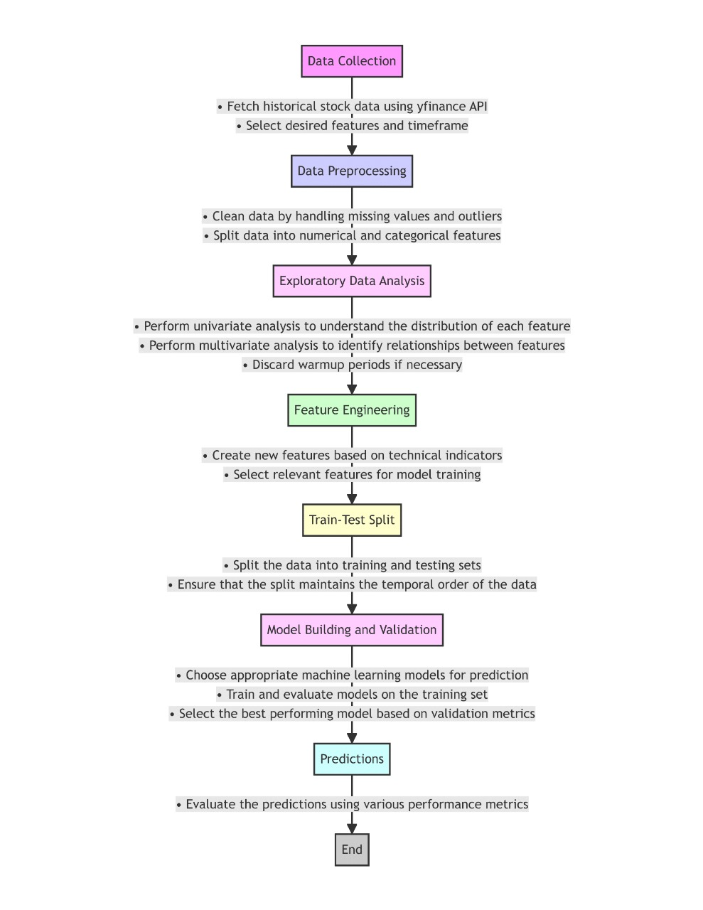
\
Workflow

Slide 11
Data Set
NIFTY 50 (NSEI)
SENSEX (BSESN)
Time Span: September 17, 2007, to May 13, 2024
Total Years: Nearly seventeen years
Features: Includes Open, High, Low, and Close prices, as well as Volume for each trading day. Captures long-term trends, seasonal fluctuations, and other patterns influencing market behavior over time
Time Span: July 1, 1997, to May 13, 2024
Total Years: Over twenty-six years
Features: Includes Open, High, Low, and Close prices, as well as Volume for each trading day. The attributes reflect daily trading activity, capturing price movements and liquidity of the BSE SENSEX index. Each observation represents a single trading day, with 'Date' serving as the index.

Slide 12
Data Preprocessing
Warm-up Period in Data Prep
During data prep, we use a warm-up period to kick things off right, especially in financial analysis. We toss out the initial parts of our data to ensure what we analyze is consistent and reliable. This helps our predictions be more accurate and prevents our models from overfitting.
Volume Metric in Data Analysis
The Volume column in datasets often contains outliers and zero values, which could indicate errors or missing data. Since Volume reflects trading activity, not stock prices, it's crucial for market analysis. Technical indicators like the Force Index heavily rely on Volume, so inaccuracies here can affect analysis reliability. Filtering out entries where Volume is zero helps refine the dataset for better analysis and prediction.
\

Slide 13
Exploratory Data Analysis
Multivariate Analysis:
Correlation Matrix Heatmap: Displays pairwise correlations between features, aiding in pattern identification and model development.
Interdependencies Among Variables: Helps understand complex relationships, aiding in feature selection and model interpretation.
\

Slide 14
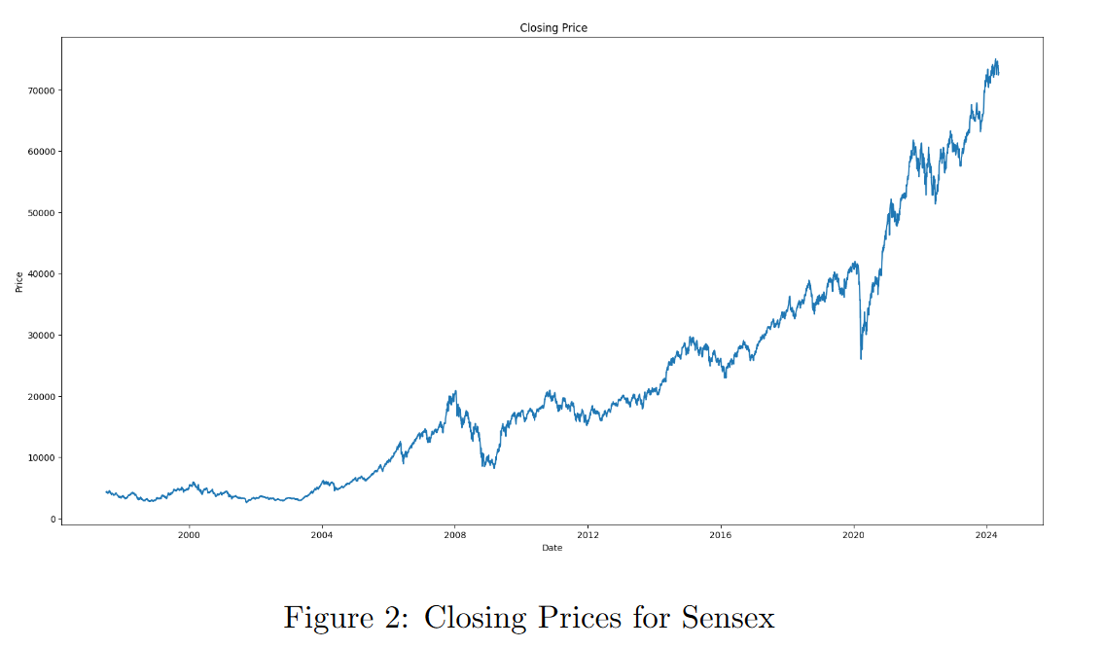
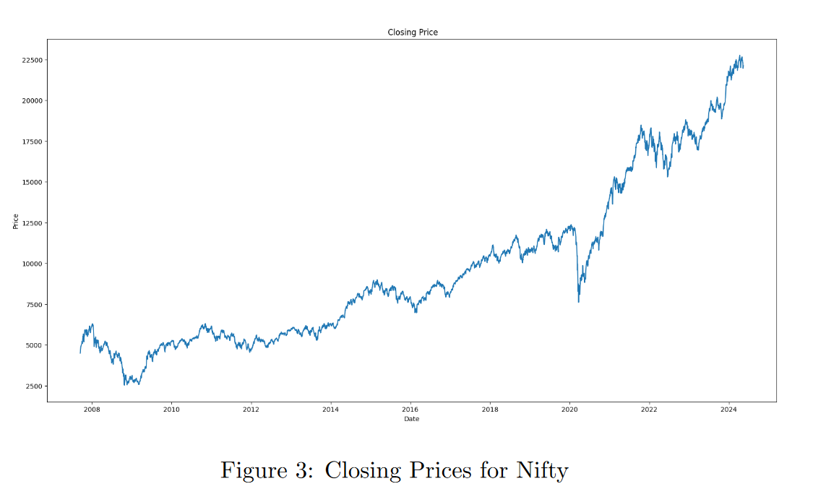
Exploratory Data Analysis
\

Slide 15
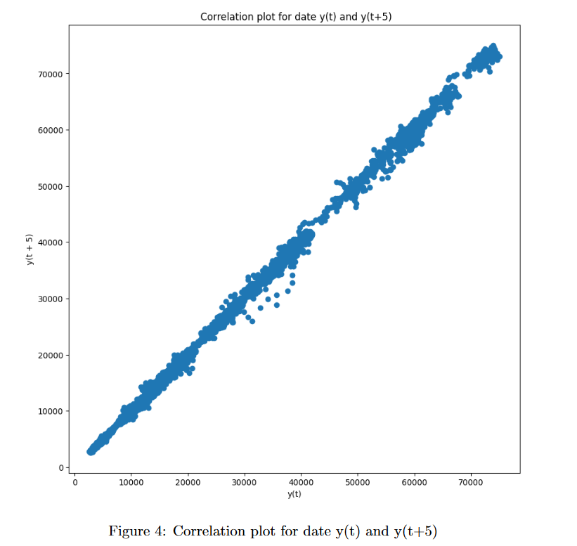
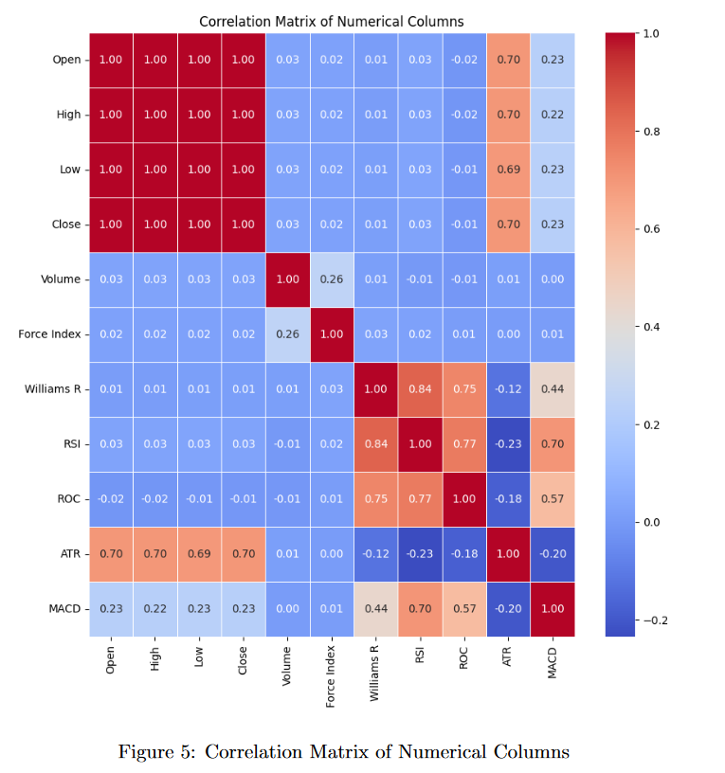
Exploratory Data Analysis
\

Slide 16
Data Labelling
The dataset is divided into training and testing sets, comprising initial 80% and latest 20% of the data, respectively.
This division ensures that the model learns from historical data while being evaluated on unseen data.
Training on historical data helps the model understand market patterns, while testing on unseen data evaluates its predictive performance
This ensuring effectiveness in forecasting future stock prices.
\

Slide 17
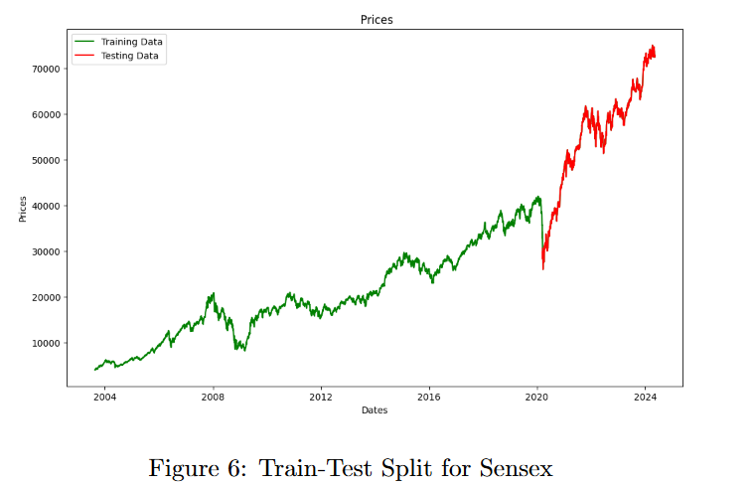
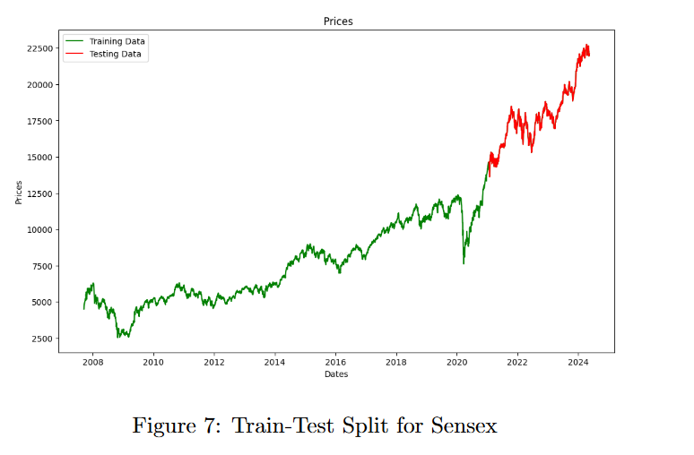
Data Labelling
\

Slide 18
Feature Engineering
Force Index | The Force Index combines price action and volume into a single value to the strength of price movements. ForceIndex = Volume ∗ (Close − PreviousClose)
Williams Percent Range | Williams %R measures overbought/oversold levels based on closing prices, helping traders identify potential reversal points. %R = (HighestHigh − Close)/(HighestHigh − LowestLow) ∗ −100
Relative Strength Index | RSI is a momentum oscillator that measures the speed and change of price movements, indicating overbought or oversold conditions. RSI = 100 − (100/(1 + RS)) { RS = Average Gain / Average Loss}

Slide 19
Feature Engineering
Rate of Change | ROC measures the percentage change in price over a specific period, indicating the momentum of price movements. ROC = ((Close − Closenperiodsago)/Closenperiodsago) ∗ 100
Average True Range | ATR measures market volatility by calculating the average range between high and low prices over a specific period AT R = (1/N ) ∗∑ X(High − Low)
Moving Average Convergence Divergence | MACD is a trend-following momentum indicator that shows the relationship between two moving averages of an asset’s price. MACD = 12dayEMA − 26dayEMA

Slide 20
Feature Selection
Backward feature elimination based on correlation with dependent variable

Slide 21
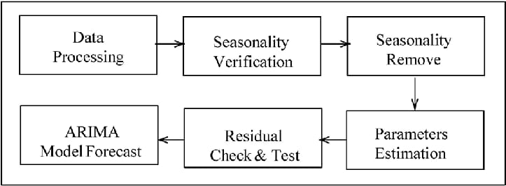
Applied algorithms
1. AutoRegressive Integrated Moving Average
\

Slide 22
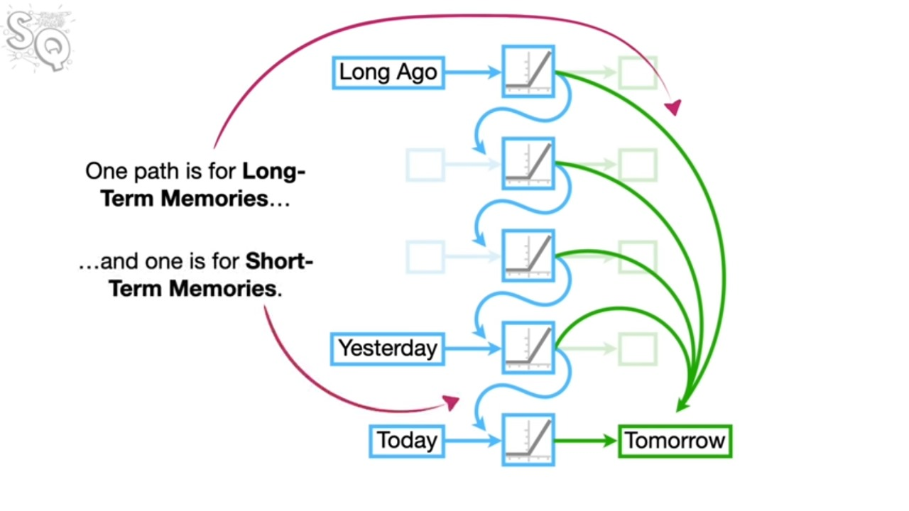
Applied algorithms
2. Long Short-Term Memory
\

Slide 23
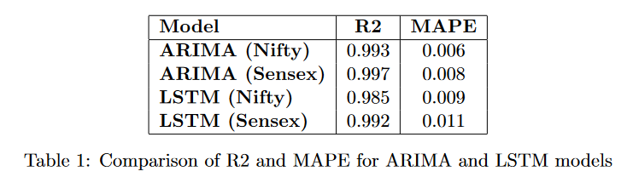
Experimental Results and Discussions
1. Performance Metrics
R2 and MAPE are used for evaluating the performances of ARIMA and LSTM models
Predictions. R2 evaluates how well independent variables explain the dependent variable's variability, while MAPE measures prediction accuracy by comparing actual and predicted values' percentage difference.
\

Slide 24
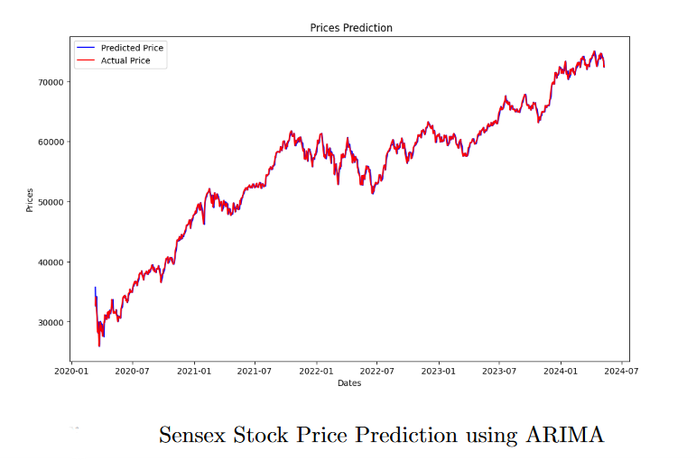
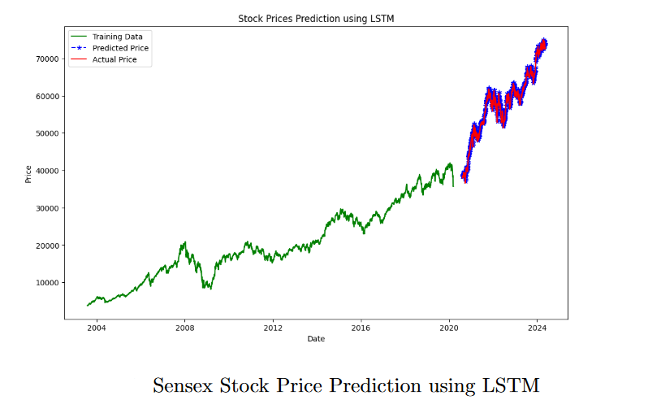
Experimental Results and Discussions
2. Performance Visualization
\

Slide 25
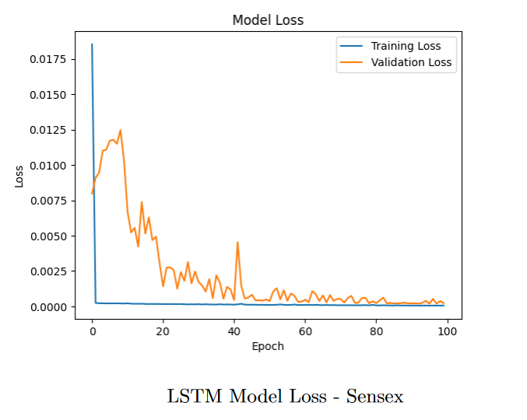
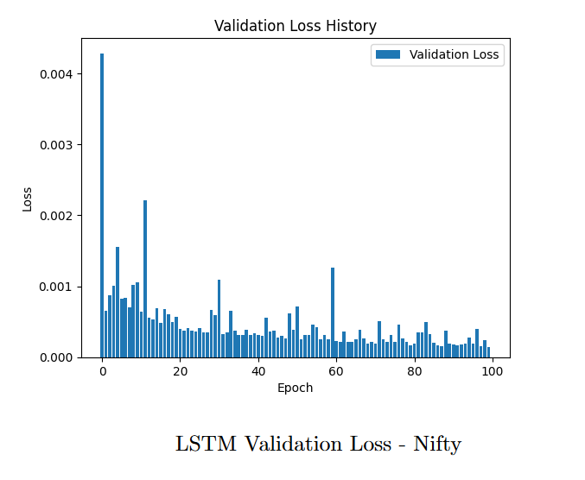
Experimental Results and Discussions
3. Performance and Loss Evaluation
\

Slide 26
Future Scope
Explore ensemble methods like Boosting for improved accuracy.
Investigate Recurrent Neural Networks and hybrid models for complex pattern recognition.
Optimize models for financial time series data to enhance performance.
Incorporate news sentiment analysis and social media data for a comprehensive view.
Consider alternative datasets to augment existing data sources.
Further research on classification-based price prediction for practical decision-making.
\

Slide 27
Conclusion
\
Explored ARIMA and LSTM models for stock price prediction.
Acknowledged the limitations of relying solely on technical indicators.
Highlighted the need for incorporating fundamental factors and alternative datasets.
Suggested framing price prediction as a classification problem for actionable insights.

Slide 28
Thank You!

