Slide 1


CORBA
Common Object Request Broker Archietecture

Slide 2
AIM
To connect devices from different platforms
Example : Java(server) and C(client)
We can achieve this via an object
In our case its an ORB object

Slide 3
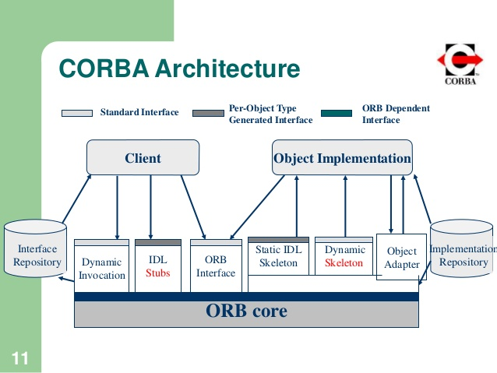

Slide 4
Create folder or a project as CorbaAdditionServer
Then create a file Addition.idl
module AdditionApp{
interface Addition{
long add(in long a,in long b);
oneway void shutdown();
};
};
Command idlj -fall Addition.idl

Slide 5
class AdditionObj extends AdditionPOA {
private ORB orb;
public void setORB(ORB orb_val) {
orb = orb_val;
}
// implement add() method
public int add(int a, int b) {
int r=a+b;
return r;
}
// implement shutdown() method
public void shutdown() {
orb.shutdown(false);
}
}
Create a class named AdditionObj in src folder
import AdditionApp.*;
import org.omg.CosNaming.*;
import org.omg.CosNaming.NamingContextPackage.*;
import org.omg.CORBA.*;
import org.omg.PortableServer.*;
import org.omg.PortableServer.POA;
import java.util.Properties;

Slide 6
import AdditionApp.*;
import org.omg.CosNaming.*;
import org.omg.CosNaming.NamingContextPackage.*;
import org.omg.CORBA.*;
import org.omg.PortableServer.*;
import org.omg.PortableServer.POA;
import java.util.Properties;
public class StartServer {
public static void main(String args[]) {
try{
// create and initialize the ORB //// get reference to rootpoa &amp; activate the POAManager
ORB orb = ORB.init(args, null);
POA rootpoa = POAHelper.narrow(orb.resolve_initial_references("RootPOA"));
rootpoa.the_POAManager().activate();
// create servant and register it with the ORB
AdditionObj addobj = new AdditionObj();
addobj.setORB(orb);

Slide 7
// get object reference from the servant
org.omg.CORBA.Object ref = rootpoa.servant_to_reference(addobj);
Addition href = AdditionHelper.narrow(ref);
org.omg.CORBA.Object objRef = orb.resolve_initial_references("NameService");
NamingContextExt ncRef = NamingContextExtHelper.narrow(objRef);
NameComponent path[] = ncRef.to_name( "ABC" );
ncRef.rebind(path, href);
System.out.println("Addition Server ready and waiting ...");
// wait for invocations from clients
for (;;){
orb.run();
}
}
catch (Exception e) {
System.err.println("ERROR: " + e);
e.printStackTrace(System.out);
}
System.out.println("HelloServer Exiting ...");
}
}

Slide 8
Run the command in cmd
start orbd -ORBInitialPort 1050
Then in configuration in Java Application
In arguments , set program argument as
-ORBInitialPort 1050 -ORBInitialHost localhost
Or
javac StartServer.java
java StartServer.class -ORBInitialPort 1050 -ORBInitialHost localhost

Slide 9
Similarly create a new project for the client side as CorbaAdditionClient etc.
Copy the AdditionApp package from the previous project
Now under default packages create a Java File StartClient.java

Slide 10
import java.util.Scanner
import org.omg.CORBA.ORB;
import org.omg.CosNaming.NamingContextExt;
import org.omg.CosNaming.NamingContextExtHelper
import AdditionApp.Addition;
import AdditionApp.AdditionHelper;
public class StartClient {
/**
* @param args the command line arguments
*/
public static void main(String[] args) {
try {
ORB orb = ORB.init(args, null);
org.omg.CORBA.Object objRef = orb.resolve_initial_references("NameService");
NamingContextExt ncRef = NamingContextExtHelper.narrow(objRef);
Addition addobj = (Addition) AdditionHelper.narrow(ncRef.resolve_str("ABC"));

Slide 11
Scanner c=new Scanner(System.in);
System.out.println("Welcome to the addition system:");
for(;;){
System.out.println("Enter a:");
String aa = c.nextLine();
System.out.println("Enter b:");
String bb = c.nextLine();
int a=Integer.parseInt(aa);
int b=Integer.parseInt(bb);
int r=addobj.add(a,b);
System.out.println("The result for addition is : "+r);
System.out.println("-----------------------------------");
}
}
catch (Exception e) {
System.out.println("Hello Client exception: " + e);
e.printStackTrace();
}
}
}

Slide 12
Then in configuration in Java Application
In arguments , set program argument as
--ORBInitialPort 1050 -ORBInitialHost localhost
Or
javac StartClient.java
java StartClient.class -ORBInitialPort 1050 -ORBInitialHost localhost

