Slide 1
LIBMATE
Our one stop solution to library management

Slide 2
Problem statement
Build a Library Management System of Andaman college
Automatically categorize the books in the library based on information about them extracted from the web.
But why? What’s the underlying problem?
Notes:
Let’s take a step back and try to understand why this problem statement exists.

Slide 3
Proposed Deliverables
Automated tag generation for books as they arrive at the library doorstep (via advanced web scraping and reinforcement learning models)
Recommender system that operates on the reading habits of every visitor, to tailor for your experiences (by understanding the features and semantics of every book)
Personal speech assistant to take you on an excursion from aisle to aisle, leading you to books that you and your peers have loved.

Slide 4
The Tagger
Segment-1

Slide 5
Book Tagging (Category)
Our model learns from a variety of input parameters like the Name, Author, Publisher, Publish Date and the Summary of the book.
If the tags are directly found online, it scrapes and assigns tags automatically.
For books which do not have tags directly available, the tags are generated by using the tags of related books found by performing a k-Nearest Neighbours pass.
This way new books can also be easily tagged even if information about them online is insufficient.

Slide 6
The Vector Tag
If exact tag matching does not work, Vector Space embeddings are a good idea for fuzzy matching.
For this, we can use the last but one layer of our tag generation model.
Dot product of this vector with certain query vectors will give us the cosine similarity.
(This helps us do the k-nearest neighbours for unknown books)

Slide 7
Hierarchical Book Tagging
Science
Physics
Optics
Mechanics
Chemistry
Stoichiometry
We maintain a tree of tags which get hierarchically clustered to form more general tags. We use decision trees on our target parameters to output the tag set as a confidence vector.

Slide 8
The Recommender
Segment-2

Slide 9
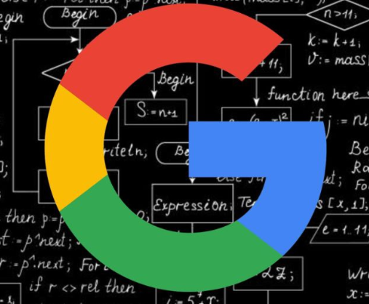
Our “BookRank” algorithm
We believe that your reading habits are best modeled as a walk in a directed graph, where the edges indicate transition probability of switching from your current book to the next.
The probability values can be learnt by the model live in action using a technique isomorphic to Value Iteration (Q-Learning).
The idea is inspired by Google’s PageRank (Brin, Page, ‘98), that’s how you would stably index the web, we hope to convert that to books.

Slide 10
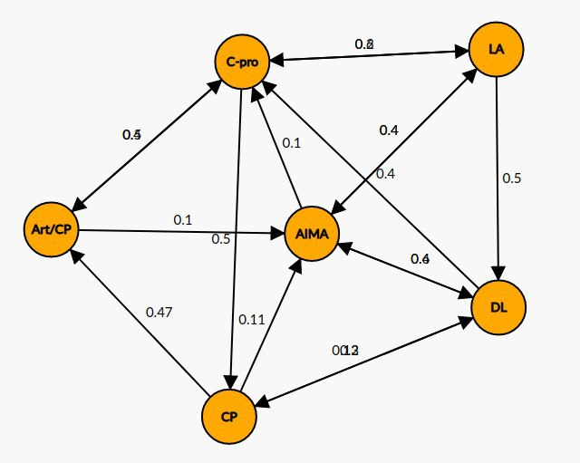
Peer based Probability Nets
We maintain a transition probability graph from each book to the next (Markov model).
We get a measure of “popularity” of each book from the stable state of the Graph.
A measure of “difficulty” is also obtained from the expected length of reaching a node.

Slide 11
The Talker
Segment-3

Slide 12
Why Voice?
It’s conveniently delivered to every phone. No extra app installs.
It’s a lot easier for a user to tag something interesting he sees, reads, or hopes to read.

Slide 13
Our three basic tenets
Smart
State of the art ML techniques to ensure our inferences and recommendations are almost always accurate and interesting.
Seamless
Have a precise question if you need answered. It’s just one voice command away. Have a generic exploratory request. Same thing.
Systematic
Integrates administrative, teacher, student needs together into a single system

