Slide 1

Decentralized Voting System Using Blockchain
A decentralized application to help the nation conduct an election
that is secure and convenient.

Slide 2
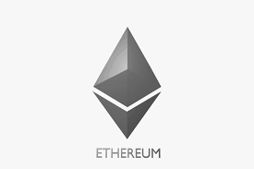
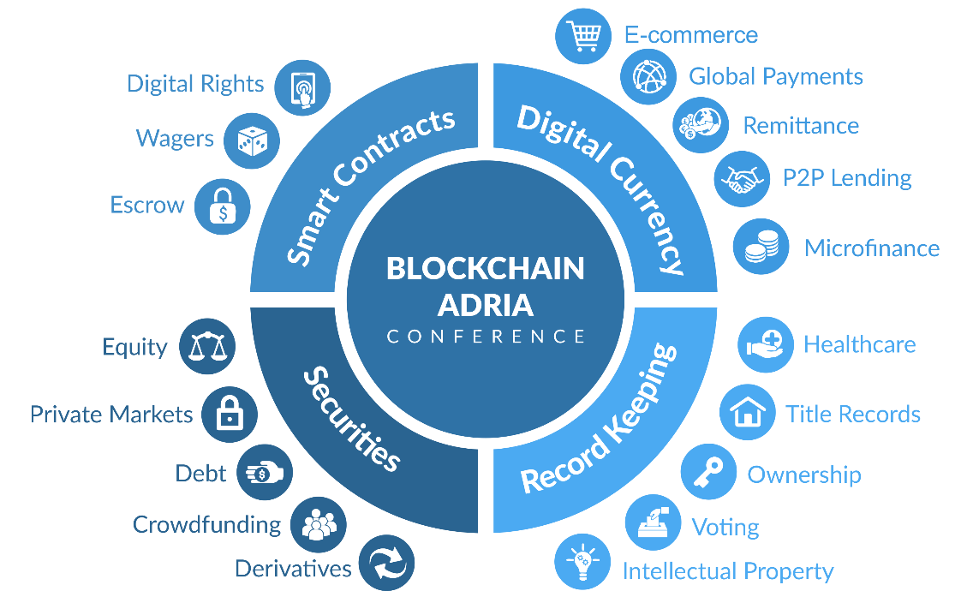
What is Block-chain?
The blockchain is an undeniably ingenious invention that works by allowing digital information to be distributed but not copied, blockchain technology created the backbone of a new type of internet. Originally devised for the digital currency, Bitcoin, the tech community is now finding other potential uses for the technology.
Ethereum is a public, open-source, Blockchain-based distributed software platform that allows developers to build and deploy decentralized applications. It is a decentralized system, which means it utilizes a peer-to-peer approach. It supports a modified version of Nakamoto consensus via transaction-based state transitions.

Slide 3
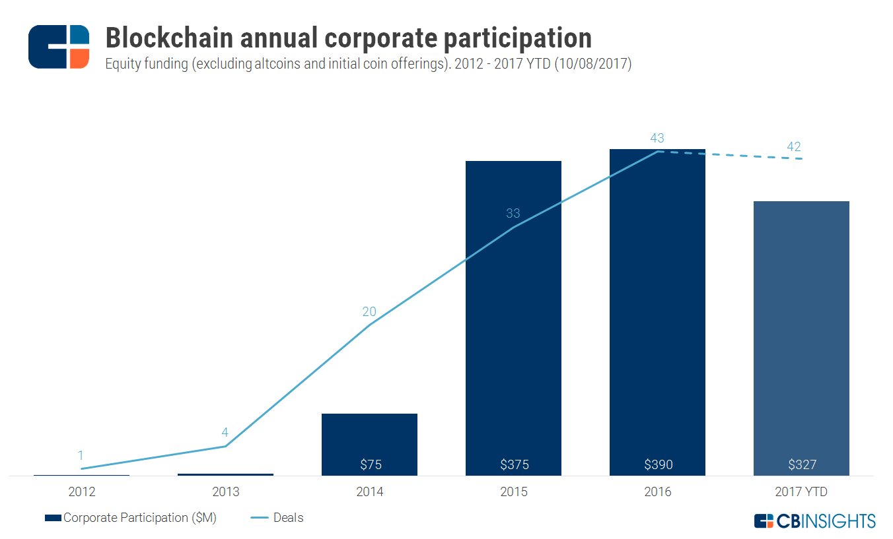

Why Block-chain?
The above graph can show the increasing use of block-chain technology in recent years which shows that the world is moving towards distributed systems that is more secure and tamperproof to execute transactions.
The whole point of using a block-chain is to let people—in particular, people who don’t trust one another—share valuable data in a secure, tamperproof way as block-chains store data using sophisticated math and innovative software rules that are extremely difficult for attackers to manipulate.

Slide 4

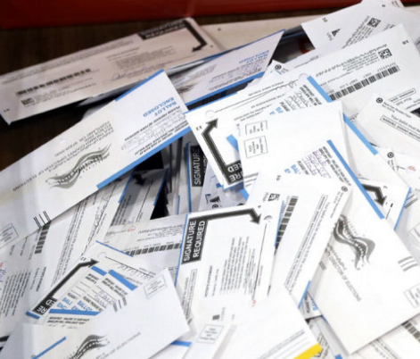

The Problem
TIME!
Think of how much time is spent on counting the votes and conducting a fair election…
SECURITY!
Think of how error prone and unsecure traditional voting methods are…
JUNK!
Think of the vast amount of ballot papers that are trashed after the election.

Slide 5
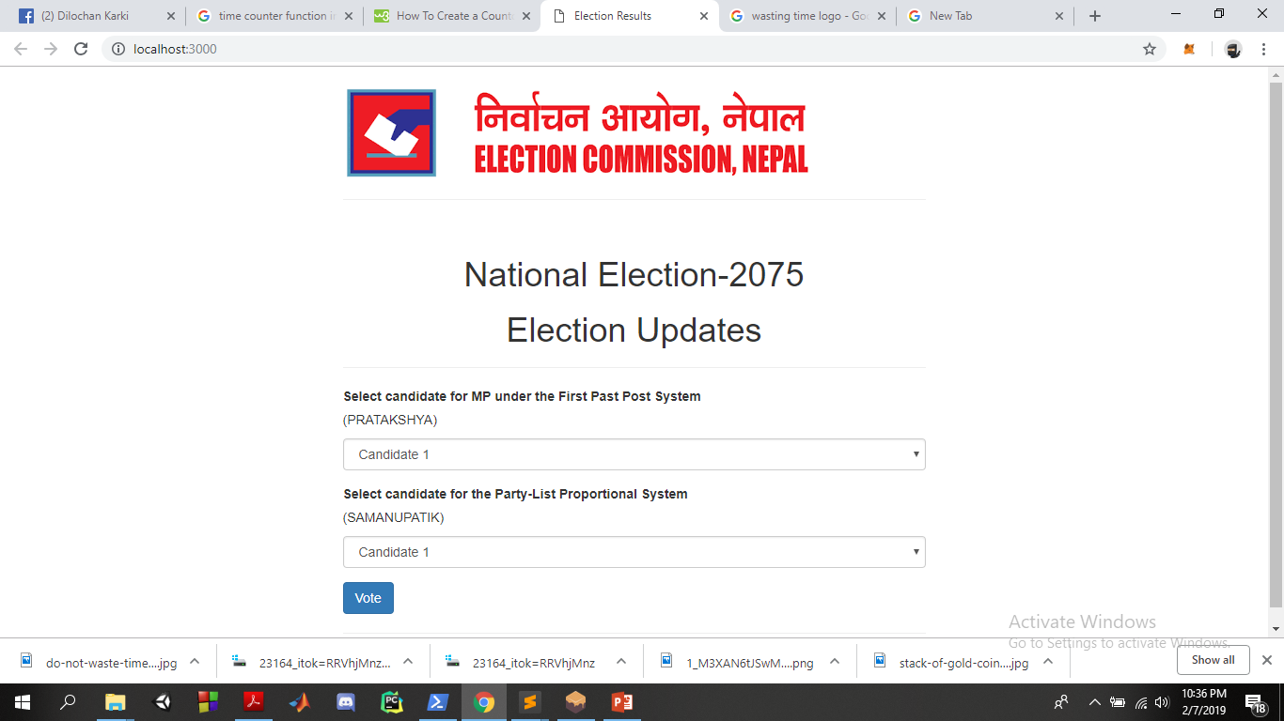
The Solution
A lot of time spent on counting the votes and the probable errors would be saved as the result post-voting can be saved in the contract and update in the event a vote is cast.
With e-voting the problem of ballot papers that are trashed either due to misplacement of vote or post-voting can be avoided with e-voting.
A block-chain technology based approach would be superior to ballot papers and central server based e-voting.

Slide 6
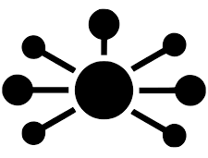




The Procedure
A decentralized voting application would make it easier and more secure to caste a vote that is confidential and errorless.
Identify as a valid voter
Choose your candidate
Get your policy!

Slide 7
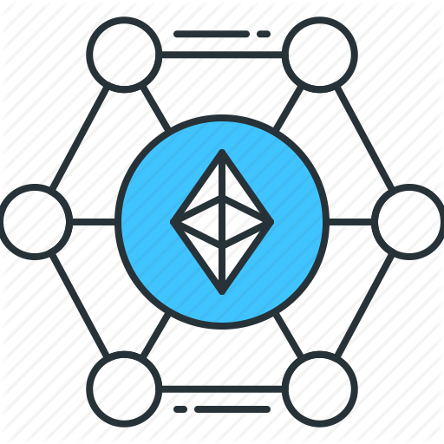


Technologies Used
We have used the Ethereum block-chain network to simulate the functions and transactions of the decentralized application.
We have made use of the Node JS library to build the backend function of the decentralized application.
We have made use of the React native JS library to build the app that would function as a QR-Scanner.

Slide 8


Real World Applications
Using the similar approach, the implementation can be obtained in different sectors such as provincial, local and corporal elections as it would be easier, more secure and less error prone as compared to traditional methods of election.
We have only tried showing what can be achieved with block-chain technology. This product can be used nation wide under the supervision of the government. Similarly, several other applications can be developed using the similar approach.

Slide 9

Future Enhancements
Currently, most of the tasks that could have been automated to make the voting process convenient have been limited due to the use of the Ethereum block-chain network. A real world approach would be much better with a custom block-chain network developed for the purpose of election only where tasks such as voter registration, candidate registration, voter identification and voting process can be made more user friendly. Furthermore, we would also propose extending its scope to the entire nation so as to spark the innovation of distributed systems all over the nation and set an example globally.

Slide 10

Team Members
Animesh Timsina – Full Stack and App Developer
Lakshya Pandit – Front-End and App Developer
Dilochan Karki – Backend and Smart Contract Developer

