Slide 1
BRAIN MENTOR
NEW GENERATION EXAMINATION CENTER

Slide 2
CONTENTS
About the Company
Introduction
Technologies Used
System Design
Screenshots
Conclusion
Limitations
Future Scope
References

Slide 3
ABOUT NIIT TECHNOLOGIES
NIIT Technologies is a leading global IT solutions organization-servicing customers across the Americas, Europe, Asia and Australia.
It focuses on Digital Services, the company is helping businesses design agile, scalable and digital operating models.
NIIT Technologies services clients in travel and transportation, banking and financial services, insurance, manufacturing and media verticals, offering a range of services including Application Development and Maintenance, Infrastructure Management, and Business Process Management.

Slide 4
INTRODUCTION
Brain Mentor is developed for educational institutes to prepare an exam, to save the time that will take to check the paper and prepare mark sheets.
The system will help the institute to develop and test the skills of students.
The effective use of “Brain Mentor“ is that any educational institute or training center can use it to develop their strategy for putting the exams and for getting better results in less time.

Slide 5
Users of Brain Mentor are classified into two categories:
Administrator
Administrator is responsible for management of system users, subjects, tests, questions, result, system backup and recovery etc.
Users
Users can be the candidates appearing for the examination and testing their skills.

Slide 6

TECHNOLOGIES USED
Client Side Scripting -
HTML 5
CSS
AJAX
Javascript
Server Side Scripting -
Java
Hibernate
Spring

Slide 7

SYSTEM DESIGN

Slide 8
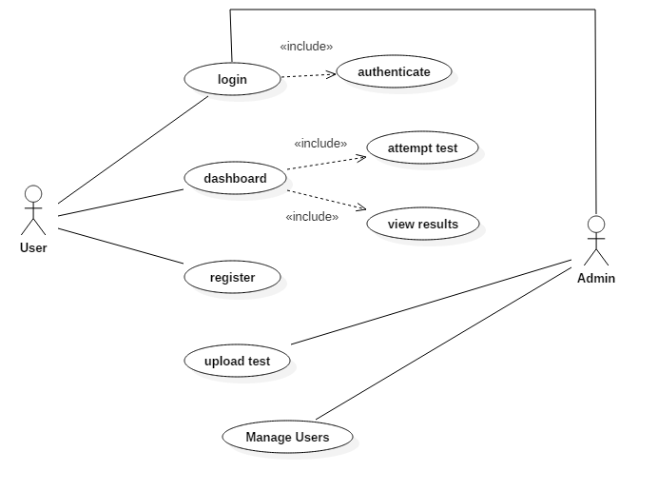
USE CASE DIAGRAM

Slide 9
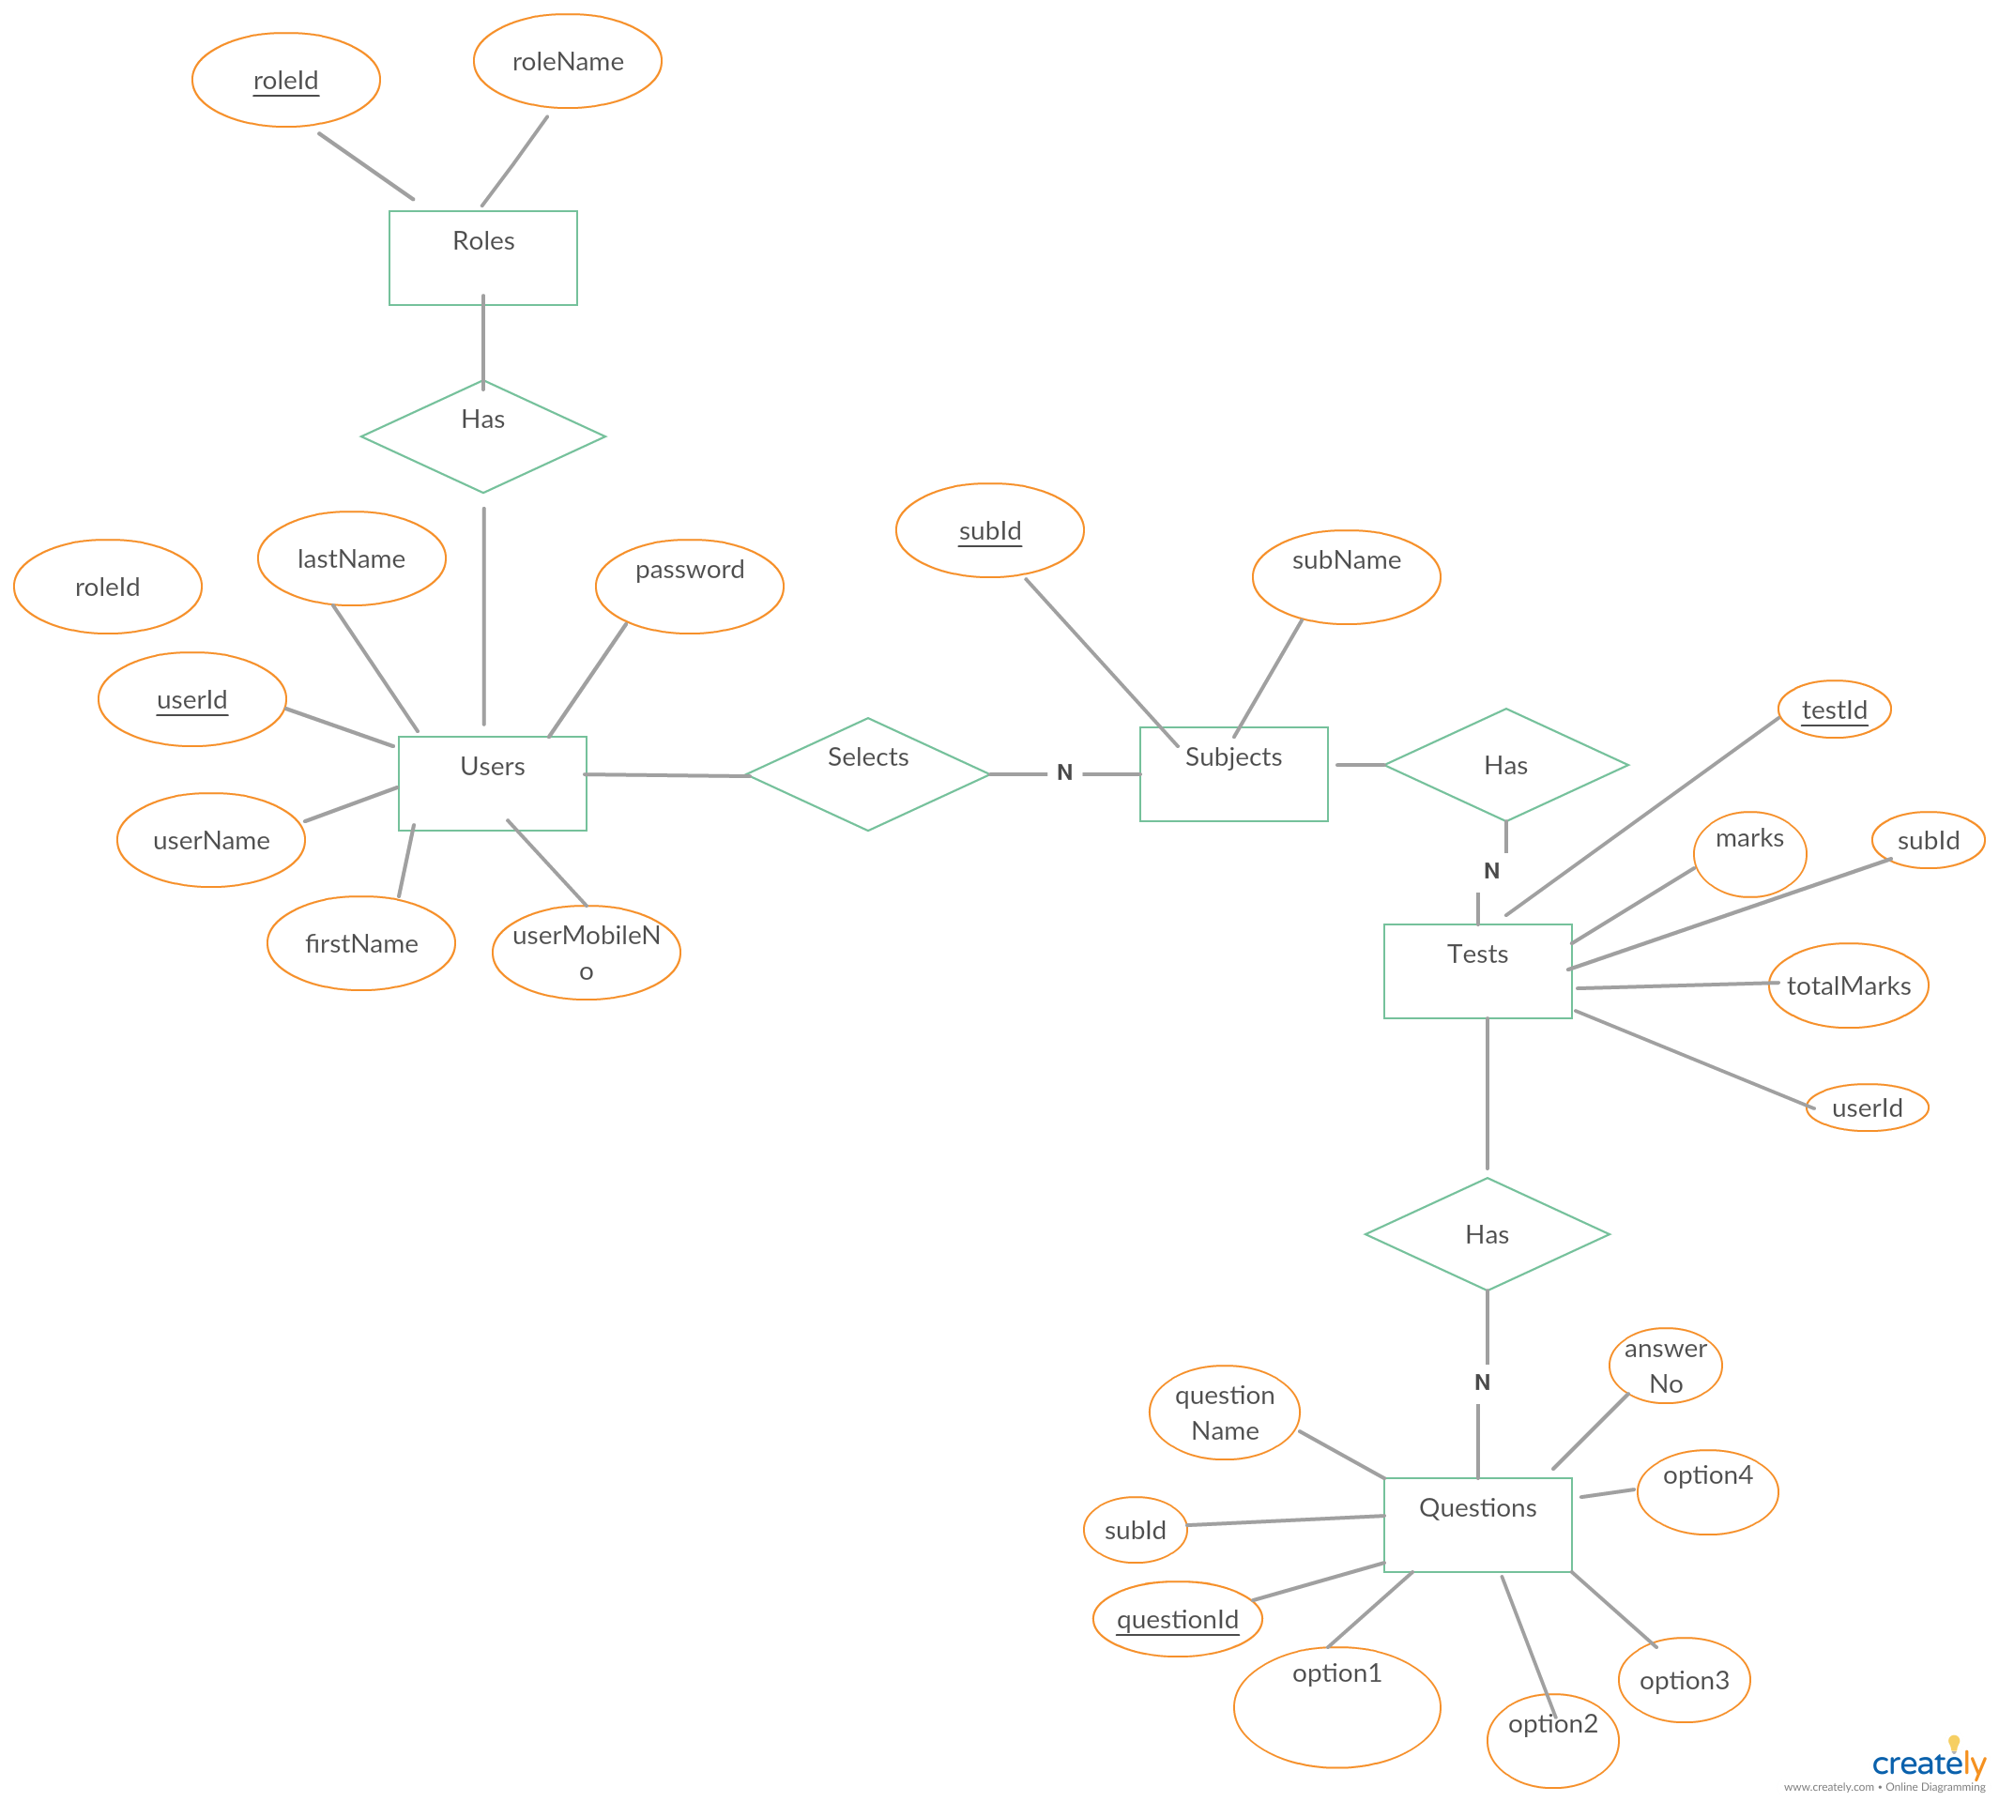
ENTITY RELATIONSHIP DIAGRAM

Slide 10

CONTEXT LEVEL DIAGRAM (LEVEL 0 DFD)

Slide 11
LEVEL 1 DFD

Slide 12
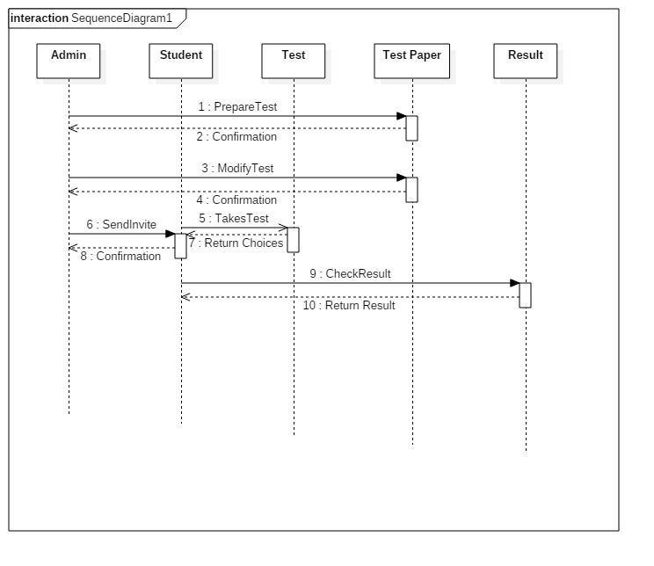
Sequence Diagram

Slide 13
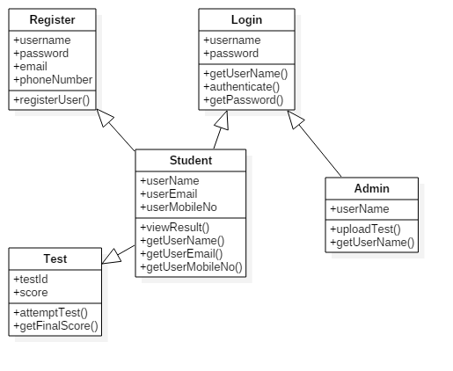
Class Diagram

Slide 14
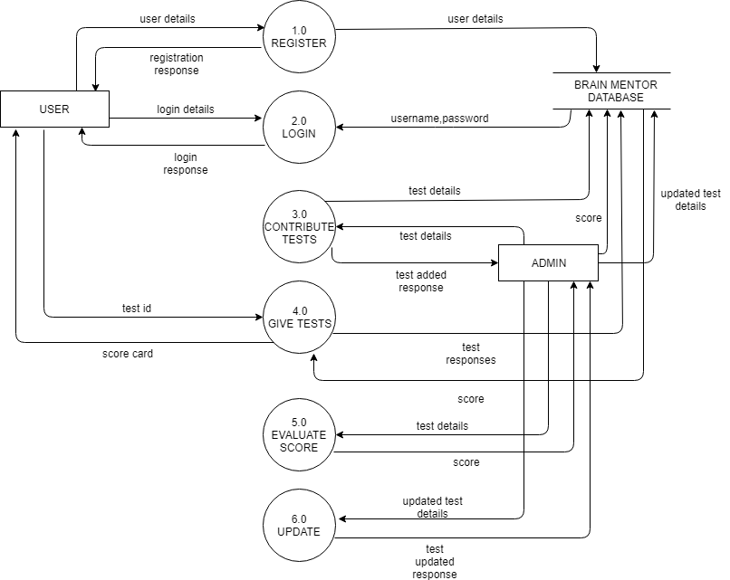

Slide 15
LIMITATIONS
This system capable of handling only objective type of question.
Time per question facility is not included.

Slide 16
FUTURE SCOPE
Implementation of payment module for subscription.
Mobile application to be developed.

Slide 17
REFERENCES
http://www.javatpoint.com/spring-tutorial
http://mvnrepository.com
http://www.designmantic.com
http://stackoverflow.com
http://www.pluralsight.com
http://www.w3schools.com

Slide 18


