Slide 1

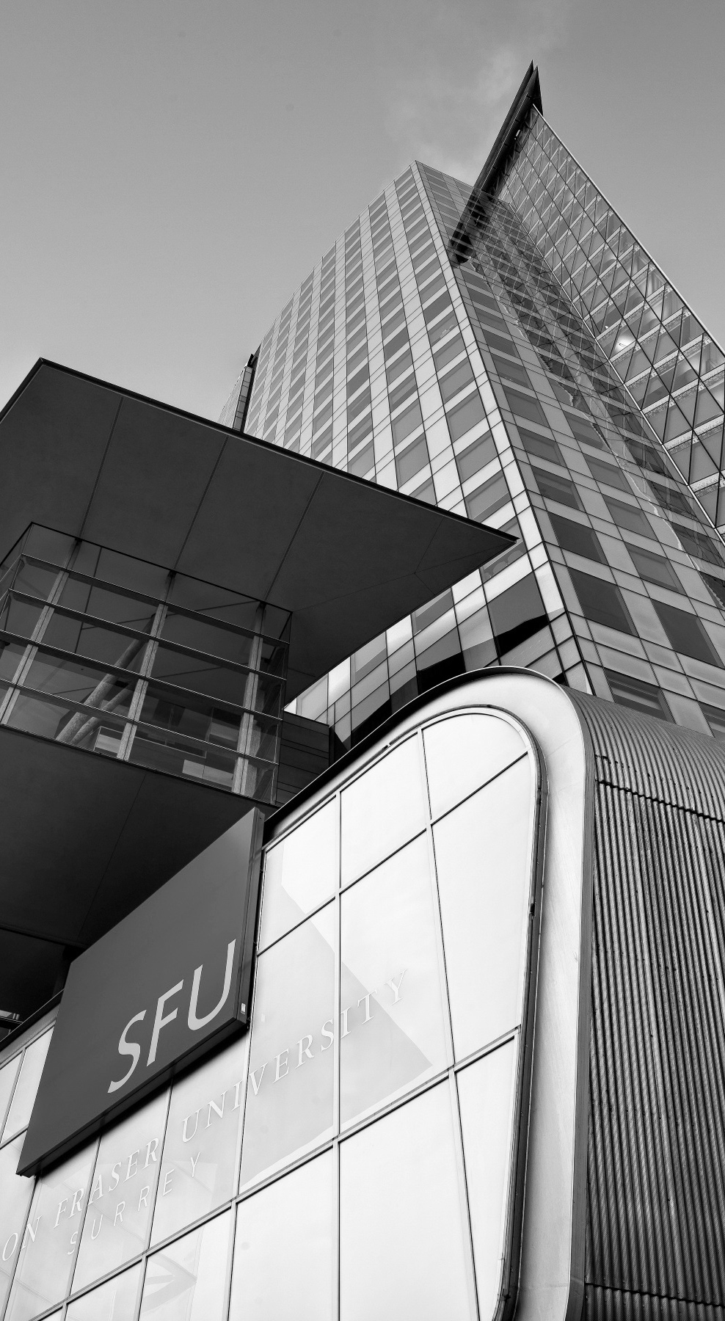

ANC Helmets
Animesh( Leader ), Nikita and Charley
9th August 2021
Notes:
HOW TO CHANGE IMAGE:
Click on image box.
Go to “Picture Format” tab
Click “Change Picture”
FONT: Impact, uppercase
Do not extend text outside of white section.
SUBHEADS / DAY MONTH YEAR:
Trebuchet MS, bold, uppercase

Slide 2
What if we tell you that you could have a smart helmet without buying a new helmet?
Notes:
FONT: Impact, uppercase
SUBHEADS / DAY MONTH YEAR:
Trebuchet MS, bold, uppercase

Slide 3
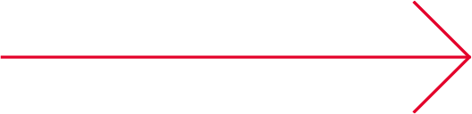
Today’s discussion
Architecture
Requirement Breakdown Structure
Live Demo
Timeline
Critical Path
Customer needs VS wants
Risk
Benefit-Cost Ratio analysis
Conclusion and Future Proposal
Notes:
On-brand bullet points
* copy and paste to reuse *
FONT: Header:
Impact, uppercase Subheads and Table: Trebuchet MS, bold, uppercase Body: Times, sentence-case

Slide 4
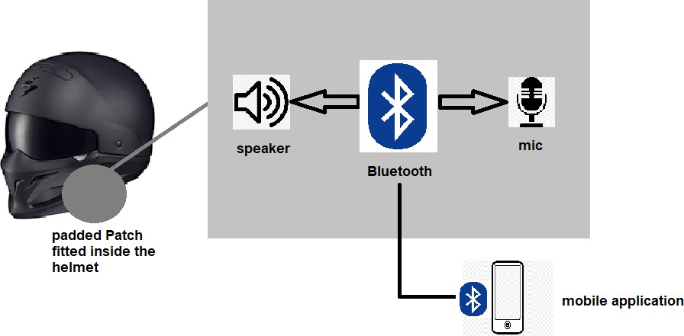
Architecture
ANC Helmets
Notes:
FONT: Header:
Impact, uppercase Subheads and Table: Trebuchet MS, bold, uppercase Body: Times, sentence-case

Slide 5
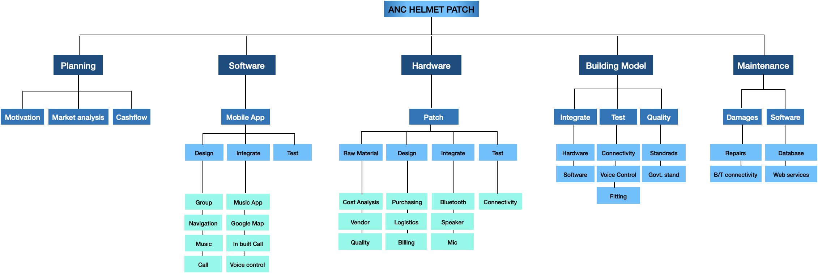
Requirement Breakdown Structure

Slide 6
Live - Demo

Slide 7
TimeLine

Slide 8
Critical Path
Activities | Code | Immediate Predecessor | Duration (Days)
Project Proposal | A | - | 4
Requirement and Feasibility | B | A | 11
Market analysis | C | A,B | 9
Budget cost ratio | D | C | 6
Design /software | E | B | 14
Design / hardware | F | B | 5
Order material | G | F | 10
Code / prototype | H | E | 12
Hardware / prototype | I | F,G | 11
Integrate device with app | J | H,I | 5
Testing prototype | K | J | 3
Documenting | L | D,K | 3
Presentation | M | L | 6
Project completion and submission | N | M | 1

Slide 9
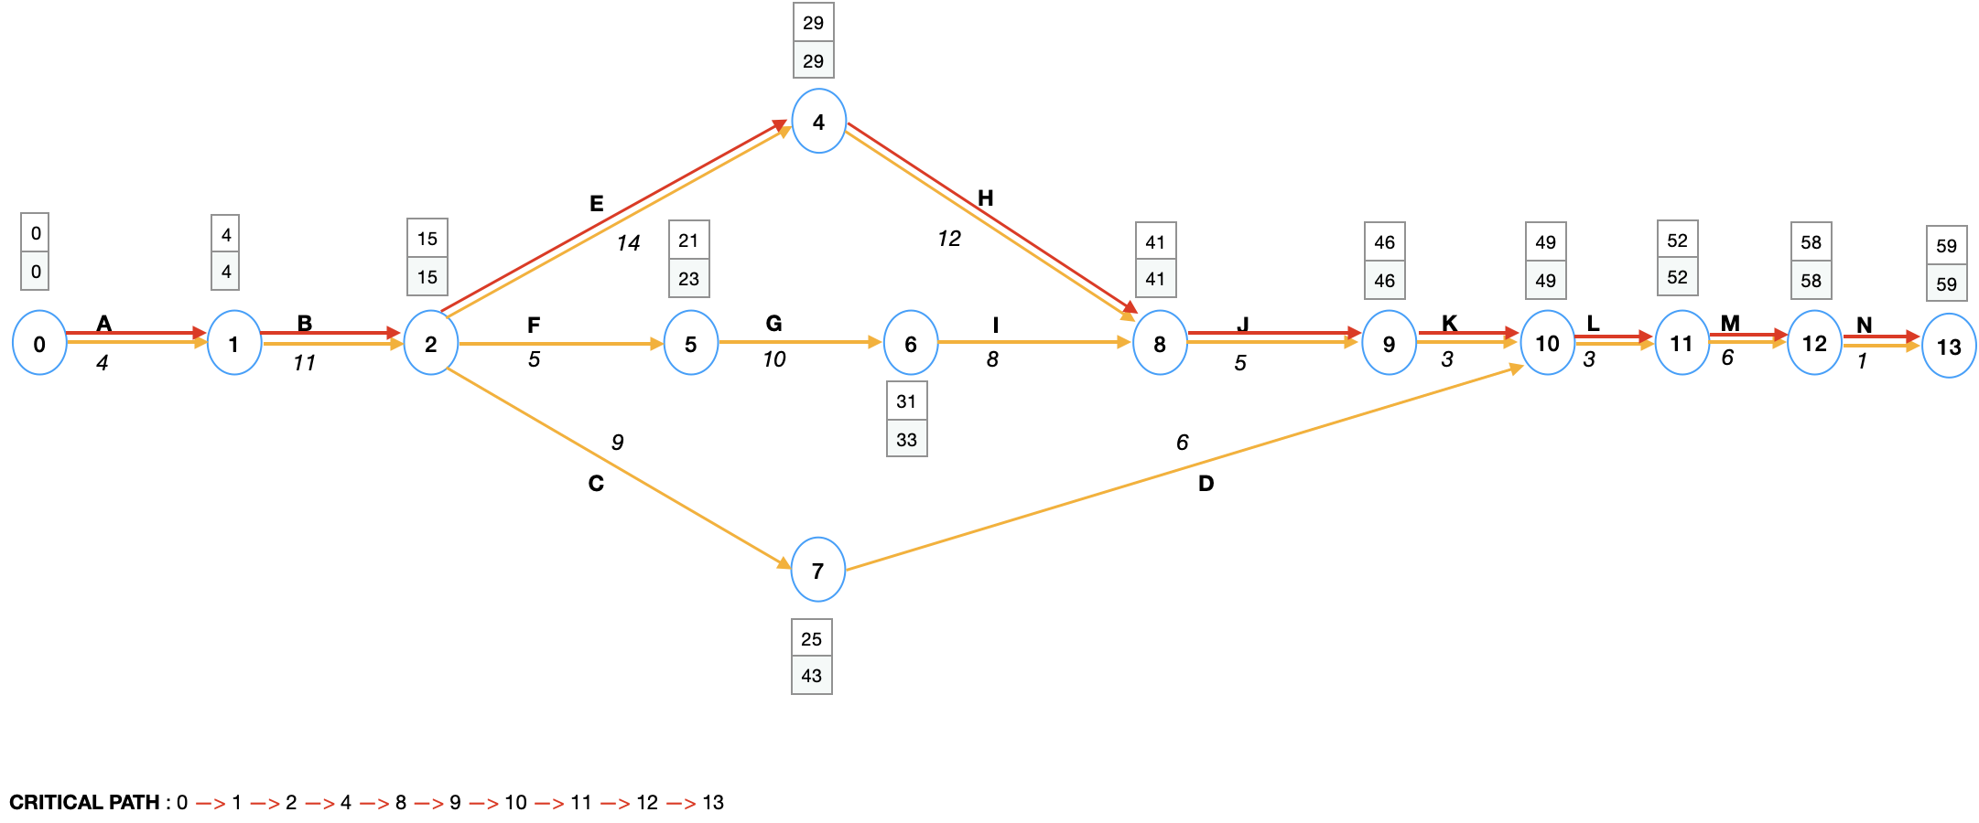
Critical Path
 | Duration | Total Float | Free Float
2-7 | 9 | 19 | 0
2-5 | 5 | 3 | 0
7-10 | 6 | 19 | 19
5-6 | 10 | 3 | 0
6-8 | 8 | 3 | 3

Slide 10
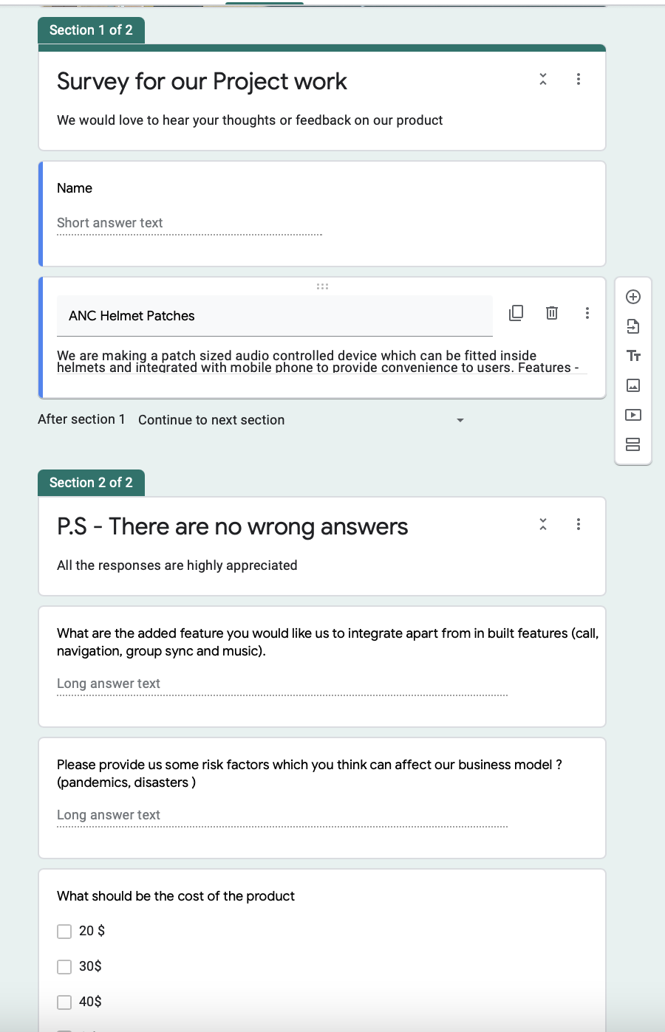
Customer Wants Vs Needs
A Short Survey
https://forms.gle/DQmQbG66wmDbdgYE9

Slide 11
Outcome
Features | Client Want | Client Need
Colourful Patch | Y | N
Navigation | Y | Y
Music | Y | Y
Radium Glow | Y | N
Display screen on Visor | Y | N
Control button on Helmet | Y | Y
Calls | Y | Y
Virtual Reality | Y | N
Group Sync | Y | Y
Noise reduction | Y | N

Slide 12
Risk Identification Index
Risk Category | Scope Triangle | Event# | Event | Y/N | Probability | Priority(H/L/M) | Mitigate(Y/M/N)
Technology | Scope | TS1 | Hardware might not connect with future devices | Y | 30% | M | Y
 |  | TS2 | Present web services might stop its services | Y | 5% | H | Y
 |  | TS3 | Device not syncing with group of mobiles(BT capacity is 7 peoples) | Y | 50% | M | Y
 |  | TS4 | Hardware availability or change of vendor | Y | 60% | H | M
 | Cost | TC1 | Unexpected need to acquire hardware | Y | 20% | H | M
 |  | TC2 | Unexpected need to acquire software | Y | 10% | H | M
 |  | TC3 | Cost of Web services might increase | Y | 90% | L | Y
 | Time | TT1 | Service disruptions by vendors | Y | 15% | H | N
 |  | TT2 | Software integrated API’s updates might cause delay | Y | 20% | L | N
 | Quality | TQ1 | Cotton patch might come off | Y | 10% | H | Y
 |  | TQ2 | Patch might not be properly stitch | Y | 10% | M | Y

Slide 13
Risk Identification Index
Risk Category | Scope Triangle | Event# | Event | Y/N | Probability | Priority(H/L/M) | Mitigate(Y/M/N)
Project Management | Quality | PQ1 | Incase of accidents the device might break and cause injury | Y | 2% | H | N
 |  | PQ2 | Inaccurate budget assumptions | Y | 30% | M | Y
 | Scope | PS1 | Existing market coming up with better solutions | Y | 28% | M | N
 |  | PS2 | Unavailibilty of internet | Y | 15% | L | N
 | Resource | PR1 | Delivery of raw material | Y | 10% | M | N
 |  | PR2 | Return/replace damaged materials | Y | 15% | M | M
 | Time | PT1 | Task duration estimate too optimistic | Y | 15% | L | Y
 |  | PT2 | Difficulty scheduling meeting | Y | 5% | L | Y
 | Cost | PC1 | Less demand but high production | Y | 20% | L | Y

Slide 14
Risk Identification Index
Risk Category | Scope Triangle | Event# | Event | Y/N | Probability | Priority(H/L/M) | Mitigate(Y/M/N)
Organizational | Cost | OC1 | Deliverable rejected at last minute | Y | 5% | H | M
 |  | OC2 | Unable to payoff the loan amount | Y | 25% | H | Y
 | Scope | OS1 | Hired employee left before completing the task | Y | 30% | M | Y
 | Time | OT1 | Slow knowledge transfer | Y | 5% | L | Y
 |  | OT2 | Excessive amount of leaves | Y | 5% | L | Y
External | Resources | ER1 | Unavailability of hardware raw material (pandemic/disaster) | Y | 4% | H | N
 | Cost | EC1 | Inflation due to pandemic | Y | 4% | M | N
 | Time | ET1 | Employee availability due to pandemics/disasters | Y | 20% | H | N
 |  | ET2 | Natural disasters might delay the production and sales | Y | 10% | M | N
 | Scope | ES1 | Pandemic might reduce the product usage | Y | 5% | H | N
 | Quality | EQ1 | Weather conditions might affect the internet connectivity | Y | 15% | M | N

Slide 15

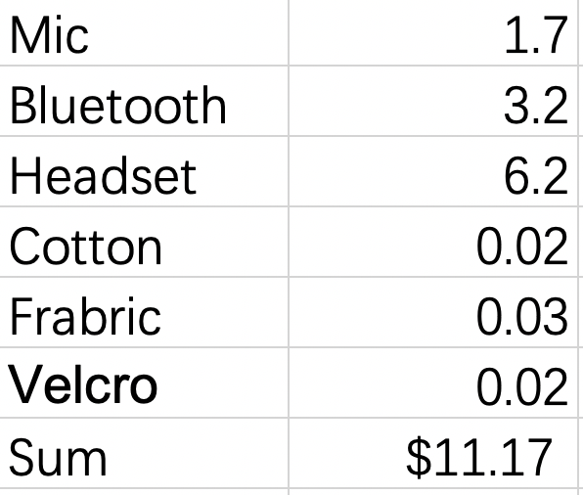
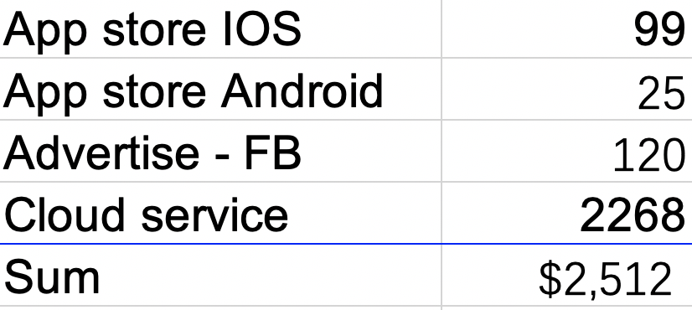
Cost Analysis
Operating costs
Manufacturing Costs
Operating Costs

Slide 16
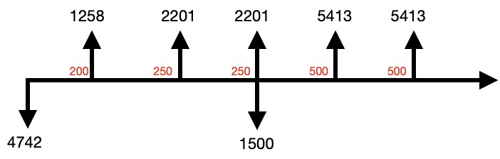
 | Products | Cost | Extra cost | Per product cost | Input | Return | Profit
1st Year | 200 | 11.15 | 2512 | 30 | 4742 | 6000 | 1258
2nd Year | 250 | 11.15 | 2512 | 30 | 5299 | 7500 | 2201
3rd Year | 250 | 11.15 | 2512 | 30 | 5299 | 7500 | 2201
Money
4th Year | 500 | 11.15 | 2512 + 1500 | 30 | 9587 | 15000 | 5413
5th Year | 500 | 11.15 | 2512 + 1500 | 30 | 9587 | 15000 | 5413
Benefit | 15280
Cost | 5976
BC ratio | 2.55
Benefit Cost Ratio

Slide 17
Benefit Cost Ratio
Benefit | 15280
Cost | 5976
1
Benefit | 15280 | 15280*0.85 | 12988 | Ratio = 2.415
Cost | 5976 | 5976*0.90 | 5378
2
Benefit | 15280 | 15280*0.60 | 9168 | Ratio = 1.534
Cost | 5976 | 5976*1.00 | 5976
BEST CASE-WORST CASE
Notes:
Best case scenario : 1. If we do not receive any defective goods and that would save us on return cost.
2. If demand of our product goes up, it will increase the overall benefit cost.
Worst case scenario : 1. Due to pandemic, there is no use of bikes and there will be no use of helmets.
2. Competitors came out with better features in helmets.
3. Labour prices increased and raw material became expensive. (Cost 3000 - 1.7 bc)
4. Server crashed and data got lost/leaked.

Slide 18
Conclusion and Future Proposal
As per the benefit cost ratio analysis, the best and the worst case both provide a ratio above 1.
Many people in the survey want our product.
Natural disasters pose a high risk.
Survey on a larger scale for future proposal.
The prototype is prepared and can be used for future proposal.
Advertising fee for future proposal.
Make deals with other helmet companies.
Quality certification and Patent.

Slide 19
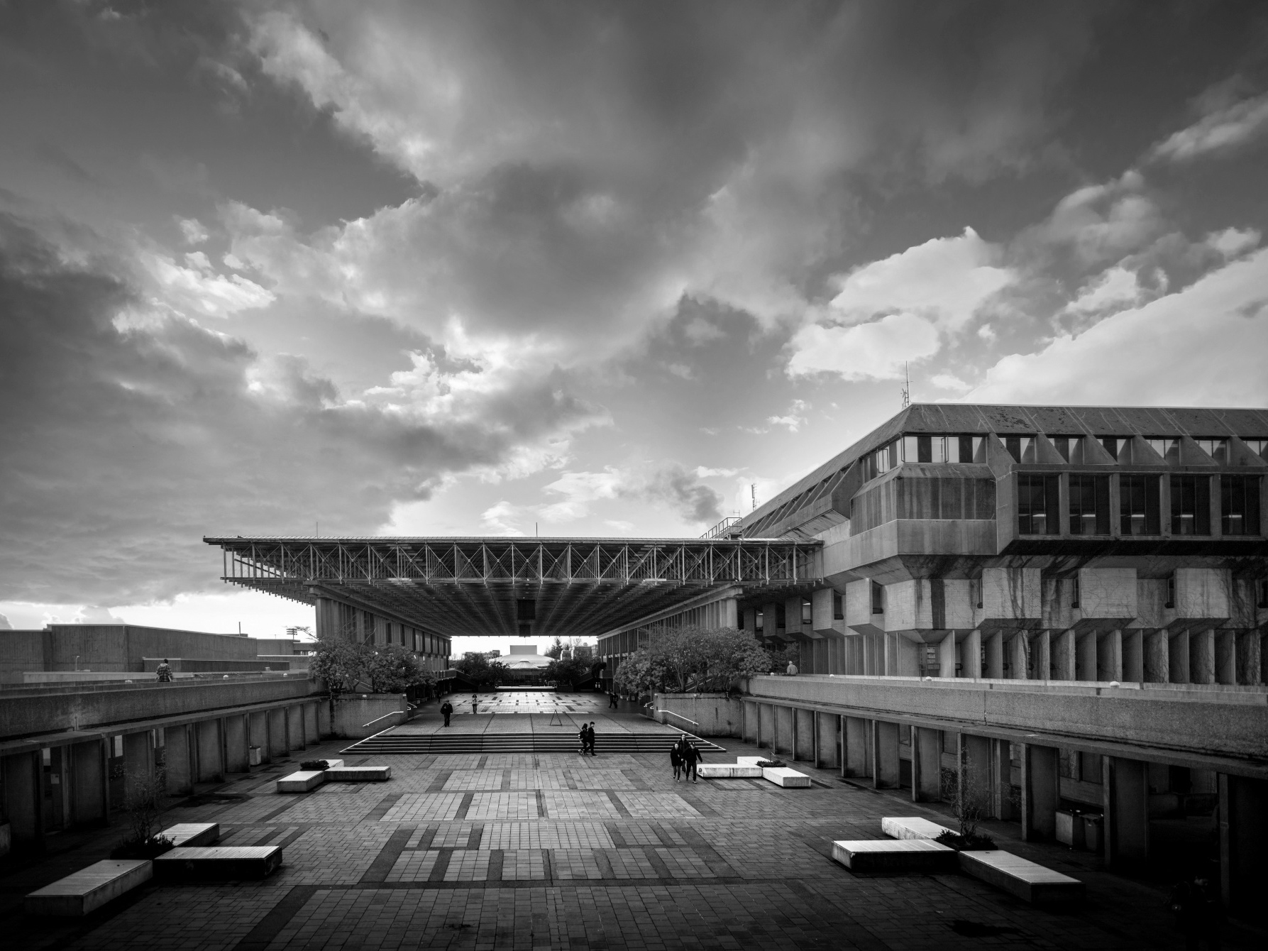
Thank You
Notes:
HOW TO CHANGE IMAGE:
Click on image box.
Go to “Picture Format” tab
Click “Change Picture”

