Slide 1



Jawaharlal Nehru New College of Engineering Shimogga, Karnataka.
Department of Electrical and Electronics Engineering
RES Based Project Presentation on
“AI - ML BASED AUTONOMOUS SOLAR PANEL CLEANING BOT ”
PRESENTED BY:
Animisha P (4JN22EE005)
Anagha S (4JN23EE007)
Neha A Kuruvinashetty (4JN23EE033)
Nisarga G (4JN23EE034)
GUIDED BY :
Prof Manjula M G
Asst. Professor
Dept. of EEE JNNCE , shimoga

Slide 2
CONTENT
Abstract
Introduction
Literature Survey
Objectives
Problem statement
Block Diagram and Circuit Diagram
Methodology
Hardware and software requirements
Advantages and Disadvantages
Applications
Result and Conclusion
Future scope
References

Slide 3
INTRODUCTION
Solar energy is one of the most promising renewable energy sources, but dust and pollution accumulating on panel surfaces can reduce efficiency by 5–30%, particularly in dry and dusty regions. Traditional manual cleaning methods are labor-intensive, costly, and require frequent human intervention, making them impractical for large-scale solar installations.
This project addresses these challenges by introducing an AI-based autonomous solar panel cleaning system. The system continuously monitors panel power output using embedded sensors and fetches real-time air quality data to determine when cleaning is actually needed — rather than cleaning on a fixed schedule regardless of panel condition.
By combining ESP32 microcontrollers, MQTT communication, machine learning, and a mobile application, the system makes intelligent cleaning decisions automatically, reducing water usage, minimizing maintenance costs, and maximizing solar energy output without human involvement.

Slide 4
Abstract
Solar panels lose 15–25% of their energy output due to dust and dirt accumulation on their surface. Traditional manual cleaning methods are labor-intensive, water-wasteful, and economically inefficient. This project presents an AI-powered autonomous solar panel cleaning system that combines two ESP32 microcontrollers, a Python FastAPI backend server, a PostgreSQL database, real-time air quality monitoring, machine learning, and a React Native mobile application into a single integrated solution.
A static ESP32 node measures solar panel voltage, current, power, and energy output, sending data to the backend every five seconds via HTTP. The backend fetches dust AQI data from the OpenWeatherMap API every thirty minutes and compares it with a threshold. If dust exceeds the limit, the backend commands a cleaning robot ESP32 through MQTT to clean the panel using a water spray pump and roller brush automatically.

Slide 5
LITERATURE SURVEY
Sl.No. | Author and year | Title of the paper | Citation | Observation
1 | M. R. Habib et al., 2021 | Automatic Solar Panel Cleaning System Based on Arduino for Dust Removal | M. R. Habib et al., "Automatic Solar Panel Cleaning System Based on Arduino for Dust Removal," 2021 International Conference on Artificial Intelligence and Smart Systems (ICAIS), Coimbatore, India, 2021, pp. 1555-1558, doi: 10.1109/ICAIS50930.2021.9395937. | The waterless cleaning mechanism (air blower + wiper) effectively removes dust, making it suitable for water-scarce or desert regions. The system is automatic and low-cost, using simple components like an Arduino and DC motor, making it practical for real-world use.
2 | S. Gochhait, R. Asodiya, T. Hasarmani, V. Patin and O. Maslova 2022 | Application of IoT: A Study on Automated Solar Panel Cleaning System | S. Gochhait, R. Asodiya, T. Hasarmani, V. Patin and O. Maslova, "Application of IoT: A Study on Automated Solar Panel Cleaning System," 2022 4th International Conference on Electrical, Control and Instrumentation Engineering (ICECIE), KualaLumpur, Malaysia, 2022, pp. 1-4, doi: 10.1109/ICECIE55199.2022.10000375. | Manual cleaning is inefficient and costly, while automated systems reduce time, labor, and risk of panel damage. Automated cleaning systems improve performance, offering up to ~32% efficiency boost and ~1.6–2.2% regular gains, while using less water and enabling smart monitoring through IoT.

Slide 6
SL.NO | Author and year | Title of the paper | Citation | Observation
3 | M. Jboor et al., 2023 | Automated Solar Panel cleaning System | M. Jboor et al., "Automated Solar Panel Cleaning System," 2023 2nd International Engineering Conference on Electrical, Energy, and Artificial Intelligence (EICEEAI), Zarqa, Jordan, 2023, pp. 1-5, doi: 10.1109/EICEEAI60672.2023.10590137. | The proposed system uses a water-based roller brush with automated motion, controlled by Arduino and components like limit switches and relays, eliminating manual effort. Performance improves after cleaning, as shown by increased electrical parameters (power, voltage, current), proving that automated cleaning enhances overall efficiency
4 | N. Prastomo, Ryan and W. Budiman 2023 | Automatic Dust Cleaning system with wiper and sprinkler for solar panel | N. Prastomo, Ryan and W. Budiman, "Automatic Dust Cleaning System with Wiper and Sprinkler for Solar Panel," 2023 3rd International Conference on Smart Cities, Automation & Intelligent Computing Systems (ICON-SONICS), Bali, Indonesia, 2023, pp. 20-25, doi: 10.1109/ICON-SONICS59898.2023.10435085 | The combined cleaning method (wiper + sprinkler) is the most effective, achieving up to 93.9% cleanliness compared to other methods. The system is practical for hard-to-reach rooftop panels, using the panel frame as a track for automated cleaning.

Slide 7
SL.NO | Author and year | Title of the paper | Citation | Observation
5 | K. C. Mane, D. A. Pawar, S. M. Kalhapure, S. G. Aher, P. V. Thokal and D. B. Pardeshi, 2023 | Automatic Cleaning and Maintenance of Solar Panel and Efficiency Monitoring | K. C. Mane, D. A. Pawar, S. M. Kalhapure, S. G. Aher, P. V. Thokal and D. B. Pardeshi, "Automatic Cleaning and Maintenance of Solar Panel and Efficiency Monitoring," 2023 2nd International Conference on Edge Computing and Applications (ICECAA), Namakkal, India, 2023, pp. 1582-1586, doi: 10.1109/ICECAA58104.2023.10212231. | India faces significant energy challenges, with a large dependence (60–70%) on conventional sources like fuel, wood, and agricultural waste. Solar energy is a promising renewable alternative, but its effectiveness is impacted by environmental factors like dust.

Slide 8
OBJECTIVES
To develop an AI-based automatic solar panel cleaning system that monitors real-time voltage, current, power, and energy output using embedded ESP32 sensors and transmits data continuously to a backend server.
To predict dust accumulation at the solar installation location using real-time AQI data from the OpenWeatherMap API and autonomously trigger the cleaning robot when dust levels exceed a configurable threshold.
To provide manual control functionality through a React Native mobile application, allowing users to directly operate the cleaning robot's movement, water spray, and charging relay in case of server or network failure.
To improve overall solar energy efficiency while minimizing water consumption by cleaning only when environmental dust levels justify it, reducing unnecessary maintenance and operational costs.

Slide 9
PROBLEM STATEMENT
Solar photovoltaic systems experience significant power output reduction due to dust, dirt, and bird droppings accumulating on panel surfaces, with efficiency losses ranging from 5–30% in dry and polluted regions. Existing cleaning solutions rely on fixed schedules or manual labor, resulting in unnecessary water usage, increased operational costs, and safety risks — without considering actual dust levels at the installation site.
There is a clear need for an intelligent automated system that continuously monitors solar panel performance in real time, fetches environmental dust data from external sources to detect when cleaning is genuinely required, and autonomously initiates cleaning operations only when dust levels exceed a critical threshold. The system must also remain functional during server or network failures by providing direct manual control to the user.
This project addresses these challenges by developing an end-to-end IoT and AI-based solar panel cleaning system that integrates embedded sensor nodes, real-time air quality monitoring, machine learning-based predictions, autonomous robot control via MQTT, and a mobile application — ensuring maximum energy output, minimal water consumption, reduced maintenance costs, and reliable operation under all network conditions.

Slide 10
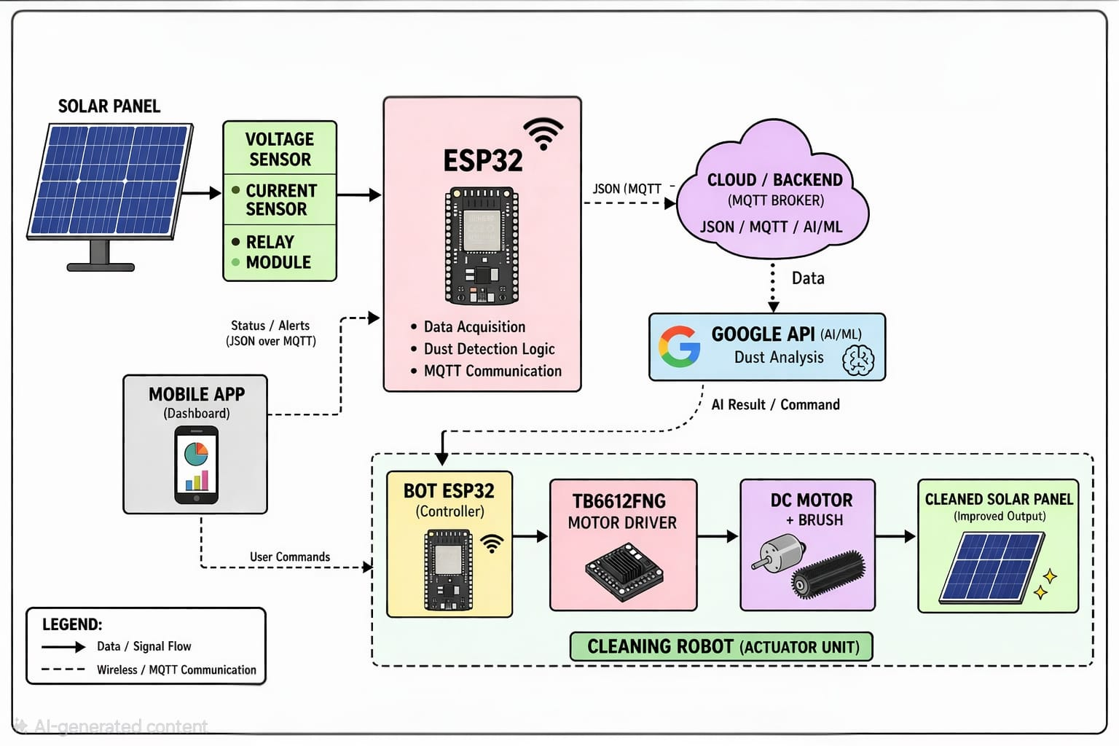
BLOCK DIAGRAM
HTTTP
HTTTP

Slide 11
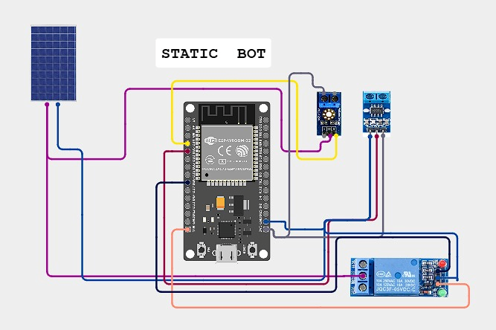
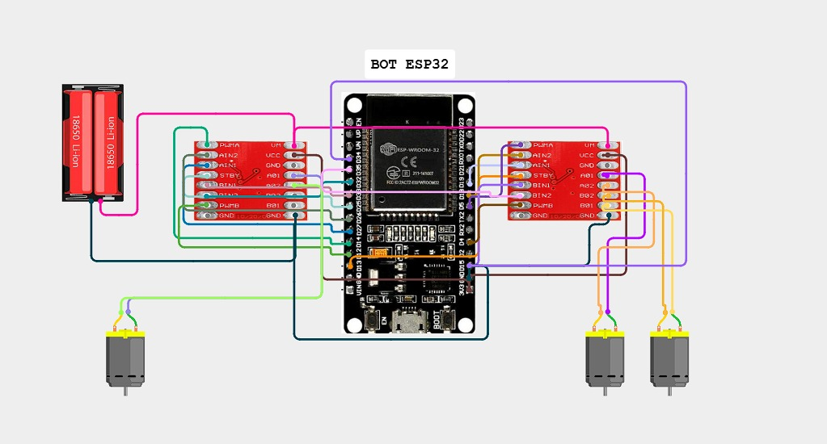
CIRCUIT DIAGRAM

Slide 12
METHODOLOGY
Monitoring & AI Decision: Voltage and current sensors continuously monitor the solar panel performance. The data is sent through the ESP32 to the cloud, where AI analyzes efficiency drop and decides whether cleaning is required.
Cleaning Control (Automatic & Manual): If efficiency falls below a set limit, the AI sends a command to activate the relay module for automatic cleaning. Additionally, users can manually control the cleaning system through the cloud interface whenever needed. this is methodology and add the points how exactly API sends data and air quality index.
What is API and API key?
API stands for Application Programming Interface. It is a set of rules and protocols that allow different software systems or components to communicate and interact with each other.
API key is a digital access badge — without it, the API won’t let you in. It’s issued by the API provider and tied to your account

Slide 13
System Architecture and Hardware Setup
The system consists of two ESP32 microcontroller units connected over a common WiFi network. The first unit is a static measurement node mounted at the solar panel, equipped with a voltage sensor on GPIO 34 and a current sensor on GPIO 35. It continuously reads analog values at 12-bit ADC resolution, converts them to real voltage and current using calibration factors, calculates power (W = V × I) and cumulative energy (Wh), and transmits this data every five seconds to the Python FastAPI backend server via HTTP POST request in JSON format. The second unit is embedded inside an autonomous cleaning robot and controls four motors through two TB6612FNG motor driver chips — two 600 RPM drive wheels for panel traversal, and one water spray pump — all controlled via PWM signals from the ESP32.

Slide 14
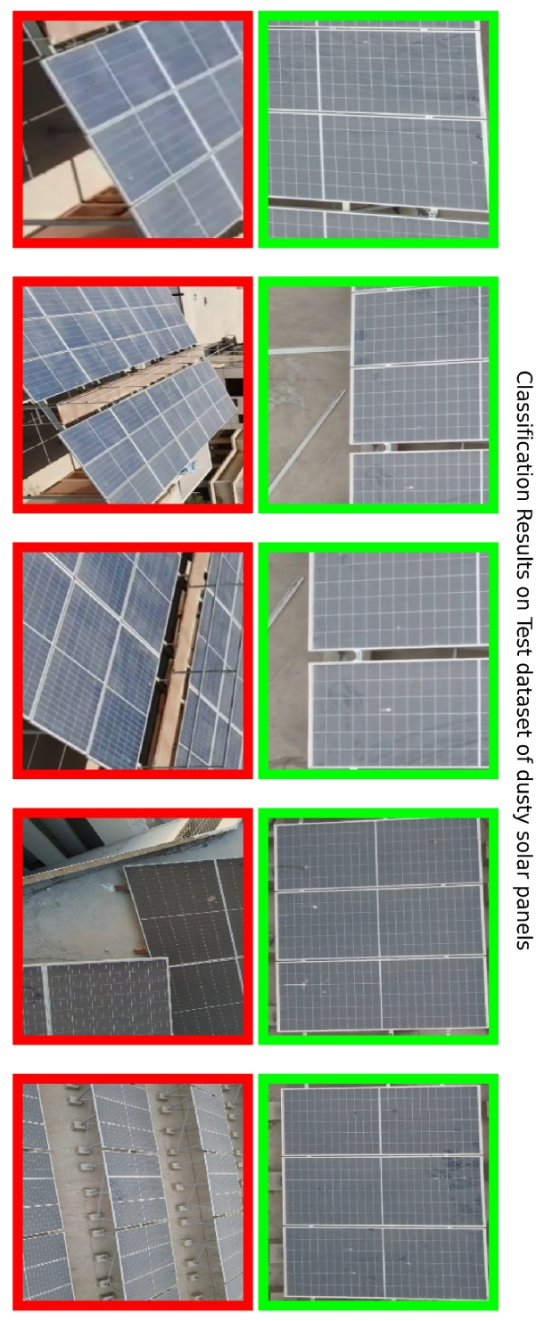
Real-Time Air Quality Monitoring and AI Control
The backend server connects to the OpenWeatherMap Air Quality API to monitor environmental dust levels near the solar panel location. Every thirty minutes, the backend sends an HTTP GET request to fetch AQI data using the panel’s GPS coordinates.
The AQI value is converted to the standard 0–500 scale and compared with a configurable threshold stored in the system. If the AQI exceeds the limit, the backend automatically publishes a CLEAN command to the MQTT topic solar/bot/command.
The Mosquitto MQTT broker delivers this command to the cleaning robot ESP32. The robot then moves across the panel while simultaneously activating the water spray pump and rotating roller brush, completing a fully automatic cleaning cycle. Each cleaning operation is stored in the PostgreSQL database along with AQI value, trigger type, and timestamp for monitoring and analysis.

Slide 15
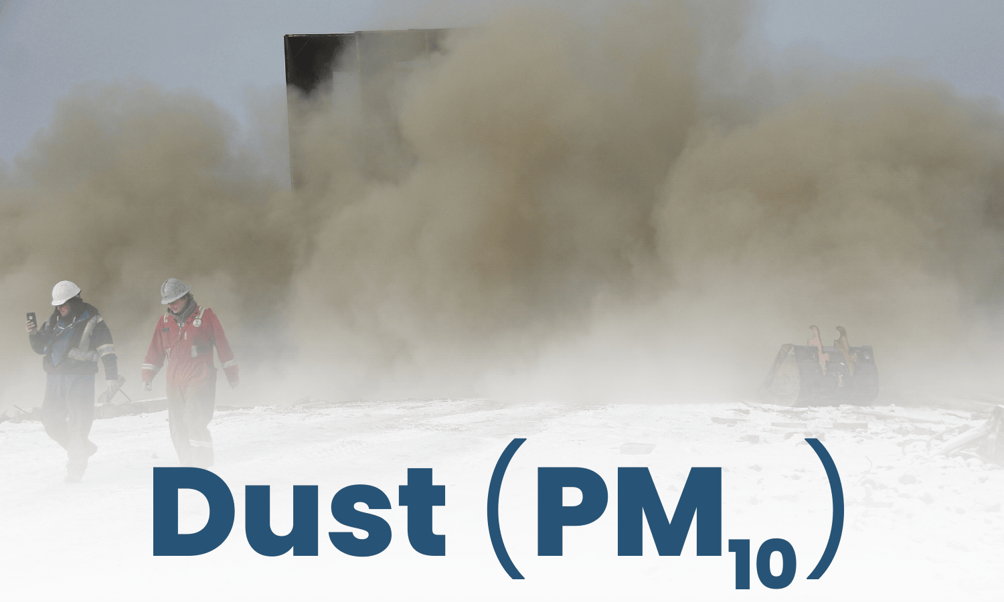
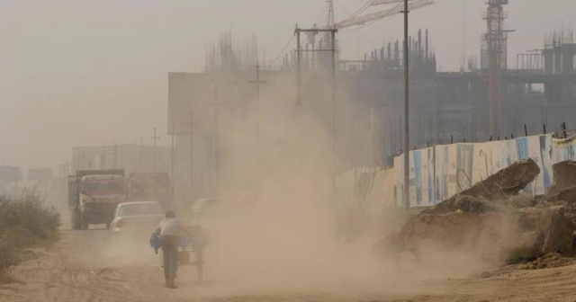
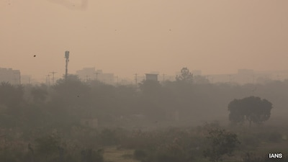
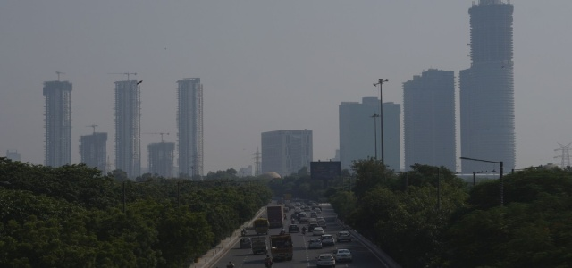
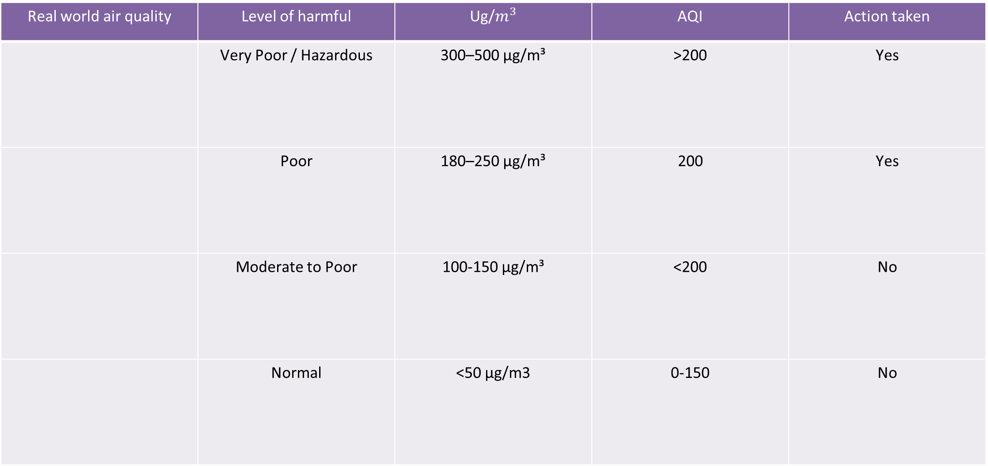
Air quality data
Real world air quality | Level of harmful |  | AQI | Action taken
 | Very Poor / Hazardous | 300–500 µg/m³ | >200 | Yes
 | Poor | 180–250 µg/m³ | 200 | Yes
 | Moderate to Poor | 100-150 µg/m³ | <200 | No
 | Normal | ​<50 μg/m3 | 0-150 | No

Slide 16
Machine Learning and Manual Control
Two machine learning models run continuously on the backend. The first model uses Linear Regression trained on historical power output readings to forecast solar energy production for the next six hours, enabling proactive energy management decisions. The second model analyzes the AQI trend over the past seven days to predict when dust levels will next exceed the threshold, providing advance warning of the next required cleaning cycle before panel efficiency degrades. Both predictions are stored in the database and displayed in the mobile application. For situations where the server is unavailable or network connectivity fails, the React Native mobile application provides a complete manual control interface allowing users to independently command robot forward and backward movement, activate or deactivate the water spray pump, control the roller brush, and toggle the solar charging relay — all communicated directly to the ESP32 via the MQTT broker. When the external air quality API is unavailable, the system automatically generates estimated AQI values between 30 and 50, refreshed every fifteen minutes, maintaining operational continuity and a functional user interface without interruption.

Slide 17
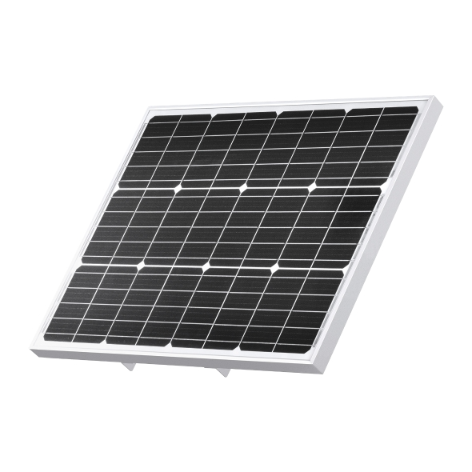
HARDWARE AND SOFTWARE REQUIREMENTS
HARDWARE REQUIREMENT
1. Solar Panel
Type: Monocrystalline
Rated power (Pmax): 20W
Maximum voltage (Vmp): Typically 17–18V (for 12V panel)
Maximum current (Imp): Depends on wattage (e.g., ~1A for 20W)
Open circuit voltage (Voc): ~21–22V (for 12V panel)
Short circuit current (Isc): Slightly higher than Imp
Efficiency: ~15% – 22%
Operating temperature: -40°C to +85°C

Slide 18
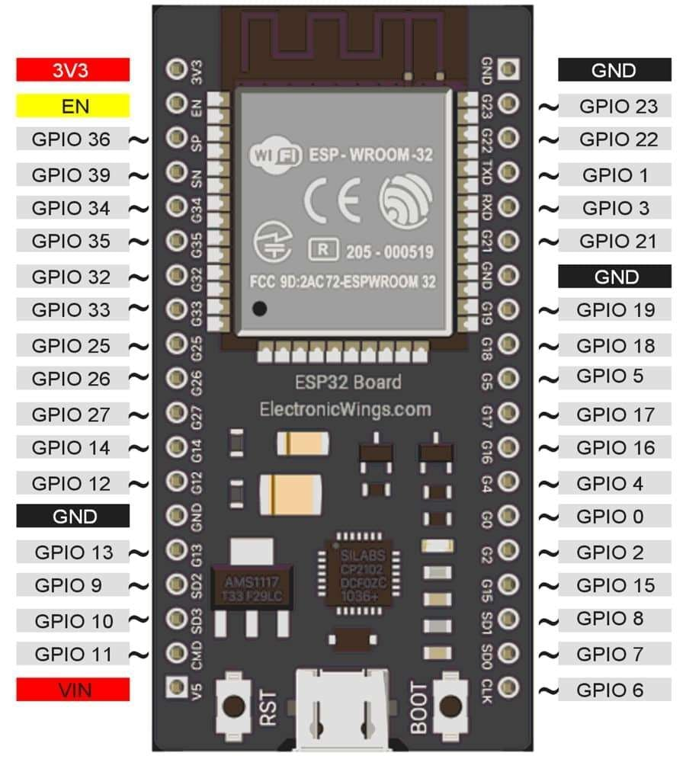
2. ESP32
Microcontroller: ESP32 * 2
Clock Speed: Up to 240 MHz
Operating Voltage: 3.0V – 3.6V (Recommended 3.3V)
Flash Memory: 4MB (external SPI flash, varies by model)
SRAM: 520KB
EEPROM: Available
Power Consumption: Low power, multiple sleep modes

Slide 19
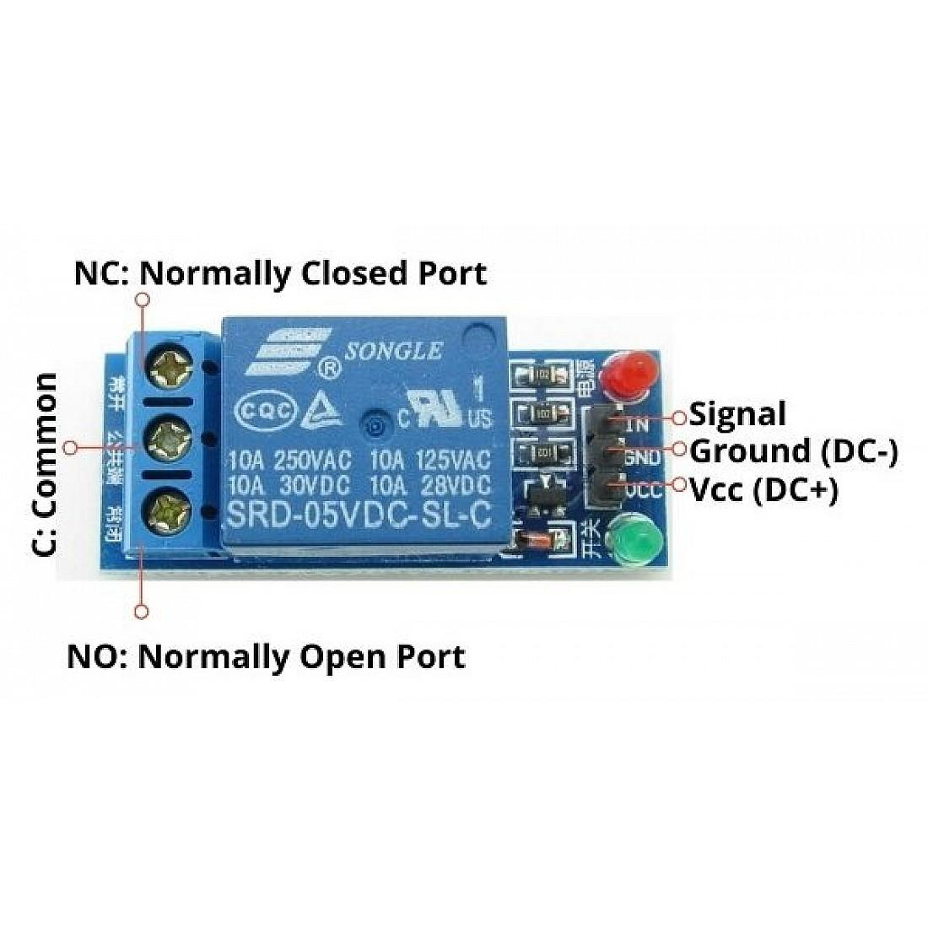
3. Relay module
Operating Voltage: 5V DC (to power the relay coil)
Trigger Voltage:
Works with 3.3V or 5V logic signals
Compatible with ESP32 (3.3V GPIO)
Current Consumption:~70–100 mA per relay when activated
Switching Capacity: 10A at 250V AC and 10A at 30V DC
Pins
VCC → 5V supply
GND → Ground
IN → Control signal from ESP32
Output Terminals
COM (Common)
NO (Normally Open)
NC (Normally Closed)

Slide 20
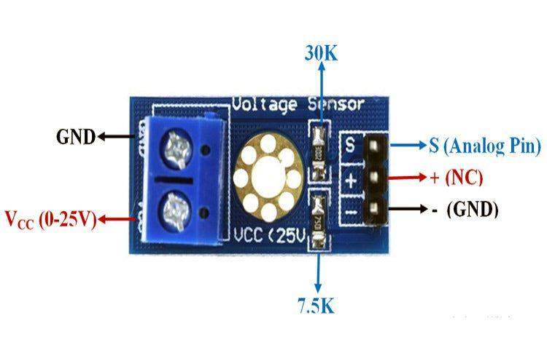
4. Voltage Sensor
Voltage Input Range:0 to 25V DC
Voltage Detection Range:0 to 25V DC
Voltage Divider Ratio: 5:1
(R1 = 30kΩ, R2 = 7.5kΩ)
Analog Voltage Resolution
Depends on microcontroller ADC
For ESP32 (12-bit ADC):
Resolution ≈ 0.006V (6 mV per step)
Maximum Output Voltage
5V (when input is 25V)

Slide 21
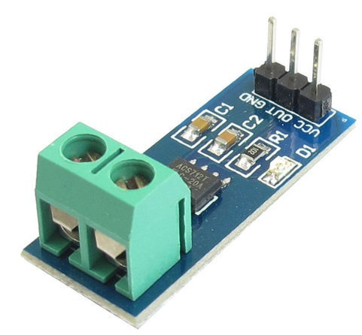
5.ACS712 current sensor
Supply Voltage (Vcc): 5V DC
Current Detection Range:
ACS712-05B: ±5A
ACS712-20A: ±20A
ACS712-30A: ±30A
Output Voltage Range: 0.5V to 4.5V (centered at 2.5V for 0A)
Sensitivity:
185 mV/A (5A version)
100 mV/A (20A version)
66 mV/A (30A version)
Measurement Type: AC and DC current
Isolation Voltage: 2.1 kVRMS (internal isolation)

Slide 22
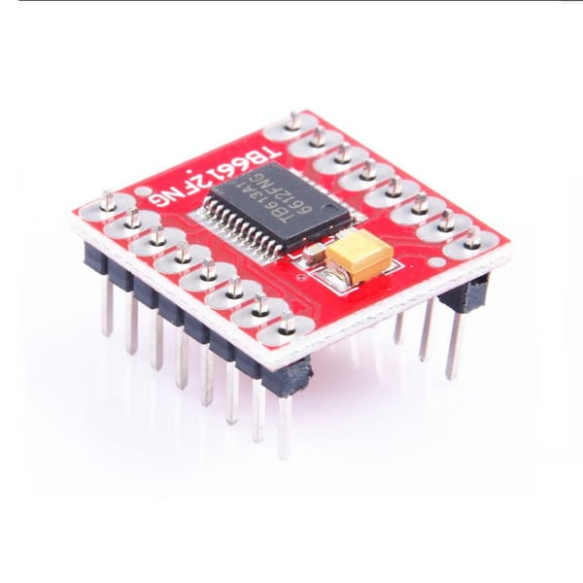
6. L298N Motor Driver
Motor Channels: 2 Channels (can drive two DC motors or one stepper motor).
Motor Supply Voltage (): 15V Max (recommended 2.5V ~ 13.5V).
Logic Voltage (): 2.7V to 5.5V.
Continuous Output Current: 1.2 A per channel.
Peak Output Current: 3.2 A (single pulse).
Output ON Resistor: 0.5Ω (upper + lower typical @ ).
PWM Frequency: Up to 100 kHz.
Operating Temperature: -20°C to 85°C.
SparkFun Electronics: SparkFun Electronics +5

Slide 23
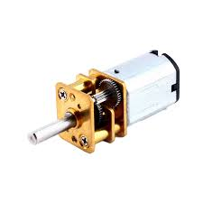
7. Motor
Rated speed: 600 RPM (no-load)
Operating voltage: 6V – 12V DC (commonly 12V)
Type: Brushed DC motor with gearbox
Torque: High torque (due to gear reduction)
Current consumption:No-load: ~100–300 mAFull-load: ~1–2 A
Shaft type: Metal shaft (D-type for better grip)
Rotation: Bidirectional (CW & CCW)
Applications: Robotics, line followers, automated vehicles, conveyors

Slide 24
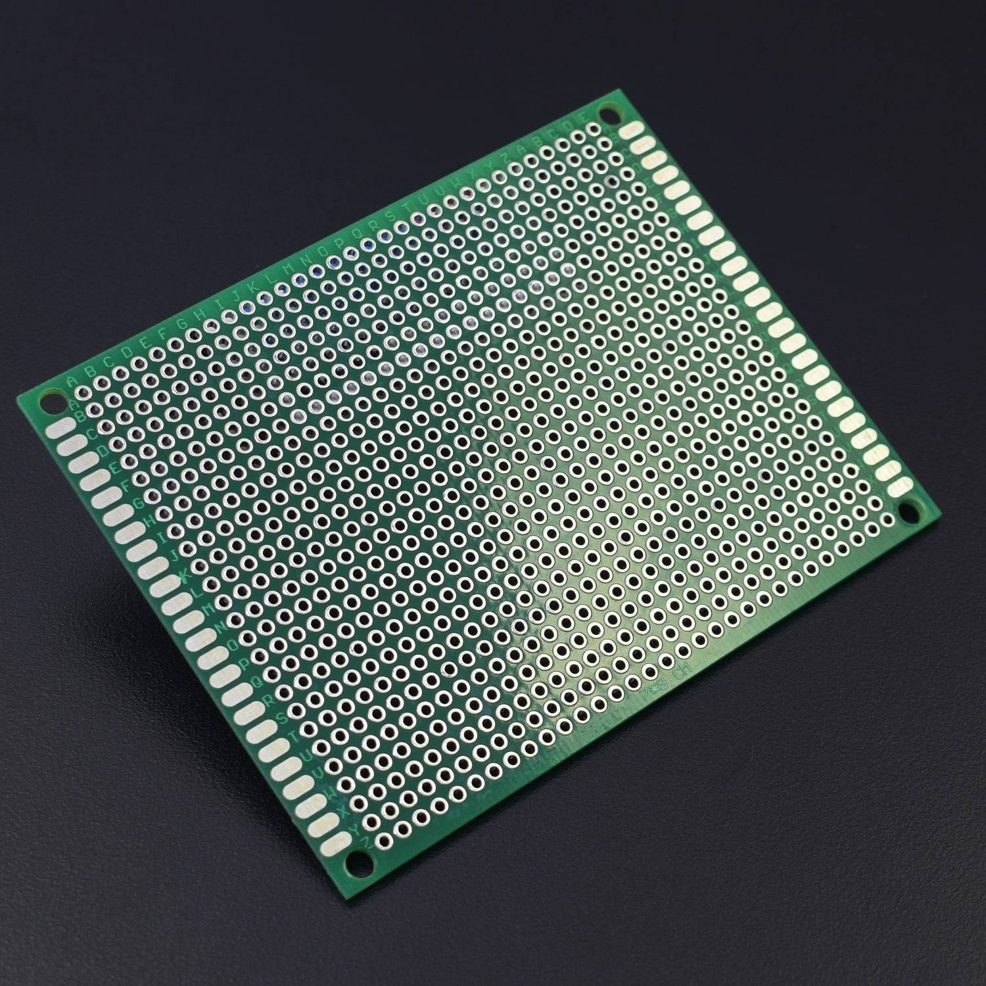
8. PCB Board
Material: FR4 (Fiberglass epoxy – most common)
Board type: Single-layer / Double-layer / Multi-layer
Thickness: Typically 1.6 mm (standard)

Slide 25
SOFTWARE REQUIREMENT
Arduino IDE
Expo Go
Postgre SQL
Visual studio
Cirkit Designer
pgAdmin 4
ML Model
Linear Regression for Power Forecast ,Cleaning Prediction

Slide 26
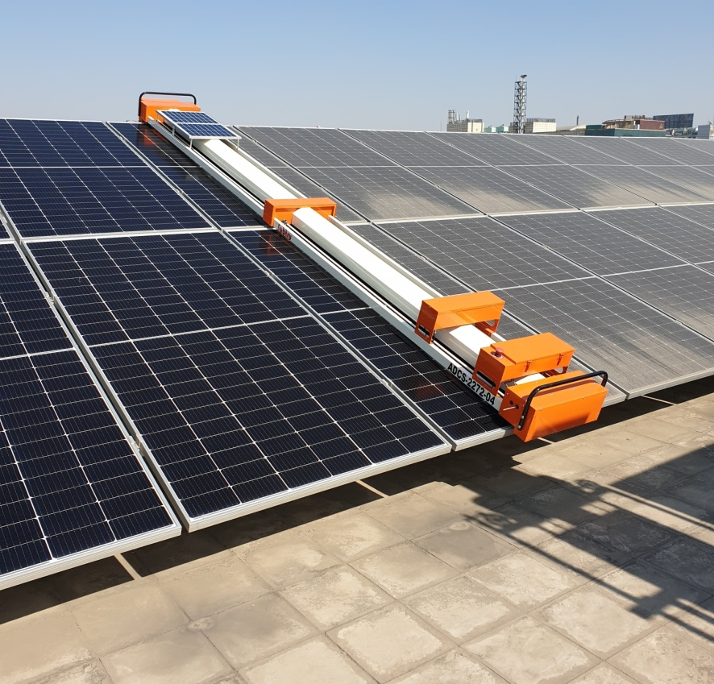
ADVANTAGES
Improved Efficiency — AI triggers cleaning only when AQI exceeds the threshold, keeping panels efficient while avoiding unnecessary cleaning.
Water Conservation — Water spray activates only during required cleaning cycles, reducing wastage.
Reduced Maintenance Cost — Autonomous cleaning lowers manual labor and inspection costs.
Increased Energy Generation — Clean panels absorb more sunlight, improving power output.
Real-Time Monitoring — Voltage, current, power, and energy data are updated every five seconds in the mobile app.
Eco-Friendly Operation — Uses minimal water, avoids chemicals, and supports sustainable energy generation.

Slide 27
DISADVANTAGES
Complex System Design — The system uses multiple hardware components and communication protocols, requiring technical knowledge for setup and configuration.
Component Maintenance — Outdoor exposure to dust, heat, and moisture can affect motors, sensors, and electronics, requiring regular servicing.
Power Consumption — ESP32 units, motors, sensors, WiFi communication, and the backend system consume additional power during operation.

Slide 28
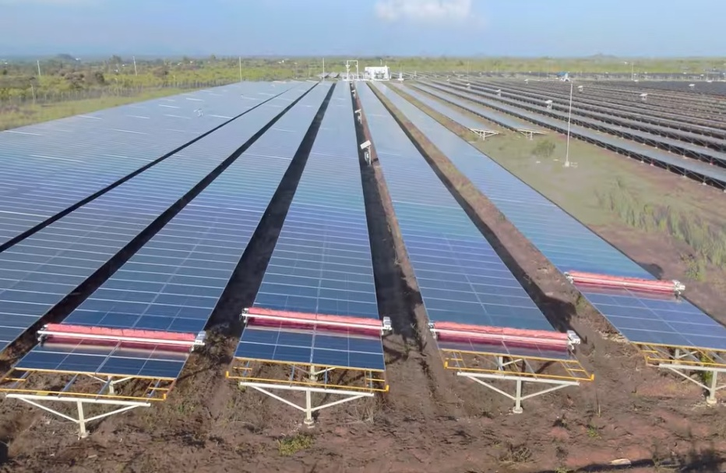

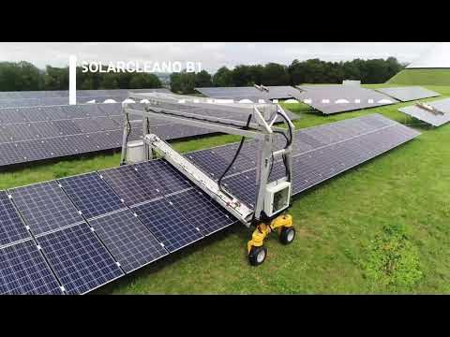
APPLICATIONS
Residential Rooftops — Maintains home solar panels automatically without manual cleaning.
Industrial Facilities — Supports factories and warehouses with large solar installations.
Solar Farms — Useful for large-scale solar plants where manual cleaning is difficult.
Smart City Projects — Enables automated and efficient energy management.
Educational Institutions — Provides sustainable and low-maintenance solar systems for campuses.
Hospitals & Critical Facilities — Ensures reliable power generation for essential services.

Slide 29
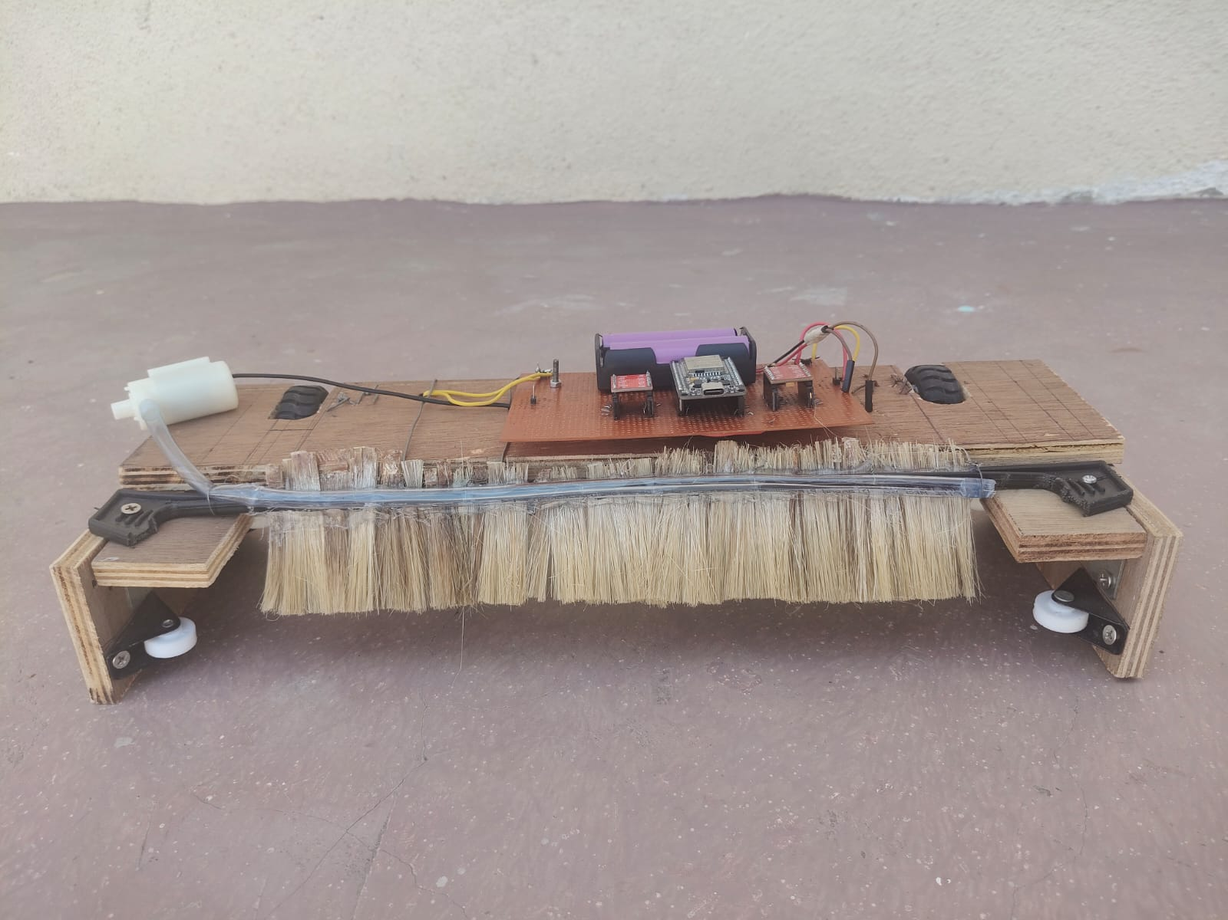
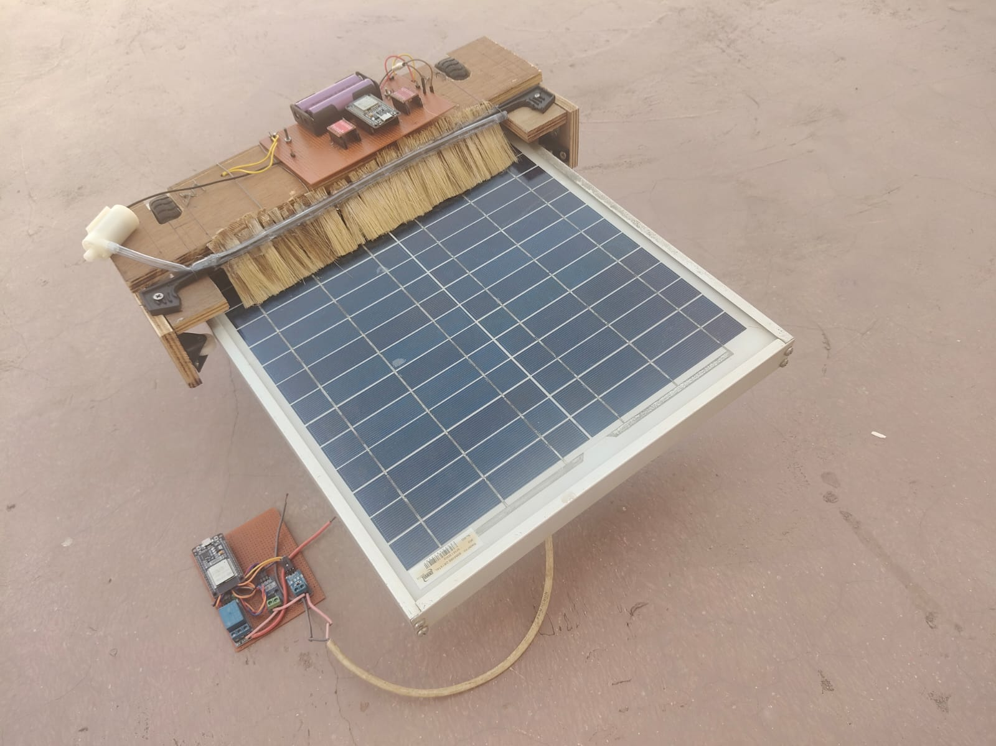
PROTOTYPE

Slide 30
WORKING

Slide 31
RESULT
No of cleaning Action | Voltage In V
 | Before cleaning | After cleaning
1 | 13 | 15
2 | 17 | 20
3 | 17 | 17
4 | 16 | 18

Slide 32
CONCLUSION
This project demonstrates an AI-based autonomous solar panel cleaning system designed to reduce efficiency loss caused by dust accumulation. The system integrates two ESP32 microcontrollers, real-time AQI monitoring using the Open WeatherMap API, MQTT-based robot control, machine learning prediction models, and a React Native mobile application into a complete IoT solution.
The AI engine monitors AQI data continuously and starts cleaning only when dust levels exceed the set threshold, reducing unnecessary cleaning and saving water. Machine learning models are used for solar power forecasting and predicting future cleaning requirements, helping maintain maximum panel efficiency.
The system improves solar energy generation by keeping panels clean through automatic and timely cleaning cycles. It also provides real-time monitoring, manual control through the mobile app, and database logging for all sensor data and cleaning events. The solution can be applied to residential, industrial, and large-scale solar installations for efficient and sustainable solar energy management.

Slide 33
FUTURE SCOPE
Portable Bot
The existing Bot, dust can be detected only in the particular IP address provided. In the future the Bot can be developed such that the bot runs in any location.
Self-Navigation & Autonomous Movement
Future bots can use computer vision and obstacle detection to move across large solar farms without human control.
Water Optimization Techniques
AI can optimize water usage by selecting dry cleaning or minimum-water cleaning methods based on dirt conditions.
Weather-Adaptive Cleaning
System can avoid cleaning during rain, high winds, or extreme temperatures using weather prediction models.

Slide 34
REFERENCES
[1] M. R. Habib et al., "Automatic Solar Panel Cleaning System Based on Arduino for Dust Removal," 2021 International Conference on Artificial Intelligence and Smart Systems (ICAIS), Coimbatore, India, 2021, pp. 1555-1558, doi: 10.1109/ICAIS50930.2021.9395937.
[2]S. Gochhait, R. Asodiya, T. Hasarmani, V. Patin and O. Maslova, "Application of IoT: A Study on Automated Solar Panel Cleaning System," 2022 4th International Conference on Electrical, Control and Instrumentation Engineering (ICECIE), KualaLumpur, Malaysia, 2022, pp. 1-4, doi: 10.1109/ICECIE55199.2022.10000375.
[3] M. Jboor et al., "Automated Solar Panel Cleaning System," 2023 2nd International Engineering Conference on Electrical, Energy, and Artificial Intelligence (EICEEAI), Zarqa, Jordan, 2023, pp. 1-5, doi: 10.1109/EICEEAI60672.2023.10590137.
[4] N. Prastomo, Ryan and W. Budiman, "Automatic Dust Cleaning System with Wiper and Sprinkler for Solar Panel," 2023 3rd International Conference on Smart Cities, Automation & Intelligent Computing Systems (ICON-SONICS), Bali, Indonesia, 2023, pp. 20-25, doi: 10.1109/ICON-SONICS59898.2023.10435085
[5] K. C. Mane, D. A. Pawar, S. M. Kalhapure, S. G. Aher, P. V. Thokal and D. B. Pardeshi, "Automatic Cleaning and Maintenance of Solar Panel and Efficiency Monitoring," 2023 2nd International Conference on Edge Computing and Applications (ICECAA), Namakkal, India, 2023, pp. 1582-1586, doi: 10.1109/ICECAA58104.2023.10212231.

Slide 35
THANK YOU

