Slide 1
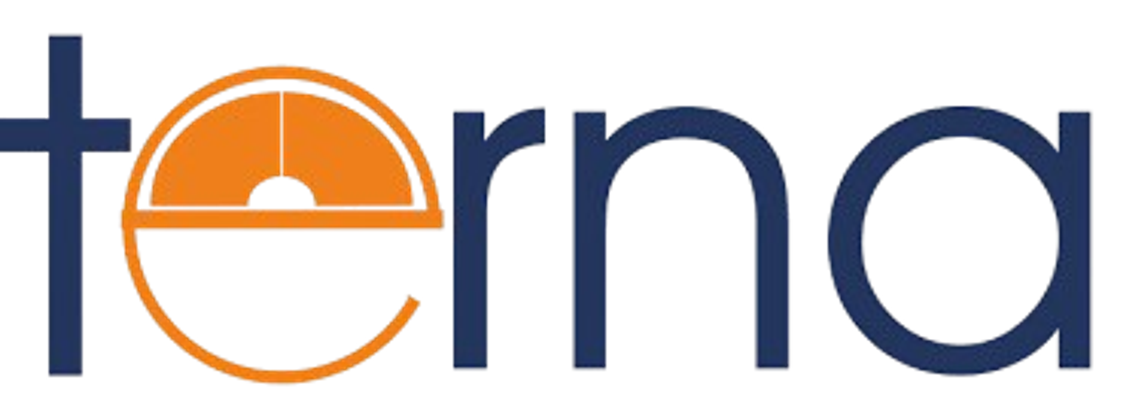
NIRMAN LAB-SEC2-73 (SH26)
Problem Statement ID – 3
Problem Statement Title:
Millions of eligible PM-JAY beneficiaries in aspirational districts remain unaware of their entitlements or are unable to navigate a claims system that was not designed for low-literacy, low connectivity populations

Slide 2
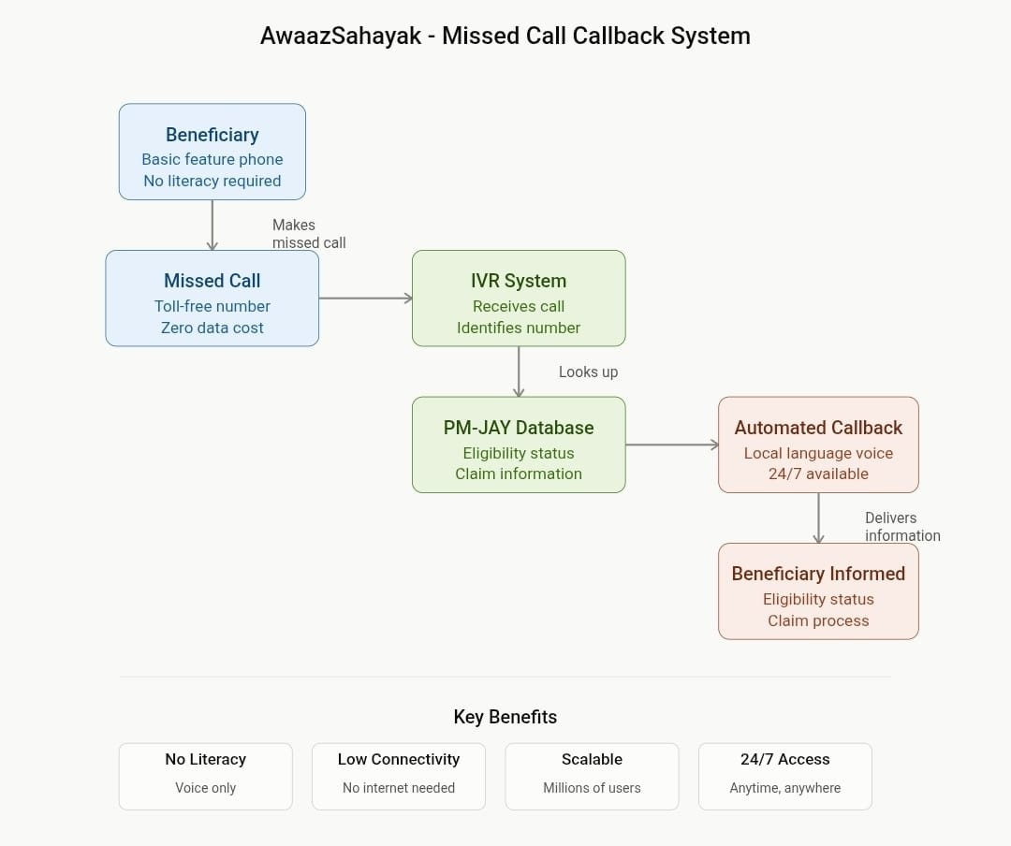
PM-JAY AwaajSahayak
Proposed Solution :
• Voice-based IVR system requiring only a missed call (no data/ literacy needed)
• Automated callback with eligibility status, claim instructions in local languages
• Works on basic feature phones with minimal/zero connectivity
• Reduces barriers: no reading, no typing, no app download required
• Proven model: successfully used for banking, utilities across India
• Scalable to handle thousands of beneficiaries simultaneously

Slide 3
TECHNICAL APPROACH
Technologies to be Used:
Telecom API (Twillio/Netcore) for IVR and callback automation
Node.js/Python backend for call routing and data processing
PostgreSQL for beneficiary database & eligibility records
Cloud infrastructure (AWS/Azure) for scalability
Multi-language NLP for local language support
Implementation Methodology:
• Phase 1: IVR system setup with local language prompts
• Phase 2: Integration with PM-JAY eligibility database
• Phase 3: Pilot testing in 2-3 aspirational districts
• Phase 4: Full rollout with continuous monitoring

Slide 4
FEASIBILITY AND VIABILITY
Feasibility Analysis:
• Telecom infrastructure already exists across rural India
• Technology stack is well-established and cost-effective
• Can be deployed in 3-4 months
• Low maintenance requirements post-deployment
Potential Challenges & Mitigation:
• Challenge: Language accuracy → Solution: Native speaker testing
• Challenge: Database integration → Solution: API standardization
• Challenge: User awareness → Solution: Ground-level community campaigns
• Challenge: Backend load → Solution: Cloud auto-scaling

Slide 5

IMPACT AND BENEFITS
Impact on Target Audience:
• Reaches millions of low-literacy, low-connectivity beneficiaries
• Enables 24/7 access to PM-JAY information without intermediaries
• Reduces time to claim information from weeks to minutes
• Increases claim acceptance rates and beneficiary satisfaction

Slide 6
RESEARCH AND REFERENCES
• PM-JAY Official Portal: https://pmjay.gov.in
• NITI Aayog Report on Digital Healthcare in Aspirational Districts (2024)
• IVR Technology Case Study: IRCTC e-ticketing system
• WHO Report on Digital Health Solutions for Low-Literacy Populations
• McKinsey Report: Digital Healthcare in Emerging Markets
• Government of India: Ministry of Health & Family Welfare Guidelines

Slide 7
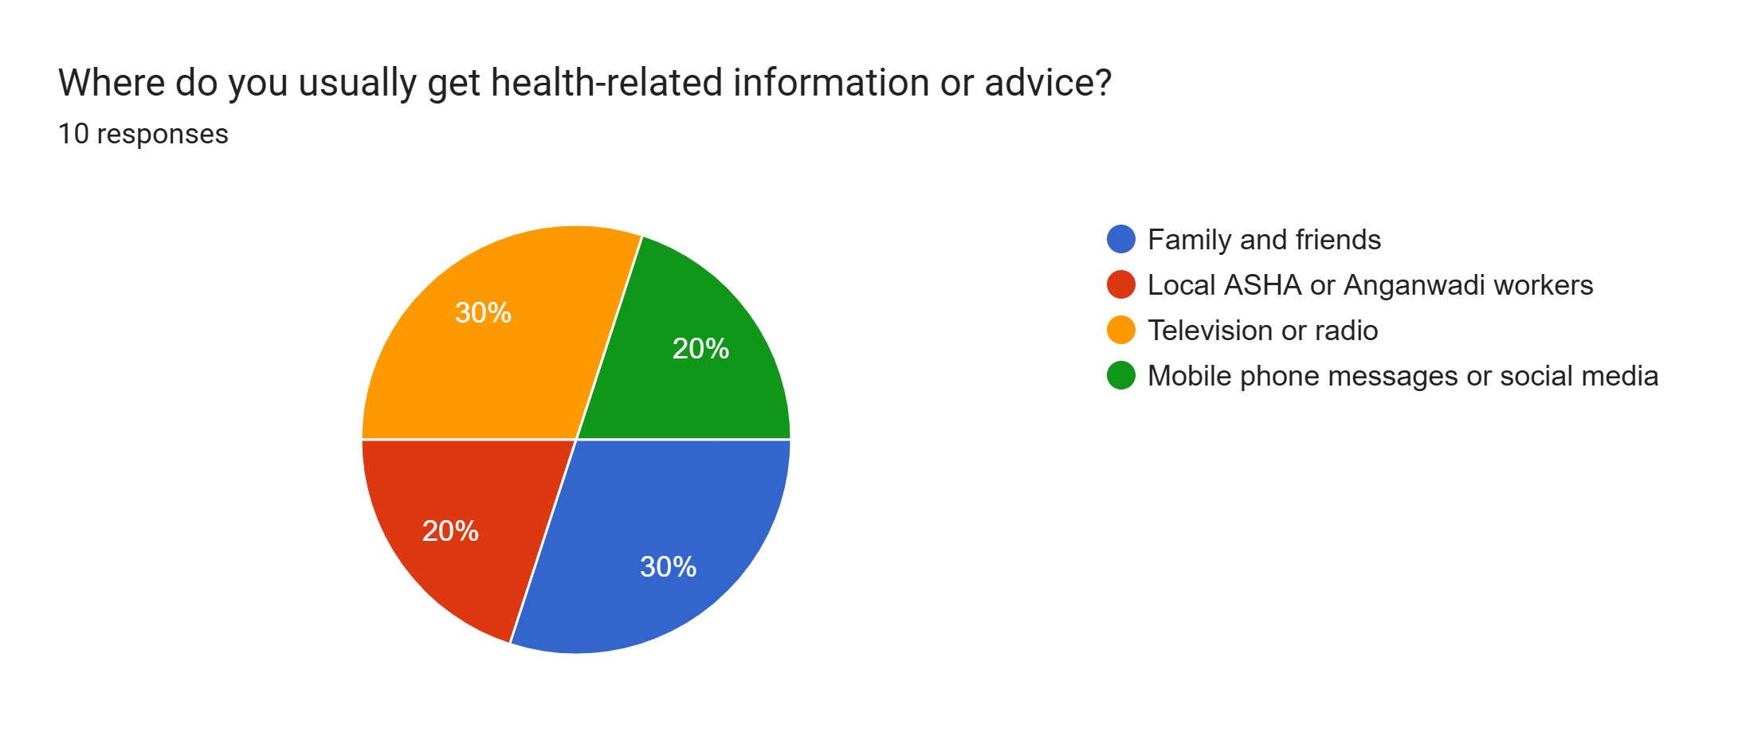
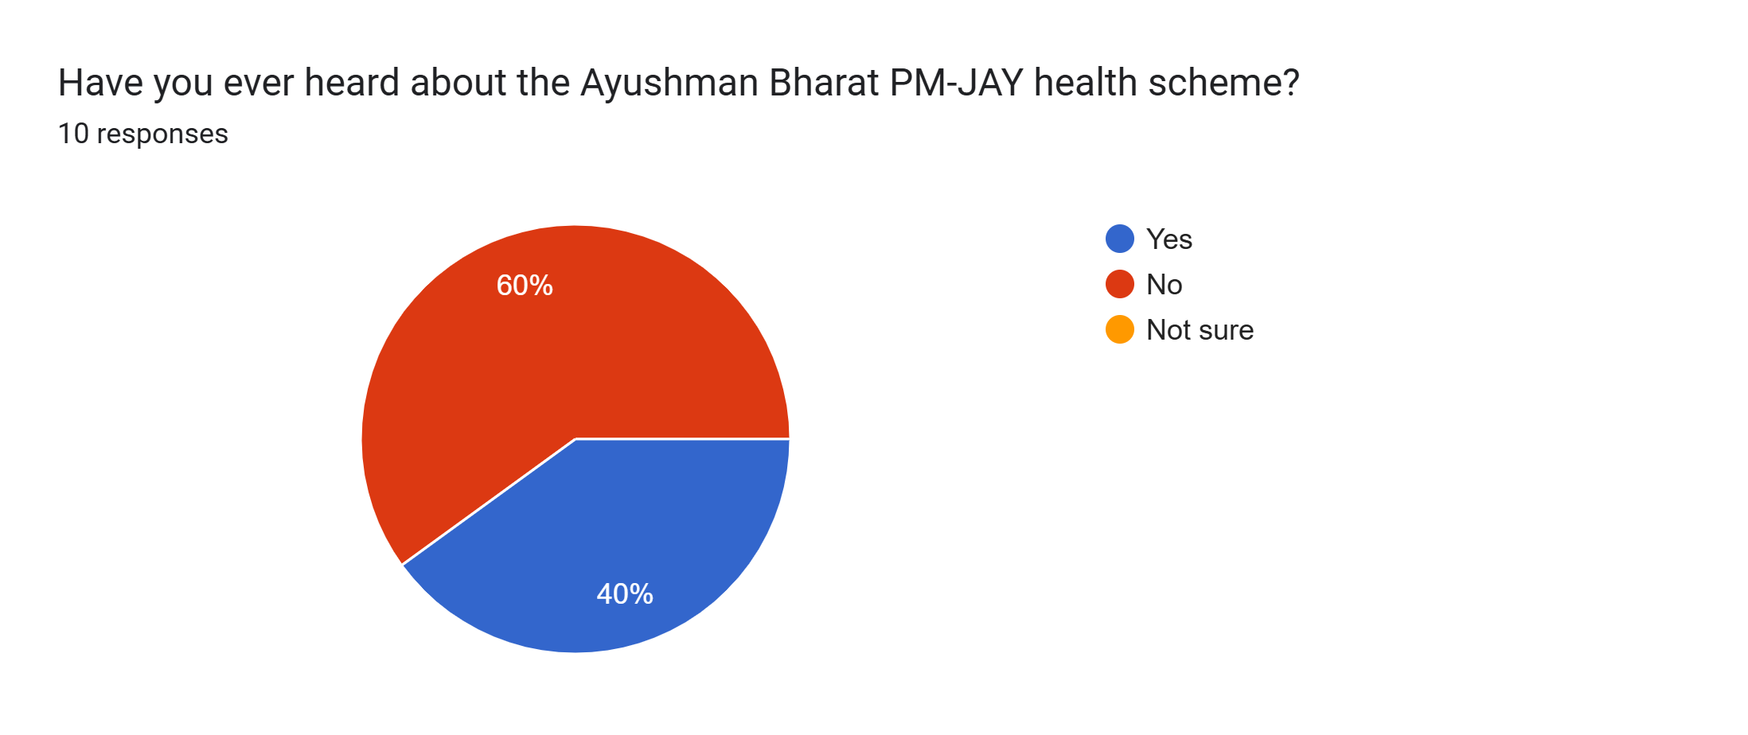
SURVEY FINDINGS
Only 4 of 10 respondents had heard of PM-JAY
Only 2 of 10 knew their family was eligible
Only 1 of 10 had used the PM-JAY claims process
7 of 10 would be willing to use a voice-based tool to file claims
Average rating for ease of understanding hospital forms: 3.1 out of 5
Main challenge: awareness and eligibility knowledge, not willingness to adopt new tools

Slide 8
Problem Context
PM-JAY (Ayushman Bharat) provides free hospital coverage of up to ₹5 lakh per family per year to eligible households in economically backward sections
Eligible families are concentrated in aspirational districts where awareness and digital access are lowest
Coverage exists on paper, but millions of families never use it because they don't know they're eligible or don't understand how to access it
The scheme has enrolled over 50 million families nationally, yet claim utilization remains low in rural areas

Slide 9
Barriers to Access
Low literacy: forms and portals are hard to use
Low connectivity: no smartphone or reliable internet in many areas
Limited awareness: many don't know they are eligible
Complex claims: unclear steps and documents discourage people
Dependency on intermediaries: People often rely on ASHA workers, agents, or hospital staff, creating delays and potential for misinformation

Slide 10
Target Users
Primary users: PM-JAY-eligible families in aspirational districts (low literacy, low connectivity)
Secondary users: ASHA workers and community health volunteers who can help spread awareness and guide families
Geographic focus: Districts identified as aspirational by NITI Aayog
Technology requirement: Only a basic feature phone needed; no smartphone, app, or internet required

Slide 11
How It Works
Step 1: Beneficiary dials a toll-free number and lets it ring once (missed call) - no cost, no data needed
Step 2: System recognizes the phone number and checks the PM-JAY eligibility database in real-time
Step 3: Within seconds, the system calls the beneficiary back automatically
Step 4: A recorded voice message in the local language provides: eligibility status, remaining coverage amount, required documents, and claim process steps
Step 5: For complex queries, the caller can be transferred to a human helpline operator

Slide 12
Current vs Proposed Process
Current Process:-
Beneficiary visits hospital or CSC center during office hours
Staff explains process verbally (often unclear)
If documents are missing, beneficiary must travel again
Process takes days or weeks
Information only available in English or Hindi
Proposed Process:-
Beneficiary makes one missed call from home
Receives callback within minutes with complete information
Information in their local language- Available 24/7, no travel needed
Zero data cost, works on any phone

Slide 13
Prototype & Demo
A working 3-page website has been built to demonstrate the AwaazSahayak system
The website features a virtual phone that simulates the missed call callback experience
Users can interact with the demo to see how beneficiaries receive information in their local language
The demo is fully functional and cost-free to access
Shows the real user journey: missed call -> system response -> eligibility information

Slide 14
Why Voice-Based Approach Works
Voice is the most accessible technology for low-literacy populations - no reading required
Missed calls are already familiar behavior across rural India - used for bank alerts, mobile recharges, utility payments
No app installation barrier - works on any phone, including basic feature phones from 10+ years ago
Zero data cost - missed call charges are minimal or free on most plans
Multi-language support is straightforward with voice recordings - can be updated quickly
Higher adoption rate compared to apps or websites in low-connectivity areas
Proven success in similar use cases: IRCTC railway booking, bank balance checks, government schemes across India

Slide 15
Conclusion
A simple, low-cost voice-based system can bridge the gap between millions of eligible families and the healthcare benefits they deserve
The solution requires no new infrastructure - it works on phones people already have and networks that already exist
Missed call technology is proven, trusted, and widely used across India for banking and utilities
Early survey results show 70% willingness to adopt such a tool

