Slide 1
Goals
Illustrate a typical machine learning workflow
Demonstrate techniques that can improve predictive performance of machine learning models
Compare predictive performance of multiple models by applying these techniques

Slide 2
A Typical Workflow
Model Estimation
CART
Random Forest
Tree Boosting
Model Comparison
Cross Validation
Parameter Turning
Model Performance
Determine out-of-sample Performance
Prediction
of Unseen Data
Data
Preprocessing
Divide data into training and testing sets
Predict new data using whole original dataset
Evaluate performance
of best model on testing set
Do k-fold CV on training set

Slide 3
Data Feature Explanation
A synthetic financial dataset for fraud detection downloaded from Kaggle Datasets.
The features used in the modeling include:
type - CASH-IN, CASH-OUT, DEBIT, PAYMENT and TRANSFER
amount - amount of the transaction in local currency
oldbalanceOrg - initial balance before the transaction
newbalanceOrig - new balance after the transaction
oldbalanceDest - initial balance recipient before the transaction
newbalanceDest - new balance recipient after the transaction
The class label is:
isFraud - This is the transactions made by the fraudulent agents inside the simulation. In this specific dataset the fraudulent behavior of the agents aims to profit by taking control of customers accounts and trying to empty the funds by transferring to another account and then cashing out of the system.
Notes:
Our dataset for this project is a synthetic financial datasets for fraud detection downloaded from Kaggle Datasets (https://www.kaggle.com/ntnu-testimon/paysim1). It is a synthetic dataset generated using the simulator called PaySim. PaySim uses aggregated data from the private dataset to generate a synthetic dataset that resembles the normal operation of transactions and injects malicious behavior to later evaluate the performance of fraud detection methods. PaySim simulates mobile money transactions based on a sample of real transactions extracted from one month of financial logs from a mobile money service implemented in an African country. The original logs were provided by a multinational company, who is the provider of the mobile financial service which is currently running in more than 14 countries all around the world. This synthetic dataset is scaled down 1/4 of the original dataset and it is created just for Kaggle.
This is a sample of 1 row with headers explanation:
1,PAYMENT,1060.31,C429214117,1089.0,28.69,M1591654462,0.0,0.0,0,0
step - maps a unit of time in the real world. In this case 1 step is 1 hour of time. Total steps 744 (30 days simulation).
type - CASH-IN, CASH-OUT, DEBIT, PAYMENT and TRANSFER.
amount - amount of the transaction in local currency.
nameOrig - customer who started the transaction
oldbalanceOrg - initial balance before the transaction
newbalanceOrig - new balance after the transaction
nameDest - customer who is the recipient of the transaction
oldbalanceDest - initial balance recipient before the transaction. Note that there is not information for customers that start with M (Merchants).
newbalanceDest - new balance recipient after the transaction. Note that there is not information for customers that start with M (Merchants).
isFraud - This is the transactions made by the fraudulent agents inside the simulation. In this specific dataset the fraudulent behavior of the agents aims to profit by taking control of customers accounts and trying to empty the funds by transferring to another account and then cashing out of the system.
isFlaggedFraud - The business model aims to control massive transfers from one account to another and flags illegal attempts. An illegal attempt in this dataset is an attempt to transfer more than 200.000 in a single transaction.

Slide 4
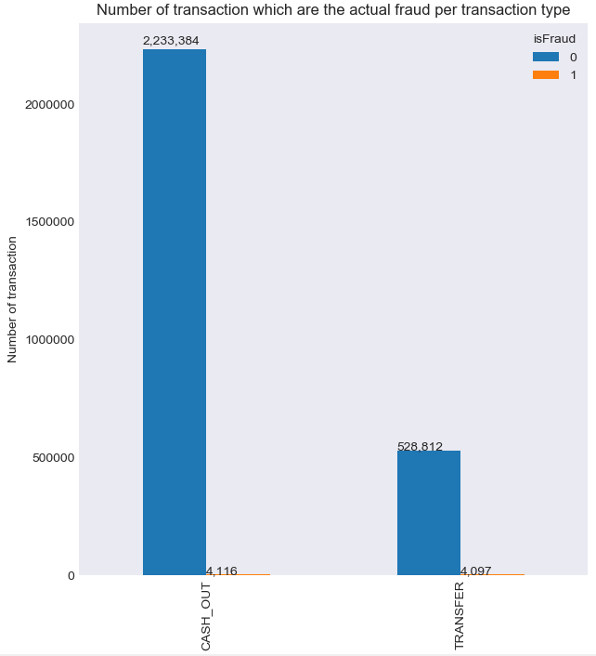
Data Preprocessing: Summary
Number of transaction which are the actual fraud per transaction type
Number of Transaction
Cash_Out
Transfer
Notes:
The dataset has 6,362,620 records, 10 features, and 1 class feature. We checked missing data and there were no null values. There are 5 transaction types, but we only focused on “Transfer” and “Cash out” transaction types, as they had been identified to have fraud transactions. Therefore, records of unrelated transaction types were deleted, which finally produced 2,770,409 records.
2. The ratio of fraud transactions of the filtered dataset was only 0.2965%. This is a very imbalanced dataset. We sampled it to have a balanced data. We sampled the dataset to create a 50-50 ratio by randomly selecting 8,213 records from the majority class, with the number 8,213 representing the total number of records in the minority class. It produced 16,426 records.
Resampling
Class imbalanced problem: The data distribution of each class differs substantially where the main class or classes of interest are rare.
Class imbalance problem: An accuracy rate of, say, 97% may make the classiﬁer seem quite accurate, but what if only, say, 3% of the training tuples are actually cancer? Clearly, an accuracy rate of 97% may not be acceptable—the classiﬁer could be correctly labeling only the non-cancer tuples, for instance, and misclassifying all the cancer tuples.
Ways to deal with class imbalanced data: oversampling, under-sampling, threshold moving, ensemble techniques
Perform under-sampling approach: It randomly eliminates cases from the majority (negative) class until there are an equal number of positive and negative cases.

Slide 5
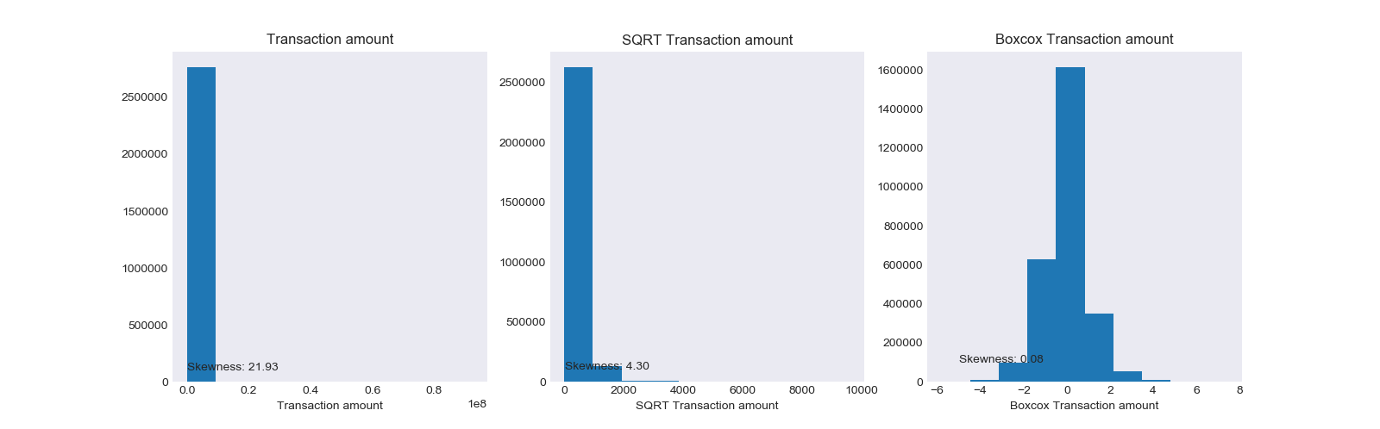


Data Preprocessing: Normalization
Count
Transaction amount
SQRT Transaction amount
Boxcox Transaction amount
Notes:
3. The relevant features to fraud transaction were “type”, “amount”, “oldbalanceOrg”, “newbalanceOrig”, “oldbalanceDest”, and “newbalanceDest”. We thus deleted the unrelated features. We binarized the values of “type” feature from string into binary numeric. All relevant features were used as predictors. Feature selection will be refined at the later stage.
4. We standardized the continuous features—“amount”, “oldbalanceOrg”, “newbalanceOrig”, “oldbalanceDest”, and “newbalanceDest”—through boxcox transformation.
Normalization: this technique is needed for distance-based mining algorithms
Reasons for Normalization:
Facilitate convergence in classification for ANN algorithm;
Reduce the effect of outliers or extreme values on classification in decision tree algorithm that is sensitive to deviations;
For distance-based methods, such as clustering, prevent attributes with initially large ranges (e.g., income) from outweighing attributes with initially smaller ranges (e.g., binary attributes)
Normal Distribution
Many ML algorithms assume data are normally distributed. Normalizing data distribution can improve prediction accuracy.
This procedure finds the appropriate Box-Cox power transformation (1964) for a single batch of data. It is used to
modify the distributional shape of a set of data to be more normally distributed so that tests and confidence limits
that require normality can be appropriately used. It cannot correct every data ill. For example, data that contain
outliers may not be properly normalized by this technique.
The Box-Cox transformation has the following mathematical form
𝑌 = (𝑋 + 𝛿)Power(𝜆)
where λ is the exponent (power) and δ is a shift amount that is added when X is zero or negative. When λ is zero,
the above definition is replaced by
𝑌 = ln(X + δ)
Usually, the standard λ values of -2, -1.5, -1, -0.5, 0, 0.5, 1, 1.5, and 2 are investigated to determine which, if any,
is most suitable. The program will also solve for the optimum value of λ using maximum likelihood estimation.
The program also calculates confidence limits about the optimum value. The usual procedure is to adopt the most
convenient standard value between the confidence limits. For example, if the confidence limits were 0.4 to 1.1, λ
would be set to the standard value of ‘1’ (no transformation) since this is the most convenient. Care must be used
when using the confidence limits, because they are heavily dependent on the sample size.
Also see scipy.stats.boxcox() documentation for operational details.
scipy.stats.boxcox¶
scipy.stats.boxcox(x, lmbda=None, alpha=None)[source]¶
Return a positive dataset transformed by a Box-Cox power transformation.
Parameters:
x : ndarrayInput array. Should be 1-dimensional.
lmbda : {None, scalar}, optionalIf lmbda is not None, do the transformation for that value.
If lmbda is None, find the lambda that maximizes the log-likelihood function and return it as the second output argument.
alpha : {None, float}, optionalIf alpha is not None, return the 100 * (1-alpha)% confidence interval for lmbda as the third output argument. Must be between 0.0 and 1.0.
Returns:
boxcox : ndarrayBox-Cox power transformed array.
maxlog : float, optionalIf the lmbda parameter is None, the second returned argument is the lambda that maximizes the log-likelihood function.
(min_ci, max_ci) : tuple of float, optionalIf lmbda parameter is None and alpha is not None, this returned tuple of floats represents the minimum and maximum confidence limits given alpha.

Slide 6
Implementation
Consistent across classifiers:
Filtered/sampled balanced data were used for supervised learning.
Training and testing sets were spitted at ratio 7:3.
Cross validation procedures were performed to optimize the parameters with CV Fold = 10.
Varying across classifiers:
The model parameters as well as the range of sensible values

Slide 7
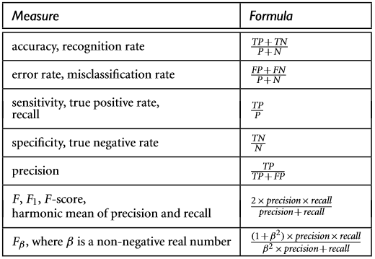
Model Evaluation – Evaluation Measures
Notes:
For the model evaluation, we are more inclined to increase the recall score rather than the precision score or the accuracy score in order to capture the most fraudulent transactions. This is because if we predict a normal transaction to be fraudulent, it is not as serious as the opposite situation.

Slide 8
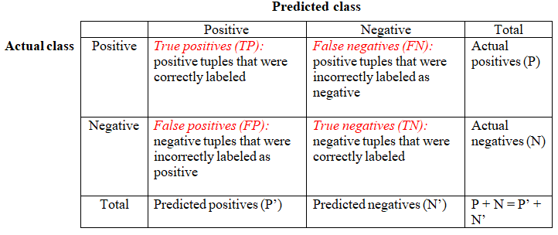
Model Evaluation – Confusion Matrix
Actual Class
Recall = TP/P

Slide 9
Supervised vs. Unsupervised Learning
Supervised learning (classification)
Supervision: The training data (observations, measurements, etc.) are accompanied by labels indicating the class of the observations
New data is classified based on the training set
Unsupervised learning (clustering)
The class labels of training data are unknown
Given a set of measurements, observations, etc. with the aim of establishing the existence of classes or clusters in the data

Slide 10

Illustrating Classification Task
Classification
Algorithms
Learn Model
Classifier
(Model)
Apply Model
Testing Set
Unseen Data
Notes:
Classification is a two-step process:
Model construction: describing a set of predetermined classes
Each sample is assumed to belong to a predefined class, as determined by the class label attribute
The set of samples used for model construction is training set
The model is represented as classification rules or mathematical formulae
Model usage: for classifying future or unknown objects
Estimate accuracy of the model
The known label of test sample is compared with the classified result from the model
Accuracy rate is the percentage of test set samples that are correctly classified by the model
Test set is independent of training set (otherwise over-fitting)
If the accuracy is acceptable, use the model to classify data tuples whose class labels are not known

Slide 11
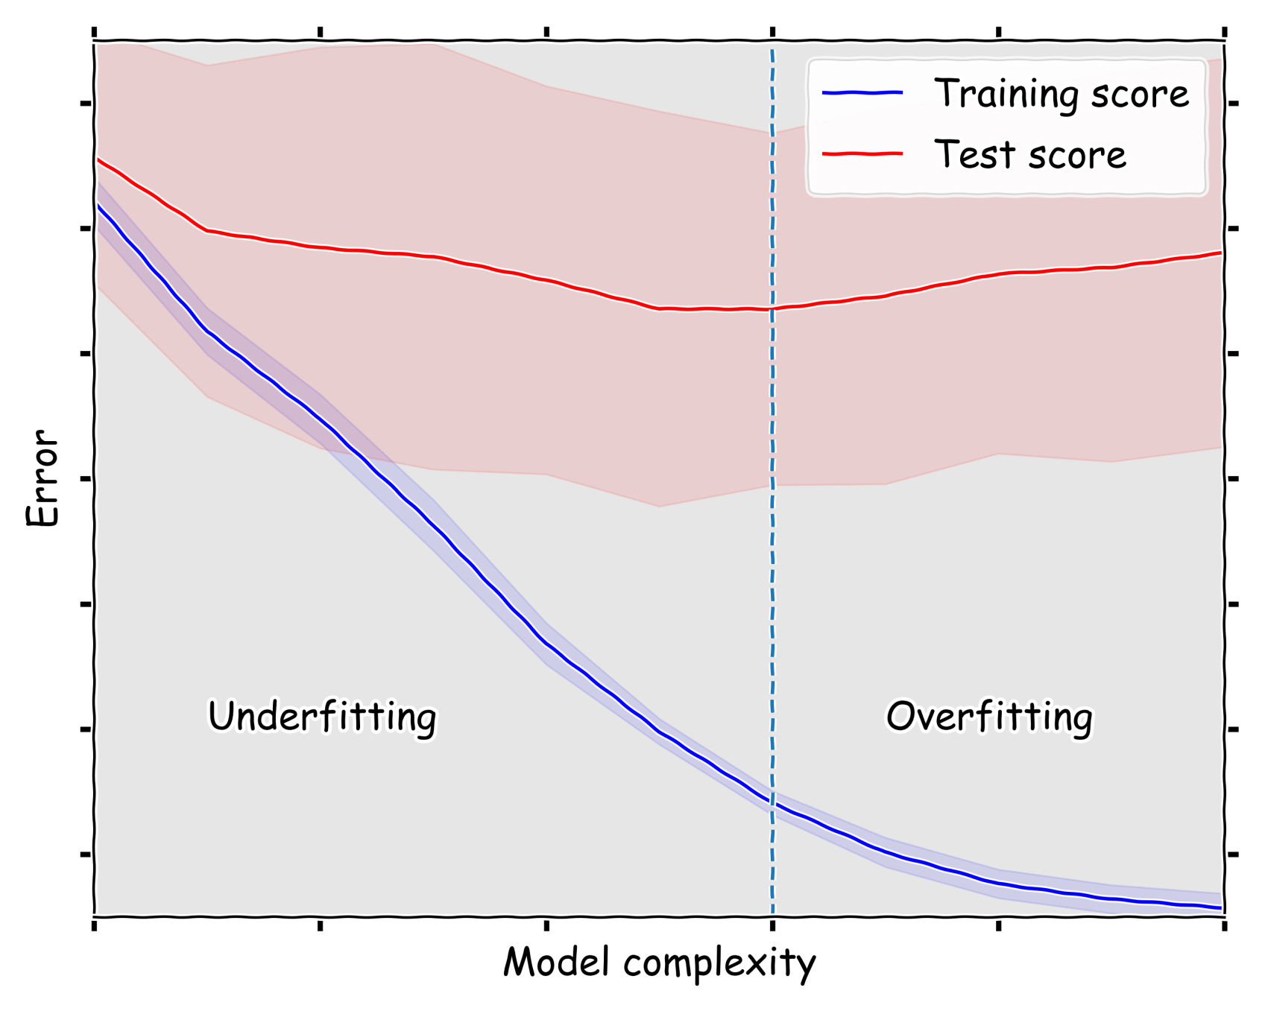
Model Underfitting and Overfitting
Notes:
A good classification model must not only fit the training data well, it must also accurately classify records it has never seen before. This is important because a model that fits the training data too well can have a poorer prediction over the testing data than a model with a higher training error. Such a situation is known as model overfitting. As the slide shows,
Underfitting: when the classification model is too simple, both training and testing errors are large. It occurs because the model has yet to learn the true structure of the data.
Overfitting: as we increase the complexity of the model, both training errors and testing errors become smaller. But as we continue to increase the complexity of the model beyond some cutoff point, it will overfit the training data. Training errors continue to lower, but testing errors rise up. This is because when the model is too complicated, it may reflect anomalies due to noise or outliers. These specifics do not generalize well on the testing examples. In the extreme situation, a model can perfectly fits the training data. In this case, the model is purely descriptive, describing every detail of the training data.
Overfitting thus leads to poor accuracy for testing set and unseen samples.

Slide 12
The Approach: Use a Validation Set
Training Set
Testing Set
Rest of Training Set
Validation Set
Used for Model Performance Estimation
Reserved for Model Building
Used for Error Estimation
Notes:
How do we determine the right model complexity? The ideal complexity of a model is that the model has the lowest testing error. The problem is that the learning algorithm has only access to the training set during the model building process, it has no knowledge about the testing set, thus does not know how well the model will perform on the testing set. The best it can do is to estimate the testing error of the induced tree.
How to estimate testing errors? There are several approaches. For example, one approach explicitly computes testing errors as the sum of training errors and a penalty term for model complexity. The approach we cover here is to use a validation set. In this approach, instead of using the training set to estimate the testing error, the original training data is divided into two smaller subsets. One of the subsets is used for training, while the other, known as the validation set, is used for estimating the testing error.

Slide 13
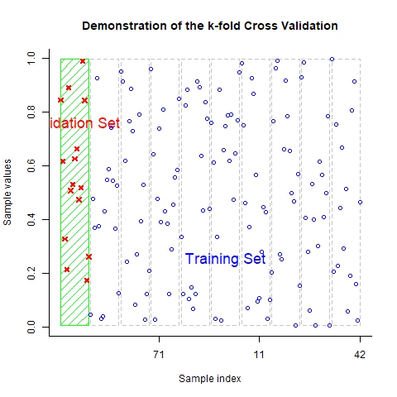
Cross-Validation
Notes:
The method of using a validation set to estimate testing errors can be repeated several times in order to improve the testing error estimation. This approach is known as k-fold cross-validation. How to cross-validate then?
Divide the training set into 𝑘 mutually exclusive subsets or folds, each of approximately equal size;
The k rectangles in the plot denote the k folds of data. The validation set and the training set are marked with different colors.
Training and testing is performed 𝑘 times. In each iteration, fit a model on the “blue” data, test it on the “green” data;
Keep track of accuracy score for each iteration
Each example is used the same number of times for training and exactly once for testing.

Slide 14
Grid Search Method
Parameter 1 Parameter 2 Parameter 3 Cross-Validated Mean
Gini 20 10 0.992
Gini 20 15 0.990
Gini 30 10 0.993
Gini 30 15 0.991
Gini 40 10 0.994
Gini 40 15 0.992
Entropy 20 10 0.994
Entropy 20 15 0.992
Entropy 30 10 0.995
Entropy 30 15 0.993
Entropy 40 10 0.996
Entropy 40 15 0.994
Notes:
The cross-validation approach is typically used with the classification techniques that can be parameterized to obtain models with different levels of complexity. The complexity of the best model can be estimated by adjusting the parameter of the learning algorithm (e.g., the pruning level of a decision tree) until the empirical model produced by the learning algorithm attains the lowest error rate on the validation set.
Specify a set of reasonable parameter settings for the optimization;
For each parameter setting, do 𝑘-fold cross-validation, get the average accuracy from the 𝑘 times of iteration;
Select the parameter setting that corresponds to the highest average accuracy;
By doing this, we can find a model of the right complexity that is not susceptible to overfitting.
Once the model has been constructed, run the model (with the selected parameter setting) over the testing set to get the performance of the model. It is often useful to measure the performance of the model on the testing set because such a measure provides an unbiased estimation of its accuracy. The accuracy score computed from the testing set can be used to compare the relative performance of different classifiers on the same domain.
The performance of the model should be better than the default model (with no cross-validation) because it controls overfitting.

Slide 15
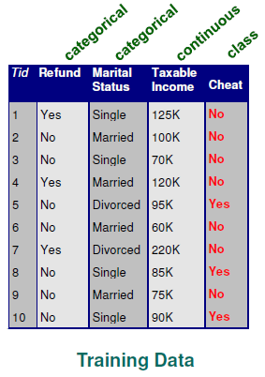
Classification and Regression Trees (CART)
Splitting Attributes
Refund
Yes
No
NO
Mar St
Single, Divorced
Married
Tax Inc
NO
< 80K
> 80K
NO
YES
Notes:
Example of decision tree classification
Basic algorithm: Tree is constructed in a top-down recursive partitioning manner
At start, all the training examples are at the root. Consider all possible values of all variables;
Select the variable/value (X=t1) that produces the greatest “separation” in the target. (X=t1) is called a “split”;
If X< t1 then send the data to the “left”; otherwise, send data point to the “right”;
Now repeat same process on these two “nodes”. You get a “tree”;
Note: CART only uses binary splits.

Slide 16
Classification and Regression Trees (CART)
Splitting Attributes
Mar St
Married
Single, Divorced
NO
Refund
Yes
No
NO
Tax Inc
< 80K
> 80K
NO
YES
Notes:
Example of decision tree classification
Basic algorithm: Tree is constructed in a top-down recursive partitioning manner
At start, all the training examples are at the root. Consider all possible values of all variables;
Select the variable/value (X=t1) that produces the greatest “separation” in the target. (X=t1) is called a “split”;
If X< t1 then send the data to the “left”; otherwise, send data point to the “right”;
Now repeat same process on these two “nodes”. You get a “tree”;
Note: CART only uses binary splits.

Slide 17
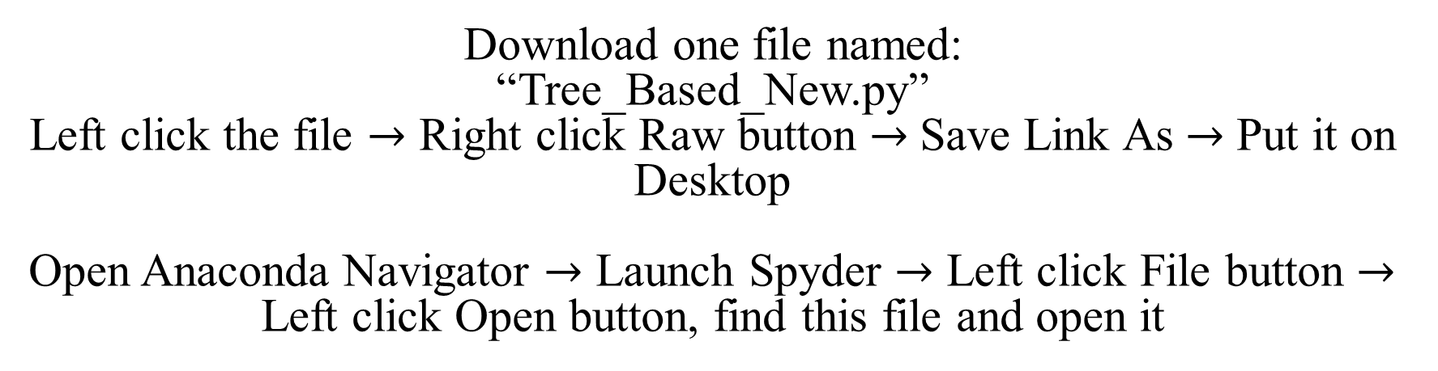
Implementation 1
http://bit.ly/Datafest19_ML
Download one file named:
“Tree_Based_New.py”
Left click the file $→$ Right click Raw button $→$Save Link As $→$ Put it on Desktop
Open Anaconda Navigator $→$ Launch Spyder $→$ Left click File button $→$ Left click Open button, find this file and open it
Notes:
The smaller the degree of impurity, the more skewed the class distribution. For example, a node with class distribution (0, 1) has zero impurity, whereas a node with uniform class distribution (0.5, 0.5) has the highest impurity.
$$Entropy \left(t\right)=−\sum_{i=0}^{c−1}{p(i|t)\log_{2}{p\left(i | t\right),}}$$
$Gini\left(t\right)=1−\sum_{i=0}^{c−1}{{\left[p(i|t)\right]}^{2}}$,
$Classification error\left(t\right)=1−\max_{i}\left[p(i|t)\right]$,
where $p\left(i | t\right)$denotes the fraction of records belonging to class i at a given node t. c is the number of classes and $0\log_{2}{0=0}$ in entropy calculations.
Need some thing more here.
It illustrates the consistency among different impurity measures. The choice of impurity measure has little effect on the performance of decision tree induction algorithms.
To determine how well a test condition performs, we need to compare the degree of impurity of the parent node (before splitting) with the degree of impurity of the child nodes (after splitting). The larger their difference, the better the test condition. The gain is a criterion that can be used to determine the goodness of a split. Decision tree induction algorithms often choose a test condition that maximizes the gain. Since parent is the same for all test conditions, maximizing the gain is equivalent to minimizing the weighted average impurity measures of the child nodes. When entropy is used as the impurity measure, the difference in entropy is known as the information gain.
Typical stopping conditions for a node:
When all records for a given node belong to the same class;
When there are no remaining attributes for further partitioning—when all the records have similar attribute values;
When there are no samples left;
Early termination (Pre-pruning)
Address overfitting
Impose more restrictive conditions for node splitting
User-specified thresholds are the input values for the model parameters that control model complexity. Use cross-validation to select the best parameters so as to get the optimal decision tree.
More restrictive conditions for node splitting:
Stop if the depth of the tree is larger than some user-specified threshold;
Stop if the number of samples required to split an internal node is less than some user-specified threshold;
Stop if expanding the current node does not improve impurity measures (e.g., Gini or entropy) with some user-specified threshold.
need more information here.
Stop if the number of samples required to be at a leaf node is less than some user-specified threshold;
Stop if the weighted fraction of the sum total of weights (of all the input samples) required to be at a leaf node is less than some user-specified threshold;
Stop if the number of features to consider when looking for the best split is larger than some user-specified threshold;
Stop if the number of leaf nodes is larger than some user-specified threshold;
Stop if the split at a node induces a decrease of the impurity less than or equal to some user-specified threshold;

Slide 18
EXERCISE 1 CART
1) Explore the dataset: a. print out the first 10 records;
b. print out the class distribution.
2) Preprocess the dataset: a. separate feature columns from the class label column;
b. separate data into a training and testing sets at ratio 8:2;
c. reshape the class column into an 1d array for both training and testing sets.
3) Build a DEFAULT CART model and report its accuracy performance.
4) Use grid search method with 5-fold cross-validation to find the best tree parameters and setting as well as corresponding mean accuracy. You could choose parameters different from those used in demonstration.
5) Report accuracy performance of the optimal tree. Compare this performance with that of the default tree.
6) (Optional) Report feature importance of the optimal tree.

Slide 19

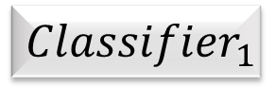


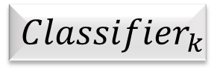
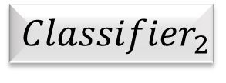
Ensemble Methods: Increasing the Accuracy
New Data Tuple
$${Classifier}_{1}$$
$${Data}_{1}$$
$${Classifier}_{2}$$
Data
Class Prediction
$${Data}_{2}$$
Combine Votes
…
$${Data}_{k}$$
$${Classifier}_{k}$$
Notes:
A set of weak learners are combined to create a strong learner that obtains better performance than a single one.
A given data set, D, is used to create k training sets, D1, D2, ……, Dk. Each of these training sets is used to generate a base classifier Ci. The classifiers can be the same or be different. Given a new data tuple to classify, the new data tuple could be from the testing set or the unseen data, the base classifiers each vote by returning a class prediction for the new data tuple. The ensemble returns a class prediction based on the votes of the base classifiers.
Multiple training sets are created by resampling the original data according to some sampling distribution. The sampling distribution determines how likely it is that an example will be selected for training, and it may vary from one trial to another. A classifier is then built from each training set using a particular learning algorithm. Bagging and boosting are two examples of ensemble methods that manipulate their training sets.
The base classifiers can be generated sequentially (one after another) or in parallel (all at once).
Ensemble methods work better with unstable classifiers, i.e., base classifiers that are sensitive to minor perturbations in the training set. Examples of unstable classifiers include decision trees, artificial neural networks.
The class can be obtained by taking a majority vote on the individual predictors or by weighting each prediction with the accuracy of the base classifier.

Slide 20
Rational for Ensemble Method
In general, ensembles improve accuracy by aggregating predictions of multiple classifiers.
But two necessary conditions for an ensemble to perform better than a single classifier:
The base classifiers should be independent of each other;
The base classifiers should do better than a classifier that performs random guessing.
Notes:
For example, consider an ensemble that performs majority voting. That is, given a tuple X to classify, it collects the class label predictions returned from the base classifiers and outputs the class in majority. The base classifiers may make mistakes, but the ensemble will misclassify X only if over half of the base classifiers are in error.
If the base classifiers are independent—i.e., their errors are uncorrelated—then, the ensemble makes a wrong prediction only if more than half of the base classifiers predict incorrectly
$$e_{ensemble}=\sum_{i=\left[\frac{n}{2}\right]+1}^{n}{\left(\begin{matrix}n \\ i\end{matrix}\right)}ε^{i}{\left(1−ε\right)}^{n−i}$$
In practice, it is difficult to ensure total independence among the base classifiers. Improvements in accuracies have been observed in ensemble methods in which the base classifiers are slightly correlated.
The figure shows the error rate of an ensemble of 25 binary classifiers for different base classifier error rates € and for different degree of independence among base classifiers. Here, each of the 25 binary classifiers has the same error rate e. The ensemble classifier predicts the class label of a test example by taking a majority vote on the predictions made by the base classifiers.
The diagonal line represents the case in which the base classifiers are identical. This means the base classifiers are all the same, and the training set for each base classifier is the same, too. If the base classifiers are the same, and the error rates are the same, when aggregating them, then the ensemble will misclassify the same examples predicted incorrectly by the base classifiers. Thus, the error rate of the ensemble remains the same.
The solid lines represent the cases in which the base classifiers are correlated with different degrees. Improvement in accuracy is less in the case where the base classifiers are correlated. Improvement in accuracy is more in the case where the base classifiers are independent.
Ensemble performs worse than the base classifiers when e is larger than 0.5.

Slide 21
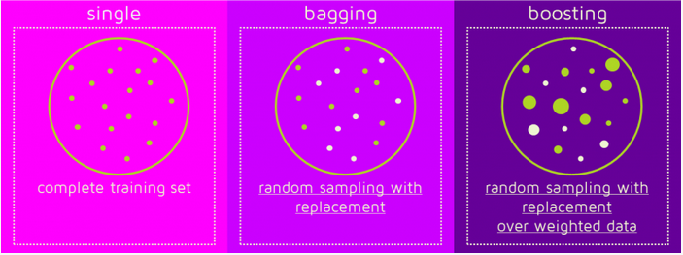
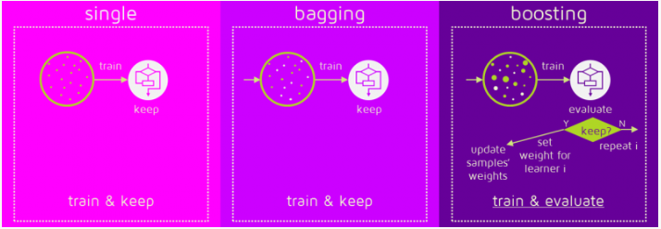
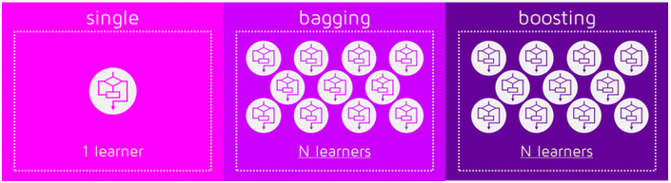
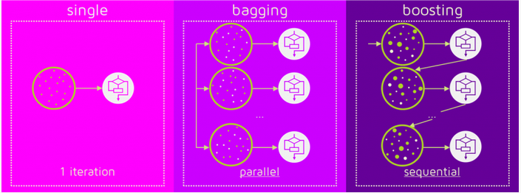
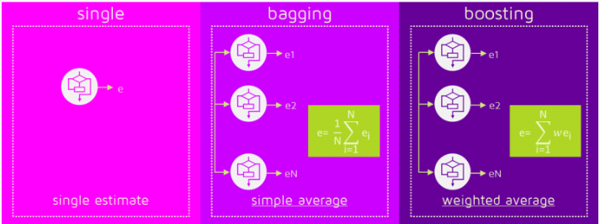
Ensemble Methods
Notes:
Picture 1: To use Bagging or Boosting you must select a base learner algorithm. For example, if we choose a classification tree, Bagging and Boosting would consist of a pool of trees as big as we want.
Picture 2: Bagging and Boosting get N learners by generating additional data in the training stage. N new training data sets are produced by random sampling with replacement from the original set. By sampling with replacement some observations may be repeated in each new training data set. In the case of Bagging, any element has the same probability to appear in a new data set. However, for Boosting the observations are weighted and therefore some of them will take part in the new sets more often. These multiple sets are used to train the same learner algorithm and therefore different classifiers are produced.
Picture 3: While the training stage is parallel for Bagging (i.e., each model is built independently), Boosting builds the new learner in a sequential way. In Boosting algorithms each classifier is trained on data, taking into account the previous classifiers’ success. After each training step, the weights are redistributed. Misclassified data increases its weights to emphasize the most difficult cases. In this way, subsequent learners will focus on them during their training.
Picture 4: Some of the Boosting techniques include an extra-condition to keep or discard a single learner. For example, in AdaBoost, the most renowned, an error less than 50% is required to maintain the model; otherwise, the iteration is repeated until achieving a learner better than a random guess.
Picture 5: To predict the class of new data we only need to apply the N learners to the new observations. In Bagging the result is obtained by averaging the responses of the N learners (or majority vote). However, Boosting assigns a second set of weights, this time for the N classifiers, in order to take a weighted average of their estimates. In the Boosting training stage, the algorithm allocates weights to each resulting model. A learner with good a classification result on the training data will be assigned a higher weight than a poor one. So when evaluating a new learner, Boosting needs to keep track of learners’ errors, too.

Slide 22
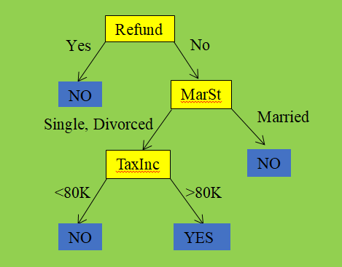
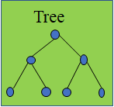
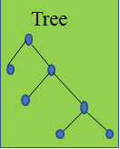
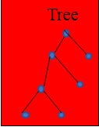
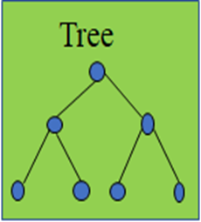
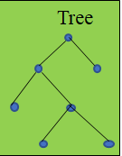
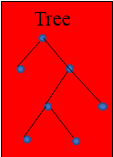

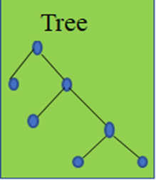
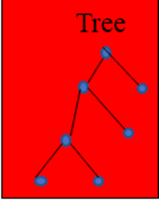
Random Forest
All Training Data
Notes:
Each tree is planted and grown as follows:
Assume number of cases in the training set is N. Then, sample of these N cases is taken at random but with replacement. This sample will be the training set for growing the tree.
If there are M input variables, a number of m < M is specified such that at each node, m variables are selected at random out of the M. The best split on these m is used to split the node. The value of m is held constant while we grow the forest.
Each tree is grown to the largest extent possible and there is no pruning.
Predict new data by aggregating the predictions of the ntree trees (i.e., majority votes for classification).
Why take random sample with replacement?
This step is the bagging method. Bagging, known as bootstrap aggregating, is a technique that repeatedly samples (with replacement) from a data set according to a uniform probability distribution. Each bootstrap sample has the same size as the original data. Because the sampling is done with replacement, some instances may appear several times in the same training set, while others may be omitted from the training set. On average, a bootstrap sample contains approximately 63% of the original training data. Random sample with replacement ensures that every sample has an equal probability of being selected. Bagging does not focus on any particular instance of the training data. It is therefore less susceptible to model overfitting when applied to noisy data.
Why take random selection of subset of features?
Decision trees aspire to minimize the cost, which means they make use of strongest predictors/classifiers for splitting the branches. So, most of the trees made from bootstrapped samples would use the same strong predictor in different splits. This relates the trees and leads to variance. We can improve the prediction accuracy of Bagged Trees using Random Forests. While splitting branches of any tree, a random sampled of m predictors is chosen as split candidates from the full set of p predictors. The split is then allowed to only use one of those m predictors. A fresh sample of m predictors is taken at each split. You can try different values and tune it using cross validation. Thus, on average, (p — m) / p of the splits will not even consider the strong predictor. This is known as decorrelating the trees, as we fix the issue of each tree using same strong predictor.
Randomly select F input features to split at each node of the decision tree. The strength and correlation of random forests may depend on the size of F. if F is small, then the trees tend to be less correlated. On the other hand, the strength of the tree classifier tends to improve with a larger number of features. As a tradeoff, the number of features chosen is one of the parameters to turn and select.
Why each tree is grown to the largest extent without pre- or post-pruning?
1. This may help reduce the bias present in the resulting tree.

Slide 23

Random Forest
Each tree is planted as follows:
Take a sample from the training set at random with replacement
At each node, choose a subset of variables out of all input variables at random
Find a variable (and a value for that variable) which optimizes the split
All Training Data
Notes:
Each tree is planted and grown as follows:
Assume number of cases in the training set is N. Then, sample of these N cases is taken at random but with replacement. This sample will be the training set for growing the tree.
If there are M input variables, a number of m < M is specified such that at each node, m variables are selected at random out of the M. The best split on these m is used to split the node. The value of m is held constant while we grow the forest.
Each tree is grown to the largest extent possible and there is no pruning.
Predict new data by aggregating the predictions of the ntree trees (i.e., majority votes for classification).
Why take random sample with replacement?
This step is the bagging method. Bagging, known as bootstrap aggregating, is a technique that repeatedly samples (with replacement) from a data set according to a uniform probability distribution. Each bootstrap sample has the same size as the original data. Because the sampling is done with replacement, some instances may appear several times in the same training set, while others may be omitted from the training set. On average, a bootstrap sample contains approximately 63% of the original training data. Random sample with replacement ensures that every sample has an equal probability of being selected. Bagging does not focus on any particular instance of the training data. It is therefore less susceptible to model overfitting when applied to noisy data.
Why take random selection of subset of features?
1. Randomly select F input features to split at each node of the decision tree. The strength and correlation of random forests may depend on the size of F. if F is small, then the trees tend to be less correlated. On the other hand, the strength of the tree classifier tends to improve with a larger number of features. As a tradeoff, the number of features chosen is one of the parameters to turn and select.
Why each tree is grown to the largest extent without pre- or post-pruning?
1. This may help reduce the bias present in the resulting tree.
Tree boosting vs. random forest:
Tree boosting: the base learners are decision trees, they are trained sequentially with the later trees focusing more on the mistakes made by the earlier ones. There is the dependence among the individual trees.
Random forest: the base learners are decision trees, they are trained in parallel on different data subsets and using random features. The randomness makes the individual trees less dependent.
2.

Slide 24
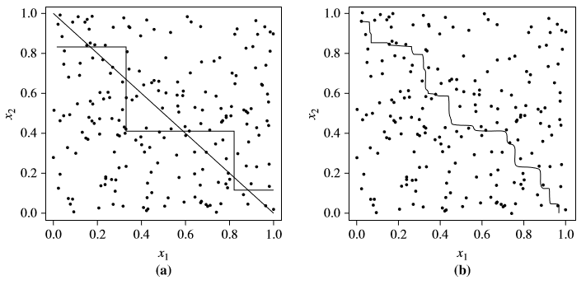

Random Forest
True Decision Boundary
True Decision Boundary
Single Decision Tree Boundary
Random Forest Boundary
Notes:
Decision boundary by (a) a single decision tree, (b) an ensemble of decision trees. The actual decision boundary is a straight line.
Random forest improves accuracy compared with a single tree because (1) it aggregates predictions from multiple trees, and (2) it builds randomness into the process so that the individual trees are less dependent.
This figure illustrates the power of random forest. Consider a simple two-class problem described by two attributes, x1 and x2. The ensemble’s decision boundary is much closer to the true linear decision boundary than the decision boundary of a single tree. This is because the error rate of the ensemble is considerably lower than the error rate of the base classifiers if the base classifiers do a reasonably good job.
The “random” part of random forest is that for each split on a tree, you take a random subset of the features but still use the same splitting criteria.
The parameters for decision trees are also available for random forest implementations but each have additional parameters.
Spark has two additional parameters: “numTrees” — how many trees to use in the random forest; and “featureSubsetStrategy” — how to select the subset of features at each split.
Scikit-learn has two parameters that map with those seen with Spark: “n_estimators” — the number of trees; “max_features” — the number of features in your subset (this is also available in the decision tree algorithm). It also has the following: “bootstrap” — whether the data should be bootstrapped when sampling for trees; “oob_score” — whether the score should be based only on examples that haven’t been used in each tree (out-of-bag); “n_jobs” — the number of jobs (trees to build) to run in parallel; “verbose” — a value to indicate how much information to print when fitting and predicting; and “warm_start” — to be used if you are adding more estimators (trees) to an existing ensemble (forest).
Here’s an article for more information on random forest parameter tuning with Scikit-learn: https://www.analyticsvidhya.com/blog/2015/06/tuning-random-forest-model/

Slide 25
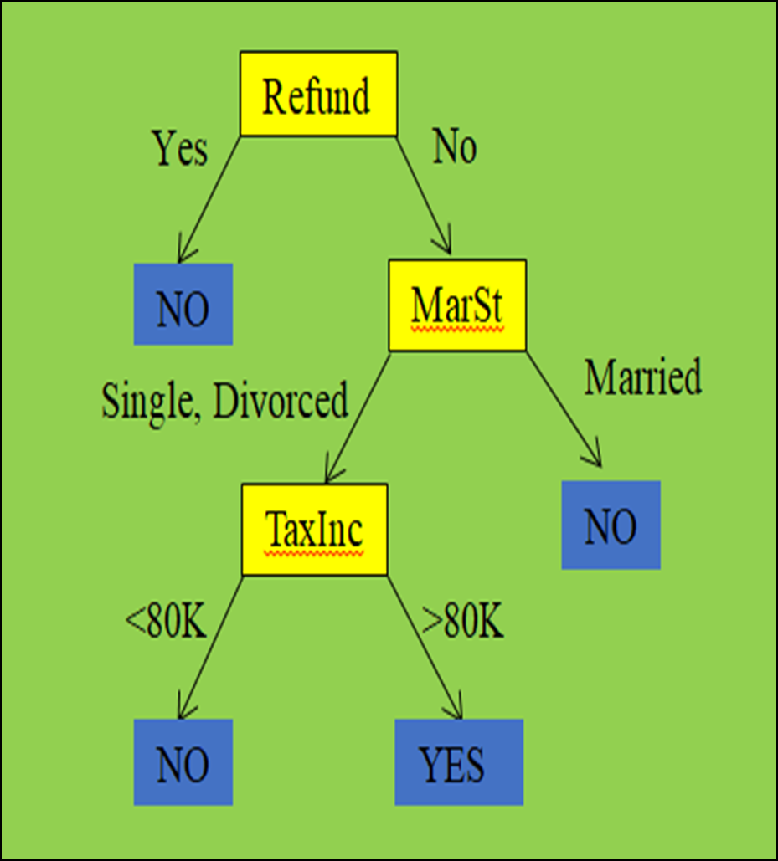
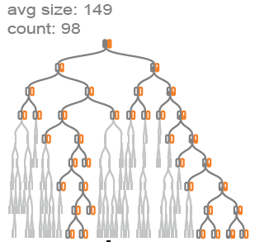
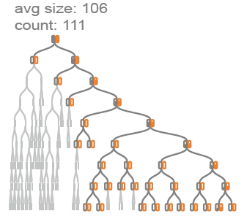
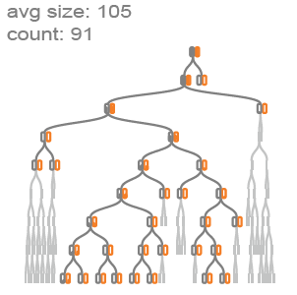
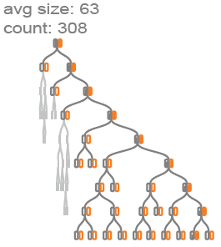


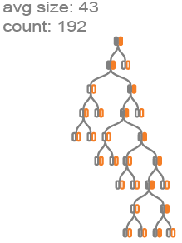


Tree Boosting
Notes:
Bagging is to repeatedly sample from a data set with replacement. Random forest is bagging plus random selection of features. Boosting is to adaptively change the distribution of training examples so that the base classifiers will focus on examples that are hard to classify.
Tree boosting vs. random forest:
Tree boosting: the base learners are decision trees, they are trained sequentially with the later trees focusing more on the mistakes made by the earlier ones. There is the dependence among the individual trees.
Random forest: the base learners are decision trees, they are trained in parallel on different data subsets and using random features. The randomness makes the individual trees less dependent.
The algorithm:
Weights are assigned to each training tuple
A series of k classifiers is iteratively learned
Choose a classifier with the lowest error (in the case where sampling distribution is changed, the classifier that classifies the hard tuples correctly will have the lowest error rate because more hard tuples are chosen in the sample. In the case where to build a model toward high-weighted tuples, the classifier that classifies the hard tuples correctly will have the lowest error rate because the model error rate is based on the weight of each tuple)
Use the classifier chosen to make predictions on the full set of observations
After a classifier is learned, the weights are updated to allow the subsequent classifier to pay more attention to the training tuples that were misclassified by the last learner
The final ensemble learner combines the votes of each individual classifier, where the weight of each classifier’s vote is a function of its accuracy.
This is a classifier-level view of how tree boosting works.
The figure shows the structures of decision trees during iterations in a tree boosting model.
A tree boosting model often contains hundreds and thousands of decision trees. In each round, the sampling distribution of the training set is updated. Because of that, in each round, a new training set that biased toward high-weight tuples is used. As a result, we expect different tree structures during the iteration process.
In this tree boosting model, individual trees induced are clustered based on the tree structure , and for each cluster, it displays its most representative tree.
The x dimension is the iterations. Larger trees occurred at the beginning of the training process, while the later iterations generate much smaller trees. It shows that earlier trees are the more important classifiers, doing harder job to classify with more node splitting.

Slide 26
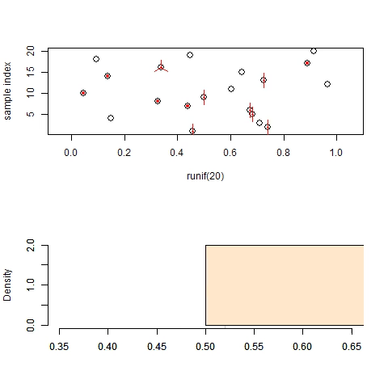
Tree Boosting
Weights are used to change sampling distribution.
Notes:
Boosting is an iterative procedure used to adaptively change the distribution of training examples so that the base classifiers will focus on examples that are hard to classify. Boosting assigns a weight to each training example and may adaptively change the weight at the end of each boosting round. The weights assigned to the training examples can be used as a sampling distribution to draw a set of bootstrap samples from the original data.
Initially, the examples are assigned equal weights, 1/N, so that they are equally likely to be chosen for training. A sample is drawn according to the sampling distribution of the training examples to obtain a new training set. Next, a classifier is induced from the training set and used to classify all the examples in the original data. The weights of the training examples are updated at the end of each boosting round. Examples that are classified incorrectly will have their weights increased, while those that are classified correctly will have their weights decreased. This forces the classifier to focus on examples that are difficult to classify in subsequent iterations.
The table shows the examples chosen during each boosting round. Initially, all the examples are assigned the same weights. However, some examples may be chosen more than once, e.g., examples 3 and 7, because the sampling is done with replacement. A classifier built from the data is then used to classify all the examples. Suppose example 4 is difficult to classify. The weight for this example will be increased in future iterations as it gets misclassified repeatedly. Meanwhile, examples that were not chosen in the previous round, e.g., examples 1 and 5, also have a better chance of being selected in the next round since their predictions in the previous round were likely to be wrong. As the boosting rounds proceed, examples that are the hardest to classify tend to become even more prevalent. The final ensemble is obtained by aggregating the base classifiers obtained from each boosting round.
Each tuple’s chance of being selected is based on its weight. A tuple’s weight reflects how difficult it is to classify. The basic idea is that when we build a classifier, we want it to focus more on the misclassified tuples of the previous round. Some classifiers may be better at classifying some difficult tuples than others. In this way, we build a series of classifiers that complements each other.
Unlike bagging, where each classifier was assigned an equal vote, boosting assigns a weight to each classifier’s vote, based on how well the classifier performed. The lower a classifier’s error rate, the more accurate it is, the higher its weight for voting should be.

Slide 27
Tree Boosting
Weights are used to learn a model that is biased towards high-weighted examples.
+
+
_
+
_
_
+
+
+
+
+
+
_
_
_
_
_
_
+
_
+
+
+
_
+
_
_
+
_
_
+
_
+
+
+
_
_
_
+
_
Notes:
Let’s assume we have 10 input observations that we want to classify as + or -.
The boosting algorithm will start with box 1 as shown above. It assigns equal weights (denoted by size of the signs) to all inputs and predicts + for inputs in blue region and – for inputs in the pink region, using a decision tree D1.
In the next iteration, box 2, weights of wrongly classified plus signs are greater than other inputs. A decision tree D2 is chosen such that these observations are now classified correctly.
In the final iteration, box 3, it has 3 misclassified negatives from the previous run. So a decision tree D3 is chosen to correct that.
Finally, the output strong learner or box 4, has a strong rule that is made by combining individual weak decision rules.

Slide 28
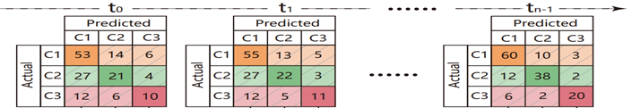
Tree Boosting
Notes:
This is another class-level view of how tree boosting works.
This figure displays the temporal confusion matrix. (a) confusion matrices are organized along the training iterations. (b) Each column is represented by a stacked bar with the solid class color for true positives (TPs, the diagonal cell), transparent and the shaded class colors for false positives (FPs, the non-diagonal cells), and the bar height representing the instance number in the cell. (c) Stacked bars at different iterations are connected to form a stripe. (d) All the stripes are stacked to form the temporal confusion matrix that reveals the change of TP and FP for each class over iterations.
It visually illustrates the performance changes of the model through a training process. Later trees improves the performance because later trees focus more on the mistakes made by the earlier ones.
Performance comparison of tree boosting versus random forest
Random Forest: In this approach, trees are grown deep and are not pruned. Thus each individual tree has high variance, but low bias. Averaging these trees reduces the variance dramatically.
In tree boosting, specifically gradient boosting decision tree (GBDT), the base learners are decision trees, and they are trained sequentially with the later trees focusing more on the mistakes made by the earlier ones. This makes the decision trees complementary to each other, and hence their ensemble greatly reduces the bias in each individual tree.
A cousin of GBDT is random forest (RF) whose base learners are also decision trees, but they are trained in parallel on different data subsets and using random features. This randomness makes the individual trees less dependent. As a result, their ensemble reduces the variance when applying to different data, but cannot reduce the bias. Large individual trees are usually generated in RF to alleviate the bias. The dependence of the individual trees in GBDT makes it generally perform better than RF.

Slide 29
Implementation 2

Slide 30
EXERCISE 2 TREE BOOSTING
1) For a given learning rate at 0.1, tune two boosting parameters—number of trees and size of subsample—together to report their best combination and corresponding average accuracy. Number of trees could be [50, 60, 70, 80]. Size of subsample could be [0.6, 0,7, 0.8, 0.9].
2) Given the best combination of number of trees and size of subsample from 1), tune boosting parameter learning rate to report its optimal setting. Learning rate values could be [0.01, 0.05, 0.1, 0.2].
3) Report accuracy performance of the optimal tree boosting model. Compare this performance with that of the grid random forest model.
4) (Optional) Report feature importance of the optimal tree boosting model.

Slide 31
Feature Selection: Benefits
Eliminate irrelevant or redundant features
Reduce the curse of dimensionality
Lead to a more understandable model
Improve model efficiency
Notes:
There are a variety of benefits to dimensionality reduction. A key benefit is that many data mining algorithms work better if the dimensionality the number of attributes in the data-is lower. This is partly because dimensionality reduction can eliminate irrelevant features and reduce noise and partly because of the curse of dimensionality, which is explained below. Another benefit is that a reduction of dimensionality can lead to a more understandable model because the model may involve fewer attributes. Also, dimensionality reduction may allow the data to be more easily visualized. Even if dimensionality reduction doesn't reduce the data to two or three dimensions, data is often visualized by looking at pairs or triplets of attributes, and the number of such combinations is greatly reduced. Finally, the amount of time and memory required by the data mining algorithm is reduced with a reduction in dimensionality.
The curse of dimensionality refers to the phenomenon that many types of data analysis become significantly harder as the dimensionality of the data increases. Specifically, as dimensionality increases, the data becomes increasingly sparse in the space that it occupies. For classification, this can mean that there are not enough data objects to allow the creation of a model that reliably assigns a class to all possible objects. For clustering, the definitions of density and the distance between points, which are critical for clustering, become less meaningful. As a result, many clustering and classification algorithms (and other data analysis algorithms) have trouble with high-dimensional data-reduced classification accuracy and poor quality clusters.
Filter approaches Features are selected before the data mining algorithm is run, using some approach that is independent of the data mining task. For example, we might select sets of attributes whose pairwise correlation is as low as possible.
Wrapper approaches These methods use the target data mining algorithm as a black box to find the best subset of attributes, in a way similar to that of the ideal algorithm described above, but typically without enumerating all possible subsets.
It is possible to encompass both the filter and wrapper approaches within a common architecture. The feature selection process is viewed as consisting of four parts: a measure for evaluating a subset, a search strategy that controls the generation of a new subset of features, a stopping criterion, and a validation procedure. Filter methods and wrapper methods differ only in the way in which they evaluate a subset of features. For a wrapper method, subset evaluation uses the target data mining algorithm, while for a filter approach, the evaluation technique is distinct from the target data mining algorithm.
An integral part of the search is an evaluation step to judge how the current subset of features compares to others that have been considered. This requires an evaluation measure that attempts to determine the goodness of a subset of attributes with respect to a particular data mining task, such as classification or clustering. For the filter approach, such measures attempt to predict how well the actual data mining algorithm will perform on a given set of attributes. For the wrapper approach, where evaluation consists of actually running the target data mining application, the subset evaluation function is simply the criterion normally used to measure the result of the data mining.
Because the number of subsets can be enormous and it is impractical to examine them all, some sort of stopping criterion is necessary. This strategy is usually based on one or more conditions involving the following: the number of iterations, whether the value of the subset evaluation measure is optimal or exceeds a certain threshold, whether a subset of a certain size has been obtained, whether simultaneous size and evaluation criteria have been achieved, and whether any improvement can be achieved by the options available to the search strategy.
Finally, once a subset of features has been selected, the results of the target data mining algorithm on the selected subset should be validated. A straightforward evaluation approach is to run the algorithm with the full set of features and compare the full results to results obtained using the subset of features. Hopefully, the subset of features will produce results that are better than or almost as good as those produced when using all features. Another validation approach is to use a number of different feature selection algorithms to obtain subsets of features and then compare the results of running the data mining algorithm on each subset.

Slide 32
Implementation 3
Notes:
The default tree -- no thresholds
y_data_test shape before: (4928, 1)
y_data_test shape after: (4928,)
y_data_train shape before: (11498, 1)
y_data_train shape after: (11498,)
default tree recall:: 0.98721591
Feature ranking::Default Single Tree:
1. feature 3 [oldbalanceOrg_boxcox] importance (0.588757)
2. feature 1 [amount_boxcox] importance (0.157569)
3. feature 4 [newbalanceDest_boxcox] importance (0.135222)
4. feature 5 [newbalanceOrig_boxcox] importance (0.108221)
5. feature 0 [type_num] importance (0.005228)
6. feature 2 [oldbalanceDest_boxcox] importance (0.005002)
Grid Parameter Search via 10-fold cross-validation
Best Parameters based on Recall:
parameter: criterion setting: gini
parameter: max_depth setting: 10
parameter: min_samples_leaf setting: 5
parameter: min_samples_split setting: 30
Testing best parameters [Grid] based on Recall...
Grid search tree Recall:: 0.99384742
Feature ranking::Grid Single Tree:
1. feature 3 [oldbalanceOrg_boxcox] importance (0.567796)
2. feature 1 [amount_boxcox] importance (0.182193)
3. feature 4 [newbalanceDest_boxcox] importance (0.136072)
4. feature 5 [newbalanceOrig_boxcox] importance (0.110699)
5. feature 0 [type_num] importance (0.002999)
6. feature 2 [oldbalanceDest_boxcox] importance (0.000241)
C:\Program Files (x86)\Microsoft Visual Studio\Shared\Python36_64\lib\site-packages\sklearn\ensemble\forest.py:246: FutureWarning: The default value of n_estimators will change from 10 in version 0.20 to 100 in 0.22.
"10 in version 0.20 to 100 in 0.22.", FutureWarning)
Random Forest default recall:: 0.98396916
Feature ranking::Default Random Forest:
1. feature 3 [oldbalanceOrg_boxcox] importance (0.389425)
2. feature 4 [newbalanceDest_boxcox] importance (0.232314)
3. feature 1 [amount_boxcox] importance (0.167007)
4. feature 2 [oldbalanceDest_boxcox] importance (0.114294)
5. feature 5 [newbalanceOrig_boxcox] importance (0.060431)
6. feature 0 [type_num] importance (0.036529)
Example -- Recall at numTrees = 50, max_features = log2:: mean: 0.98874653 (std: 0.00465857)
Recall at numTrees = 100, max_features = None:: mean: 0.99705523 (std: 0.00269079)
Recall at numTrees = 100, max_features = log2:: mean: 0.99099656 (std: 0.00463140)
Recall at numTrees = 100, max_features = sqrt:: mean: 0.99099656 (std: 0.00463140)
Recall at numTrees = 150, max_features = None:: mean: 0.99705523 (std: 0.00269079)
Recall at numTrees = 150, max_features = log2:: mean: 0.98961098 (std: 0.00444730)
Recall at numTrees = 150, max_features = sqrt:: mean: 0.98961098 (std: 0.00444730)
Recall at numTrees = 200, max_features = None:: mean: 0.99688192 (std: 0.00266283)
Recall at numTrees = 200, max_features = log2:: mean: 0.99064874 (std: 0.00432738)
Recall at numTrees = 200, max_features = sqrt:: mean: 0.99064874 (std: 0.00432738)
Recall at numTrees = 250, max_features = None:: mean: 0.99722824 (std: 0.00270765)
Recall at numTrees = 250, max_features = log2:: mean: 0.99064874 (std: 0.00418675)
Recall at numTrees = 250, max_features = sqrt:: mean: 0.99064874 (std: 0.00418675)
Recall at numTrees = 300, max_features = None:: mean: 0.99705523 (std: 0.00269079)
Recall at numTrees = 300, max_features = log2:: mean: 0.99099446 (std: 0.00437030)
Recall at numTrees = 300, max_features = sqrt:: mean: 0.99099446 (std: 0.00437030)
best number of trees: 250; max number of fearures: None
Testing Random Forest Grid based on Recall...
Random Forest Grid Recall:: 0.99630845
Feature ranking: Random Forest Grid
1. feature 3 [oldbalanceOrg_boxcox] importance (0.588184)
2. feature 1 [amount_boxcox] importance (0.153277)
3. feature 4 [newbalanceDest_boxcox] importance (0.142348)
4. feature 5 [newbalanceOrig_boxcox] importance (0.111348)
5. feature 0 [type_num] importance (0.002432)
6. feature 2 [oldbalanceDest_boxcox] importance (0.002411)
GBM default recall:: 0.98051948
Feature ranking::Default GBM:
1. feature 3 [oldbalanceOrg_boxcox] importance (0.629770)
2. feature 4 [newbalanceDest_boxcox] importance (0.170017)
3. feature 5 [newbalanceOrig_boxcox] importance (0.110982)
4. feature 1 [amount_boxcox] importance (0.077894)
5. feature 0 [type_num] importance (0.009508)
6. feature 2 [oldbalanceDest_boxcox] importance (0.001827)
Example -- when learning_rate = 0.2, recall at numTrees = 70 and at subsample = 0.8:: mean: 0.99722973 (std: 0.00158691)
when learning_rate = 0.2, recall at numTrees = 20:: mean: 0.99670950 (std: 0.00250494)
when learning_rate = 0.2, recall at numTrees = 30:: mean: 0.99670980 (std: 0.00211457)
when learning_rate = 0.2, recall at numTrees = 40:: mean: 0.99688341 (std: 0.00150951)
when learning_rate = 0.2, recall at numTrees = 50:: mean: 0.99688341 (std: 0.00186438)
when learning_rate = 0.2, recall at numTrees = 60:: mean: 0.99740275 (std: 0.00177415)
when learning_rate = 0.2, recall at numTrees = 70:: mean: 0.99722973 (std: 0.00158691)
when learning_rate = 0.2, recall at numTrees = 80:: mean: 0.99740275 (std: 0.00177415)
when learning_rate = 0.2, recall at numTrees = 90:: mean: 0.99722973 (std: 0.00158691)
when learning_rate = 0.2, recall at numTrees = 100:: mean: 0.99722973 (std: 0.00158691)
GBM Grid:: best number of trees: 60
when learning_rate = 0.2, tree number = 60, recall at subsample = 0.6:: mean: 0.99757516 (std: 0.00176743)
when learning_rate = 0.2, tree number = 60, recall at subsample = 0.7:: mean: 0.99757546 (std: 0.00176696)
when learning_rate = 0.2, tree number = 60, recall at subsample = 0.75:: mean: 0.99740215 (std: 0.00208668)
when learning_rate = 0.2, tree number = 60, recall at subsample = 0.8:: mean: 0.99740275 (std: 0.00177415)
when learning_rate = 0.2, tree number = 60, recall at subsample = 0.85:: mean: 0.99722884 (std: 0.00192979)
when learning_rate = 0.2, tree number = 60, recall at subsample = 0.9:: mean: 0.99688281 (std: 0.00169699)
GBM Grid:: best subsample size: 0.7
when learning rate = 0.1, number of trees = 120, recall:: mean: 0.99722884 (std: 0.00192979)
when learning rate = 0.05, number of trees = 240, recall:: mean: 0.99774877 (std: 0.00155906)
when learning rate = 0.01, number of trees = 1200, recall:: mean: 0.99774877 (std: 0.00155906)
GBM Grid:: best pair of learning rate and number of trees: 0.05 and 240
Testing GBM Grid based on Recall...
GBM Grid Recall:: 0.99753897
Feature ranking: GBM Grid
1. feature 3 [oldbalanceOrg_boxcox] importance (0.574897)
2. feature 1 [amount_boxcox] importance (0.168064)
3. feature 4 [newbalanceDest_boxcox] importance (0.140347)
4. feature 5 [newbalanceOrig_boxcox] importance (0.108500)
5. feature 2 [oldbalanceDest_boxcox] importance (0.004406)
6. feature 0 [type_num] importance (0.003786)

Slide 33
EXERCISE 3 FEATURE IMPORTANCE
1) Print out the ranked features of the optimal tree boosting model that you derived from EXERCISE 2 based on feature importance.
2) Plot its feature importance.
Notes:
Python 3.7.1 (default, Dec 10 2018, 22:54:23) [MSC v.1915 64 bit (AMD64)]
Type "copyright", "credits" or "license" for more information.
IPython 7.2.0 -- An enhanced Interactive Python.
runfile('D:/DataFest_Coding/Tree_Based_Models(sklearn_0.20_python_3.6)/Tree_Based/Tree_Based_New/Tree_Based_New/Tree_Based_New.py', wdir='D:/DataFest_Coding/Tree_Based_Models(sklearn_0.20_python_3.6)/Tree_Based/Tree_Based_New/Tree_Based_New')
0.20.1
isFraud type_num amount_boxcox oldbalanceDest_boxcox \
0 1 1 -4.096788 -1.885453
1 1 0 -4.096788 -0.907107
2 1 1 -2.778780 -1.885453
3 1 0 -2.778780 -0.859264
4 1 1 -1.574428 -1.885453
oldbalanceOrg_boxcox newbalanceDest_boxcox newbalanceOrig_boxcox
0 0.087705 -3.872813 -0.33113
1 0.087705 -3.872813 -0.33113
2 0.570908 -3.872813 -0.33113
3 0.570908 -3.872813 -0.33113
4 0.906331 -3.872813 -0.33113
1 8213
0 8213
Name: isFraud, dtype: int64
classLabel_test shape before: (4928, 1)
classLabel_test shape after: (4928,)
classLabel_train shape before: (11498, 1)
classLabel_train shape after: (11498,)
default tree recall:: 0.99261690
parameter: criterion setting: gini
parameter: max_depth setting: 10
parameter: min_samples_leaf setting: 5
parameter: min_samples_split setting: 30
Mean recall score of the best parameters: 0.99324694
Grid search tree Recall:: 0.99384742
Recall at numTrees = 100, max_features = None:: mean: 0.99705523 (std: 0.00269079)
Recall at numTrees = 100, max_features = log2:: mean: 0.99099656 (std: 0.00463140)
Recall at numTrees = 100, max_features = sqrt:: mean: 0.99099656 (std: 0.00463140)
Recall at numTrees = 150, max_features = None:: mean: 0.99705523 (std: 0.00269079)
Recall at numTrees = 150, max_features = log2:: mean: 0.98961098 (std: 0.00444730)
Recall at numTrees = 150, max_features = sqrt:: mean: 0.98961098 (std: 0.00444730)
Recall at numTrees = 200, max_features = None:: mean: 0.99688192 (std: 0.00266283)
Recall at numTrees = 200, max_features = log2:: mean: 0.99064874 (std: 0.00432738)
Recall at numTrees = 200, max_features = sqrt:: mean: 0.99064874 (std: 0.00432738)
Recall at numTrees = 250, max_features = None:: mean: 0.99722824 (std: 0.00270765)
Recall at numTrees = 250, max_features = log2:: mean: 0.99064874 (std: 0.00418675)
Recall at numTrees = 250, max_features = sqrt:: mean: 0.99064874 (std: 0.00418675)
best number of trees: 250; max number of fearures: None; maximum cross-validated mean recall: 0.997228235773869
Random Forest Grid Recall:: 0.99630845
when learning_rate = 0.2, recall at numTrees = 20 and subsample size = 0.6:: mean: 0.99722884 (std: 0.00207962)
when learning_rate = 0.2, recall at numTrees = 20 and subsample size = 0.7:: mean: 0.99688251 (std: 0.00242626)
when learning_rate = 0.2, recall at numTrees = 20 and subsample size = 0.75:: mean: 0.99688251 (std: 0.00254664)
when learning_rate = 0.2, recall at numTrees = 20 and subsample size = 0.8:: mean: 0.99670950 (std: 0.00250494)
when learning_rate = 0.2, recall at numTrees = 20 and subsample size = 0.85:: mean: 0.99740185 (std: 0.00208706)
when learning_rate = 0.2, recall at numTrees = 20 and subsample size = 0.9:: mean: 0.99653619 (std: 0.00189907)
when learning_rate = 0.2, recall at numTrees = 30 and subsample size = 0.6:: mean: 0.99757546 (std: 0.00158789)
when learning_rate = 0.2, recall at numTrees = 30 and subsample size = 0.7:: mean: 0.99688281 (std: 0.00202072)
when learning_rate = 0.2, recall at numTrees = 30 and subsample size = 0.75:: mean: 0.99688251 (std: 0.00202051)
when learning_rate = 0.2, recall at numTrees = 30 and subsample size = 0.8:: mean: 0.99670980 (std: 0.00211457)
when learning_rate = 0.2, recall at numTrees = 30 and subsample size = 0.85:: mean: 0.99722884 (std: 0.00207962)
when learning_rate = 0.2, recall at numTrees = 30 and subsample size = 0.9:: mean: 0.99653649 (std: 0.00173281)
when learning_rate = 0.2, recall at numTrees = 40 and subsample size = 0.6:: mean: 0.99792178 (std: 0.00151054)
when learning_rate = 0.2, recall at numTrees = 40 and subsample size = 0.7:: mean: 0.99740215 (std: 0.00177561)
when learning_rate = 0.2, recall at numTrees = 40 and subsample size = 0.75:: mean: 0.99740185 (std: 0.00208706)
when learning_rate = 0.2, recall at numTrees = 40 and subsample size = 0.8:: mean: 0.99688341 (std: 0.00150951)
when learning_rate = 0.2, recall at numTrees = 40 and subsample size = 0.85:: mean: 0.99722884 (std: 0.00192979)
when learning_rate = 0.2, recall at numTrees = 40 and subsample size = 0.9:: mean: 0.99653619 (std: 0.00173370)
when learning_rate = 0.2, recall at numTrees = 50 and subsample size = 0.6:: mean: 0.99792148 (std: 0.00151116)
when learning_rate = 0.2, recall at numTrees = 50 and subsample size = 0.7:: mean: 0.99740215 (std: 0.00177561)
when learning_rate = 0.2, recall at numTrees = 50 and subsample size = 0.75:: mean: 0.99722884 (std: 0.00207962)
when learning_rate = 0.2, recall at numTrees = 50 and subsample size = 0.8:: mean: 0.99688341 (std: 0.00186438)
when learning_rate = 0.2, recall at numTrees = 50 and subsample size = 0.85:: mean: 0.99722854 (std: 0.00221969)
when learning_rate = 0.2, recall at numTrees = 50 and subsample size = 0.9:: mean: 0.99670920 (std: 0.00211511)
when learning_rate = 0.2, recall at numTrees = 60 and subsample size = 0.6:: mean: 0.99774847 (std: 0.00155963)
when learning_rate = 0.2, recall at numTrees = 60 and subsample size = 0.7:: mean: 0.99740245 (std: 0.00159768)
when learning_rate = 0.2, recall at numTrees = 60 and subsample size = 0.75:: mean: 0.99740215 (std: 0.00208668)
when learning_rate = 0.2, recall at numTrees = 60 and subsample size = 0.8:: mean: 0.99740275 (std: 0.00177415)
when learning_rate = 0.2, recall at numTrees = 60 and subsample size = 0.85:: mean: 0.99722884 (std: 0.00192979)
when learning_rate = 0.2, recall at numTrees = 60 and subsample size = 0.9:: mean: 0.99688281 (std: 0.00169699)
when learning_rate = 0.2, recall at numTrees = 70 and subsample size = 0.6:: mean: 0.99757516 (std: 0.00176743)
when learning_rate = 0.2, recall at numTrees = 70 and subsample size = 0.7:: mean: 0.99740245 (std: 0.00159768)
when learning_rate = 0.2, recall at numTrees = 70 and subsample size = 0.75:: mean: 0.99757546 (std: 0.00176696)
when learning_rate = 0.2, recall at numTrees = 70 and subsample size = 0.8:: mean: 0.99722973 (std: 0.00158691)
when learning_rate = 0.2, recall at numTrees = 70 and subsample size = 0.85:: mean: 0.99740245 (std: 0.00177459)
when learning_rate = 0.2, recall at numTrees = 70 and subsample size = 0.9:: mean: 0.99688281 (std: 0.00151034)
when learning_rate = 0.2, recall at numTrees = 80 and subsample size = 0.6:: mean: 0.99809479 (std: 0.00143977)
when learning_rate = 0.2, recall at numTrees = 80 and subsample size = 0.7:: mean: 0.99757546 (std: 0.00176696)
when learning_rate = 0.2, recall at numTrees = 80 and subsample size = 0.75:: mean: 0.99740245 (std: 0.00193646)
when learning_rate = 0.2, recall at numTrees = 80 and subsample size = 0.8:: mean: 0.99740275 (std: 0.00177415)
when learning_rate = 0.2, recall at numTrees = 80 and subsample size = 0.85:: mean: 0.99722944 (std: 0.00158737)
when learning_rate = 0.2, recall at numTrees = 80 and subsample size = 0.9:: mean: 0.99688281 (std: 0.00151034)
when learning_rate = 0.2, recall at numTrees = 90 and subsample size = 0.6:: mean: 0.99792148 (std: 0.00129726)
when learning_rate = 0.2, recall at numTrees = 90 and subsample size = 0.7:: mean: 0.99757546 (std: 0.00176696)
when learning_rate = 0.2, recall at numTrees = 90 and subsample size = 0.75:: mean: 0.99740245 (std: 0.00193646)
when learning_rate = 0.2, recall at numTrees = 90 and subsample size = 0.8:: mean: 0.99722973 (std: 0.00158691)
when learning_rate = 0.2, recall at numTrees = 90 and subsample size = 0.85:: mean: 0.99722944 (std: 0.00176590)
when learning_rate = 0.2, recall at numTrees = 90 and subsample size = 0.9:: mean: 0.99688281 (std: 0.00151034)
when learning_rate = 0.2, recall at numTrees = 100 and subsample size = 0.6:: mean: 0.99792148 (std: 0.00129726)
when learning_rate = 0.2, recall at numTrees = 100 and subsample size = 0.7:: mean: 0.99757546 (std: 0.00176696)
when learning_rate = 0.2, recall at numTrees = 100 and subsample size = 0.75:: mean: 0.99740245 (std: 0.00193646)
when learning_rate = 0.2, recall at numTrees = 100 and subsample size = 0.8:: mean: 0.99722973 (std: 0.00158691)
when learning_rate = 0.2, recall at numTrees = 100 and subsample size = 0.85:: mean: 0.99722944 (std: 0.00176590)
when learning_rate = 0.2, recall at numTrees = 100 and subsample size = 0.9:: mean: 0.99688281 (std: 0.00151034)
GBM Grid:: best number of trees: 80; best subsample size: 0.6; maximum cross-validated mean recall: 0.99809479
when learning rate = 0.1, number of trees = 160, recall:: mean: 0.99757546 (std: 0.00176696)
when learning rate = 0.05, number of trees = 320, recall:: mean: 0.99774877 (std: 0.00155906)
when learning rate = 0.01, number of trees = 1600, recall:: mean: 0.99774877 (std: 0.00155906)
GBM Grid:: best pair of learning rate and number of trees: 0.05 and 320, maximum cross-validated mean recall: 0.99774877
GBM Grid Recall:: 0.99712879
[2.99883702e-03 1.82193176e-01 2.40739209e-04 5.67796280e-01
1.36072321e-01 1.10698647e-01]
[3 1 4 5 0 2]
Feature ranking::Grid Single Tree:
1. feature 3 [oldbalanceOrg_boxcox] importance (0.567796)
2. feature 1 [amount_boxcox] importance (0.182193)
3. feature 4 [newbalanceDest_boxcox] importance (0.136072)
4. feature 5 [newbalanceOrig_boxcox] importance (0.110699)
5. feature 0 [type_num] importance (0.002999)
6. feature 2 [oldbalanceDest_boxcox] importance (0.000241)
￼
[0.00348122 0.01822242 0.00175863 0.01763899 0.01451278 0.00718725]
Feature ranking: Random Forest Grid
1. feature 3 [oldbalanceOrg_boxcox] importance (0.588184)
2. feature 1 [amount_boxcox] importance (0.153277)
3. feature 4 [newbalanceDest_boxcox] importance (0.142348)
4. feature 5 [newbalanceOrig_boxcox] importance (0.111348)
5. feature 0 [type_num] importance (0.002432)
6. feature 2 [oldbalanceDest_boxcox] importance (0.002411)
￼
Feature ranking: GBM Grid
1. feature 3 [oldbalanceOrg_boxcox] importance (0.577690)
2. feature 1 [amount_boxcox] importance (0.162684)
3. feature 4 [newbalanceDest_boxcox] importance (0.144398)
4. feature 5 [newbalanceOrig_boxcox] importance (0.106614)
5. feature 2 [oldbalanceDest_boxcox] importance (0.005181)
6. feature 0 [type_num] importance (0.003433)
￼

