Slide 1


— Advanced R for Econometricians —
Interactive Diagnostics for Linear and Logistic Regression Models
────────────
Design, Implementation and Validation of the diag_lm Framework
Rezaul Hoque · Sarah Al-Talal · Thi Hong Cam Nguyen
University of Duisburg-Essen — Chair of Econometrics

Slide 2

AGENDA
Presentation Overview
01 · Motivation — Why Model Diagnostics Matter
02 · The diag_lm Framework
03 · Different Models Need Different Diagnostics
04 · Validation with Known Ground Truth
05 · Linear Regression Validation
06 · Time-Series Validation
07 · Logistic Regression Validation
08 · From Framework to Interactive Application
09 · From Statistical Tests to Visual Diagnostics
10 · Statistics First — AI Interpretation Second
11 · Real-Data Case Study: Hourly Wages
12 · Diagnostics Guide Model Improvement
13 · What Did We Achieve?
14 · Thank You & Questions

Slide 3



MOTIVATION
Why Model Diagnostics Matter
01
02
03
Assumption Violations
Different Models
Manual Workflow
Heteroskedasticity, serial correlation, non-normality, and multicollinearity can undermine statistical inference.
Linear, logistic, time-series, and panel models each require distinct diagnostic procedures.
Running and interpreting separate tests repeatedly is time-consuming and error-prone.
Our Goal: Create one reusable, interactive, and model-aware framework for regression diagnostics.
1

Slide 4

FRAMEWORK
The diag_lm Framework
DATA
S3 Architecture
Modular Computation
Example · Simulation · CSV
Automatic model-specific method dispatch
Diagnostics are reusable and independently testable
MODEL
lm/glm · plm · Time Series
Consistent Interface
diag_lm
One workflow across multiple model families
Detects model class and dispatches appropriate diagnostic methods
How it connects to the app: The Shiny app provides the interface; diag_lm acts as the statistical engine. User selections trigger the framework, which returns structured results.
DIAGNOSTICS
Runs model-specific statistical tests and diagnostic plots
RESULTS
PASS/CHECK indicators and structured recommendations
One diagnostic engine powers multiple model-specific workflows within the same interactive application.
2

Slide 5
DIAGNOSTICS
Different Models Need Different Diagnostics
01 LINEAR
02 LOGISTIC
03 TIME SERIES
04 PANEL
Breusch-Pagan - Heteroskedasticity
Durbin-Watson - Serial correlation
Shapiro-Wilk - Residual normality
VIF - Multicollinearity
Hosmer-Lemeshow - Goodness of fit
ROC/AUC - Discrimination performance
Calibration - Predicted vs. observed
VIF - Multicollinearity
ADF - Stationarity / unit roots
Ljung-Box - Serial dependence
ACF/PACF - Autocorrelation structure
Normality - Residual distribution
Panel LM - Pooled vs. panel structure
Hausman - Fixed vs. random effects
Panel Breusch-Godfrey - Serial correlation
Time-effects test - Time-specific effects
3

Slide 6

FRAMEWORK
Why Time Series and Panel Models Need Separate Diagnostics
Their data structures introduce dependencies that standard cross-sectional diagnostics do not fully address.
TIME SERIES
PANEL DATA
Observations are ordered over time — errors and values may depend on past behavior.
Entities tracked over time — creating cross-sectional and temporal dependence.
Serial Correlation
Panel Structure
Are residuals correlated across time?
Is panel specification preferable to pooled OLS?
Test: Ljung-Box / Breusch-Godfrey
Test: Panel LM
Stationarity
Fixed vs. Random Effects
Are statistical properties stable over time?
Which panel specification is appropriate?
Test: ADF test
Test: Hausman test
Dependence Structure
Within-Entity Correlation
How does correlation behave across lags?
Are errors correlated over time within entities?
Test: ACF / PACF
Test: Panel Breusch-Godfrey
Different data structures create different statistical problems - therefore diag_lm follows model-specific diagnostic paths.
4

Slide 7
VALIDATION
Validation with Known Ground Truth
Validation Process
Violations Tested
01
02
01 · Heteroskedasticity
02 · Multicollinearity
03 · AR(1) Serial Correlation
04 · Unit Roots
05 · Panel Effects
Generate Baseline
Inject Violation
Clean data, no violations
Introduce known assumption breach
03
04
Diagnose with diag_lm
Verify Against Truth
Run full diagnostic suite
Compare results to known ground truth
5

Slide 8
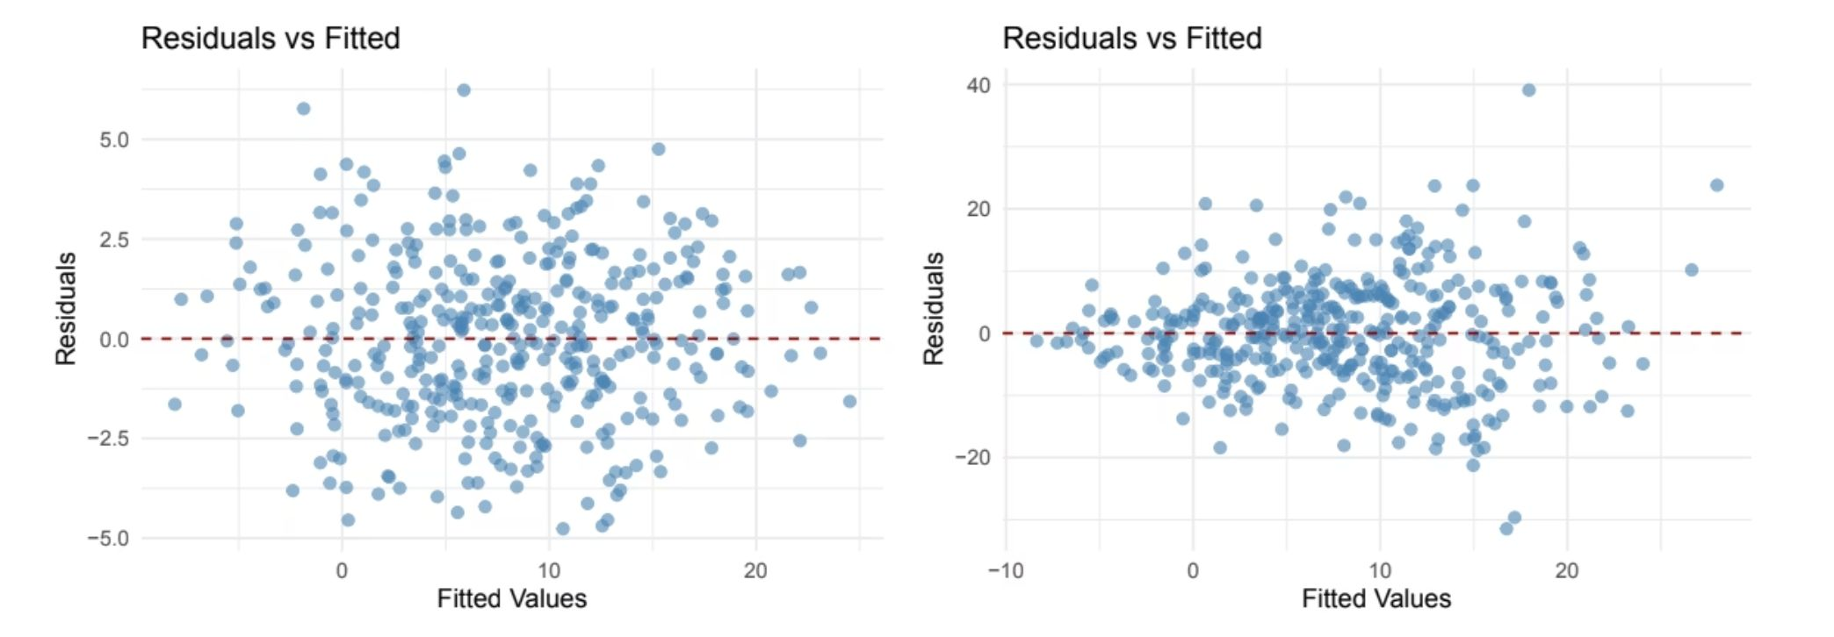
RESULTS — OLS
Linear Regression Validation
Injected violations produce the expected diagnostic response.
BASELINE
HETEROSKEDASTICITY INJECTED
BP p = 0.486
Random scatter → no heteroskedasticity detected
BP p ≈ 0
Funnel-shaped spread → violation detected
Additional validation · Multicollinearity injected → Max VIF = 15.68
The diagnostics respond specifically to the violations introduced in simulation.
6

Slide 9
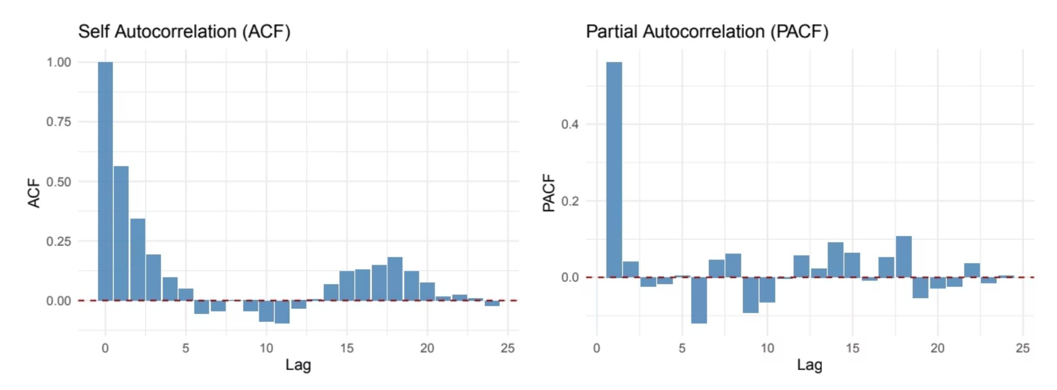
RESULTS — TIME SERIES
Time-Series Validation: Detecting Serial Correlation
AR(1) dependence was deliberately introduced to test whether diag_lm detects it.
ACF
PACF
Slowly decaying autocorrelation → persistent serial dependence
Strong first lag → pattern consistent with a low-order AR process
Breusch–Godfrey: p ≈ 0 · Ljung–Box: p ≈ 0 · Both tests reject the null of no serial correlation.
ADF: Stationary AR(1) p = 0.010 · Random Walk p = 0.073
7

Slide 10
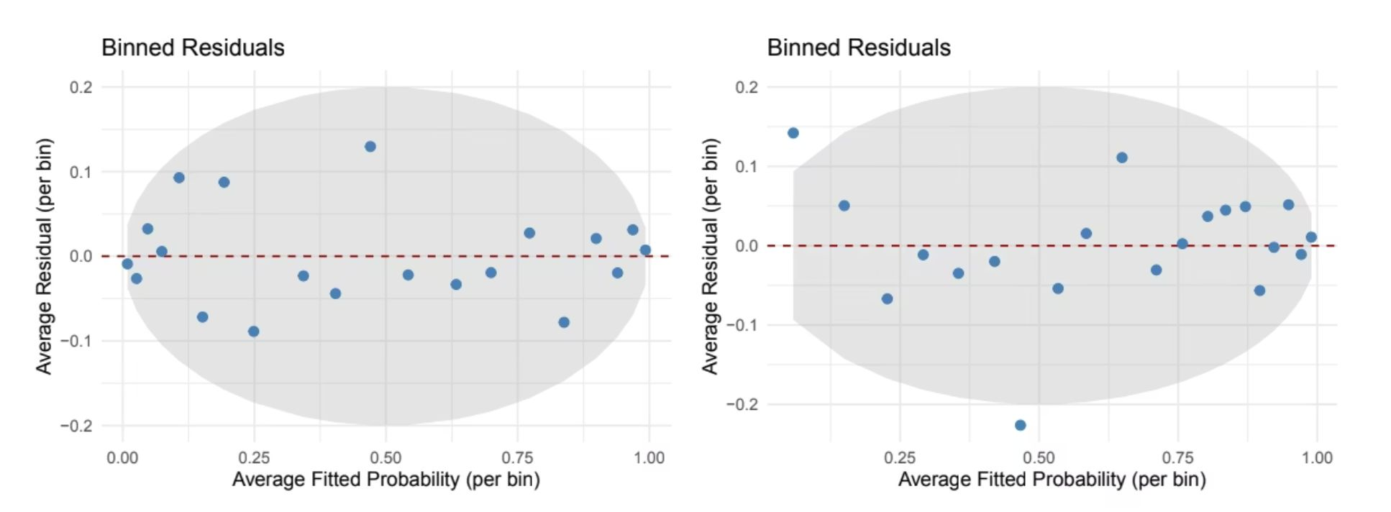
RESULTS — LOGISTIC
Logistic Regression Validation: Detecting Misspecification
BASELINE
OMITTED NONLINEARITY
Residuals scatter randomly within the reference band → no systematic misspecification
Systematic curvature appears → model misspecification detected
Hosmer–Lemeshow: p-value collapses when nonlinearity is omitted · Formal goodness-of-fit confirms the pattern in binned residuals.
Multicollinearity injected → Max VIF = 18.60 · Baseline AUC = 0.894
8

Slide 11
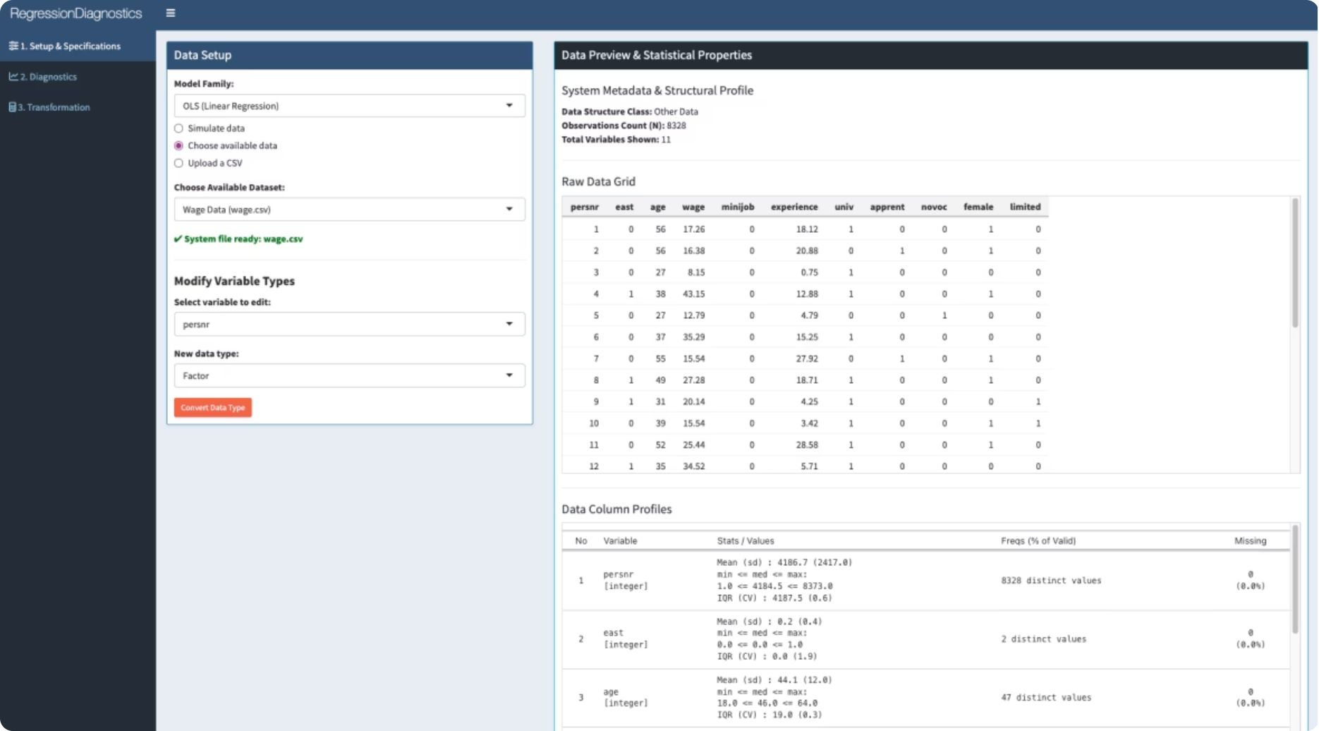
APPLICATION
From Framework to Interactive Application
The Shiny interface turns the diagnostic framework into a guided workflow for data setup, model specification and analysis.
1 — SETUP
2 — SPECIFY
Choose example data, simulate data or upload a CSV
Select the model family and configure variable types
3 — PREVIEW
Inspect raw data, structure and statistical properties before modelling
Setup → Diagnostics → Transformation
One interface from data preparation to model refinement.
Users can prepare data and specify the analysis before moving directly into model-aware diagnostics.
9

Slide 12
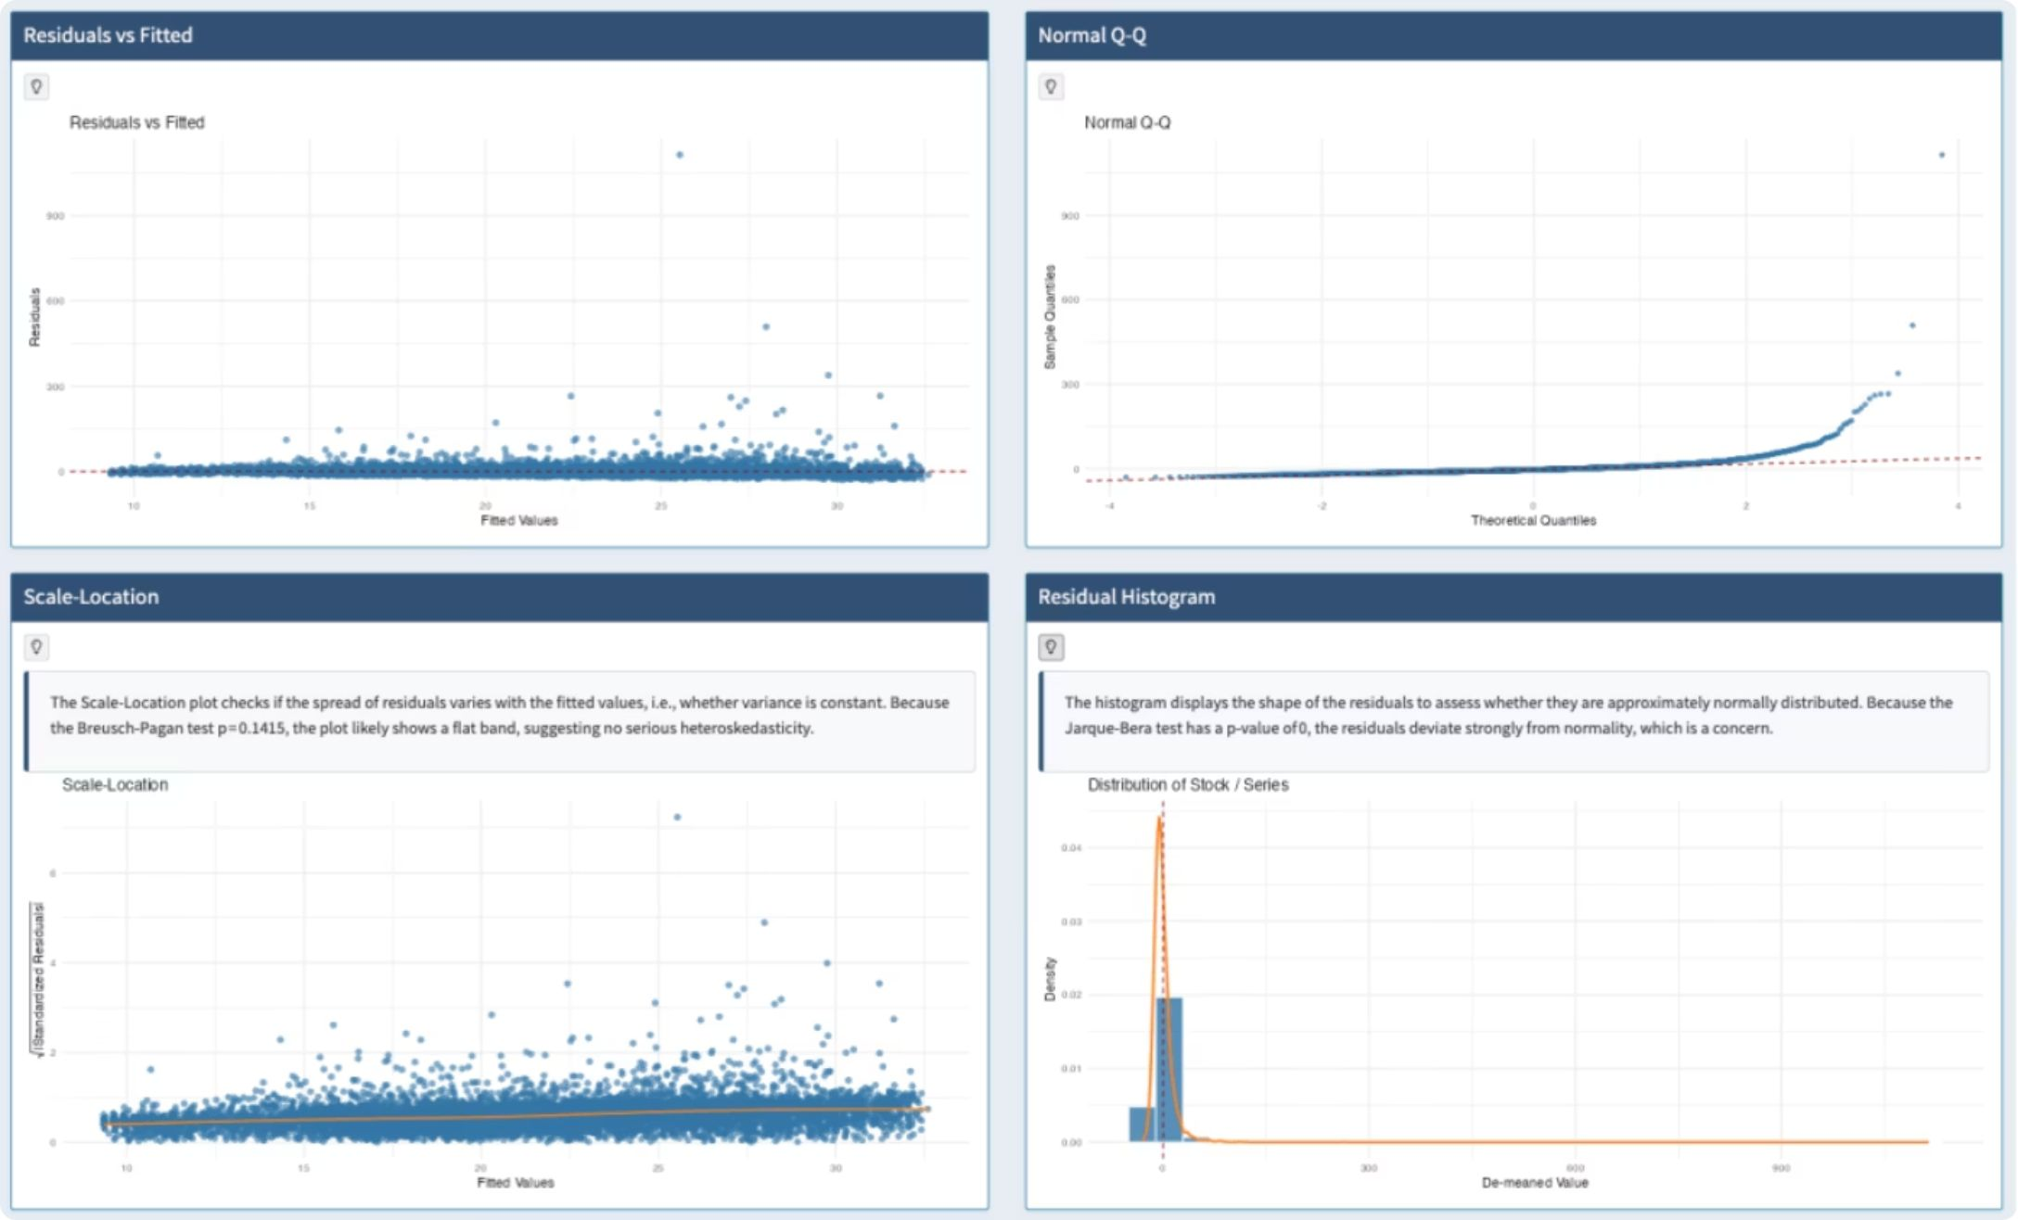
APPLICATION
From Statistical Tests to Visual Diagnostics
LINEARITY
Residuals vs Fitted · look for patterns
NORMALITY
Q–Q + Histogram · check distribution
CONSTANT VARIANCE
Scale–Location · check residual spread
INTERPRETATION
Visual checks complement formal tests
Example shown: BP p = 0.1415 → no serious heteroskedasticity · Jarque–Bera p ≈ 0 → strong departure from normality
10

Slide 13
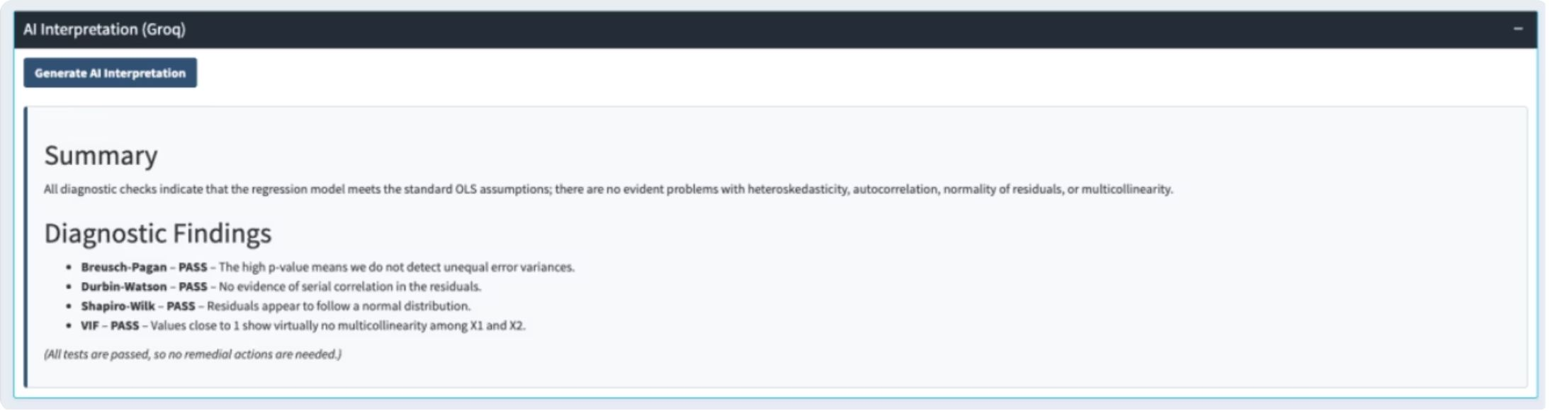
AI INTEGRATION
Statistics First — AI Interpretation Second
AI translates computed diagnostic results into a concise, plain-language interpretation and suggested actions.
01 — COMPUTE
diag_lm runs the statistical diagnostics
02 — SUMMARIZE
Only computed diagnostic results are prepared
AI explains the diagnostics — it does not calculate or replace them.
03 — INTERPRET
AI explains findings and recommended actions
OPT-IN · NO RAW DATA · WORKS WITHOUT API KEY
User-controlled · Diagnostic summaries only · AI remains optional
11

Slide 14
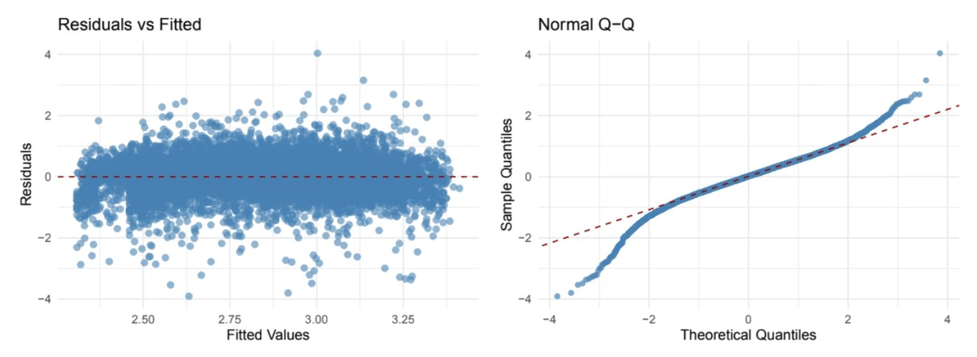
CASE STUDY
Real-Data Case Study: Hourly Wages
Model: log(hourly wage) ~ experience + age + female · N = 832
+0.95% / year
+1.09% / year
−14.05%
Experience
Age
Female indicator
Diagnostic Results
[!] Breusch–Pagan — CHECK · Heteroskedasticity
[!] Shapiro–Wilk — CHECK · Non-normal residuals
[OK] Durbin–Watson — PASS
[OK] VIF 4.13 — PASS
Residual spread changes across fitted values → consistent with heteroskedasticity
Q–Q tails deviate strongly from reference line → non-normal residuals
The coefficients are interpretable, but diagnostics reveal remaining model problems that motivate re-specification.
12

Slide 15

MODEL REFINEMENT
Diagnostics Guide Model Improvement
Experience β
Experience² β
Diagnose
Investigate
Check heteroskedasticity and normality of residuals.
Test transformations and alternative specifications.
+0.0530 — positive wage growth
−0.0010 — diminishing marginal return
The quadratic term captures a concave earnings profile: wages rise with experience, but the marginal gain decreases over time — consistent with standard human capital theory.
Initial Model
Re-specify
Baseline linear specification with experience.
Introduce nonlinear (quadratic) experience term.
"Diagnostics are not simply PASS/FAIL checks — they guide model refinement."
13

Slide 16
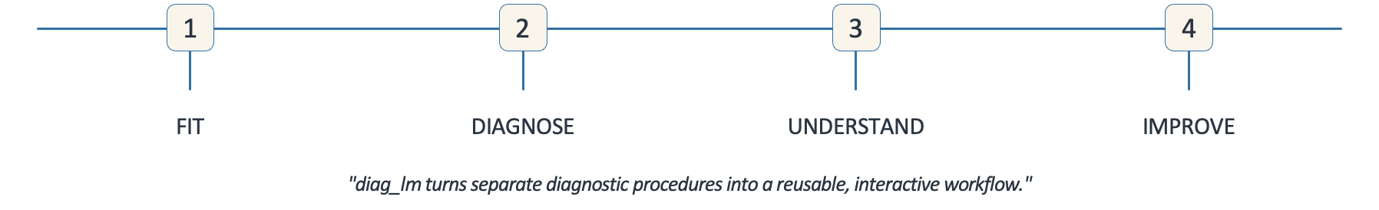
CONCLUSION
What Did We Achieve?
Model-Aware
Validated
Interactive
One framework for linear, logistic, time-series, and panel diagnostics.
Controlled simulations, real data, and automated software testing.
Shiny interface with optional AI-assisted interpretation.
14

Slide 17
Thank You
Questions & Discussion
We'd love to hear your thoughts, feedback, and questions
15

