Slide 1
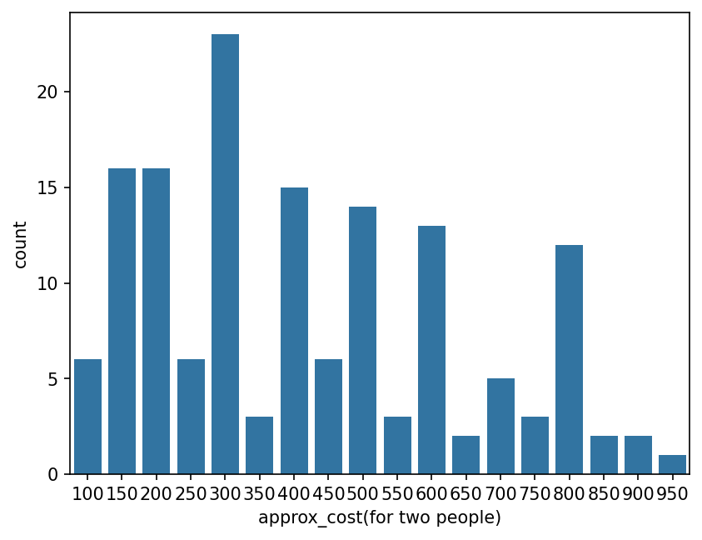
Approx Cost (for two people)
The majority of couples prefer restaurants with an approximate cost of 300 rupees.

Slide 2
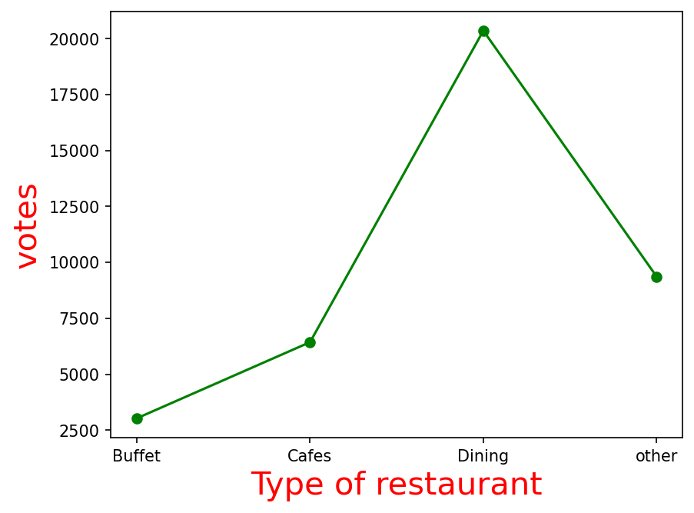
Dining restaurants get majority votes by customers

Slide 3
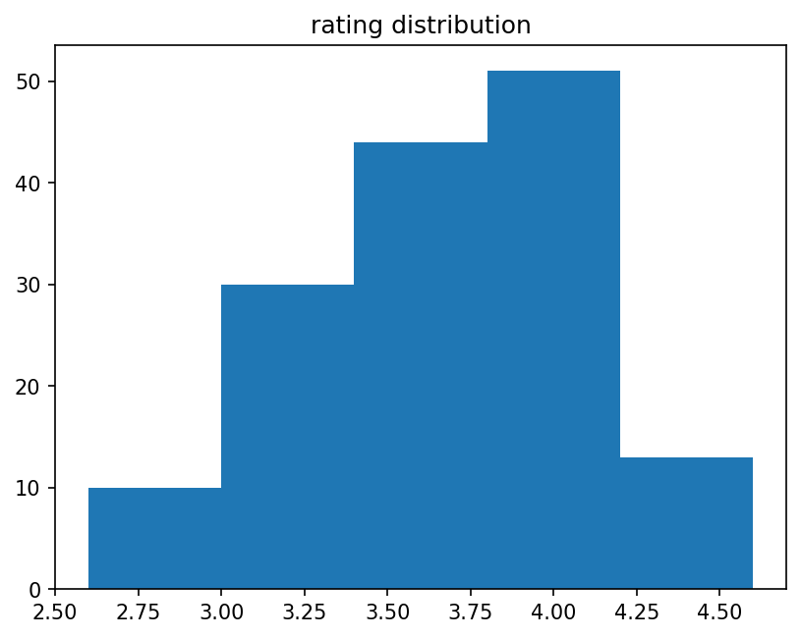
Average rating for restaurants

Slide 4
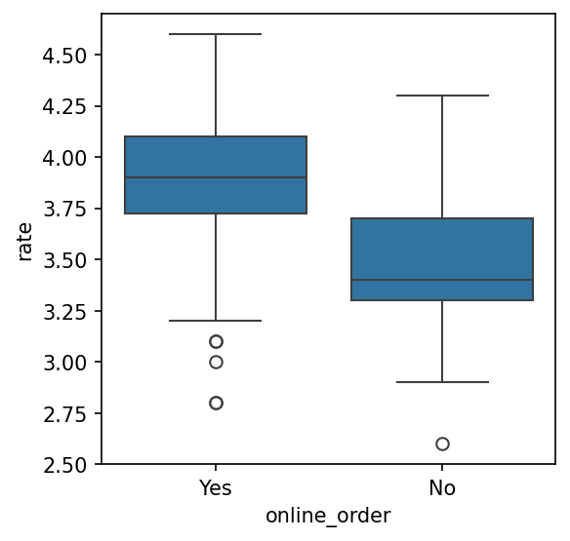
Recommendation based on rating for online order

Slide 5
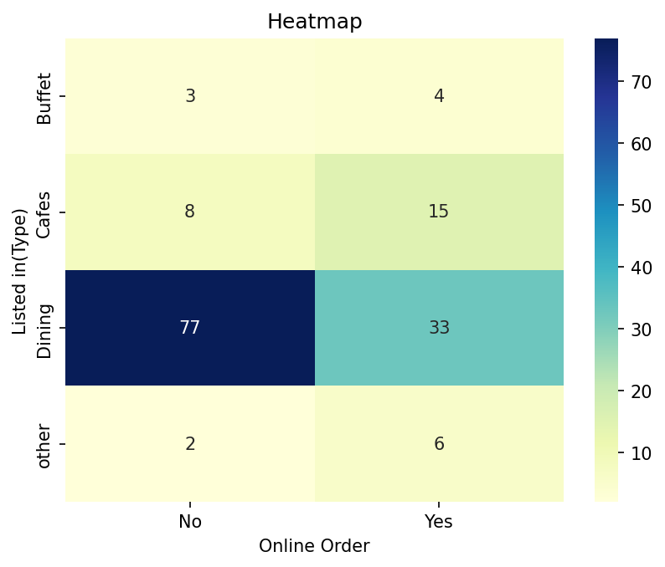
Type of restaurants recommended for online order

