Slide 1
Maximum Likelihood Estimation
Video link -
https://drive.google.com/file/d/1il0TcUb2jmel7uWt8d_IlcbNfj6Px_lD/view?usp=sharing

Slide 2
With prior assumption or knowledge about the data distribution, Maximum Likelihood Estimation helps find the most likely-to-occur distribution parameters.
For instance, let us say we have data that is assumed to be normally distributed, but we do not know its mean and standard deviation parameters. Maximum Likelihood Estimation iteratively searches the most likely mean and standard deviation that could have generated the distribution.

Slide 3


Bernoulli Distribution and its Likelihood Function

Slide 4

Log of the Likelihood Function (binomial loglikelihood function).
By taking the derivative w.r.t. p of the binomial loglikelihood function we get
p = x/n , where x is the number of of successes over n.

Slide 5



MLE for Normal Distribution (estimate for mean and variance)
Probability distribution:
Likelihood Function:
Loglikelihood Function:

Slide 6
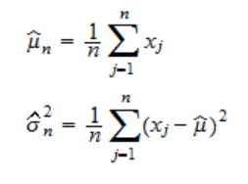
By taking derivative of the loglikelihood function w.r.t. mean and variance respectively we get the estimates as

Slide 7
References
Python Guide To Maximum Likelihood Estimation by Analytics India Magazine
Maximum-likelihood (ML) Estimation by The Pennsylvania State University
Normal Distribution - Maximum Likelihood Estimation by StatLect

