Slide 1








B-READI Building Reliable Effective and Aware DIsaster emergency and prevention managing skills
B-READI Building Reliable Effective and Aware DIsaster emergency and prevention managing skills
B-READI PILOT
University of L'Aquila - from 26 to 30 June 2023

Slide 2

Data Analytics & Visualizations
Ariadne Tsiakara
B-READI PILOT
University of L'Aquila - from 26 to 30 June 2023

Slide 3

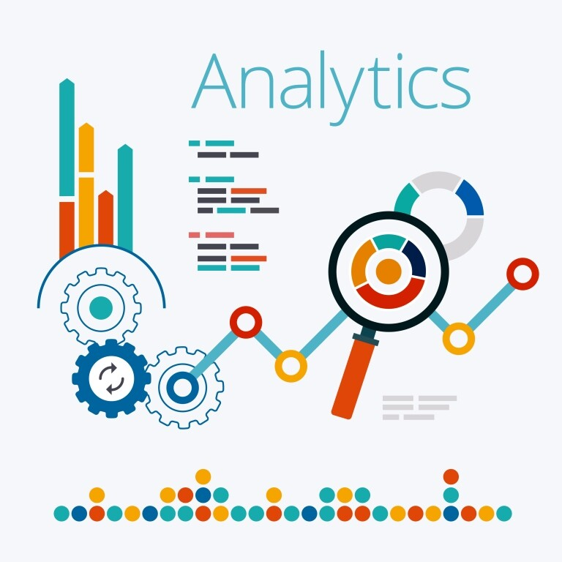
What is Data analytics and visualization?
Data visualization is the practice of translating information into a visual context, such as a map or graph, to make data easier for the human brain to understand and pull insights from.
The main goal of data visualization is to make it easier to identify patterns, trends and outliers in large data sets.
B-READI PILOT
Data Analytics & Visualizations
University of L'Aquila - from 26 to 30 June 2023

Slide 4




What’s top of mind?
Data Literacy
Identify how data works. This includes how data is defined, how to ask the right questions, how to measure, draw decisions, and then share your findings.
Artificial Intelligence (AI)
Consumers and Businesses alike utilize AI daily. Discover about the versatile field that is AI, including definitions, examples, advantages, disadvantages, history, and explorations of the theoretical and ethical.
Data Science
Detect the “how”s and “why”s behind how data analysis works. Learn about data preparation and analysis, and different data science tools and skills, like data mining, mapping, cleaning, and different analysis techniques.
Business Intelligence (BI)
Classify how data analysis, reporting, benchmarking, visualization, and more come together in BI to create a powerful business tool with the goal of equipping businesses to make data-driven decisions.
B-READI PILOT
Data Analytics & Visualizations
University of L'Aquila - from 26 to 30 June 2023

Slide 5
Covid-19 Pandemic crisis
B-READI PILOT
Data Analytics & Visualizations
University of L'Aquila - from 26 to 30 June 2023

Slide 6
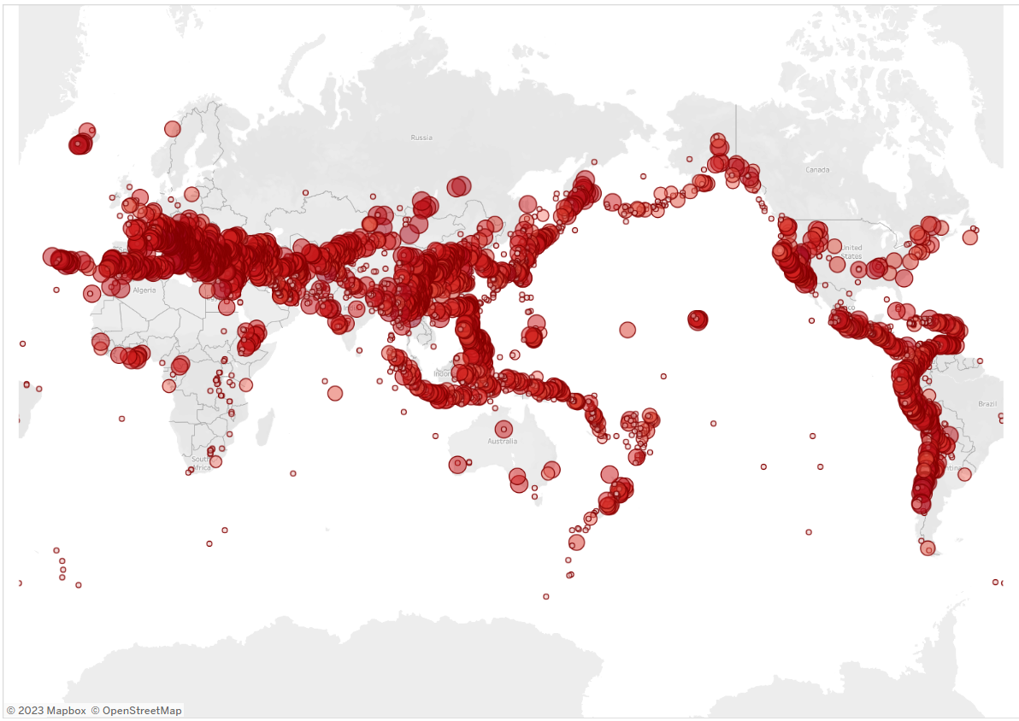
Earthquake Data Visualization
B-READI PILOT
Data Analytics & Visualizations
University of L'Aquila - from 26 to 30 June 2023

Slide 7
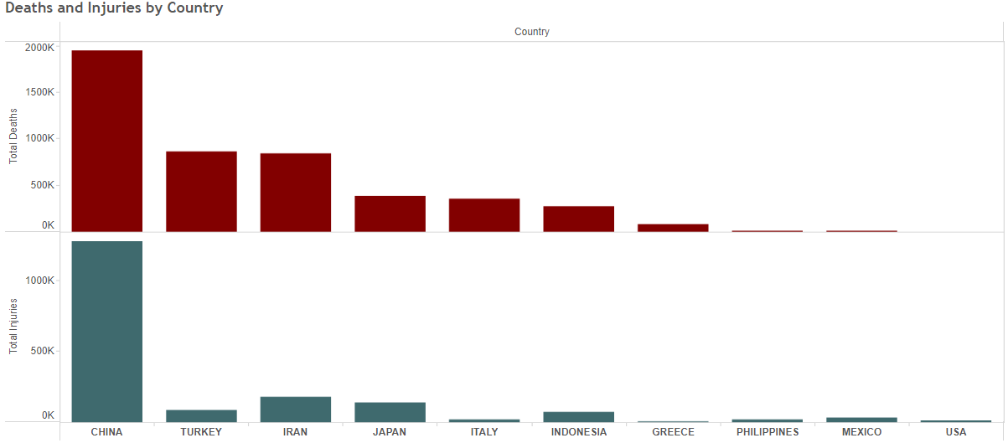
Earthquake Data Visualization
B-READI PILOT
Data Analytics & Visualizations
University of L'Aquila - from 26 to 30 June 2023

Slide 8
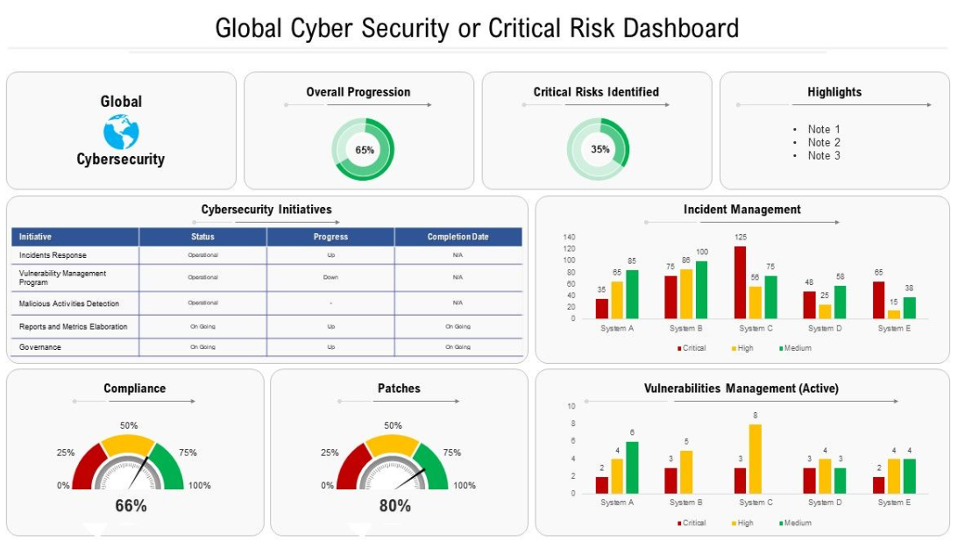
Cyber Security Visualization
B-READI PILOT
Data Analytics & Visualizations
University of L'Aquila - from 26 to 30 June 2023

Slide 9
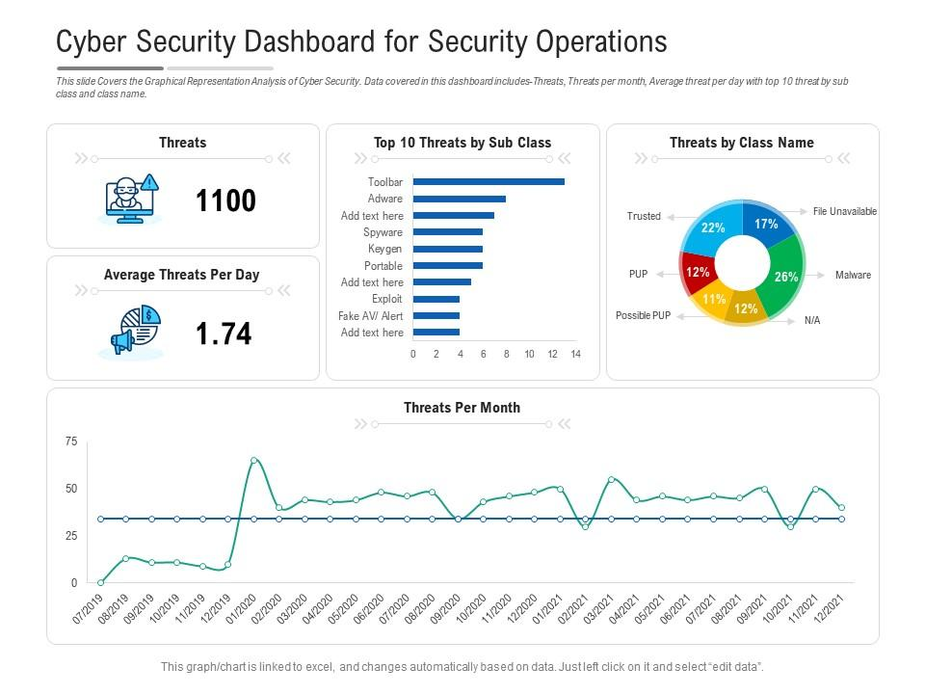
B-READI PILOT
Data Analytics & Visualizations
University of L'Aquila - from 26 to 30 June 2023

Slide 10
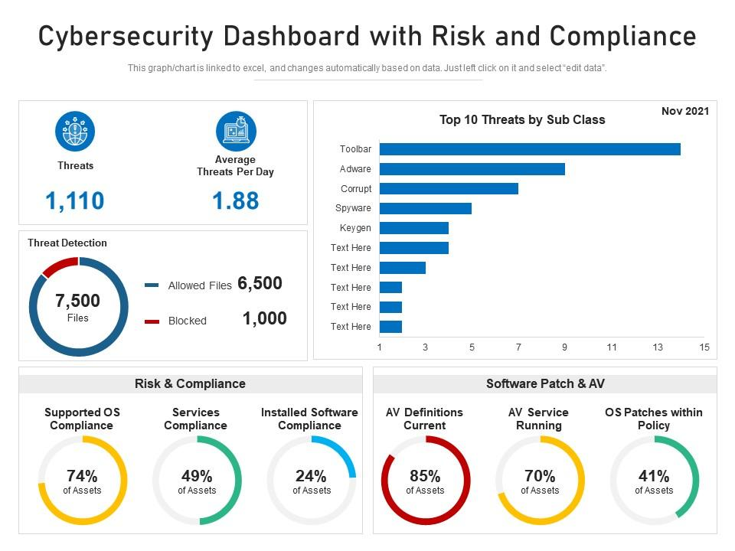
B-READI PILOT
Data Analytics & Visualizations
University of L'Aquila - from 26 to 30 June 2023

Slide 11
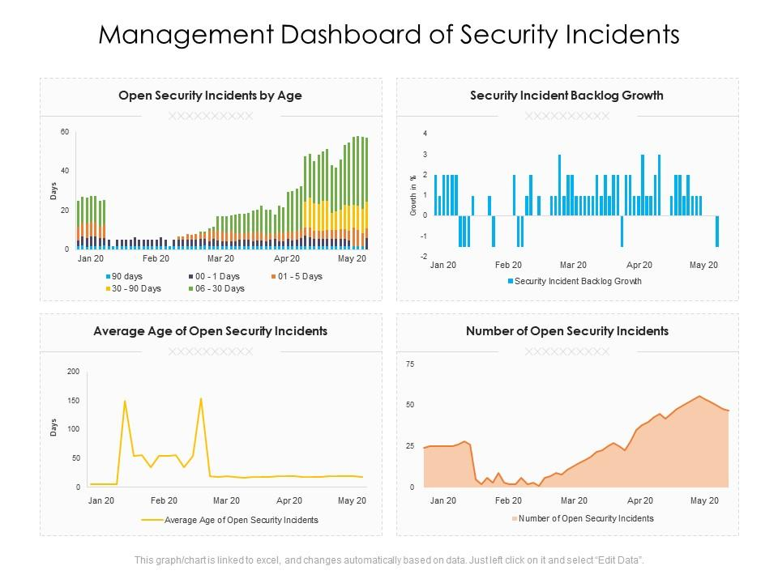
B-READI PILOT
Data Analytics & Visualizations
University of L'Aquila - from 26 to 30 June 2023

Slide 12
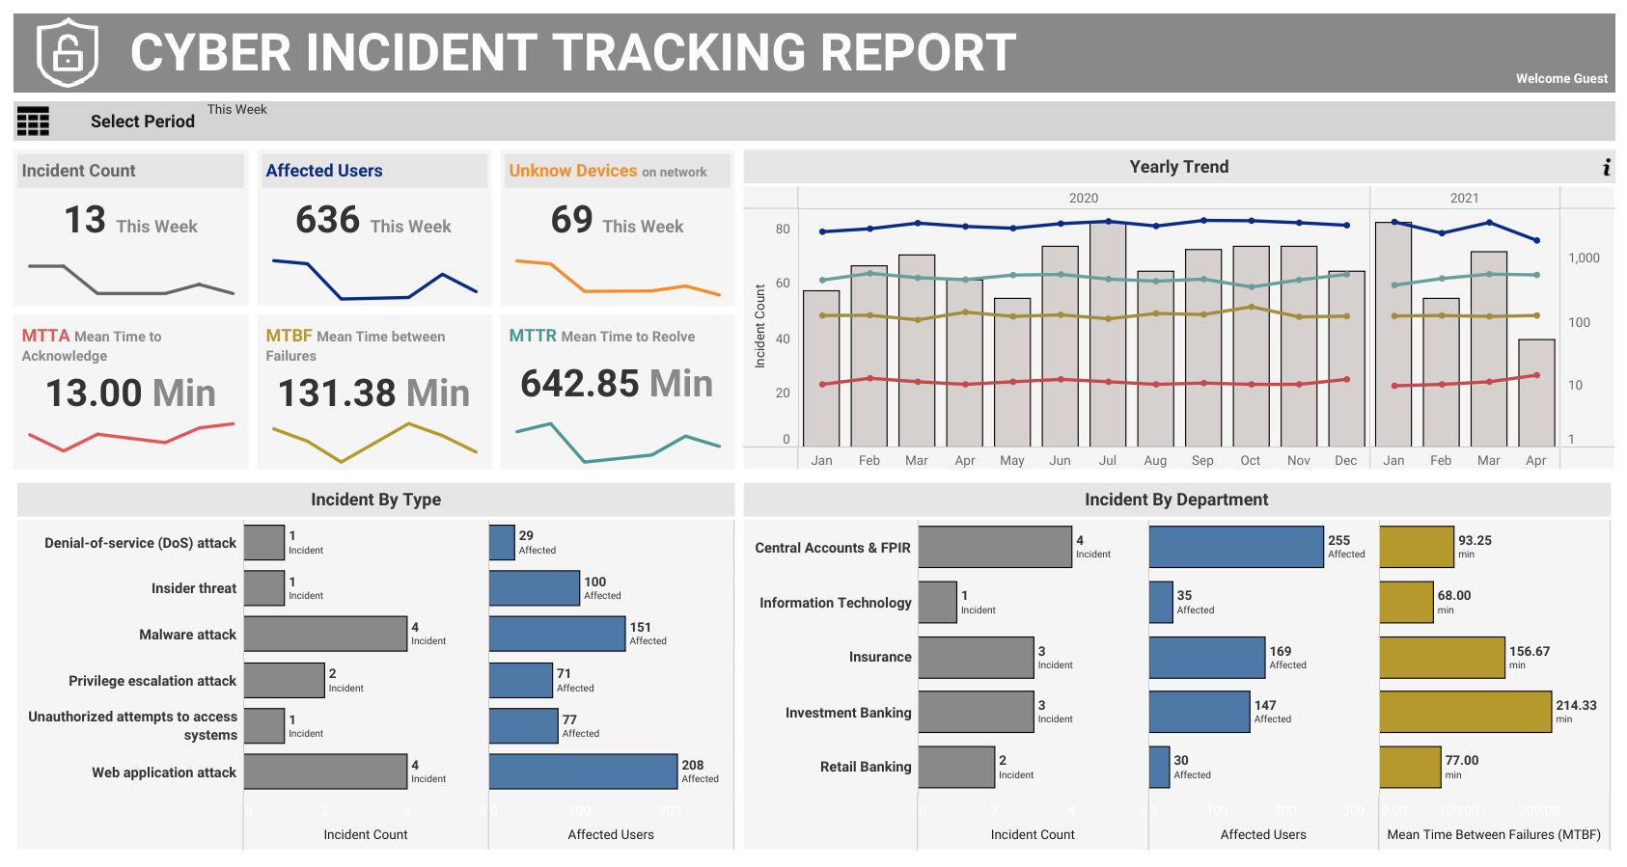
B-READI PILOT
Data Analytics & Visualizations
University of L'Aquila - from 26 to 30 June 2023

Slide 13

B-READI PILOT
University of L'Aquila - from 26 to 30 June 2023

