Slide 1
Time Series Analysis on Air Quality and Weather Prediction
Presented By
ANIRBAN BERA
Exam Roll No: MCA2360039
Registration No: 154245 of 2020-21

Slide 2
Introduction
Time Series Analysis
Essential for understanding and forecasting complex phenomena over time.
Advances driven by data proliferation and challenges like nonlinearity and high-dimensionality.
Recurrent Neural Networks (RNNs) and deep learning improve performance.
Classical statistical methods like autoregressive integrated moving average (ARIMA) and exponential smoothing (ETS) remain effective benchmarks.
Application
Finance
Healthcare
Traffic
Retail

Slide 3
Air Quality Prediction and Weather Prediction
Air Quality Prediction
Importance of predicting air quality index (AQI) for public health and decision making.
Advances in machine learning enable accurate AQI predictions.
Challenges include pollution patterns, environmental factors, and data availability.
Methods like deep learning show promising results.
Weather Prediction
Critical for decision making in various sectors like agriculture, transportation, energy and more.
Traditional methods based on numerical weather models.
Machine learning techniques enhance prediction accuracy.
Deep learning models, such as convolutional neural networks (CNN) and RNN, are effective for weather prediction.

Slide 4
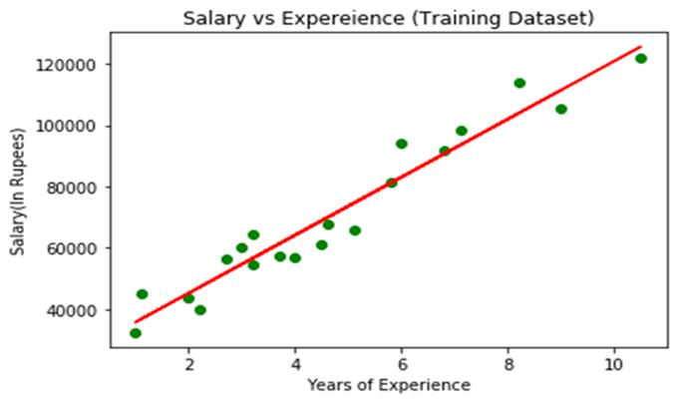
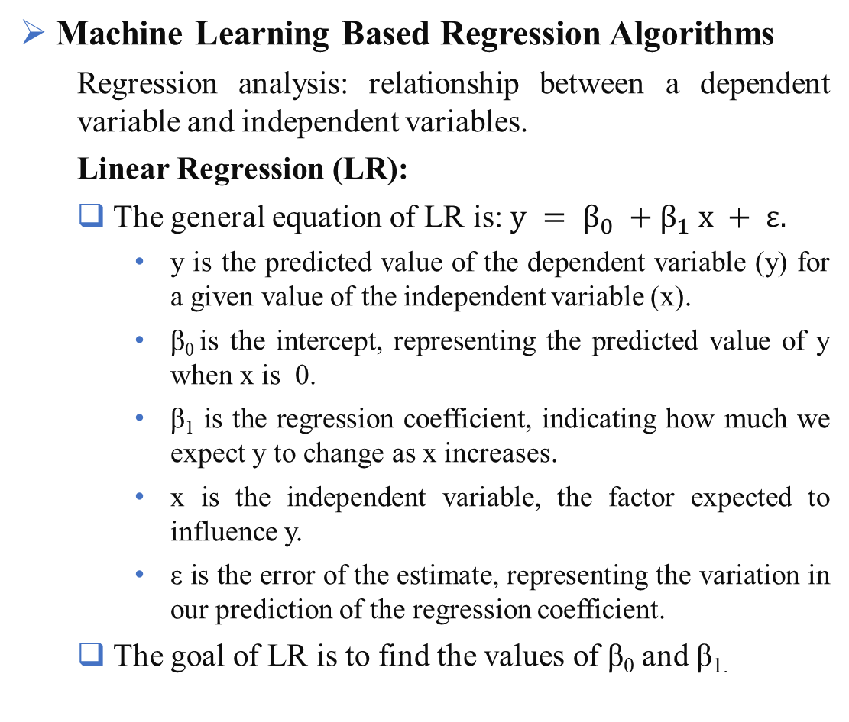
Working Methodologies
Machine Learning Based Regression Algorithms
Regression analysis: relationship between a dependent variable and independent variables.
Linear Regression (LR):
The general equation of LR is: $y = β_{0} +β_{1} x + ε.$
y is the predicted value of the dependent variable (y) for a given value of the independent variable (x).
β₀ is the intercept, representing the predicted value of y when x is 0.
β₁ is the regression coefficient, indicating how much we expect y to change as x increases.
x is the independent variable, the factor expected to influence y.
ε is the error of the estimate, representing the variation in our prediction of the regression coefficient.
The goal of LR is to find the values of β₀ and β_{1.}
Illustration of Linear regression

Slide 5
Multiple Linear Regression (MLR)
MLR is extension of linear regression.
General equation of MLR: y = β₀ + β₁x₁ + β₂x₂ + ... + β_{n}x_{n} + ε
y is the predicted value of the dependent variable.
β₀ is the y-intercept, representing the value of y when all other parameters are set to 0.
β₁x₁ is the regression coefficient of the first independent variable x₁, indicating the effect of increasing its value on the predicted y value.
β_{n}x_{n} is the regression coefficient of the last independent variable.
ε is the error of the estimate, representing the variation in our prediction of the regression coefficient.
The goal of MLR is to find the values of β₀, β₁, β₂, ..., β_{n}
The coefficients can be estimated by solving a system of equations or employing numerical optimization techniques.

Slide 6
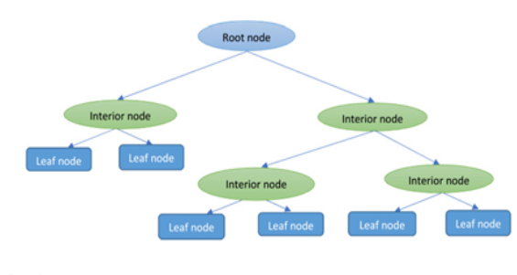
Decision Tree
Quantitative Variable Prediction: Recursive Splits.
Splitting Criterion: Standard Deviation.
Key points about Decision Trees:
Recursive partitioning
Root node
Splitting process
Termination criterion
Leaf nodes
Decision Trees offer interpretable results and can handle various data types.
Decision Tree Structure

Slide 7
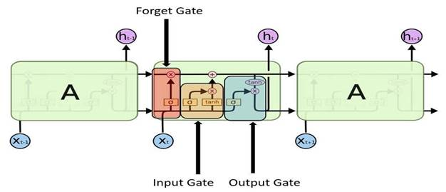
Deep Learning Models
Deep learning models, such as Artificial Neural Networks (ANNs), consist of neurons organized in three layers: input layer, hidden layers and output layer.
Connections between layers carry weights, and each node applies an activation function to the weighted input.
Long-Short Term Memory Neural Networks (LSTMs):
LSTMs have an extended memory capable of handling long-term dependencies.
LSTMs maintain a cell state that is updated by three gates: input gate, forget gate, and output gate.
These gates determine which information to retain, discard, or output, contributing to effective predictions.
Architecture of a LSTM Model

Slide 8
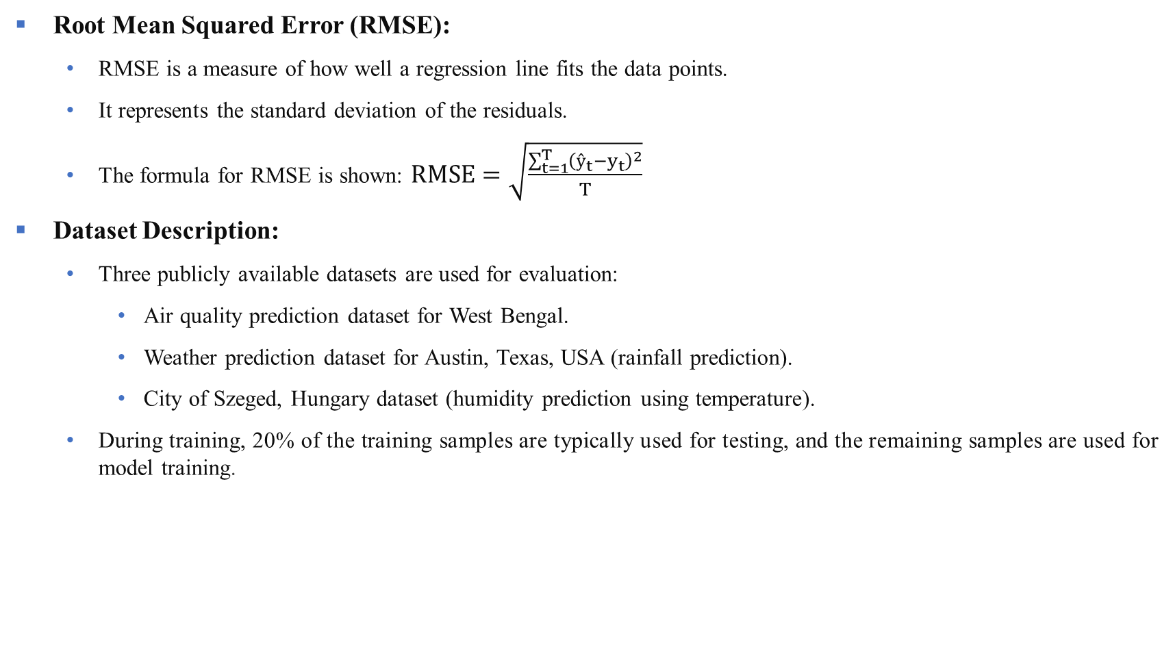
Evaluation Metrics and Dataset Description
Root Mean Squared Error (RMSE):
RMSE is a measure of how well a regression line fits the data points.
It represents the standard deviation of the residuals.
The formula for RMSE is shown: $RMSE=\sqrt{\frac{\sum_{t=1}^{T}{{\left(ŷ_{t}−y_{t}\right)}^{2}}}{T}}$
Dataset Description:
Three publicly available datasets are used for evaluation:
Air quality prediction dataset for West Bengal.
Weather prediction dataset for Austin, Texas, USA (rainfall prediction).
City of Szeged, Hungary dataset (humidity prediction using temperature).
During training, 20% of the training samples are typically used for testing, and the remaining samples are used for model training.

Slide 9
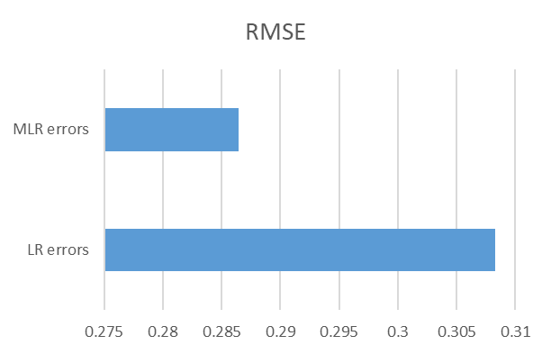
Detail Experimental Findings
Austin Weather Dataset:
LR and MLR
Parameter | LR error | MLR error
RMSE | 0.30829466911952685 | 0.2864271847316872
Comparison between LR and MLR error values
Comparison of error between LR and MLR

Slide 10
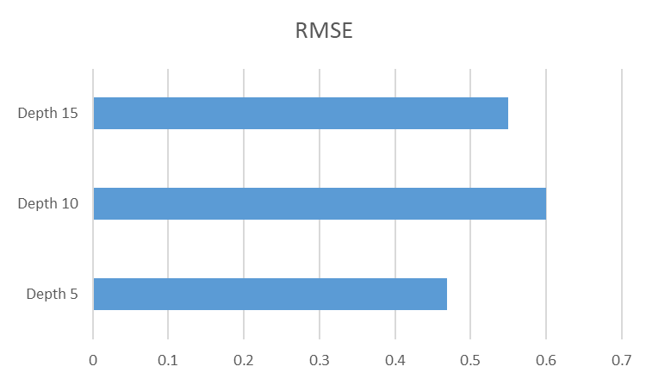
Detail Experimental Findings
Decision Tree
Parameter | Depth 5 | Depth 10 | Depth 15
RMSE | 0.46943246301264524 | 0.5996067918375381 | 0.5494359401428661
Comparison of Decision tree errors
Error Comparison of decision tree

Slide 11
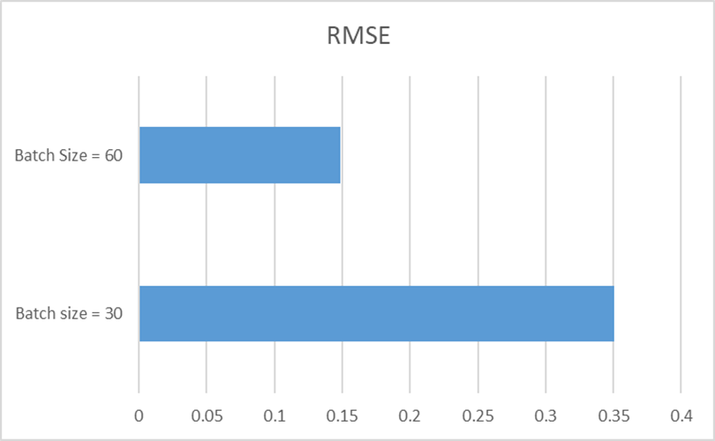
Detail Experimental Findings
LSTM
Parameter | Batch size = 30 | Batch Size = 60
RMSE | 0.35026184421252865 | 0.1486208459753456
Comparison of LSTM models when epochs are 50
Comparison of LSTM error when epochs are 50

Slide 12
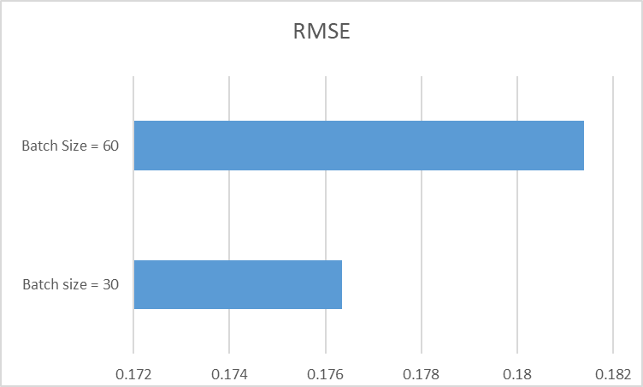
Detail Experimental Findings
LSTM
Parameter | Batch size = 30 | Batch Size = 60
RMSE | 0.1763390598071492 | 0.18138402632980596
Comparison of LSTM models when epochs are 100
Comparison of LSTM errors when epochs are 100

Slide 13
Detail Experimental Findings
Szeged Weather Dataset:
LR and MLR
Parameter | LR errors | MLR errors
RMSE | 0.10589191629442367 | 0.09158295375526093
Comparison between LR and MLR error values
Comparison of error between LR and MLR

Slide 14
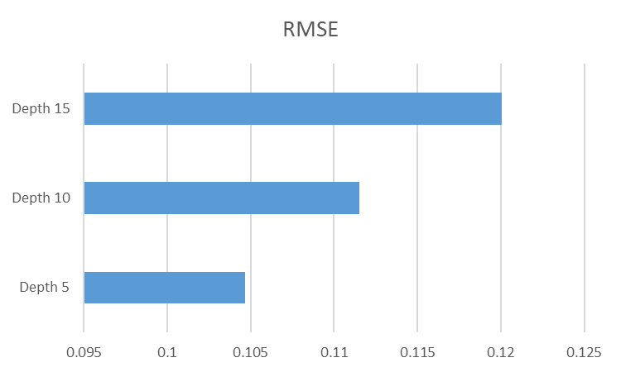
Detail Experimental Findings
Decision Tree
Parameter | Depth 5 | Depth 10 | Depth 15
RMSE | 0.10468486695790355 | 0.1115155680674694 | 0.12007350084828675
Comparison of Decision tree errors
Error Comparison of decision tree

Slide 15
Detail Experimental Findings
LSTM
Parameter | Batch size = 30 | Batch Size = 60
RMSE | 0.09863644679878764 | 0.1801251463305666
Comparison of LSTM models when epochs are 50
Comparison of LSTM error when epochs are 50

Slide 16
Detail Experimental Findings
LSTM
Parameter | Batch size = 30 | Batch Size = 60
RMSE | 0.21243911821607453 | 0.21332113255839377
Comparison of LSTM models when epochs are 100
Comparison of LSTM errors when epochs are 100

Slide 17
Detail Experimental Findings
AQI Dataset:
LR and MLR
Parameter | LR errors | MLR errors
RMSE | 34.28428473704663 | 11.864126631236314
Comparison between LR and MLR error values
Comparison of error between LR and MLR

Slide 18
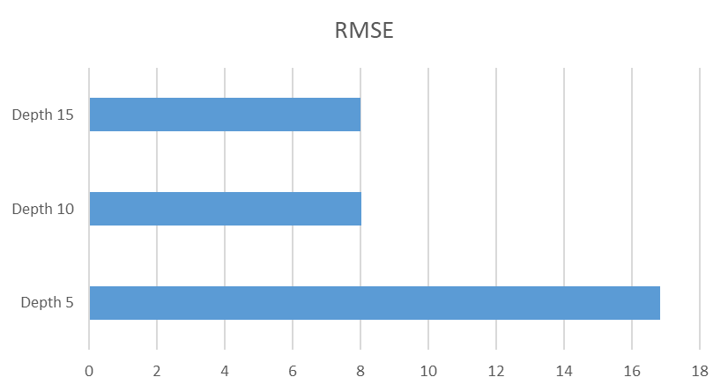
Detail Experimental Findings
Decision Tree
Parameter | Depth 5 | Depth 10 | Depth 15
RMSE | 16.82173435620712 | 8.01774153077837 | 8.013653469038966
Comparison of Decision tree errors
Error Comparison of decision tree

Slide 19
Detail Experimental Findings
LSTM
Increasing the batch size, the error values are also increased and difference between the errors are very huge.
Parameter | Batch size = 30 | Batch Size = 60
RMSE | 8.518217883753636 | 58410.94132890068
Comparison of LSTM models when epochs are 50

Slide 20
Conclusion
Conducted comprehensive time series analysis on weather data and AQI to understand their relationship and develop predictive models.
Significant correlations observed between weather variables and AQI, highlighting the influence of weather conditions on air quality.
Findings contribute to air quality management and public health initiatives by enabling proactive measures to mitigate air pollution.

Slide 21
Limitations and Future Work
Limitations
Models may have limitations in capturing complex relationships and nonlinear patterns.
LSTM models may require higher time and hardware resources, potentially affecting processing speed.
Future Work
Incorporate additional variables such as traffic data and geographical features to improve prediction accuracy.
Analyze long-term trends in weather and AQI data to assess the impact of climate change on air quality.

Slide 22
References
Z. C. Lipton, D. C. Kale, C. Elkan and R. Wetzell, Learning to diagnose with LSTM recurrent neural networks., p. 18, 2015.
Z. Che, S. Purushotham, K. Cho, D. Sontag and Y. Liu, Recurrent Neural Networks for Multivariate Time Series with Missing Values, vol. 8, no. 1, p. 6085, 2018.
R. J. Hyndman and G. Athanasopoulos, Forecasting: Principles and Practice, 2nd ed., Australia, 2018.
J. Shao, Y. Liu, H. Wu and J. Zhang, "Air quality index prediction based on a convolutional neural network with residual connections (ResNet-AQI)," Atmospheric Environment, vol. 214, p. 116834, 2019.
Z. Chen, H. Li and H. Du, "A hybrid model for the prediction of air quality index," PLoS ONE, vol. 12, no. 6, 2017.
N. N. Maltare and S. Vahora, "Air Quality Index prediction using machine learning for Ahmedabad city," Digital Chemical Engineering, vol. 7, p. 100093, 2023.
L. D. Monache, F. Eckel, D. L. Rife, B. Nagarajan and K. Searight, "Probabilistic Weather Prediction with an Analog Ensemble," Monthly Weather Review, vol. 141, no. 10, p. 3498–3516, 2013
L. Balogun and A. Tella, "Modelling and investigating the impacts of climatic variables on ozone concentration in Malaysia using correlation analysis with random forest, decision tree regression, linear regression, and support vector regression," Chemosphere, vol. 299, no. 134250, 2022.

Slide 23


