Slide 1
Lecture 11: Machine Learning II
DS 503: Advanced Data Analytics
Instructor: Dr. Gagan Raj
Based on lecture slides by Dr. Piyush Rai at IITK, mmds.org

Slide 2
Decision Trees
A Decision Tree (DT) defines a hierarchy of rules to make a prediction
Root and internal nodes test rules. Leaf nodes make predictions
Decision Tree (DT) learning is about learning such a tree from labeled data
Root Node
Body
temp.
Warm
Cold
Non-mammal
An Internal Node
A Leaf Node
Gives
birth
Yes
No
Mammal
Non-mammal

Slide 3


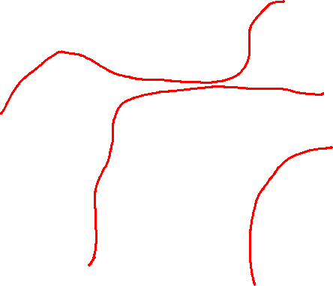
Decision Trees for Supervised Learning
The basic idea is very simple
Recursively partition the training data into homogeneous regions
Within each group, fit a simple supervised learner (e.g., predict the majority label)
What do you mean by “homogeneous” regions?
Even though the rule within each group is simple, we are able to learn a fairly sophisticated model overall (note in this example, each rule is a simple horizontal/vertical classifier but the overall decision boundary is rather sophisticated)
A homogeneous region will have all (or a majority of) training inputs with the same/similar outputs

Slide 4
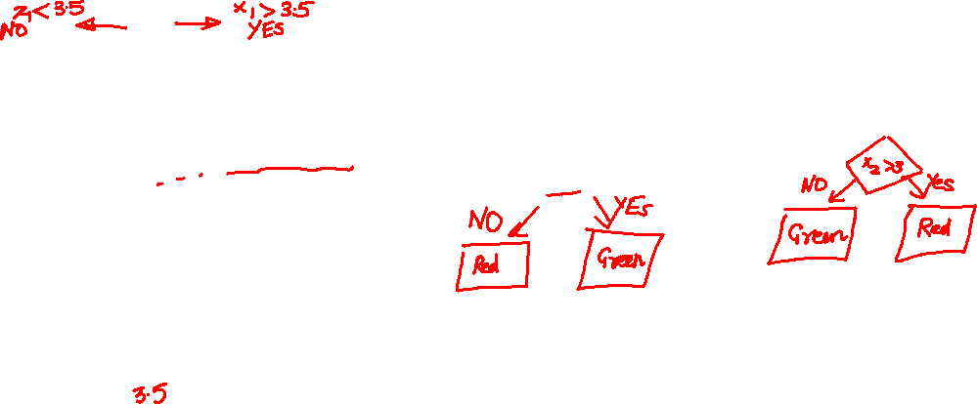
Decision Trees for Classification
5
NO
YES
Test input
$$x_{1}>3.5 ?$$
4
NO
YES
NO
YES
3
$$x_{2}>2 ?$$
$$x_{2}>3 ?$$
Feature 2 ($x_{2})$
2
Predict Red
Predict Green
Predict Green
Predict Red
1
1
2
3
4
5
6
Feature 1 ($x_{1})$
Remember: Root node contains all training inputs
Each leaf node receives a subset of training inputs
DT is very efficient at test time: To predict the label of a test point, nearest neighbors will require computing distances from 48 training inputs. DT predicts the label by doing just 2 feature-value comparisons! Way more fast!!!

Slide 5
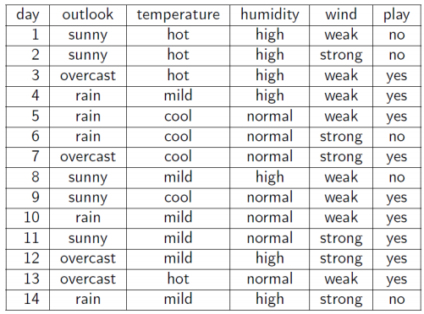
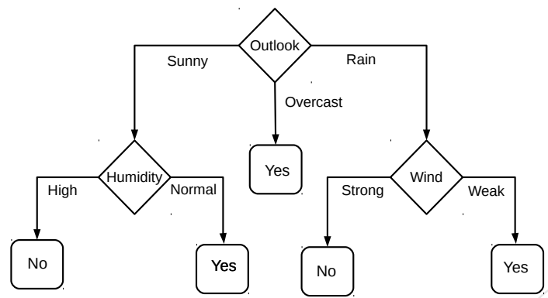
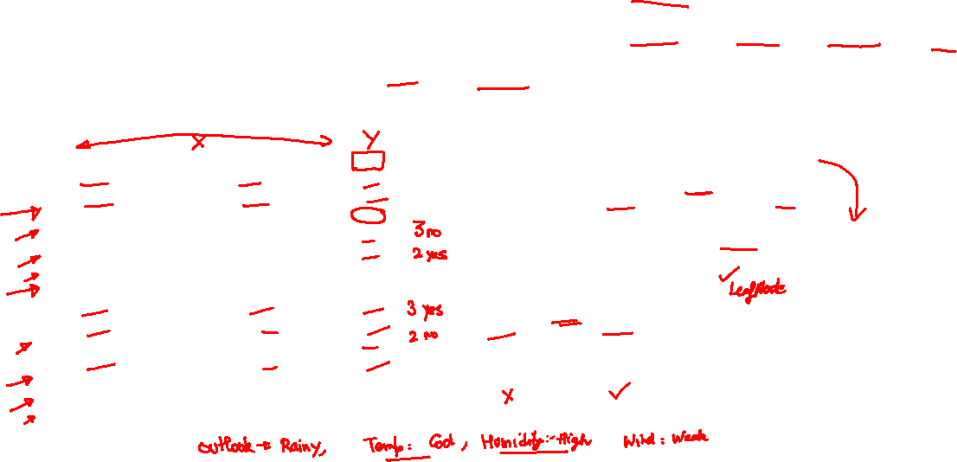
Decision Trees for Classification: Another Example
Deciding whether to play or not to play Tennis on a Saturday
Each input (Saturday) has 4 categorical features: Outlook, Temp., Humidity, Wind
A binary classification problem (play vs no-play)
Below Left: Training data, Below Right: A decision tree constructed using this data
Example credit: Tom Mitchell

Slide 6
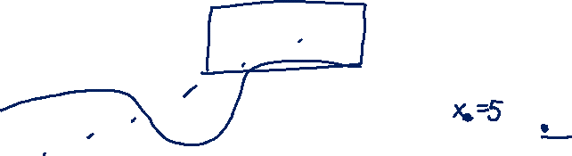
Decision Trees for Regression
Can use any regression model but would like a simple one, so let’s use a constant prediction based regression model
Another simple option can be to predict the average output of the training inputs in this region
4
3
2
1
NO
YES
$$x>4 ?$$
$$y$$
NO
YES
Predict $y=3.5$
$$x_{2}>3 ?$$
Predict $y=3$
Predict $y=1.5$
1 2 3 4 5
$$x$$
To predict the output for a test point, nearest neighbors will require computing distances from 15 training inputs. DT predicts the label by doing just at most feature-value comparisons! Way more fast!!!

Slide 7
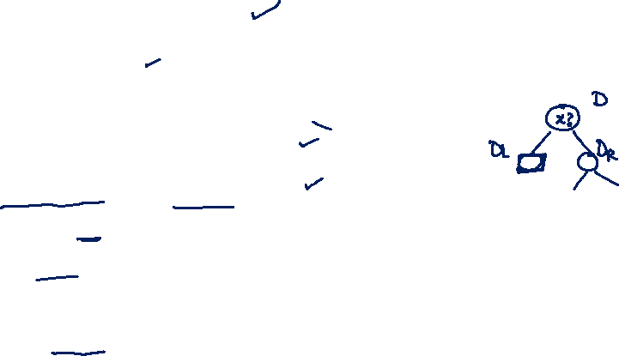
3 Step in constructing Decision Tree
Requires at least a single pass over the data.

Slide 8
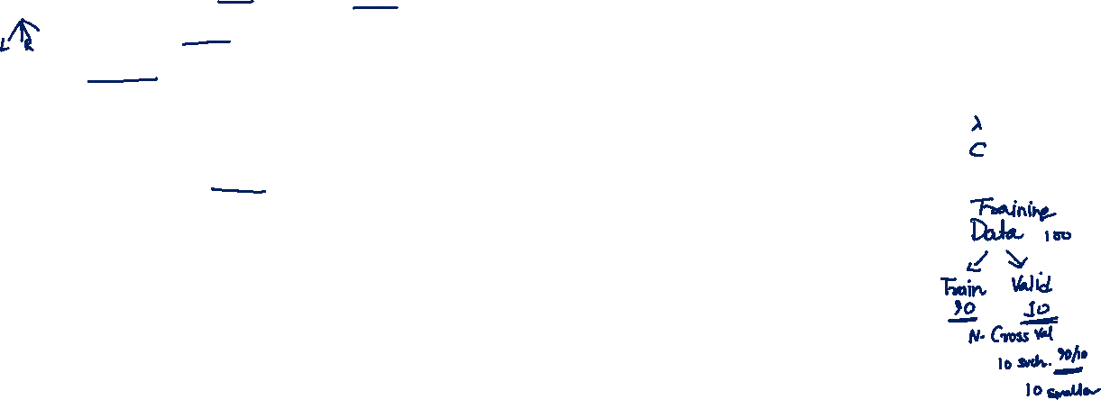
Decision Trees: Some Considerations
Usually, cross-validation can be used to decide size/shape
What should be the size/shape of the DT?
Number of internal and leaf nodes
Branching factor of internal nodes
Depth of the tree
Split criterion at internal nodes
Use another classifier?
Or maybe by doing a simpler test?
What to do at the leaf node? Some options:
Make a constant prediction for each test input reaching there
Use a nearest neighbor based prediction using training inputs at that leaf node
Train and predict using some other sophisticated supervised learner on that node
Usually, constant prediction at leaf nodes used since it will be very fast

Slide 9
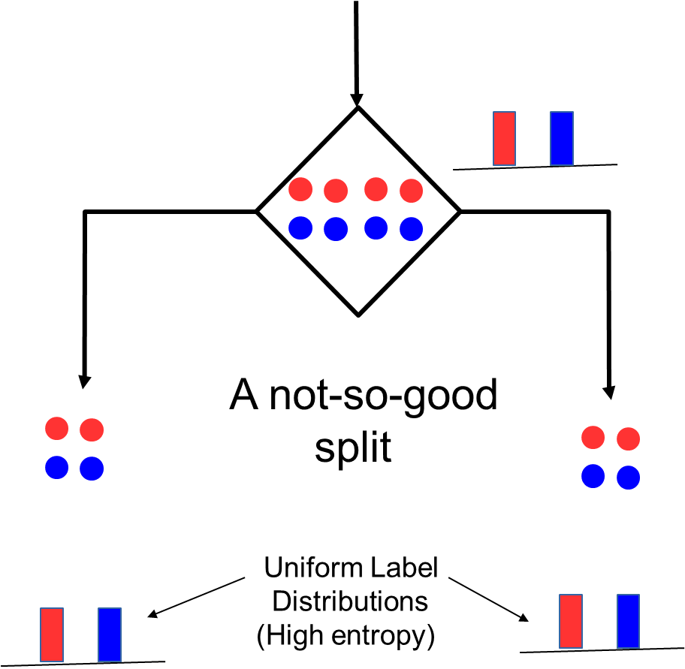
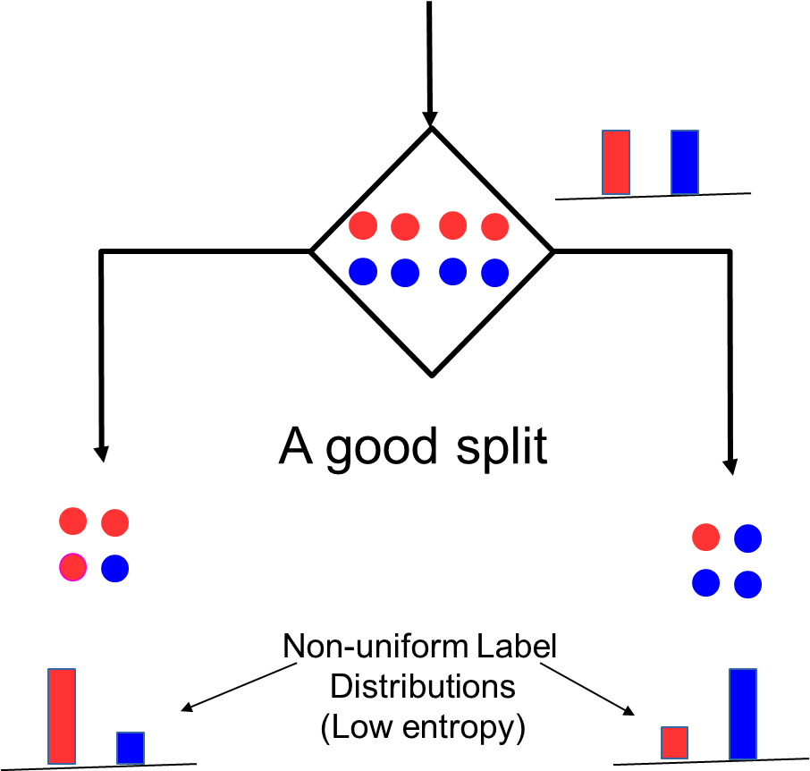

How to Split at Internal Nodes?
9
Recall that each internal node receives a subset of all the training inputs
Regardless of the criterion, the split should result in as “pure” groups as possible
A pure group means that the majority of the inputs have the same label/output
For classification problems (discrete outputs), entropy is a measure of purity
Low entropy ⇒ high purity (less uniform label distribution)
Splits that give the largest reduction (before split vs after split) in entropy are preferred (this reduction is also known as “information gain”)

Slide 10
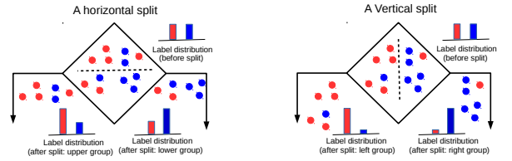
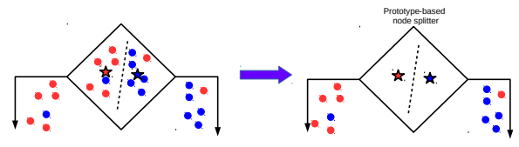
Techniques to Split at Internal Nodes?
10
Each internal node decides which outgoing branch an input should be sent to
This decision/split can be done using various ways, e.g.,
Testing the value of a single feature at a time (such internal node called “Decision Stump”)
Learning a classifier (e.g., LwP or some more sophisticated classifier)
With this approach, all features and all possible values of each feature need to be evaluated in selecting the feature to be tested at each internal node
(can be slow but can be made faster using some tricks)
DT methods based on testing a single feature at each internal node are faster and more popular (e.g., ID3, C4.5 algos)
DT methods based on learning and using a separate classifier at each internal node are less common. But this approach can be very powerful and are sometimes used in some advanced DT methods

Slide 11
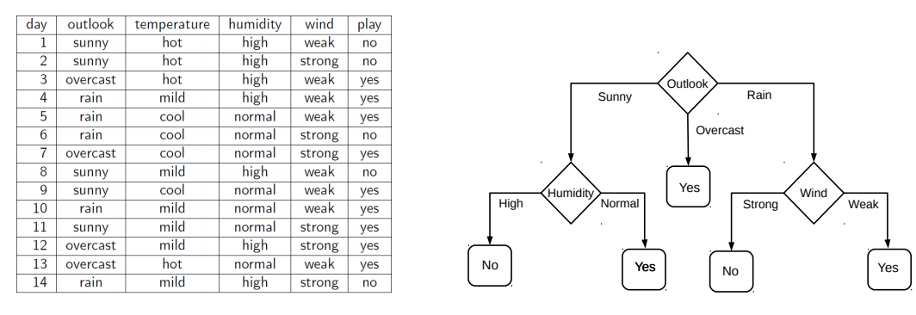
Decision Tree Construction: An Example
11
Let’s consider the playing Tennis example
Assume each internal node will test the value of one of the features
Question: Why does it make more sense to test the feature “outlook” first?
Answer: Of all the 4 features, it’s the most informative
It has the highest information gain as the root node

Slide 12

Constructing Decision Trees
Given some training data, what’s the “optimal” DT?
5
How to decide which rules to test for and in what order?
NO
YES
$$x_{1}>3.5 ?$$
4
NO
YES
NO
YES
How to assess informativeness of a rule?
3
$$x_{2}>2 ?$$
$$x_{2}>3 ?$$
Feature 2 ($x_{2})$
2
Predict Red
Predict Green
Predict Green
Predict Red
1
In general, constructing DT is an intractable problem (NP-hard)
1
2
3
4
5
6
Feature 1 ($x_{1})$
The rules are organized in the DT such that most informative rules are tested first
Often we can use some “greedy” heuristics to construct a “good” DT
Hmm.. So DTs are like the “20 questions” game (ask the most useful questions first)
To do so, we use the training data to figure out which rules should be tested at each node
Informativeness of a rule is of related to the extent of the purity of the split arising due to that rule. More informative rules yield more pure splits
The same rules will be applied on the test inputs to route them along the tree until they reach some leaf node where the prediction is made

Slide 13
Decision Tree Construction: An Example
13
Let’s consider the playing Tennis example
Assume each internal node will test the value of one of the features
Question: Why does it make more sense to test the feature “outlook” first?
Answer: Of all the 4 features, it’s the most informative
It has the highest information gain as the root node

Slide 14
Information theory detour
What is the amount of information contained in a dataset?
How many bits do you need to represent n items?
Eg. There are 8 people in a village and you need to give them a phone number. What is the minimum number of bits you have to use?
If X can take N different values, then information content of X is log N
But what if each value occurs with different probabilities?
We need an averaging formula.
Intuition: measure how much surprise there is in an event. Those events that are rare (low probability) are more surprising and therefore have more information than those events that are common (high probability).
Rare events are more uncertain or more surprising and require more information to represent them than common events.

Slide 15

Hartley’s Hat Example
We choose a bit, X, randomly from this hat.
What is the information carried in X?

Slide 16
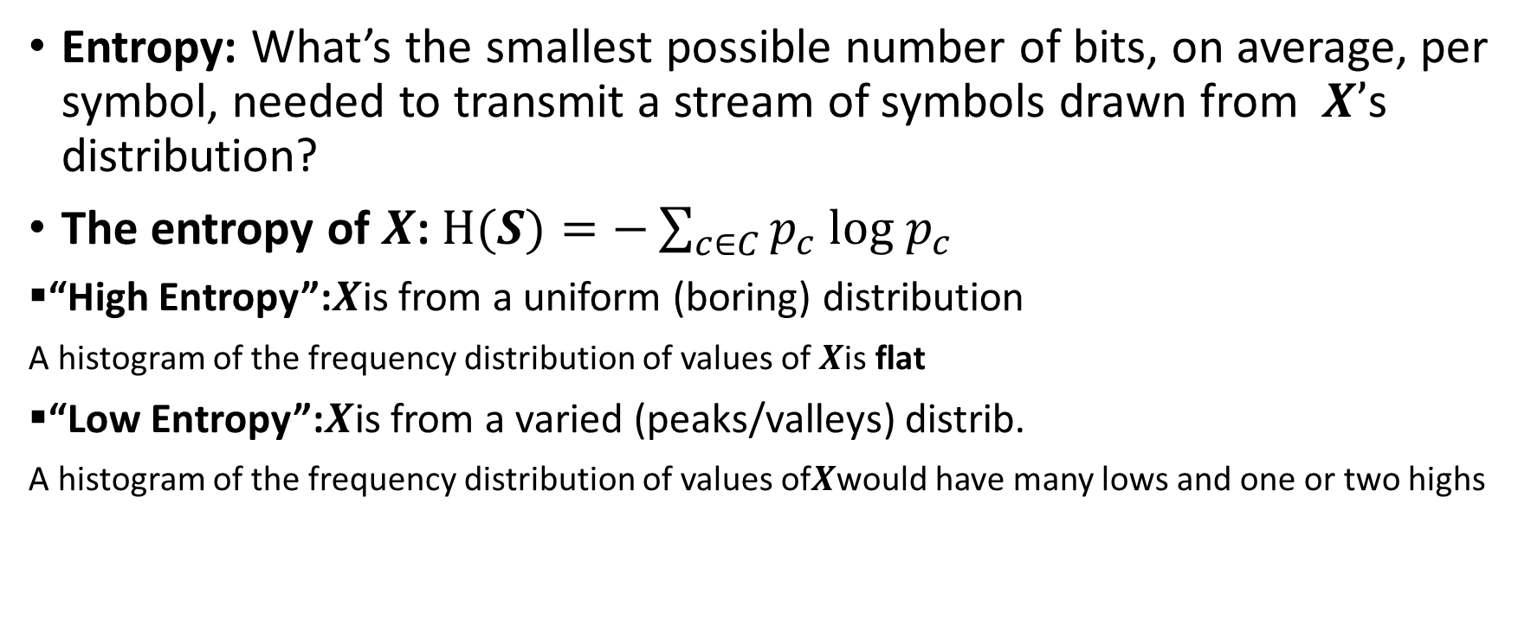
Entropy
Entropy: What’s the smallest possible number of bits, on average, per symbol, needed to transmit a stream of symbols drawn from 𝑿’s distribution?
The entropy of 𝑿: $H(S)=−\sum_{c∈C}{p_{c} log p_{c}}$
▪“High Entropy”:𝑿is from a uniform (boring) distribution
A histogram of the frequency distribution of values of 𝑿is flat
▪“Low Entropy”:𝑿is from a varied (peaks/valleys) distrib.
A histogram of the frequency distribution of values of𝑿would have many lows and one or two highs

Slide 17
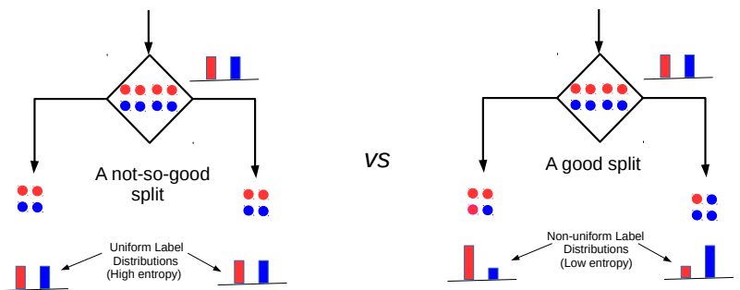
Entropy and Information Gain
17
Assume a set of labelled inputs $S$ from C classes, $p_{c}$ as fraction of class c inputs
Entropy of the set $S$ is defined as $H(S)=−\sum_{c∈C}{p_{c} log p_{c}}$
Suppose a rule splits $S$ into two smaller disjoint sets $S_{1}$ and $S_{2}$
Reduction in entropy after the split is called information gain
Uniform sets (all classes roughly equally present) have high entropy; skewed sets low
$IG=H\left(S\right)− \frac{\left|S_{1}\right|}{\left|S\right|}H\left(S_{1}\right)$ $− \frac{\left|S_{2}\right|}{\left|S\right|}H\left(S_{2}\right)$
This split has a low IG
(in fact zero IG)
This split has higher IG

Slide 18
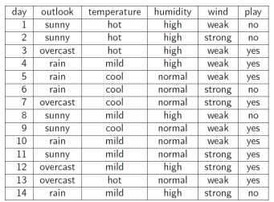
Entropy and Information Gain
18
Let’s use IG based criterion to construct a DT for the Tennis example
At root node, let’s compute IG of each of the 4 features
Consider feature “wind”. Root contains all examples S = [9+,5-]
S_{weak} = [6+, 2−] ⇒ H(S_{weak} ) = 0.811
S_{strong} = [3+, 3−] ⇒ H(S_{strong}) = 1
Likewise, at root: IG(S, outlook) = 0.246, IG(S, humidity) = 0.151, IG(S,temp) = 0.029
Thus we choose “outlook” feature to be tested at the root node
Now how to grow the DT, i.e., what to do at the next level? Which feature to test next?
Rule: Iterate - for each child node, select the feature with the highest IG
$$\text{H}\text{(}\text{S} \text{) =}\text{ −(9/14) }\text{log}\text{2}\text{(9/14) − (5/14) }\text{lo}\text{g}\text{2}\text{(5/14) = 0.94}$$
$IG(S,wind)=H\left(S\right)− \frac{\left|S_{weak}\right|}{\left|S\right|}H\left(S_{weak}\right)$ $− \frac{\left|S_{strong}\right|}{\left|S\right|}H\left(S_{strong}\right)$ = 0.94 − 8/14 ∗ 0.811 − 6/14 ∗ 1 = 0.048

Slide 19
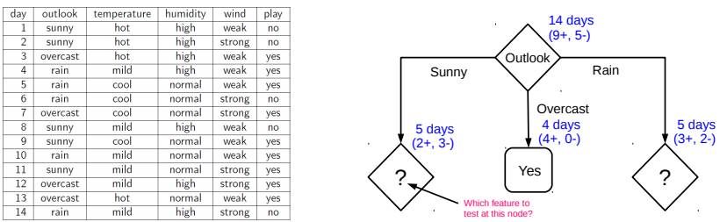
Growing the tree
19
Proceeding as before, for level 2, left node, we can verify that
IG(S,temp) = 0.570, IG(S, humidity) = 0.970, IG(S, wind) = 0.019
Thus humidity chosen as the feature to be tested at level 2, left node
No need to expand the middle node (already “pure” - all “yes” training examples ☺)
Can also verify that wind has the largest IG for the right node
Note: If a feature has already been tested along a path earlier, we don’t consider it again

Slide 20
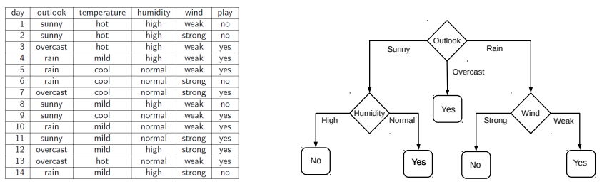
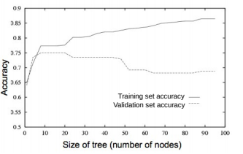
When to stop growing the tree?
20
Stop expanding a node further (i.e., make it a leaf node) when
It consist of all training examples having the same label (the node becomes “pure”)
We run out of features to test along the path to that node
The DT starts to overfit (can be checked by monitoring
the validation set accuracy)
Important: No need to obsess too much for purity
It is okay to have a leaf node that is not fully pure, e.g., this
At test inputs that reach an impure leaf, can predict probability of belonging to each class (in above example, p(red) = 3/8, p(green) = 5/8), or simply predict the majority label
To help prevent the tree from growing too much!
OR

Slide 21
Avoiding Overfitting in DTs
21
Desired: a DT that is not too big in size, yet fits the training data reasonably
Note: An example of a very simple DT is “decision-stump”
A decision-stump only tests the value of a single feature (or a simple rule)
Not very powerful in itself but often used in large ensembles of decision stumps
Mainly two approaches to prune a complex DT
Prune while building the tree (stopping early)
Prune after building the tree (post-pruning)
Criteria for judging which nodes could potentially be pruned
Use a validation set (separate from the training set)
Prune each possible node that doesn’t hurt the accuracy on the validation set
Greedily remove the node that improves the validation accuracy the most
Stop when the validation set accuracy starts worsening
Use model complexity control, such as Minimum Description Length (will see later)
Either can be done using a validation set

Slide 22
Decision Trees: Some Comments
For regression, outputs are real-valued and we don’t have a “set” of classes, so quantities like entropy/IG/gini etc. are undefined
22
Gini-index defined as $\sum_{c=1}^{C}{p_{c}(1−p_{c})}$ can be an alternative to IG
For DT regression¹, variance in the outputs can be used to assess purity
When features are real-valued (no finite possible values to try), things are a bit more tricky
Can use tests based on thresholding feature values (recall our synthetic data examples)
Need to be careful w.r.t. number of threshold points, how fine each range is, etc.
More sophisticated decision rules at the internal nodes can also be used
Basically, need some rule that splits inputs at an internal node into homogeneous groups
The rule can even be a machine learning classification algo (e.g., LwP or a deep learner)
However, in DTs, we want the tests to be fast so single feature based rules are preferred
Need to take care handling training or test inputs that have some features missing
An illustration on the next slide
¹Breiman, Leo; Friedman, J. H.; Olshen, R. A.; Stone, C. J. (1984). Classification and regression trees

Slide 23
An Illustration: DT with Real-Valued Features
23
Test example
“Best” (purest possible) Horizontal Split
“Best”(purest possible) Vertical Split
Up Down
Left Right
Between the best horizontal vs best vertical split, the vertical split is better (more pure), hence we use this rule for the internal node
This illustration’s credit: Purushottam Kar

Slide 24

Regression: Purity Metric
Find split $\left(X^{i}, v\right)$ that creates $D, D_{L}, D_{R}$: parent, left, right child datasets and maximizes:
$$\left|D\right|.Var\left(D\right)−\left(\left|D_{L}\right|.Var\left(D_{L}\right)+ | D_{R}|.Var(D_{R})\right)$$
Var(D) = $\frac{1}{\left|D\right|}\sum_{i∈D }{{\left(y_{i}−\overline{y}\right)}^{2}}$ .. Variance of $y_{i}$ in D

Slide 25
Decision Trees: A Summary
25
.. thus helping us learn complex rule as a combination of several simpler rules
Some key strengths:
Simple and easy to interpret
Nice example of “divide and conquer”
paradigm in machine learning
Easily handle different types of
features (real, categorical, etc.)
Very fast at test time
Multiple DTs can be combined
via ensemble methods: more powerful
(e.g., Decision Forests; will see later)
Used in several real-world ML applications, e.g., recommender systems, gaming (Kinect)
Some key weaknesses:
Learning optimal DT is (NP-hard) intractable. Existing algos mostly greedy heuristics
Can sometimes become very complex unless some pruning is applied
5
NO
YES
$$x_{1}>3.5 ?$$
4
NO
YES
NO
YES
3
$$x_{2}>2 ?$$
$$x_{2}>3 ?$$
Feature 2 ($x_{2})$
2
Predict Red
Predict Green
Predict Green
Predict Red
1
1
2
3
4
5
6
Human-body pose estimation
Feature 1 ($x_{1})$

