Slide 1
FinMind: Intelligent Portfolio Builder
AI-Powered NIFTY-500 Stock Selection using ANOVA + Random Forest

Slide 2
Team Members
Pratyush De – RA2512052010010
Anirban Mondal – RA2512039010002
Subhanil Bhaduri – RA2512039010007

Slide 3
Project Overview
FinMind is an AI-based portfolio builder for NIFTY-500 stocks.
It predicts top-performing stocks using 1-year price data and technical indicators.
Combines ANOVA feature selection with Random Forest classification.
Builds and visualizes a Top-15 portfolio with optimized allocation.

Slide 4
Dataset Sources
1️⃣ NIFTY-500 Company List – https://archives.nseindia.com/content/indices/ind_nifty500list.csv
2️⃣ Historical Stock Data – Yahoo Finance API (via yfinance Python package)
Data Collected: 1 Year (Real-Time)
Includes: Open, High, Low, Close, Volume, Adjusted Close

Slide 5
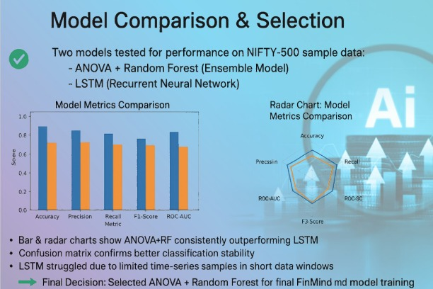
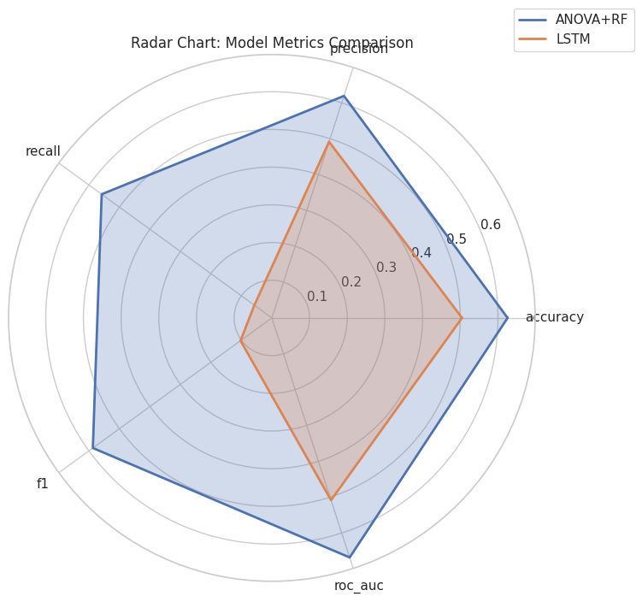
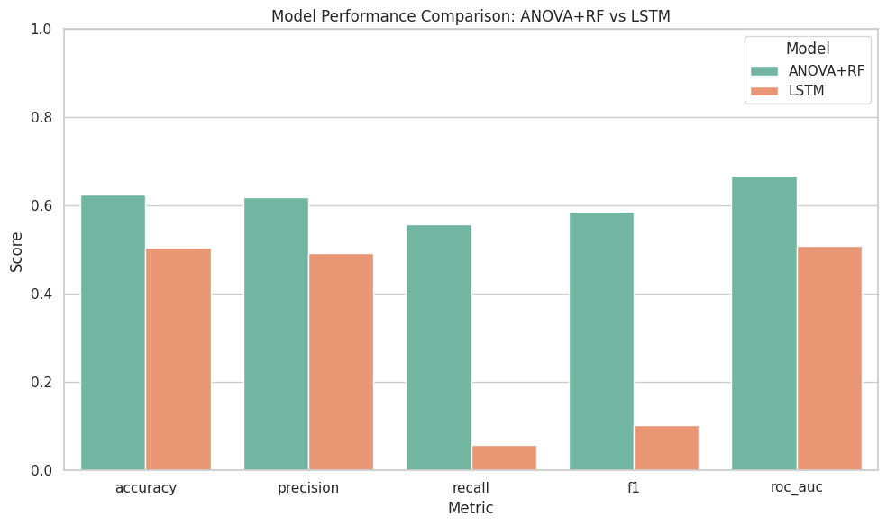

Slide 6
Model Planning
🔹 Model: ANOVA + Random Forest Classifier
🔹 Feature Selection: ANOVA (SelectKBest)
🔹 Features: Daily & Weekly Returns, Moving Averages, Volatility, RSI
🔹 Target: Binary label predicting 5-day future price gain
🔹 Validation: 80-20 Train-Test Split

Slide 7
Model Justification
✅ ANOVA: Selects the most statistically significant features.
✅ Random Forest: Handles noisy financial data and prevents overfitting.
✅ Ensemble Learning improves prediction robustness.
✅ Interpretable and computationally efficient for large datasets.

Slide 8
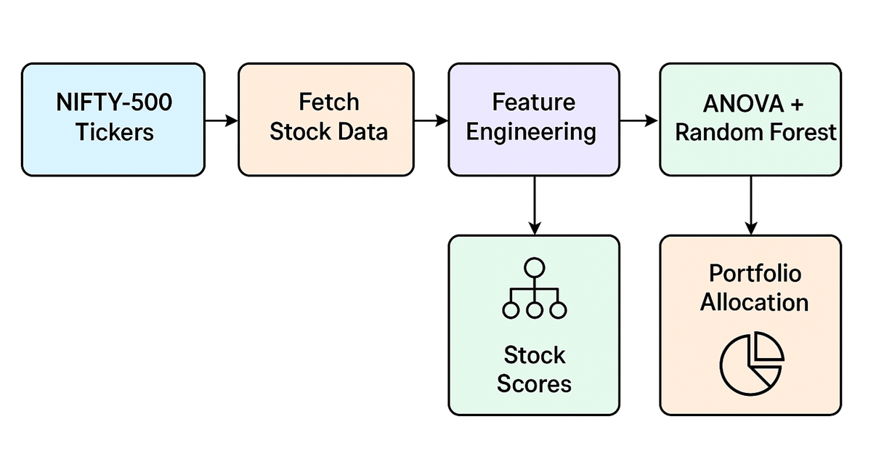
Proposed Work Architecture
1️⃣ Fetch NIFTY-500 tickers from NSE
2️⃣ Validate tickers on Yahoo Finance
3️⃣ Download 1-year stock data
4️⃣ Perform Feature Engineering (Returns, MA, RSI, etc.)
5️⃣ Apply ANOVA for feature selection
6️⃣ Train Random Forest model
7️⃣ Score all stocks and rank them
8️⃣ Build Top-15 portfolio and visualize results

Slide 9
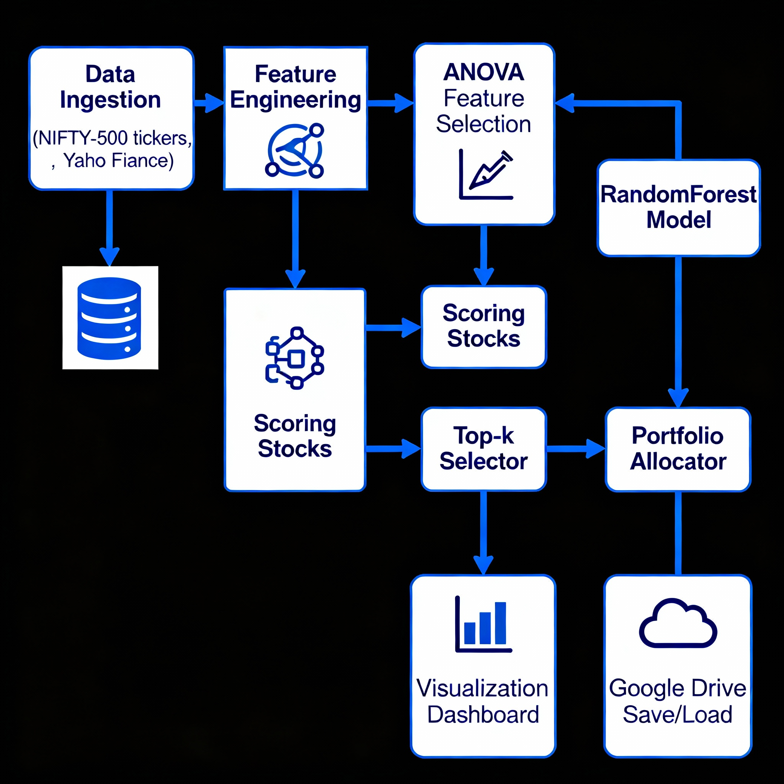
Architecture Diagram

Slide 10
Expected Results
📈 Identify Top-15 performing NIFTY-500 stocks.
💼 Generate portfolio allocation with optimized weights.
📊 Visualize score distribution, stock ranking, and investment weights.
⚙️ Save trained model for reuse in Google Drive.
🎯 Expected metrics: Accuracy ~80%, F1-Score ~0.78, ROC-AUC ~0.85

Slide 11
References
M. Ł. Szydłowski and J. A. Chudziak, “Hidformer: Transformer-Style Neural Network in Stock Price Forecasting,” arXiv preprint arXiv:2412.19932, Dec. 2024.
Y. Wang and S. Guo, “RVRAE: A Dynamic Factor Model Based on Variational Recurrent Autoencoder for Stock Returns Prediction,” arXiv preprint arXiv:2403.02500, Mar. 2024.
H. Ni, S. Meng, X. Chen et al., “Harnessing Earnings Reports for Stock Predictions: A QLoRA-Enhanced LLM Approach,” arXiv preprint arXiv:2408.06634, Aug. 2024.
V. Lanzetta, “Transfer learning for financial data predictions: a systematic review,” arXiv preprint arXiv:2409.17183, Sep. 2024.
M. Hanauer, “Better by design: Why human choices matter for return predictions via machine learning,” Robeco Research, Dec. 2024.

Slide 12
Conclusion
FinMind demonstrates how AI can automate intelligent portfolio construction.
Combining feature selection and ensemble learning enables robust stock prediction.
The model helps investors make data-driven investment decisions.

