Slide 1
Case Study
Implementing IaaS and PaaS in Azure

Slide 2

Business Requirements
Nilavembu Herbs provides a safer alternative to modern medicine wherever possible and to offer simple, effective and safe remedies for common problems. spreads awareness about the medicinal uses of these natural and safe herbs all over the world and to make it easily available through their online store for all those who want to enjoy its benefits
Nilavembu Herbs requires
A low cost solution based on demand of dynamic business conditions.
As the business expands across EastUS and SEA, they would like to have their DataCenter virtualised using cloud computing.
Critical Data should be made available in case of disaster
As of now they want to have Proof Of Concept(POC) in Microsoft Azure
You have been deployed for POC
The following slides will provides required details.

Slide 3
SEA region
2 web servers with 99.95% high availability
These web services has to be utilised with proper balance with client affinity with Public IP
Selected web servers should be reachable via RDP from internet
A jump port should accessible from internet to upload contents to web servers.
Protect web server traffic restricted to allowed based on ip addresses which will be updated as warranted
Enable backup for WebServers
Have alert generated in case of 80% above cpu usage

Slide 4
EastUS
EastUS server (Server11) should be accessible from internet via public IP
Establish secure Connection to SEA-EUS Azure sites
All servers should be reachable with internal ip addresses

Slide 5
Storage Requirements
EUS based resources should provide data resiliency in case of azure datacentre failure.
The storage should be accessible by applications with secure access. provide access urls and keys.
Sales manager should access his resource from windows explorer.
SEA data resources must provide high resiliency in case of even multiple azure data center failures

Slide 6
Azure Resource management
Create Vmadmin user who can manage all VM in the subscription
Create Backup_admin user who can manage backup only in EUS servers in EURG

Slide 7
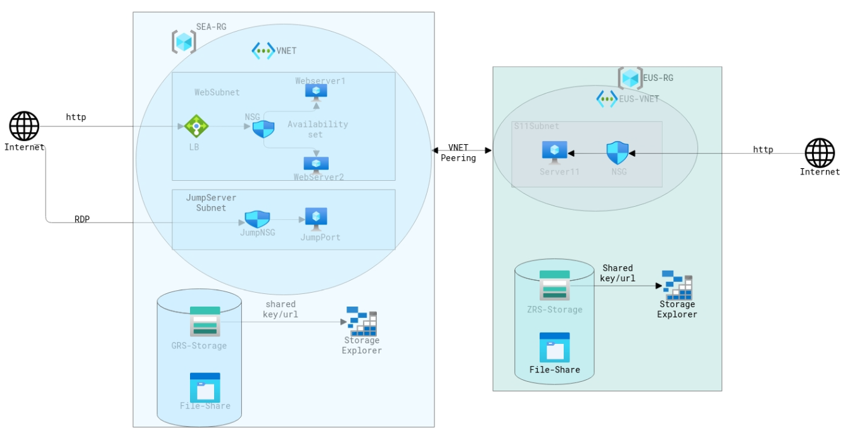
Architecture Diagram

Slide 8
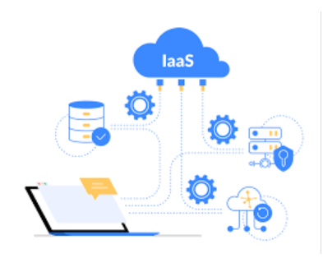
Implementation Flow
IaaS- VNET, NSG,IP,LB,VM
Storage Account
Backup
Monitoring
Azure AD

Slide 9
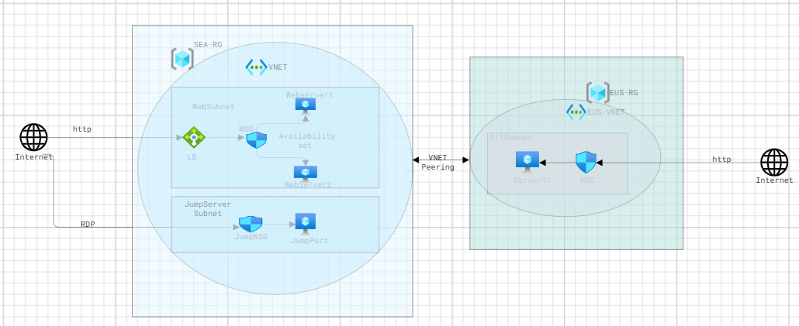
Implementation Order Network
Resource Group –per region (SEA and EUS)
VNET – each per region with subnets(SEA-2 and EUS-1)
NSG –Rule as per business requirement
Availability Set- 1
VM – 2VMs in Availability set, 1 in EUS region and 1 Jump server
Load Balancer –BP,HP,LBR,InboundNAT
VNET Peering

Slide 10
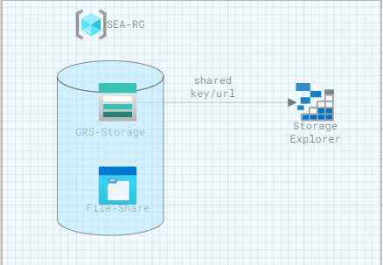
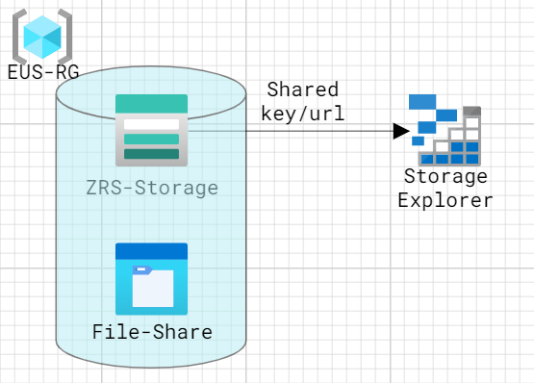
Implementation Order Storage
Storage Account-1 GRS in SEA location
Storage Account-1 ZRS in EUS location

Slide 11
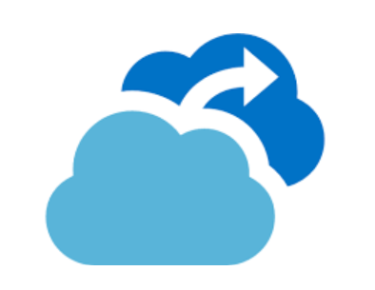
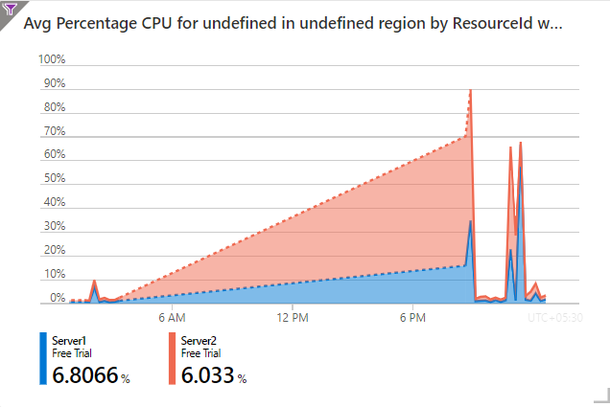
Implementation Order Backup and Monitoring
Backup – Backup Vault (All VMs)
Monitoring – Alert for SEA Region VMs if CPU utilization is >80

Slide 12
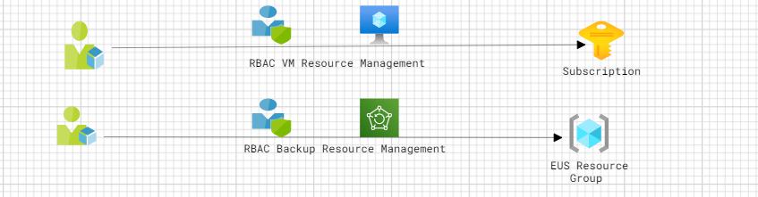
Implementation Order Azure AD
Azure AD – 1 User ID with RBAC VM Resource Management for the subscription
Azure AD – 1 User ID with RBAC Backup Resource Management for the EUS Region

