Slide 1
Amazon Sales Analysis
Generated on 2025-08-24 13:16

Slide 2
Executive KPIs
Used Encoding: cp1252
Total Rows: 128,976.00
Columns Detected: index, order_id, date, status, fulfilment, sales_channel, ship_service_level, category, size, courier_status, qty, currency, amount, ship_city, ship_state, ship_postal_code, ship_country, b2b, fulfilled_by, new, pendings
Total Revenue: 78,590,170.25
Avg Order Value: 648.56
Total Units: 116,646.00
Total Orders: 120,229.00

Slide 3
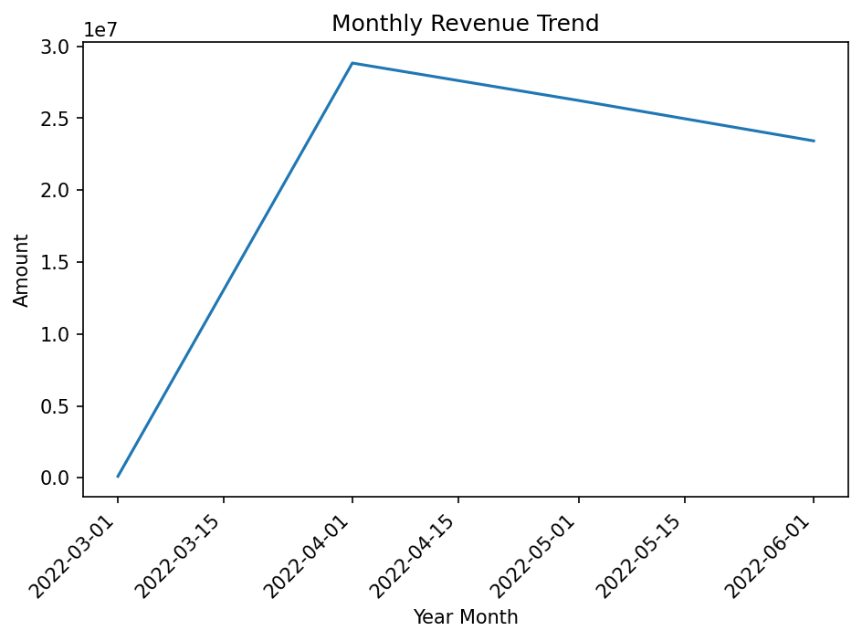
Chart Monthly Revenue

Slide 4
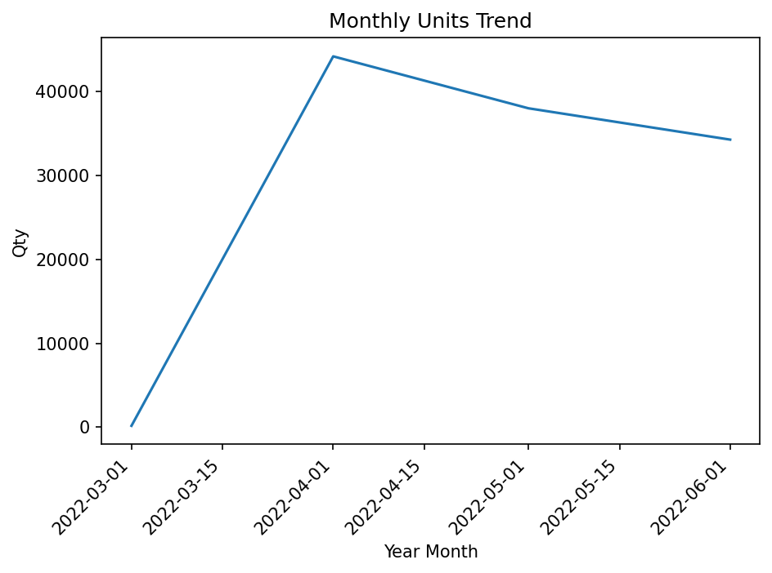
Chart Monthly Units

Slide 5
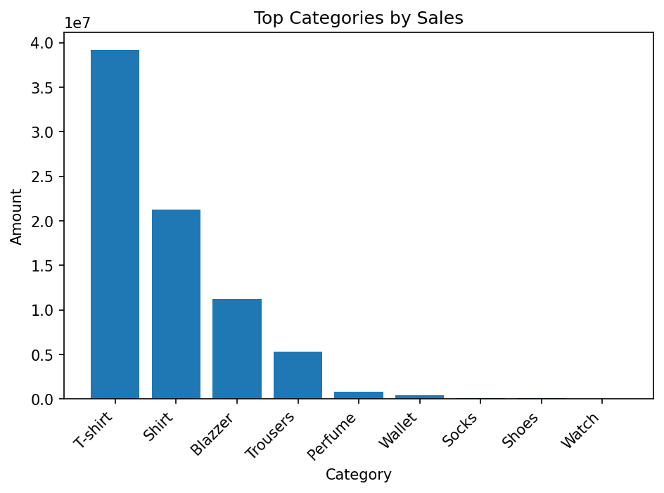
Chart Top Categories Sales

Slide 6
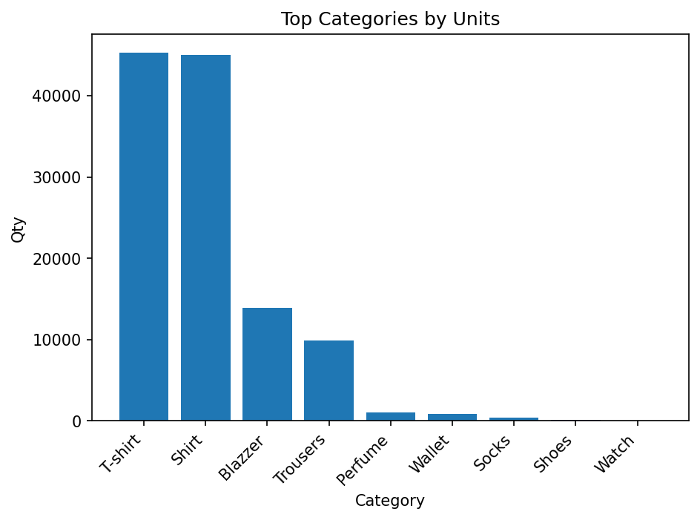
Chart Top Categories Units

Slide 7
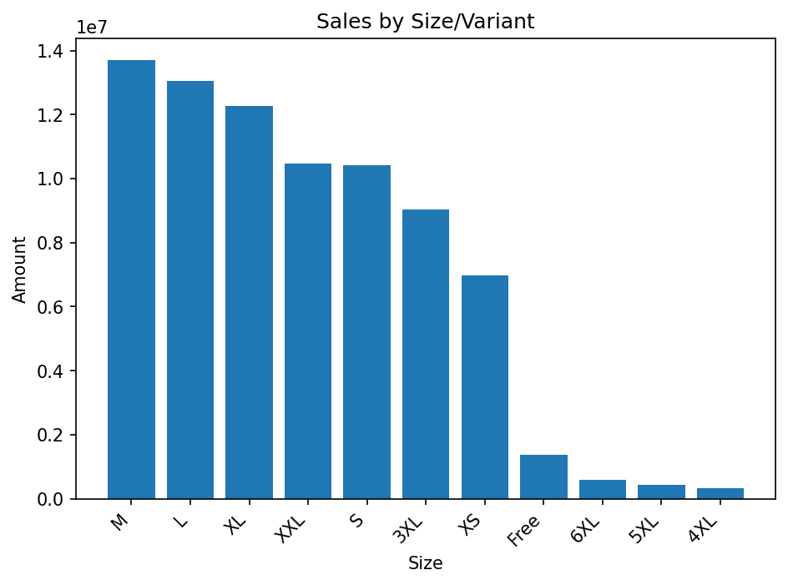
Chart Sales By Size

Slide 8
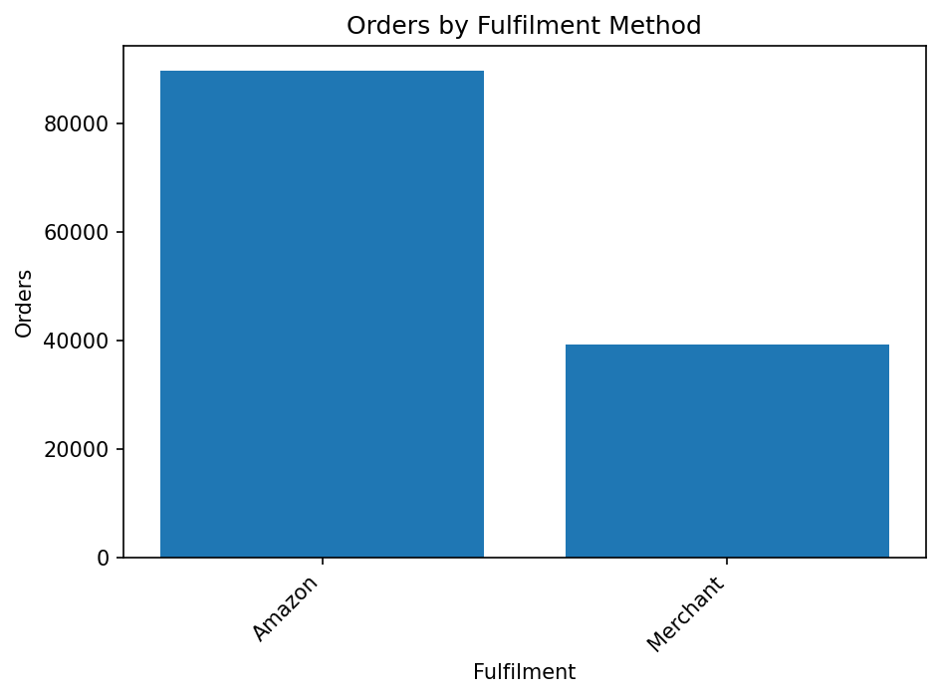
Chart Orders By Fulfilment

Slide 9
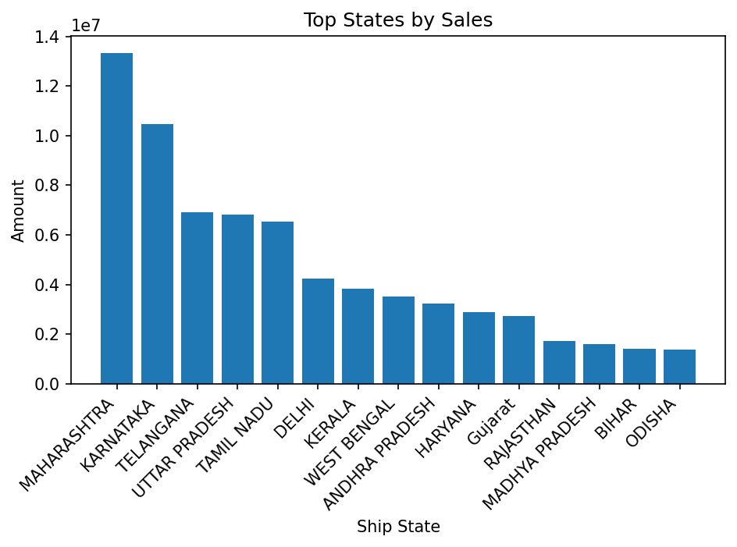
Chart Top States By Sales

Slide 10
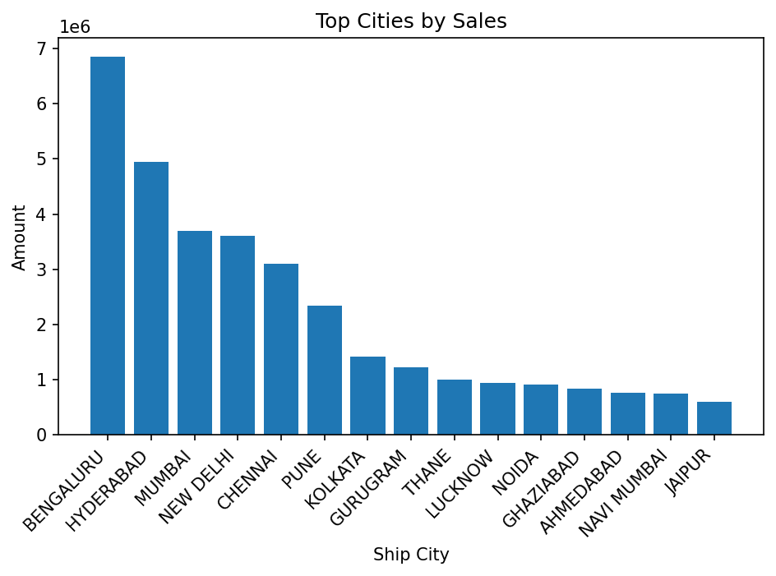
Chart Top Cities By Sales

