Slide 1


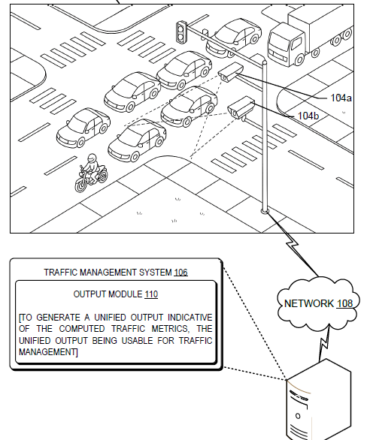
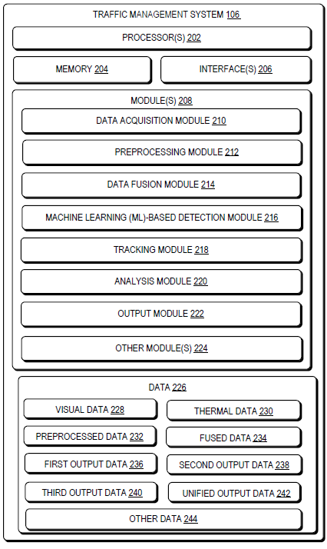
Technology Transfer Office
TTO - IPM Cell
Industrial Consultancy & Sponsored Research (IC&SR)
MANAGEMENT OF VEHICULAR TRAFFIC ON ROADWAYS
IITM Technology Available for Licensing
Problem Statement
Research Lab
The invention falls within the domain of intelligent transportation systems and computer vision, using ground level and aerial image processing of RGB and thermal cameras for analysing traffic characteristics for Indian Roads.
Conventional traffic management systems primarily rely on standalone RGB cameras or thermal cameras for vehicle detection and traffic monitoring.
However, RGB-based systems suffer from poor performance under low-light, glare, fog, rain, and adverse weather conditions, while thermal-only systems lack detailed color and texture information required for accurate vehicle classification and lane-level analysis.
Therefore, there is a need for a technique that allows for accurate and reliable monitoring and management of vehicular traffic under diverse environmental and operational conditions
Prof. LELITHA DEVI V
Department of Civil Engineering
Prof. CHANDRA SHEKAR
Department of Data Science and Artificial Intelligence
Intellectual Property
(a)
IITM IDF Ref 3548
IN 202541133784 Patent Application
TRL (Technology Readiness Level)
Figure: (a) illustrates a network environment for implementing example techniques for managing vehicular traffic on roadways.
TRL 6 - Technology demonstrated in relevant environment
Technology Category/ Market
Category – Data Science & Database System
Industry :
Intelligent transportation systems, smart city infrastructure, urban traffic management, highway surveillance industries.
Applications :
real-time traffic monitoring, congestion analysis, adaptive traffic signal control, vehicle tracking, smart city mobility management.
(b)
Market :
The global traffic management system market size was estimated at USD 34.6 billion in 2025. The market is expected to grow from USD 37.5 billion in 2026 to USD 107 billion in 2035, at a CAGR of 12.4%.
Figure: (b) illustrates a system for managing vehicular traffic on roadways.
CONTACT US
Dr. Dara Ajay, Head TTO
Technology Transfer Office,
IPM Cell - IC&SR, IIT Madras
Email: headtto-icsr@icsrpis.iitm.ac.in
ttooffice@icsrpis.iitm.ac.in
Phone: +91-44-2257 9756/ 9843
IITM TTO Website :
https://ip.iitm.ac.in

Slide 2
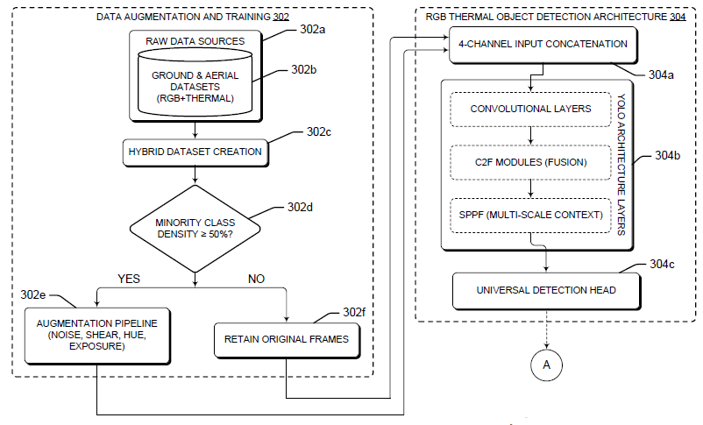
Technology Transfer Office
TTO - IPM Cell
Industrial Consultancy & Sponsored Research (IC&SR)
(c)
Figure: (c) illustrate a block diagram of traffic management and analysis framework implemented by the traffic management system.
Technology
The technology utilizes synchronized RGB and thermal cameras to capture real-time visual and thermal traffic data under varying environmental conditions.
A multi-channel data fusion technique combines RGB and thermal frames to improve vehicle detection accuracy in low-light, glare, fog, and adverse weather conditions.
Machine learning-based detection models are employed to identify and classify heterogeneous vehicle types including two-wheelers, three-wheelers, and heavy vehicles.
Advanced analytics modules compute traffic metrics such as vehicle speed, traffic density, lane-changing frequency, queue length, and stop-go behavior for intelligent traffic management.
The system performs continuous vehicle tracking across successive frames to generate trajectory data for analyzing traffic movement and behavior.
Key Features / Value Proposition
The system provides accurate vehicle detection and tracking even under low-light, glare, fog, rain, and adverse weather conditions.
Fusion of RGB and thermal imaging improves reliability and robustness compared to conventional single-camera traffic monitoring systems.
The technology supports accurate classification of heterogeneous vehicle types, including two-wheelers and three-wheelers common in developing regions.
Real-time computation of traffic metrics enables efficient congestion management, adaptive signal control, and roadway safety enhancement.
The system supports smart city applications by enabling data-driven traffic analysis, infrastructure planning, and emergency response optimization.
CONTACT US
Dr. Dara Ajay, Head TTO
Technology Transfer Office,
IPM Cell - IC&SR, IIT Madras
Email: headtto-icsr@icsrpis.iitm.ac.in
ttooffice@icsrpis.iitm.ac.in
Phone: +91-44-2257 9756/ 9843
IITM TTO Website :
https://ip.iitm.ac.in

