Slide 1

RAMBO-RL: Robust Adversarial Model-Based Offline Reinforcement Learning
Marc Rigter, Bruno Lacerda, Nick Hawes
Presented by:
Anirud N
CE21B014

Slide 2
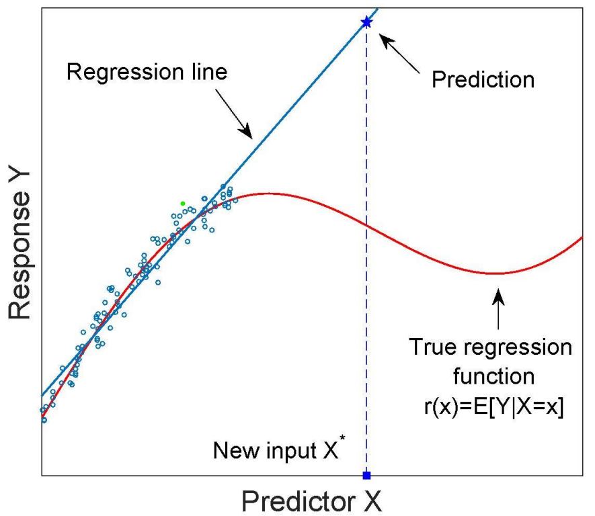
Introduction
Introduction to Offline RL
Model Based vs Model Free Offline RL
Model-free Offline RL | Model-based Offline RL
Train only from Dataset Incorporates conservatism | Model the environment Use of Synthetic data
Why RAMBO-RL?
Previous model-based approaches involve “Uncertainty estimation” Unreliability of “Uncertainty estimation” – efforts to not use this
Notes:
Previous approaches to model-based offline RL incorporate conservatism by estimating the uncertainty in the model and applying reward penalties for state-action pairs that have high uncertainty

Slide 3
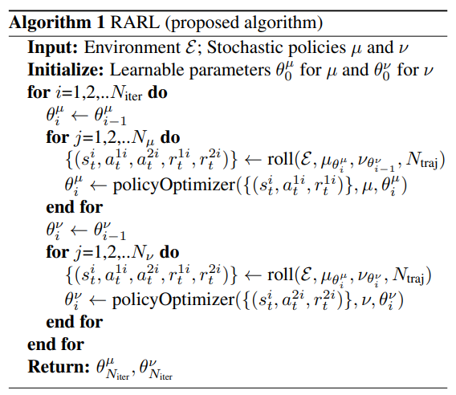


Introduction to RAMBO-RL and RARL
Hero needs a Villain for Character Development!
RARL – two-player zero-sum game
Hero – agent learns policy
Villain – “super-powers” – changes the environment
Villain rewarded for Hero’s failure
RARL | ROMBO
Learning two policies | Instead of a villain policy – A villain Transition dynamics. Model is Adversarially trained
Min – Max Optimization problem

Slide 4



Model-Based Offline RL
Maximum Likelihood Estimation!
Estimated MDP!
Sadly, this doesn’t perform well due to distributional shift☹
How different is RAMBO-RL?
Adversarially modifies the transition dynamics to enforce conservatism
Notes:
Estimated and actual MDP have same state action space- just that the rewards and transition dynamics are estimated/learnt

Slide 5


Problem Formulation
Total Variance between the Villain environment and MLE estimate of the environment
Models the Worst case Transition Dynamics
Backed by PAC – Probably Approximately Correct Guarantee
1) “The policy has a high probability of being as good as the Optimal Policy”
2) “We can expect the performance of any policy in the true MDP to be at least as good as the value in the worst-case model above”
MOPO and MOReL modifies the reward function and Penalises uncertainties

Slide 6
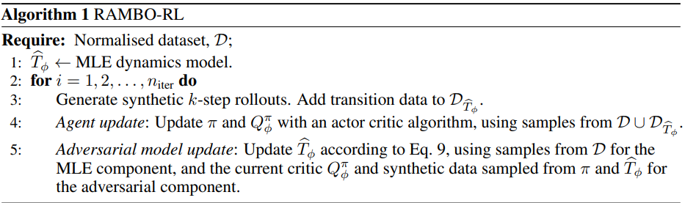
Algorithmic Framework
Soft Actor-Critic
Model Gradient – inspired by Policy Gradient Approach Gradient Descent to Minimize Value Function!!
Mini-batch of transitions using the current policy in the current distribution

Slide 7

Model Gradient
Discounted State Visitation of a policy
Expected Value of taking a state s and following the policy thereafter
Adding a Baseline independent of s’ and r
Reduces Variance and Helps Learning
Advantage terms are normalized
How different is Model Gradient from Policy gradient?
Updates the Likelihood of successor states in the model, instead of the actions in a policy Advantage term compares the realized outcome to the expected outcome of the current state-action pair.

Slide 8


Adversarial Model Training
Constrained Optimization
Using Lagrange Multipliers to convert it into unconstrained
To keep things simple, Just MLE Loss
Smaller lambda – MLE dominates – model fits the dataset well
Normalization of every feature of the states in D for easier tuning of lambda.

Slide 9
Implementation Details
What is K-Step Rollout??
Why Rollouts?
To generate Synthetic Data – so that we have more data representing the environment – better training But taking a large step rollout is bad! WHY? – Errors keep accumulating as we progress along the steps

Slide 10
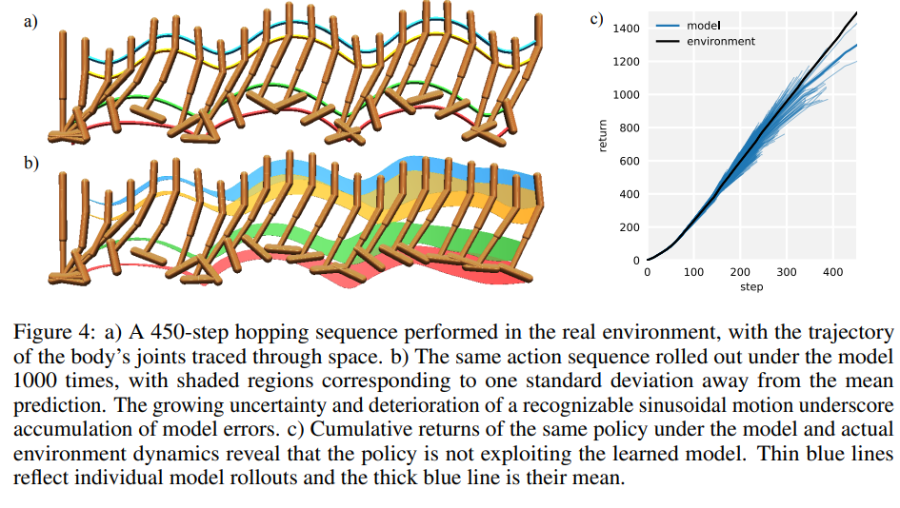
K-Step Rollout
Why k- step Rollouts?
As the number of steps increases – Variance increases Need to take only a few steps that are a good representative of the environment
Source: Model based Policy Optimization

Slide 11

Implementation Details
Ensemble neural nets that output a Gaussian
The synthetic data is now combined with the offline dataset.
Soft Actor-Critic is used. The data from the Offline dataset is chosen with probability = f and synthetic with probability 1-f.
Notes:
To arrive at a heuristic that can be evaluated offline, we use the intuition that the value function should be regularised (i.e. low) as well as stable during training. Therefore, our heuristic makes the final hyperparameter selection from the set of candidate parameters according to: min Qavg + Qvar), where Qavg is the average Q-value at the end of training, and Qvar is the variance of the average Q-value over the final 100 iterations of training.

Slide 12
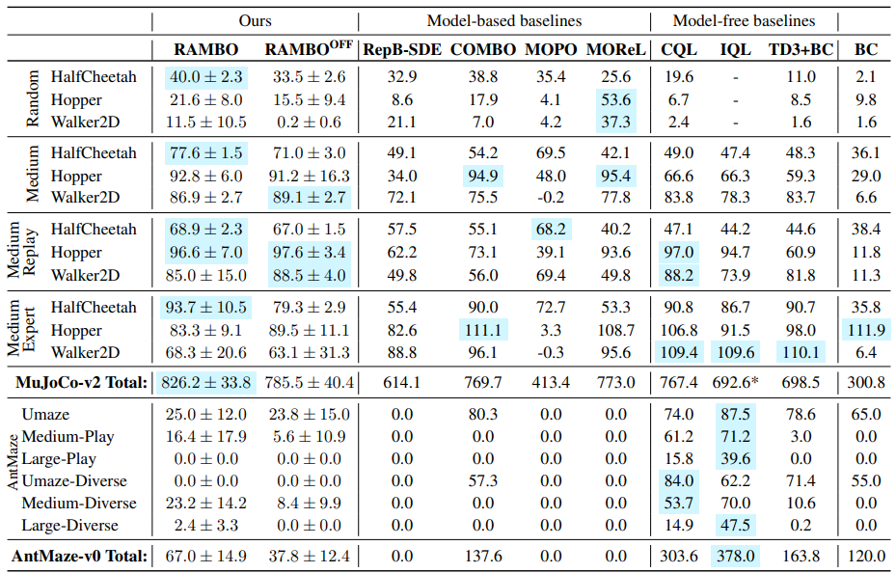
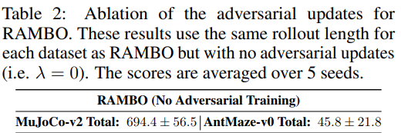
Experiments and Results
Key Inferences
RAMBO achieves the best total in MuJoCo RAMBO achieves the best overall score in Medium and Medium-replay – RAMBO performs well for suboptimal and noisy dataset Outperformed by most of the algorithms in Medium-Expert In Ant Maze, RAMBO performs better than Model, but it is outperformed by model-free algorithms ( because model-based algorithms are aggressive and collide with the wall) Table 2 shows the importance of adversarial updates

Slide 13
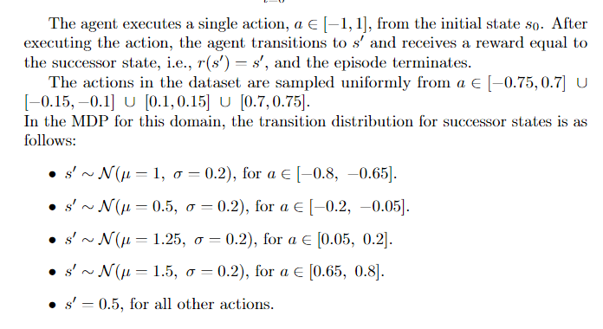
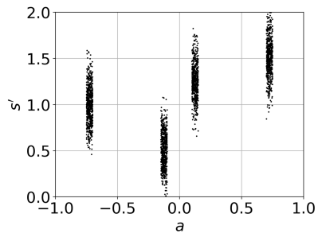
Comparing COMBO and RAMBO
COMBO | ROMBO
Penalizes the value function in state-action pairs that are unsupported by the offline dataset Pessimism from the start | Doesn’t modify the value function, rather works with the distribution Gradual pessimism
A single Transition Environment was used for comparison!

Slide 14
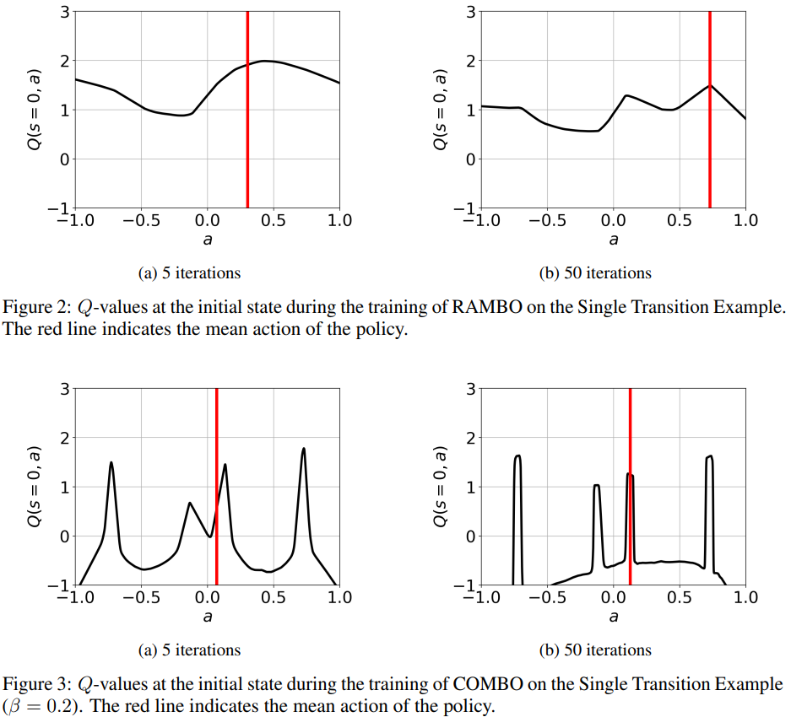
Comparing COMBO and RAMBO
Initially optimistic and gradually pessimistic
The gradual introduction of pessimism avoids getting stuck at local maxima
Pessimism from the start, value estimates penalize out-of-dataset actions
Gradient-based Policy Optimization gets stuck at local maxima

Slide 15
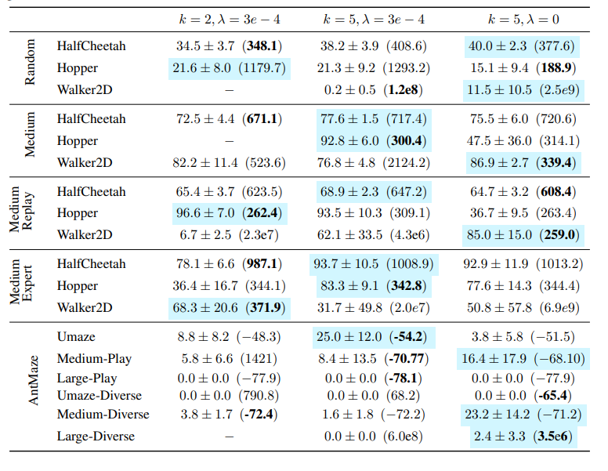
Conclusions and Future Possibilities
Analysing the reason for failure in Ant Maze problem Combining RAMBO with reverse rollouts. (Offline Reinforcement Learning with Reverse Model-based Imagination) Few environments in MoJoCo gave lambda = 0 upon hyperparameter tuning, implying that a potential direction for future work could be trying to identify which types of problems do not require regularisation for a successful policy to be trained offline with model-based RL
What are reverse rollouts?
First, use the offline data to find the MLE policy Estimating reverse dynamic model and reward model We could add more synthetic data from both forward and revere rollouts

Slide 16
Thank You!

