Slide 1
Healthcare Patient Management System
From a flat CSV to a secured, audited, scheduled data system
UCI Diabetes 130-US Hospitals, 1999-2008 | Educational use only
Dates in this data are simulated | Findings are associations, not causes
Notes:
Say first: admission dates are simulated because the dataset has no dates, and every finding is an association, not a cause.

Slide 2
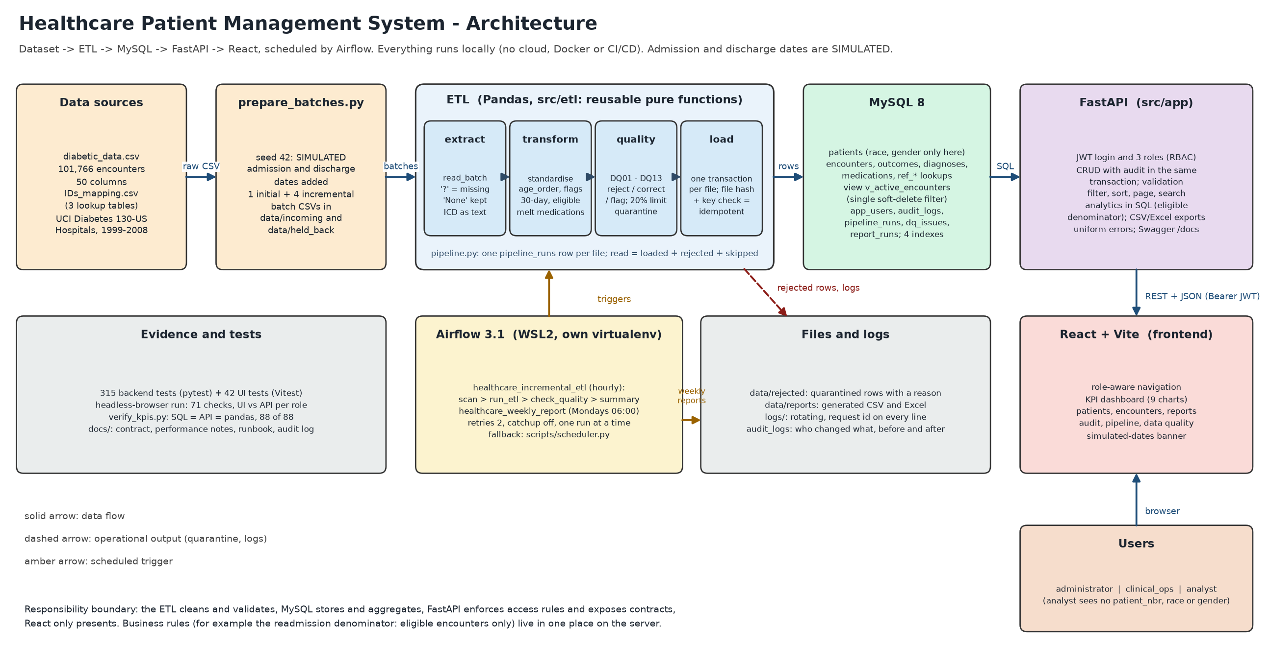
The problem and four questions
• 101,766 encounters, 71,518 patients, flat CSV, no dates
• Q1 What is the 30-day readmission rate, and for whom?
• Q2 How long do patients stay?
• Q3 How do admissions trend over time? (simulated dates)
• Q4 Which medication, lab and prior-visit patterns are associated with readmission?
2
Notes:
One row is one encounter, not one patient: patients repeat. The data has no hospital id, so we compare categories, never hospitals.

Slide 3
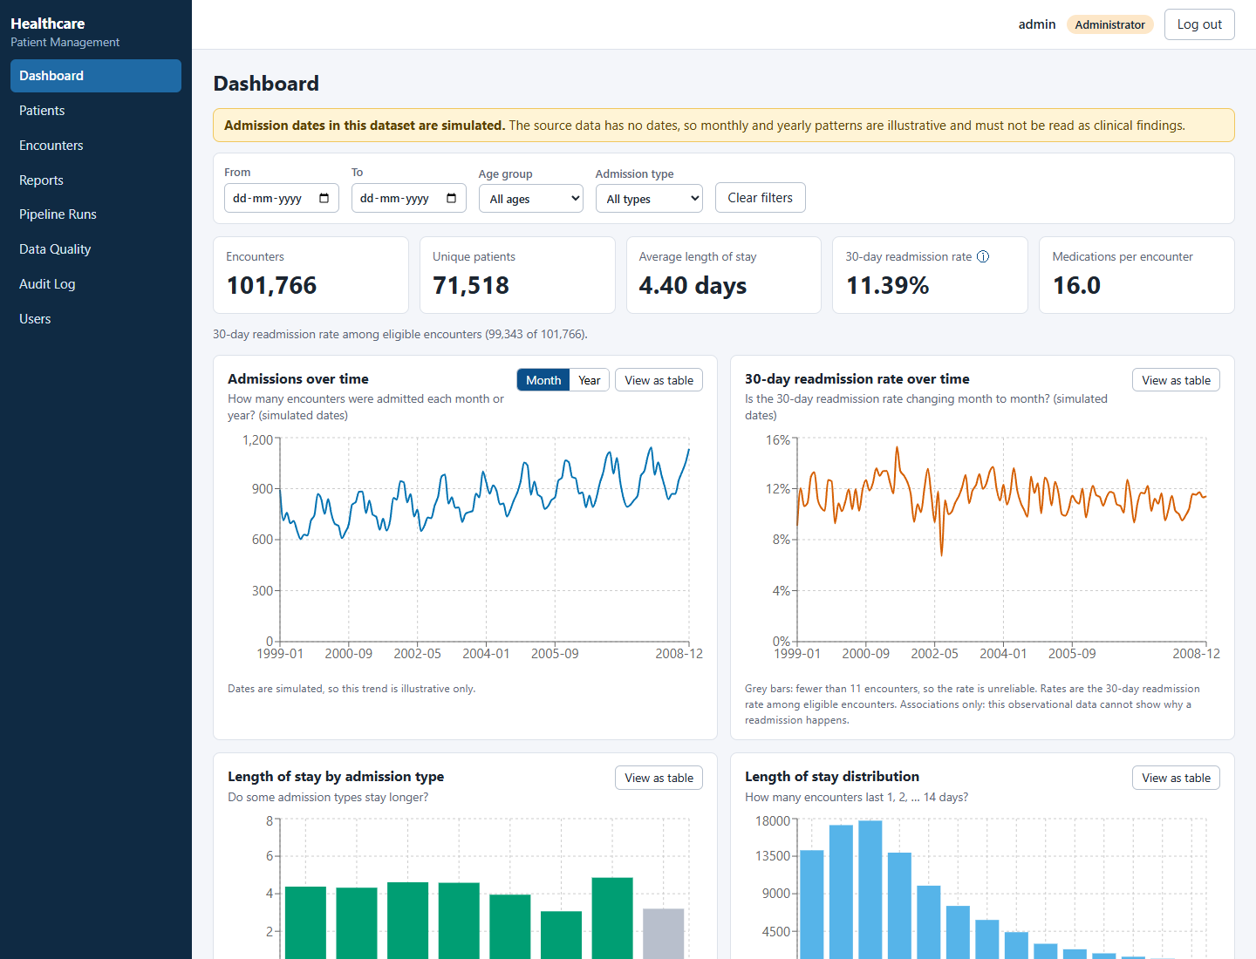
Solution overview
• ETL: 13 quality rules, quarantine, idempotent reloads
• MySQL: 16 tables, one view as the soft-delete filter
• FastAPI: 32 operations, JWT, 3 roles, audit trail
• React dashboard, CSV and Excel reports
• Airflow: hourly load, weekly reports
3
Notes:
Everything runs locally: no Docker, cloud or CI/CD. Headline: 11.39% 30-day readmission over eligible encounters.

Slide 4
Architecture and data flow
Dataset to ETL to MySQL to API to React; Airflow triggers; quarantine, logs and reports on the side
4
Notes:
Walk the arrows: batches in, one transaction per file, SQL via a view, role checks and audit in the API, React only presents. Quality lives in the ETL, audit in the API.

Slide 5
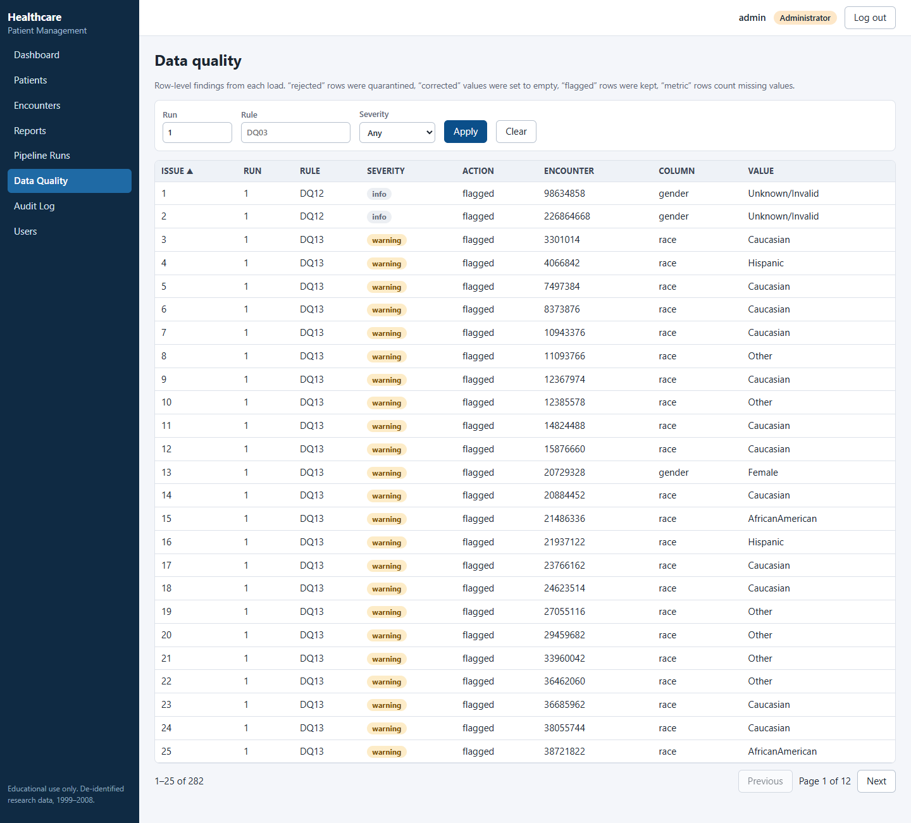
Data and quality rules
• '?' is missing; the word 'None' is a real lab value
• DQ01-DQ13: reject, correct, flag, measure
• Bad file (over 20% rejected) loads nothing
• Faulty batch: 23 rows quarantined, with reasons
• Same file twice: SKIPPED_DUPLICATE_FILE
5
Notes:
Live demo: load a held-back batch, show the pipeline_runs row, counts reconcile (read = loaded + rejected + skipped), then the faulty batch with reasons. Dates are simulated; the rules are real.

Slide 6
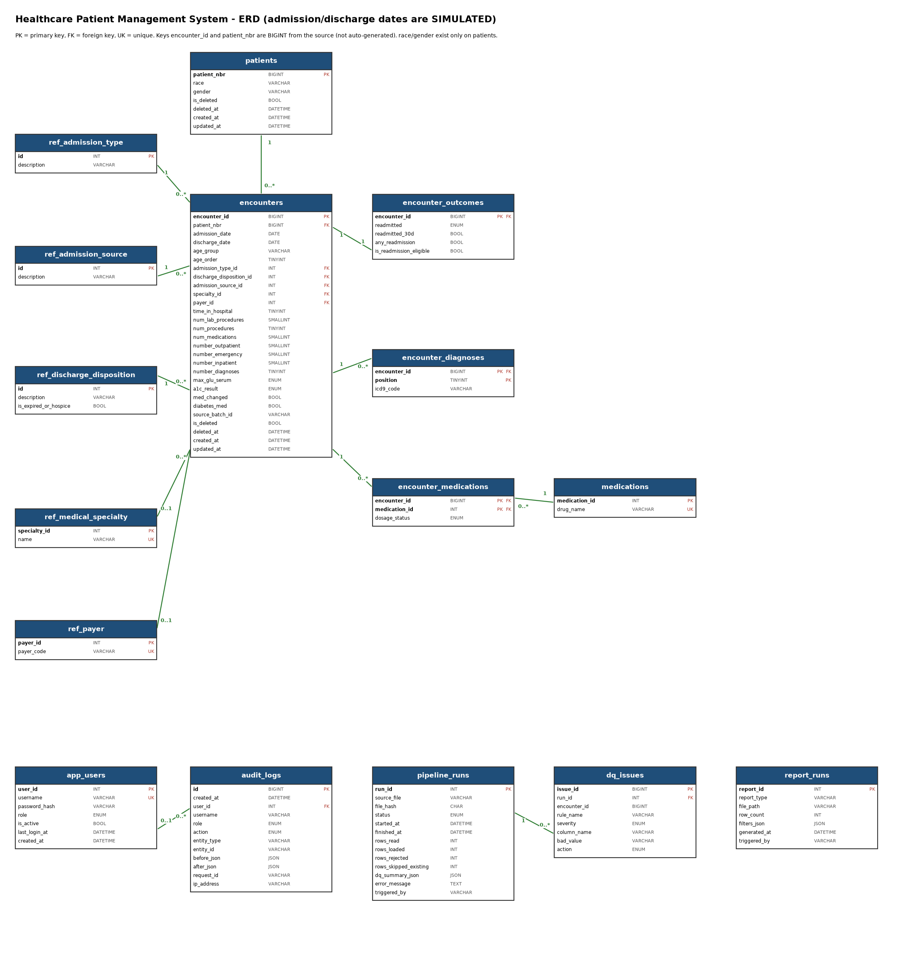
Database design
• Third normal form: race and gender on patients only
• Diagnoses and medications as child tables
• Medications: only prescribed rows, 120,054 vs 2.1M
• 4 indexes, each proven by EXPLAIN
• Date-range list: 256 ms to 0.8 ms; ICD search: 765 ms to 9 ms
6
Notes:
One EXPLAIN before and after. The biggest win was rewriting the view as NOT EXISTS, not an index. One proposed index was rejected because it did not help.

Slide 7
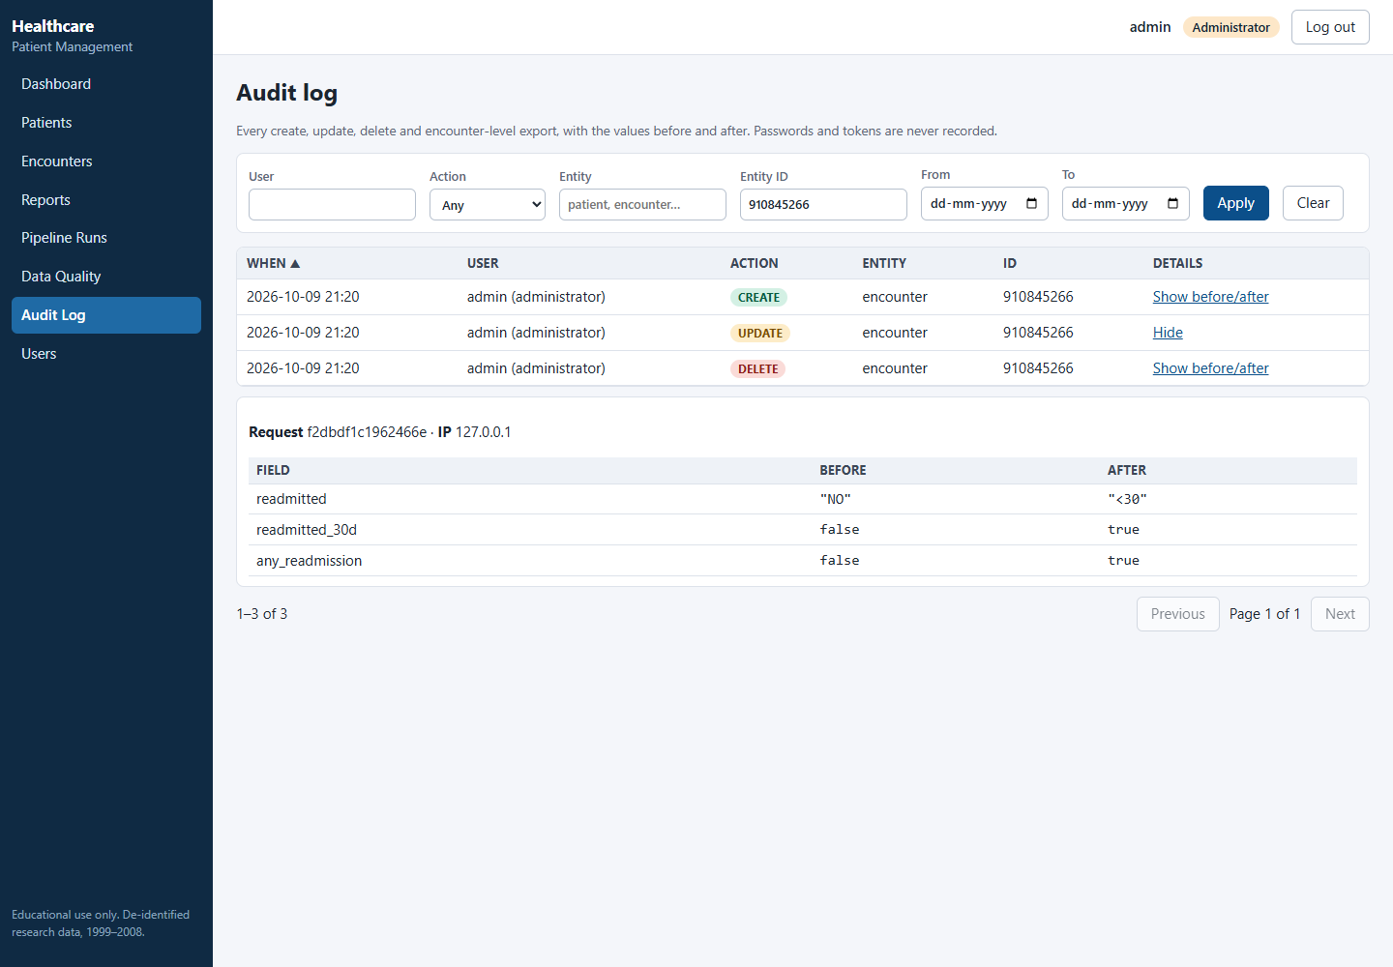
API and security
• JWT, 60 minutes; role read from the database each request
• Roles enforced on the server, not in the UI
• Analyst: no patient id, race or gender; 403 on patients
• Audit row written in the same transaction as the change
• Errors: one contract, never a stack trace
7
Notes:
Swagger demo: login, filtered and paged encounters, 403 for the wrong role, the audit row after an update. The audit records which field changed, never race or gender values.

Slide 8
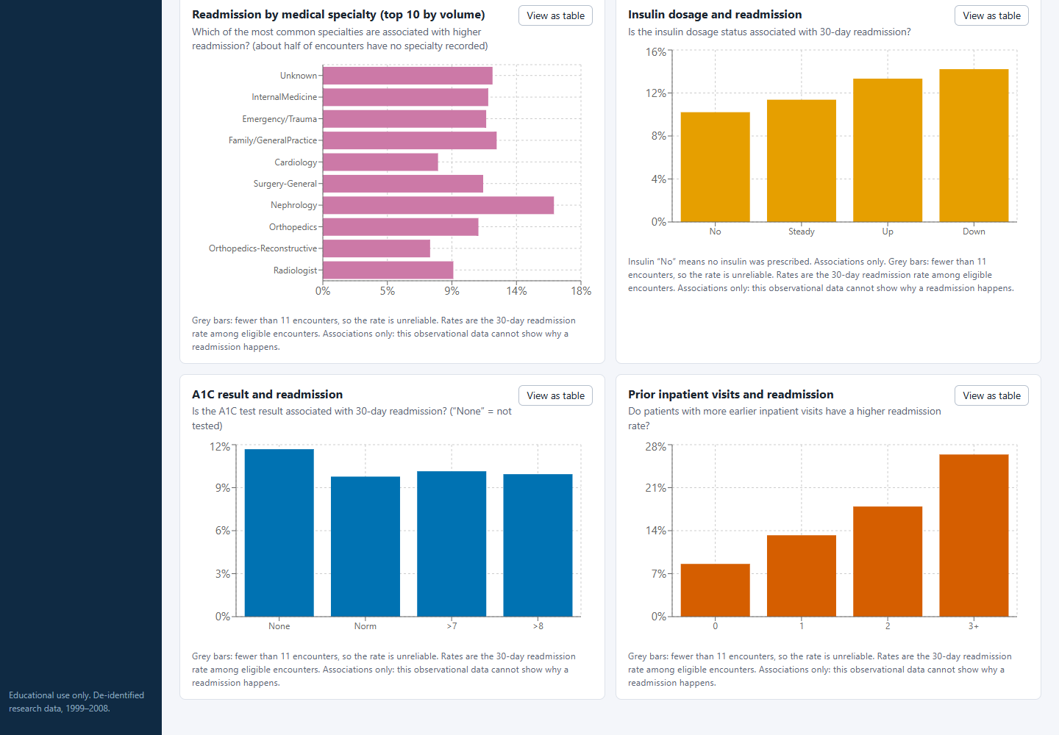
Dashboard results
• Prior inpatient visits 0 vs 3+: 8.6% vs 26.4% readmitted within 30 days
• Insulin dose 'Down' 14.2% vs 'No insulin' 10.2%
Associated with, not caused by. Dates simulated.
8
Notes:
Switch to analyst and show what disappears; export Excel. Say 'associated with' every time. Trends are illustrative because dates are simulated.

Slide 9
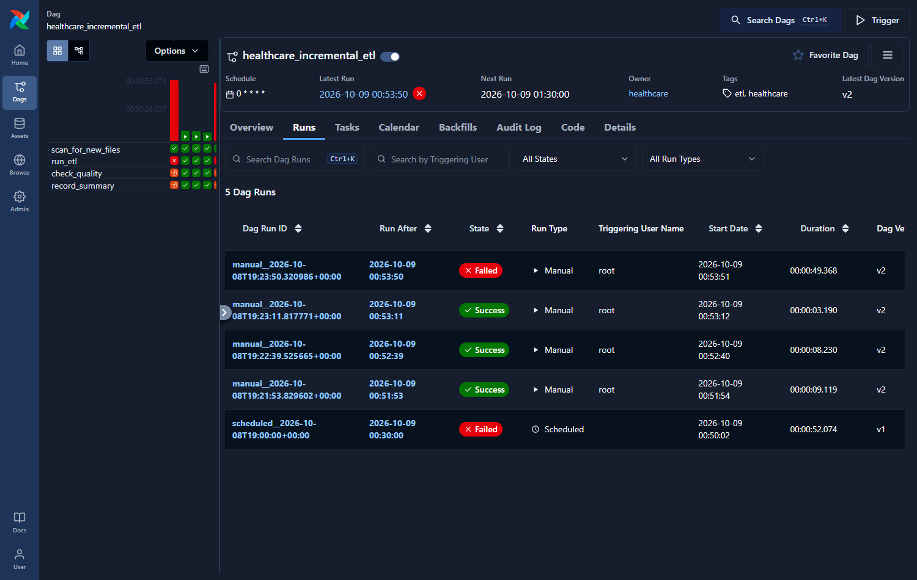
Testing and reliability
• 315 backend tests on a real MySQL schema, 94% line coverage
• 42 UI tests; 71 real-browser checks per role
• 88 KPI checks: SQL = API = pandas on the raw CSV
• Deliberate bug (wrong denominator): 6 tests fail
• Hard-kill test: nothing half-loaded
9
Notes:
State the gaps honestly: no real tablet, no screen reader, Excel not opened in Excel, Airflow 3.1 only. Mocked: nothing in the database layer.

Slide 10
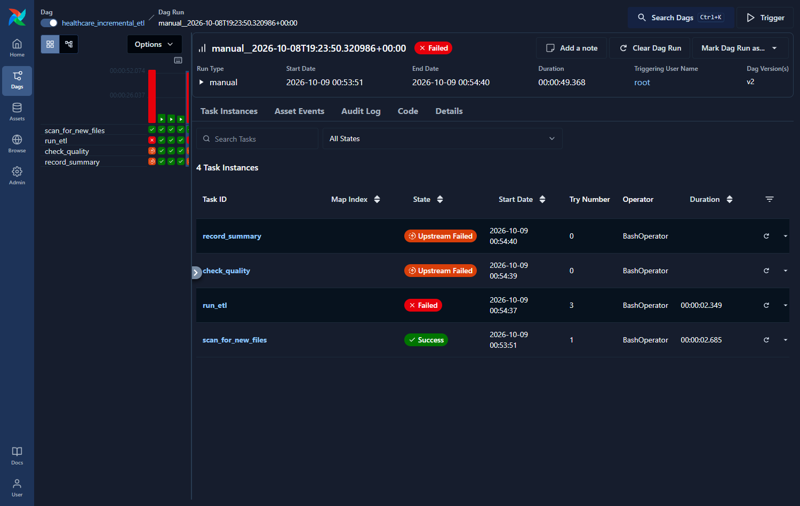
Challenges, trade-offs and limits
• Simulated dates: trends are illustrative only
• No hospital id: categories compared, not hospitals
• Whole-file reject above 20%: safe, but strict
• No summary table: two queries stay at 0.6-0.8 s
• Airflow in WSL2: two environments to maintain
10
Notes:
Each limit has a stated reason. Bugs found by running, not reading: WSL path variable, view plan flip, ICD rule rejecting 5,732 real codes, demographics in the audit trail.

Slide 11
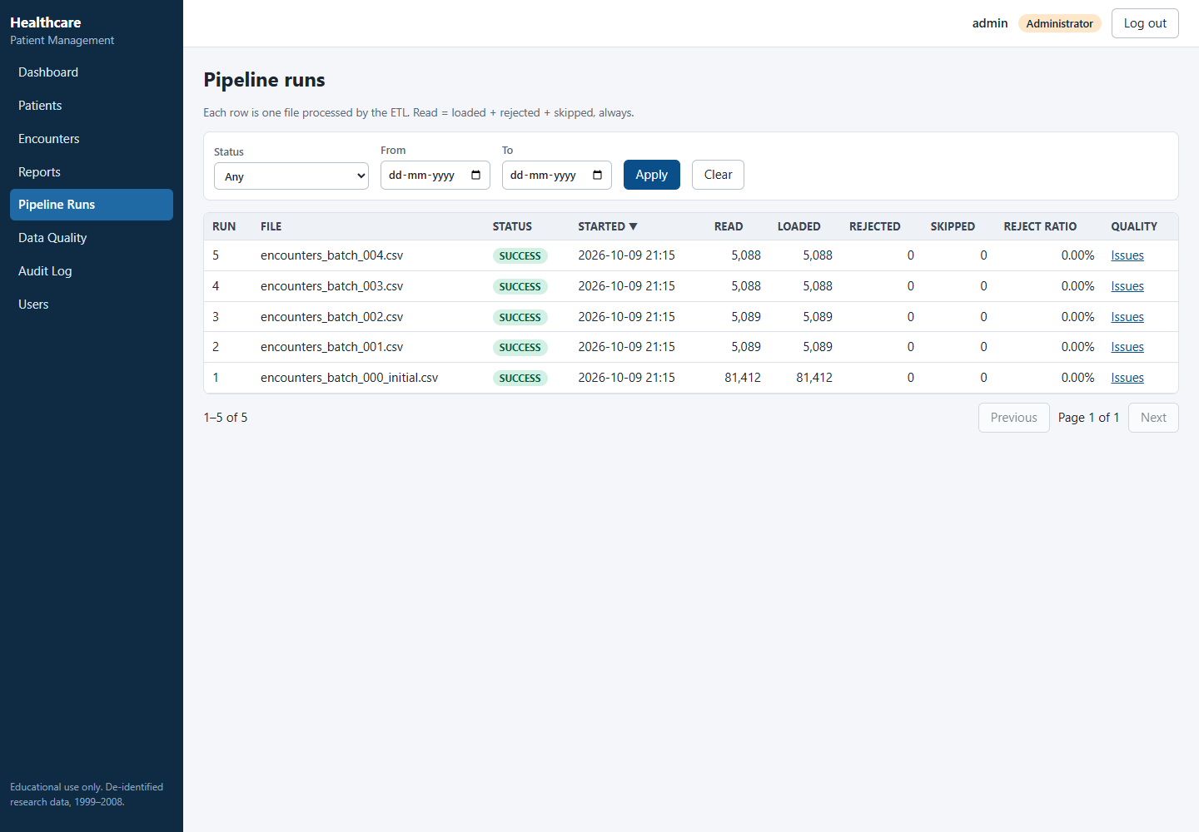
Learnings and next steps
• A plausible number can be wrong: check the denominator
• Measure first; one index was rejected on evidence
• Run the commands: fresh-clone check found real gaps
• Next: real timestamps, hospital dimension
• Next: validated risk model; alerting on failed runs
11
Notes:
Close on scale: 100x data means summary tables, partitioning by admission date, read replicas and queued exports.

