Slide 1

AI Personal Trainer Department Of Computer Science And Engineering
By
Aniruddh Verma
Md.Anas
Himanshu Dixit

Slide 2
Introduction
AI personal trainers are Artificial Intelligence-powered virtual trainers who assist you in achieving your fitness goals. The computerized personal trainer may provide you with tailored training after gathering few facts about Body Measurements,Fitness level and your Goal.
Depending upon your Goal it will give you a set of Exercises,where you can perform and track your Movements by the help of this project.By tracking your movements it will guide you through the Exercise you perform .
This AI-Personal Trainer will also count the number of Repetitions performed by the End-User.It also make sure if the repetition is fully complete.

Slide 3
Objective
The purpose of this project is to provide services to the end user which helps them meet there Fitness Goals without the help of a Physical Personal Trainer.
It also reduce the cost of hiring a Physical Personal Trainers.
It also helps the End-User to determine the Quality and Quantity of repetitions which is being performed.

Slide 4
System Requirements
Software Requirements
Operating System – Microsoft Windows 10,11.
Hardware Requirements
Processor - Intel core i3 or Later or Compatible
SSD - 32 GB or more
RAM - minimum of 4 GB or more
A Camera for Video Input to track movements

Slide 5
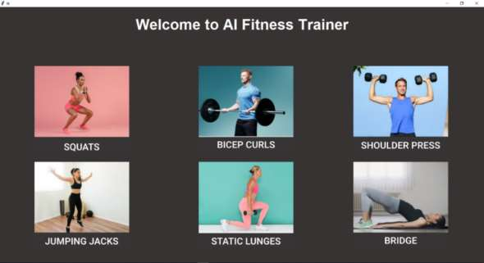
USER INTERFACE

Slide 6


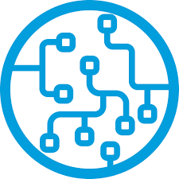

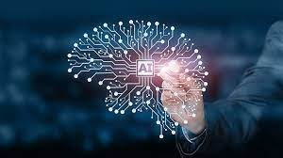
Technologies Used
Python
Open CV- Pose Estimation
MediaPipe framework
Artificial Intelligence
Machine Learning

Slide 7
FUTURE SCOPE
Further application of this in future it is that it can be combined with Augmented Reality and Virtual Reality .
With the help of A.I it will create a Perosnalised Workout for Optimal Growth and improved Fitness levels of Strength, Endurance, Power and Stamina.
It can track Data and Analyse workout for more accurate Movements.
We are also planning to add more complex movements for tracking better performance workouts which involves more compound movements and mobility exercises.
This application will also support Android/IOS devices in future for ease of use in future.

Slide 8
CONCLUSION
End-User can track thier workouts for better Fitness Performance .
AI is at the centre of a new enterprise to build computational models of intelligence which
These days our life is becoming busier and that we hardly find time in our schedules to be healthy and fit and exercise daily.
This ends up with many health issues. Our main motive is to spread the importance of good health and fitness among common people and help them to achieve it.

Slide 9
THANK YOU!!!

