Slide 1
INDIA CPI
INFLATION ANALYTICS
Professional analytical presentation | 2013 – May 2023
CPI TRENDS • FOOD INFLATION • COVID IMPACT • IMPORTED OIL
2013 – MAY 2023

Slide 2
Executive Overview
ONE-PAGE STORY
LATEST YOY CPI
6.46%
May 2023
PEAK YOY CPI
7.57%
2020
FOOD 12M HIGH
16.34%
Spices
STRONGEST OIL–CPI LINK
−0.482
Milk & products
01 PRICE PRESSURE
Inflation peaked in 2020 at 7.57% in the available annual YoY analysis, while 2023 is a partial Jan–May period.
02 FOOD DIVERGENCE
Food categories moved in different directions: Spices rose strongly, while Oils and fats and Vegetables recorded negative 12-month changes.
03 SHOCK RESPONSE
COVID effects were mixed across categories, and imported-oil movements showed different associations across the CPI basket.
The presentation focuses on what the data says — not on formula mechanics.
Project scope
Five analytical questions covering latest CPI contribution, YoY trend, food inflation, COVID impact and imported oil.
Interpretation note
Q1 shares are normalized analytical shares; Q4 Essential Services is an analytical unweighted composite; Q5 correlation indicates association, not causation.
CPI project workbook • Data available through May 2023

Slide 3
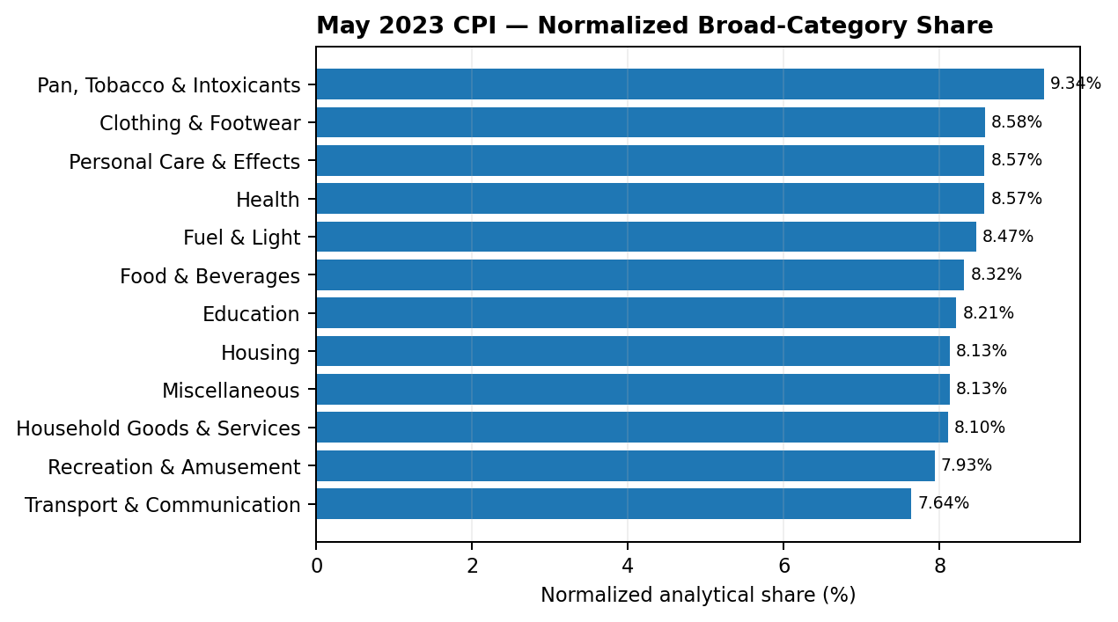
01 Latest CPI Contribution
MAY 2023
Highest normalized category
Pan, Tobacco & Intoxicants recorded the highest normalized analytical share at 9.34%.
Lowest normalized category
Transport & Communication recorded the lowest normalized analytical share at 7.64%.
How to read this
These are normalized analytical shares across the selected broad categories, not official CPI expenditure weights.
CPI project workbook • Data available through May 2023

Slide 4
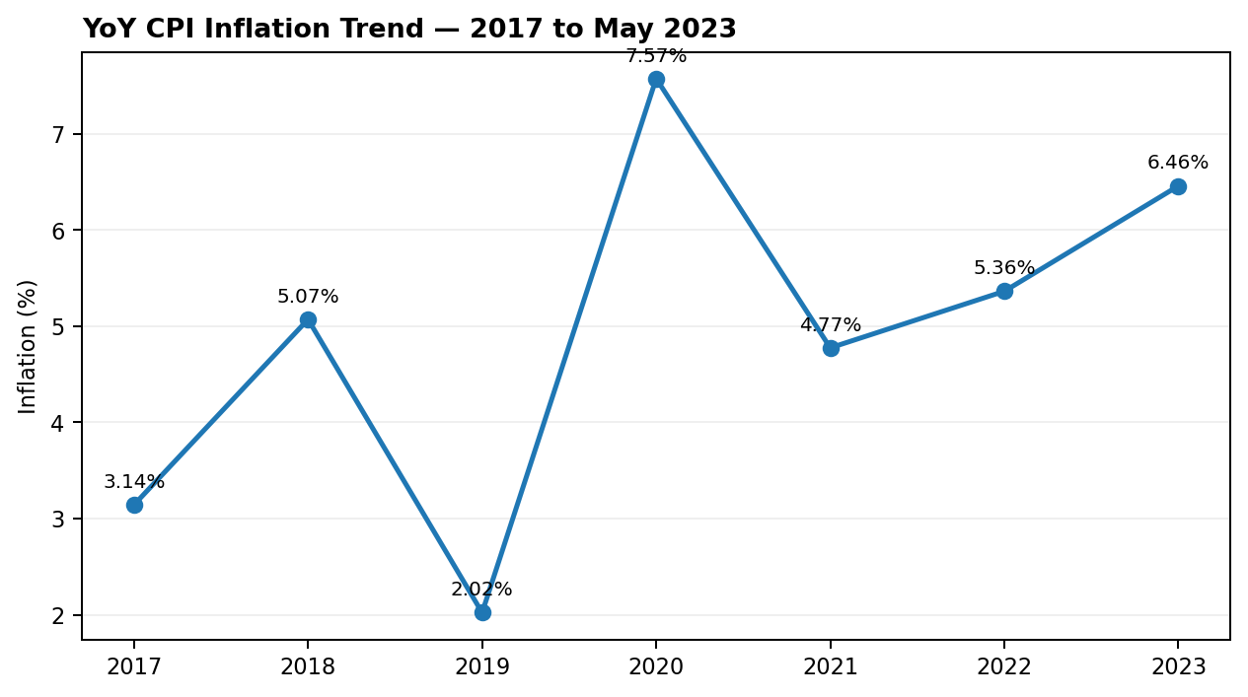
02 YoY CPI Trend
2017 – MAY 2023
Peak year
2020 recorded the highest annual YoY CPI value in this project table at 7.57%.
2023 context
The 2023 value of 6.46% represents the available Jan–May period, not a full year.
Trend story
Inflation rose sharply into 2020, eased in 2021, then moved higher again in the available 2022–May 2023 period.
CPI project workbook • Data available through May 2023

Slide 5
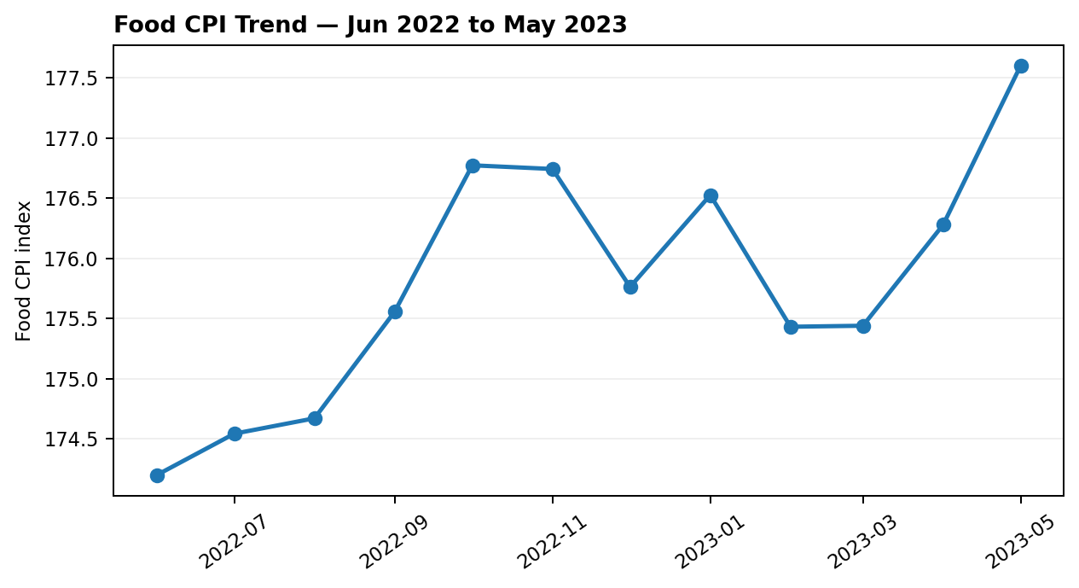
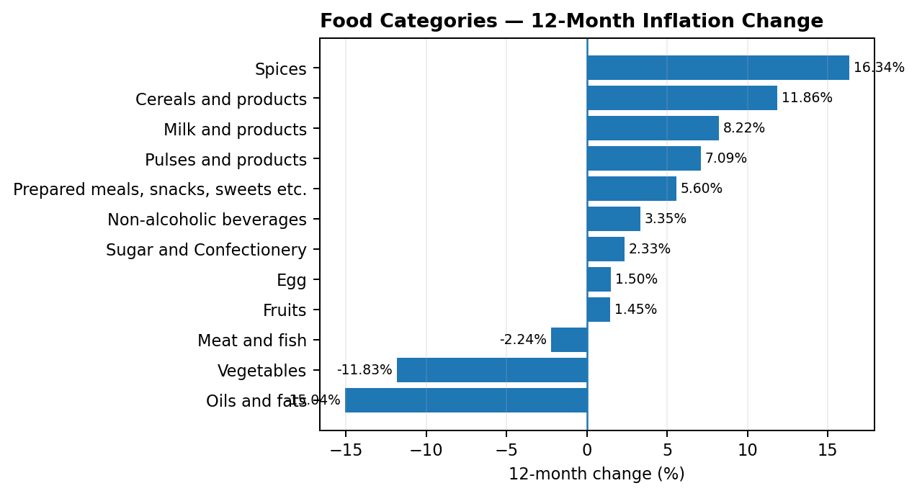
03 Food Inflation
12-MONTH PERIOD ENDING MAY 2023
Food trend
Food CPI moved from 175.53 in Jun 2022 to 179.67 in May 2023, with the highest index level at 180.10 in Oct 2022.
Largest positive move
Spices recorded the largest positive 12-month change at +30.47 index points, equal to +16.34%.
Largest negative move
Oils and fats recorded the largest negative 12-month change at −29.97 index points, equal to −15.04%.
CPI project workbook • Data available through May 2023

Slide 6
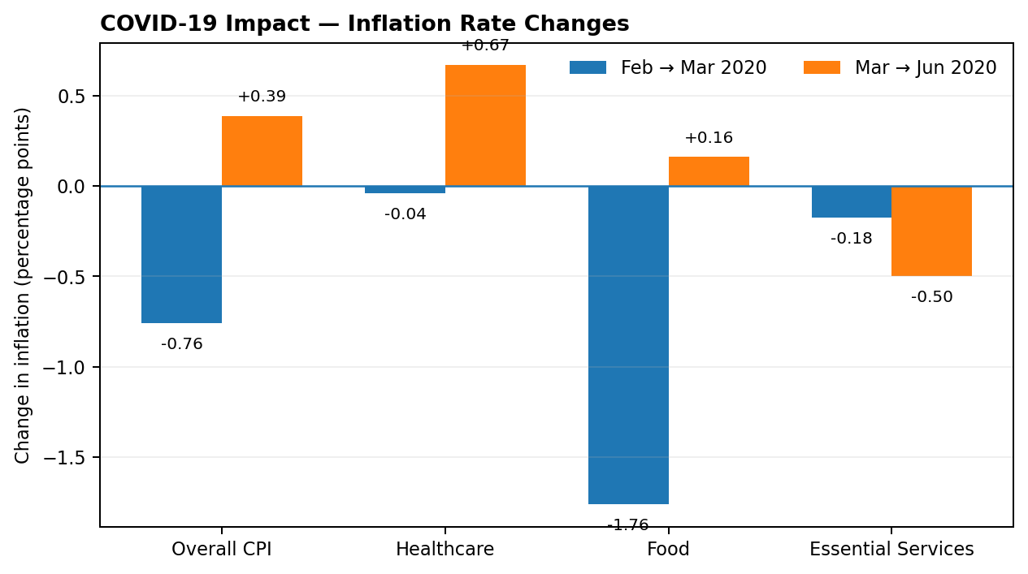
04 COVID-19 Impact on Inflation
2020
Feb → Mar 2020
Overall CPI fell 0.76 pp; Food fell 1.76 pp; Healthcare changed −0.04 pp; Essential Services fell 0.18 pp.
Mar → Jun 2020
Overall CPI rose 0.39 pp; Healthcare rose 0.67 pp; Food rose 0.16 pp; Essential Services fell 0.50 pp.
Key interpretation
The inflation response was not uniform across categories during the COVID period.
Source: Q4 COVID impact analysis • Changes shown in percentage points

Slide 7
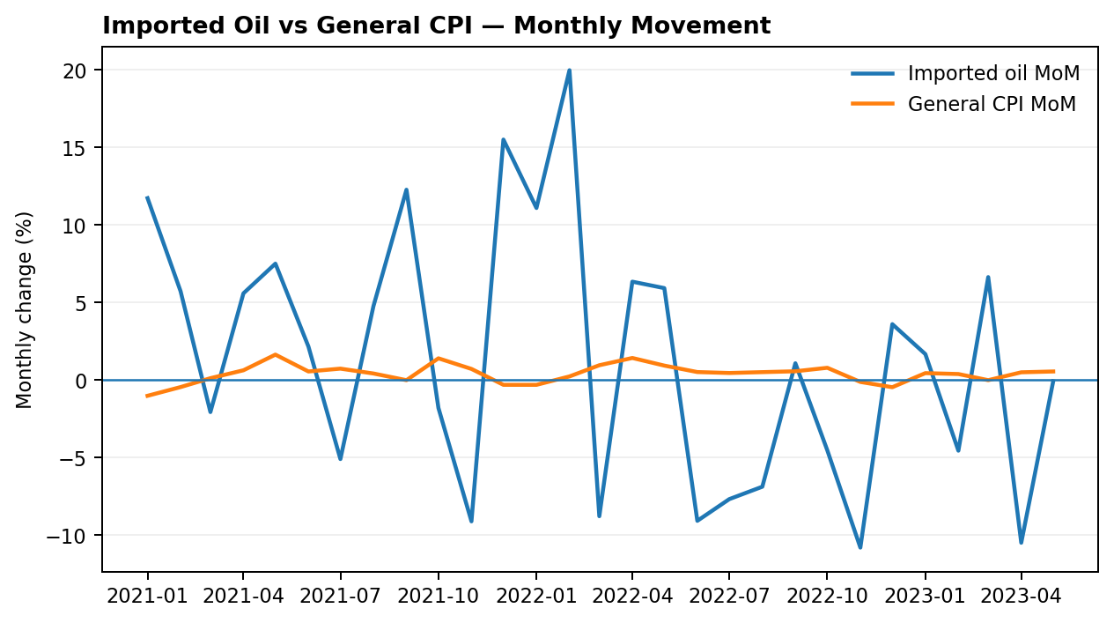
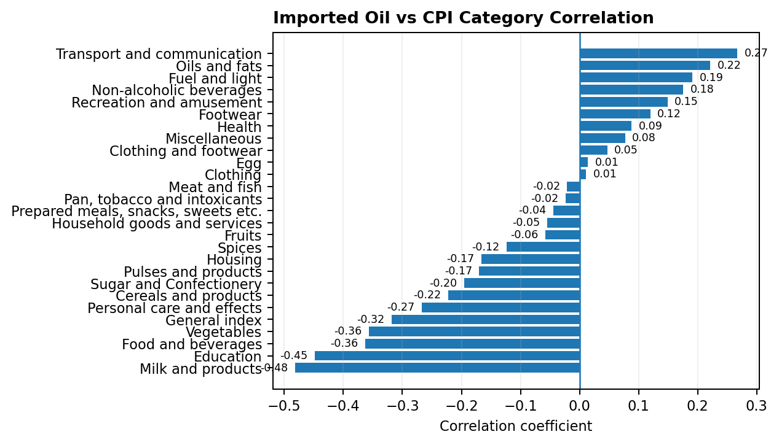
05 Imported Oil & CPI
2021 – MAY 2023
Strongest observed link
Milk & products had the strongest observed correlation with imported-oil MoM changes: −0.482.
Other notable relationships
Education (−0.449), Food & beverages (−0.363) and Vegetables (−0.356) also showed relatively stronger negative associations.
Interpretation
Oil-price movements were associated differently across categories; correlation alone does not establish causation.
Source: PPAC Indian Basket crude oil prices + CPI project data • Common comparison period through May 2023

Slide 8
Key Insights
WHAT THE ANALYSIS TELLS US
01 Inflation cycle
The project data shows a clear inflation surge into 2020, followed by easing and renewed pressure in the later available period.
02 Food is uneven
Food inflation was not a single-direction story: individual categories diverged sharply over the 12 months ending May 2023.
03 COVID was uneven
The selected inflation measures moved differently between the March 2020 onset and June 2020.
04 Oil transmission varies
Imported-oil changes did not show one uniform relationship across the CPI basket.
05 Strongest observed association
Milk & products had the largest absolute correlation in the project analysis at 0.482.
06 Latest position
The latest available YoY CPI value in the project is 6.46% for May 2023.
Bottom line: inflation is multi-dimensional — category mix, shocks and external price movements can behave differently over time.
Decision-ready view
Use the charts to explain the movement, and the insights to explain the story behind the movement.
CPI project workbook • Data available through May 2023

Slide 9
Scope & Interpretation Notes
READ THIS BEFORE USING THE RESULTS
Q1 — Latest-month contribution
May 2023 broad-category values are normalized across the selected categories for analytical comparison; they are not official CPI expenditure weights.
Q2 — YoY trend
2023 is partial through May. Annual values should therefore be interpreted with the available period in mind.
Q4 — Essential Services
Essential Services is an analytical unweighted composite of selected service-related CPI categories used for this project.
Q5 — Imported oil
Oil analysis uses Indian Basket crude-oil monthly movements and compares them with CPI monthly movements through the common period available in the project.
Correlation caveat
A correlation describes linear association in the study period. It does not by itself prove that imported-oil movements caused changes in a CPI category.
Prepared from the CPI project workbook • Analysis period: 2013–May 2023 • Oil comparison: 2021–May 2023
CPI project workbook • Data available through May 2023

