Slide 1
ANIRUDDH MURALIDARAN
Final Project:
Fashion Product Image Generation Using GAN
01/04/2024 Annual Review

Slide 2
Generative Adversarial Network (GAN) for Handwritten Digit Generation
Create a Generative Adversarial Network (GAN) that can produce images of fashion products similar to those found in the MNIST dataset.
01/04/2024 Annual Review

Slide 3

AGENDA
Problem Statement
Project Overview
End Users
Solution and Value Proposition
Unique Aspects of the Solution
Modelling
Results
01/04/2024 Annual Review

Slide 4

PROBLEM STATEMENT
The aim of the project is to produce fashion products like those present in the MNIST dataset using a Generative Adversarial Network(GAN). MNIST comprises 28x28 grayscale images of handwritten digits ranging from 0 to 9.
01/04/2024 Annual Review

Slide 5

PROJECT OVERVIEW
Acquiring data, designing the model, training, evaluating, and deploying are some of the major processes in the project. To construct and train the GAN architecture, it makes use of deep learning frameworks like TensorFlow and Keras. The project also places a strong emphasis on optimization and experimentation to produce the best outcomes.
01/04/2024 Annual Review

Slide 6

WHO ARE THE END USERS?
Researchers and developers who are studying GANs, image generation.
Educators who teach deep learning, GANs, or image generation can use the tool.
Developers or engineers working on applications that use image generation of any niche, in this case, a fashion product line.
01/04/2024 Annual Review

Slide 7

SOLUTION AND ITS VALUE PROPOSITION
Using TensorFlow/Keras, create a GAN architecture with a discriminator network and a generator.
Construct a neural network that has several layers of activation layers (such as ReLU and Tanh) and fully connected (Dense) layers.
Make modifications to the layer sizes, depth of the network, and normalization methods.
Create a neural network with a binary classification output that shares architectural decisions with the generator.
Use activation functions to create probability scores and introduce non-linearity, such as Sigmoid and Leaky ReLU.
01/04/2024 Annual Review

Slide 8

THE WOW IN SOLUTION
Innovative Network Architectures: Exploring varied architectural designs for both the generator and discriminator networks to ensure the creation of realistic and diverse digit images.
Performance Optimization: Conducting thorough experimentation and hyperparameter tuning to maximize the GAN model's performance, resulting in improved image quality and stability.
01/04/2024 Annual Review
8

Slide 9
MODELLING
Create a realistic representation of numbers by experimenting with different layer widths, depths, and activation functions such as ReLU and Tanh when designing the architecture of the generator network.
Discriminator Network Design: To discern between actual and produced images, develop the discriminator network design by experimenting with various layer topologies and activation functions, such as Sigmoid and Leaky ReLU.
Hyperparameter Tuning: To maximize the performance of the GAN model, execute a thorough experimentation and hyperparameter tuning process, paying particular attention to factors such as learning rate, batch size, and network depth. Training: To improve the quality and stability of picture generation, train the GAN model using the MNIST dataset, iteratively updating the generator and discriminator networks. Evaluation: Examine the realism and diversity of the generated digit images to gauge the performance of the trained GAN model.
DEMO LINK
01/04/2024 Annual Review
9

Slide 10
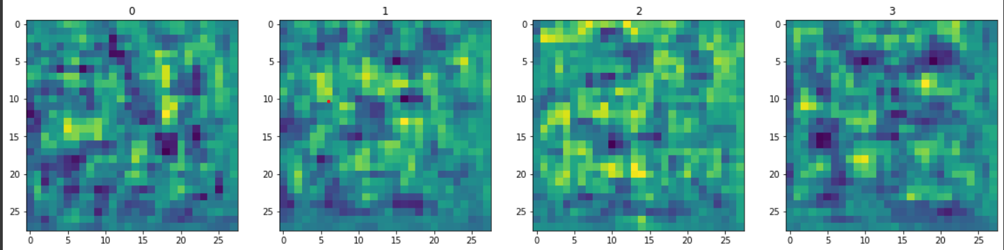
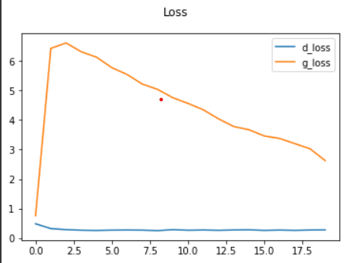
RESULTS
Demo_link
01/04/2024 Annual Review
10

Slide 11
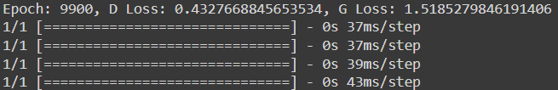
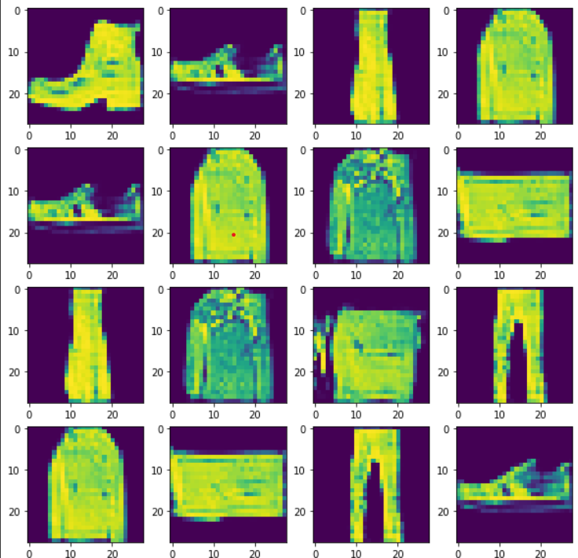
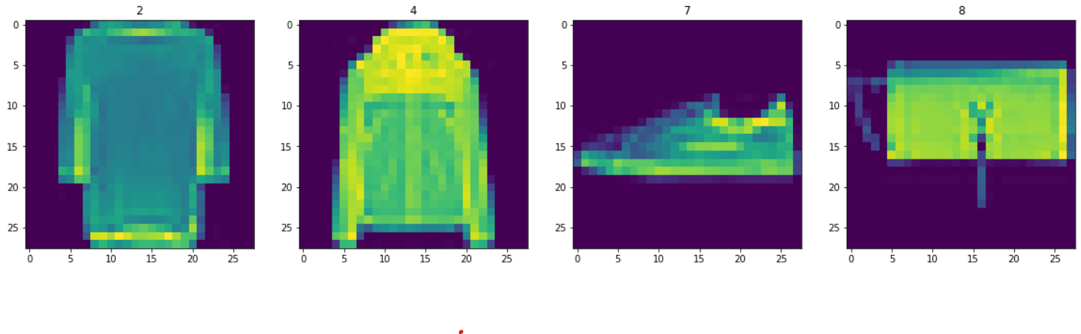
RESULTS
11

Slide 12
CONCLUSION
In summary, our Generative Adversarial Network (GAN) has shown remarkable progress in generating lifelike fashion product images similar to the MNIST dataset. By exploring diverse network architectures and fine-tuning parameters, we've achieved high image quality and stability. The detailed documentation ensures easy deployment and accessibility, promising broader applications in image generation and beyond.
01/04/2024 Annual Review
12

Slide 13
REFERENCES
https://www.tensorflow.org/
https://keras.io/
https://numpy.org/
https://matplotlib.org/
scikit-learn: machine learning in Python — scikit-learn 1.4.1 documentation
https://www.geeksforgeeks.org/generative-adversarial-network-gan/
01/04/2024 Annual Review
13

