Slide 1
DevOps
Lesson 01:Introduction to DevOps
Notes:
Add instructor notes here.

Slide 2
Lesson Objectives
Introduction to DevOps
What is DevOps
Evolution of DevOps
Agile Methodology
Why DevOps
Agile vs DevOps
DevOps Principles
DevOps Lifecycle
DevOps Tools
Benefits of DevOps
Continuous Integration and Delivery pipeline
Use-case walkthrough
Notes:
Add instructor notes here.

Slide 3
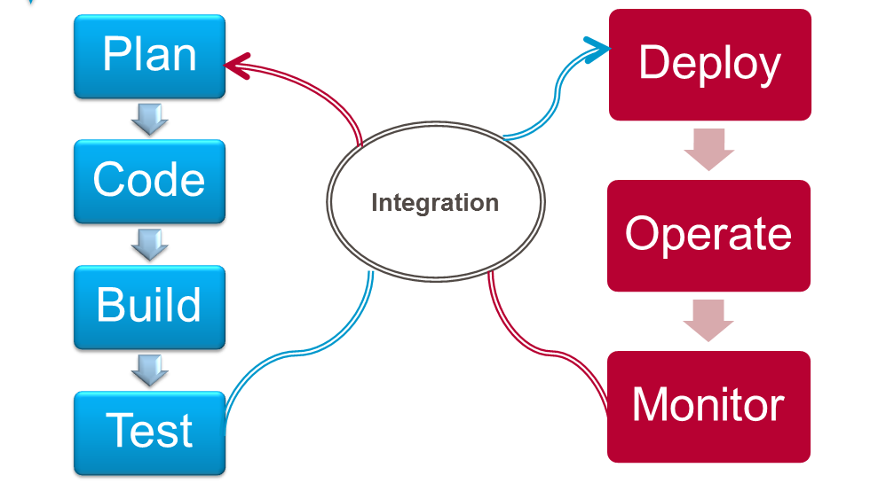
1.1: What is DevOps What is DevOps
DevOps is a term used to refer to a set of practices that emphasize
the collaboration and communication of both software developers and information technology (IT) professionals while automating the process of software delivery and infrastructure changes.
It aims at establishing a culture and environment where building, testing, and releasing software can happen rapidly, frequently, and more reliably

Slide 4
1.1: What is DevOps What is DevOps
Gartner defines DevOps as a change in IT culture, focusing on rapid IT service delivery through the adoption of agile, lean practices in the context of a system-oriented approach.
DevOps emphasizes people (and culture), and seeks to improve collaboration between operations and development teams
DevOps has many definitions
Can be termed as an operational model of collaboration
Culture of high performance IT

Slide 5
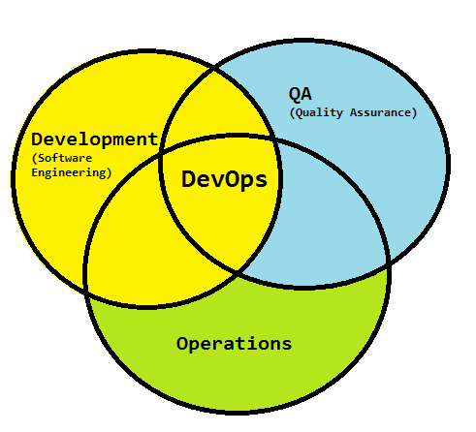
1.1: What is DevOps What is DevOps
DevOps integrates developers and operations team in order to improve collaboration and productivity by:
Automating infrastructure
Automating workflows
Continuous measuring application performance

Slide 6
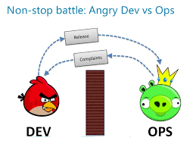
1.1: What is DevOps Dev and Ops
DevOps can be explained simply as operations working together with engineers to get things done faster in an automated and repeatable way.
Growing pains of operation
When we are responsible for large distributed applications the operations complexity grows quickly.
How do you provision virtual machines?
How do you configure network devices and servers?
How do you deploy applications?
How do you collect and aggregate logs?
How do you monitor services?
How do you monitor network performance?
How do you monitor application performance?
How do you alert and remediate when there are problems?

Slide 7

1.1: What is DevOps Dev and Ops
Growing pain of developer
Dev is often unaware of Ops roadblocks that prevent the program from working as anticipated
Combining the power of developers and operations
The focus on the developer/operations collaboration enables a new approach to managing the complexity of real world operations.
The operations complexity breaks down into a few main categories: infrastructure automation, configuration management, deployment automation, log management, performance management, and monitoring.

Slide 8
1.1: What is DevOps What is DevOps Not ?
It’s Not (Just) Tools
It’s Not (Just) Culture
It’s Not (Just) Devs and Ops
It’s Not (Just) A Job Title
It’s Not Everything

Slide 9
1.2: Evolution of DevOps Evolution of DevOps
DevOps is the offspring of agile software development – born from the need to keep up with the increased software velocity and throughput agile methods have achieved.
The DevOps ideals extend agile development practices by further streamlining the movement of software change thru the build, validate, and deploy and delivery stages, while empowering cross-functional teams with full ownership of software applications – from design thru production support.
DevOps is an IT mindset that encourages communication, collaboration, integration and automation among software developers and IT operations in order to improve the speed and quality of delivering software.
DevOps teams focus on standardizing development environments and automating delivery processes to improve delivery predictability, efficiency, security and maintainability.
The DevOps ideals provide developers more control of the production environment and a better understanding of the production infrastructure

Slide 10
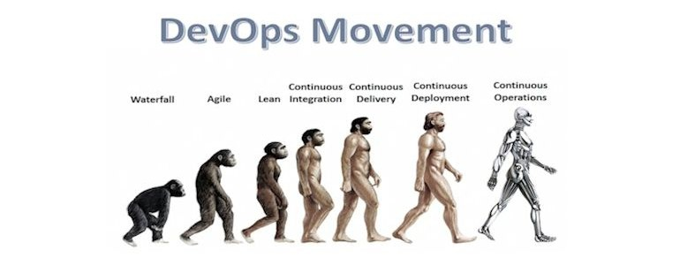
1.2: Evolution of DevOps DevOps Movement

Slide 11
1.3: Agile Methodology Agile Methodology
Agile Methodology: In the Agile approach, software is developed and released incrementally in the iterations
This results in small incremental releases with each release building on previous functionality
Each release is thoroughly tested to ensure software quality is maintained
It is used for time critical applications

Slide 12
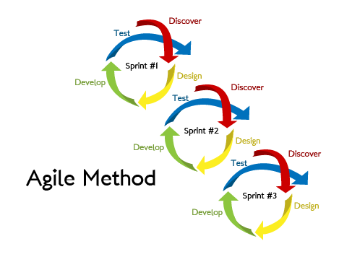
1.3: Agile Methodology Agile Methodology
http://www.cleanri.com/post_agile-methodology-diagram_43651/
Notes:
In the Agile methodology, each project is broken up into several ‘Iterations’.
All Iterations should be of the same time duration (between 2 to 8 weeks).
At the end of each iteration, a working product should be delivered.
Sprint- the agile(scrum) term for iteration
Within each sprint, the development team builds and tests a functional part of the product until the product owner accepts it and the functionality becomes a potentially shippable product. When one sprint finishes, another sprint starts.
Agile teams deliver product features in increments at the end of each sprint.
A product release occurs at the end of a sprint or after several sprints.
A core principle of the sprint is its cyclical nature: The sprint, as well as the processes within it, repeats over and over, as shown:

Slide 13
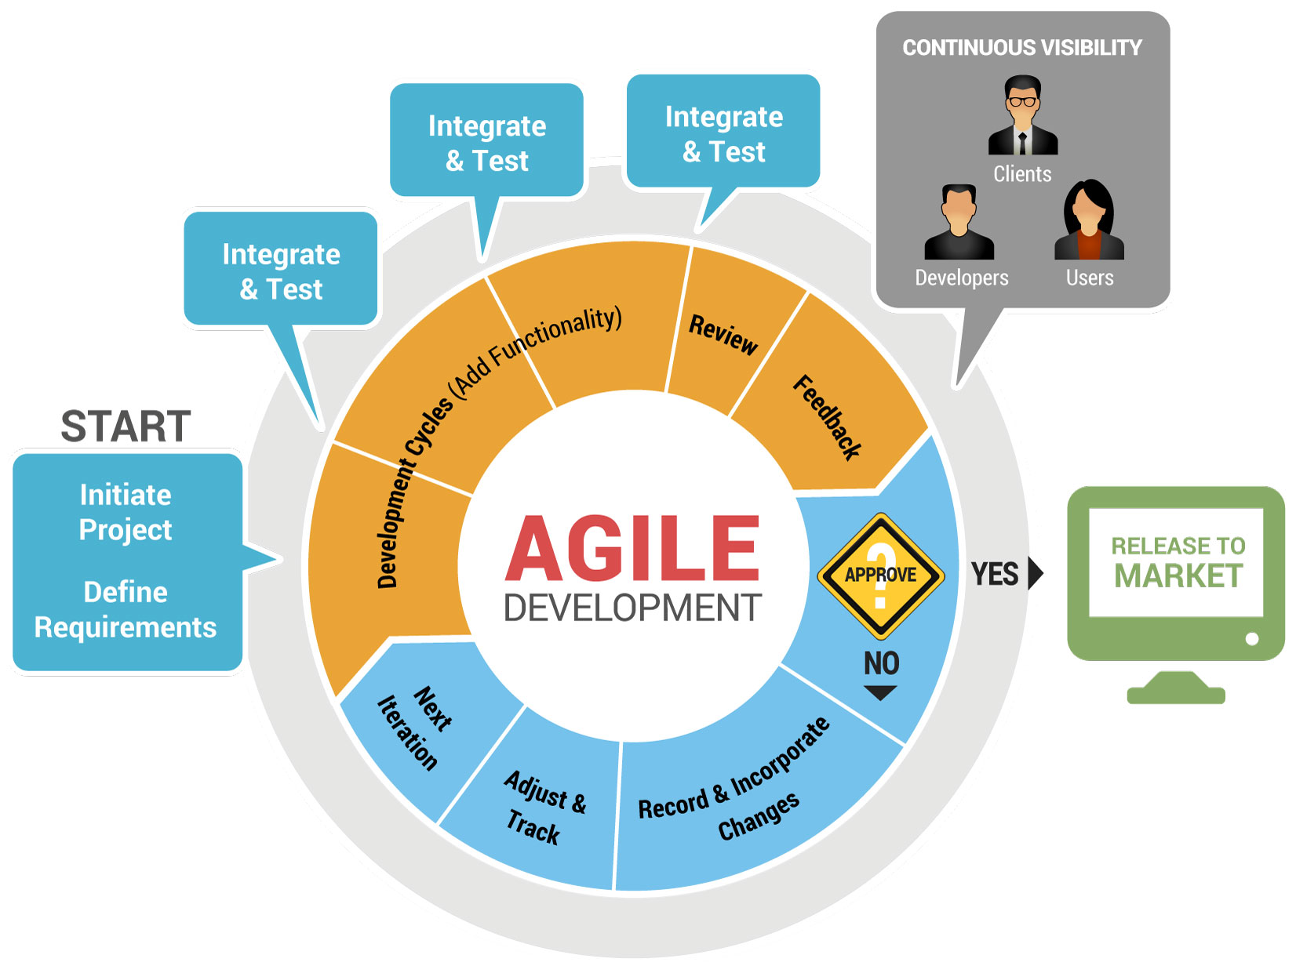
1.3: Agile Methodology Agile Methodology
http://www.cleanri.com/post_agile-methodology-diagram_43651/
Notes:
This approach allows the customer to interact and work with functioning software at the end of each iteration and provide feedback on it.
This approach allows teams to take up changes more easily and make course corrections if needed.
In the Agile approach, software is developed and released incrementally in the iterations.
Agile methodology gives more importance to collaboration within the team, collaboration with the customer, responding to change and delivering working software.
Advantages of Agile model:
Customer satisfaction by rapid, continuous delivery of useful software.
People and interactions are emphasized rather than process and tools. Customers, developers and testers constantly interact with each other.
Working software is delivered frequently (weeks rather than months).
Face-to-face conversation is the best form of communication.
Close, daily cooperation between business people and developers.
Continuous attention to technical excellence and good design.
Regular adaptation to changing circumstances.
Even late changes in requirements are welcomed

Slide 14
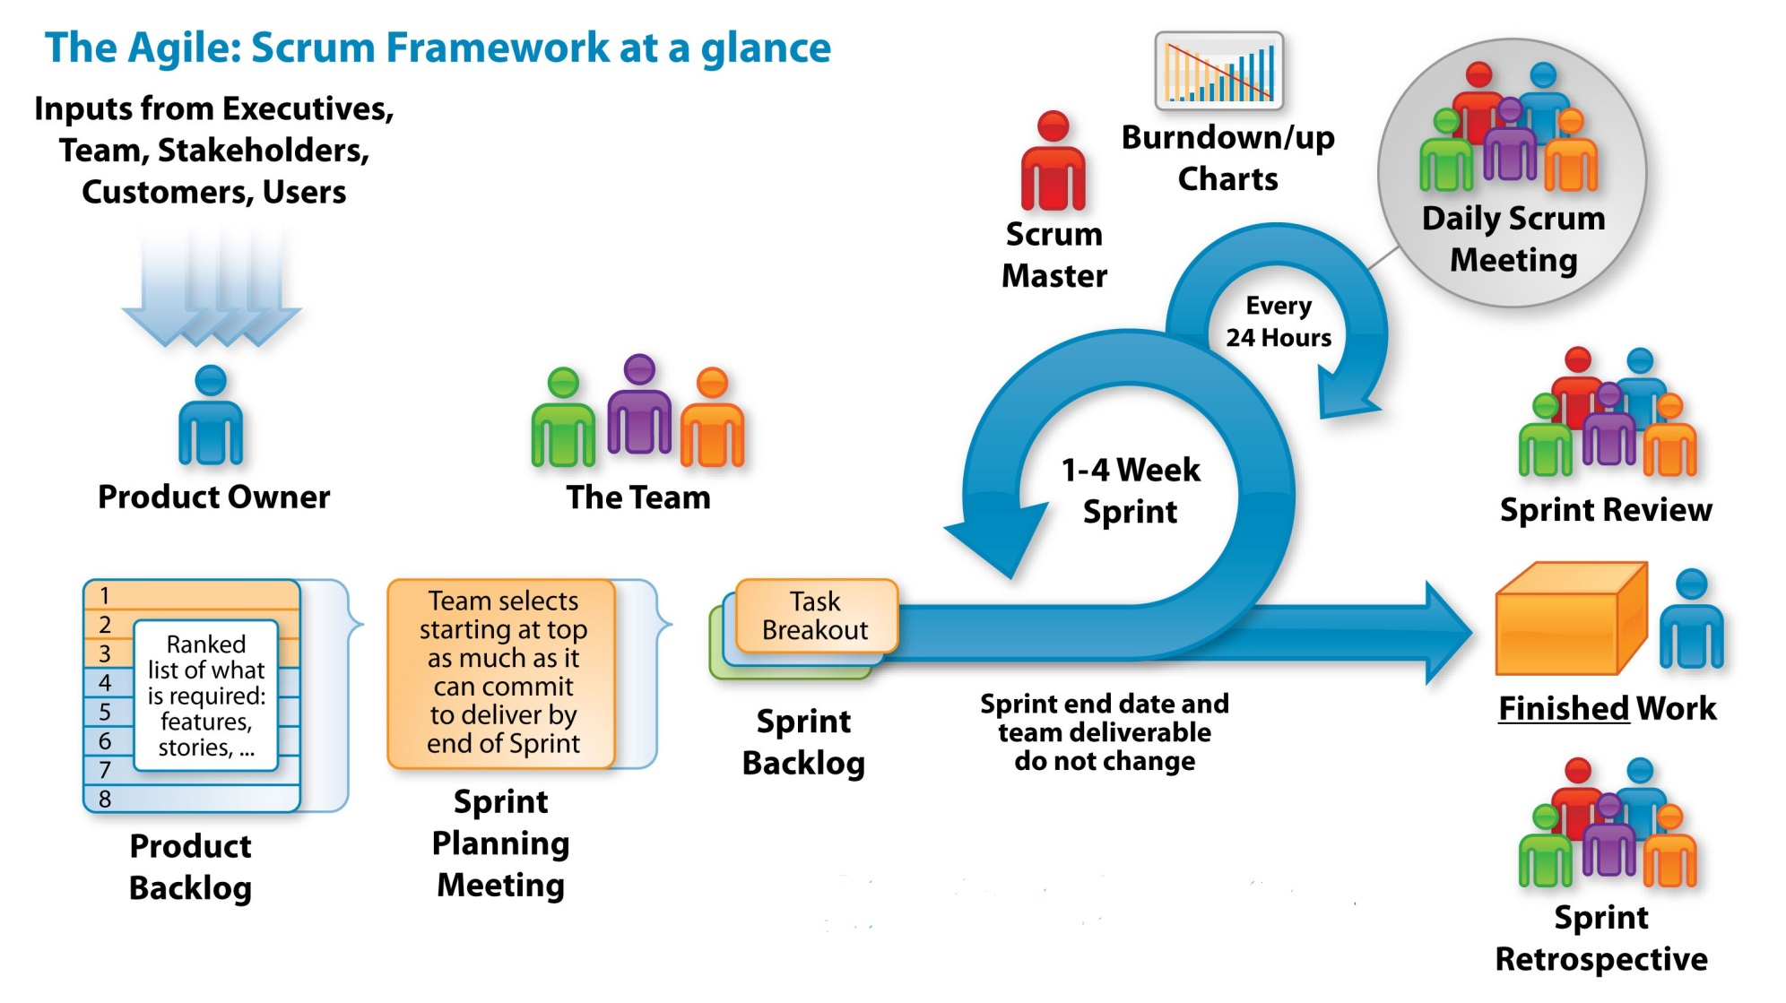
1.3: Agile Methodology Agile- Scrum Framework
http://www.cleanri.com/post_agile-methodology-diagram_43651/
Notes:
Scrum is an efficient framework within which you can develop software with teamwork. It is based on agile principles.
Scrum Team : is a team comprising of 7 with + or - two members. These members are a mixture of competencies and comprise of developers, testers, data base people, support people etc. along with the product owner and a scrum master
Sprint: the scrum term for iteration.
Product Owner: is the key stakeholder or the lead user of the application to be developed.
Scrum Master: is the facilitator of the scrum team. He / she make sure that the scrum team is productive and progressive.
User Story: User stories are nothing but the requirements or feature which has to be implemented. In scrum, we don’t have those huge requirements documents, rather the requirements are defined in a single paragraph
Product Backlog: Product backlog is a kind of bucket: or source where all the user stories are kept. This is maintained by Product owner. Product backlog can be imagined as a wish list of the product owner who prioritizes it as per business needs.
Sprint Backlog: Based on the priority, user stories are taken from the Product Backlog one at a time. The Scrum team brainstorms on it, determines the feasibility and decides on the stories to work on a particular sprint. The collective list of all the user stories which the scrum team works on a particular sprint is called s Sprint backlog.
Story Points: Story points are quantitative indication of the complexity of a user story. Based on the story point, estimation and efforts for a story is determined. Story point is relative and is not absolute.

Slide 15
1.3: Agile Methodology Agile- Scrum Framework
Notes:
THE FUNCTION OF THE SCRUM AND SPRINT WITHIN AN AGILE PROJECT
Scrum, the most popular agile framework in software development, is an iterative approach that has at its core the sprint — the scrum term for iteration.
Scrum teams use inspection throughout an agile project to ensure that the team meets the goals of each part of the process.
The scrum approach includes assembling the project’s requirements and using them to define the project.
You then plan the necessary sprints, and divide each sprint into its own list of requirements.
Daily scrum meetings help keep the project on target as do regular inspections and reviews.
At the end of every sprint, you hold a sprint retrospective to look for ways to improve the next sprint.
The process looks as shown in the diagram:
Within each sprint, the development team builds and tests a functional part of the product until the product owner accepts it and the functionality becomes a potentially shippable product.
When one sprint finishes, another sprint starts.
Scrum teams deliver product features in increments at the end of each sprint.
A product release occurs at the end of a sprint or after several sprints.

Slide 16
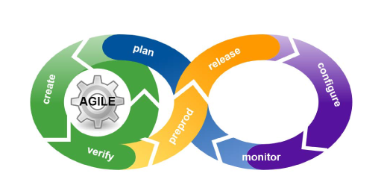
1.3: Agile Methodology Agile Practices
Development is Agile, what about Agility in Operations?

Slide 17
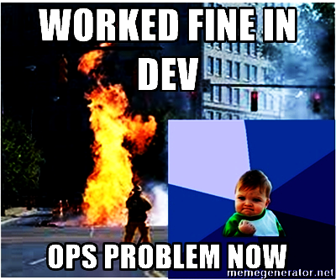
1.3: Agile Methodology Agile Practices

Slide 18
1.4: Why DevOps Evolution of Software Development
DevOps evolved from existing software development strategies/methodologies over the years in response to business needs
The slow and cumbersome Waterfall model evolved into Agile
While this Agile SCRUM approach brought agility to development, it was lost on Operations which did not come up to speed with Agile practices
Lack of collaboration between Developers and Operations Engineers still slowed down the development process and releases
DevOps methodology was born out of this need for better collaboration and faster delivery
DevOps enables continuous software delivery with less complex problems to fix and faster resolution of problems

Slide 19
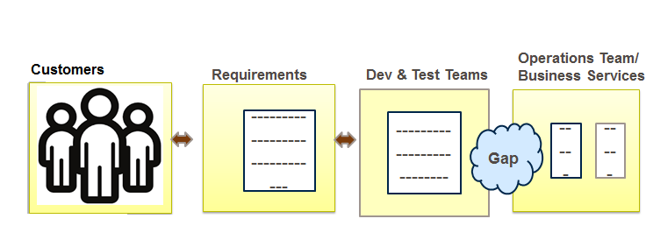
1.4: Why DevOps Why DevOps

Slide 20
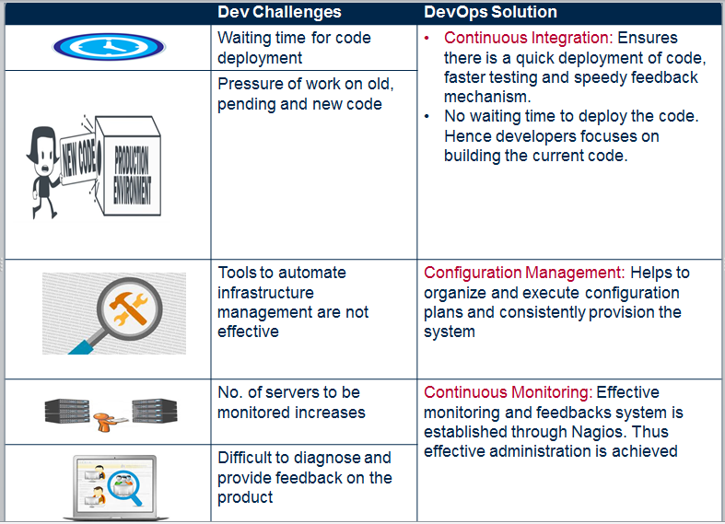
1.4: Why DevOps Why DevOps
DevOps takes care of the challenges faced by Development and Operations
Below table describes how DevOps addresses Dev Challenges
Notes:
Accelerate software delivery Reduce time to customer feedback Balance speed, cost, quality and risk

Slide 21
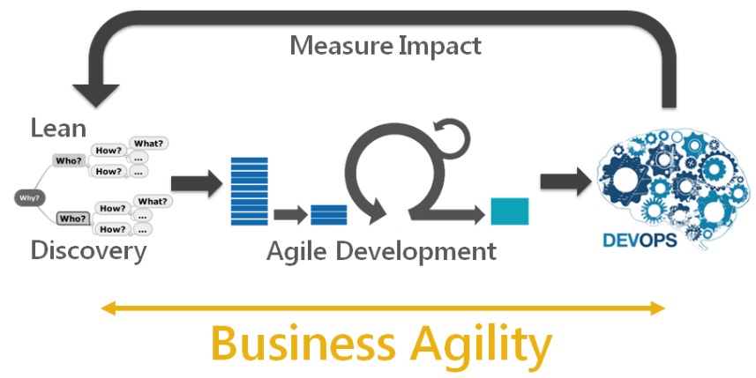
1.4: Why DevOps Emergence of DevOps: Influence on DevOps

Slide 22
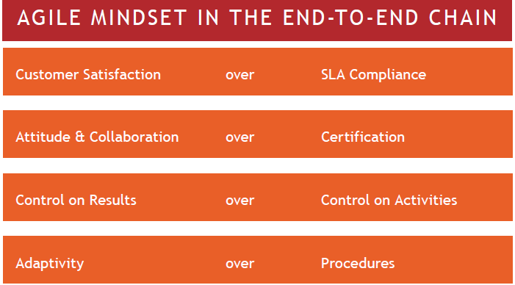
1.5: Agile Vs DevOps Agile Vs DevOps

Slide 23
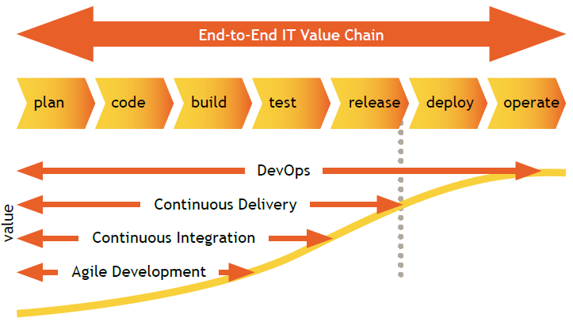
1.5: Agile Vs DevOps Agile Vs DevOps

Slide 24
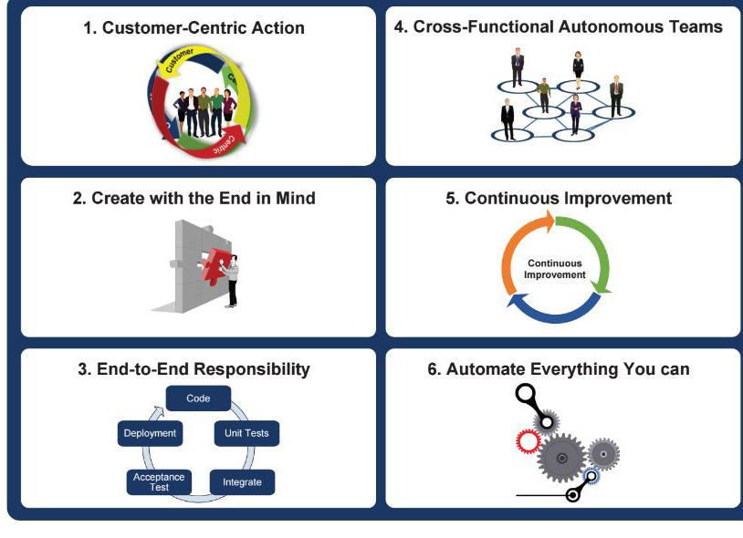
1.6:DevOps Principles DevOps Principles

Slide 25
1.7: DevOps Life Cycle DevOps Life Cycle- it’s all about “continuous”
DevOps Life Cycle can be broadly broken down into the below stages:
Continuous Development :In this stage of DevOps life cycle the Software is developed continuously
Continuous Integration: In this stage the code supporting new functionality is integrated with the existing code
Continuous Testing: In this stage the developed software is continuously tested for bugs
Continuous Monitoring: This practice involves the participation of the Operations team who will monitor the user activity for bugs / any improper behavior of the system

Slide 26
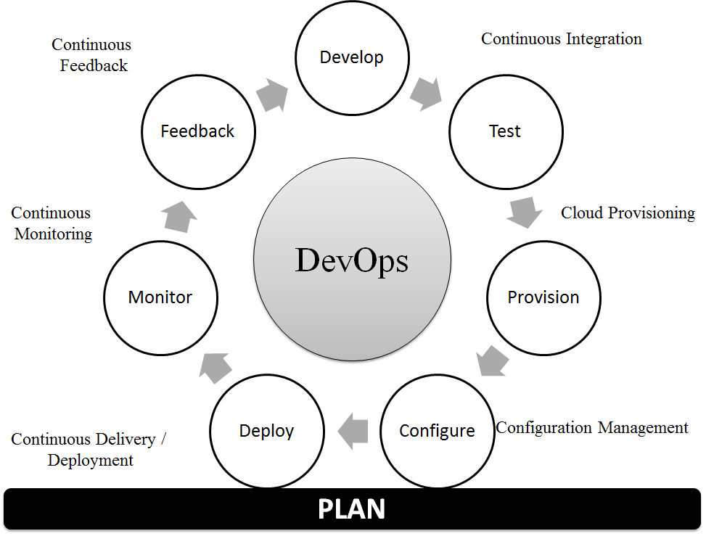
1.7: DevOps Life Cycle DevOps SDLC
DevOps life cycle and Software Development stages depicted in the diagram below.

Slide 27
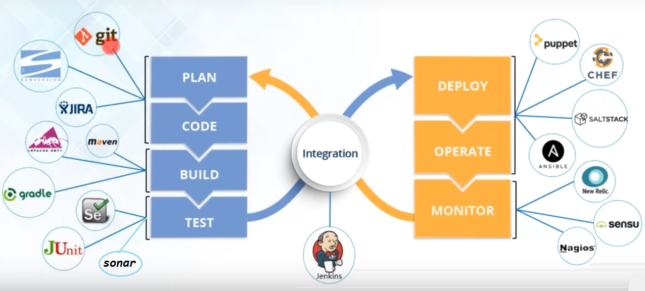
1.8: DevOps Tools DevOps Tools
The below diagram shows which tools can be used in which stage of the DevOps life cycle.

Slide 28
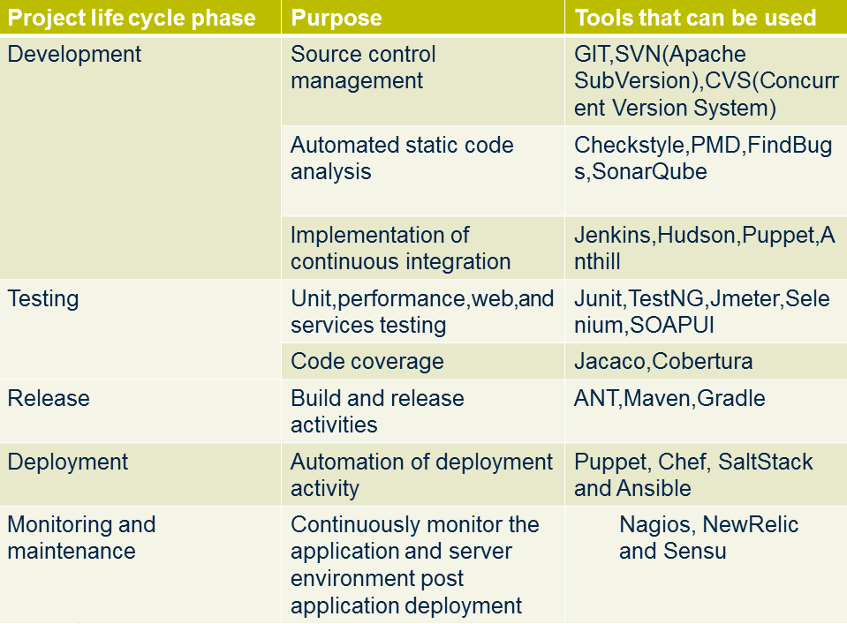
1.8: DevOps Tools Tools used in various stages of Project Lifecycle
Notes:
DevOps life cycle stages are carried out on loop continuously until the desired product quality is achieved.
Continuous Development:
This is the stage in the DevOps life cycle where the Software is developed continuously.
This stage involves the Coding and Building phases
Tools Used
Git and SVN are used for maintaining the different versions of the code
Ant, Maven, Gradle for building / packaging the code into an executable file that can be forwarded to the QAs for testing.
Continuous Testing-Test Automation
It is the stage where the developed software is continuously tested for bugs
Once the code is tested, it is continuously integrated with the existing code
Tools Used
For Continuous testing ,testing automation tools like Selenium, JUnit are used
These tools enables the QA’s for testing multiple code-bases thoroughly in parallel to ensure that there are no flaws in the functionality
Continuous Integration:
This is the stage where the code supporting new functionality is integrated with the existing code
Since there is continuous development of software, the updated code needs to be integrated continuously as well as smoothly with the systems to reflect changes to the end users
Tools Used
Jenkins, SonarQube is a very popular tool used for Continuous Integration
Using Jenkins one can pull the latest code revision from GIT repository and produce a build which can finally be deployed to test or production server
It can be set to trigger a new build automatically as soon as there is change in the GIT repository or can be triggered manually on click of a button.

Slide 29
1.8: DevOps Tools Tools used in various stages of Project Lifecycle
Notes:
Continuous Deployment:
It is the stage where the code is deployed to the production environment
Here it is ensured that the code is correctly deployed on all the servers
Since the new code is deployed on a continuous basis, automation tools play an important role for executing tasks quickly and frequently
Tools Used
Puppet, Chef, SaltStack and Ansible are some popular tools that are used in this stag
Continuous Monitoring:
This stage in the DevOps life cycle is aimed at improving the quality of the software by monitoring its performance
This practice involves the participation of the Operations team who will monitor the user activity for bugs / any improper behavior of the system
This can also be achieved by making use of dedicated monitoring tools which will continuously monitor the application performance and highlight issues
Tools Used
Some popular tools used are Nagios, NewRelic and Sensu
These tools help us to monitor the application and the servers closely to check the health of the system proactively
They can also improve productivity and increase the reliability of the systems, reducing IT support costs

Slide 30
1.8: DevOps Tools DevOps Tools
Because DevOps is a cultural shift and collaboration (between development, operations and testing), there is no single "DevOps tool": it is rather a set (or "DevOps toolchain"),consisting of multiple tools.
DevOps is not about using one particular tool, it is about using the right combination of tools to accelerate development and mitigate risk. This list captures some of emergent DevOps tools categorized by purpose:

Slide 31
1.8: DevOps Tools DevOps Tools
Team and Task Coordination Slack HipChat Jostle Trello Asana Infrastructure as a Service Amazon Web Services Rackspace Cloud Foundry Azure OpenStack Virtualization Platforms VMware KVM Xen VirtualBox Vagrant Containerization Tools LXC Solaris Containers Docker Configuration Management Puppet / MCollective Chef Ansible CFEngine SaltStack RANCID Ubuntu Juju | Continuous Integration, Delivery & Release Management CircleCI TravisCI LaunchDarkly Queues and Caches ActiveMQ RabbitMQ memcache varnish Squid Logging PaperTrail Logstash Loggly Logentries Splunk SumoLogic Monitoring, Alerting, and Trending New Relic Nagios Icinga Graphite Ganglia Cacti PagerDuty Sensu

Slide 32
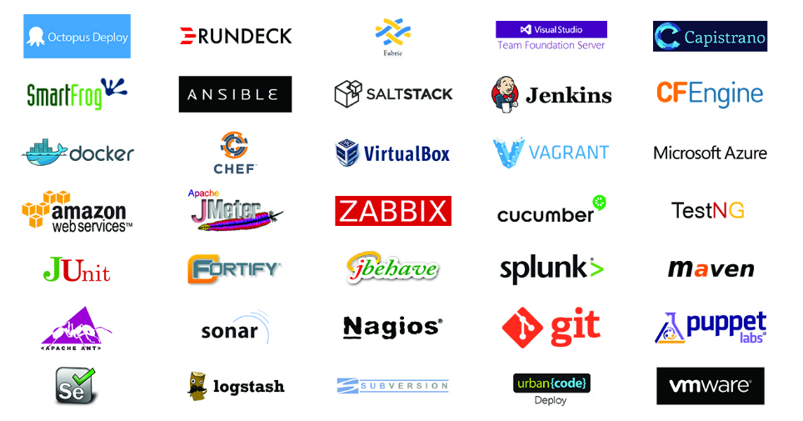
1.8: DevOps Tools DevOps Tools

Slide 33
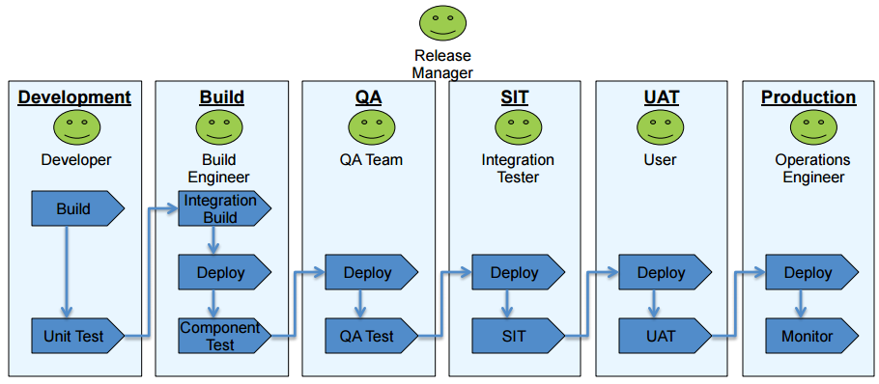
1.8: DevOps Tools A Typical Deployment Landscape

Slide 34
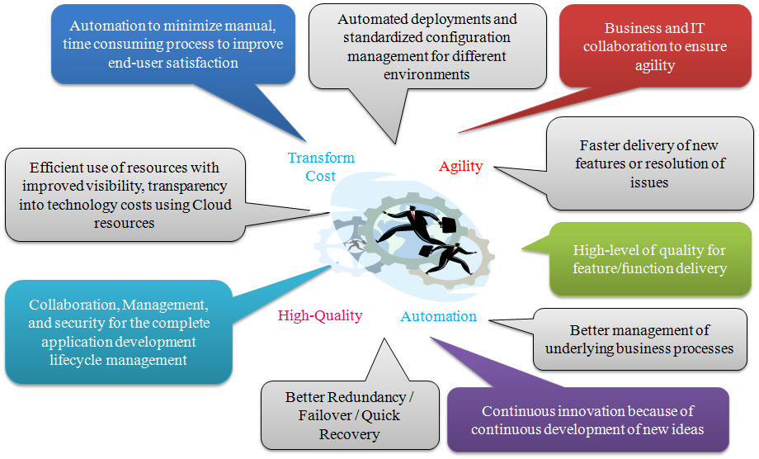
1.9: DevOps Benefits Benefits of DevOps
https://www.packtpub.com/books/content/jenkins-20-impetus-devops-movement

Slide 35
1.10: CI&CD Continuous Integration and Delivery Pipeline
Continuous Integration is a software engineering practice where each check-in made by a developer is verified by either of the following:
Pull mechanism: Executing an automated build at a scheduled time
Push mechanism: Executing an automated build when changes are saved in the repository
This step is followed by executing a unit test against the latest changes available in the source code repository.

Slide 36
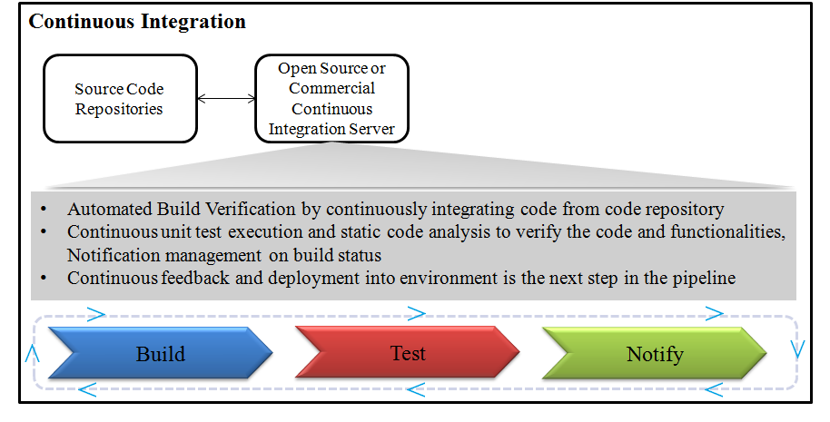
1.10: CI&CD Continuous Integration and Delivery Pipeline
The main benefit of continuous integration is quick feedback based on the result of build execution. If it is successful, all is well; else, assign responsibility to the developer whose commit has broken the build, notify all stakeholders, and fix the issue.

Slide 37
1.10: CI&CD Continuous Integration and Delivery Pipeline
Continuous Delivery is a DevOps software development practice where code changes are automatically built, tested, and prepared for a release to production
When continuous delivery is implemented properly, developers will always have a deployment-ready build artifact that has passed through a standardized test process
With continuous delivery, every code change is built, tested, and then pushed to a non-production testing or staging environment.
There can be multiple, parallel test stages before a production deployment
In the last step, the developer approves the update to production when they are ready
This is different from continuous deployment, where the push to production happens automatically without explicit approval

Slide 38
1.10: CI&CD Continuous Integration and Delivery Pipeline
Continuous delivery lets developers automate testing beyond just unit tests so they can verify application updates across multiple dimensions before deploying to customers.
These tests may include UI testing, load testing, integration testing, API reliability testing, etc.
This helps developers more thoroughly validate updates and pre-emptively discover issues.
With the cloud, it is easy and cost-effective to automate the creation and replication of multiple environments for testing, which was previously difficult to do on-premises.

Slide 39
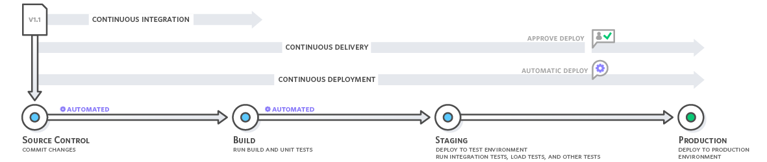
1.10: CI&CD Continuous Integration and Delivery Pipeline
Continuous delivery automates the entire software release process. Every revision that is committed triggers an automated flow that builds, tests, and then stages the update. The final decision to deploy to a live production environment is triggered by the developer

Slide 40
1.10: CI&CD Continuous Integration and Delivery Pipeline
The delivery pipeline can be broken down into a few major buckets of work, or stages, as mentioned below.
Source code control (management)
Build automation
Unit test automation (could also include Integration Testing here as well)
Deployment automation
Monitoring
The Figure shown is a sample of what the whole flow looks
from committing the code to the repo to deploying the code to an environment.
Notes:
1. Source Code Control (Management)
The basics here are that the organization stores its code in a source code control system or repository so that it can be tracked, maintained, versioned, and audited. You do not want the developers storing the code on their laptops or virtual machines and trust that will suffice for managing the code.
Possible Tools
Git is probably the most widely used SCM system out there. It is an open source system.
2. Build Automation
Once a source code management system is in place and actively being used by your development team, the team will need to be able to compile and build their code. This is probably the first step in the whole chain of Continuous Integration events. This is what gets the ball rolling. The code needs to build cleanly before you can even think about deploying out to your environments for testing and production.
Possible Tools
Gradle is an open source build automation system. Pretty widely used by top companies like Netflix, Google, and LinkedIn.
Maven is another open source build automation system.

Slide 41
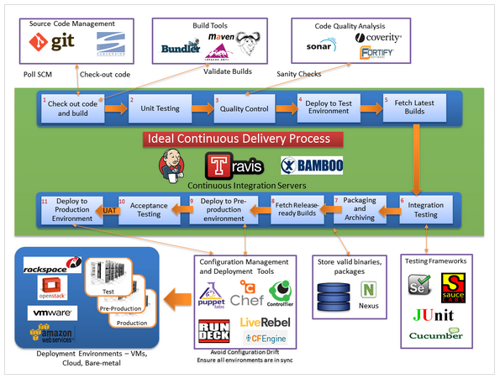
1.10: CI&CD Continuous Integration and Delivery Pipeline
Notes:
3. Unit Test Automation
Developers unit test their code to ensure that the functionality they are building works as expected. In an ideal world, the development team should be saving these unit tests, so that they can be reused and also put into a regression test bed.
Possible Tools
There are multiple tools out there for helping developers unit test their code. Many of these tools are open source and can be used freely.
JUnit is an open source unit test framework. This is pretty widely used in the industry.
CA DevTest allows for the automation of unit testing, as well as a few other bells and whistles, like service virtualization.
4. Deployment Automation
For the last stage in the process, delivery teams need to deploy their code and applications out to various test environments and, of course, production. To reduce errors and overhead in the deployment process, while increasing speed to market, this step can be automated through a variety of tools and methods.
Possible Tools
IBM Urbancode uDeploy allows you to model a process and orchestrate your deployment. This process can then be repeated across all your environments, and of course tweaked for each environment as needed.
Ansible is an open source IT automation tool. It can be used for everything from configuration management to product installation to application deployments.This tool is rapidly gaining acceptance and momentum in the DevOps community.

Slide 42
1.10: CI&CD Continuous Integration and Delivery Pipeline
Following are immediate benefits of Continuous Integration:
Automated integration with pull or push mechanism
Repeatable process without any manual intervention
Automated test case execution
Coding standard verification
Execution of scripts based on requirement
Quick feedback: build status notification to stakeholders via e-mail
Teams focused on their work and not in the managing processes
Benefits Continuous Delivery
Automate the software release process
Improve developer productivity
Find and address bugs quickly
Deliver updates faster

Slide 43
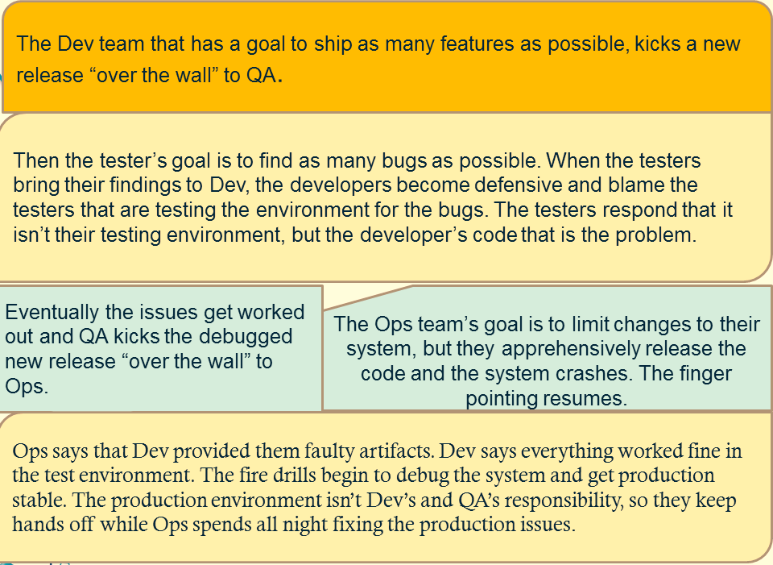
1.11: Use-case walkthrough Use-case walkthrough Pre-DevOps Scenario

Slide 44
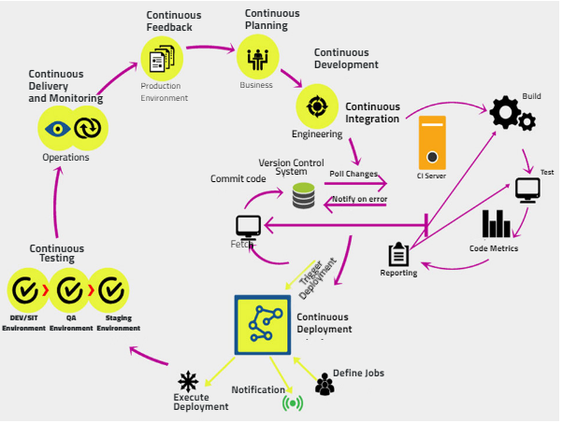
1.11: Use-case walkthrough DevOps End-to-End Implementation
Analyze, design, construct, automate and implement according to the needs identified for each project

Slide 45
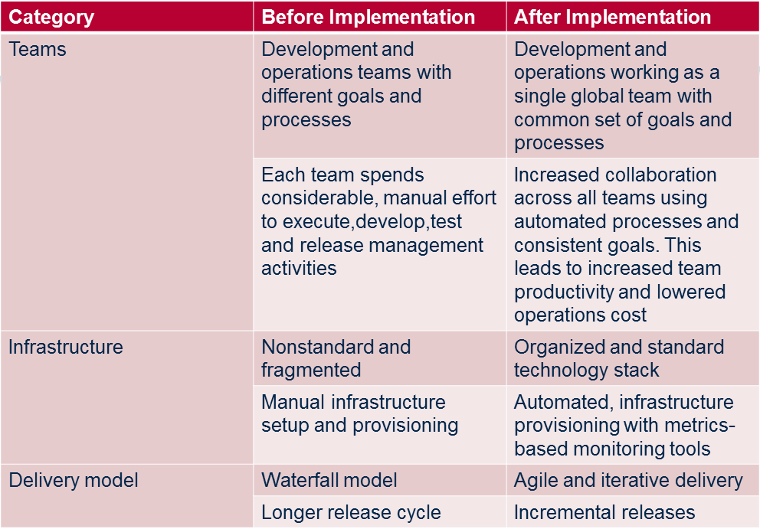
1.11: Use-case walkthrough Use-case walkthrough Post-DevOps Scenario
The table below lists typical transformations that occur post successful DevOps implementation:

Slide 46
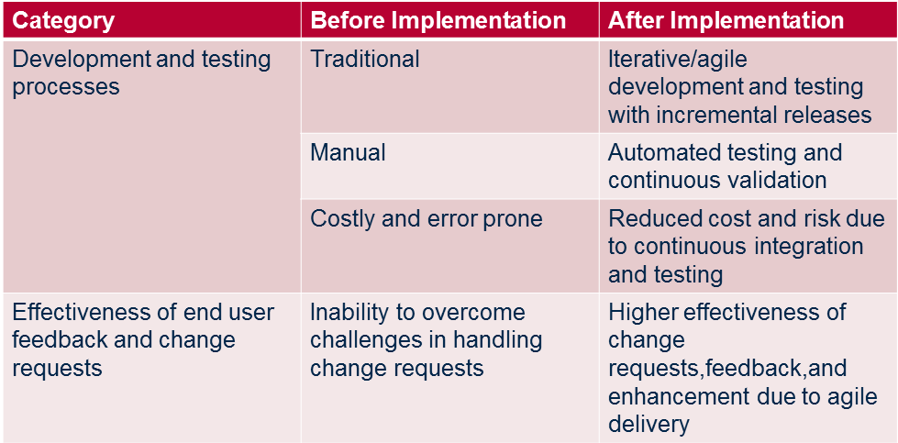
1.11: Use-case walkthrough Use-case walkthrough

Slide 47
Summary
DevOps enables continuous software delivery with less complex problems to fix and faster resolution of problems
DevOps enables
Continuous Development
Continuous Testing,
Continuous Integration
Continuous Deployment
Continuous Monitoring
DevOps integrates developers and operations team in order to improve collaboration and productivity
Notes:
Add the notes here.
Add instructor notes here.

Slide 48
Review Question
DevOps integrates Developers and Operations team for better collaboration and productivity
True
False
Select the tools used for maintaining the different versions of the code
GIT
SVN
Maven
All the above
_________ tool is used for Continuous Integration
GIT
Puppet
Jenkins
Notes:
Instructor Notes:
Question 1: True
Question 2: All the above
Question 3:Jenkins

