Slide 1
DevOps
Lesson 04-Jenkins
Notes:
Add instructor notes here.

Slide 2
Lesson Objectives
Introduction to CI
Jenkins Introduction
Creating Job in Jenkins
Adding plugin in Jenkins
Creating Job with Maven & Git
Notes:
Add instructor notes here.

Slide 3
4.1: Introduction to CI Continuous Integration(CI)
Continuous Integration involves a tool that monitors version control system for any changes and automates application building.
CI system must be executed under configuration management.
Developers are notified automatically if any build action fails.
CI brings a practice to integrate work frequently in software development.
Monitoring of Code Quality and Code coverage metrics is automated.
Notes:
In a Continuous Integration Environment source code is maintained in a central location where an application monitors the repository and springs into action when it notices changes (commits) to the code.
CI System must be able to be built and tested automatically.
A coding standard is the set of guidelines that developers must adhere to on a project. On many projects, ensuring adherence is largely a manual process that is performed by a code review. CI can run a build script to report on adherence to the coding standards by running a suite of automated static analysis tools that inspect the source code against the established standard whenever a change is applied
Add instructor notes here.

Slide 4
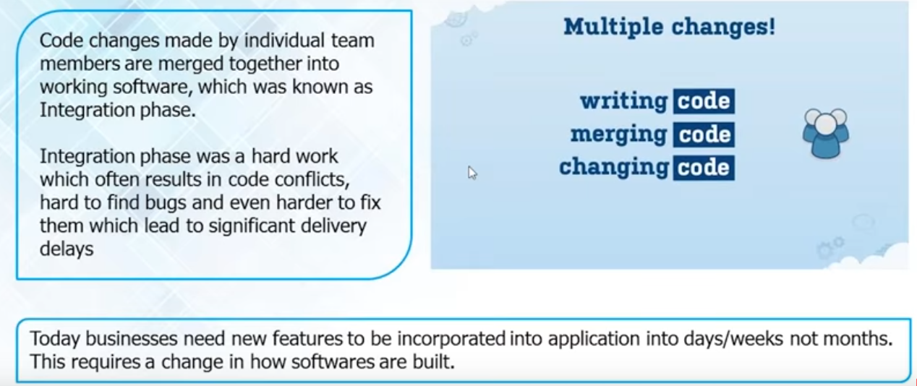
4.1: Introduction to CI Why CI?
Software Development Before CI
Notes:
Add instructor notes here.

Slide 5
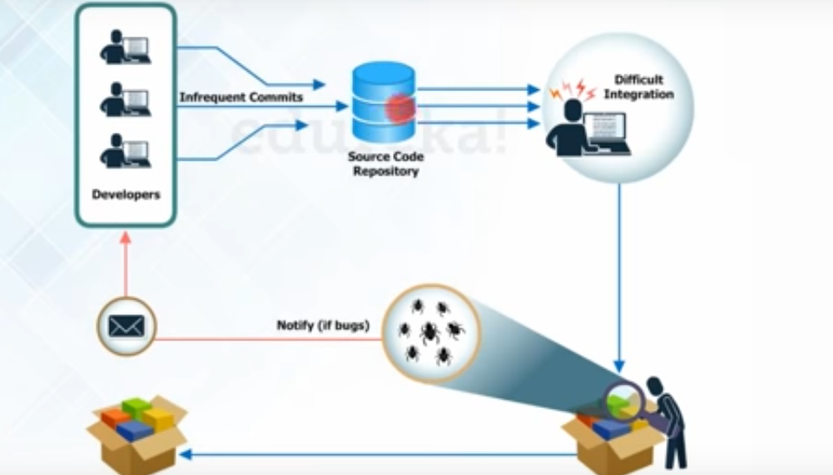
4.1: Introduction to CI Why CI?
Software Development Before CI
Notes:
Add instructor notes here.

Slide 6
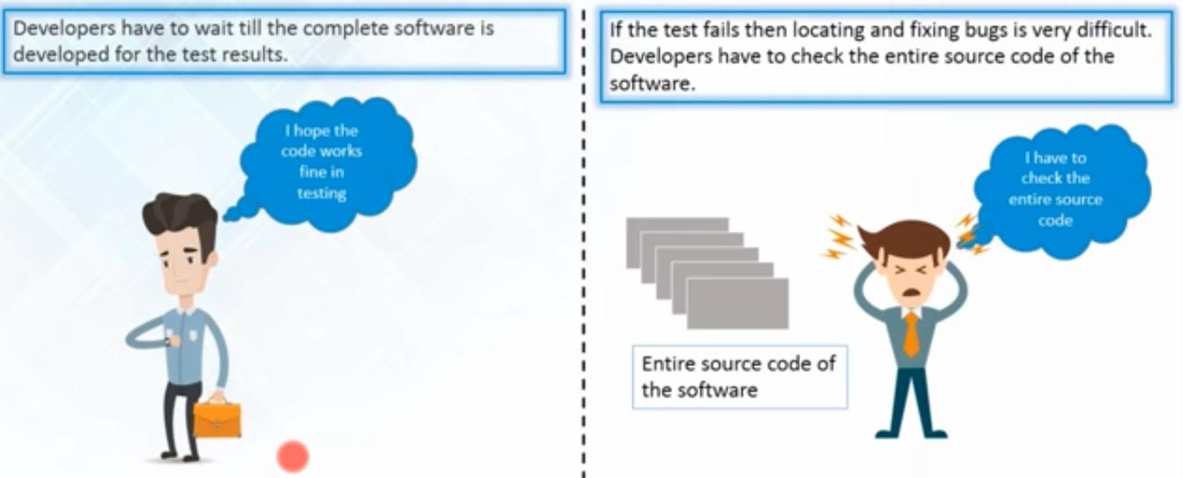
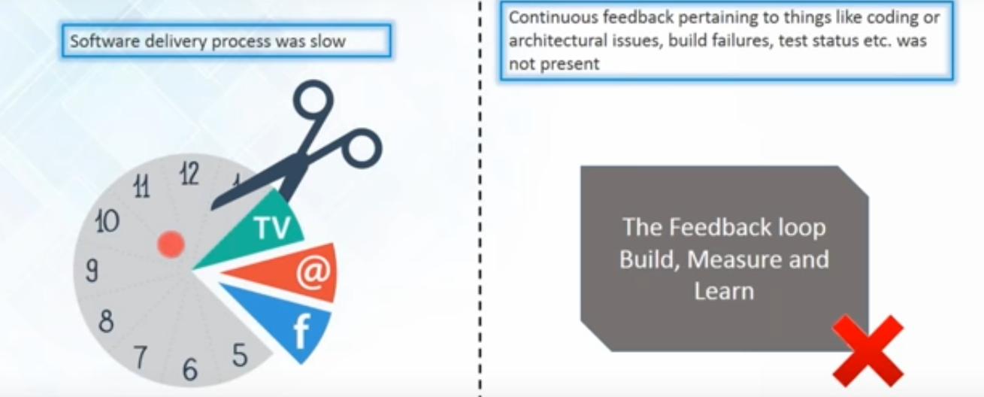
4.1: Introduction to CI Problem-Before CI
Notes:
Add instructor notes here.

Slide 7
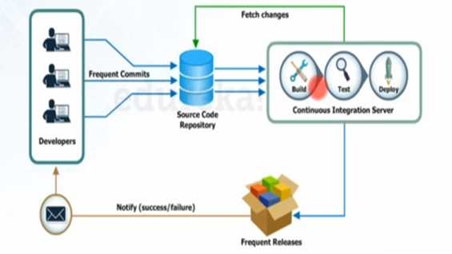
4.1: Introduction to CI Software Development With CI
After every commit of the source code an auto build is triggered & then it is automatically deployed on the test server
If the test results shows that there is bug in the code then developer only checks the last commit made to the source code
This also increases the frequency of the new software release
The concerned teams always provided with the relevant feedback
Notes:
1: Application must run under source control management
2: Daily code commits to SVN will be baseline.
3: CI polls for any code changes in SVN and triggers build actions if any.
4: Automated build, testing and deployment of an application will be performed by CI.
5: After build action, developer will be accessible with latest code and build
6: Developers will be notified with any build errors and automated test results.
Need of CI in software Development
Helps to locate code based defects in a centralized location.
Tools can be used to automate deployment.
Minimizes integration errors in SVN during build process(Errors are uncovered during Manual Build) by invoking automation.
Increase amount of quality code and improve development standards.
Add instructor notes here.

Slide 8
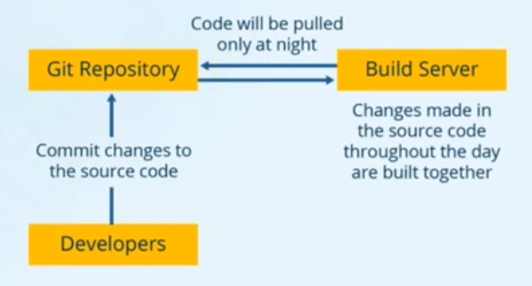
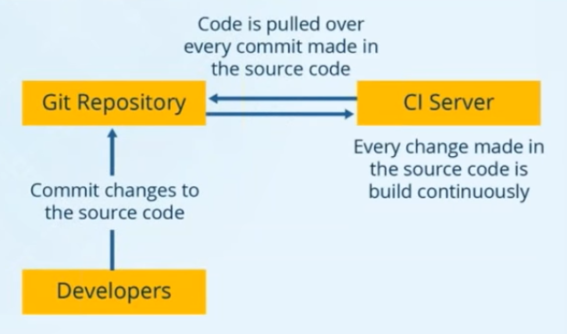
4.1: Introduction to CI Case Study on - CI
Without CI
With CI-Problem Solved
Notes:
Tell about scenario if user is doing with or without CI .Give example of Nokia uploading

Slide 9
4.1: Introduction of CI Continuous Integration -CI
Benefit to CI:
Aims to eliminate code integration issues
Minimizes project risk with notification of defects and code quality issues
Reduces cost of quality
Early warning of conflicting changes code
Automation of build and testing of an application
Notes:
Reduce risks
By integrating many times a day, you can reduce risks on your project. Doing so facilitates the detection of defects, the measurement of software health and a reduction of assumptions.
Defects are detected and fixed sooner: Because CI integrates and runs tests and inspections several times a day, there is a greater chance that defects are discovered when they are introduced (i.e., when the code is checked into the version-control repository) instead of during late-cycle testing.
Health of software is measurable: By incorporating continuous testing and inspection into the automated integration process, the software product's health attributes, such as complexity, can be tracked over time.
Reduce assumptions: By rebuilding and testing software in a clean environment using the same process and scripts on a continual basis, you can reduce assumptions (e.g., whether you are accounting for third-party libraries or environment variables).
CI provides a safety net to reduce the risk that defects will be introduced into the code base. The following are some of the risks that CI helps to mitigate. We discuss these and other risks in the next chapter.
Lack of cohesive, deployable software
Late defect discovery
Low-quality software
Lack of project visibility
Add instructor notes here.

Slide 10
4.1: Introduction of CI Continues Integration Tools
Jenkins
Buildbot
Travis CI
Bamboo

Slide 11
4.2: Jenkins Introduction Jenkins
Jenkins is a self-contained, open source automation server which can be used to automate all sorts of tasks such as building, testing, and deploying software.
Jenkins is an open source continuous integration(CI) tool written in java developed by Kohsuke Kawaguchi.
Monitors the change in the source control systems like SVN, CVS, etc.
Builds the application using various build tools like ANT, MAVEN, etc.
Provides a fresh build whenever there is a change in the source control system
Sends messages on the status of the build through Email, SMS, etc
Plugins allows integration of the various DevOps Stage
Notes:
Add instructor notes here.

Slide 12
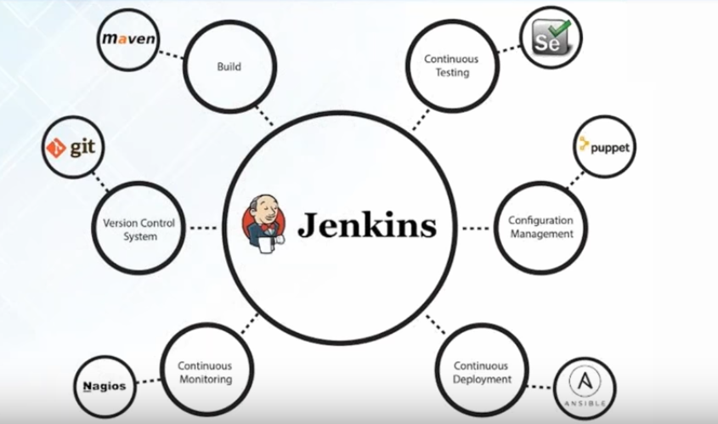
4.2: Jenkins Introduction Jenkins
Notes:
What different models we can integrate with jenkin

Slide 13
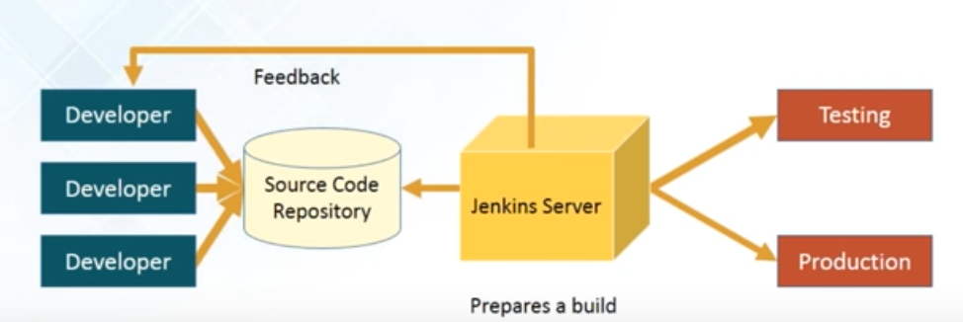
4.2: Jenkins Introduction How Jenkins Works
How Jenkins works:
Developers Commit changes to the source code
CI server pulls that code & triggers a build
The build application is then deployed on testing server for testing
After testing the application ,it is then deployed on production server
The concerned team constantly notified about build & test result
Notes:
Add instructor notes here.

Slide 14
4.2: Jenkins Introduction Jenkins Installation
Jenkins is easy to install.
Download Jenkins.war file from the Jenkins site:
http://jenkins-ci.org
Jenkins can be installed in different ways:
As a standalone application
Windows Service
Deploy it on any application server.
Notes:
Add instructor notes here.

Slide 15
4.2: Jenkins Introduction Jenkins Installation
To start Jenkins as a standalone application execute the below command in command prompt:
java –jar jenkins.war -- On Port 8080
java -jar jenkins.war --ajp13Port=-1 --httpPort=8082 –On different port
Once Jenkins is started, the Jenkins dash board can be accessed by giving the following link in the browser
http://localhost:8080/
To stop Jenkins, press Ctrl+C
Below are the steps to start Jenkins as a windows service
First, start Jenkins as a standalone application and access Jenkins dash board.
Click “Manage Jenkins” link available in Jenkins dash board.
Select “Installation Directory” for Jenkins and click on Install.
After installation, Jenkins will always run on portno 8080.
Notes:
By default, Jenkins will run on the 8080 port. To specify the port manually, use the --httpPort option:
java -jar jenkins.war --httpPort=8081

Slide 16
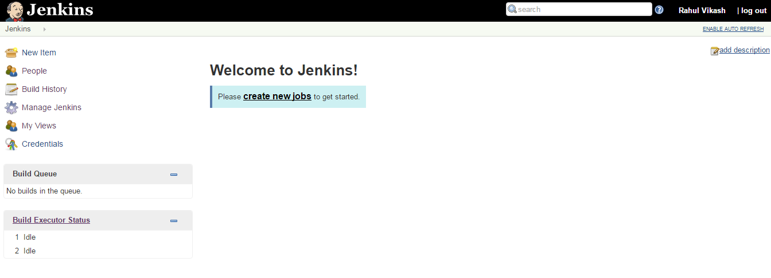
4.3: Creating Job in Jenkins Jenkins Installation
Notes:
By default, Jenkins will run on the 8080 port. To specify the port manually, use the --httpPort option:
java -jar jenkins.war --httpPort=8081

Slide 17
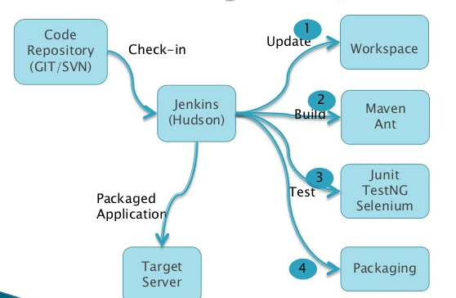
4.3: Creating Job in Jenkins Git, Maven with Jenkins
Integration Git repository with Jenkins & Build using Maven
Notes:
By default, Jenkins will run on the 8080 port. To specify the port manually, use the --httpPort option:
java -jar jenkins.war --httpPort=8081

Slide 18
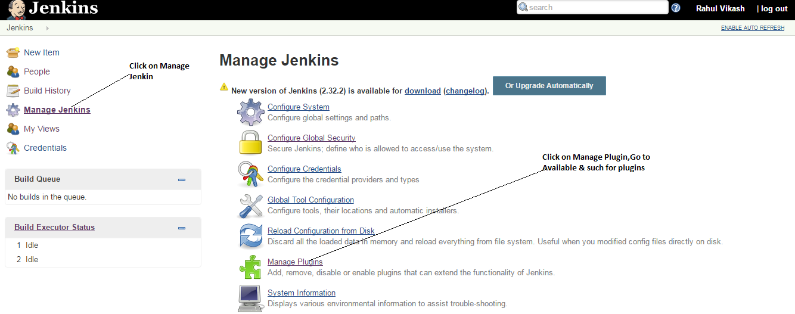
4.4: Adding plugin in Jenkins Manage plugins
Notes:
By default, Jenkins will run on the 8080 port. To specify the port manually, use the --httpPort option:
java -jar jenkins.war --httpPort=8081

Slide 19
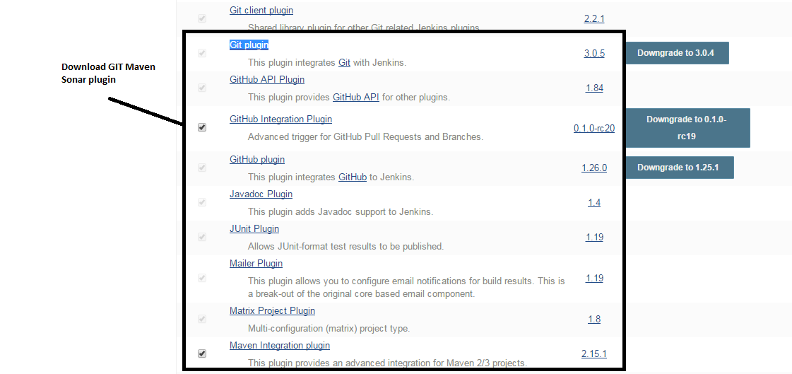
4.4: Adding plugin in Jenkins Manage plugins
Download Maven ,Git plugin
Notes:
By default, Jenkins will run on the 8080 port. To specify the port manually, use the --httpPort option:
java -jar jenkins.war --httpPort=8081

Slide 20
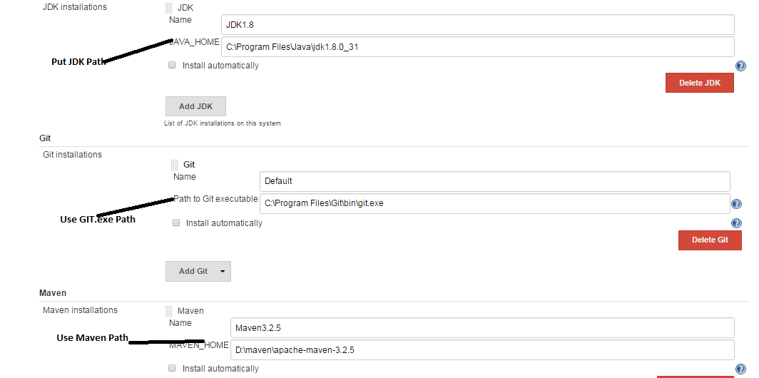
4.4: Adding plugin in Jenkins Manage plugins
Setting Configuration
Go to Manage Jenkin->Global Tools Configuration
Notes:
By default, Jenkins will run on the 8080 port. To specify the port manually, use the --httpPort option:
java -jar jenkins.war --httpPort=8081

Slide 21
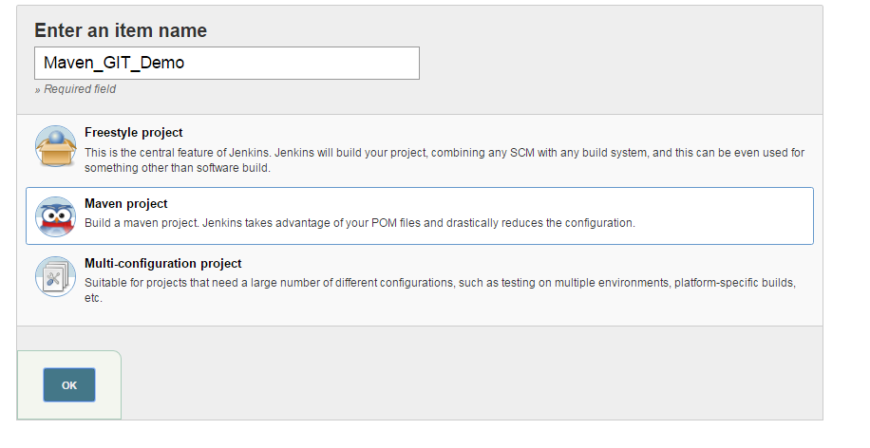
4.5: Creating Job with Maven & Git Creating Maven Project
Create a Job, Give Job Name ,Select Maven Project & press Ok
Notes:
By default, Jenkins will run on the 8080 port. To specify the port manually, use the --httpPort option:
java -jar jenkins.war --httpPort=8081

Slide 22
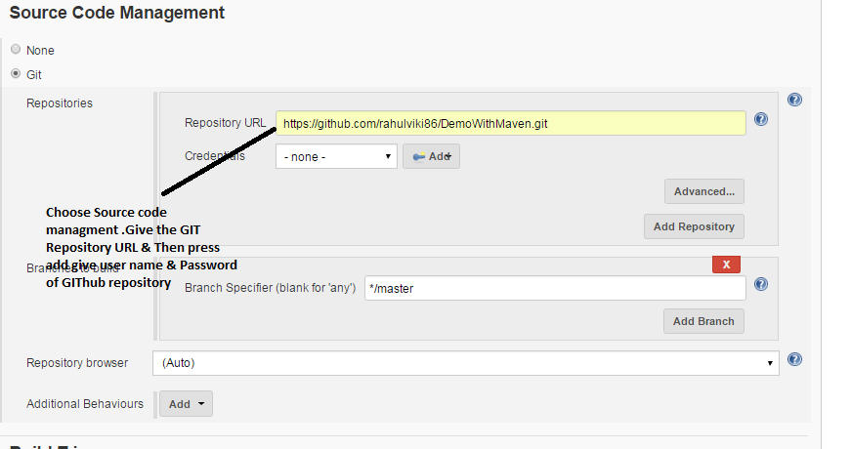
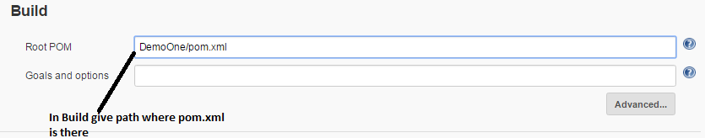
4.5: Creating Job with Maven & Git Creating Maven Project
Integrating Git with Jenkins by giving repository url(GitHub URL) & path of pom.xml in project
Notes:
By default, Jenkins will run on the 8080 port. To specify the port manually, use the --httpPort option:
java -jar jenkins.war --httpPort=8081

Slide 23
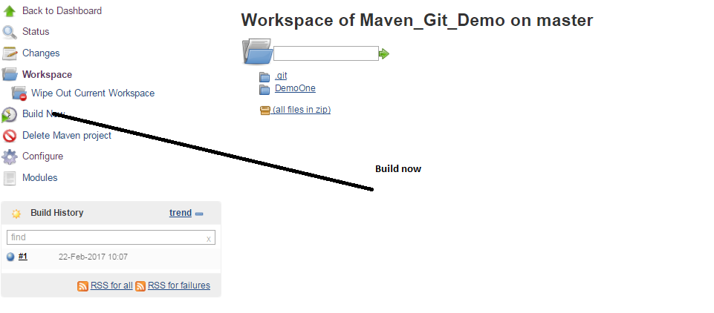
4.5: Creating Job with Maven & Git Creating Maven Project
Save & check in workspace all data fetched from Git Repository & then build
Notes:
By default, Jenkins will run on the 8080 port. To specify the port manually, use the --httpPort option:
java -jar jenkins.war --httpPort=8081

Slide 24
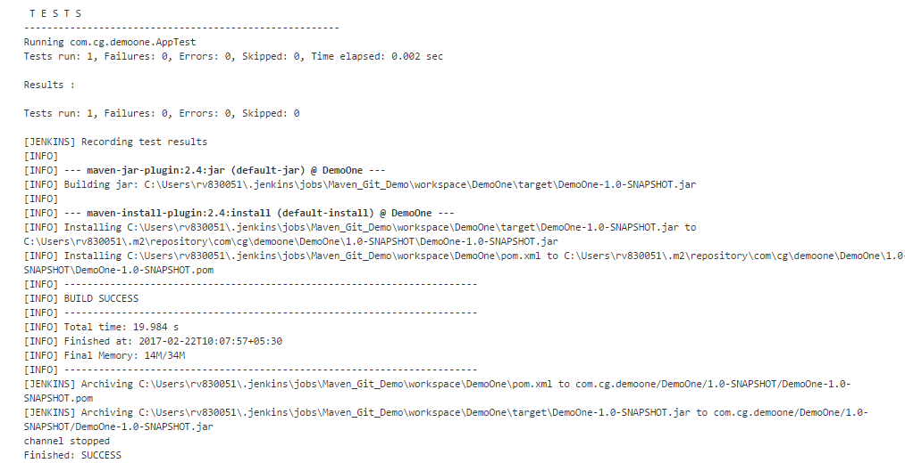
4.5: Creating Job with Maven & Git Creating Maven Project
Notes:
By default, Jenkins will run on the 8080 port. To specify the port manually, use the --httpPort option:
java -jar jenkins.war --httpPort=8081

Slide 25
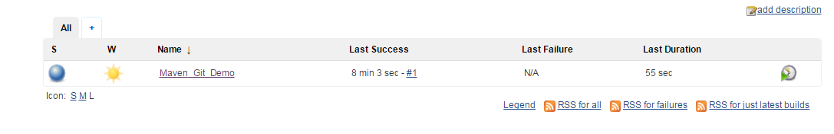
4.5: Creating Job with Maven & Git Creating Maven Project
Check & get all feedback when it changes
Build result obtained from the dashboard
Notes:
By default, Jenkins will run on the 8080 port. To specify the port manually, use the --httpPort option:
java -jar jenkins.war --httpPort=8081

Slide 26
Demo
Demo on Maven-Git-Jenkins integration
Notes:
Add the notes here.
Add instructor notes here.

Slide 27
Lab
Lab 02
Notes:
Add the notes here.
Add instructor notes here.

Slide 28
Summary
Continuous Integration involves a tool that monitors version control system for any changes and automates application building
Jenkins is an open source continuous integration(CI) tool
Integration Jenkins with Git & Maven
Notes:
Add the notes here.
Add instructor notes here.

Slide 29
Review Question
Which of the given statement is not correct for Continuous Integrations?
Continuous Integration is about reducing the risk by providing faster feedback.
Continuous Integration involves a tool that monitors version control system for changes.
Continuous Integration provides solutions to the testers for the failed test cases.
Continuous Integration helps End user to the testers and the end users faster, more reliably, and with less efforts.
Which command execution will start Jenkins as a standalone application?
jenkins.war
java -jar jenkins.war
Notes:
Add the notes here.
Q1 Continuous Integration provides solutions to the testers for the failed test cases.

Slide 30
Review Question
java jenkins.war
None of the above
___________ is the process of deploying the latest code into production.
Build job
Continuous Deployment
Continuous Testing
None of the above
Notes:
Add the notes here.
Q1 Continuous Integration provides solutions to the testers for the failed test cases.
Q2. java -jar jenkins.war
Q3 Continuous Deployment

