Slide 1
DevOps
Lesson 04-Sonar(SonarQube)
Notes:
Add instructor notes here.

Slide 2
Lesson Objectives
Introduction of Sonar
Architecture
Integration
Analyzing the Java code with Sonar
Integrating Jenkins with Sonar
Analyzing Maven, Java Code with Sonar
Notes:
Add instructor notes here.

Slide 3
5.1: introduction of Sonar Sonar
Sonar is an open source platform used by development teams to manage source code quality. Sonar has been made with a main objective in mind: make code quality management accessible to everyone with minimal effort.
SonarQube (formerly known as Sonar) is an open source tool suite to measure and analyze the quality of source code. It is written in Java but is able to analyze code in about 20 different programming languages.
Code analysis may be started manually by executing a so-called sonar runner but SonarQube’ s full potential is especially revealed when used in combination with continuous integration such as a Jenkins server.
Notes:
Add the notes here.
Add instructor notes here.

Slide 4
5.1: introduction of Sonar Why Code Analyzer tool
Why we are using SonarQube(Code analyzer tool)
Code quality analysis helps to make your code:
less error-prone
more sustainable
more reliable
more readable
more welcoming to new contributors
Notes:
Code quality analysis mainly relies on a set of tools that look at your code and give you hints. The most famous tools are Findbugs, PMD, Checkstyle but also code coverage tools such as Jacoco. JDT itself provides very powerful quality checks, but there are not enabled by default. You should go to Error/Warnings in preferences and replace all "ignore" by "Warning".
Add instructor notes here.

Slide 5
5.1: introduction of Sonar Features of Sonar
Write clean Code
DevOps Integration
Centralize Quality
Support 20+ languages
Notes:
Write clean code
Overall health
Your project home page shows where you stand in terms of quality in a glimpse of an eye. This main page also shows you an immediate sense of the good results achieved over time.
Focus on the Leak
The water leak paradigm is a simple yet powerful way to manage code quality: quality of new - changed and added - code should be put under control before anything else. Once that Leak is under control, code quality will start improving mechanically. In SonarQube, the Leak is a built-in concept that you can’t miss. Once you’ve had a look at this yellow area on the left of your project home page, you will always remain focused on it to not miss any new issues.
Enforce Quality Gate
With SonarQube, a developer has everything at hand to take ownership of the quality of his code. To fully enforce a code quality practice across all teams, you need to set up a Quality Gate. This core concept of SonarQube is a set of requirements that tells whether or not a new version of a project can go into production. SonarQube’s default Quality Gate checks what happened on the Leak period and fails if your new code got worse in this period.
Analyze pull requests
Once you have SonarQube in place, you will quickly want to make sure you add as few issues as possible to your code base. To shorten the feedback loop so you don’t have to wait for new analyses to be available on SonarQube, you can set up the analysis of your pull requests. Analyses will be run on your feature branches without being pushed to SonarQube, giving you the opportunity to fix issues before they ever reach SonarQube!
Add instructor notes here.

Slide 6
5.1: introduction of Sonar Features of Sonar
Notes:
DevOps Integration
Build Systems
For dynamic languages like JavaScript, PHP, Python, … executing an analysis is as easy as feeding SonarQube with a bunch of source files. But for languages like Java, C#, C, C++ and Objective-C, there is simply no way to provide accurate results without being part of the build. That’s why built-in integrations are provided for MSBuild, Maven, Gradle, Ant, and Makefiles.
CI Engines
Native integrations with build systems let you easily schedule the execution of an analysis from all CI engines: Jenkins, VSTS, TFS, Travis-CI… Don’t worry if your CI engine isn’t listed here, integration effort will be minimum.
Pass/Fail Notification
Once an analysis is done, a report is sent to the SonarQube server to be integrated. At the end of this integration, a standard webhook mechanism lets you notify any external system to do whatever you want: trigger an alarm, update a wallboard, notify a chat room.
Full Web API
As part of the overall development ecosystem, the SonarQube Web API can be used to automatically provision a SonarQube project, feed a BI tool, monitor SonarQube, etc. Morever the list and definition of all the Web API is built in SonarQube.
Promotion Pipelines
Using webhooks, SonarQube can be integrated as a promotion step in your delivery pipelines. This way, you can make sure that only artifacts that pass the Quality Gate will be released and deployed to production.
Add instructor notes here.

Slide 7
5.1: introduction of Sonar Features of Sonar
Notes:
Centralized Quality
All projects in one place
Getting everyone on a team on the same page about quality is hard enough. What happens when you expand the scope to a department or an entire organization? SonarQube enables you to centralize and scale a single vision of code quality.
Shared rulesets
SonarQube offers a central place to view and define the rules used during analysis of projects. These rulesets are organized in quality profiles. Every member of the organization can see which rules are applied to their project. Every project administrator can choose which quality profile is used for the project.
Unified Quality Gate
SonarQube provides out-of-the-box a default Quality Gate focusing on the Leak concept. This means that the same requirements will be applied across the board to every project - greenfield and legacy; in-house, out-source and off-shore.
Cross projects services
Most services are available cross projects. For example, as a developer you can use the issues service to get all new issues assigned to you - across projects - so that you can concentrate on your work. As a technical lead, the projects page lists all your favorite projects and lets you explore them on different axes.
Support 20+ Langauges java, C, C++, Cobol, Flex, C#, PHP, Phython ,Swift Objective C ,web,ABAP
Add instructor notes here.

Slide 8
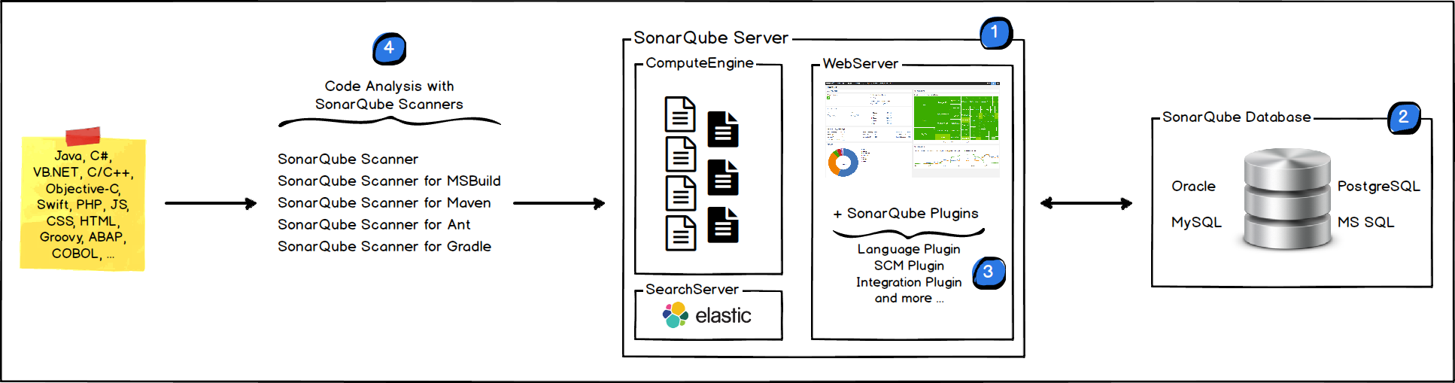
5.1: introduction of Sonar Sonar-Architecture
The SonarQube Platform is made of 4 components
SonarQube Server
SonarQube Database
SonarQube Plugins
SonarQube Scanners
Notes:
The SonarQube Platform is made of 4 components:
One SonarQube Server starting 3 main processes:
a Web Server for developers, managers to browse quality snapshots and configure the SonarQube instance
a Search Server based on Elasticsearch to back searches from the UI
a Compute Engine Server in charge of processing code analysis reports and saving them in the SonarQube Database
One SonarQube Database to store:
the configuration of the SonarQube instance (security, plugins settings, etc.)
the quality snapshots of projects, views, etc.
Multiple SonarQube Plugins installed on the server, possibly including language, SCM, integration, authentication, and governance plugins
One or more SonarQube Scanners running on your Build / Continuous Integration Servers to analyze projects
How sonar works give idea.

Slide 9
5.1: introduction of Sonar Sonar-Integration
The following schema shows how SonarQube integrates with other ALM tools where the various components of SonarQube are used.
Developers code in their IDEs and use SonarLint to run local analysis.
Developers push their code into their favorite SCM : git, SVN, TFVC, ...
The Continuous Integration Server triggers an automatic build, and the execution of the SonarQube Scanner required to run the SonarQube analysis.
The analysis report is sent to the SonarQube Server for processing.
SonarQube Server processes and stores the analysis report results in the SonarQube Database, and displays the results in the UI.
Developers review, comment, challenge their issues to manage and reduce their Technical Debt through the SonarQube UI.
Managers receive Reports from the analysis. Ops use APIs to automate configuration and extract data from SonarQube. Ops use JMX to monitor SonarQube Server.
Notes:
The SonarQube Platform is made of 4 components:
One SonarQube Server starting 3 main processes:
a Web Server for developers, managers to browse quality snapshots and configure the SonarQube instance
a Search Server based on Elastic search to back searches from the UI
a Compute Engine Server in charge of processing code analysis reports and saving them in the SonarQube Database
One SonarQube Database to store:
the configuration of the SonarQube instance (security, plugins settings, etc.)
the quality snapshots of projects, views, etc.
Multiple SonarQube Plugins installed on the server, possibly including language, SCM, integration, authentication, and governance plugins
One or more SonarQube Scanners running on your Build / Continuous Integration Servers to analyze projects
Add instructor notes here.

Slide 10
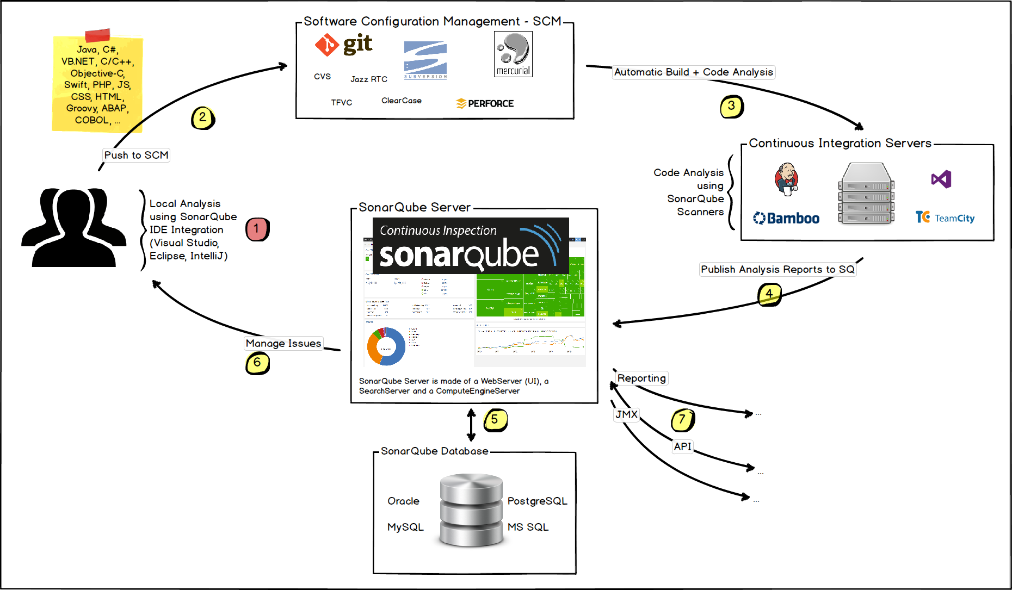
5.1: introduction of Sonar Sonar-Integration
Notes:
About Machines and Locations
The SonarQube Platform cannot have more than one SonarQube Server and one SonarQube Database.
For optimal performance, each component (server, database, scanners) should be installed on a separate machine, and the server machine should be dedicated.
SonarQube Scanners scale by adding machines.
All machines must be time synchronized.
The SonarQube Server and the SonarQube Database must be located in the same network
SonarQube Scanners don't need to be on the same network as the SonarQube Server.
There is no communication between SonarQube Scanners and the SonarQube Database.
Give idea of flow

Slide 11
5.1: introduction of Sonar Sonar-Rules
254 rules written – identify atleast 10 rules
"equals(Object obj)" and "hashCode()" should be overridden in pairs
"final" classes should not have "protected" members
"for" loop incrementers should modify the variable being tested in the loop's stop condition
"Iterator.hasNext()" should not call "Iterator.next()"
"Iterator.next()" methods should throw "NoSuchElementException"
"main" should not "throw" anything
"NullPointerException" should not be caught
"entrySet()" should be iterated when both the key and value are needed
We can see all the rules in Sonar Dashboard
Notes:
About Machines and Locations
The SonarQube Platform cannot have more than one SonarQube Server and one SonarQube Database.
For optimal performance, each component (server, database, scanners) should be installed on a separate machine, and the server machine should be dedicated.
SonarQube Scanners scale by adding machines.
All machines must be time synchronized.
The SonarQube Server and the SonarQube Database must be located in the same network
SonarQube Scanners don't need to be on the same network as the SonarQube Server.
There is no communication between SonarQube Scanners and the SonarQube Database.
Add instructor notes here.

Slide 12
5.1: introduction of Sonar Sonar Installation
Sonar is easy to install & use .
Download Sonar -Sonarqube-x.xx & Sonar-scanner-x.xx:
https://www.sonarqube.org/downloads/
Sonar can be installed in different ways:
As a standalone application
Windows Service
For starting sonar server use -StartSonar.bat
For stopping sonar server use – StopSonar.bat
Once sonar is started, the sonar dash board can be accessed by giving the following link in the browser
http://localhost:9000/
Notes:
Add the notes here.
Give Demo example

Slide 13
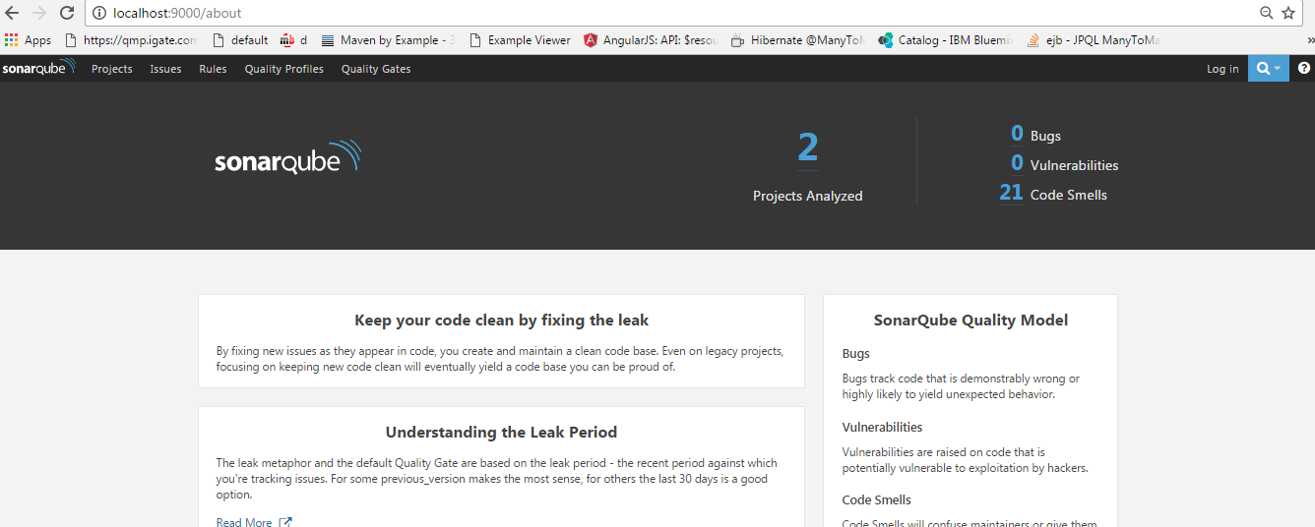
5.1: introduction of Sonar Sonar Installation
Notes:
Add the notes here.
Add instructor notes here.

Slide 14
5.2: Analyzing Java code with Sonar Analyzing Java with Sonar
Integrating Java program with SonarQube
Create a Java Project
Add description of your project in sonar-scanner-x.xx->conf ->sonar-scanner. Properties
sonar.projectKey=JavaProject
sonar.projectName=JavaProject
sonar.projectVersion=1.0
sonar.sources=C:/DevOps/Training/JavaProject/src/com/cg/sonardemo
Run Sonar server by using command StartSonar.bat
Go to project folder & run command sonar-scanner.bat
Open http://localhost:9000/ & we can see code is analyzing
Notes:
Add the notes here.
Add instructor notes here.

Slide 15
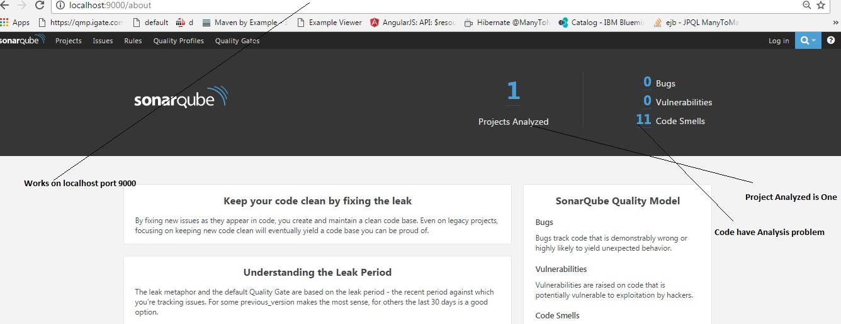
5.2: Analyzing Java code with Sonar Analyzing Java with Sonar
First Project run on http://localhost:9000
Notes:
Add the notes here.
Add instructor notes here.

Slide 16
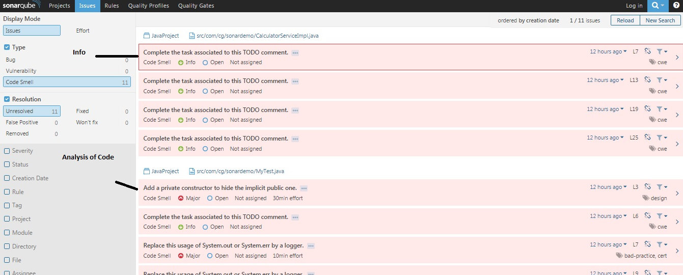
5.2: Analyzing Java code with Sonar Analyzing Java with Sonar
Select code smell after log in ,you will get all kind of major and minor problems
Notes:
Each issue has one of five severities:
BLOCKER Bug with a high probability to impact the behavior of the application in production: memory leak, unclosed JDBC connection, .... The code MUST be immediately fixed.
CRITICAL Either a bug with a low probability to impact the behavior of the application in production or an issue which represents a security flaw: empty catch block, SQL injection, ... The code MUST be immediately reviewed.
MAJOR Quality flaw which can highly impact the developer productivity: uncovered piece of code, duplicated blocks, unused parameters, ...
MINOR Quality flaw which can slightly impact the developer productivity: lines should not be too long, "switch" statements should have at least 3 cases, ...
INFO Neither a bug nor a quality flaw, just a finding.
Technical Review
Confirm, False Positive, Won't Fix, Change Severity, and Resolve fall into this category, which presumes an initial review of an issue to verify its validity. Assume it's time to review the technical debt added in the last review period - whether that's a day, a week, or an entire sprint. You go through each new issue and do one:
Confirm - By confirming an issue, you're basically saying "Yep, that's a problem." Doing so moves it out of "Open" status to "Confirmed".
False Positive - Looking at the issue in context, you realize that for whatever reason, this issue isn't actually an issue, erm... "problem." It's not actually a problem. So you mark it False Positive and move on. Requires Administer Issues permission on the project.
Won't Fix - Looking at the issue in context, you realize that while it's a valid issue it's not one that actually needs fixing. In other words, it represents accepted technical debt. So you mark it Won't Fix and move on. Requires Administer Issues permission on the project.
Change Severity - This is the middle ground between the first two options. Yes, it's a problem, but it's not as bad a problem as the rule's default severity makes it out to be. Or perhaps it's actually far worse. Either way, you adjust the severity of the issue to bring it in line with what you feel it deserves. The marker in the drilldown will change to show the new severity immediately, but the change won't be reflected in your issue counts until after the next analysis. Requires Administer Issues permission on the project.
Resolve - If you think you've fixed an open issue, you can Resolve it. If you're right, the next analysis will move it to closed status. If you're wrong, its status will go to re-opened.
.
Give Demo example

Slide 17
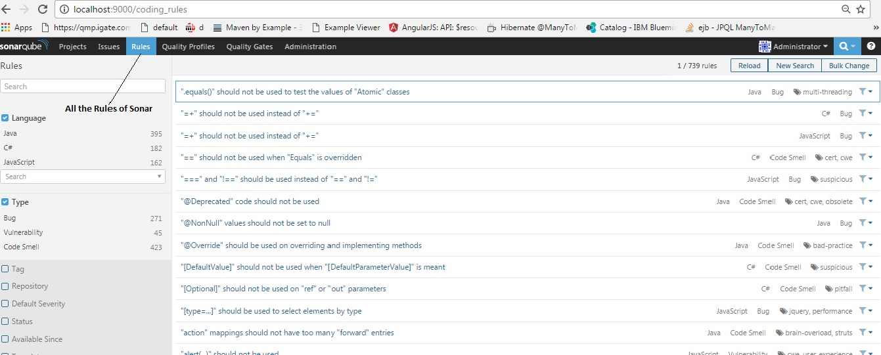
5.2: Analyzing Java code with Sonar Analyzing Java with Sonar
Rules to analyze Java Code
Notes:
Click on the top "Rules" menu item to enter the world of rules. By default, you will see all the available rules, with the ability to narrow the selection based on search criteria in the left pane:
Language: the language to which a rule applies.
Type: Bug, Vulnerability or Code Smell rules
Tag: it is possible to add tags to rules in order to classify them and to help discover them more easily.
Repository: the engine that contributes rules to SonarQube.
Default Severity: the original severity of the rule - as defined by the plugin that contributes this rule.
Status: rules can have 3 different statuses:
Beta: The rule has been recently implemented and we haven't gotten enough feedback from users yet, so there may be false positives or false negatives.
Deprecated: The rule should no longer be used because a similar, but more powerful and accurate rule exists.
Ready: The rule is ready to be used in production.
Available Since: date when a rule was first added on the SonarQube instance. This is useful to list all the new rules since the last upgrade of a plugin for instance.
Template: display rule templates that allow to create custom rules (see later on this page).
Quality Profile: inclusion in or exclusion from a specific profile
To see the details of a rule, either click on it, or use the right arrow key. Along with basic rule data, you'll also be able to see which, if any, profiles it's active in and how many open issues have been raised with it.
The 2 following actions are available only if you have the right permissions ("Administer Quality Profiles and Gates"):
Add/Remove Tags:
It is possible to add existing tags on a rule, or to create new ones (just enter a new name while typing in the text field).
Note that some rules have built-in tags that you cannot remove - they are provided by the plugins which contribute the rules.
Extend Description:
Extending rule descriptions is useful to let users know how your organization is using a particular rule for instance or to give more insight on a rule.
Note that the extension will be available to non-admin users as a normal part of the rule details.
Add instructor notes here.

Slide 18
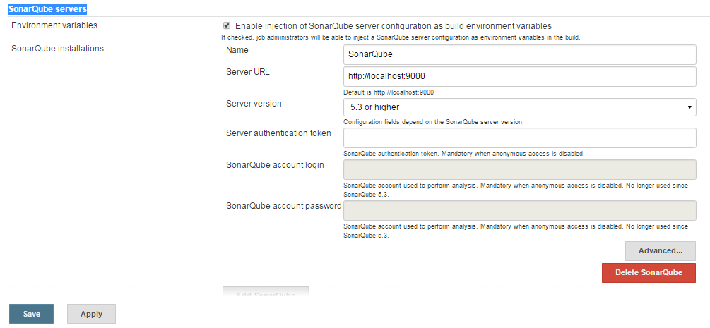
5.3: Integrating Jenkin with Sonar Sonar Jenkin Integration
Download SonarQube Plugin in Jenkins
Go to Manage Jenkin->Configure System->Go to SonarQube servers-> check on Enable injection of SonarQube->add Server name & server URL
Notes:
Click on the top "Rules" menu item to enter the world of rules. By default, you will see all the available rules, with the ability to narrow the selection based on search criteria in the left pane:
Language: the language to which a rule applies.
Type: Bug, Vulnerability or Code Smell rules
Tag: it is possible to add tags to rules in order to classify them and to help discover them more easily.
Repository: the engine that contributes rules to SonarQube.
Default Severity: the original severity of the rule - as defined by the plugin that contributes this rule.
Status: rules can have 3 different statuses:
Beta: The rule has been recently implemented and we haven't gotten enough feedback from users yet, so there may be false positives or false negatives.
Deprecated: The rule should no longer be used because a similar, but more powerful and accurate rule exists.
Ready: The rule is ready to be used in production.
Available Since: date when a rule was first added on the SonarQube instance. This is useful to list all the new rules since the last upgrade of a plugin for instance.
Template: display rule templates that allow to create custom rules (see later on this page).
Quality Profile: inclusion in or exclusion from a specific profile
To see the details of a rule, either click on it, or use the right arrow key. Along with basic rule data, you'll also be able to see which, if any, profiles it's active in and how many open issues have been raised with it.
The 2 following actions are available only if you have the right permissions ("Administer Quality Profiles and Gates"):
Add/Remove Tags:
It is possible to add existing tags on a rule, or to create new ones (just enter a new name while typing in the text field).
Note that some rules have built-in tags that you cannot remove - they are provided by the plugins which contribute the rules.
Extend Description:
Extending rule descriptions is useful to let users know how your organization is using a particular rule for instance or to give more insight on a rule.
Note that the extension will be available to non-admin users as a normal part of the rule details.
Add instructor notes here.

Slide 19
5.4: Analyzing Maven code ,Jenkin with Sonar Sonar,Maven,Git & Jenkins Integration
Create New item->Enter item name->Select Maven Project->Ok
Give Git Repository link, in build environment check prepare sonarqube scanner environment
Give path of pom.xml of your project & then select post build action as sonarqube analysis with maven
Then apply & Build now
We can see in console output build success and failure
Analyze in SonarQube
Notes:
Click on the top "Rules" menu item to enter the world of rules. By default, you will see all the available rules, with the ability to narrow the selection based on search criteria in the left pane:
Language: the language to which a rule applies.
Type: Bug, Vulnerability or Code Smell rules
Tag: it is possible to add tags to rules in order to classify them and to help discover them more easily.
Repository: the engine that contributes rules to SonarQube.
Default Severity: the original severity of the rule - as defined by the plugin that contributes this rule.
Status: rules can have 3 different statuses:
Beta: The rule has been recently implemented and we haven't gotten enough feedback from users yet, so there may be false positives or false negatives.
Deprecated: The rule should no longer be used because a similar, but more powerful and accurate rule exists.
Ready: The rule is ready to be used in production.
Available Since: date when a rule was first added on the SonarQube instance. This is useful to list all the new rules since the last upgrade of a plugin for instance.
Template: display rule templates that allow to create custom rules (see later on this page).
Quality Profile: inclusion in or exclusion from a specific profile
To see the details of a rule, either click on it, or use the right arrow key. Along with basic rule data, you'll also be able to see which, if any, profiles it's active in and how many open issues have been raised with it.
The 2 following actions are available only if you have the right permissions ("Administer Quality Profiles and Gates"):
Add/Remove Tags:
It is possible to add existing tags on a rule, or to create new ones (just enter a new name while typing in the text field).
Note that some rules have built-in tags that you cannot remove - they are provided by the plugins which contribute the rules.
Extend Description:
Extending rule descriptions is useful to let users know how your organization is using a particular rule for instance or to give more insight on a rule.
Note that the extension will be available to non-admin users as a normal part of the rule details.
Add instructor notes here.

Slide 20
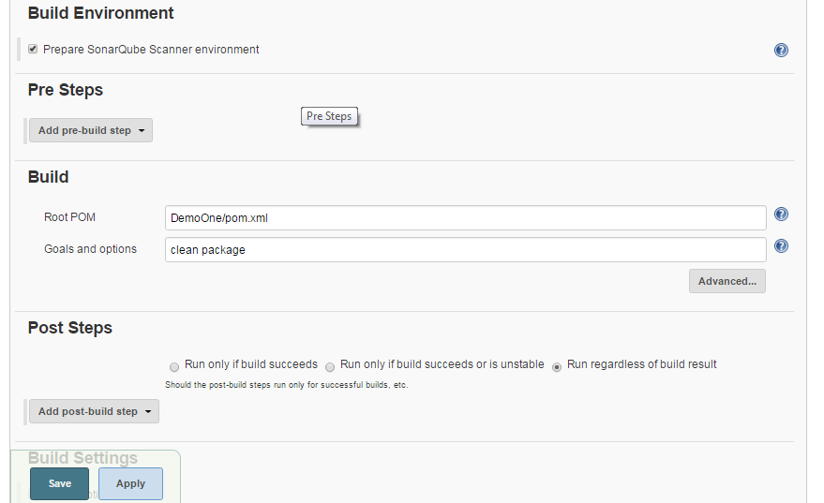
5.4: Analyzing Maven code ,Jenkin with Sonar Sonar,Maven,Git & Jenkins Integration
Notes:
Click on the top "Rules" menu item to enter the world of rules. By default, you will see all the available rules, with the ability to narrow the selection based on search criteria in the left pane:
Language: the language to which a rule applies.
Type: Bug, Vulnerability or Code Smell rules
Tag: it is possible to add tags to rules in order to classify them and to help discover them more easily.
Repository: the engine that contributes rules to SonarQube.
Default Severity: the original severity of the rule - as defined by the plugin that contributes this rule.
Status: rules can have 3 different statuses:
Beta: The rule has been recently implemented and we haven't gotten enough feedback from users yet, so there may be false positives or false negatives.
Deprecated: The rule should no longer be used because a similar, but more powerful and accurate rule exists.
Ready: The rule is ready to be used in production.
Available Since: date when a rule was first added on the SonarQube instance. This is useful to list all the new rules since the last upgrade of a plugin for instance.
Template: display rule templates that allow to create custom rules (see later on this page).
Quality Profile: inclusion in or exclusion from a specific profile
To see the details of a rule, either click on it, or use the right arrow key. Along with basic rule data, you'll also be able to see which, if any, profiles it's active in and how many open issues have been raised with it.
The 2 following actions are available only if you have the right permissions ("Administer Quality Profiles and Gates"):
Add/Remove Tags:
It is possible to add existing tags on a rule, or to create new ones (just enter a new name while typing in the text field).
Note that some rules have built-in tags that you cannot remove - they are provided by the plugins which contribute the rules.
Extend Description:
Extending rule descriptions is useful to let users know how your organization is using a particular rule for instance or to give more insight on a rule.
Note that the extension will be available to non-admin users as a normal part of the rule details.
Give Demo example

Slide 21
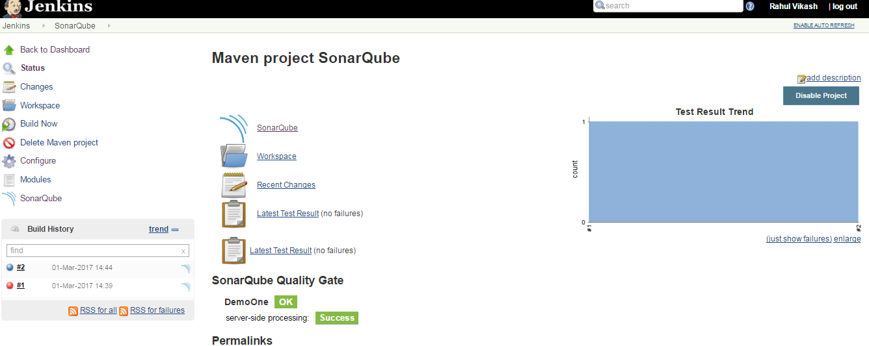
5.4: Analyzing Maven code ,Jenkin with Sonar Sonar,Maven,Git & Jenkins Integration
After successful completion, sonarqube analysis can be checked.
Click on sonarqube or Open http://localhost:9000/ & code analyzing is seen.
Notes:
Click on the top "Rules" menu item to enter the world of rules. By default, you will see all the available rules, with the ability to narrow the selection based on search criteria in the left pane:
Language: the language to which a rule applies.
Type: Bug, Vulnerability or Code Smell rules
Tag: it is possible to add tags to rules in order to classify them and to help discover them more easily.
Repository: the engine that contributes rules to SonarQube.
Default Severity: the original severity of the rule - as defined by the plugin that contributes this rule.
Status: rules can have 3 different statuses:
Beta: The rule has been recently implemented and we haven't gotten enough feedback from users yet, so there may be false positives or false negatives.
Deprecated: The rule should no longer be used because a similar, but more powerful and accurate rule exists.
Ready: The rule is ready to be used in production.
Available Since: date when a rule was first added on the SonarQube instance. This is useful to list all the new rules since the last upgrade of a plugin for instance.
Template: display rule templates that allow to create custom rules (see later on this page).
Quality Profile: inclusion in or exclusion from a specific profile
To see the details of a rule, either click on it, or use the right arrow key. Along with basic rule data, you'll also be able to see which, if any, profiles it's active in and how many open issues have been raised with it.
The 2 following actions are available only if you have the right permissions ("Administer Quality Profiles and Gates"):
Add/Remove Tags:
It is possible to add existing tags on a rule, or to create new ones (just enter a new name while typing in the text field).
Note that some rules have built-in tags that you cannot remove - they are provided by the plugins which contribute the rules.
Extend Description:
Extending rule descriptions is useful to let users know how your organization is using a particular rule for instance or to give more insight on a rule.
Note that the extension will be available to non-admin users as a normal part of the rule details.
Give Demo example
.

Slide 22
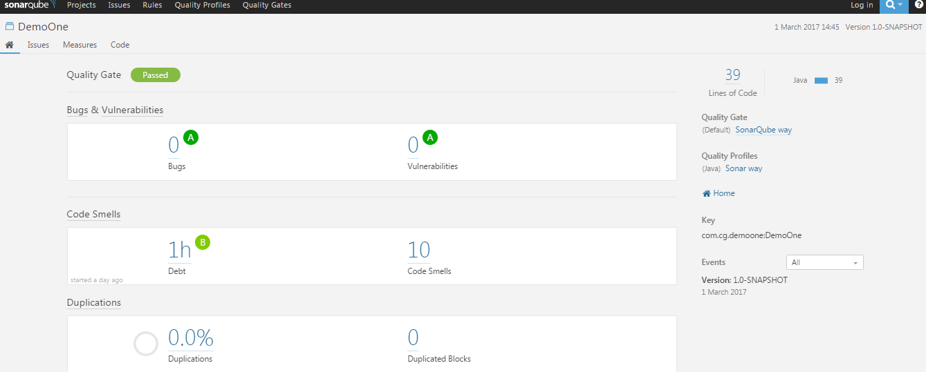
5.4: Analyzing Maven code ,Jenkin with Sonar Sonar,Maven,Git & Jenkins Integration
Clicking on SonarQube & analyzing the code
Notes:
Click on the top "Rules" menu item to enter the world of rules. By default, you will see all the available rules, with the ability to narrow the selection based on search criteria in the left pane:
Language: the language to which a rule applies.
Type: Bug, Vulnerability or Code Smell rules
Tag: it is possible to add tags to rules in order to classify them and to help discover them more easily.
Repository: the engine that contributes rules to SonarQube.
Default Severity: the original severity of the rule - as defined by the plugin that contributes this rule.
Status: rules can have 3 different statuses:
Beta: The rule has been recently implemented and we haven't gotten enough feedback from users yet, so there may be false positives or false negatives.
Deprecated: The rule should no longer be used because a similar, but more powerful and accurate rule exists.
Ready: The rule is ready to be used in production.
Available Since: date when a rule was first added on the SonarQube instance. This is useful to list all the new rules since the last upgrade of a plugin for instance.
Template: display rule templates that allow to create custom rules (see later on this page).
Quality Profile: inclusion in or exclusion from a specific profile
To see the details of a rule, either click on it, or use the right arrow key. Along with basic rule data, you'll also be able to see which, if any, profiles it's active in and how many open issues have been raised with it.
The 2 following actions are available only if you have the right permissions ("Administer Quality Profiles and Gates"):
Add/Remove Tags:
It is possible to add existing tags on a rule, or to create new ones (just enter a new name while typing in the text field).
Note that some rules have built-in tags that you cannot remove - they are provided by the plugins which contribute the rules.
Extend Description:
Extending rule descriptions is useful to let users know how your organization is using a particular rule for instance or to give more insight on a rule.
Note that the extension will be available to non-admin users as a normal part of the rule details.
Give Demo example

Slide 23
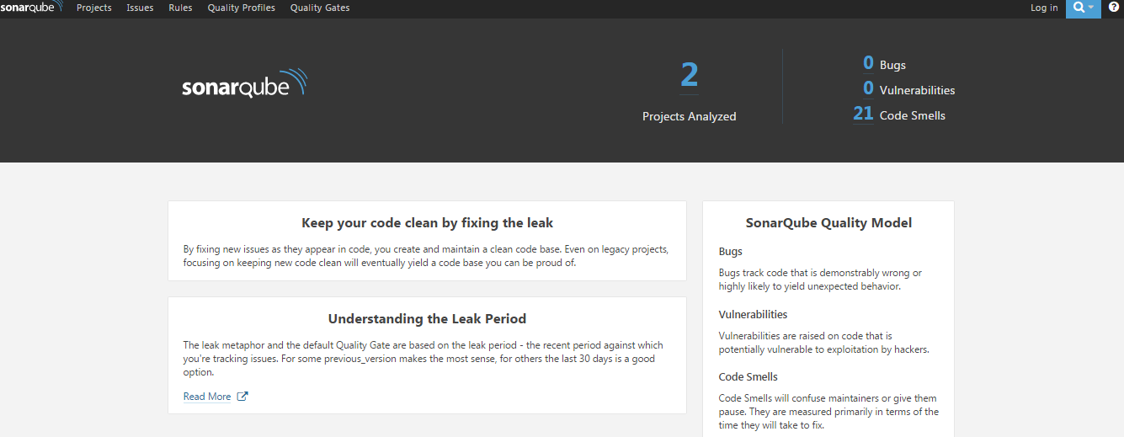
5.4: Analyzing Maven code ,Jenkin with Sonar Sonar,Maven,Git & Jenkins Integration
Open http://localhost:9000/
Notes:
Click on the top "Rules" menu item to enter the world of rules. By default, you will see all the available rules, with the ability to narrow the selection based on search criteria in the left pane:
Language: the language to which a rule applies.
Type: Bug, Vulnerability or Code Smell rules
Tag: it is possible to add tags to rules in order to classify them and to help discover them more easily.
Repository: the engine that contributes rules to SonarQube.
Default Severity: the original severity of the rule - as defined by the plugin that contributes this rule.
Status: rules can have 3 different statuses:
Beta: The rule has been recently implemented and we haven't gotten enough feedback from users yet, so there may be false positives or false negatives.
Deprecated: The rule should no longer be used because a similar, but more powerful and accurate rule exists.
Ready: The rule is ready to be used in production.
Available Since: date when a rule was first added on the SonarQube instance. This is useful to list all the new rules since the last upgrade of a plugin for instance.
Template: display rule templates that allow to create custom rules (see later on this page).
Quality Profile: inclusion in or exclusion from a specific profile
To see the details of a rule, either click on it, or use the right arrow key. Along with basic rule data, you'll also be able to see which, if any, profiles it's active in and how many open issues have been raised with it.
The 2 following actions are available only if you have the right permissions ("Administer Quality Profiles and Gates"):
Add/Remove Tags:
It is possible to add existing tags on a rule, or to create new ones (just enter a new name while typing in the text field).
Note that some rules have built-in tags that you cannot remove - they are provided by the plugins which contribute the rules.
Extend Description:
Extending rule descriptions is useful to let users know how your organization is using a particular rule for instance or to give more insight on a rule.
Note that the extension will be available to non-admin users as a normal part of the rule details.
Give Demo example

Slide 24
Demo
Analyze Java code with Sonar
Jenkins Maven Git integration & analyzing with sonar
Notes:
Add the notes here.
Add instructor notes here.

Slide 25
Lab
Lab 03
Notes:
Add the notes here.
Add instructor notes here.

Slide 26
Summary
Sonar is an open source platform used by development teams to manage source code quality. Sonar has been developed with a main objective in mind: make code quality management accessible to everyone with minimal effort.
Working with code analyzing tool with Maven Jenkins, Git
Notes:
Add the notes here.
Add instructor notes here.

Slide 27
Review Question
SonarQube platform is made of components, choose the correct one
Database
plugins
Server
All of above
_______ plugin needs to be downloaded for Jenkins and sonar integration.
_______________ command is used to run Sonar software.
Notes:
Add the notes here.
Q1.All of above.
Q2. Sonarqube
Q3StartSonar.bat

