Slide 1
DoctorMeet

Slide 2
Doctor Meet
Connecting Doctor Of Rural And Urban Areas!

Slide 3

Welcome To Doctor Meet
We Aim To Solve Most Of The Problems That Occur In Day To Day Life Of Rural Doctors Like A Lack Of Proper Resources, Poor Medical Services, Shortage Of Hospital Cots, And Many More Due To Which Patients Can’t Be Treated To Their Fullest. It Has A Simplistic User Interface That is Easy To Understand And Work Upon.

Slide 4
Main Features
Updated News-To Stay Updated With The Current World.
Messages Section: So That The User Can Know Who Was Online Lastly.
Refer Button-To Refer A Case To Any Other Doctor.
Live Chat- To Discuss Live Problems With The Other Doctor.
Facts Section: To Make The User Never Get Bored.

Slide 5
UI Features
Theme Toggle
Font Change
Birth Rate
To Change The Theme Of The Website.
To Change The Size Of The Font.
To Check The Birth Rate Of Various
Countries.
Death Rate
Grid Cards
To Check The Death Rate Of Various Countries.
To Show The Various Hidden Features.

Slide 6
Technologies
HTML
SpringBoot
It stands for Hyper Text Markup Language which help us to create the structure of the website.
It is a framework of java. Specifically, it help us to create standalone applications that run on their own, without relying on an external web server.
CSS
JAVASCRIPT
It stands for Cascading Style Sheets which help us to design the elements present inside the website.
Being a quite popular programming language it help us to give the functionality in the Website.

Slide 7
Backend Features
Entity Class
Service Layers
Application. Properties
It maps the data to the database by using spring JPA and ORM.
It provides the custom implementation of methods.
It sets the settings of the server, database and resources files.
Rest API Controller
Repository Section
Pom.xml
It maps the request coming via the cross origin of the front end.
It saves all the data of the current server and enable the user to perform crud operation using crud respositories.
It provides the configuration of the spring boot and enables user to inject the dependencies,artifacts.

Slide 8
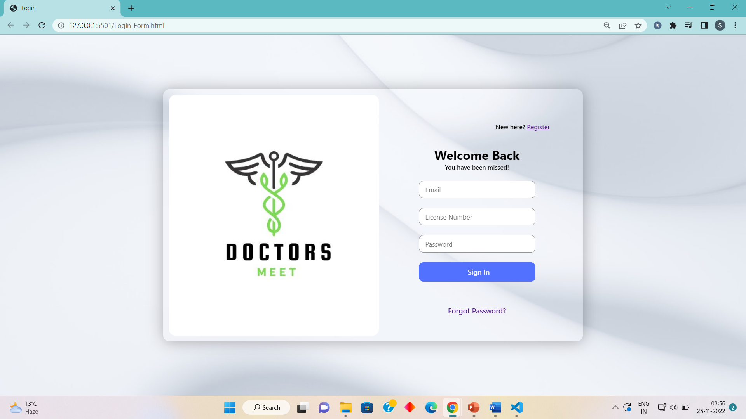
Screenshots

Slide 9
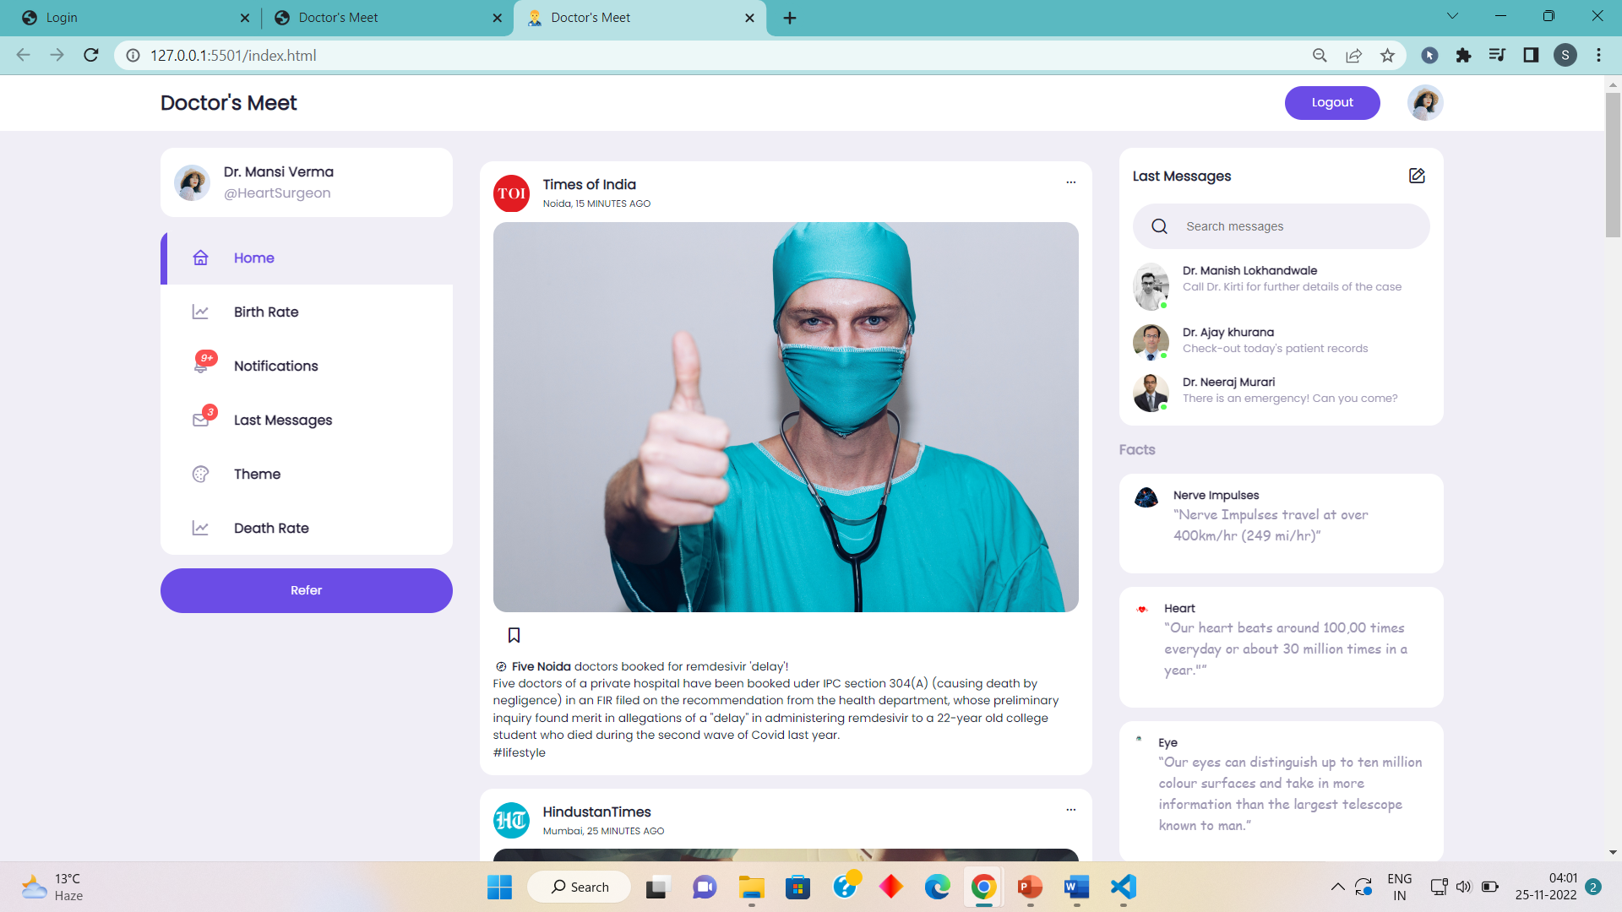
Screenshots

Slide 10
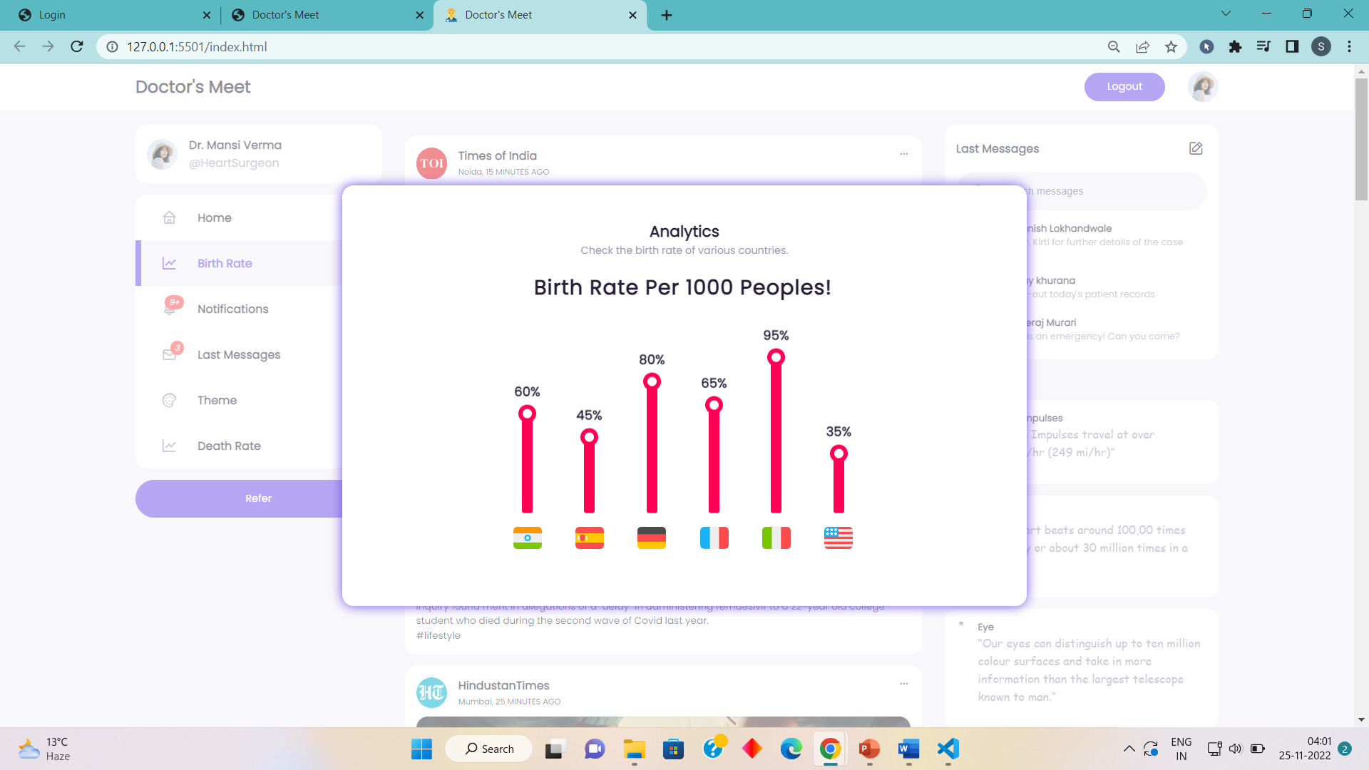
Screenshots

Slide 11
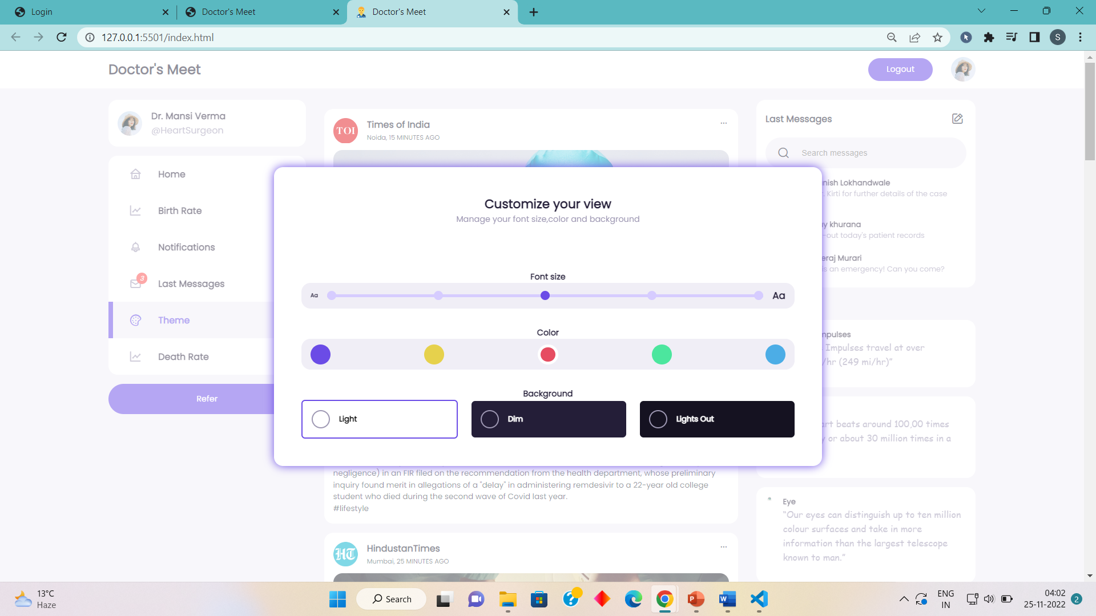
Screenshots

Slide 12
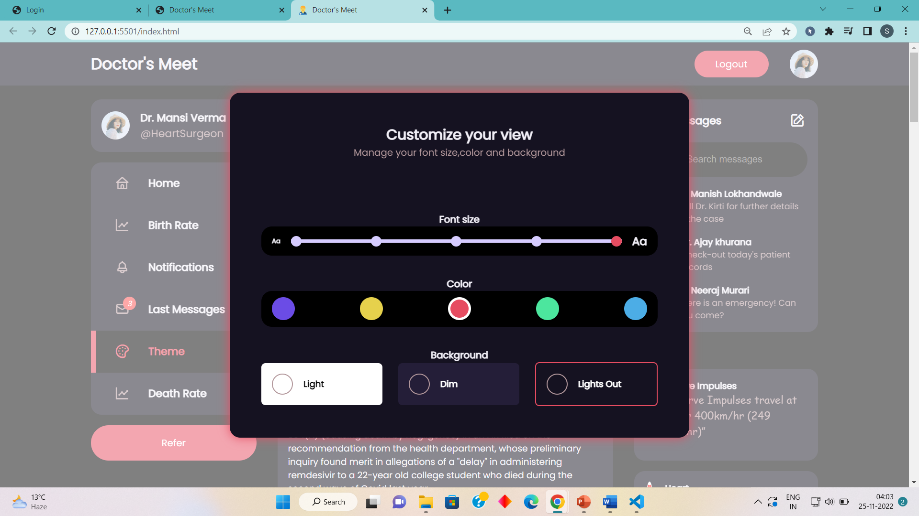
Screenshots

Slide 13
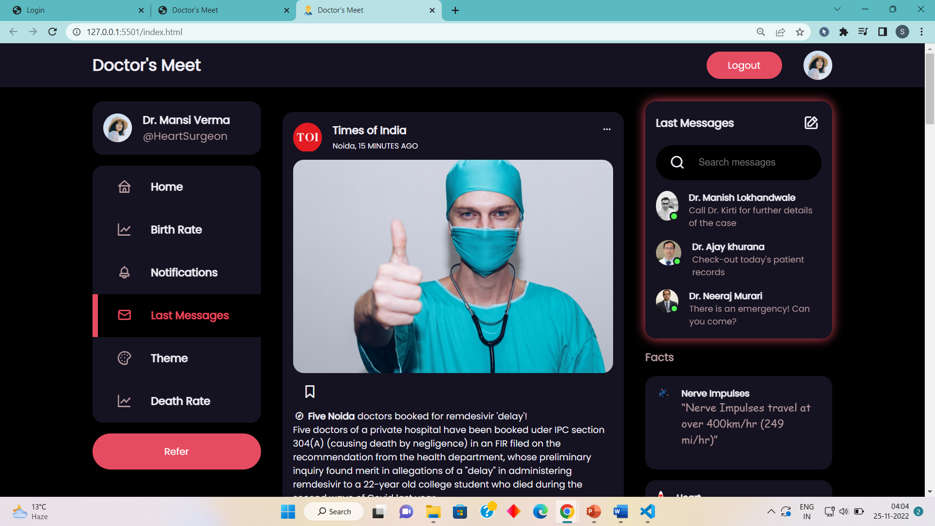
Screenshots

Slide 14
Future Enhancements
Appointment Section
Advance Search Box
To fix and appointment of patient with the other virtuoso doctor in the particular field.
To help doctors to search for specific type of doctors in a particular field thus resolving the issue of lack of knowledge in a particular case. With the help of appointment section the doctor can book an appointment for his patient.

Slide 15
Thank You
Cheers to the ones who save mankind from suffering and sickness and can give life!

Slide 16
DoctorMeet

