Slide 1

REVIEW III SMART MONITORING USING IoT In a Controlled Environment​ Project Category: RESEARCH
Student Details:​
Ponnuri Aniruddha [RA2112704010015]​
Abhay Shaji Valiyaparambil [RA2112704010006]
Guide Name: ​
Dr.K Sornalakshmi​

Slide 2
ABSTRACT
The emergence of the Internet of Things (IoT) has brought about a new era of precision agriculture, which allows researchers as well as farmers to optimize the management of crops with relentless precision. This work investigates the integration of a Raspberry Pi microcontroller with a set of sensors for crop monitoring and enabling plant growth under a controlled environment. The system employs fundamental sensors, including an NPK sensor that can track the levels of nitrogen, phosphorus, and potassium nutrients in the soil; a light sensor for measuring light intensity; a pH sensor for assessing soil acidity; and a camera for visual observation of plant growth and color. By monitoring critical parameters in real-time, the system enables crop health, growth rate, and environmental measurements in a qualitative and precise mode. This process not only improves the early detection of potential deficits or stress-related factors but also improves decision-making mechanisms aimed at increasing yield and optimizing resource redistribution. The project sheds light on the potential of low-cost, IoT-based solutions with the Raspberry Pi towards triggering sustainable agrarian systems and optimally promoting intelligent agricultural systems.

Slide 3
Introduction
This project aims to implement an IoT-based crop monitoring system using Raspberry Pi and sensors to monitor the growth of a plant in a controlled environment. Plant-level sensors like pH, soil moisture, and NPK sensors, and room-level sensors like temperature, humidity, carbon dioxide, and irrigation efficiency are the primary tools. Growth of plants is tracked with the help of cameras, and it provides a broad overview of the surroundings. Since cheap IoT hardware such as Raspberry Pi and low-cost sensors are available, it is within reach of small-scale farmers, and this promotes its mass adoption. Overall contribution of this research is not only enhancing agricultural efficiency—IoT-based monitoring systems support sustainable agriculture due to reduced wastage of resources, enhanced food security, and addressing global environmental problems.

Slide 4
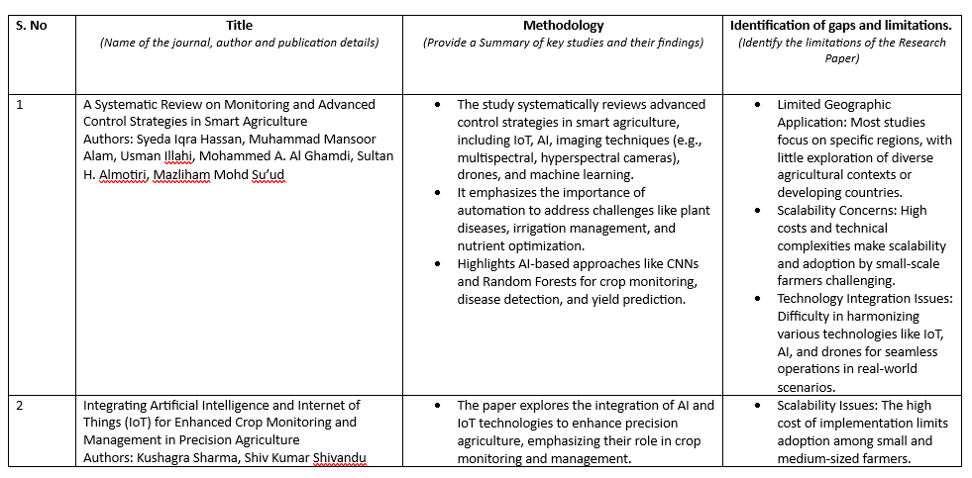
Literature Survey

Slide 5
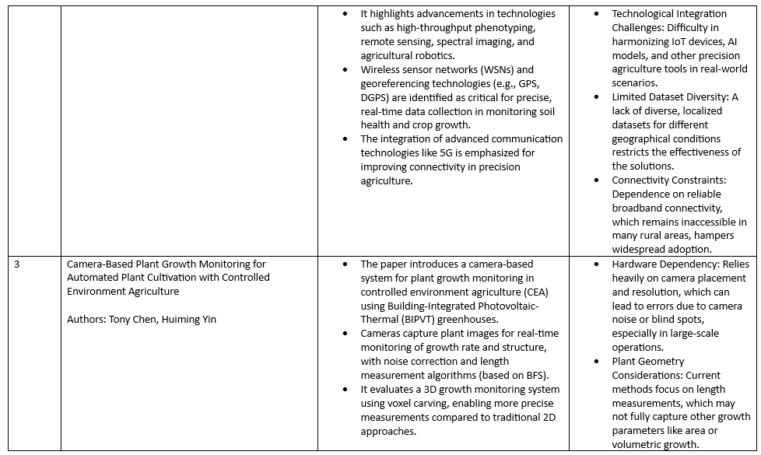
Literature Survey

Slide 6
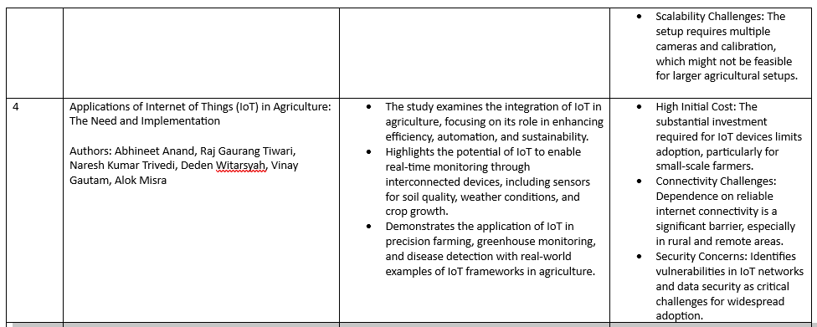
Literature Survey

Slide 7
Research Objective
Design and Implementation of a Smart Monitoring System
Objective: Develop an IoT-based monitoring system using Raspberry Pi and environmental sensors to measure critical parameters such as temperature, humidity, soil moisture, and light intensity in a polyhouse environment.
Rationale: This system enables real-time data acquisition and monitoring, providing precise control over environmental factors, which is essential for optimizing plant growth conditions in a controlled setting. Investigation of Environmental Factors Affecting Plant Growth
Objective: Analyze the influence of environmental parameters like temperature, humidity, soil moisture, and light intensity on plant development to identify optimal conditions for maximizing productivity.
Rationale: Understanding the relationships between environmental factors and plant growth enables data-driven decision-making to enhance agricultural yield and resource efficiency.

Slide 8
Research Objective
Evaluation of IoT Solutions in Controlled Farming
Objective: Assess the effectiveness of IoT technologies in reducing labor-intensive practices, improving precision, and optimizing resource management in polyhouse farming.
Rationale: IoT-based solutions offer a transformative approach to modern farming by automating processes and enhancing productivity while reducing resource wastage and manual intervention. Addressing Challenges in Traditional Polyhouse Farming
Objective: Propose a scalable and sustainable framework that bridges technological gaps, minimizes resource wastage, and reduces environmental impacts for small and medium-scale farmers.
Rationale: Providing cost-effective and adaptable solutions empowers farmers to adopt innovative farming practices, contributing to sustainable agriculture and food security.

Slide 9
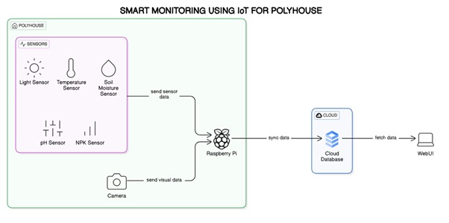
Architecture Diagram

Slide 10
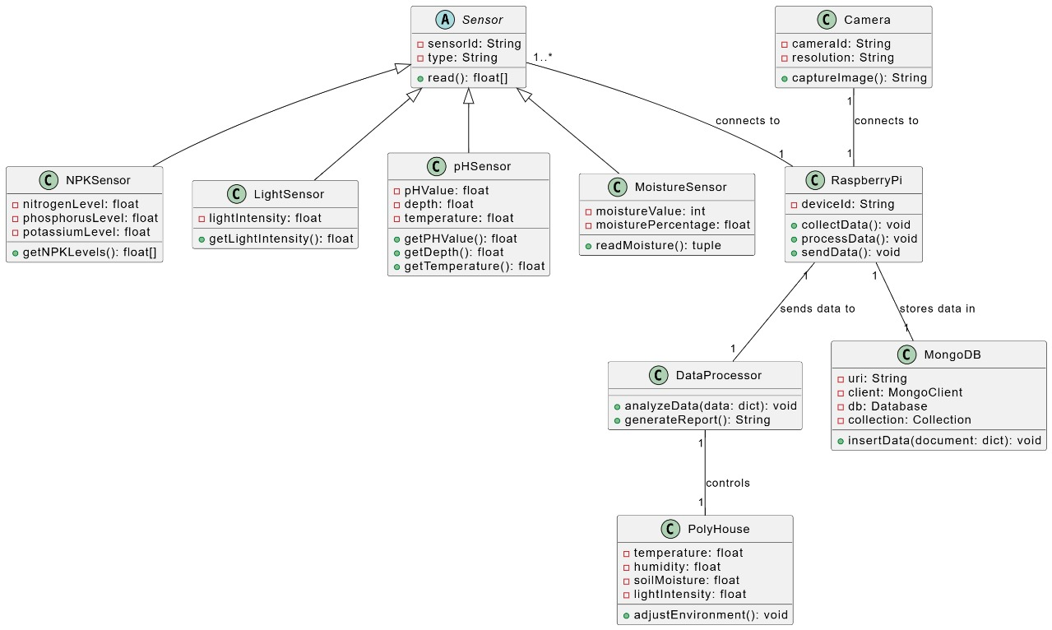
Class Diagram

Slide 11
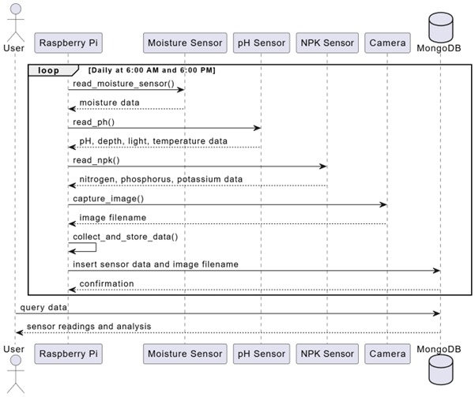
Sequence diagram

Slide 12
Data Fusion for Comprehensive Analysis
Integration of Sensor and Visual Data:
Combine soil condition data (pH, moisture, NPK levels) with visual observations from camera images.
Use timestamps to synchronize sensor readings and captured images for seamless correlation.
AutoRIFT Algorithm:
Analyze sequential images to track growth patterns, leaf movement, and color changes.
Extract visual features like displacement vectors, texture changes, and color histograms.

Slide 13
Data Fusion for Comprehensive Analysis
3. Correlation Analysis:
Link visual changes (e.g., leaf discoloration or growth rate) with sensor data trends (e.g., nutrient levels or soil pH).
Apply statistical methods (cross-correlation, Granger causality) or machine learning models for deeper insights.
4. Benefits:
Holistic understanding of plant health and development.
Enhanced decision-making for resource efficiency and yield improvement.
Scalable solution for precision agriculture using affordable technology.

Slide 14
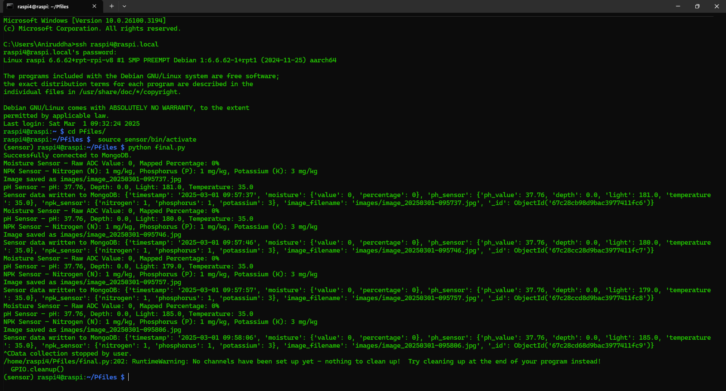
OUTPUT

Slide 15
SDG Alignment of Project
Goal 2: Zero Hunger
Objective Alignment: This research directly contributes to SDG Goal 2 by developing an IoT-enabled system to optimize the growth conditions of crops in polyhouses. By monitoring and adjusting environmental factors such as temperature, humidity, and soil moisture, the project ensures optimal crop growth, leading to improved agricultural productivity. This, in turn, helps in enhancing food security and availability by increasing yields and reducing wastage, particularly in controlled environments where space and resources are limited.
Impact: The system aims to provide sustainable and efficient farming practices that can increase food production while reducing resource wastage. By empowering small-scale farmers to use technology for better crop management, the project contributes to a more sustainable and resilient agricultural system, ultimately helping achieve global food security goals.
Goal 12: Responsible Consumption and Production
Objective Alignment: This project also aligns with SDG Goal 12 by promoting responsible resource usage in agriculture. Through IoT-enabled monitoring and data analytics, the project enables more efficient use of water, energy, and other resources in polyhouses. It helps minimize waste by ensuring that only necessary inputs (e.g., water, light) are used, contributing to more sustainable farming practices.
Impact: The research leads to reduced resource consumption and waste, aligning with the principles of responsible production and consumption. By optimizing agricultural inputs, the project supports sustainable production processes and contributes to environmental conservation, helping ensure that farming practices do not deplete resources and remain eco-friendly in the long run.

Slide 16
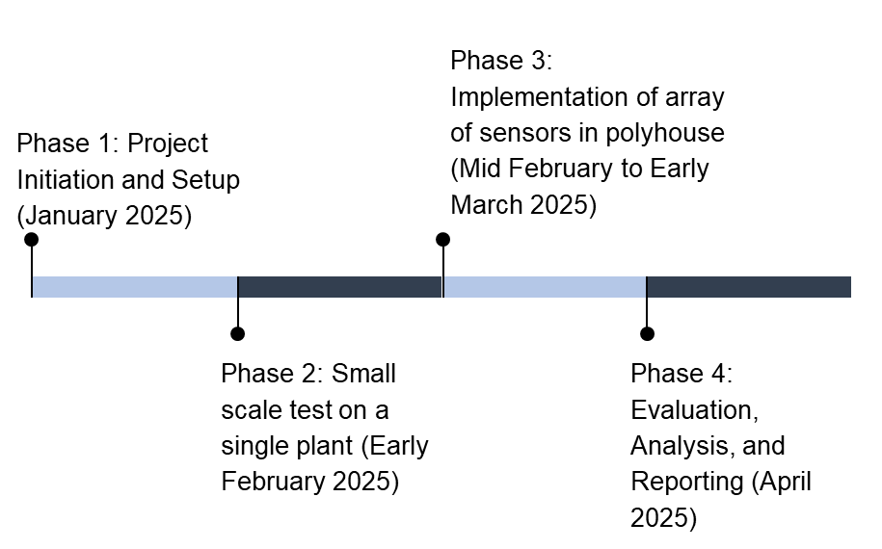
Plan of Action

Slide 17
Conclusion
The integration of IoT technologies into polyhouse farming offers significant potential for improving agricultural practices, enabling more efficient, data-driven management of crops. Through the development of a smart monitoring system using Raspberry Pi and various environmental sensors, this project successfully demonstrated how real-time data collection and analysis can optimize conditions for plant growth. By monitoring critical parameters such as temperature, humidity, soil moisture, and light intensity, it was possible to identify the key environmental factors influencing plant health and growth.The system's ability to dynamically adjust polyhouse conditions based on real-time data contributes to increased resource efficiency and crop yield while reducing labor and environmental impact. This research highlights the significant benefits of IoT-based solutions for small and medium-scale farmers, promoting sustainability and resource conservation in controlled farming environments.In conclusion, the successful application of IoT in this project not only advances the field of smart farming but also lays the foundation for broader adoption of technology in agriculture, ensuring more sustainable, resilient, and productive farming practices in the future.

